Slide 1
7 TeV Dilepton Control Plots
Ricardo Gonçalo, RHUL

Slide 2
7 TeV Dilepton ttH
Made a few plots of basic quantities using the available Monte Carlo
Used MC@NLO for ttbar and Cécile’s ntuples
Cuts:
==2 opposite sign leptons
p_{T}^{e} > 25GeV, p_{T}^{μ} > 20GeV
p_{T}^{jet} > 25GeV
eμ-channel:
H_{T} > 130GeV (using Cécile’s definition)
ee/μμ:
M_{ll} > 15GeV && |M_{ll}-M_{Z}| < 10GeV
MET > 60GeV
Looked at various N_{jet} / N_{b-jet} bins
 | 0 tag | 1 tag | 2 tag | 3 tag | ≥4 tag
2 jet | ✔ | ✔ | ✔ | ✗ | ✗
3 jet | ✗ | ✗ | ✔ | ✔ | ✗
4 jet | ✗ | ✗ | ✔ | ✔ | ✔

Slide 3
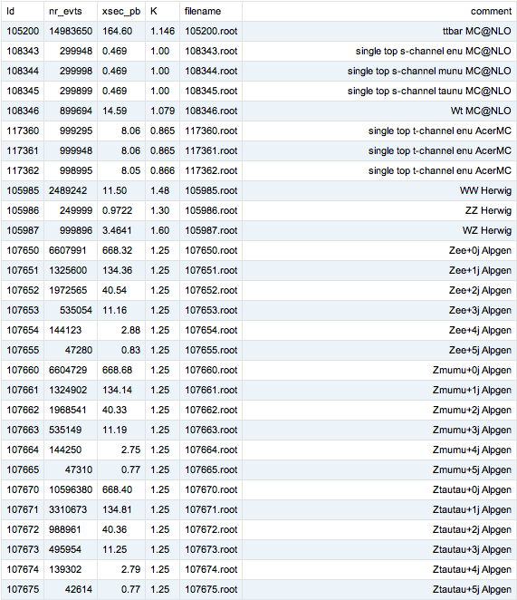
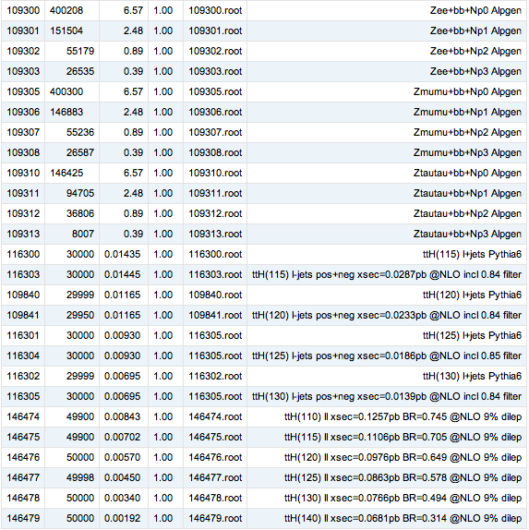
Cross sections on ttH wiki: https://twiki.cern.ch/twiki/bin/viewauth/AtlasProtected/TTH2bbWinter2013#MC11x (Corrections welcome!)

Slide 4
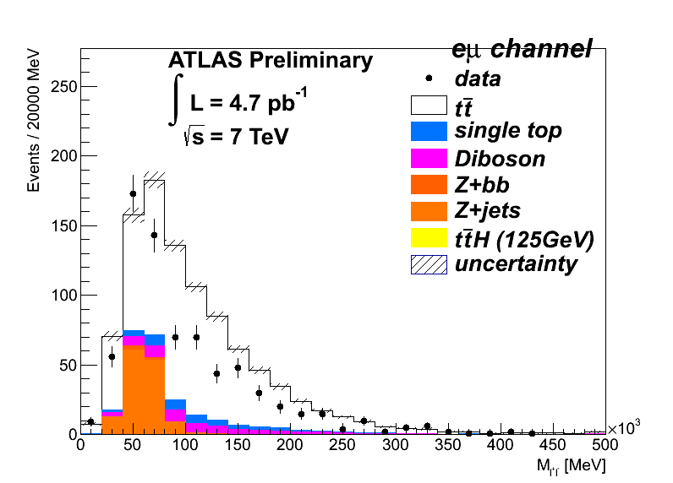
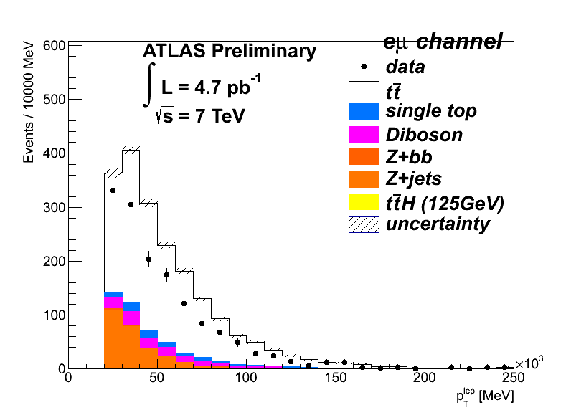
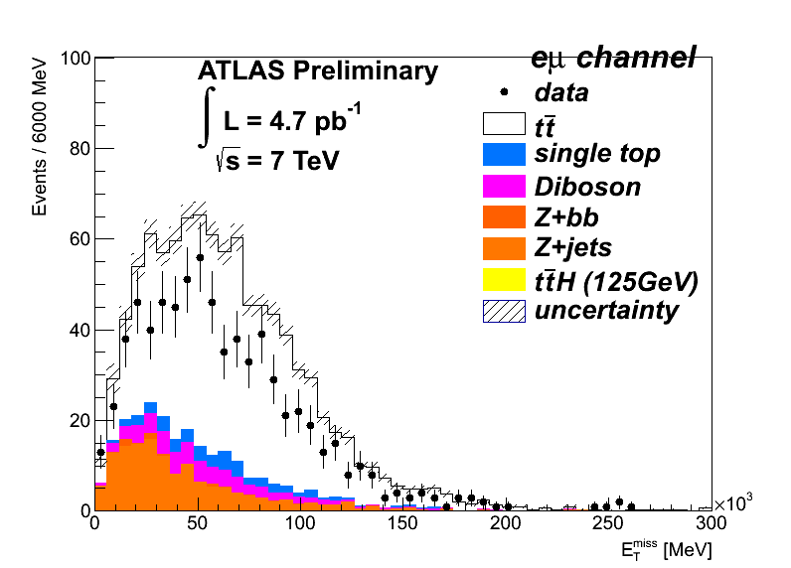
2 jets, 0 tags: MC overshoots data

Slide 5
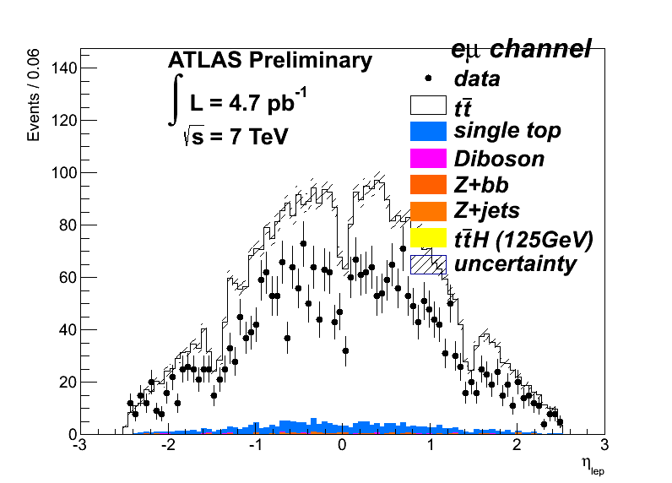
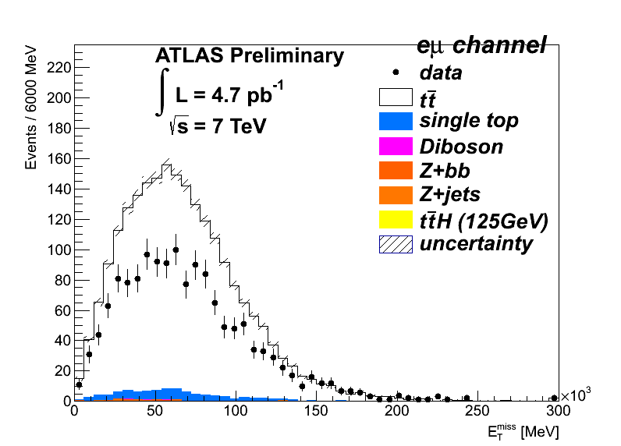
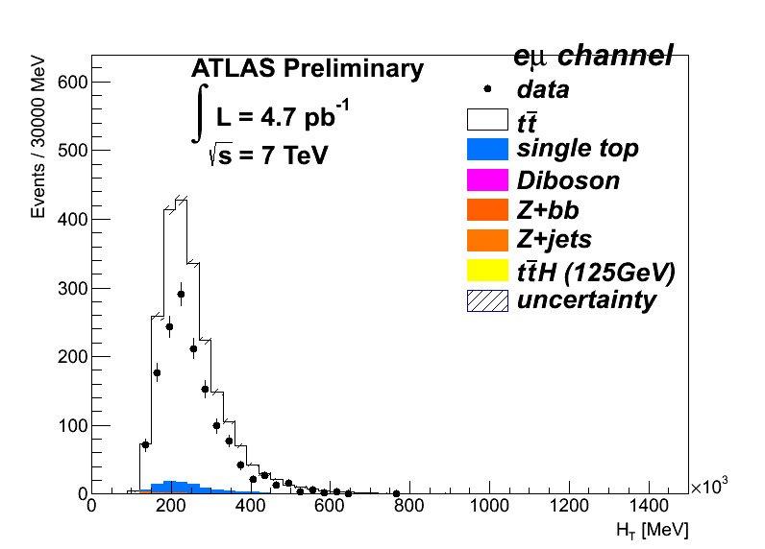
2 jets, 1 tags: MC overshoots data

Slide 6
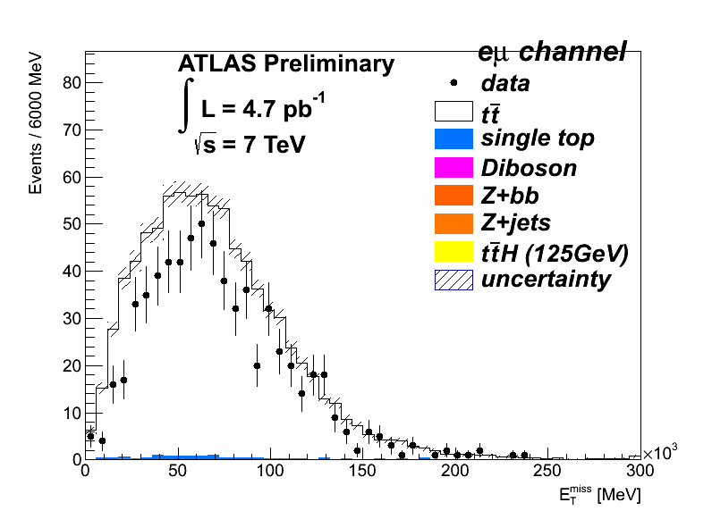
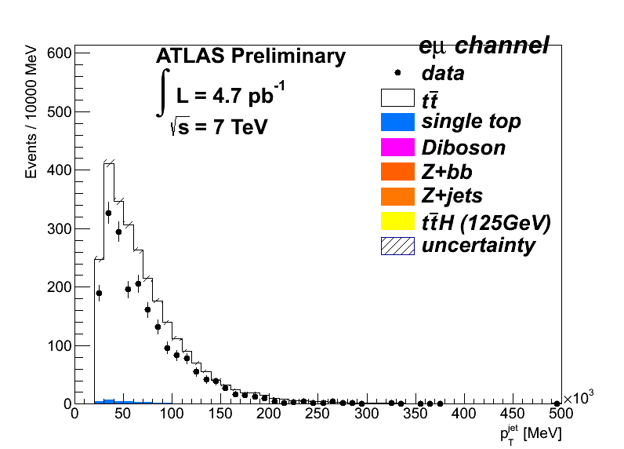
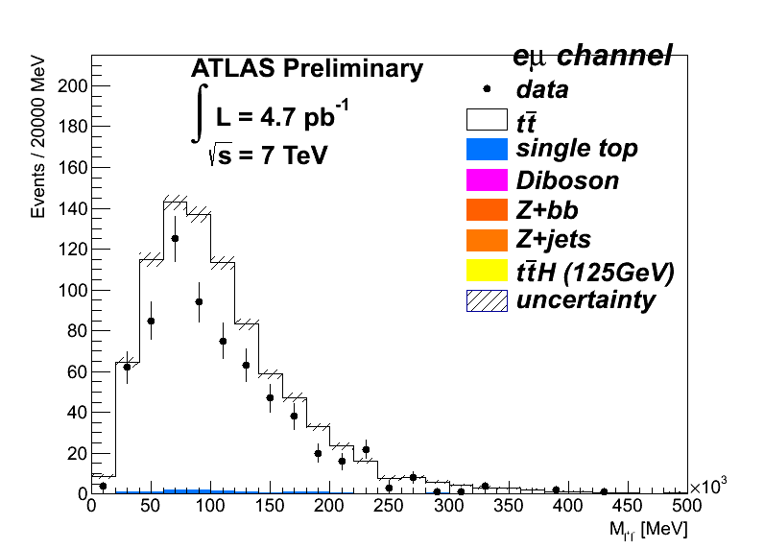
3 jets, 3 tags: Better, but MC still overshoots data

Slide 7
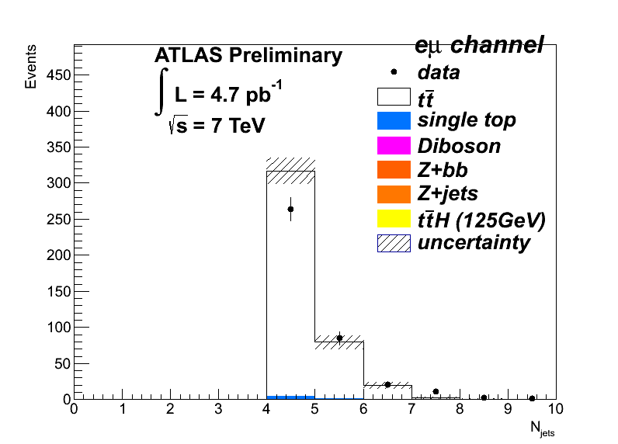
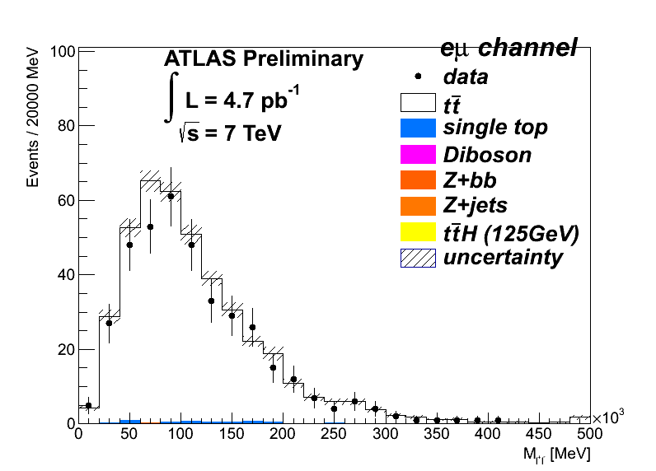
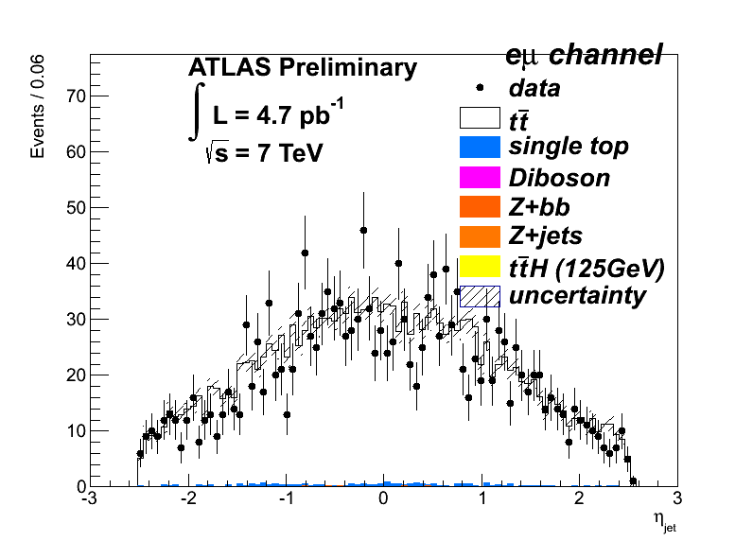
≥4 jets, ≥2 tags: Inclusive #jets distribution looks ≈ok!

Slide 8
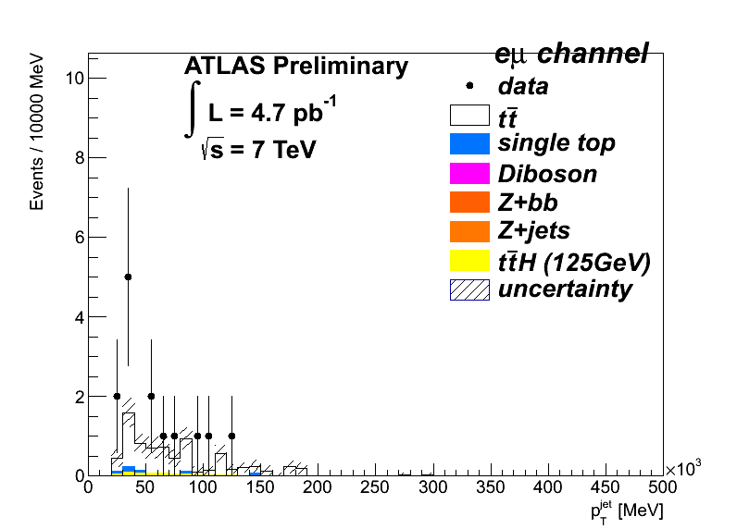
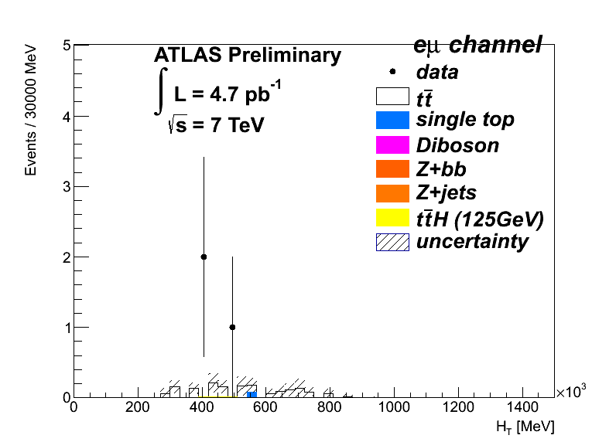
≥4 jets, ≥4 tags: Run out of events

Slide 9
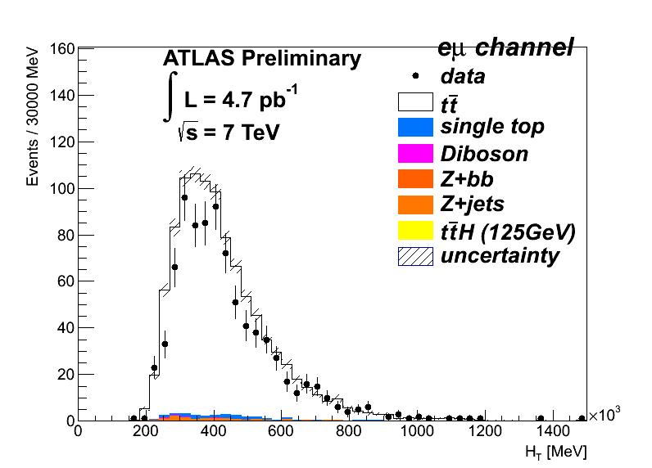
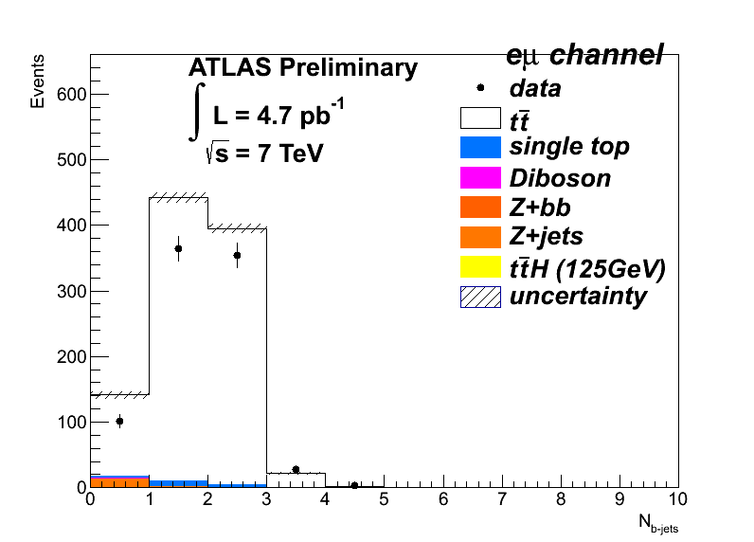
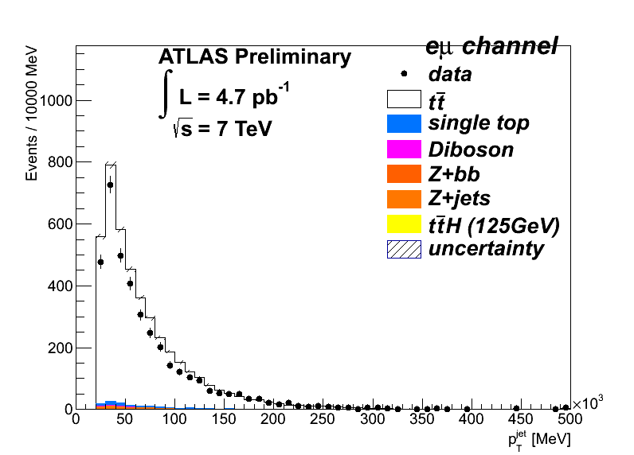
Removed HT cut: ≥4jets ≥0 btag
==2 opposite sign leptons
p_{T}^{e} > 25GeV, p_{T}^{μ} > 20GeV
p_{T}^{jet} > 25GeV
eμ-channel:
No H_{T} cut
ee/μμ:
M_{ll} > 15GeV && |M_{ll}-M_{Z}| < 10GeV
MET > 60GeV

Slide 10
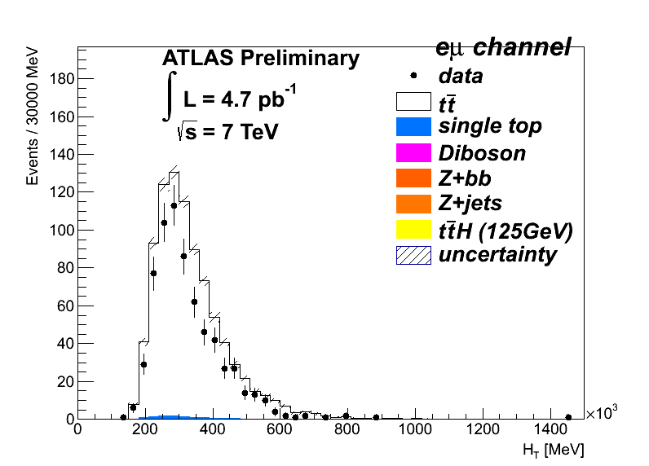
Removed HT cut: 3jets 2 btag
HT cut has little effect since HT is already quite above the standard thresholds
Left: HT>130 Right: HT>0

Slide 11
The story so far…
Looked at eμ channel – completely dominated by ttbar
Exclusive jet/b-jet bins not well described by MC@NLO
To be expected if Njets distribution not well described
HT cut seems superfluous in the cases examined
Examine HT definition and try some other possibilities… next time

Slide 12
μμ Channel
a

