Slide 1
Truth-level comparison between H➝Zγ and ZH➝llγγ
16 May 2014 – Ricardo Gonçalo, LIP

Slide 2
Event generation
Generated gg/ff➝H➝Zγ and ff➝ZH➝llγγ
Pythia 9.176
√s = 8 TeV and √s = 14 TeV
m_{H} = 125.5 GeV m_{t} = 173.07 GeV
50k events qq➝ZH with Z ➝ ll and H ➝ γγ at 8 and 14 TeV
10k events gg ➝ H + VBF with H ➝ Zγ at 8 and 14 TeV
From LHC Higgs XS Working Group: https://twiki.cern.ch/twiki/bin/view/LHCPhysics/CERNYellowReportPageBR3
NLO cross sections and branching ratios:
σ (gg➝H + VBF) = 20.69 pb (8TeV); 49.13 pb (14TeV)
σ (qq➝ZH) = 0.4102 pb (8TeV); 0.9574 pb (14TeV)
BR (H➝Zγ) = 1.58x10⁻³
BR (ZH➝ee + ZH➝μμ) = 0.067
BR (H➝γγ) = 2.28x10⁻³

Slide 3
Truth-level analysis
ATLAS H➝Zγ analysis: ATLAS-CONF-2013-009
Approximated analysis cuts by requiring:
Leptons (e or μ only):
p_{T}>10 GeV, |η|<2.5 (same for e and μ)
One photon within detector acceptance:
p_{T}>15 GeV, |η|<2.37
Reconstructed mass using truth lepton and photon momenta: i.e. includes ISR/FSR
Normalized to 20 fb⁻¹ at 8 TeV
At 8TeV:
Efficiency after cuts: ε(H➝Zγ) = 64%; ε(ZH➝llγγ) = 14%

Slide 4
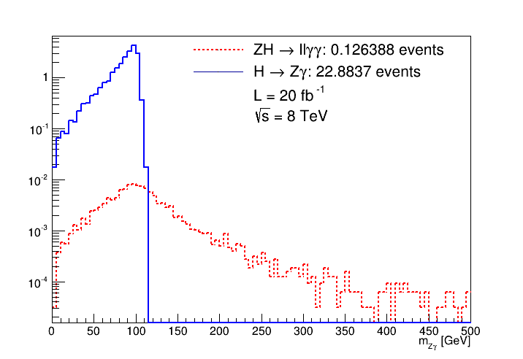
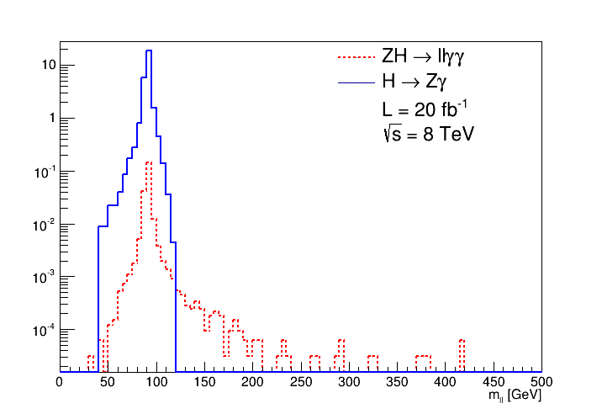
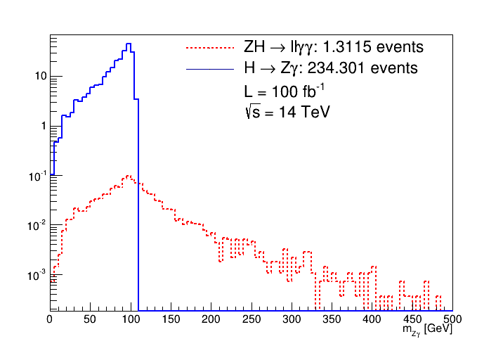
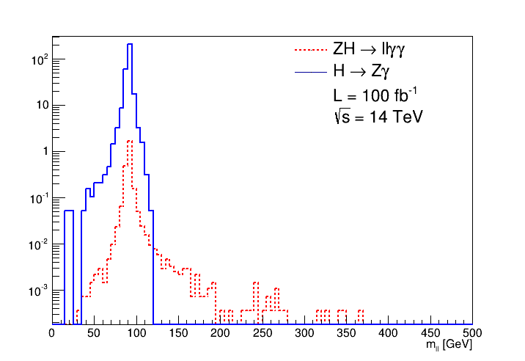
Invariant mass of Z and of Z-γ system

Slide 5
Normalisation cross check at 8 TeV
σ (gg➝H + VBF) = 20.69 pb (8TeV)
σ (qq➝ZH) = 0.4102 pb (8TeV)
BR (H➝Zγ) = 1.58x10⁻³
BR (ZH➝ee + ZH➝μμ) = 0.067
BR (H➝γγ) = 2.28x10⁻³
gg➝H + VBF with H➝Zγ and Z➝ll:
N = 20fb⁻¹ x 20690 fb x 0.067 x 1.58x10⁻³ x 64% (eff.) = 27.1 events
qq➝ZH with H➝γγ and Z➝ll:
N = 20fb⁻¹ x 410.2 fb x 0.067 x 2.28x10⁻³ x 14% (eff.) = 0.175 events

Slide 6
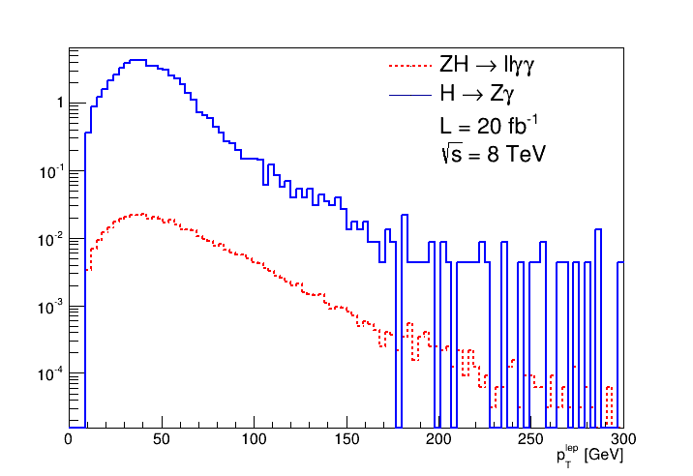
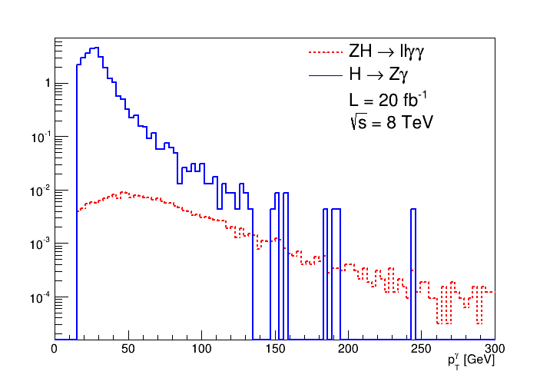
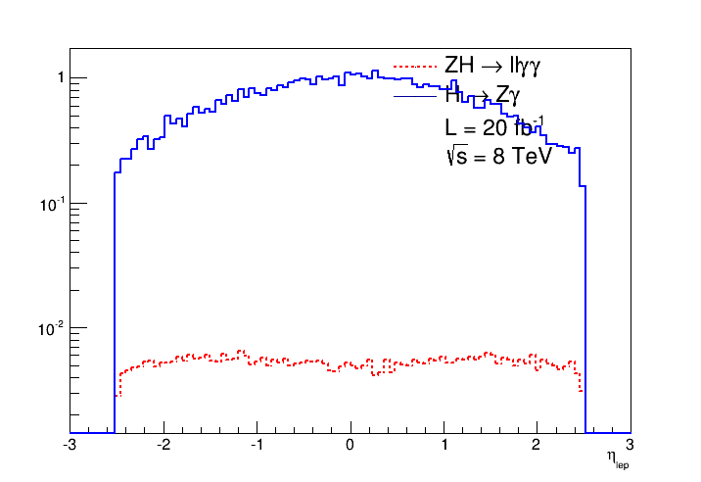
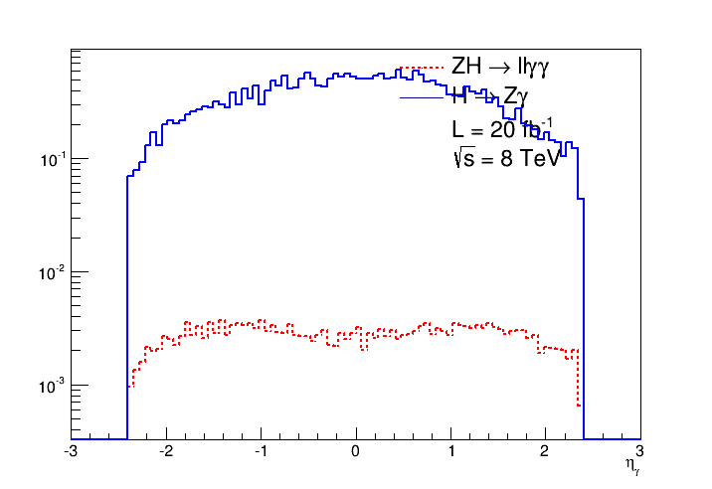
8 TeV plots: leptons and photons

Slide 7
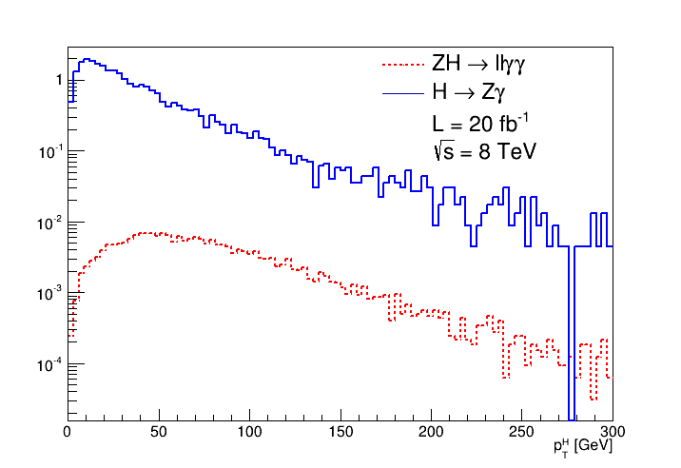
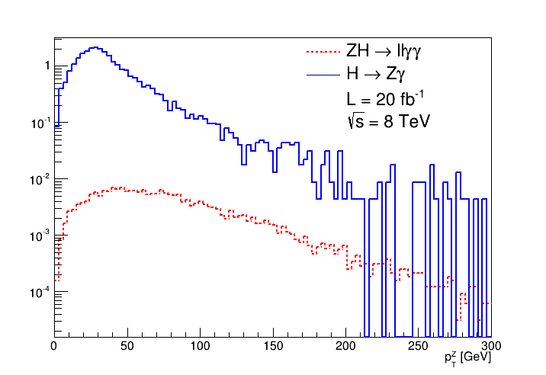
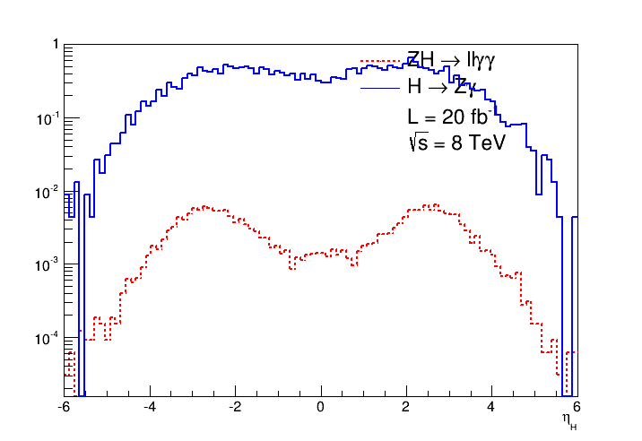
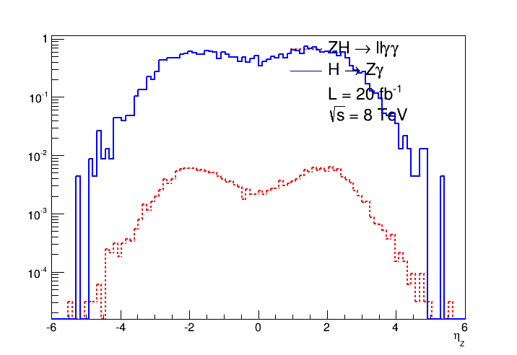
8 TeV plots: Z and H kinematics

Slide 8
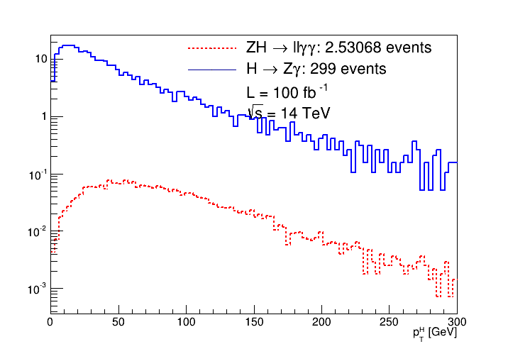
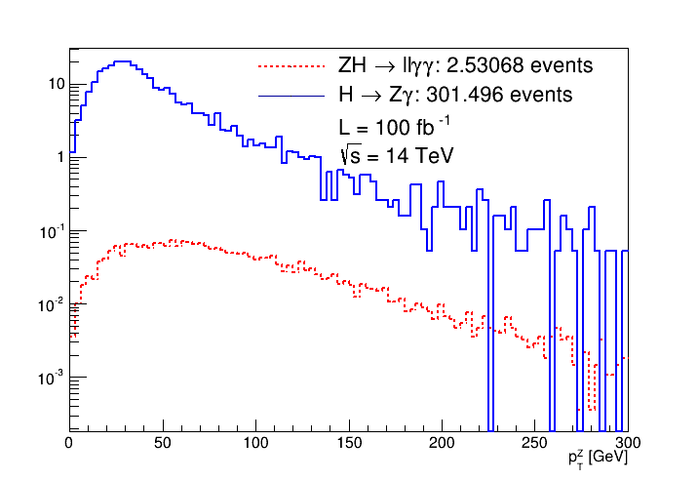
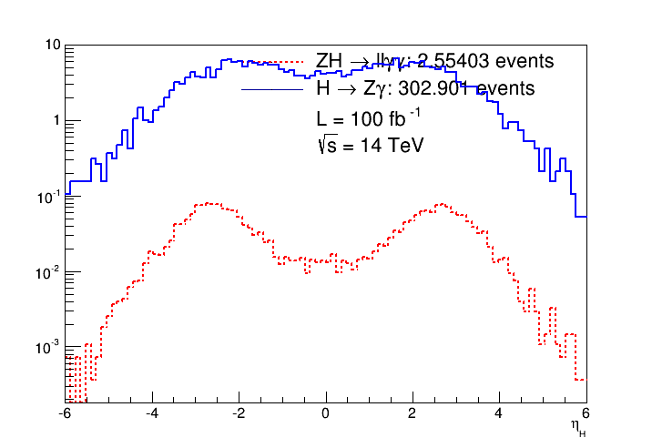
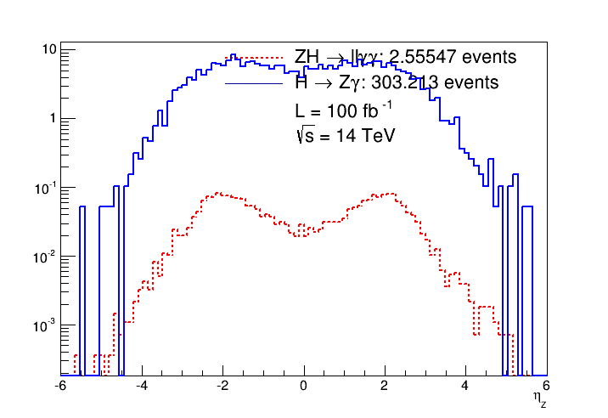
14 TeV plots: Z and H kinematics

Slide 9
Conclusions
This was a quick study at truth level only
ZH➝llγγ is a very small background for H➝Zγ

