Slide 1
Review of the Trigger Offline Monitoring
Trigger Offline Monitoring
Review aims and procedure
Review Questions and answers
Last Comments
Szymon Gadomski and Ricardo Gonçalo
Trigger Open Meeting, 21/1/2009

Slide 2
Trigger Offline Monitoring
The offline monitoring area covers two parts of the Trigger Operation:
Processing or reprocessing of jobs for:
Testing new software and menus
Producing HLT data when this was not in the run (*)
Produce ESD’s/monitoring output from bytestream with or without HLT info
Special monitoring jobs that cannot run at Tier0
Processing and classifying data from the debug stream
(*) i.e. running the HLT on data selected by Level 1 only (and with a minimal HLT menu for streaming)
Monitoring and DQ of the Trigger
Analyze the histograms from Tier0
Correlate them with the online histograms written after the run
Produce an assessment of the DQ from the Trigger
People involved:
Trigger offline expert
Trigger offline shifter
Expert(s) providing support for monitoring infrastructure
Trigger slice on-call experts

Slide 3
Review Aims
Find any necessary improvements in the organisation of the offline monitoring shifts, including documentation and flow of information
Determine the need for new functionality in the monitoring infrastructure
Help to formalize roles and responsabilities of the trigger offline monitoring shifter and expert
Establish a tentative operational schedule for each role
Estimate the use of computing resources and find any additional needs
Starting questions:
How to submit jobs? It is automatic enough?
What tools exist and what are still needed?
Where and how the log files and other data is stored?
How the DB of what was run is stored?
How results are published and documented?
Is the infrastructure for testing fast/prepared enough?
How should the histograms checking work?
What should be the interaction with the slice experts? (I believe this will improve when we are in beam)
How the report of the shifter per run should be given?
What other tools/system do we need?

Slide 4
Review Procedure
A few complementary procedures were followed:
Analyze the software infrastructure and see what is still missing
Analyze the hardware available and explore what may be needed
Build a view on how things will work when we are in running
Can the shifter be remote?
What is still needed to make sure the communication expert/shifter is efficient even in this case?
Can the expert be remote?
How tasks are assigned and resolved?
Could we describe a "working day" for a shifter and an expert?
Consult with the people who have been experts and shifters
Consult with people responsible for the software infrastructure
Take into account that the system was still in building phase and some comment might not be relevant
Extrapolate to the future to see what the week points will be
Input from shifters/experts: Olya, Iwona, Aart, Anna, Hegoi, Attila, so far (also Szymon, Ricardo)
Some partial conclusions already possible, but another week or two would help refine things

Slide 5
How to submit jobs? It is automatic enough?
What tools exist and what are still needed?
Where and how the log files and other data is stored?
Is the infrastructure for testing fast/prepared enough?

Slide 6
Trigger Tasks in CAF
CAF was used in 2008 run for 3 main purposes:
Run High Level Trigger on Level 1-selected bytestream data
Test new Super Master Keys before online deployment
Classify High Level Trigger errors, crashes, etc
Run trigger offline monitoring on bytestream data from step 1
Produce ESDs with trigger information from step 1 bytestream data for analysis
Estimate trigger rates for new menus (occasional and lower priority)
Plans for the CAF in 2009:
Initial running will be pretty much the same as 2008 (running HLT on L1-only data, etc)
Plans for steady-state data taking :
Run error analysis/classification/recovery on all debug stream events
Run Data Quality monitoring jobs on some/all express stream data
Run online/offline trigger result comparison on some/all express stream data
Continue to test new menus and code offline in the CAF before deploying them

Slide 7
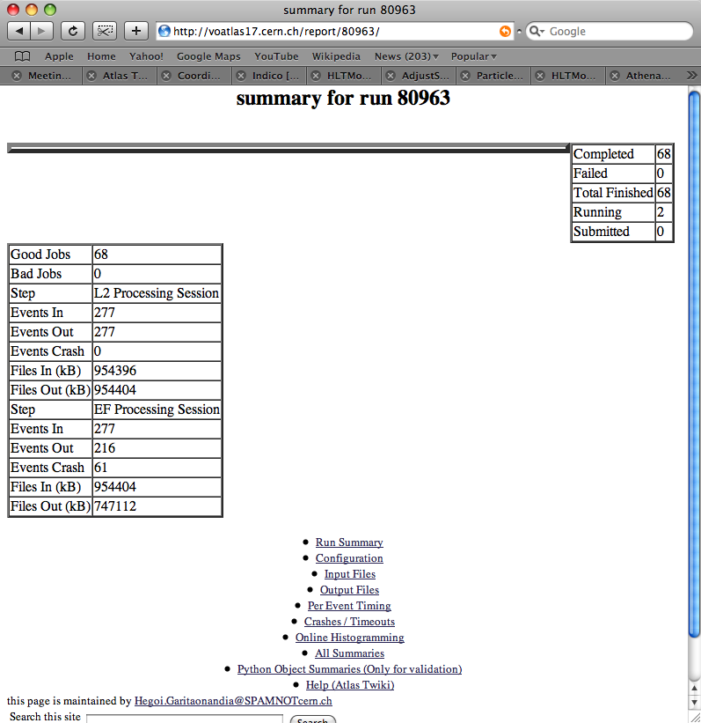
Task Management
Initial system written and developed for 2008 run:
HDEBUG framework - Hegoi Garitaonandia
Error analysis scripts - Anna Sfyrla
Offline monitoring, BS->ESD - Aart Heijboer
Job submission for step 1 used HDEBUG, based on GANGA, and publishes results to web server
Monitoring jobs run trigger monitoring tools in CAF/Tier0
Monitoring and ESD (steps 2. and 3.) used simple queue submission scripts (bsub)
Small library of useful scripts for error classification, etc
Recommendations for 2009:
Automate job submission in HDEBUG framework – eliminate manual submission of jobs on debug and express stream
Complete merger of error classification scripts into HDEBUG
Ongoing development of analysis algorithms for online/offline comparison – to be managed by HDEBUG
Continue to use CAF for testing new SMKs before online deployment of menu
Simplify submission of test jobs and make it more robust

Slide 8
Proposal for centralizing task management?
Submission of jobs on DEBUG and EXPRESS streams:
Initial data: run by hand, possibly different menu and release than was used online
Steady state: run same release and menu as used online
Hegoi and Attila working on system to automatically send jobs to all new data from these streams – perhaps also useful elsewhere
Testing new menus: need to specify data set, menu, release (possibly nightly)
Need tool to un-stream data before running – avoid mixing streams after new HLT version runs on data
Open question: do we need to be able to test nightly+extra tag? – initial answer is no
Log files for debug stream/test jobs and reference files should be stored in web server and periodically archived to castor (in automatic way if possible)
Must be accessible to shifter
Other constraints:
DQ, debug stream and test jobs need to publish results in web-accessible way for remote DQ
Need to run this asynchronously from (before) offline reconstruction
Farm/queue load varies mostly depending on demand for testing new menus (time critical)
Total farm load should be quantified and monitored

Slide 9
How the DB of what was run is stored?
How results are published and documented?

Slide 10
Data Quality Flags
Conditions DB is the place to store all DQ flags for the whole collaboration
To complement this, add eLog category for use by offline monitoring expert/shifter
Old flags: red, green, yellow, grey, AND undefined (before any value is set)
New proposal: red (bad), green (good), yellow (partially bad, some channels missing, hole in calo, etc), black (disabled, not in partition), white (in partition), grey (or blue, undefined, tried to check quality but couldn't)
Comments: can be added for each flag per lumi block,
But not in DB folder which is seen by athena
Flags and comments are stored only when something changes
Evolution with time: flags are redone for each reprocessing (yearly...)
There will be several good-run lists: DQ provides tools to query DB
Should be possible to check if a detector is in the partition and include this in the logic for deciding on data quality flags
e.g. don't use some histo for checks if some detector is not in the partition

Slide 11
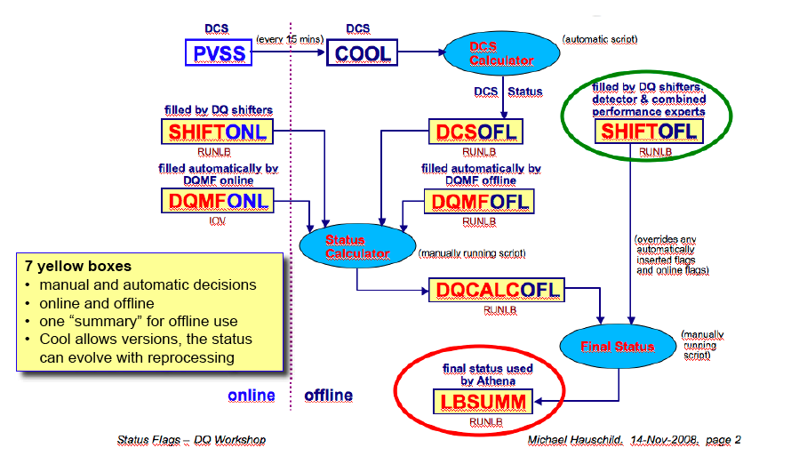
Offline DQ Monitoring

Slide 12
How should the histograms checking work?
What should be the interaction with the slice experts?
How the report of the shifter per run should be given?
What other tools/system do we need?

Slide 13
Trigger Offline Monitoring Expert Role
The expert should at any moment be aware of the ongoing operational issues
He/she must provide the link between the shifter and the trigger operations
The shifter needs clear information on the day’s priorities and instructions on what to do outside the routine tasks
Must be at CERN, at least during first year or so
The expert has several tasks assigned:
Attend the 09:00 trigger meeting, before the daily run meeting
If needed, attend the run meeting
Attend the meeting with trigger slice experts in the afternoon to be prepared for the DQ meeting
Report on the Data Quality meeting
Reassign Savannah bugs coming from Tier0
Assist the trigger offline monitoring shifter

Slide 14
Trigger Offline Monitoring Shifter Role
It should be possible to do the offline monitoring shift remotely
The shifter should be expected to:
Verify the daily monitoring histograms for each run
Provide the expert with an accurate view of the data quality:
Agreement between monitoring histograms and references
Fraction of failed jobs, error classification
General quantities such as which triggers are running, stream overlaps, trigger rates, nr events processed, etc
Be able to launch monitoring jobs on recent data and analyze output
Essential, and time critical, for testing new menus
Good communication is essential between the shifter and the expert
The shifter needs clear information on the day’s priorities and instructions on what to do outside the routine tasks
Slice experts must be accessible to shifter to help interpret monitoring histograms which fall outside the norm
Reference histograms should be made available as soon as possible, and maintained by slice experts
Even before that, essential that experts supply clear description of each monitoring histogram to be checked – should be obvious when data is bad
Shifter report might benefit from a shift checklist which writes to eLog

Slide 15
Other comments/conclusions on 2008 run

Slide 16
Other comments/conclusions on 2008 run
Expert and shifter: clearly cannot be same person, work load too much
Expert:
40% of time talking to people to understand problems and how to process data
rest looking at data quality and in meetings:
1/2 hour Data Quality
1/2 hour slice expert
1/2 hour monitoring meeting
Expert sometimes needed to know how to run jobs
Shifter:
70-80% debugging and coping with problems in the machinery or interacting with tool maintainer
Running jobs took a lot of babysitting
Whiteboard a very useful feature – needs to be kept lean and clean and up to date (expert responsibility?)
Monitoring Tools:
Changes to standard procedure required a lot of manual intervention and cleanups
E.g. keeping log files required change of framework
Robustness needs to be improved: e.g. number of failed jobs in web site not always corresponded to trigger errors (monitoring thread fragile)
BS conversion, memory leaks, etc not done

Slide 17
Documentation:
Reasonable documentation available, but still lots of interaction with tool experts essential
No description of monitoring histograms
Sometimes “too much to do to [thoroughly] read documentation” (cannot happen)
Tier0:
Should have the same histograms in Tier0 and online
Should have a comparison between online and offline trigger results
Needed reference histograms and up to date histo boundaries - most offline histos are empty
Differences between online and offline went unnoticed
CAF usage:
Perception was that farm load was excessive, but in practice lots of idle time
This should be investigated and optimised
Should improve with automatic job submission
Seems very difficult to avoid using a single (trigcomm) account

Slide 18
Conclusions
Initial system worked acceptably but needed much manual intervention
There is now opportunity to be better prepared
Short term plans are:
Improve error analysis and integrate with HDEBUG
Automatise HDEBUG job submission
Produce online/offline comparison
Should also think of shifter training
Proposal from offline DQ to have common infrastructure for CAF – will know more soon
I feel 1-2 more weeks needed to conclude this review

