Slide 1
Releases and Validation Status
Simon George, David Strom, Dmitry Emeliyanov, Monika Wielers, Ricardo Goncalo
Trigger Open Meeting – 15 July 2009

Slide 2
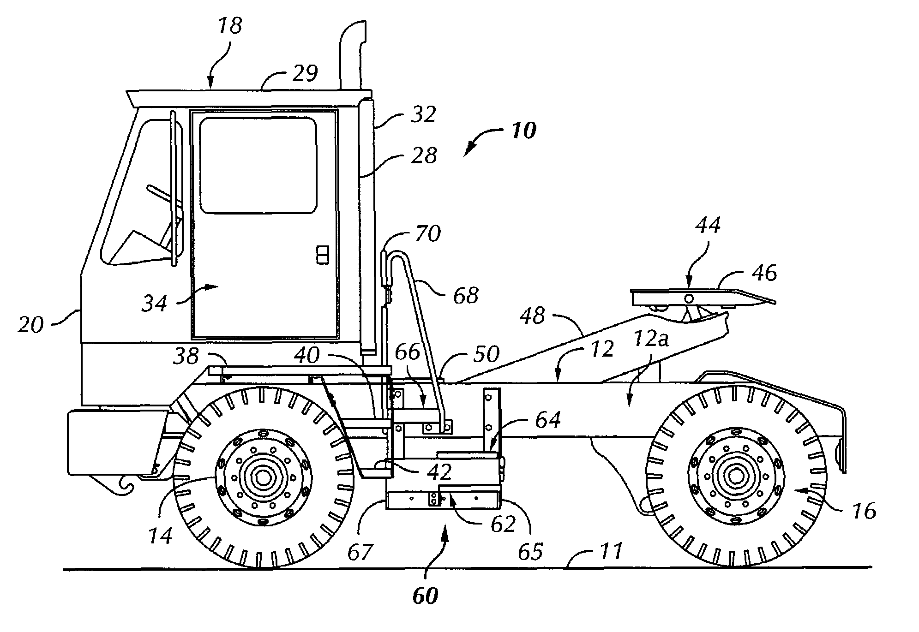
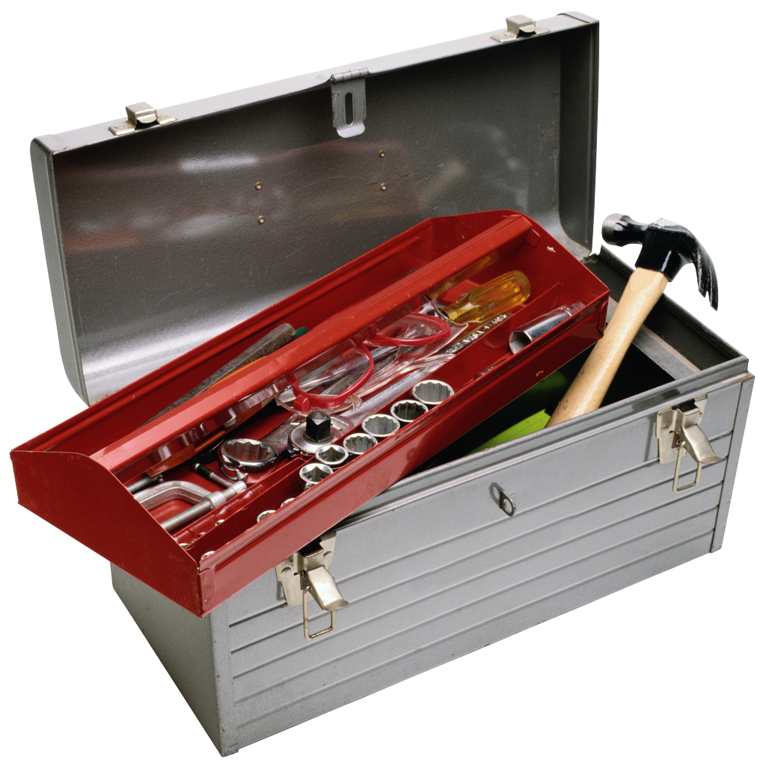
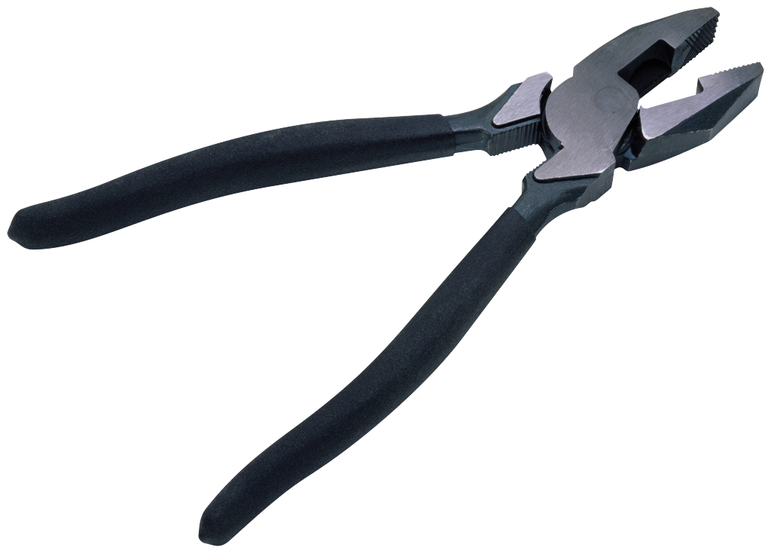
Releases
????

Slide 3
Release schedule
15.3.0 Wed 24 June
For MC09 digitization and reconstruction and MC08 re-reconstruction
Tag submission deadline Thu 18 Jun 21:00
Critical item for trigger: menus and bug fixes
Bug fixes go to AtlasProduction cache – 15.3.0.2 out in the next few days
15.4.0 Wed 22 July
For ATLAS turn-on (Sept)
tag submission deadline Thu 16 Jul 21:00 – 4-days delay being discussed: Mon 20 Jul 21:00
Must have trigger deliverables for online use in this release
LCG externals change so sync with new TDAQ release (end July)
Bug fixes go to AtlaP1HLT and AtlasTier0 caches
Post 15.4.0 ?
Series of caches and bug fix releases
Expect new features for analysis, detectors and monitoring
Plan to limit trigger to real bug fixes in cache, plus valuable enhancements via bugfix releases (to be discussed)
Releases & validation work will switch focus to cache & bugfix releases
Mid to long term plans for dev releases during data taking not yet formulated.

Slide 4
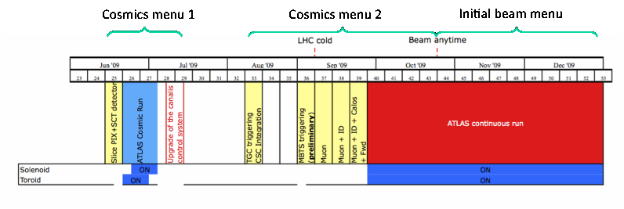
Point 1 schedule
15.2.X.Y
15.4.X.Y
TDAQ 02-00-02

Slide 5
15.4.0 status - I
Outstanding deliverables for 15.4.0; list based on: https://twiki.cern.ch/twiki/bin/view/Atlas/TriggerWorkPlanRel15#Top_Level_Deliverables
T1b Athena runs from DB jo (core) B1 J.Stelzer
T2 MC Menus uploaded to DB and distributed with release (core) B1 P. Bell
T3b Timeout handling inside algorithms (calo,id,muon) B1 calo,id,muon
T5 BeamCondSvc gets distributed online beam-spot info (core) R.Bartholdus
T8b Algorithms able to modify response to missing data modified based on DetMask? (i.e. which detectors are being read out in a run) (all slices) B1 Slices
T10a Monitoring tailored for Cosmic running (histogram ranges, ref. histos, DQ checks) (monitoring+all slices) B1 slices
T10b Monitoring tailored for Single Beam (monitoring+all slices) B2 slices
T10c Monitoring tailored for Early collisions & Stable running (monitoring+all slices) B3 slices
T11 Tier0 monitoring comparing offline and HLT quantities (all slices) B2 slices
T12 CAF monitoring in place (all slices) B3 slices
T13b Algorithms automatically configured for Solenoid and Torroid field settings (ID done, Muon) B2 Oh
T14 Completed definition of Trigger content in DPD (EDM) B3 Salvatore
T15 Changes to follow Muon Review recommendations (muon) B2 Spagnolo, Oh
T16a Minor EDM changes (ID) [Cat. B] B1 Emeliyanov (done pending tests)
T16c Minor EDM changes (Electron) [Cat. B] B1 Goncalo (done pending tests)

Slide 6
15.4.0 status – II
Outstanding deliverables for 15.4.0; list based on: https://twiki.cern.ch/twiki/bin/view/Atlas/TriggerWorkPlanRel15#Top_Level_Deliverables
T18a Add LUCID chains (min. bias) B1 P.Bell
T18b Add ZDC chains (min. bias) B2 Bell
T21d Migration of all TrigDecisionTool trigger clients B3 Slices
T22 Serializer extended to handle top level persistent class evolution (EDM) B1 Masik (done pending tests)
T23 ntuples can be written to single or multiple files configured by TriggerJobOpts? & tested with tier0 production script B3 Slices
T19a1 10³¹ revised menu for MC09 (menus) B2 Srini
T19b 10³² menu (menus) not needed in 2009 n/a Srini
T20 Menus for data taking (menus) C Srini
T21a First version of new TrigDecisionTool for Athena/ARA (menus) A Bold
T21b First version of TrigDecisionTool for users (menus) B1 Bold
T21d Migration of all TrigDecisionTool trigger clients B3 Slices
T21e Migration of all TrigDecisionTool other clients B3 Joerg
T22 Serializer extended to handle top level persistent class evolution (EDM) B1 Masik
T23 ntuples can be written to single or multiple files configured by TriggerJobOpt & tested with tier0 production script B3 Joerg+slices

Slide 7
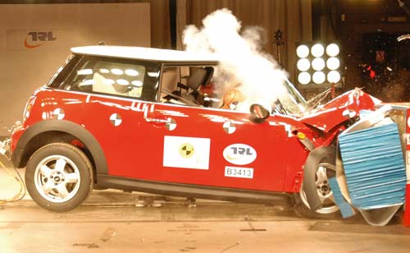
Validation
!!!

Slide 8
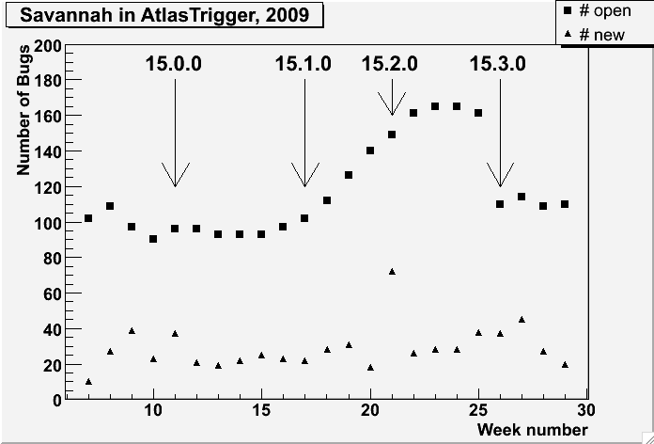
Bug counts – the calm before the storm?

Slide 9
Bug closing campaign by slice

Slide 10
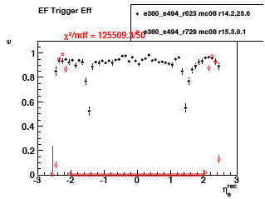
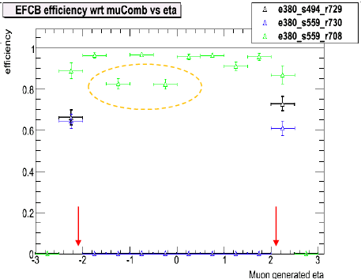
Status of 15.3.0.X – I
Validation of 15.3.0.X for MC08 reprocessing and MC09 production has started with 15.3.0.1 (not MC09 menu)
See physics validation meeting yesterday: http://indico.cern.ch/conferenceDisplay.py?confId=64334
Event filter electron and muon (comb) efficiency zero for eta < 2.1!!
Appears in AtlasProduction but not in AtlasOffline (for muons)
Probably fixed by latest InDetTrigRecExample
Seen in other slices?
We will NOT sign off on trigger validation for MC09 production before having feedback from each slice
See the muon slice presentation for a good example of what is needed: http://indico.cern.ch/materialDisplay.py?contribId=14&materialId=slides&confId=64334
J.Kretzschmar
A.Ventura

Slide 11
Status of 15.3.0.X – II
AOD size issue:
We were surprised by a huge increase in the trigger EDM size in AOD/ESD files – for ttbar events in a recently nightly:
MC menu with no pre-scales 140 kB/event
MC menu, with some prescales 110 kB/event
Physics menu with no pre-scales 50 kB/event
Physics menu with pre-scales 35 kB/event
Not a relevant problem for real data, but seriously affects how much MC can be made, kept and analysed – note nominal AOD size is 150 kB/event
The menu evolution needs to take the AOD size into account and this needs to be monitored in validation
Solution: run Physics menu on most MC09 production and the full MC menu only on min-bias, di-jets, and individual samples for trigger studies
Note that MC09 trigger menu is NOT in 15.3.0.1
MC09 trigger menu being finalised for 15.3.0.2
Sample A and enhanced bias will need to be validated!!

Slide 12
Status of 15.3.0.X – III
Menu/DB infrastructure for production ready to test
This includes no longer using $AtlasVersion
We are still left with:
#52096 – re-running hypos – maybe solved (waiting for tomorrow’s devval)
#52331 - decide what if anything to put in cache for IDScan.
#52088 - slimming broken, could affect DPD production, will try Tomasz since Ben is away and Michael is busy.
Quite a few WARNINGs – remember these can affect production if they occur too frequently!

Slide 13
Status of 15.4.0
Nightly tests have been ok lately but with large fluctuations in quality
Last 2 nightlies have serious problems
Mostly from outside the trigger but also ongoing trigger problems
A delay to the schedule of a few days is being discussed for Monday 20 July at 21:00
Not certain! Expect an announcement later today or tomorrow

Slide 14
Validation tests
There is an ongoing cleanup and improvement of trigger tests. E.g.:
Removed "Modern" from test names and add trig to the name:
AthenaModernRDO.py -> AllTrigRDO.py
Remove “CSC” from reference file names
Add “leakcheck” to the test that have this switched on (AllTrigRDO_leakecheck) and AllTrigRDO_blackhole_leakcheck)
Remove lumi0.01 tests:
lumi0.01 -> AllTrigRDO_lumi1E32
Add doc tags to all tests
Rationalize test that sort chains
Rename some tests so that the results occur together in summary page, e.g. XMLvsDBconfig
Change BStoESD for MC to use RAWtoESD transform
Remove HLTtesting and move all tests to TrigP1Test
⬆
Basic test; based on RecExCommon; read RDO; run trigger

Slide 15
Validation coordination
This is my last talk as validation coordinator
The role is changing:
David will continue through next year
A second rotating coordinator from a pool of trigger experts will serve for 2-3 months
Many thanks to Monika for agreeing to fulfill this role!!!
A detailed job description is being put together for this

