Slide 1
DPDs and Trigger
Plans for Derived Physics Data
Follow up and trigger specific issues
Ricardo Gonçalo and Fabrizio Salvatore RHUL

Slide 2
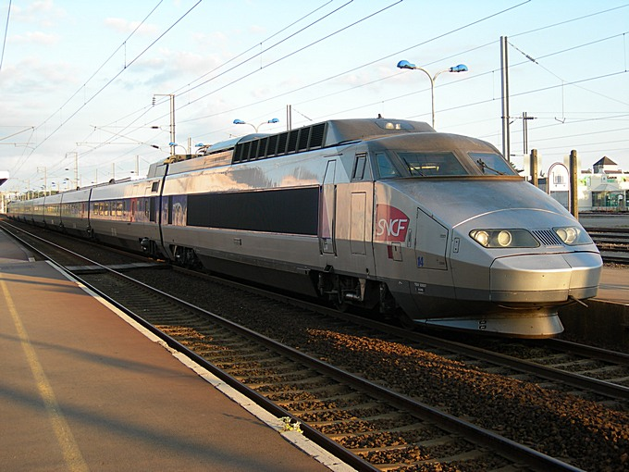
Derived Physics Data
Why do we need them?
Disk space at Tier2s
Tier2 sites will provide data access to most of ATLAS – this is not enough for many studies
Only a fraction of the space can be taken with ESD
DPDs can have some ESD-level data if on the whole they’re small enough
Centralized production – the train model
Skimming should make analysis faster
Primary DPDs produced centrally at Tier1s to optimize resources
Skimming – remove un-interesting events
Slimming – remove un-needed containers/objects
Thinning – remove un-necessary object details

Slide 3
DPD task force
Created 22 July to establish the requirements and address the design of the DPD
Led by Gustaaf Brooijmans and David Côté
First prototype is working in the FDR-2c starting today
Needs release 14.2.20.3 + PATJobTransforms-00-00-22 + PrimaryDPDMaker-00-00-28
This will be a first prototype to be improved for initial running
More details:
https://hypernews.cern.ch/HyperNews/Atlas/get/primaryDPDcontent/34.html
http://indico.cern.ch/conferenceDisplay.py?confId=39971
Trigger represented by Xin and me; Fabrizio also part of DPD Task Force

Slide 4
The story/plan so far…
Only concerned with primary DPD
D^{n}PD really means ntuples obtained from DPD
Produce 8 “Performance DPDs” at Tier0 and Tier1 for detector/reconstruction performance studies
Physics DPDs to be defined later – not immediate priority and would benefit from more experience
Design based on (trigger) streams
Rely somewhat on stream overlap ≈ 10%
not producing 8 DPDs × N streams! Count on 1 DPD/stream + few extra requests
Data formats in Tier2 disk:
25% Simulation
25% AOD
25% DPD
25% the rest: BS, ESD, user data (job output) – requested by each group
Sizes:
AOD ≈ ⅕ ESD
Performance DPD ≈ 10% ESD ≈ ½ AOD
AOD : around 50 kB/event for ttbar with 10³¹ no Bphysics menu – assume 30 kB/streamed event
Perfrormance DPD: bottom line is around 15 kB / (event × stream efficiency × skimming efficiency) assuming 1 DPD per trigger stream

Slide 5
Performance DPDs
Strategies:
“RoI DPD” – keep heavy objects only from regions of interest
E.g. calorimeter cells in a cone around an electron
Typical “efficiency” wrt full ESD found to be ~20%
Skim events to keep signal enriched sample (W/Z signal/standard candles, high-p_{T}, tight PID)
Prescale: keep only a fraction of events in some DPDs
Heavy and Light performance DPDs
Heavy:
ESD->DPD at Tier0
ESD-level information for detailed performance studies
8 heavy DPDs ≅ 80% AOD volume
Light:
AOD->DPD at Tier1
AOD-level information for quick exploration
8 light DPDs ≅ 10% AOD volume
DPD Light intended as basis for Physics DPD
DPD making:
New package PhysicsAnalysis/PrimaryDPDMaker to organise code for primary DPDs
Use Tau/Egamma/XXXDPDMakers for D²PD, D³PD only
Bookkeeping:
Use EventBookkeeper being deveoped within PAT to keep track of skim efficiencies, etc
Need to address event duplication from stream overlap

Slide 6
See PhysicsAnalysis/PrimaryDPDMaker/python/PrimaryDPD_OutputDefinitions.py for list of objects

Slide 7
DPDs and Trigger
Trigger slices interested in using Combined Performance DPDs
Important to have enough trigger info to also allow trigger studies
Monte Carlo DPDs:
DPD relies on streaming
Streaming relies on Trigger
For Monte Carlo data rely on trigger simulation

Slide 8
Trigger information in DPDs
Input from slices and physics groups collected: reported by Fabrizio in the July 23rd Menus meeting
Which triggers passed/failed, prescale, passthrough
Enough info to allow tag-and-probe (match trigger and offline objects)
Benchmark for minimal trigger info being requested!
Possibility: use for selection optimisation
Trigger navigation:
For 2008 run: store as is, no thinning
For 2009 run:
Thin down to contain only requested chains
Tomasz and Harvard group interested
Not clear how to deal with trigger features attached to deleted chains
Configuration information to remain unslimmed
Matching between offline and online objects
Quite some interest from physics groups
Existed in EventViewTrigger
Can we provide common solution? Carsten Hensel working on this

Slide 9
Menus meeting
23/7/08

Slide 10
Trigger objects currently in DPD
Configuration and steering:
TrigConf::Lvl1AODPrescaleConfigData#AODConfig-0
TrigConf::Lvl1AODPrescaleConfigData#AODConfig* duplicate
TrigConf::HLTAODConfigData#AODConfig*
TrigConf::Lvl1AODConfigData#AODConfig*
TrigDec::TrigDecision#TrigDecision*
HLT::HLTResult#HLTResult_EF
HLT::HLTResult#HLTResult_L2
TrigRoiDescriptorCollection#HLT
TrigRoiDescriptorCollection#HLT_T2TauFinal
TrigRoiDescriptorCollection#HLT_TrigT2CaloEgamma
TrigRoiDescriptorCollection#HLT_TrigT2CaloJet
TrigRoiDescriptorCollection#HLT_TrigT2CaloTau
TrigRoiDescriptorCollection#HLT_forMS
Level 1:
LVL1_ROI#LVL1_ROI
LVL1::JEMRoI#JEMRoIs
LVL1::TriggerTower#TriggerTowers
LVL1::JEMEtSums#JEMEtSums
L2 muons:
CombinedMuonFeature#HLT_egamma
CombinedMuonFeature#HLT
MuonFeatureContainer#HLT
TrigMuonEFContainer#HLT_MuonEF
L2 Jets:
TrigT2Jet#HLTAutoKey* obsolete
TrigT2JetContainer#HLT_TrigT2CaloJet
L2 Missing ET:
TrigMissingETContainer#HLT_T2MissingET
L2 tracks:
TrigInDetTrackCollection#HLTAutoKey*
TrigInDetTrackCollection#HLT
TrigInDetTrackCollection#HLT_TRTSegmentFinder
TrigInDetTrackCollection#HLT_TRTxK
TrigInDetTrackCollection#HLT_TrigIDSCAN_eGamma*
TrigInDetTrackCollection#HLT_TrigSiTrack_eGamma*
TrigInDetTrackCollection#HLT_TrigIDSCAN_Tau
TrigInDetTrackCollection#HLT_TrigSiTrack_Tau
TrigInDetTrackCollection#HLT_TrigIDSCAN_Muon
TrigInDetTrackCollection#HLT_TrigIDSCAN_Jet
TrigInDetTrackCollection#HLT_TrigIDSCAN_eGamma
L2 egamma:
TrigEMCluster#HLTAutoKey* obsolete
TrigEMClusterContainer#HLT*
TrigEMClusterContainer#HLT_TrigT2CaloEgamma
TrigElectronContainer#HLTAutoKey* obsolete
TrigPhotonContainer#HLTAutoKey* obsolete
TrigElectronContainer#HLT_L2IDCaloFex
TrigPhotonContainer#HLT_L2PhotonFex

Slide 11
L2 taus:
TrigTau#HLTAutoKey* obsolete
Trigtauclustercontainer#HLT_TrigT2CaloTau
TrigTauContainer#HLT
TrigTauTracksInfoCollection#HLT
EF taus:
Analysis::TauJetContainer#HLT_TrigTauRecMerged
Analysis::TauJetContainer#HLT_TrigTauRecCalo
Analysis::TauDetailsContainer#HLT_TrigTauDetailsCalo
Analysis::TauDetailsContainer#HLT_TrigTauDetailsMerged
Analysis::TauDetailsContainer#HLTAutoKey* duplicate
Analysis::TauJetContainer#HLTAutoKey* obsolete
Analysis::TauJetContainer#HLT_TrigTauRecMerged
Analysis::TauJetContainer#HLT_TrigTauRecCalo
TrigTauTracksInfoCollection#HLT
EF Missing ET:
TrigMissingET#HLTAutoKey*
TrigMissingETContainer#HLT_TrigEFMissingET
EF Jets:
JetCollection#HLTAutoKey* obsolete
JetCollection#HLT
JetCollection#HLT_TrigJetRec
EF Muons:
TrigMuonEFContainer#HLTAutoKey* obsolete
EF egamma:
egammaContainer#HLTAutoKey* obsolete
egammaContainer#NoIDEF_RoI*
egammaContainer#egamma_RoI*
egammaContainer#HLT_egamma
Egdetailcontainer#HLTAutoKey*
egDetailContainer#HLT_egamma*
EF tracks:
Rec::TrackParticleContainer#HLTAutoKey* obsolete?
VxContainer#HLT_PrimVx
Rec::TrackParticleContainer#HLT_InDetTrigParticleCreation_Tau_EFID
See PhysicsAnalysis/PrimaryDPDMaker/python/PrimaryDPD_OutputDefinitions.py for more details and offline objects
Please let us know what’s missing and what’s obsolete (we need confirmation)

Slide 12
Conclusions
First prototype of Performance DPDs being tried out right now in FDR-2c
All trigger information being kept
We need to know what is missing and what is old

Slide 13
EDM migration allowed improvements in data size on file
Overall size of trigger data depends strongly on data type and on menu
Running menu for L=10³¹ cm⁻²s⁻¹ (no Bphysics):
AOD total size: 48 kB/event
ESD total size: 86 kB/event
The HLTResult may be reduced further to 1-2 kB/event by slimming out navigation information - (e.g. for inclusion in DPDs)
13.7 | HLTResult
12.1 | Rec::TrackParticleContainer
9.9 | TrigInDetTrackCollection
3.6 | CaloClusterContainer
2.1 | TrigElectronContainer
1.9 | egDetailContainer
1.2 | Trk::VxContainer
0.7 | TrigTauClusterContainer

Slide 14
