Slide 1
L2 chains for single-beam menu
Muon full reconstruction
T2Calo starting from MBTS
Ricardo Gonçalo, Denis Damazio

Slide 2
Status report
The goal is to exercise trigger algorithms using single beam data
Most events will be empty
Beam-gas : can look like an event with CM frame hugely boosted wrt the lab
Beam-halo : it’s beam-gas upstream of ATLAS; looks like muons parallel top the beam
Would like to use these topologies to run calorimeter and muon algorithms at L2
Where to start from (L1 item)
How to produce RoIs
What chains to configure?
Pretty much starting/ongoing work and not much to show yet
Will shamelessly use this meeting to get some opinions and then implement what seems sensible

Slide 3
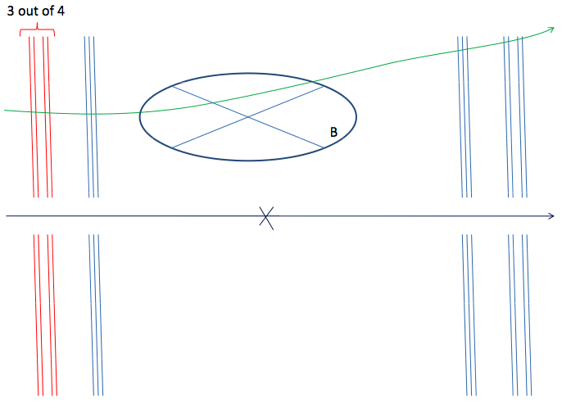
L2 muon full scan
A muon trigger from the endcap is possible (see talk by Masaya) in the last Core & Slices meeting http://indico.cern.ch/conferenceDisplay.py?confId=24854
Plan to use a chain modified from mu4_dimu_fs
Starts from L1_MU4
HLT chain counter 390
L2_MU4_DiMu_FS
EF_MU4_DiMu_FS
Uses TrigDiMuonFast at L2
Plan to use existing L2 setup in new chain

Slide 4
T2Calo_egamma starting from MBTS
For cosmics
Start from any MBTS_Ax or MBTS_Cy L1 items
Use AllTE algorithm by Alex Cerri to combine the MBTS TEs
Start one chain for side A and one for side C
RoI forced to be big chunk of endcaps
Chain proceeds as normal for photons
Add ID part when possible?
Initial prototype built by Denis and submitted to Alex
For regular menu:
Two chains starting from either MBTS_A or MBTS_C.
MBTS_A one starts EndCapA (positive eta) egamma chain.
MBTS_C does the same for a negative eta egamma chain.
Still missing chain names definition?
Again T2Calo in forced positions.
OR:
All TE to generate RoI position from MBTS id (16 MBTS scintillators on each side)
Changes to Electron.py?
Need some data sample which has MBTS information for the default menu and calorimeter (Will? Regina? David?)
Rates? (well…luminosity?)

Slide 5
Egamma chain
Plan for egamma single-beam:
Starting from L1_EM3 (?)
e5_allTracking
e5_SiTracke
5_IDSCAN
e5_TRTSegFinder
These could be the chains starting from MBTS
e5_unseeded – with L2 tracking
g5 (ie, e5_noTrack)
The cleanest way would be to have AllTE algos to start off the unseeded chains
Alternative to start 2 chains from MBTS_A and MBTS_C
Event Filter egamma with AllTE from Phillip (see next talk)
L2 tracking not yet ready – experts busy

Slide 6
Conclusions
Not very much to show yet, work ongoing
Finding best way to create these chains
Expect to have something next week

Slide 7
backup

