Slide 1
Trigger Offline Monitoring Report
Experts: Jiri Masik, Ricardo Gonçalo
Shifters: Iwona Grabowska-Bold, Holger von Radziewski, Gustavo Otero y Garzon, Michael Stoebe
Thanks to shifters and slice experts!
Trigger General Meeting – 4th October 2011

Slide 2
Summary
High load on offline DB
Tau DQ plots discrepancy in 190236
Validation of 16.1.3.14.2 for 25ns running
Panda birthing pains

Slide 3
Offline DB high load
Small problem with reprocessing opening too many connections to DB (29 Sep)
Seen in ACR during night shift: warning in CDS about high load on offline DB
Large delay in transferring data to offline (2h)
Trigger reprocessing was main client, but not only one
Would be solved by using Frontier (planned)
Not critical! Run could have survived without problems, only delay in reconstruction

Slide 4
DQ for Run 190236
Sharepoint: See link
Check that conditions are back to normal after Alfa run (190160)
egamma/tau expert (Valerio) found differences in tau efficiency wrt offline
Monitored chains: tauNoCut, tauNoCut_L1TAU50, tau20_medium1
All other slices looked fine

Slide 5
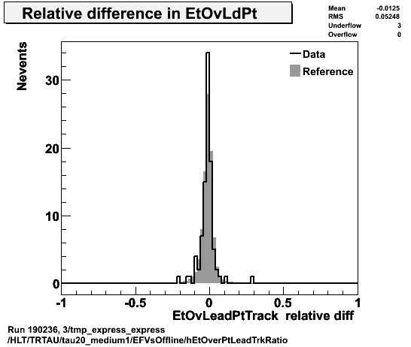
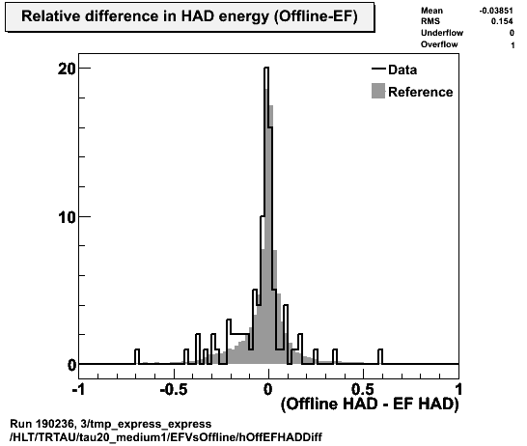
DQ for run 190236 (cont)
Likely hypothesis was that offline reconstruction was affected by bad version of Tile calorimeter DSP code, which affected eformat
DSP fragment used by offline was affected; not the one used by HLT
Express stream later reconstructed with good version of the Tile DSP code and tau plots looked fine after that (below)

Slide 6
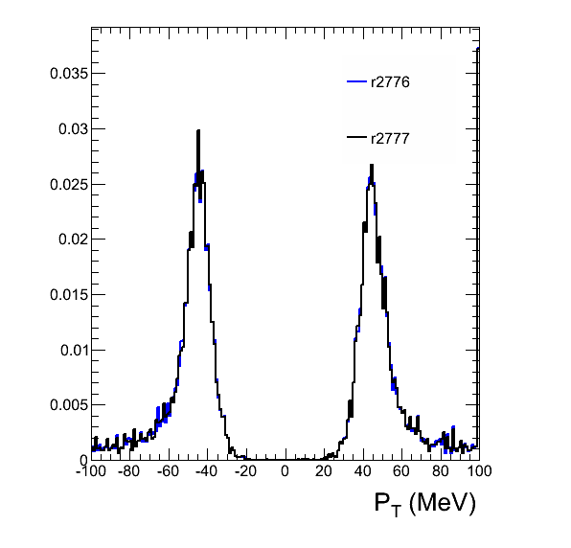
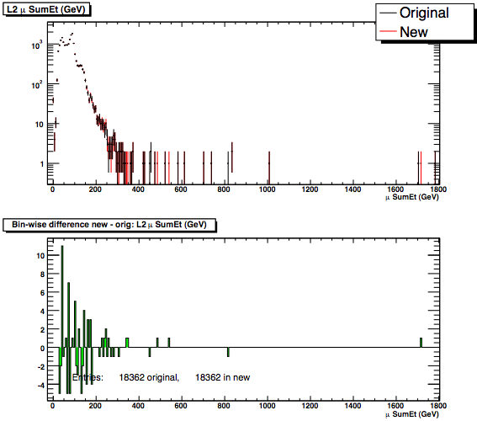
Validation of cache for 25ns running
Sharepoint link
AtlasCAFHLT-16.1.3.14.2 to be validated (tag r2776)
Included new TRT tag for 25ns running
Differences at 1/1000 level wrt reference (16.1.3.14.1, r2777)
L2 μ sum E_{T} from MET Fex
MuCombStauHypo
pT>40GeV
Difference wrt reference ≈10/10⁴

Slide 7
Panda birthing pains
Now using Panda for submitting reprocessing jobs as a replacement for TOM
Seems ok – most problems arise from lack of experience by experts – will need iterating
Real strong point is people power behind tool
Best way is to compare each task to a previous successful task – and try job transform in lxplus

Slide 8
Debug Stream
Run | Errors | DQ and Observations
190256 | 3 events with L2HltTimeou in muons; 1 ev rejected; 2 accepted | Affected chains: L2_mu10_Jpsimumu and L2_mu10_Upsimumu_tight_FS timeout at L2.
 | 3 events with L2ProcTimeout in muons; all accepted after repro | The three events have missing features in EF_2mu4T_*_noMu and EF_3mu6_Msonly
190236 | No events in debug stream | MuGirl lower eff (~93%) number of bad cells per event is off
190295 | Debug stream empty | Low stats
190297 | L2HltTimeout in taus; all recovered | All events in same lumi block

Slide 9
Reprocessing
Date | AMI Tag | Savannah | Release | Run/Stream | Reason
27 Sep 30 Sep | r2772 | #22753 – task 530246 OPEN | 16.1.3.13.1 | 186923 | Validation of new CAF build for online deployment, setting Rerun L1 to False; set enLVL1prescales=TrigByteStrTeamools.trigbs_prescaleL1
1 Oct | r2771 vs r2763 | #22913 OPEN | 14.1.3.14.1 | 189719 DRAW Z->mumu | Repro of DRAW Zmumu data to validate the new MDT muon endcap alignment
2 Oct 4 Oct | r2777 vs r2776 | #22992 - task 533374 CLOSED | 16.1.3.14.2 vs 16.1.3.14.1 | 189719 | Test new cache 16.1.3.14.2 incl. new TRT tag for 25ns running

