Slide 1
Jet trigger validation
Ricardo Gonçalo (LIP)
For the jet trigger signature group

Slide 2
Sample A ttbar alidation for MC15a
Task | Test | Container | ?
1 | 1 | run_1/HLT/JetMon/HLT/a10tcemsubFS | OK
Ref: 1) AthenaMP (r6595) 2) As 1) but with updated digi-window (r6632) Test: Full MC15 setup (AthenaMP) in 20.1.4.7 incl. digi window update; same pileup as test |  | run_1/HLT/JetMon/HLT/a4tcemjesFS | OK
 |  | run_1/HLT/JetMon/HLT/a4tcemjesPS | OK
 |  | run_1/HLT/JetMon/HLT/a4tcemsubFS | OK
 |  | run_1/HLT/JetMon/HLT/a4tcemsubjesFS | OK
 |  | run_1/HLT/JetMon/HLT/a4tclcwjesFS | OK
1 | 2 | run_1/HLT/JetMon/HLT/a10tcemsubFS | OK
Ref: 1) AthenaMP (r6595) 2) As 1) but with updated digi-window (r6632) Test: Full MC15 setup (AthenaMP) in 20.1.4.7 incl digi window update; slightly updated pileup distribution |  | run_1/HLT/JetMon/HLT/a4tcemjesFS | OK
 |  | run_1/HLT/JetMon/HLT/a4tcemjesPS | OK
 |  | run_1/HLT/JetMon/HLT/a4tcemsubFS | OK
 |  | run_1/HLT/JetMon/HLT/a4tcemsubjesFS | OK
 |  | run_1/HLT/JetMon/HLT/a4tclcwjesFS | OK

Slide 3
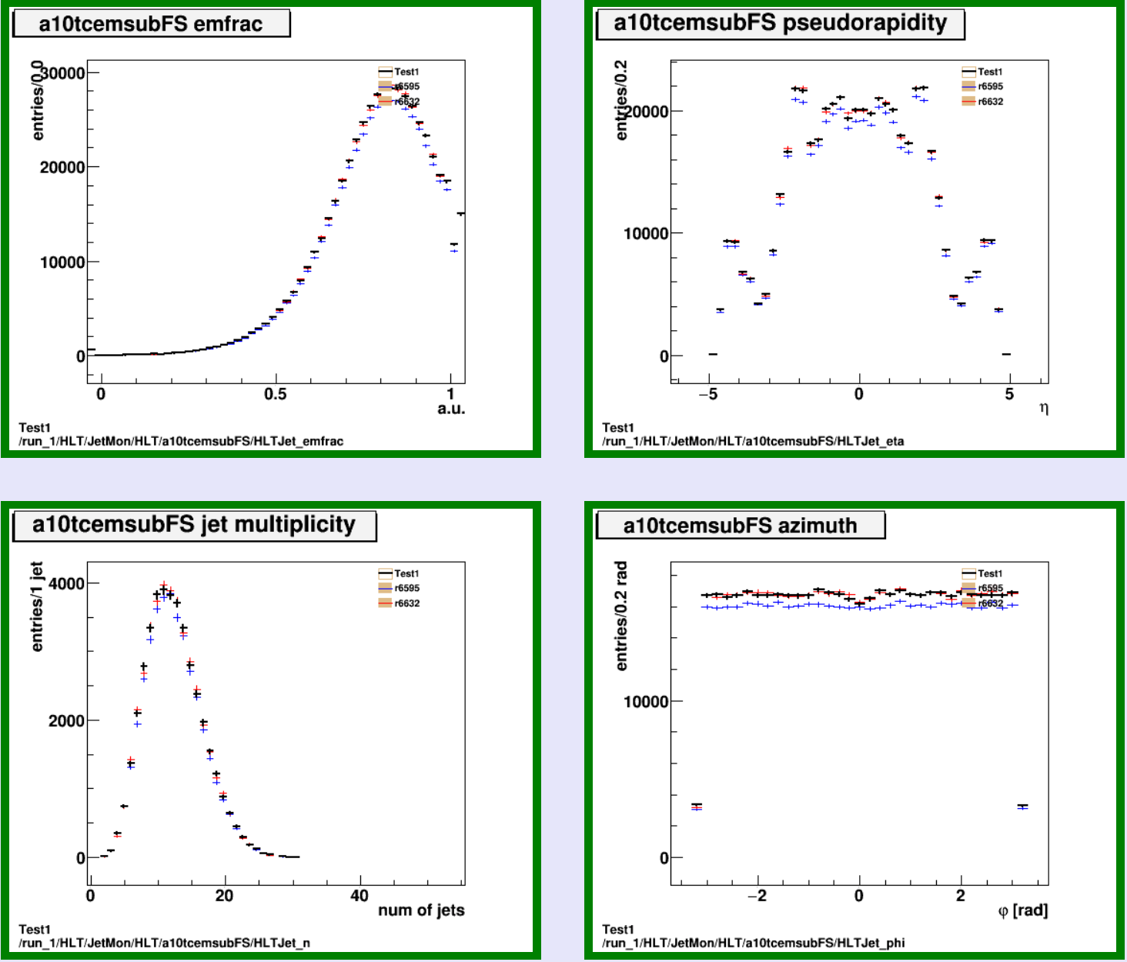
Test 1
Ref:
R6595
r6632: as 1) but with updated digi-window
Test: incl. digi-window update; same pileup as ref
Slightly less events with jets passing L1 in ref.1
Consistent with same digi. window in ref.2 and test?

Slide 4
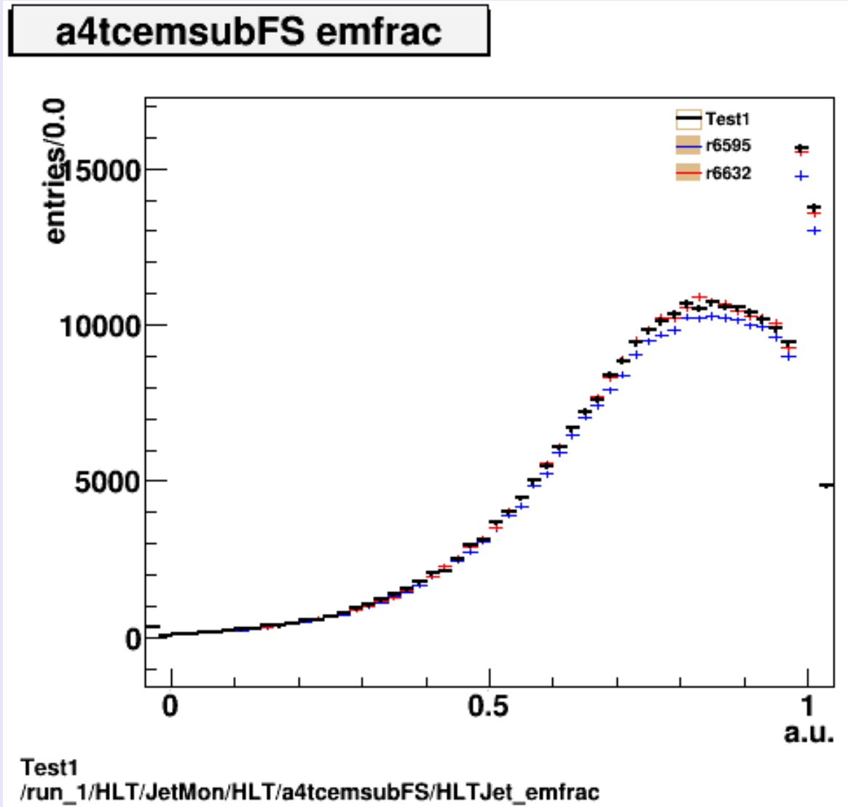
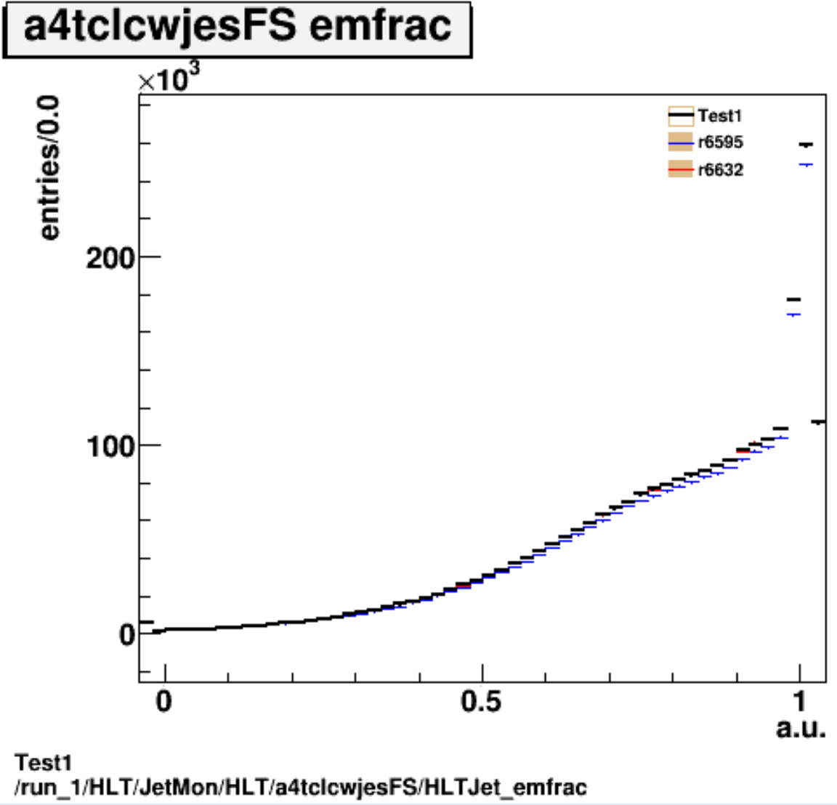
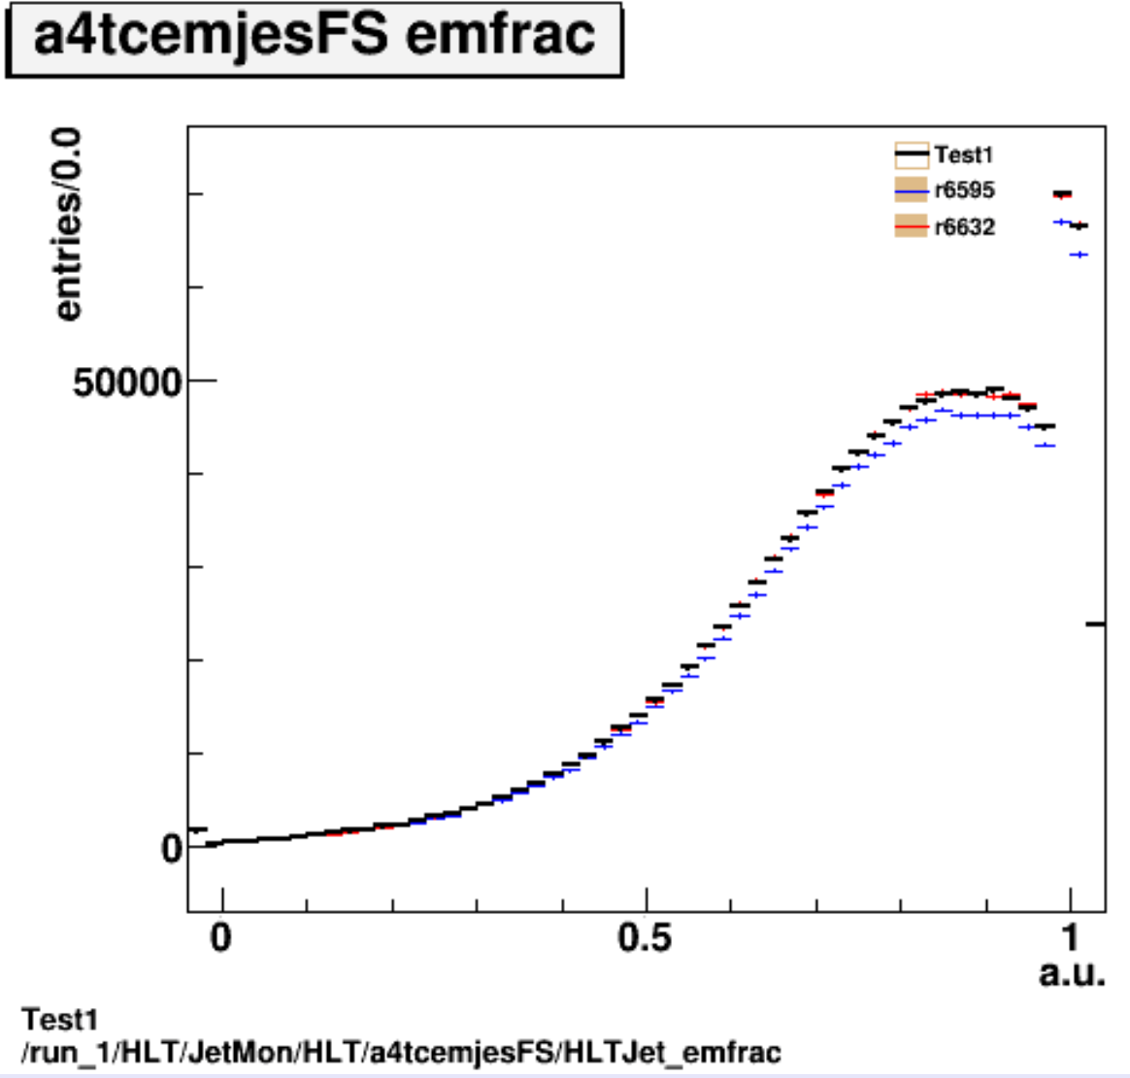
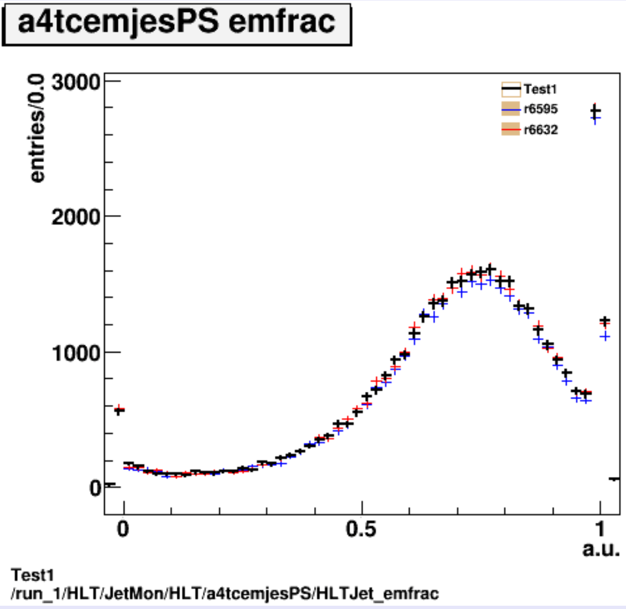
Test 1
Ref:
R6595
r6632: as 1) but with updated digi-window
Test: incl. digi-window update; same pileup as ref.
Differences in EMfrac between EM and LCW calibrations as expected

Slide 5
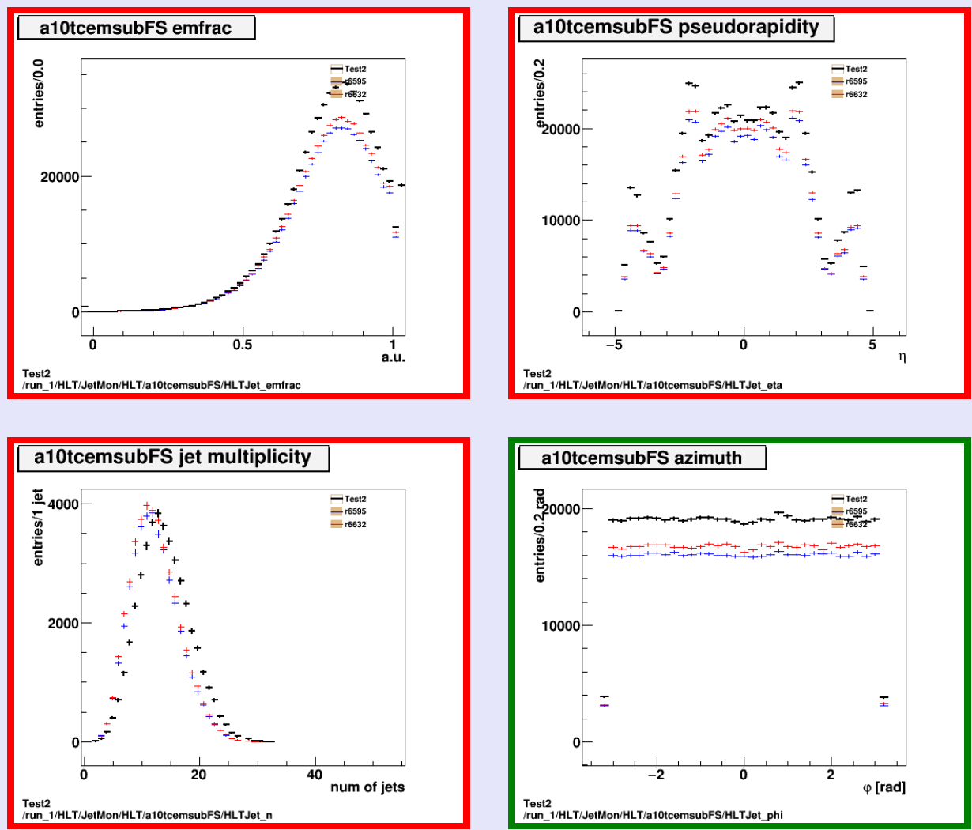
Test 2
Ref:
R6595
r6632: as 1) but with updated digi-window
Test: Full MC15 setup (AthenaMP) in 20.1.4.7 incl digi window update; slightly updated pileup
More jets in test, consistent with more pileup on average

Slide 6
Summary
Ref:
R6595
r6632: as 1) but with updated digi-window
Test 1: includes updated digi-window
Test 2: updated pileup
Conclusions:
Looks essentially fine
Small doubt about what to expect from difference digitization window in test 1

