Slide 1
Jet trigger validation
Ricardo Gonçalo (LIP)
For the jet trigger signature group

Slide 2
Sample A ttbar alidation for MC15a
Task | Test | Tags / container | ?
1 | 1 | s2578_r6588 run_1/HLT/JetMon/HLT/a10tcemsubFS | OK
No pileup Reference: 20.1.4.3 Test: 20.1.4.5 |  | s2578_r6588 run_1/HLT/JetMon/HLT/a4tcemjesFS | OK
 |  | s2578_r6588 run_1/HLT/JetMon/HLT/a4tcemjesPS | OK
 |  | s2578_r6588 run_1/HLT/JetMon/HLT/a4tcemsubFS | OK
 |  | s2578_r6588 run_1/HLT/JetMon/HLT/a4tcemsubjesFS | OK
 |  | s2578_r6588 run_1/HLT/JetMon/HLT/a4tclcwjesFS | OK
1 | 2 | s2578_r6589 run_1/HLT/JetMon/HLT/a10tcemsubFS | OK
No pileup As test 1 but SDR-28 conditions |  | s2578_r6589 run_1/HLT/JetMon/HLT/a4tcemjesFS | OK
 |  | s2578_r6589 run_1/HLT/JetMon/HLT/a4tcemjesPS | OK
 |  | s2578_r6589 run_1/HLT/JetMon/HLT/a4tcemsubFS | OK
 |  | s2578_r6589 run_1/HLT/JetMon/HLT/a4tcemsubjesFS | OK
 |  | s2578_r6589 run_1/HLT/JetMon/HLT/a4tclcwjesFS | OK

Slide 3
Sample A ttbar validation for MC15a
Task | Test | Tags / container | ?
2 | 1 | s2578_r6590 run_1/HLT/JetMon/HLT/a10tcemsubFS | OK
Ref.: no pileup Test: 50 ns pileup |  | s2578_r6590 run_1/HLT/JetMon/HLT/a4tcemjesFS | OK
 |  | s2578_r6590 run_1/HLT/JetMon/HLT/a4tcemjesPS | OK
 |  | s2578_r6590 run_1/HLT/JetMon/HLT/a4tcemsubFS | OK
 |  | s2578_r6590 run_1/HLT/JetMon/HLT/a4tcemsubjesFS | OK
 |  | s2578_r6590 run_1/HLT/JetMon/HLT/a4tclcwjesFS | OK
2 | 2 | s2578_r6591 run_1/HLT/JetMon/HLT/a10tcemsubFS | OK
As test 1 but digitization time window set via pileupFinalBunch = 6 |  | s2578_r6591 run_1/HLT/JetMon/HLT/a4tcemjesFS | OK
 |  | s2578_r6591 run_1/HLT/JetMon/HLT/a4tcemjesPS | OK
 |  | s2578_r6591 run_1/HLT/JetMon/HLT/a4tcemsubFS | OK
 |  | s2578_r6591 run_1/HLT/JetMon/HLT/a4tcemsubjesFS | OK
 |  | s2578_r6591 run_1/HLT/JetMon/HLT/a4tclcwjesFS | OK

Slide 4
Sample A ttbar validation for MC15a
Task |  | Test | Tags / container | ?
2 |  | 3 | s2578_r6593 run_1/HLT/JetMon/HLT/a10tcemsubFS | OK
Ref.: no pileup Test: 50 ns pileup SDR-26 for updated LCW for jets |  |  | s2578_r6593 run_1/HLT/JetMon/HLT/a4tcemjesFS | OK
 |  |  | s2578_r6593 run_1/HLT/JetMon/HLT/a4tcemjesPS | OK
 |  |  | s2578_r6593 run_1/HLT/JetMon/HLT/a4tcemsubFS | OK
 |  |  | s2578_r6593 run_1/HLT/JetMon/HLT/a4tcemsubjesFS | OK
 |  |  | s2578_r6593 run_1/HLT/JetMon/HLT/a4tclcwjesFS | OK
2 | 4 |  | s2578_r6594 run_1/HLT/JetMon/HLT/a10tcemsubFS | OK
Ref.: no pileup Test: 50 ns pileup As test 3 but with SDR-28 to test dead maps and b-tag calib |  |  | s2578_r6594 run_1/HLT/JetMon/HLT/a4tcemjesFS | OK
 |  |  | s2578_r6594 run_1/HLT/JetMon/HLT/a4tcemjesPS | OK
 |  |  | s2578_r6594 run_1/HLT/JetMon/HLT/a4tcemsubFS | OK
 |  |  | s2578_r6594 run_1/HLT/JetMon/HLT/a4tcemsubjesFS | OK
 |  |  | s2578_r6594 run_1/HLT/JetMon/HLT/a4tclcwjesFS | OK

Slide 5
Sample A ttbar validation for MC15a
Task | Test | Tags / container | ?
2 | 5 | s2578_r6595 run_1/HLT/JetMon/HLT/a10tcemsubFS | OK
Ref.: no pileup Test: 50 ns pileup As test 3 but with AthenaMP |  | s2578_r6595 run_1/HLT/JetMon/HLT/a4tcemjesFS | OK
 |  | s2578_r6595 run_1/HLT/JetMon/HLT/a4tcemjesPS | OK
 |  | s2578_r6595 run_1/HLT/JetMon/HLT/a4tcemsubFS | OK
 |  | s2578_r6595 run_1/HLT/JetMon/HLT/a4tcemsubjesFS | OK
 |  | s2578_r6595 run_1/HLT/JetMon/HLT/a4tclcwjesFS | OK
3 |  | s2578_r6596 run_1/HLT/JetMon/HLT/a10tcemsubFS | OK
Ref.1: no pileup Ref.:2: 50ns pileup Test: 25 ns pileup |  | s2578_r6596 run_1/HLT/JetMon/HLT/a4tcemjesFS | OK
 |  | s2578_r6596 run_1/HLT/JetMon/HLT/a4tcemjesPS | OK
 |  | s2578_r6596 run_1/HLT/JetMon/HLT/a4tcemsubFS | OK
 |  | s2578_r6596 run_1/HLT/JetMon/HLT/a4tcemsubjesFS | OK
 |  | s2578_r6596 run_1/HLT/JetMon/HLT/a4tclcwjesFS | OK

Slide 6
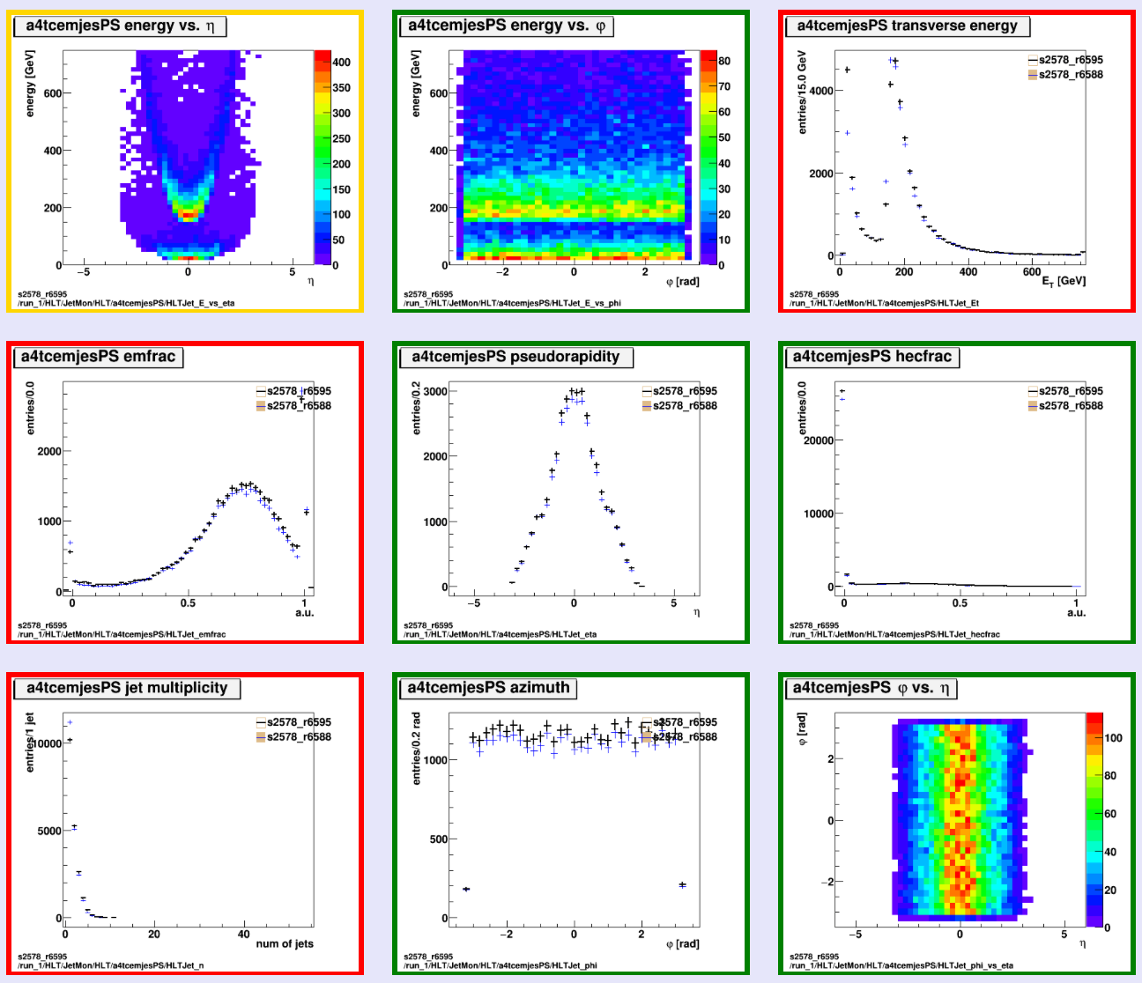
Histograms
L1_J100 turn on
L1_J100 turn on
j200_jes_PS <= L1_J100
3j175_jes_PS <=L1_J100
s2578_r6595 run_1/HLT/JetMon/HLT/a4tcemjesPS
|eta|<3.2 for these PS chains
Good pileup behaviour wrt no-PU reference

Slide 7
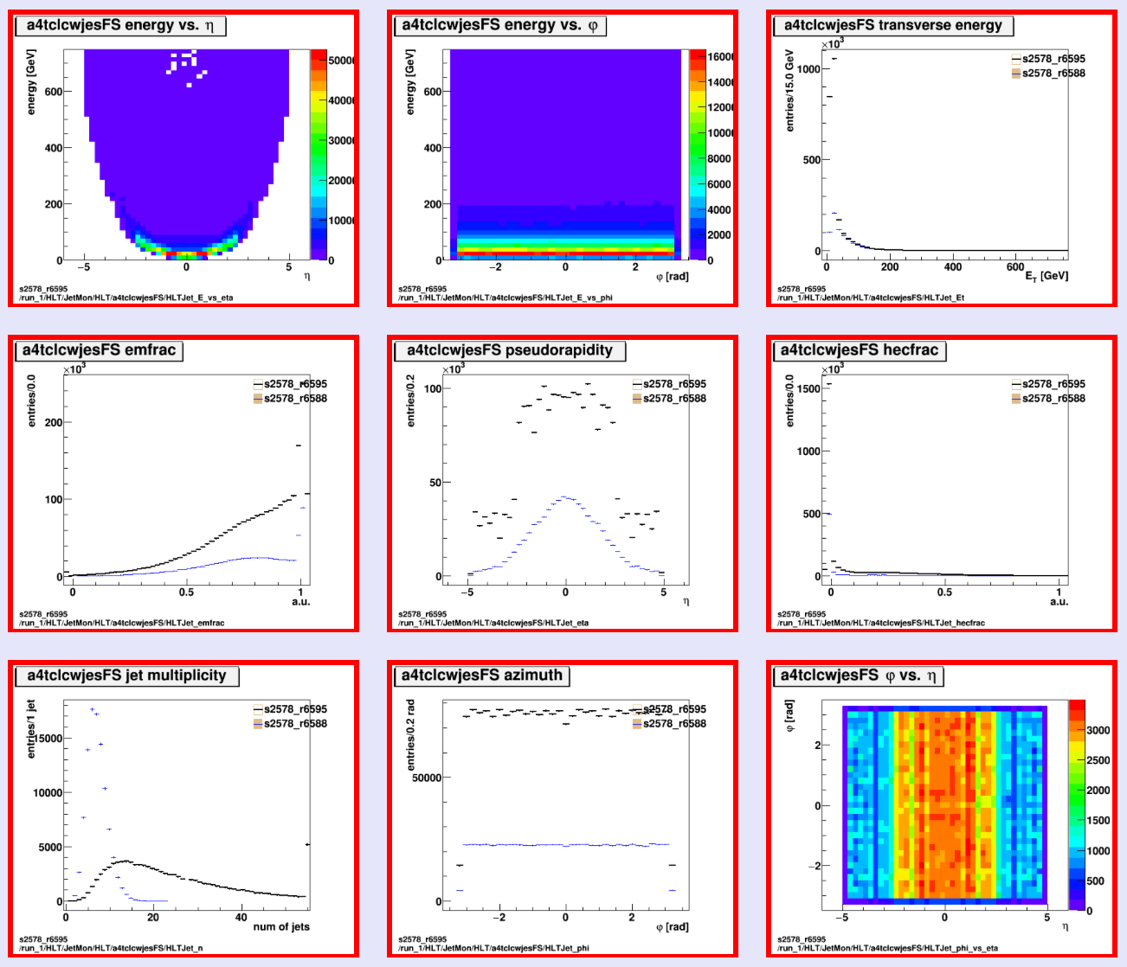
Histograms
Sharp turn-on wrt offline
Sensitive to pileup
s2578_r6595 run_1/HLT/JetMon/HLT/a4tclcwjesFS
Sensitive to pileup

Slide 8
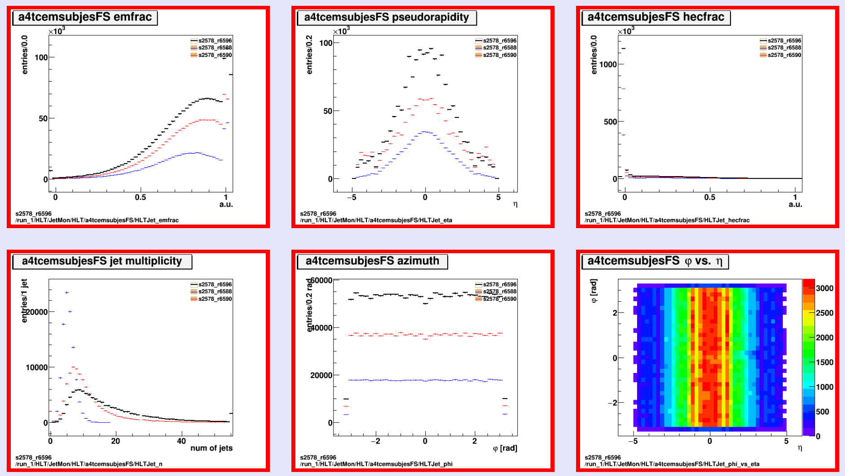
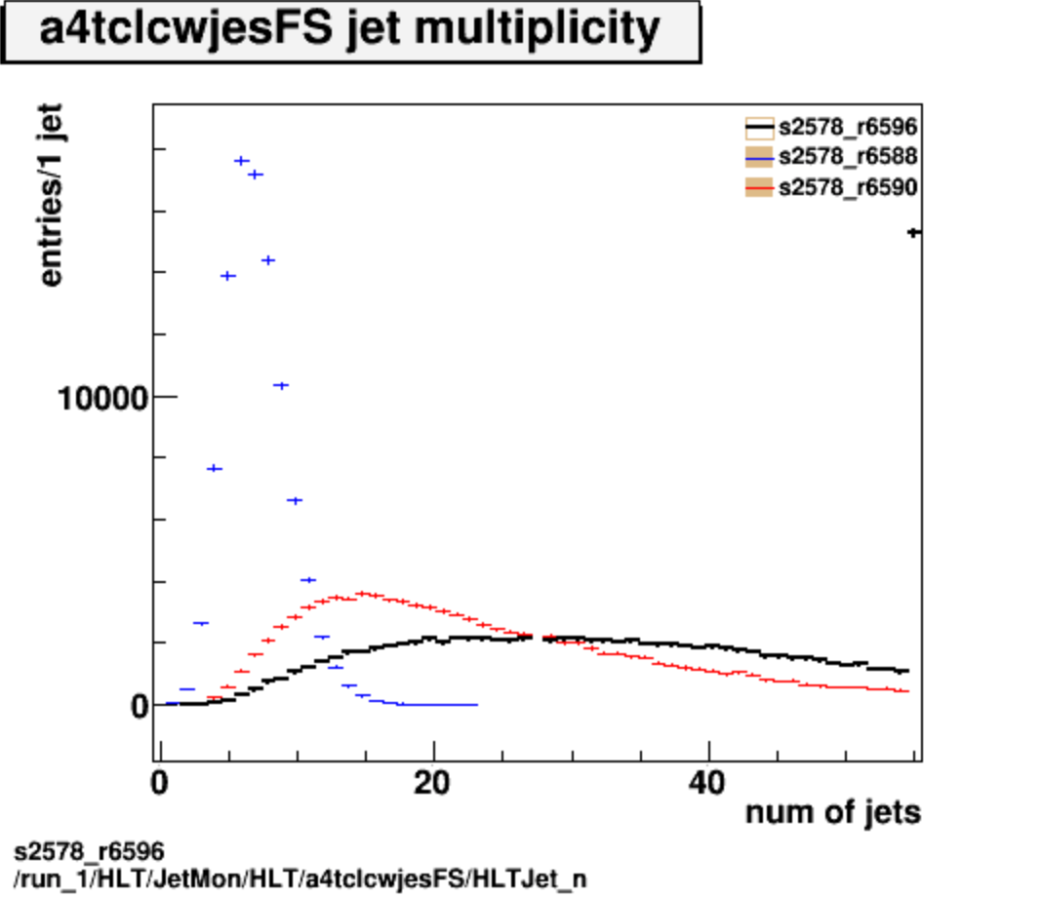
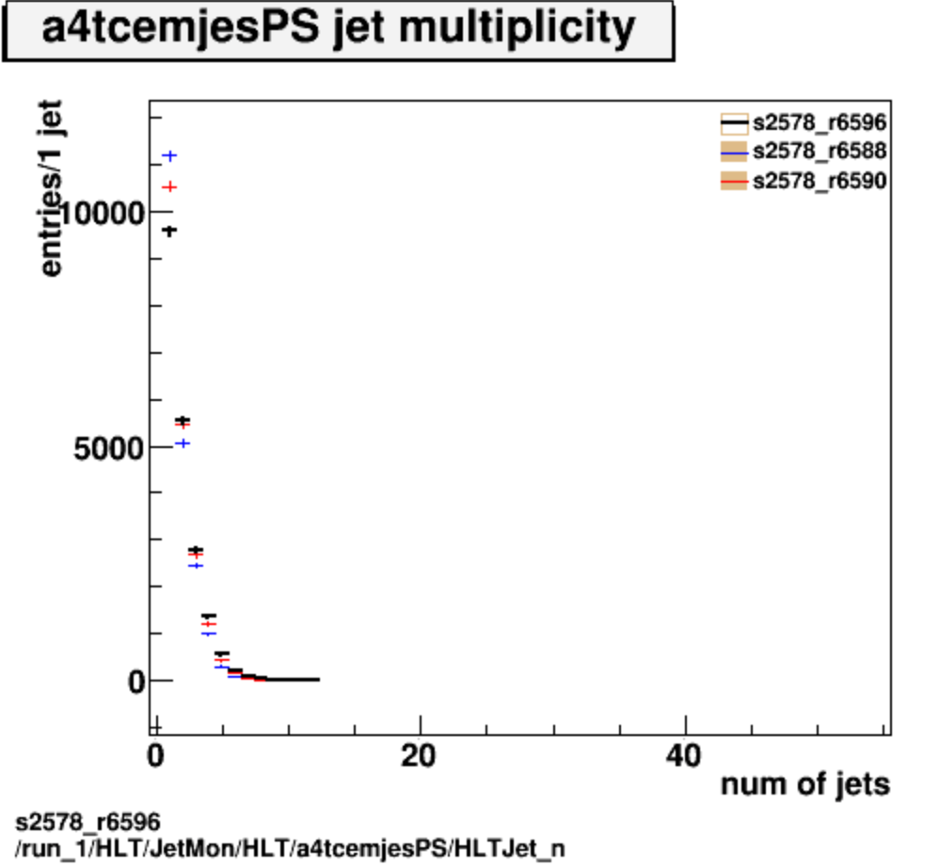
Histograms
No pileup
50ns pileup
25ns pileup
No pileup
50ns pileup
25ns pileup
25ns pileup
Partial Scan
HLT_j200
HLT_3j175
s2578_r6596 run_1/HLT/JetMon/HLT/a4tcemsubjesFS

Slide 9
Summary
Features of different calibrations etc clearly visible in plots
Effect of different pileup scenarios also clear:
50ns pileup increases number of jets
25ns pileup results in even more jets
LCW seems more sensitive to pileup jets than EM+JES
No bad surprises!…

