Slide 1
e/gamma report
Ricardo Gonçalo for the e/γ slice

Slide 2
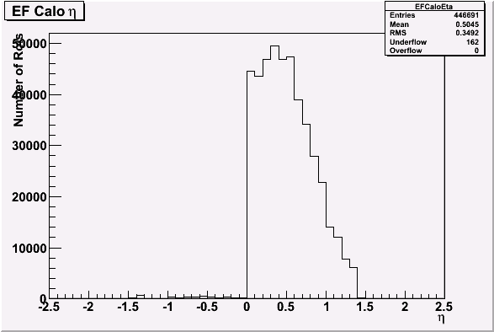
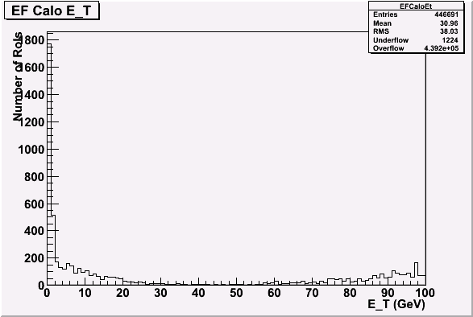
Single beam
Danilo Ferreira
Run 87764
Single-beam
HLT run offline
EDM seems ok from HLT running offline
Except for ID-related objects
Chains don’t get there?
A lot more clusters with eta < 0 for EFCalo than for T2Calo
EF energy completely off
Wrong LAr gain factor?
Last minute:
This may be caused by wrong timing and missing conditions for parts of Lar
Some of it solved since then, but offline need one preliminary iteration to synchronise digits

Slide 3
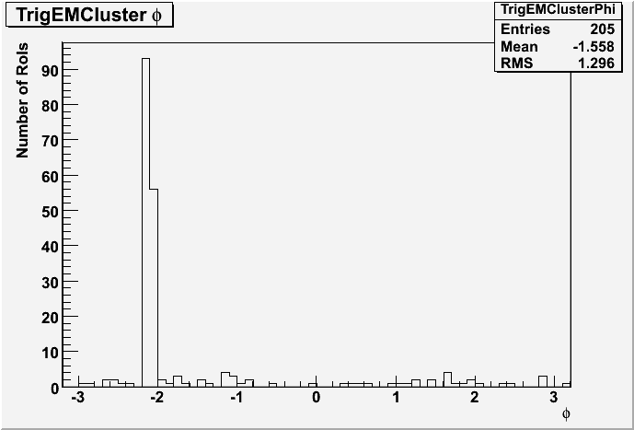
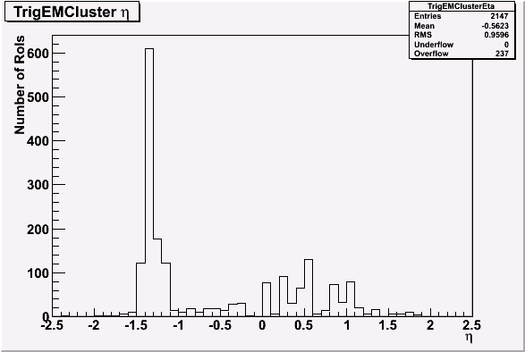
Eta and phi
Spikes at L2
eta≈-1.3; phi≈-2.1
Very odd EF eta distribution

Slide 4
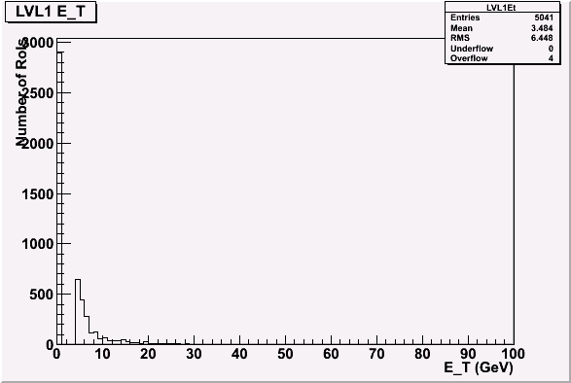
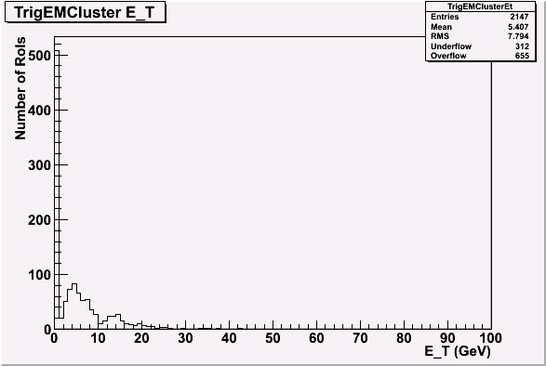
Calorimeter E_{T} per RoI

Slide 5
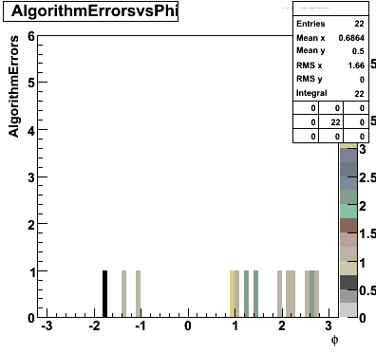
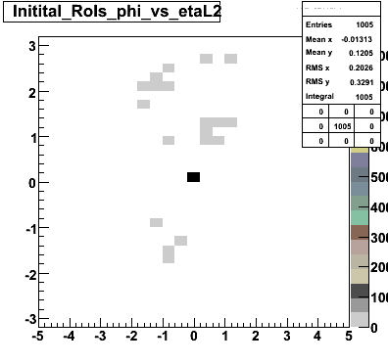
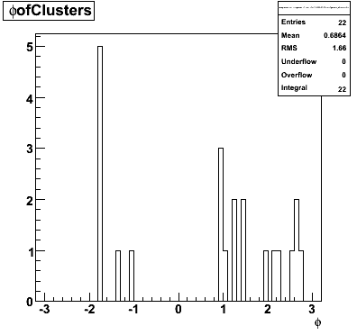
HLT running algorithms online!
Ricardo Gonçalo
Run 89293
SingleBeam_v1 HLT menu running online on cosmics

Slide 6
EDM
File:/data2/jgoncalo/SingleBeam/Cosmics/data08_cosmag.00089293.physics_L1Calo.recon.ESD.o4_f58._lb0001._sfo01._0001.1
Size: 57901.312 kb
Nbr Events: 125
================================================================================
Mem Size Disk Size Size/Evt MissZip/Mem items (X) Container Name (X=Tree|Branch)
================================================================================
3264.682 kb 951.958 kb 7.616 kb 0.024 125 (T) DataHeader
--------------------------------------------------------------------------------
114.586 kb 0.371 kb 0.003 kb 0.975 125 (B) TrigEMClusterContainer_tlp1_HLT
114.688 kb 0.371 kb 0.003 kb 0.975 125 (B) TrigEMClusterContainer_tlp1_HLT_TrigT2CaloCosmic
540.546 kb 0.371 kb 0.003 kb 0.995 125 (B) Rec::TrackParticleContainer_tlp1_HLT_InDetTrigParticleCreation_Electron_EFID
540.546 kb 0.371 kb 0.003 kb 0.995 125 (B) Rec::TrackParticleContainer_tlp1_HLT_InDetTrigParticleCreation_FullScan_EFID
540.534 kb 0.371 kb 0.003 kb 0.995 125 (B) Rec::TrackParticleContainer_tlp1_HLT_InDetTrigParticleCreation_Photon_EFID
113.887 kb 0.373 kb 0.003 kb 0.975 125 (B) TrigElectronContainer_tlp2_HLT_L2IDCaloFex
172.136 kb 0.378 kb 0.003 kb 0.983 125 (B) TrigInDetTrackCollection_tlp1_HLT_TrigIDSCAN_eGamma
172.166 kb 0.378 kb 0.003 kb 0.983 125 (B) TrigInDetTrackCollection_tlp1_HLT_TrigIDSCAN_eGamma_Brem
Containers seem to be there
But lots of work still needed to check things!

Slide 7
Other issues
Problems trying to run on ESDs from run 89293 (used ATLAS-GEO-03-00-00)
Couldn’t find trigger configuration in ESD file
IOVDbSvc errors
Stefan Ask sees same problem (in up-to-date code)
Current chains:
“normal” e5 chains starting from EM3; separate chains for IDScan, SiTrack, FwdBckdTracking, TRTxK
Calibration chain: g10
New chains starting from MBTS+BPTX: g0_mbts_a/c
ABORT_CHAIN:
Throws events to DEBUG stream (exclusive! Events lost from “physics”)
T2CaloEgamma now returns HLT::ErrorCode(CONTINUE, USERDEFS_2)
To avoid debug stream; but creates warnings! (NOTE: trigger shifter should see warnings)
Other ABORT_CHAIN still exist in chains
Would be useful to have list of files with event ranges in interesting runs page

Slide 8
Conclusions
LOTS of work is needed!!
People in e/gamma on-call shifts
Denis Damazio
Danilo Ferreira de Lima
Ricardo Goncalo
Phillip Urquijo
Andrew Hamilton
Monika Wielers

