Slide 1
Jet/MET/Calo expert on-call
Ricardo Gonçalo (LIP)
Weeks of 5 to 11 June
MET and Jet Trigger Meetings – 11 and 12 June 2018

Slide 2
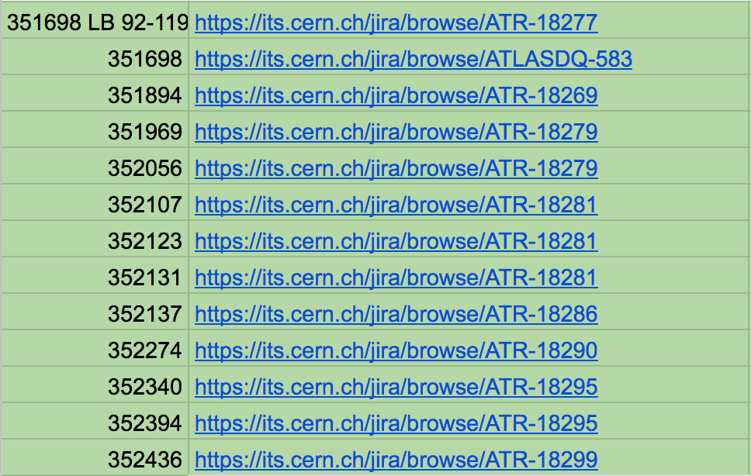
Summary of the week:
No reprocessings this week, but ATR-18276 to be checked soon
Express stream:
See spreadsheet
Physics BULK:

Slide 3
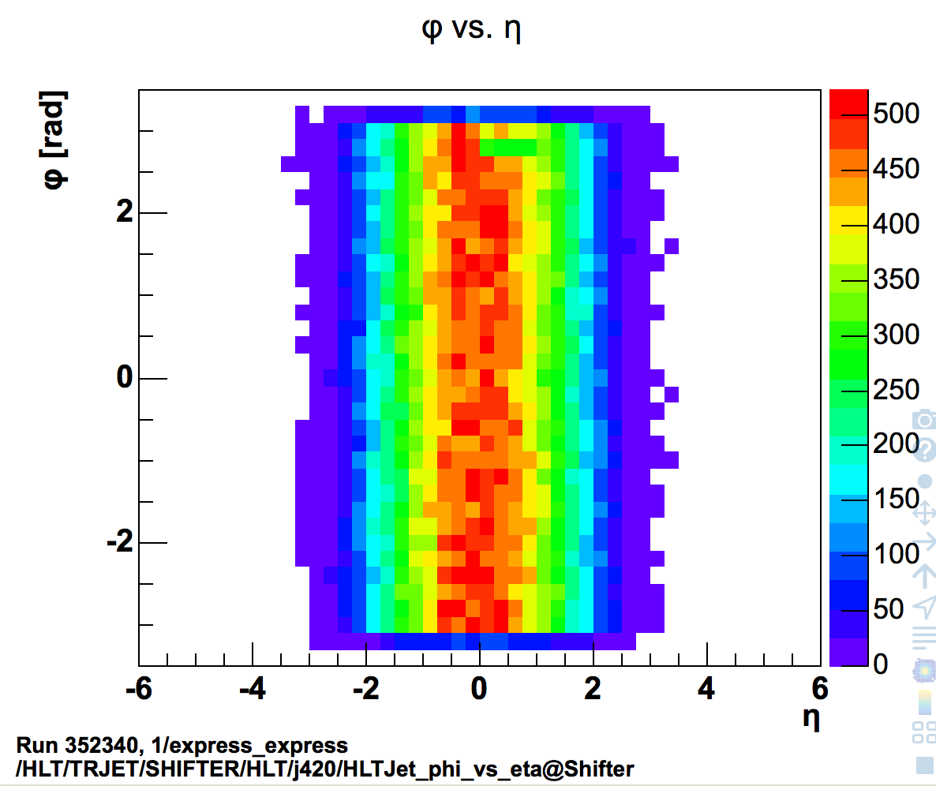
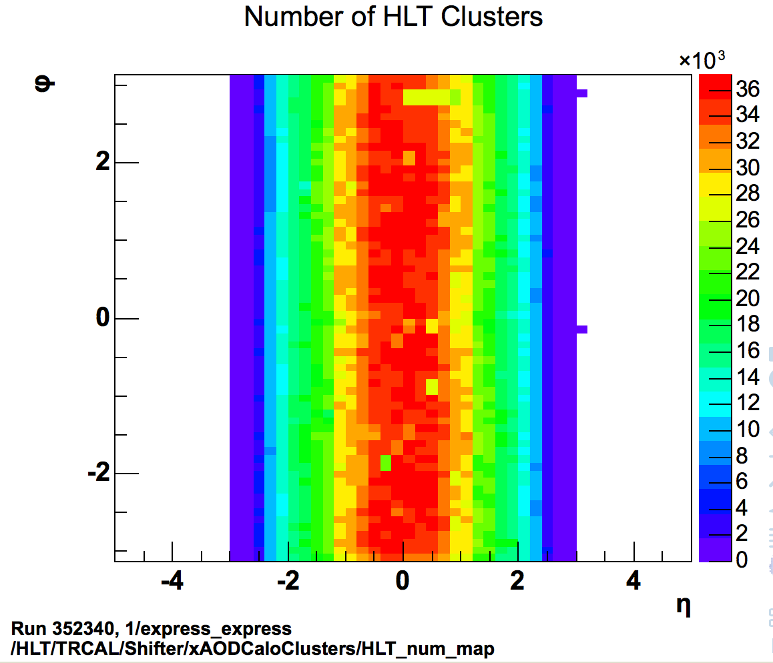
Summary of the week:
Quiet week, with a few issues to report:
Tile towers LBA29 and LBA30 missing due to a cooling problem (will be fixed at next access)
Seen in TopoClusters and high-pT jets
Set defect TRIG_HLT_CAL_TILE_SourceMinor

Slide 4
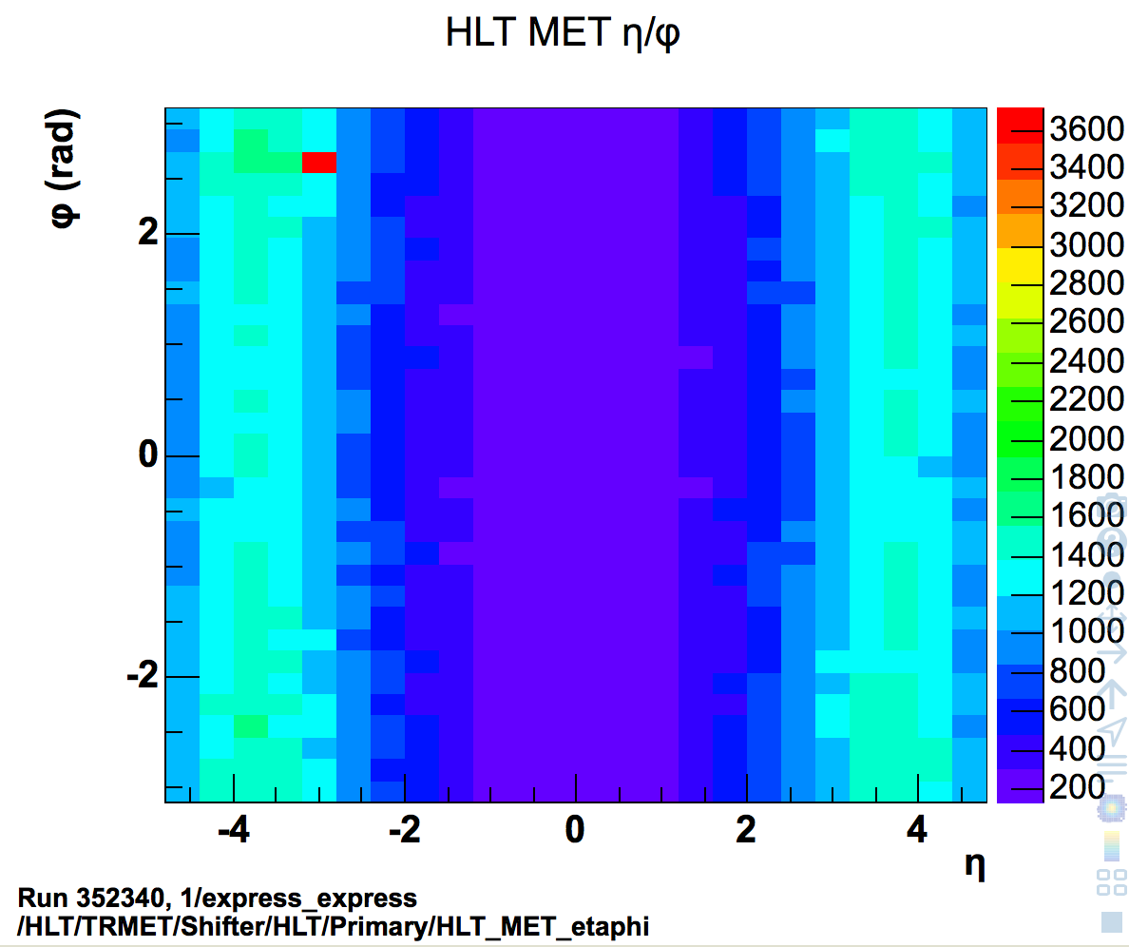
Summary of the week:
Spike at η = -3 / ϕ = 2.6 seen in lcw and pufit MET
Since run 351832 at least
Fixed in BULK after LAr masks noisy cells
Set defect TRIG_HLT_MET_phi_spike

Slide 5
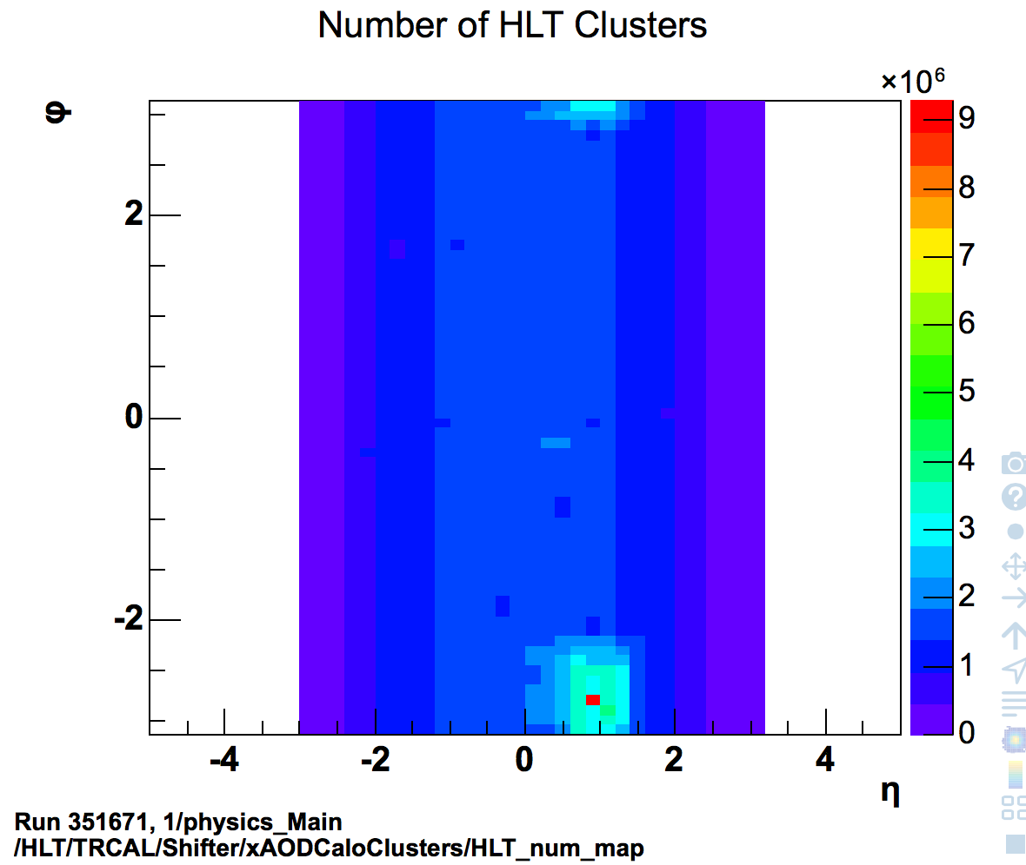
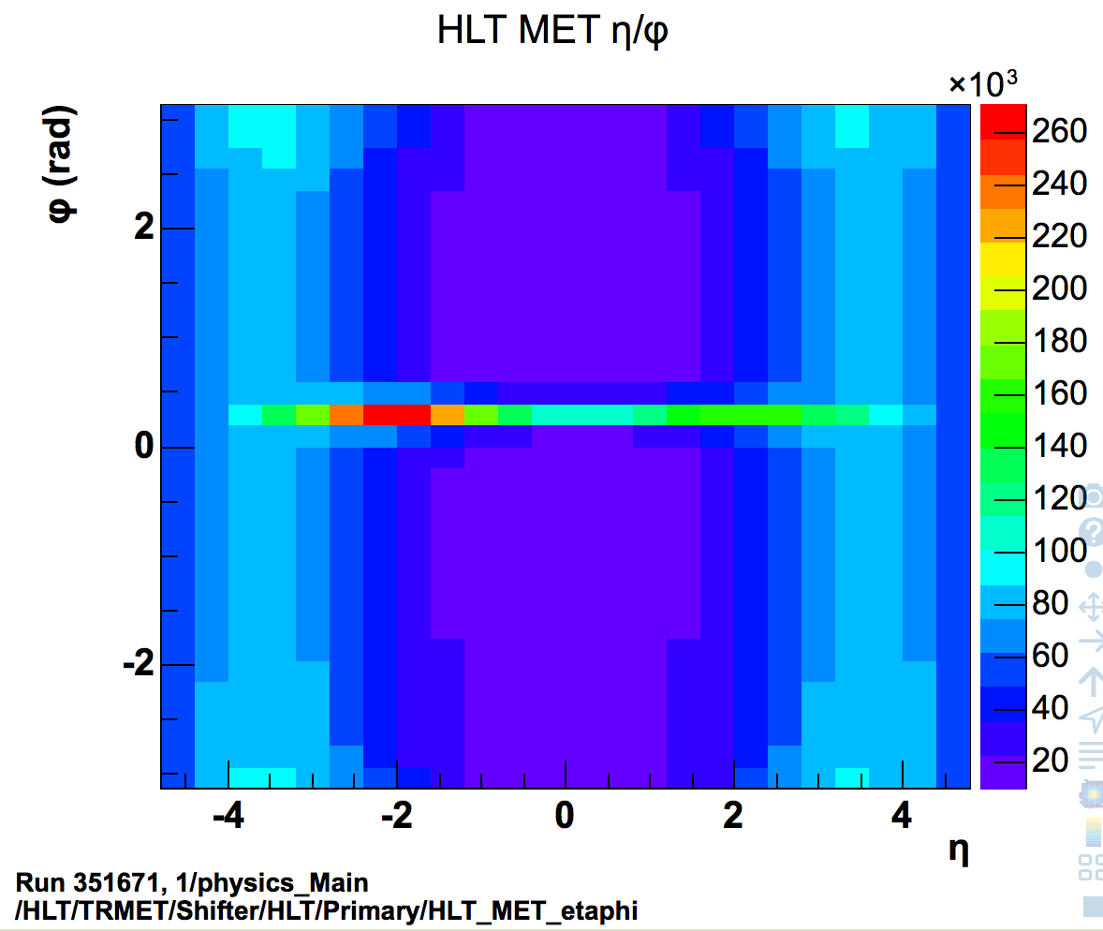
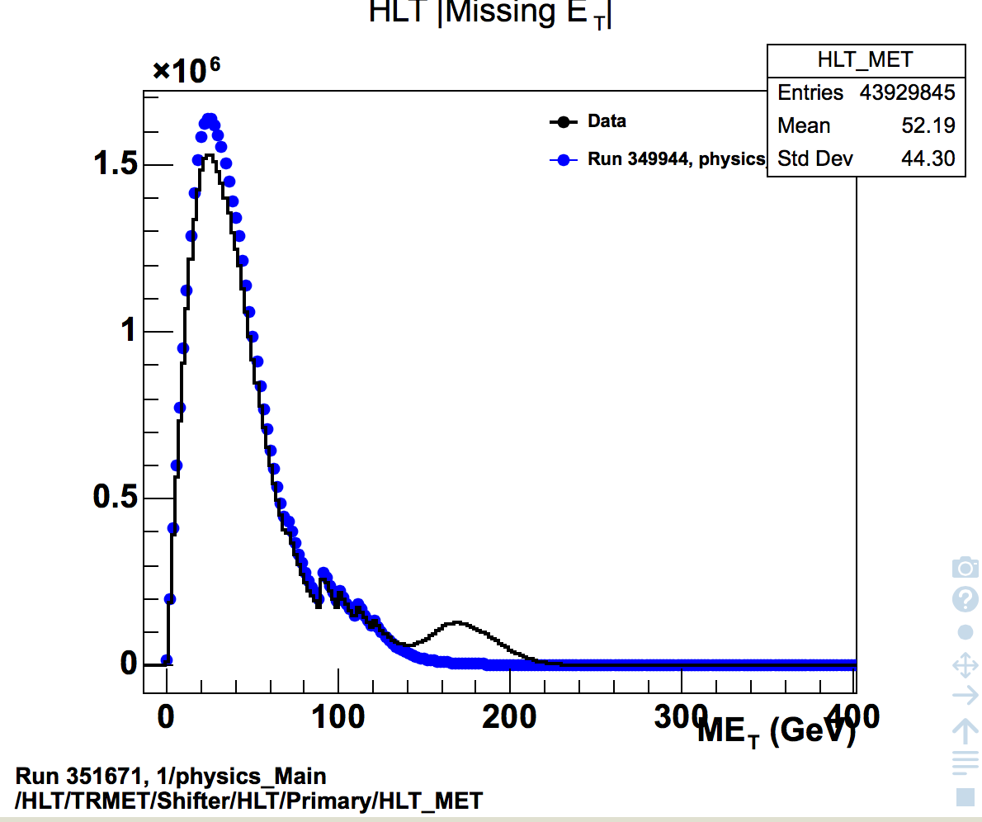
Summary of the week:
Lumi/LUCID problem:
In run 351671 there was a period where the online lumi that went to HLT was wrong and this affected MET
Lumi blocks 92 to 119 were fine in the express stream, but problem can be seen in bulk Physics_main
See ATR-18280

Slide 6
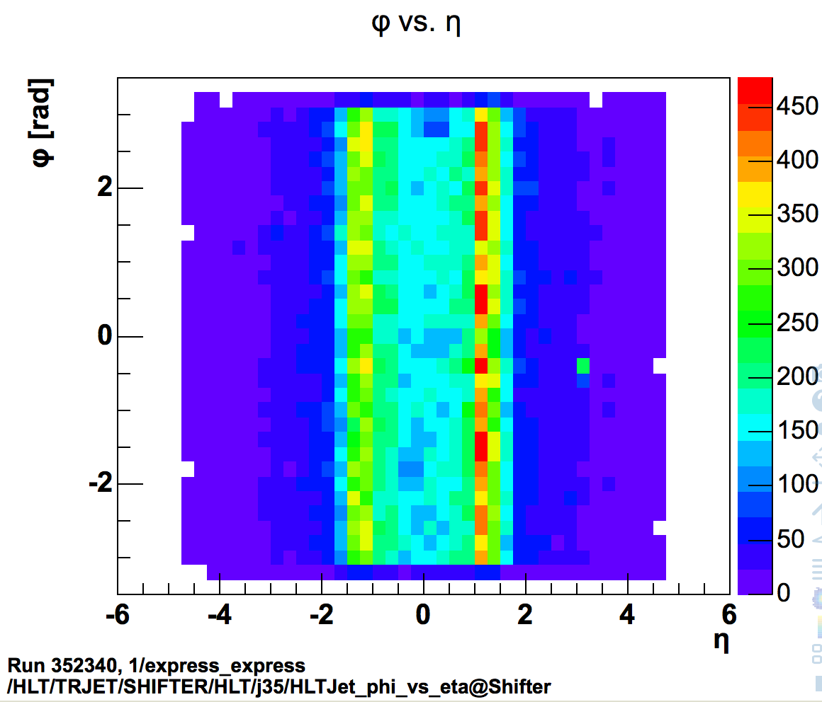
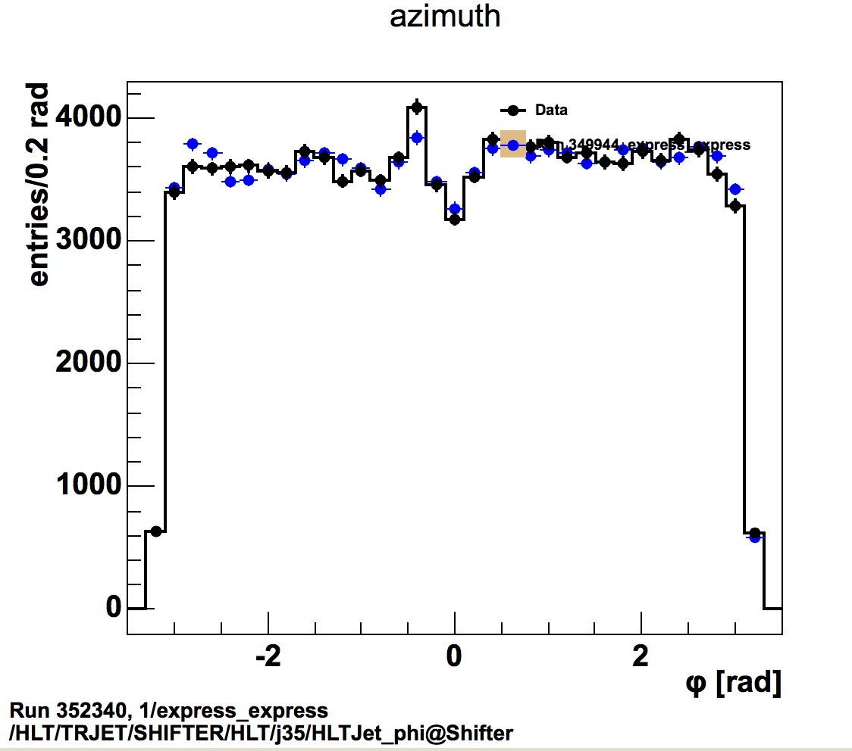
Summary of the week:
For future follow up:
Small jet spike in phi (~10%) is actually part of “warm” strip at η = 1.1
Cell calibration?
No defect set

Slide 7
Summary of the week:
New procedure for checking MET hot spots
Check Calo/Jet/MET Expert instructions wiki
NOTE : There are two types of hot spots (spikes): (1) Many low energy activities due to noisy cells or other noise like problems. (2) Mis-reconstructed high energy objects (jets). Usually only one or two extremely high pt jets. When (1) is happening, you'll see spikes in nominal eta-phi plots, but no spike in Et weighted eta-phi plots because they are low energy activities. Also, you don't see spikes in SignalEl and SignalMu nominal eta-phi histograms. When (2) is happening, you don't see spikes in nominal eta-phi plots but spikes in Et weighted eta-phi plots. If you are checking this for DQ (data quality) sign off, if you don't see spikes in nominal eta-phi plots, there is no problem on data. If you see spikes (hot spots) in nominal eta-phi plots, check the Et weighted ones and SignalEl and SignalMu ones. If you don't see spikes there, the data has no problem. But, if you see spikes at the same location, please do further investigation and contact experts. Also, you need to make sure that 2d eta-phi and 1d eta and 1d phi plots have spikes at the same location. Often, spikes are clearer in 1d phi plots. Check CaloMonitoring/CaloMonShift/CaloMonBAR/EMTopoClustersBAR if you see a hot spot in the opposite direction. The wavy structure in phi changes often. It depends on the position of beam collision. It moves from time to time. The structure in eta is rather stable but details change often. Usually forward region in the calorimeter gets more energy deposit than central region, so it has peaks at high eta.

Slide 8
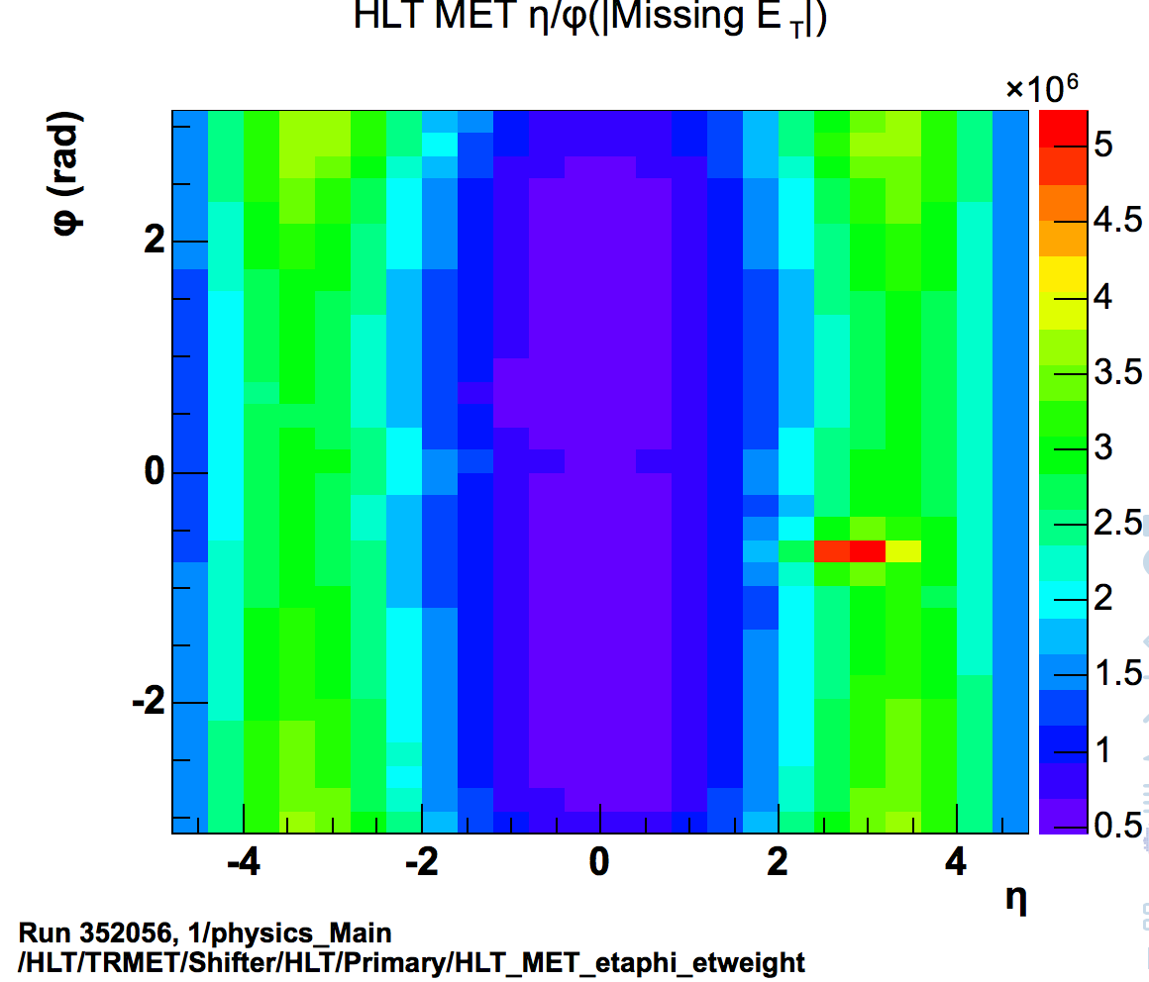
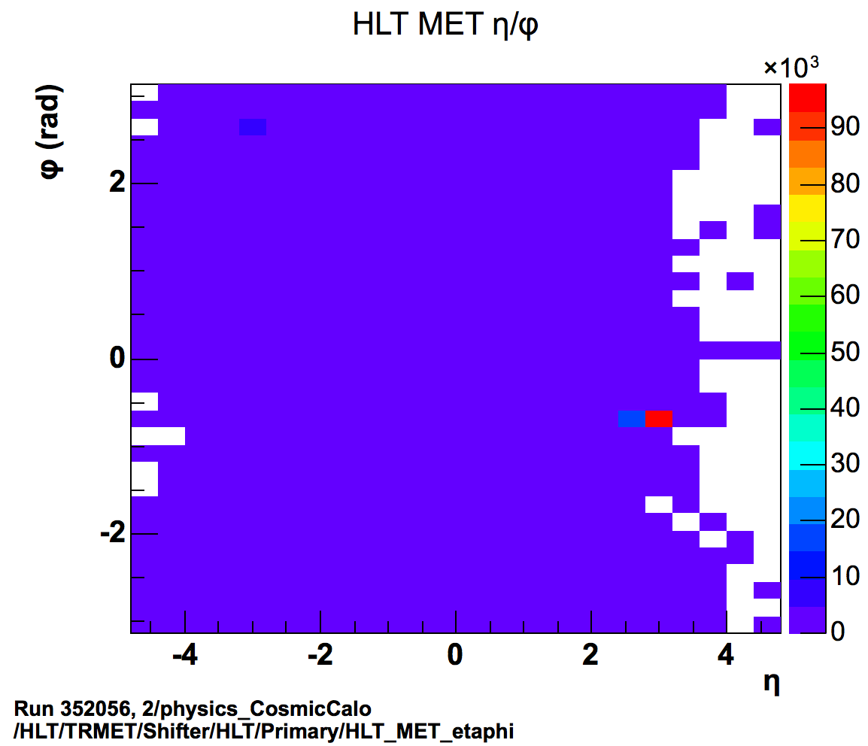
Summary of the week:
Example:
Run 352056
MET spike correlated to spike in Lar
Set defect TRIG_HLT_MET_phi_spike

