Slide 1
Jet/MET/Calo expert on-call
Ricardo Gonçalo (LIP)
Weeks of 15 to 21 May
MET and Jet Trigger Meetings – 21 and 23 May 2018

Slide 2
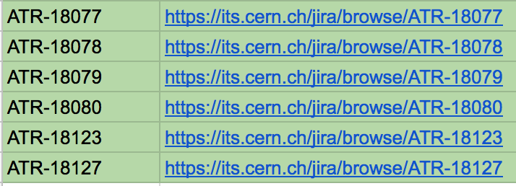
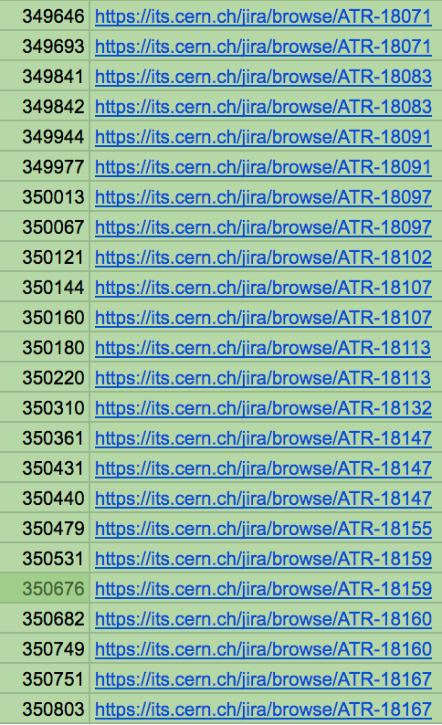
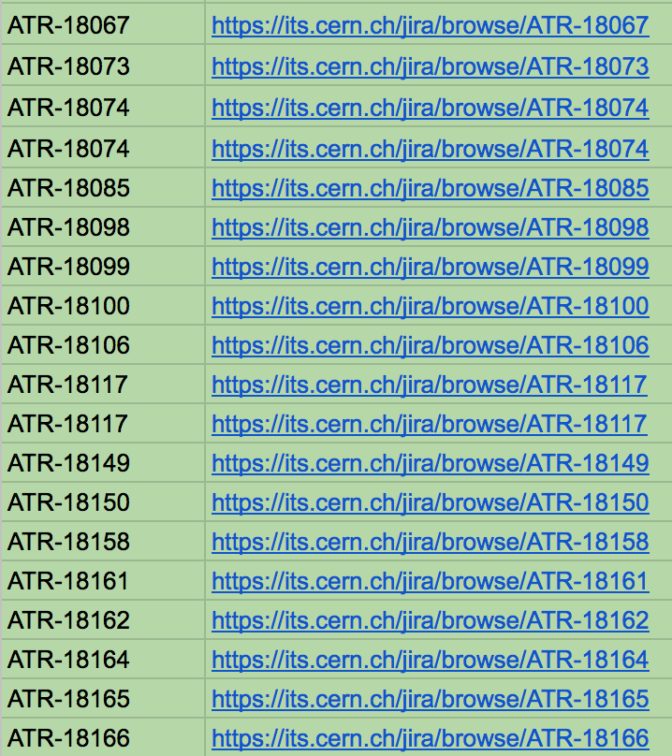
Two-week summary:
Reprocessings:
Physics BULK:
Express stream:

Slide 3
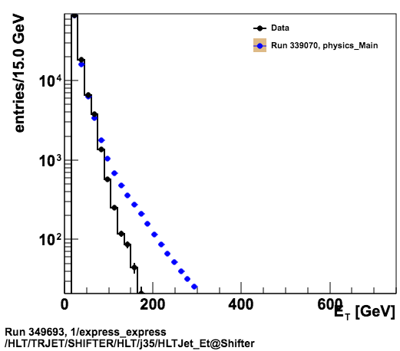
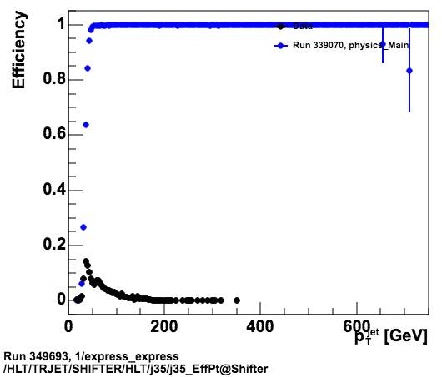
J35 Efficiency Mystery
j35 efficiency looks weird – e.g. run 349693, express_express
L1_RD0_FILLED -> HLT_j35 – prescales: 20-50k (L1) and 15 (j35)
(TProfile in HLT/TRJET/SHIFTER/HLT/j35/j35_EffPt@Shifter)

Slide 4
j35 Mystery - investigation
Checked monitoring code here: https://gitlab.cern.ch/atlas/athena/blob/master/Trigger/TrigMonitoring/TrigJetMonitoring/src/HLTJetMonTool.cxx Around line 2594:
// fill num HLT eff
if(m_doHLTTrigEff) {
if (isLeadingJet(jet,jetcoll,EtaLowThres,EtaHighThres,NJet)){ //OF leading jet in the same eta region
if(getTDT()->isPassed(Form("HLT_%s",chainName.c_str()))) {
if((p = profile(Form("%s_EffPt",chainName.c_str())))) p->Fill(jet->pt()/CLHEP::GeV,1.0,1.0);
} if (! getTDT()->isPassed(Form("HLT_%s",chainName.c_str()))){
if((p = profile(Form("%s_EffPt",chainName.c_str())))) p->Fill(jet->pt()/CLHEP::GeV,0.0,1.0);
Checked prescales: https://atlas-trigconf.cern.ch/run2/smkey/2695/l1key/20513/hltkey/15168/
Also looked at other efficiency plots for other chains
All seems normal: prescales give flat efficiency reduction

Slide 5
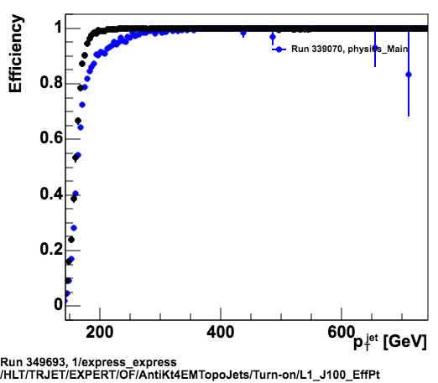
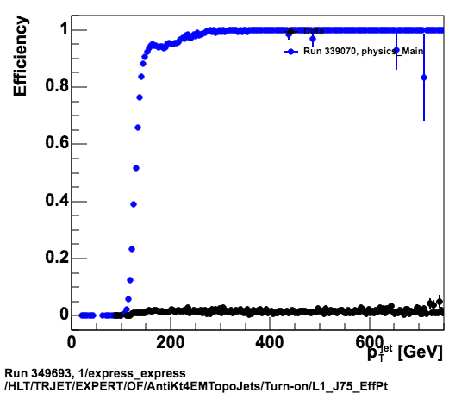
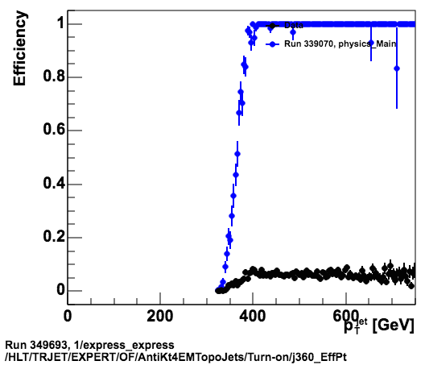
j35 Efficiency
Unlike high-pT jet chains, j35 is seeded from RD0_FILLED
Low-energy jet response sculpts efficiency
Run 349693, 1/express_express
Constant factor from prescale
Constant factor from prescale
L1_J100
L1_J75
j360

Slide 6
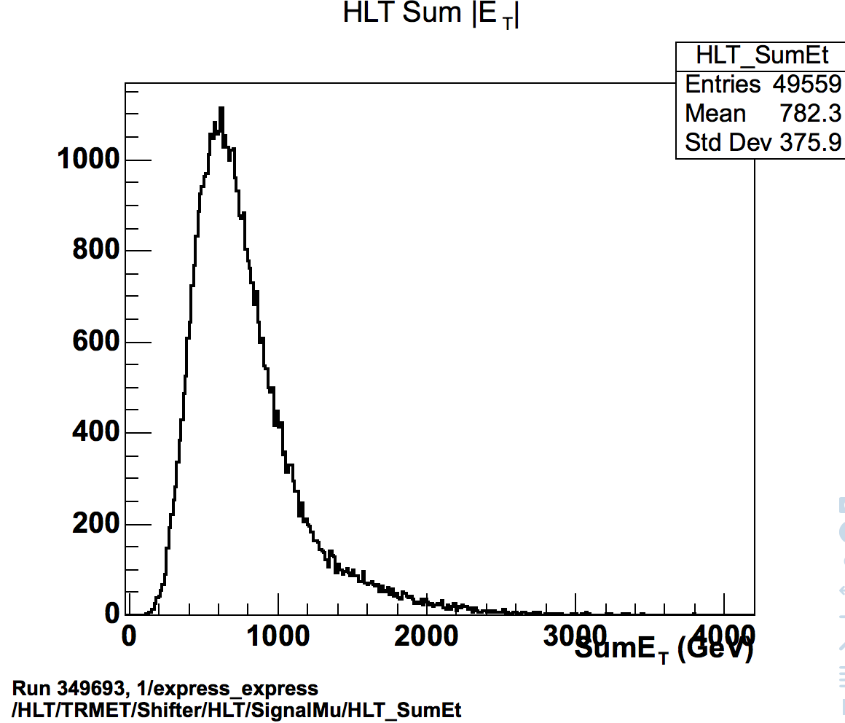
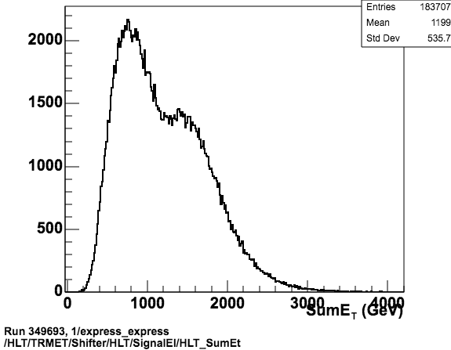
Bump in SumET
E.g.:https://atlasdqm.cern.ch/webdisplay/tier0/1/express_express/run_349693/run/HLT/TRMET/Shifter/HLT/SignalEl/HLT_SumEt
Visible in SignalEl and primary algorithm (left) but not in SignalMu (right)
Not present in BULK
Conclusion: feature of Express stream menu

Slide 7
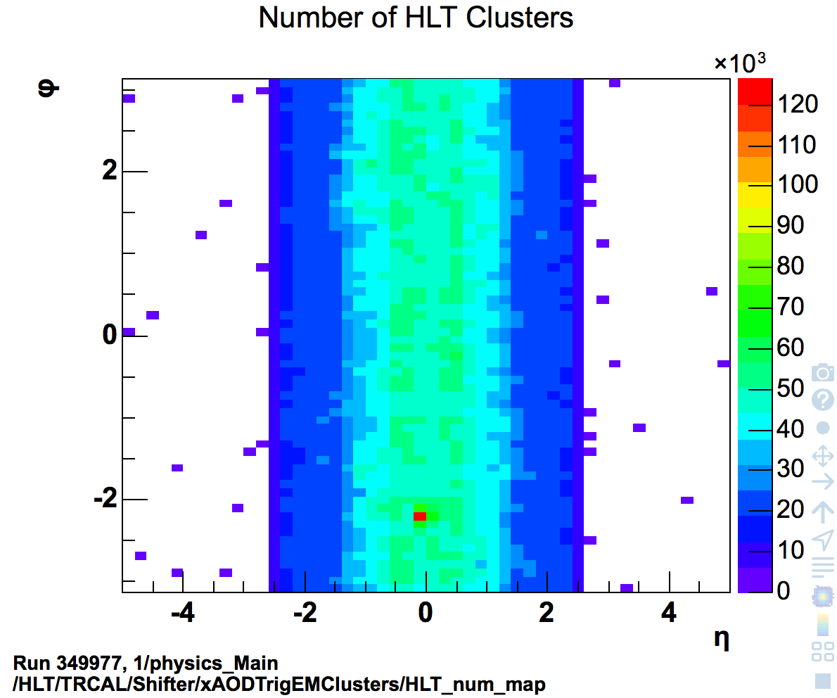
Mystery calo spike
Spike in TrigEMClusters at
eta ~ 0; phi ~ -2
Turns out was due to L1Calo miscalibration (gain turned from 1 to 1.929) see: https://its.cern.ch/jira/browse/ATLASDQ-562
Affected runs 349646, 349693, 349841, 349842, 349944, 349977, 350013, 350067, 350121, 350144, 350160, 350184
Corrected in run 350220

Slide 8
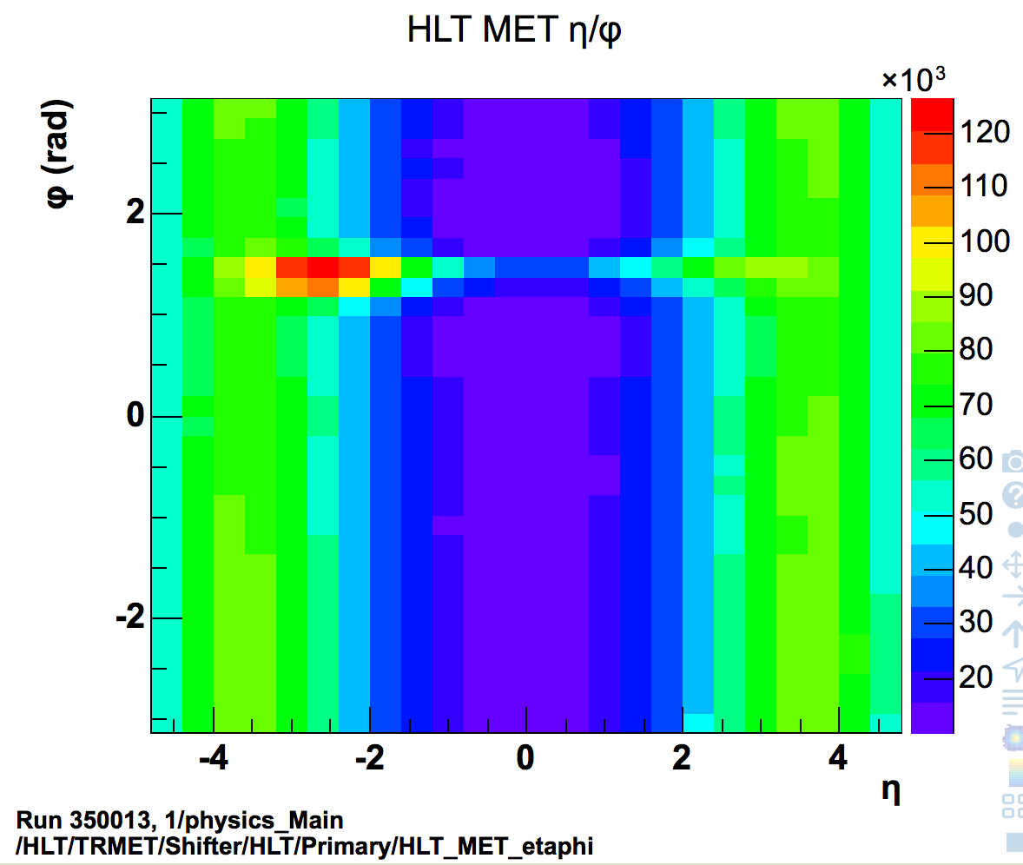
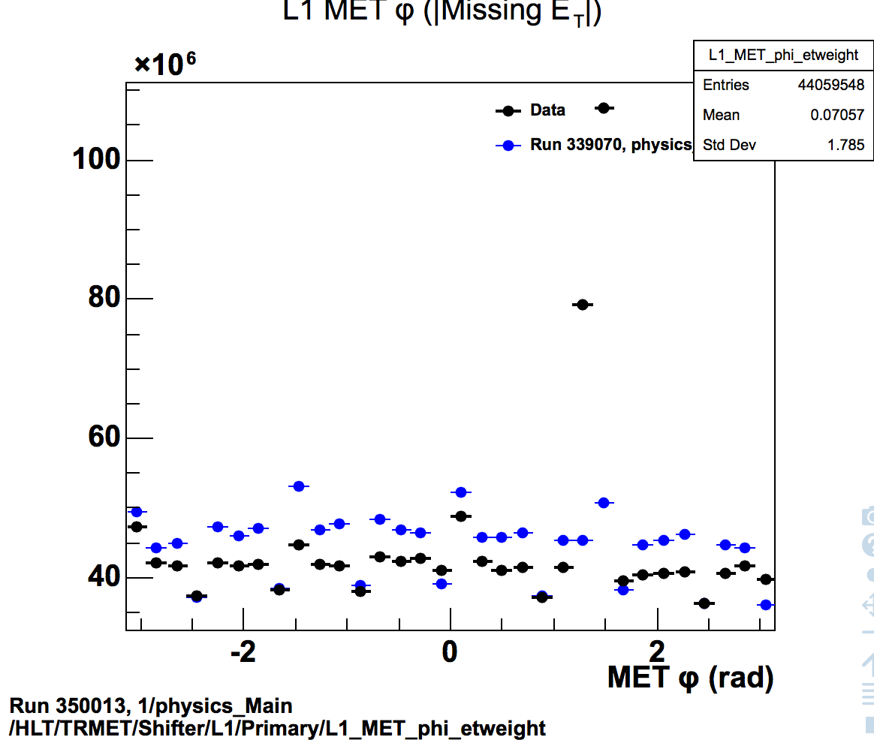
MET Phi Hotspot
MET spike appeared to be correlated with EM cluster hotspot: phi ~ -2 + 3.14 ~ 1.14 → turns out to appear in different set of runs
Turns out to be already in L1 MET (thanks Kenji!)
Runs affected: 350013, 350144, 350184, 350310, 350361, 350431
Set defect MET phi spike tolerable

Slide 9
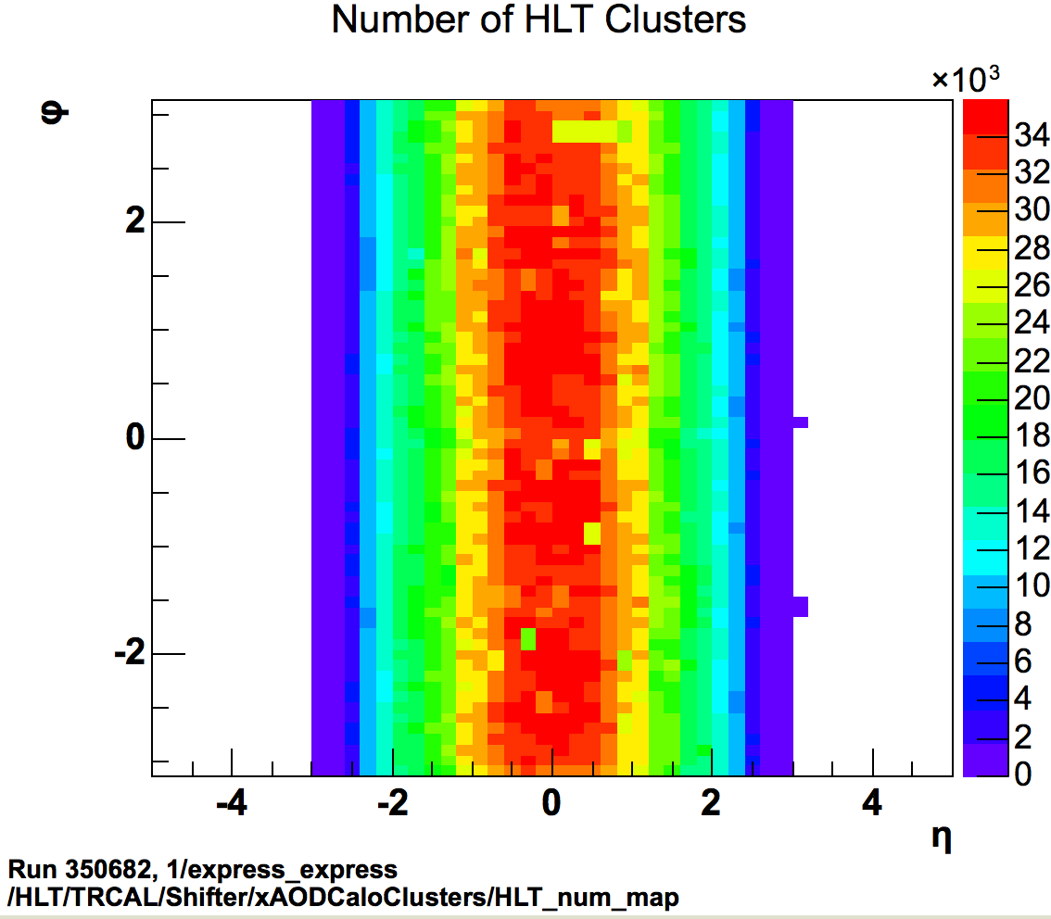
TileCal Hole
Visible in jet and HLCalo
Runs affected: 350310, 350440, 350361, 350431, 350682, 350749, etc
Hard to see in Express stream: only in L1_J100 from run 350479 (thanks Ren-Jie!)
Set defect TRIG_HLT_ CAL_Tile_SourceMinor

Slide 10
Backup

Slide 11
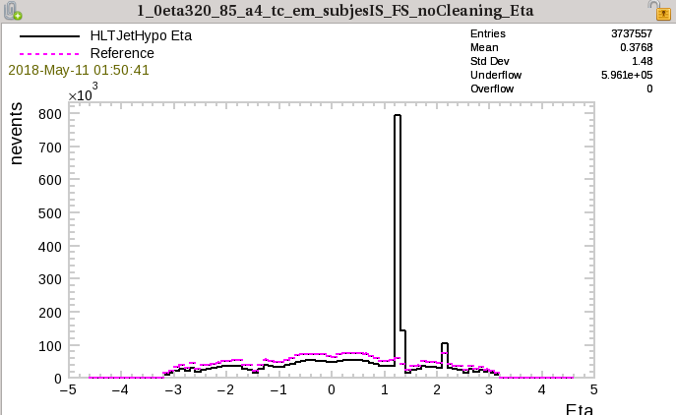
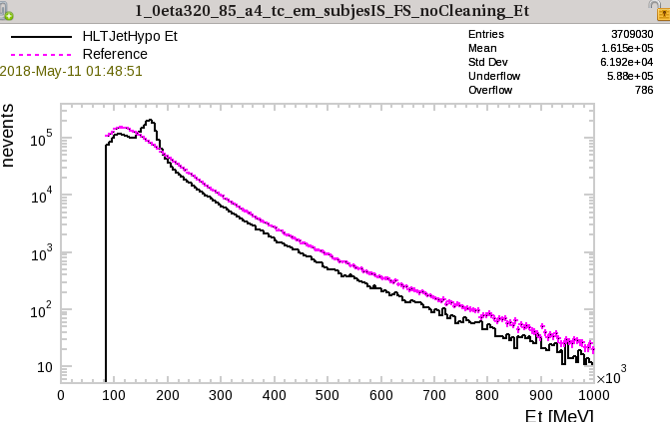
Mystery calo spike Nr.1
Mystery Jet spike appeared online at Eta = 2.2, phi=-2
Affected runs 377981, 377982
Not seen in offline plots

