Slide 1
Jet/MET/Calo expert on-call
Ricardo Gonçalo (LIP)
Week of 3 to 11 December
MET and Jet Trigger Meetings – 10 and 12 October 2018

Slide 2
News (at the beginning of the shift)
Summary of the week:
Cleaned up backlog of un-signed runs

Slide 3
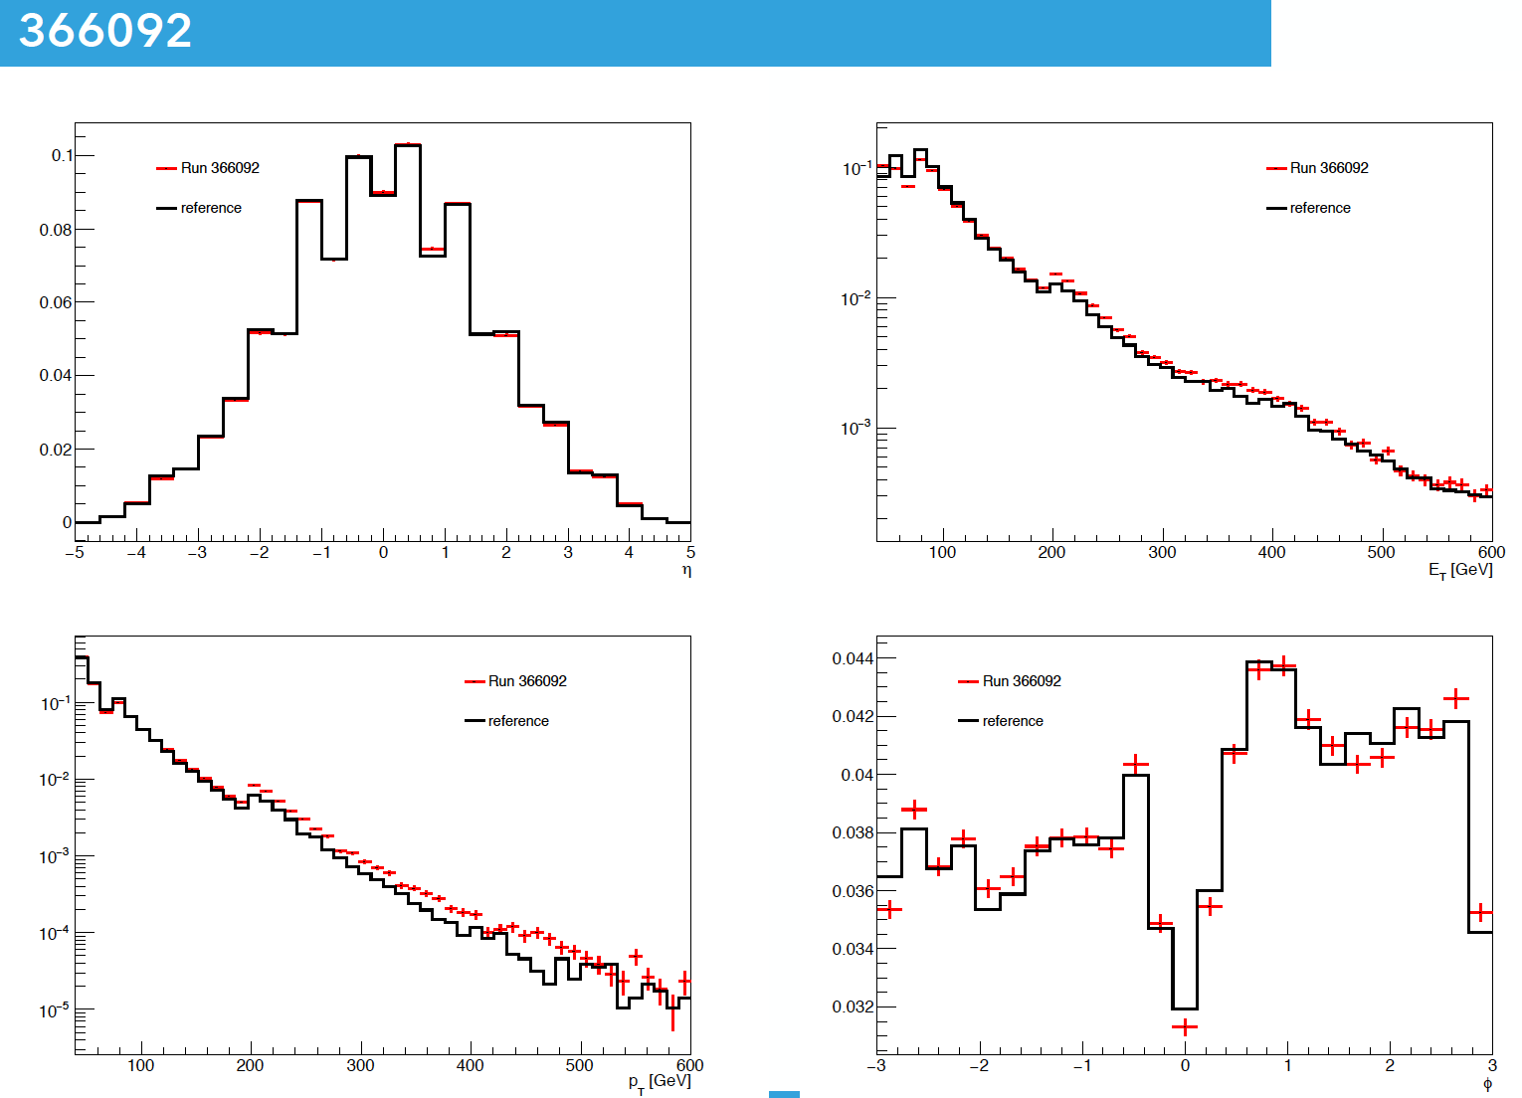
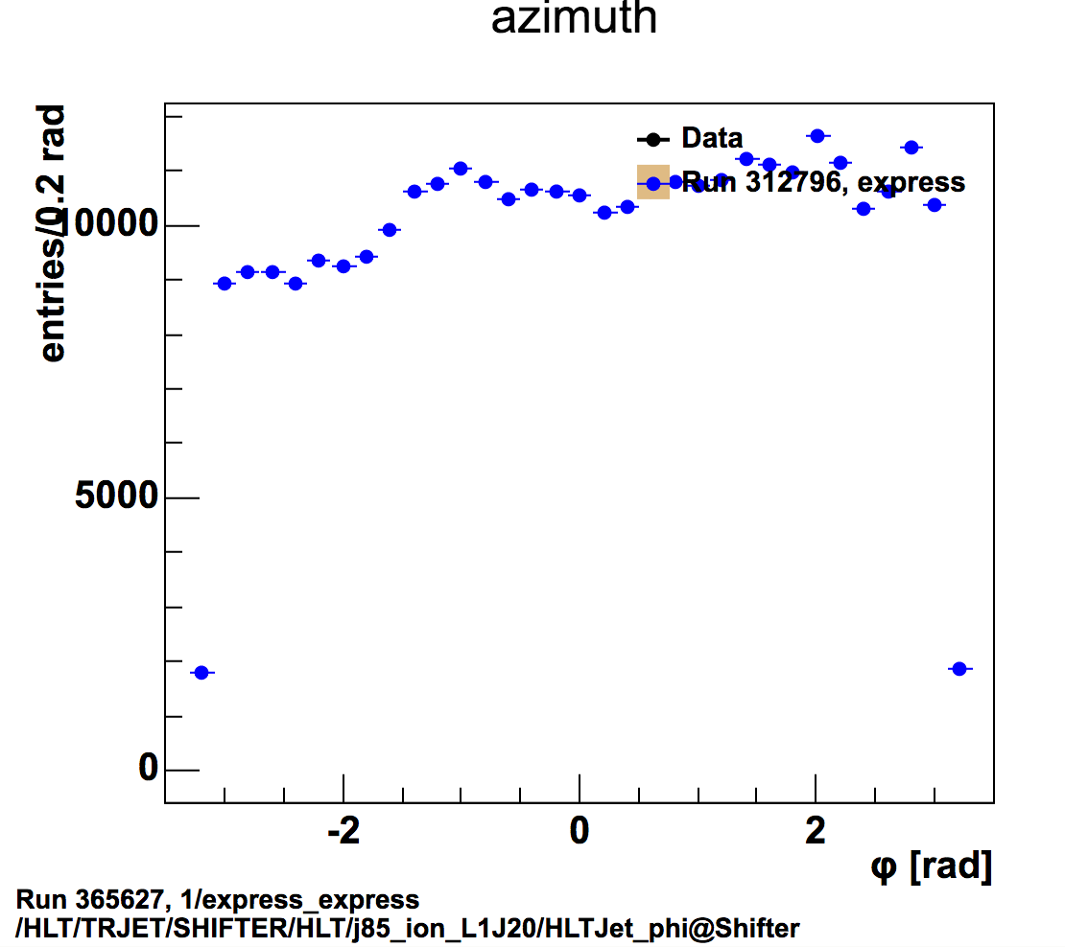
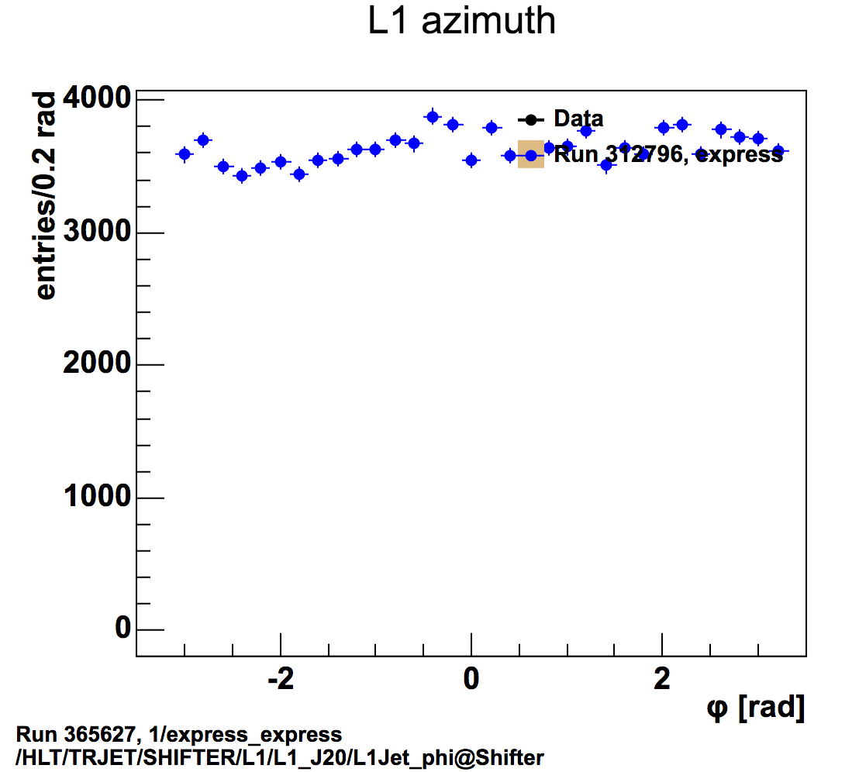
Runs with no HLT jet histograms
ATLASDQ-659
Runs: 365627, 366092, 366383, 366413:
Clear phi asymmetry
Confirmed in run 365627 for j85_L1J20
Looks like it comes from L1
Feature was understood. It came from missing HEC modules

Slide 4
Summary of the week
See spreadsheet
Reprocessing:
ATR-19122 - HLT Reprocessing for validation with AthenaP1,21.1,r2018-11-30T2139 with EB run 365573, Physics_HI_v5
DQ Sign off:
https://its.cern.ch/jira/browse/ATR-19070
BULK:
https://its.cern.ch/jira/browse/ATR-19109
https://its.cern.ch/jira/browse/ATR-19135
https://its.cern.ch/jira/browse/ATR-19141
https://its.cern.ch/jira/browse/ATR-19181
https://its.cern.ch/jira/browse/ATR-19182
https://its.cern.ch/jira/browse/ATR-19141
https://its.cern.ch/jira/browse/ATR-19135
https://its.cern.ch/jira/browse/ATR-19109
Plus: https://its.cern.ch/jira/browse/ATLASDQ-659

Slide 5
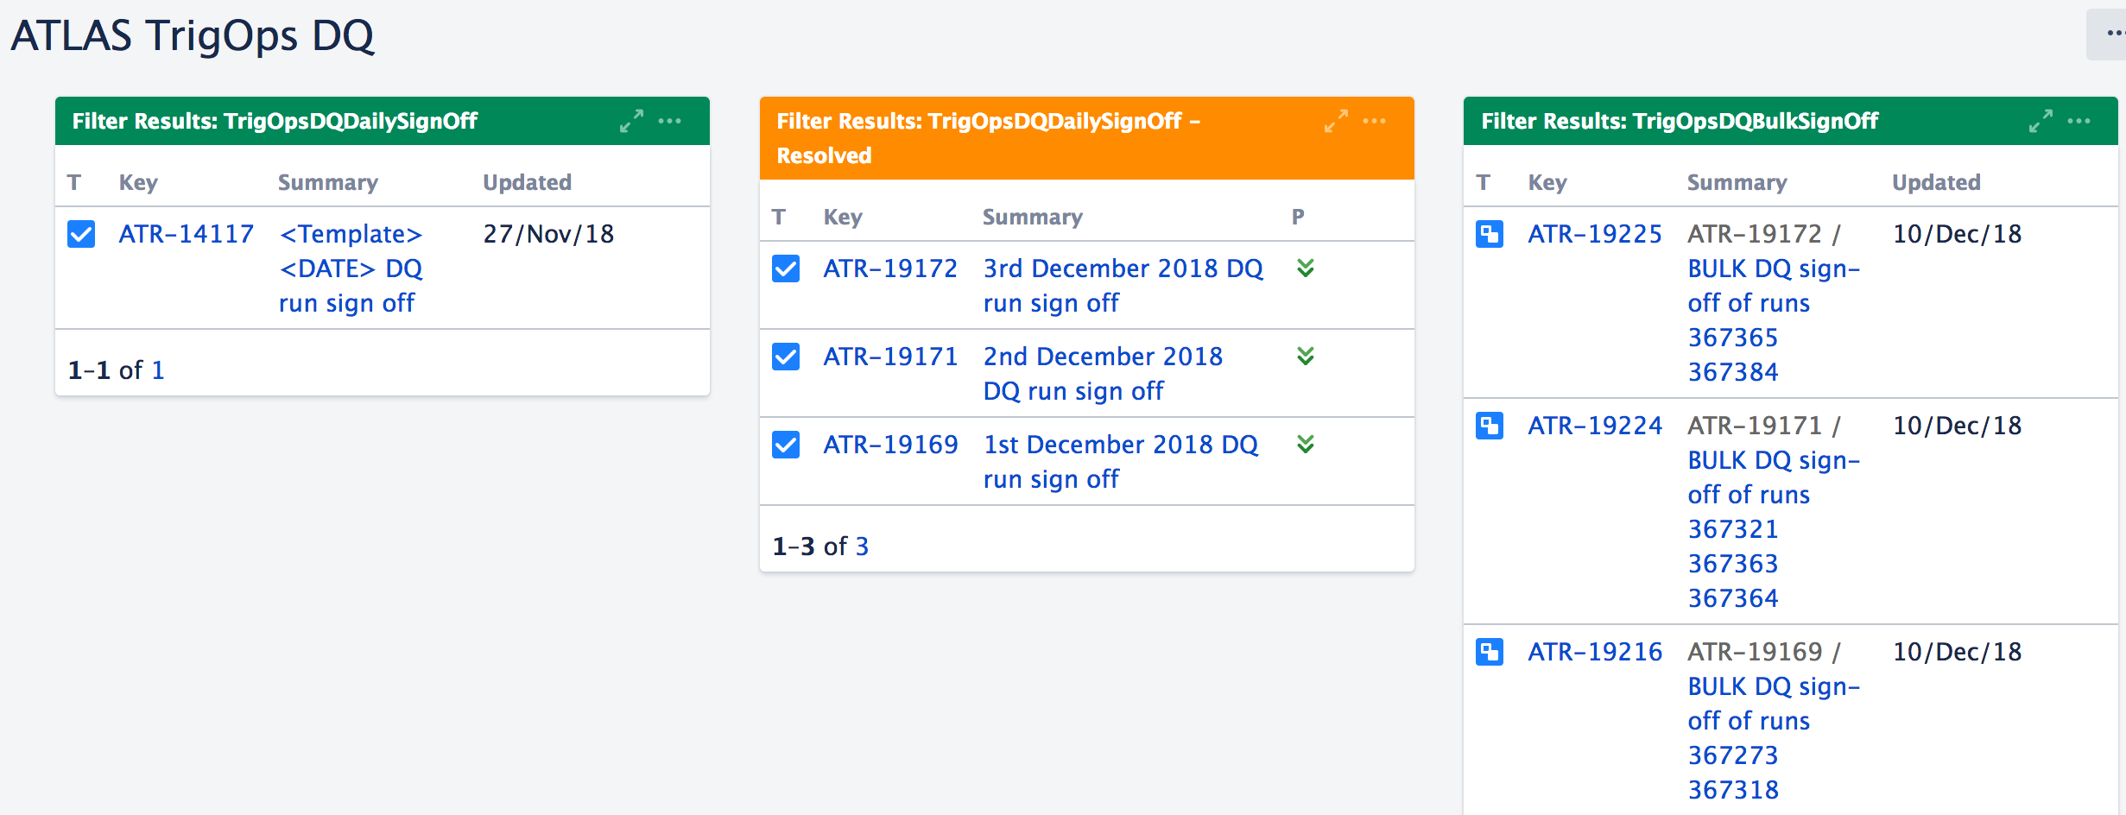
Conclusion
Dashboard nicely empty
(all tickets on the right are now signed off)
Next on shift: Ana Peixoto on-call for next week

