Slide 1
ttH Status report
Ricardo Gonçalo (RHUL)
On behalf of the HSG5 ttH group

Slide 2
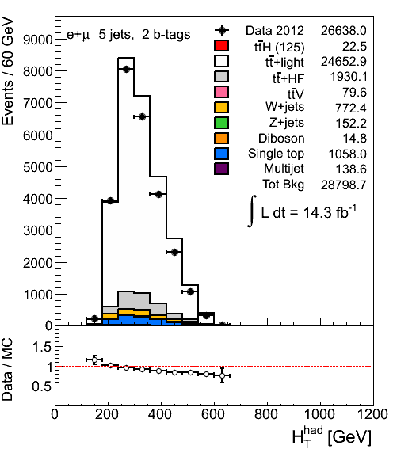
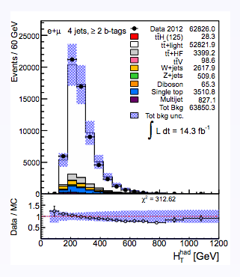
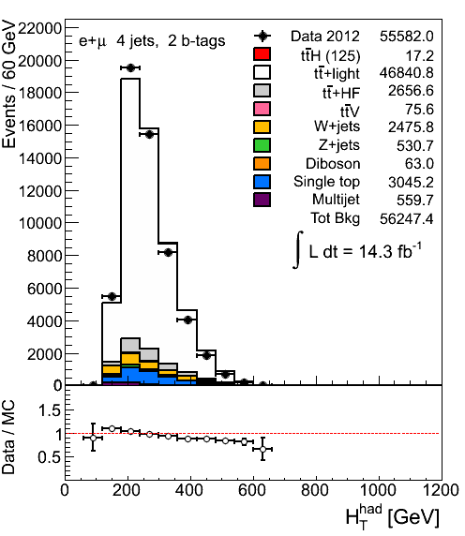
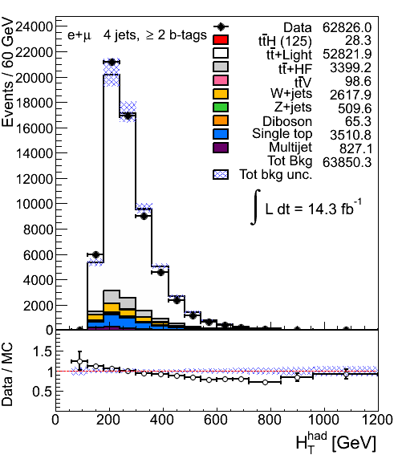
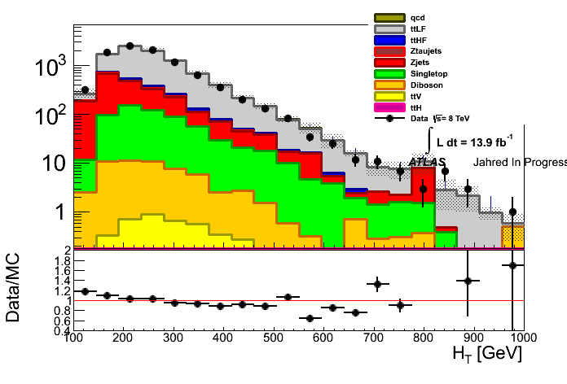
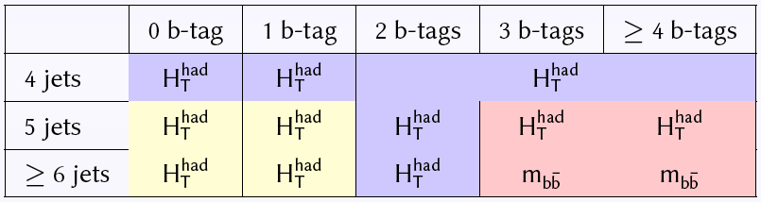

The issue
ttH analysis for Moriond is performed using two options
  single variable fit (exactly same approach as used in the approved CONF note)
    HT and mbb variables
  fit to NN discriminant in signal bins and HT in other bins
For both approaches good modelling of data by MC model is critical
We observe slopes in data/MC ratio in all analysis bins with at least one tag
5j 2b
4j 2b
only ttbar modelling uncertainties
≥2j ≥1b
4j ≥2b
Same trend in dilepton channel!

Slide 3
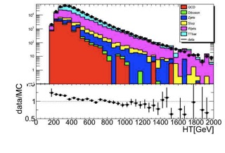
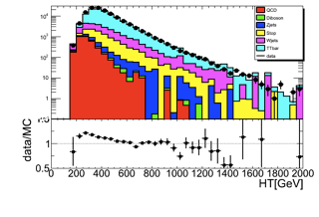
Other top analysis
≥0 b
4j+5j
≥ 1b
the first plot produced outside ttH group
  uses the same TopRootCore package
similar trend
  could be a problem in TopRootCore, but at least this shows it’s not just a bug in our code

Slide 4
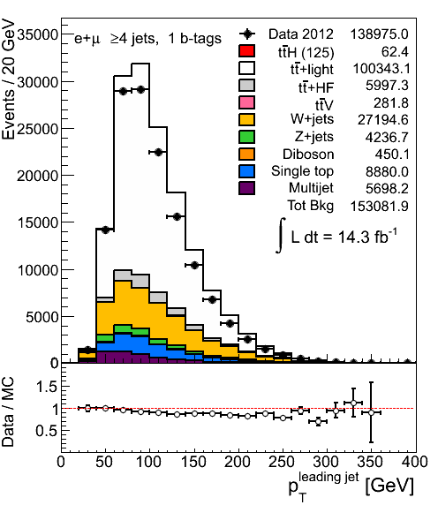
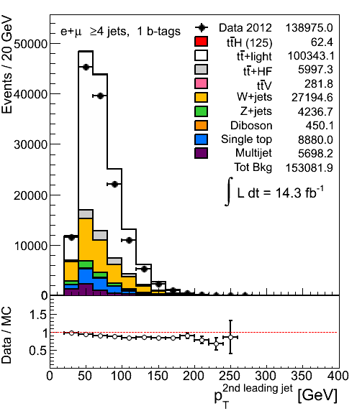
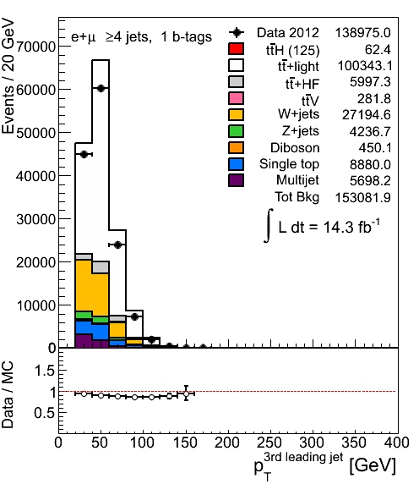
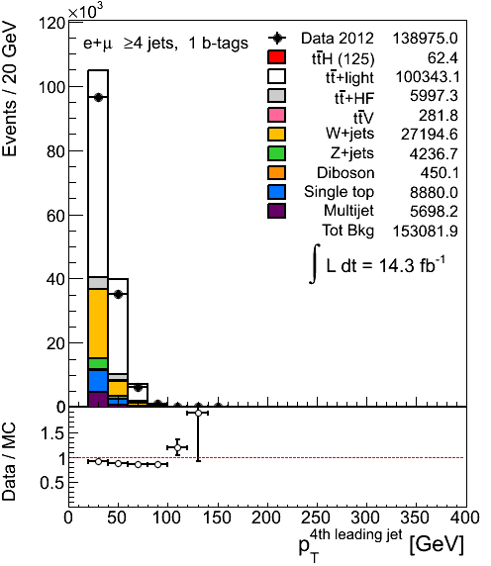
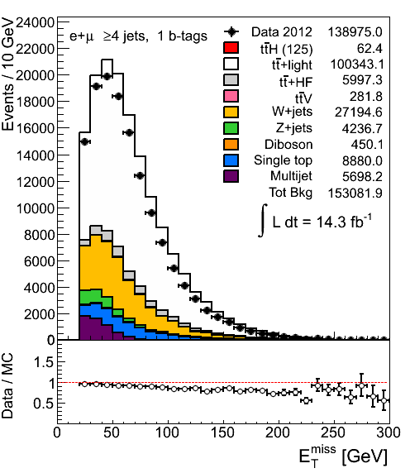
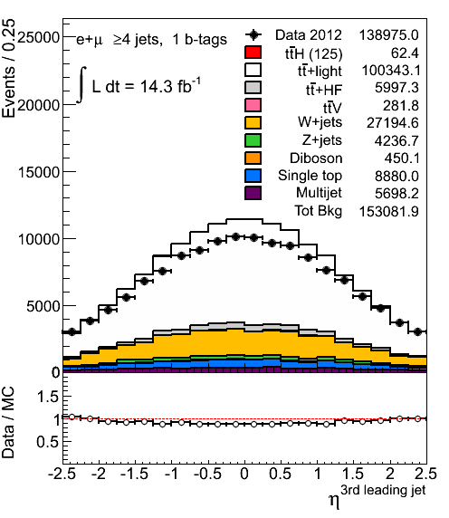
More distributions
Mismodelling of HT comes from mismodelling of jet PTs and ηs
4j1b
Same features are observed in other jet and tag multiplicity bins

Slide 5
What is it?
ttbar modelling
pileup modelling
effect of various scale factors
  b-tagging (we are using pTrel calibration)
  JVF
test of b-tagging SFs
  try SFs from ttbar calibration
p_{T}^{W} reweighting
  Top W reweighting?
do we see this somewhere else? VH cuts
multiparton interactions?
jets - JES?
  tried EM+JES instead of the default LC jets

Slide 6
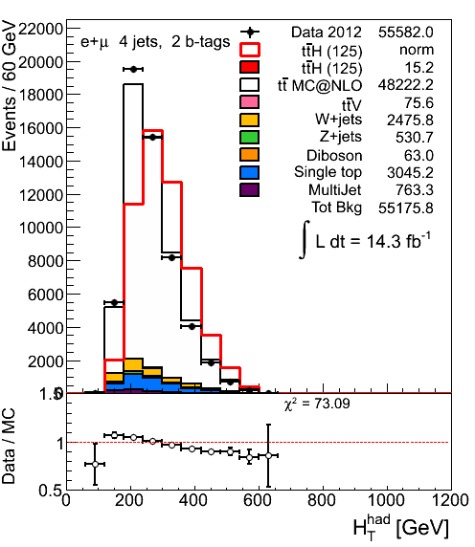
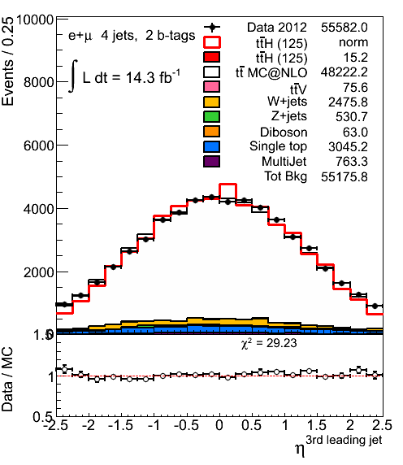
ttbar modelling - I
Given that the problem is seen in ttbar dominated regions we suspected ttbar modelling
Default: Alpgen+Herwig
Tried
  MC@NLO
  Powheg+Herwig (AFII)
  Powheg+Pythia (AFII)
MC@NLO
same slope in HT
jet η looks better

Slide 7
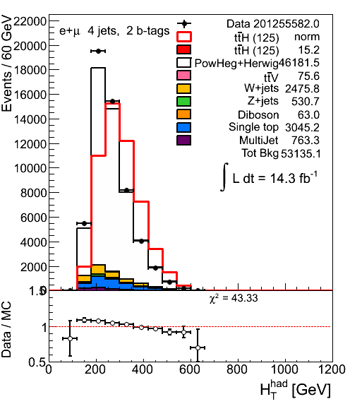
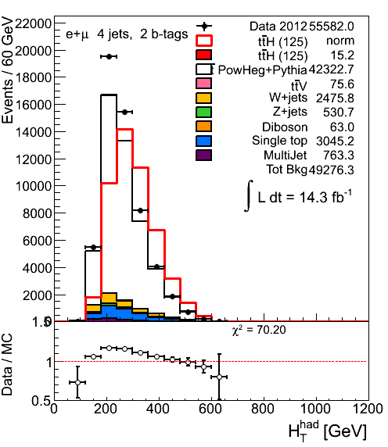
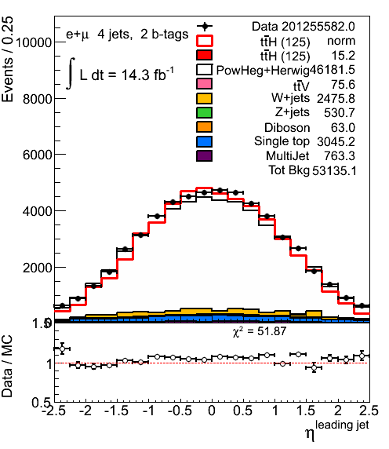
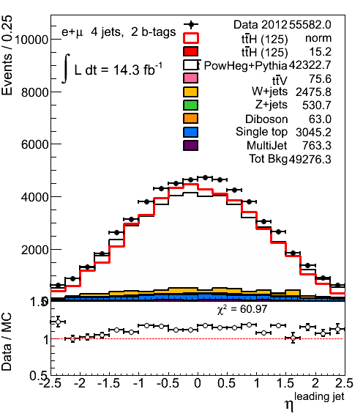
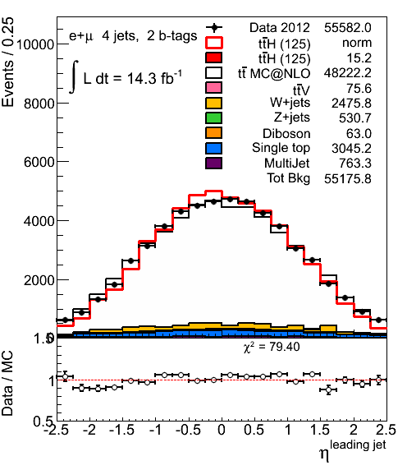
ttbar modelling - II
Powheg+Herwig
Powheg+Pythia
MC@NLO
NLO MC describes jet η distribution better
7

Slide 8
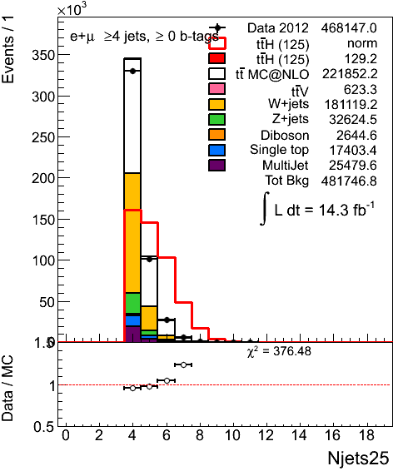
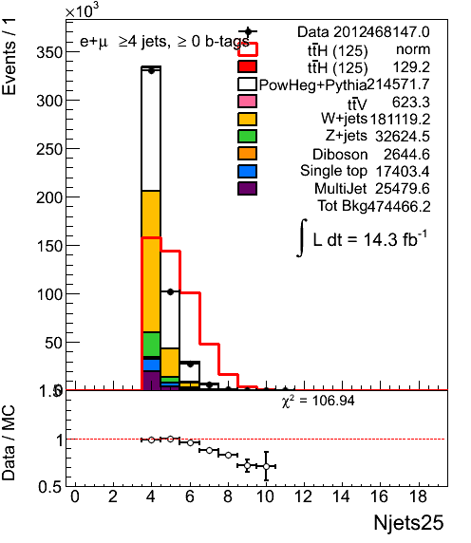
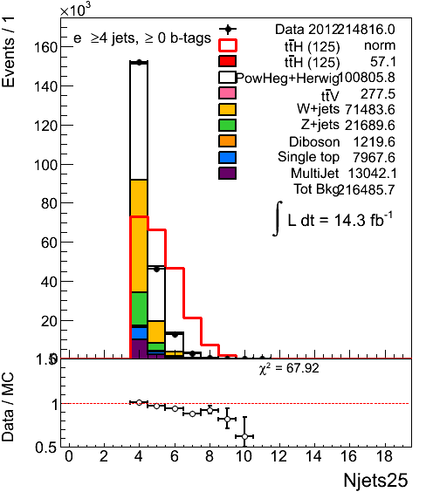
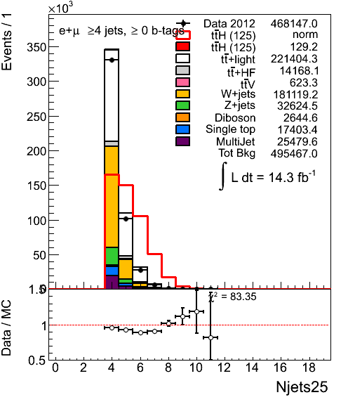
Jet multiplicity
MC@NLO
Powheg+Pythia
Powheg+Herwig
4 jets inclusive pretag
Alpgen+Herwig default

Slide 9
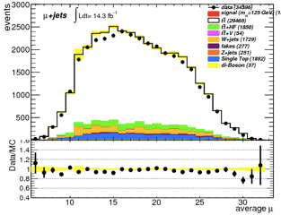
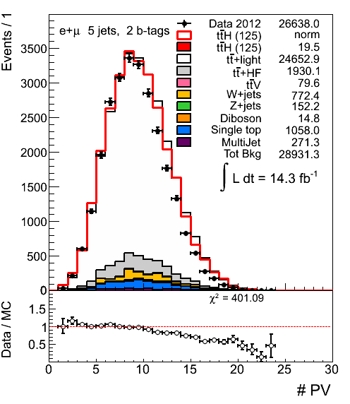
Pileup
We perform luminosity reweighting following recommendations but the NPV distribution in data is not well described
MC overestimates NPV in data
However the twiki says that agreement in NPV is not expected to be perfect even after μ reweighting
https://twiki.cern.ch/twiki/bin/viewauth/AtlasProtected/InDetTrackingPerformanceGuidelines#Analyses_based_on_Athena_release

Slide 10
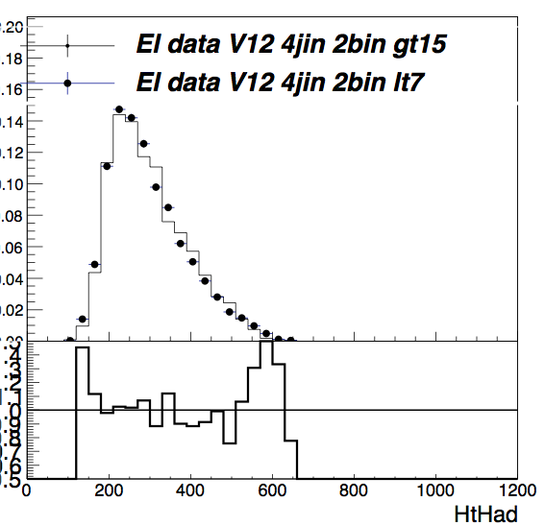
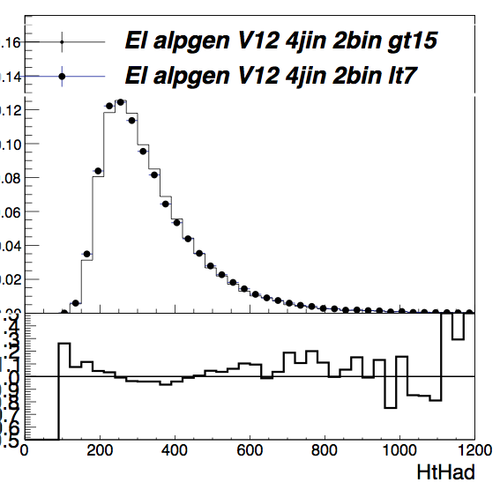
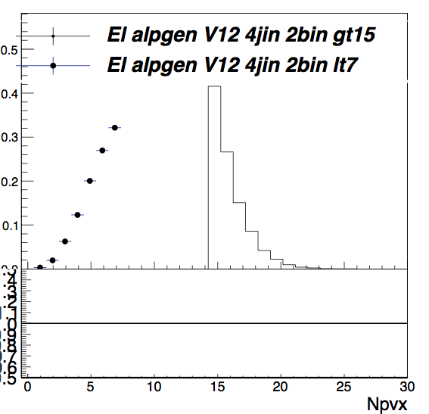
NPV<7 vs NPV>15
e+jets, 4 jet incl 2b incl
HT data
HT MC
NPV<7 - points, NPV>15 - histogram
shape does not change significantly between low and high NPV
trend in MC follows trend in data
does not seem to explain the problem

Slide 11
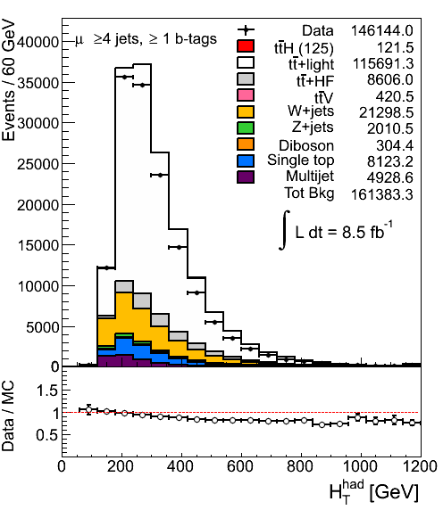

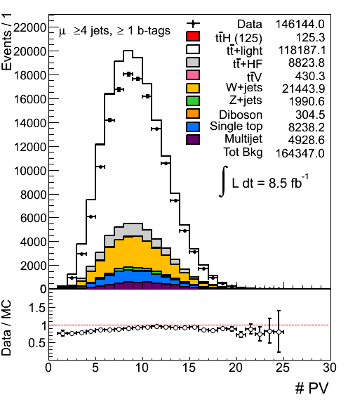
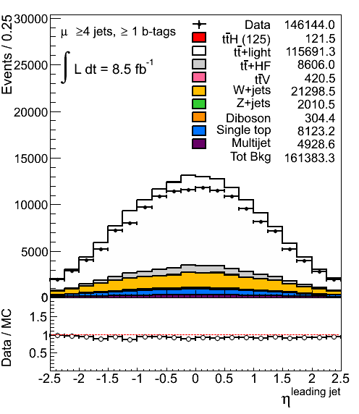
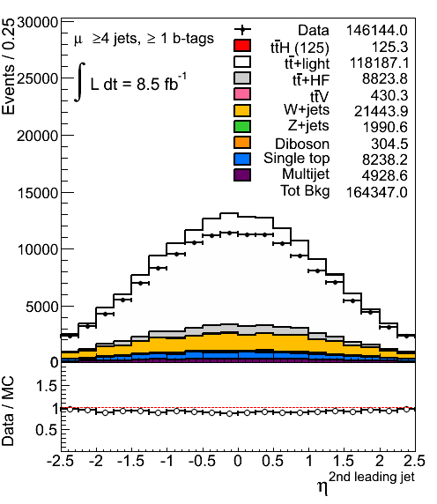
NPV reweighting
Although effect is expected to be small let’s reweight NPV to match data better
before NPV reweighting
after NPV reweighting
reweighted in 2j inclusive
does not help!

Slide 12
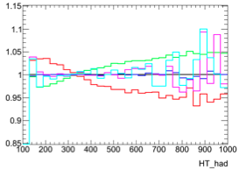
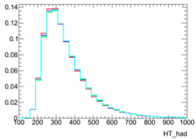
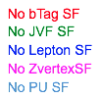
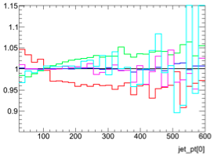
Impact of SFs on HT shape
remove various SFs one by one and look at the effect on HT shape
study on ttbar MC
  tt+light and tt+HF
removing bTag SF: this seems to have a pretty large impact and goes in the direction we would like (increasing low side, decreasing high side)
bTag SF: largest effect on nuisance parameters in the fit

Slide 13
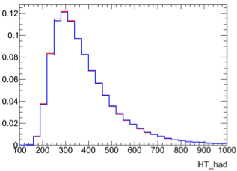

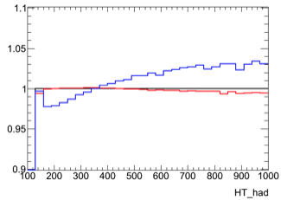
JVF SF
We use “old” JVF SF derived for EMJES jets
In the meantime new JVF SFs were announced
  derived for LC jets!
blue: no scale factor
red: new JVF SF
  effect seems to be small but it goes in the right direction
black: old JVF SF
5jets exclusive, 2tags inclusive

Slide 14
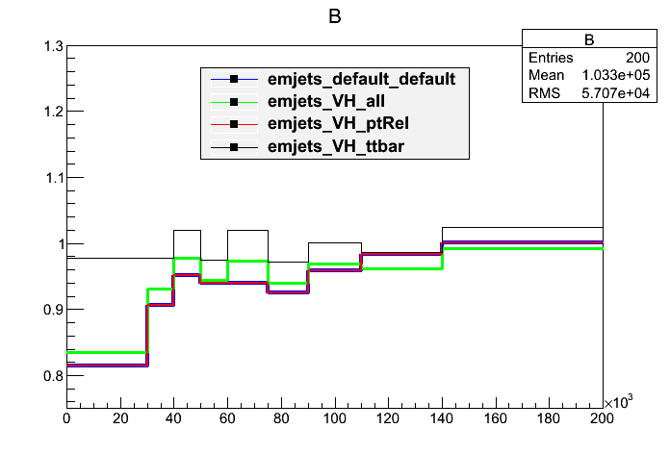

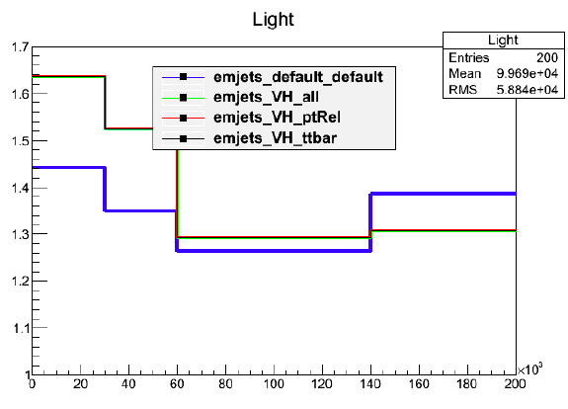
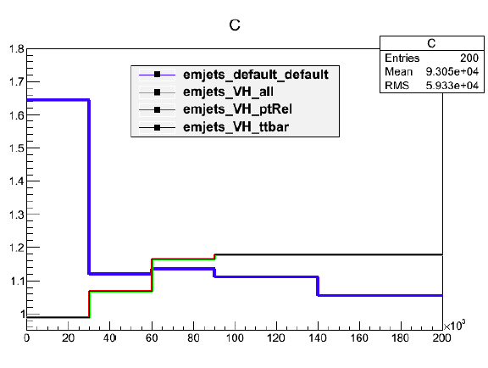
Study of b-tagging
So far using 2011 pTrel calibration
Need to get HCP recommended file:
  2011+2012(a) pTrel calibration
  2011 ttbar calibration
Note:
  VH_ptrel is the one we are using
  We don’t understand what the c and light calibrations are showing

Slide 15
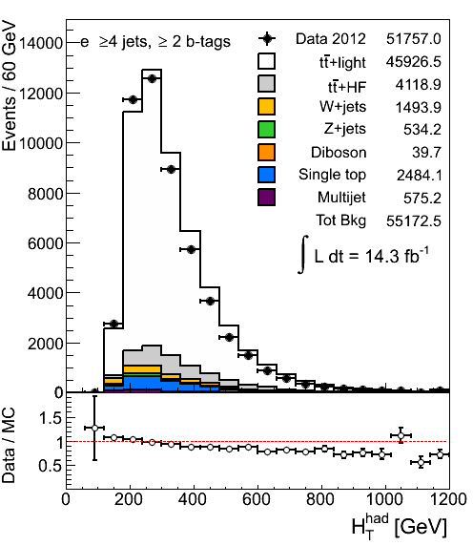
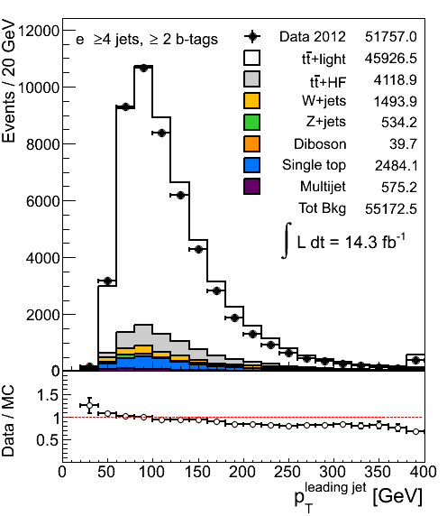
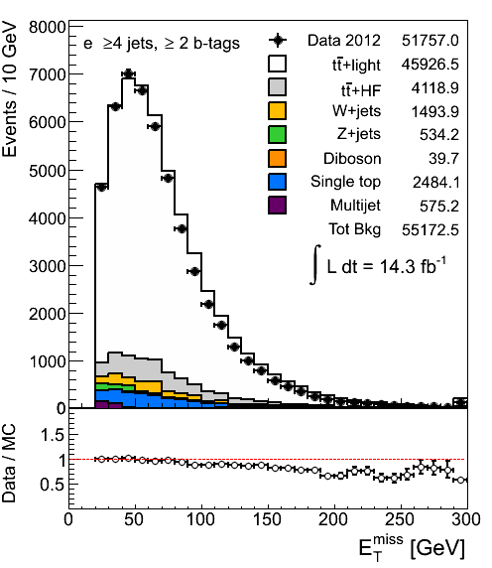
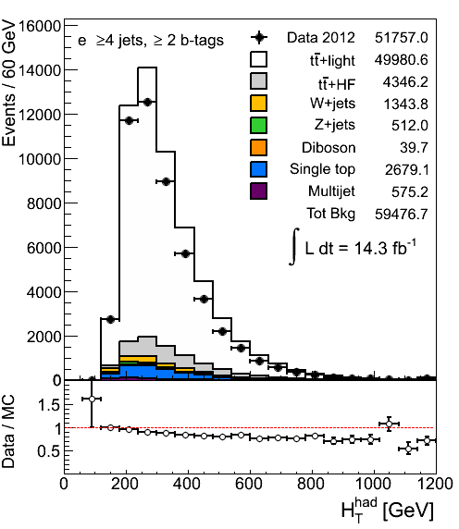
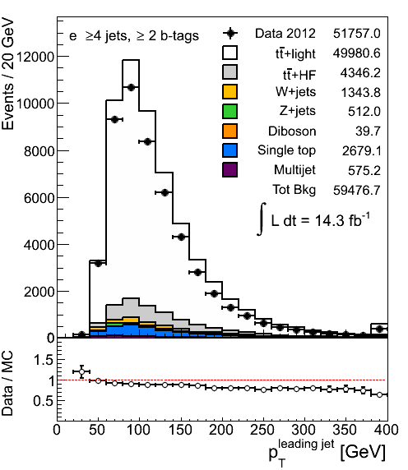
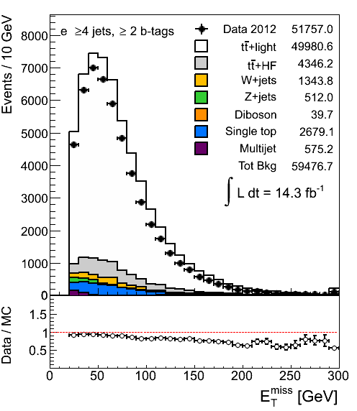
Comparison: ttbar control region
Electron channel, 4jet inclusive, 2tag inclusive
PtRel calibration
ttbar calibration

Slide 16
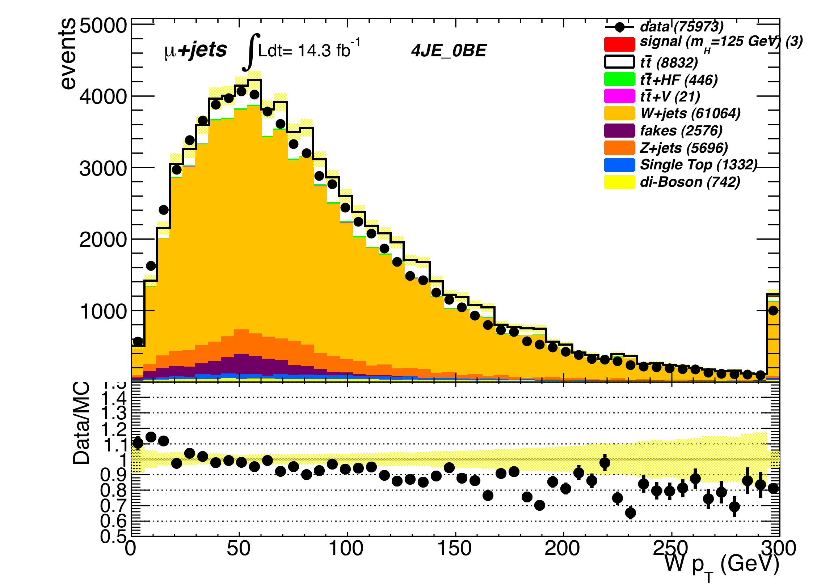


p_{T}^{W} reweighting
4 jet (exclusive) no b-tags
Reweight p_{T}^{W} as done by VH analysis for HCP
Minimizer is Linear
Chi2 = 130.962
NDf = 38
p0 = 1.126 +/- 0.01
p1 = -0.0020 +/- 0.0001

Slide 17






No reweight (up) , reweight (down)
Some improvement but features are still there

Slide 18




No reweight (up) , reweight (down)
Improvement in Jet eta …

Slide 19

Ttbar reweighting?
In progress… we want to test it to see what we get
BUT not clear we should do it when we use the modeling nuisance parameters from Alpgen

Slide 20







Do we see this with VH cuts?
ttH cuts (top)/ VH cuts (bottom)
Can’t tell if it’s really better (low jet pt can be QCD)

Slide 21



Do we see this with VH cuts?
VH analysis ~ with ttH cuts:
≥ 4jets and ≥ 2 b-tags
No p_{T}^{W} reweighting applied

Slide 22



MultiParton Interaction Study
STDM-2012-11: http://cdsweb.cern.ch/record/1456092
Two independent scattering
2 parton pairs: W, dijet.
Δ_{jets}=|p_{T1}-p_{T2}|/|p_{T1}|+|p_{T2}|
JES ≈cancels, should be 0
No indication of missing contribution in e+2jet.
Electrons
2 jets
Pretag
Electrons
4 jets
Pretag

Slide 23



LC jets vs EM+JES
EM+JES seem to give better description of data, but same features as LC
LC jets
EM+JES
jets

Slide 24

Latest Changes
Switched from a theoretical uncertainty in W+4jets production (48%) to the experimental one given by the charge asymmetry normalization
Implemented latest prescription (from 7TeV) for W+HF systematics, they should be uncorrelated against Njets
All systematics are shape+normalization
  For simplicity JVFSF and Xtag were normalization only for the small backgrounds
Introduced ttbarHF systematic
Introduced jet energy resolution
Introduced the breakdown of JES into 8 components
Rebinned the JES breakdown so that the relative error per bin is 2% or less
Corrected a discrepancy in electron QCD in the forward region for 0tag
Rescaled the MC for the missing luminosity (-3% muon, -0.5% electron)

Slide 25






Pre/post fit plots
Prefit: 4jetex 0btagex 4jetex 1btagex 4jetex 2btagin
Postfit: 4jetex 0btagex 4jetex 1btagex 4jetex 2btagin

Slide 26








Pre- and Post-fit in validation regions: H_{T}
Pre-fit
5 jets 0 btags
5 jets 1 btags
6 jets 0 btags
6 jets 1 btags
Post-fit

Slide 27


8TeV Dileptons: Pre and Post Fit Plots (Valid.reg.)
Prefit HT
Postfit HT

Slide 28


Dileptons: Pre and Post Fit Plots (Signal)
Prefit HT
Postfit HT

Slide 29
Conclusions
A huge amount of work on studying HT problem
  No silver bullet: looks like combination of several effects
Fits looking better but a few things still to understand
To do:
Some improvement expected but not huge:
  p_{T}^{W} reweighting for 8TeV
  Compare with Z+jets p_{T}^{Z} reweighting and uncertainty derived from the dilepton analysis
  Introduce the recent JVF SF derived for LCjets, there were only available for EM+JES jets until recently (small difference)
  More realistic uncertainties for QCD

Slide 30

Backup
B-tagging eigenvectors

Slide 31

Backup
C-tagging eigenvectors

Slide 32




Pre/post fit plots
Prefit: 5jetex 2btagex 6jetex 2btagex
Postfit: 5jetex 2btagex 6jetex 2btagex

Slide 33




Pre/post fit plots
Prefit: 4jetex 3btagex 4jetex 4btagin
Postfit: 4jetex 3btagex 4jetex 4btagin

Slide 34






ttbar modelling - II
Powheg+Herwig
Powheg+Pythia
MC@NLO
NLO MC describes jet η distribution better

Slide 35

Systematics in 6jetin 0btagex

