Slide 1
Hadronic Calibration Workshop 2019
R. Gonçalo (U.Coimbra/LIP)

Slide 2
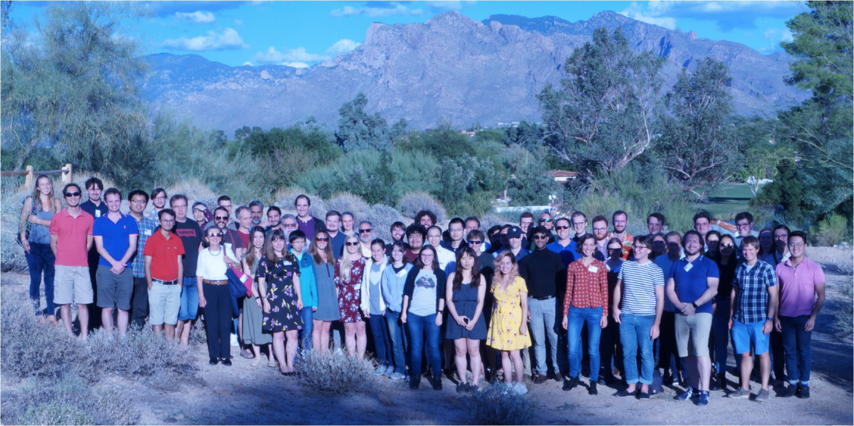
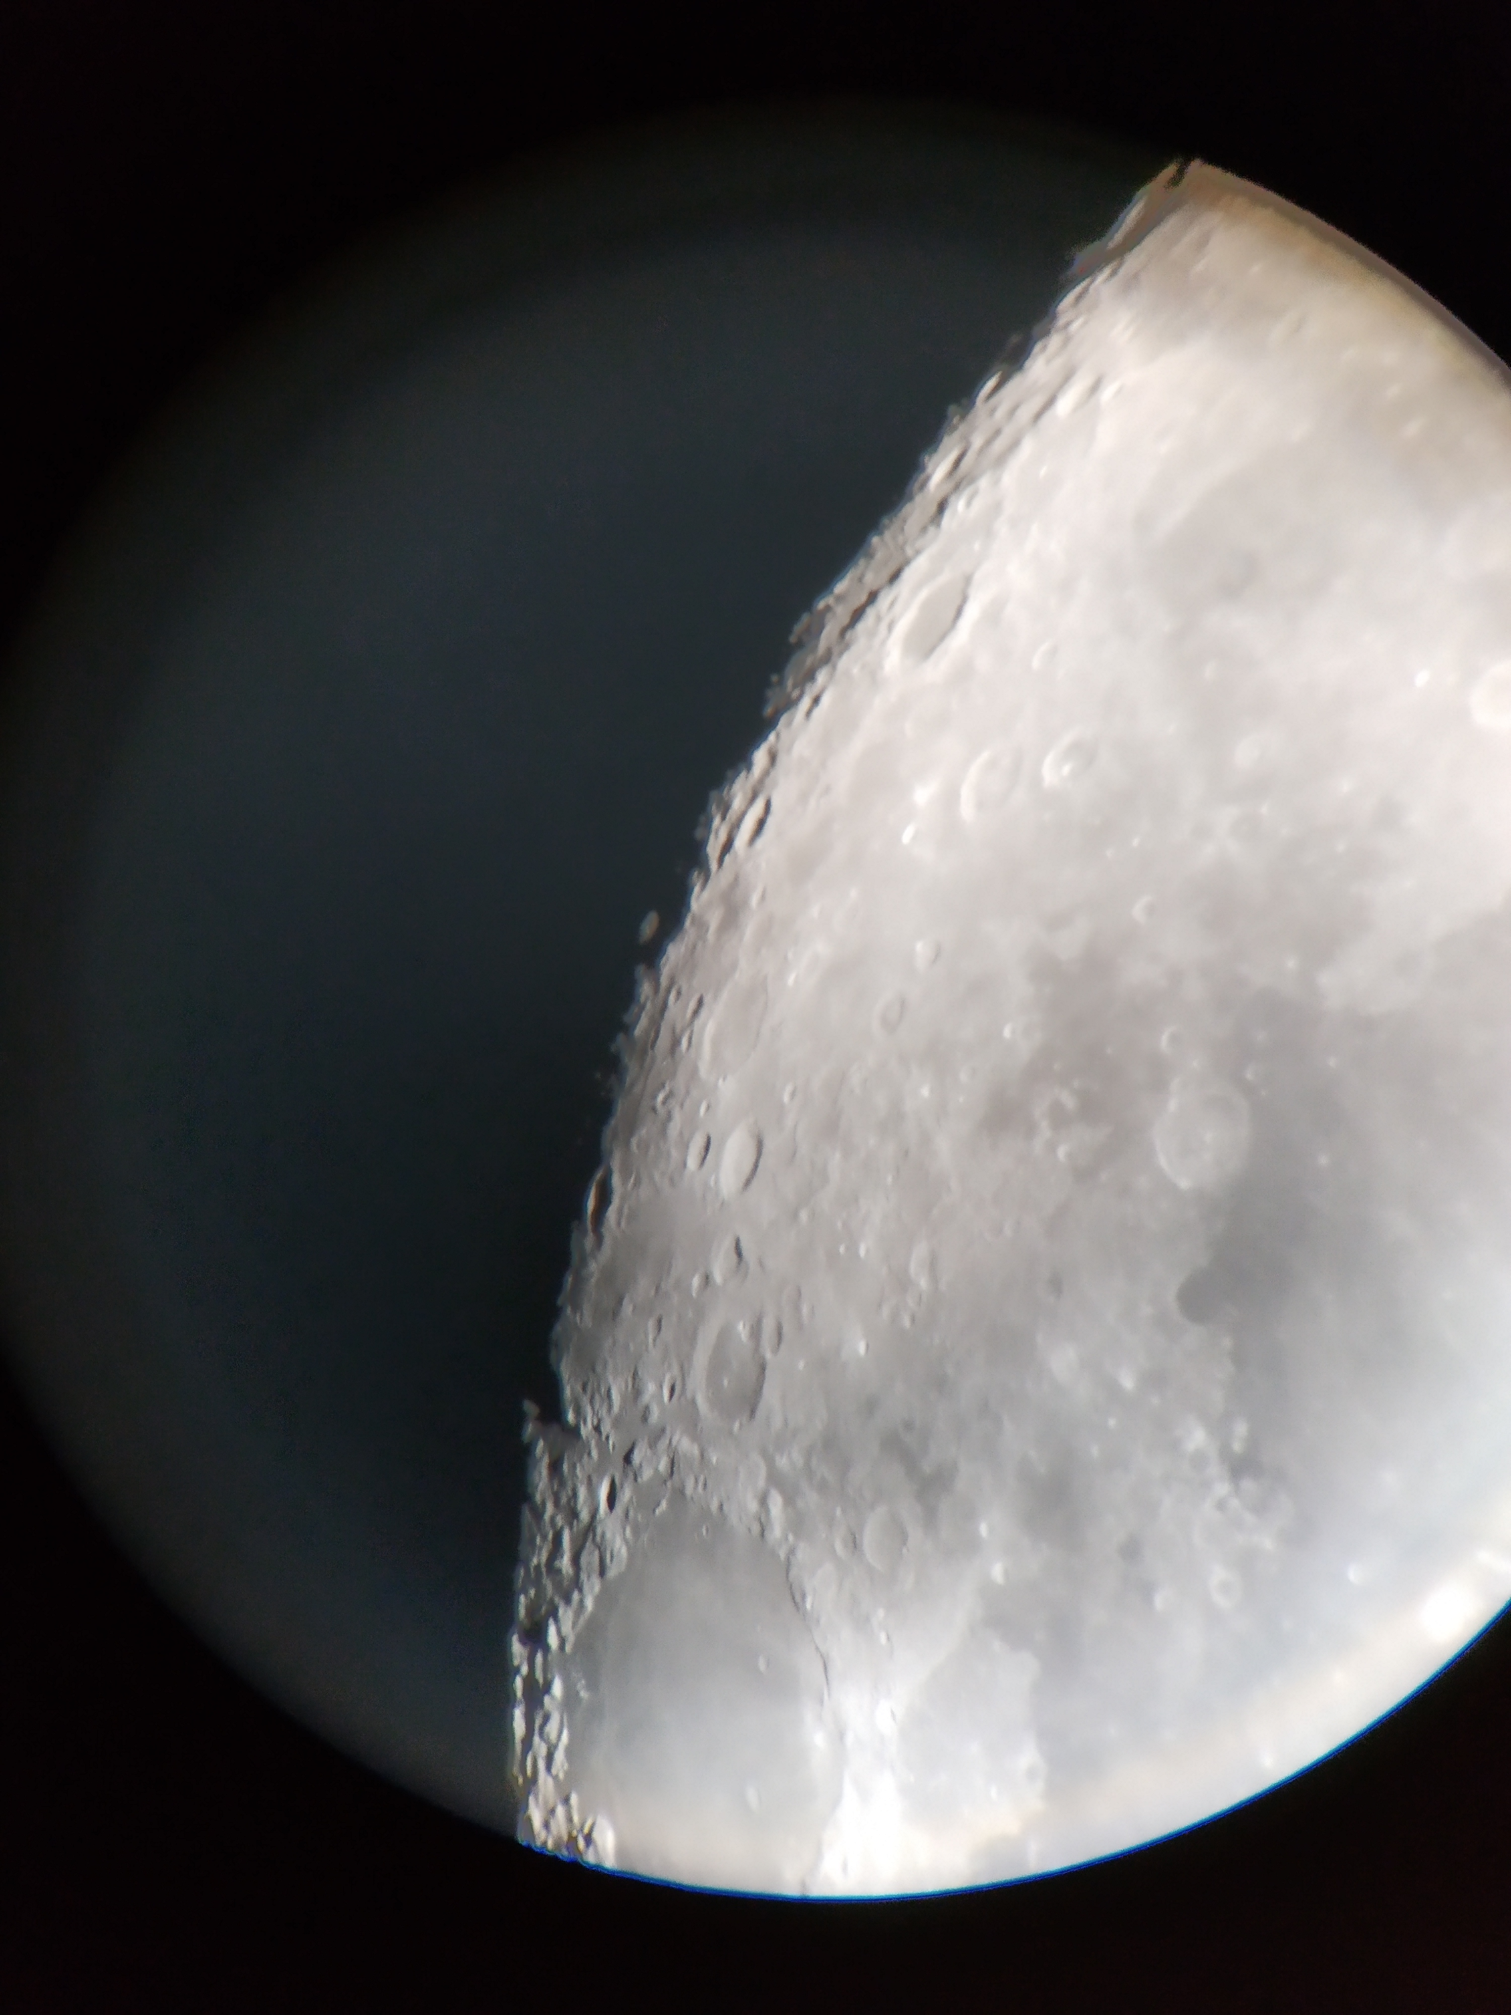
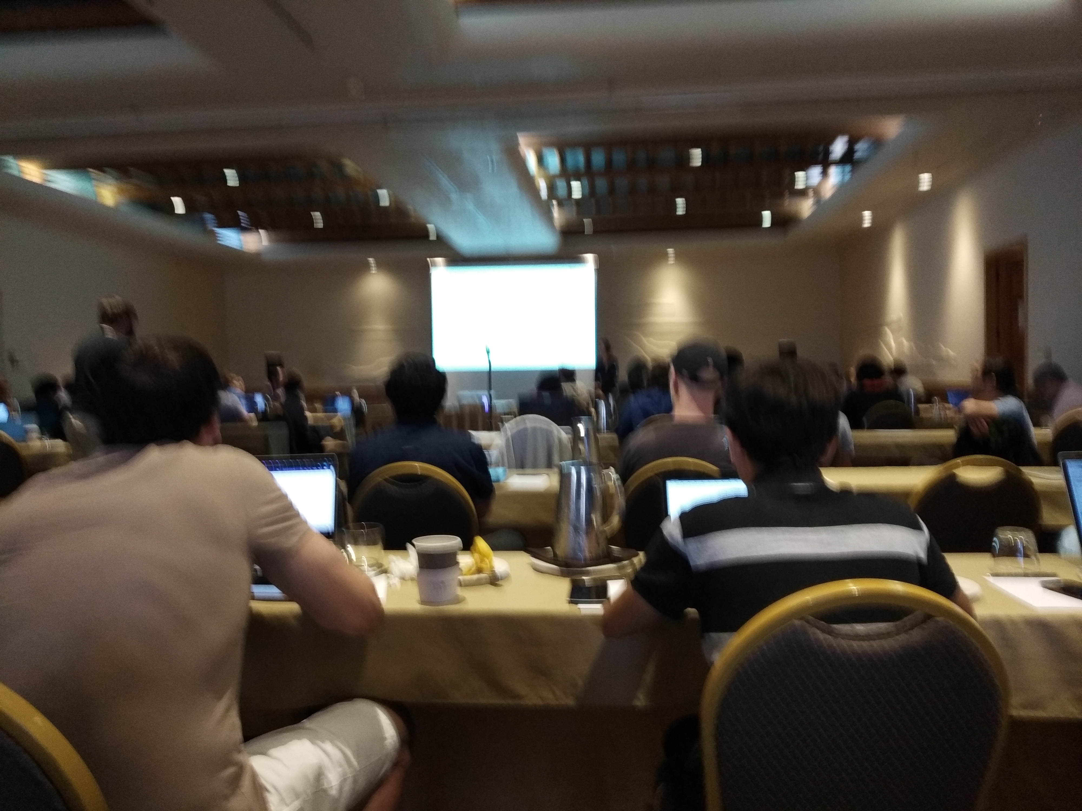
Hadronic Calibration Workshop
Annual workshop of the Jet/ETmiss group and related activities
Format:
Contributions submitted to each session by physics and CP groups throughout ATLAS
Summarised in presentations by session conveners in order to generate debate
Trigger sessions since 2014 – was instrumental in jet trigger strategy for early Run 2
This year convened by Ben Carlson, Kenji Hamano, RG
Always a lively and interesting workshop!
This year in Tucson, Arizona:
231 contributions
149 items to follow up on (Jet/MET conveners)
84 participants
37.5 hours of talks
12 hours of coffee break and lunch chats
Stargazing session with local astronomer
Great karaoke session! ☺

Slide 3
The Jet and MET Triggers

Slide 4
Jet and MET are not usual triggers
Usual game is to trigger on distinctive objects
E.g. electron trigger: play with identification selection to improve purity
Jet and MET are different:
MET needs all reconstructed objects
Jets are defined by jet algorithm – extended objects which depend on QCD
All events have jets and MET ≠ 0: cut on phase-space (resolution is essential!)
Then clean up false positives: pileup jets, fake MET

Slide 5
Effect of Resolution
Emulate j150
Jet selection based on phase space cuts
Resolution is essential!
Resolution is wrt offline
Plots from Will Kalderon:Jet trigger overview in HCW2018

Slide 6
Jet / MET Input Objects

Slide 7
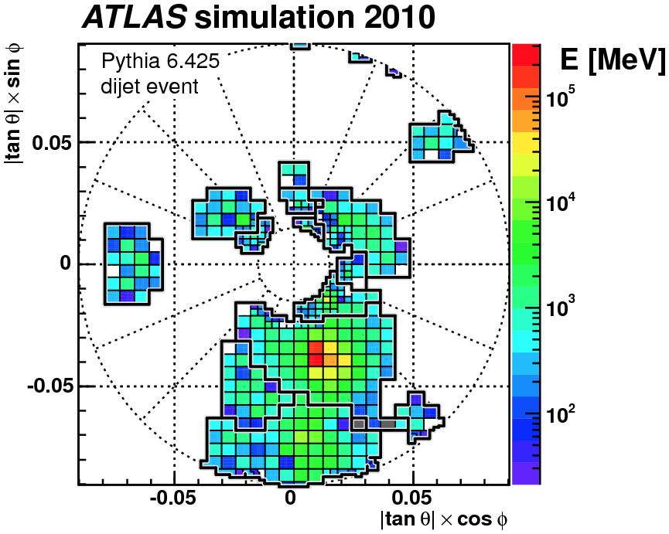
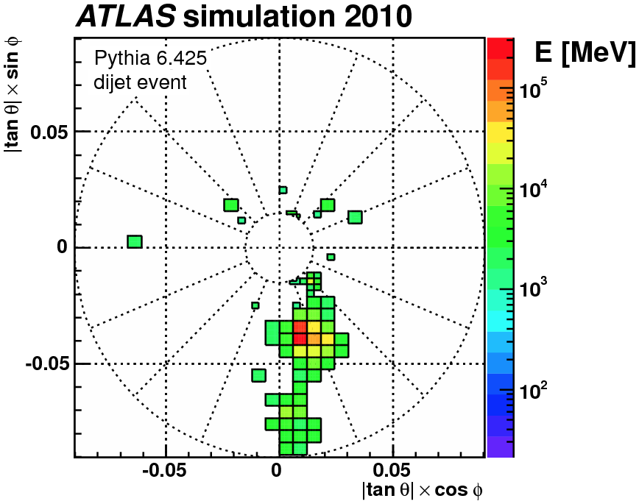
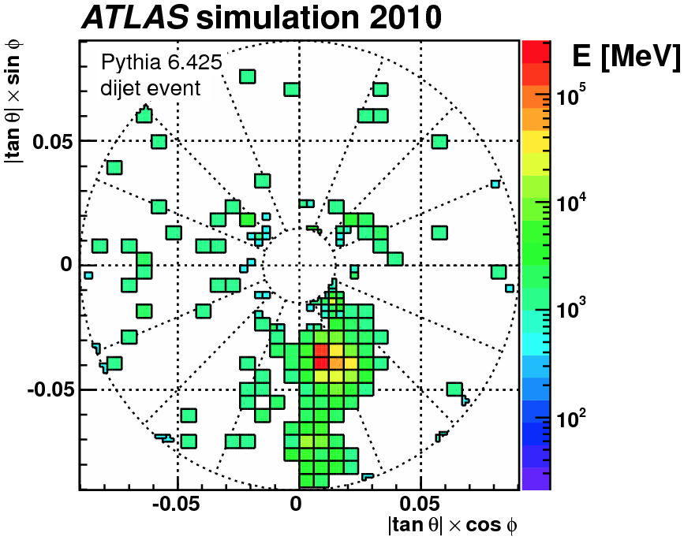
Basic objects: TopoClusters
Seed cells with large energy / noise: E/n > 4
Expanded to neighbouring cells with E/n > 2
Layer of neighbouring cells added (E/n > 0)
See talk by Dilia Maria Quintero

Slide 8
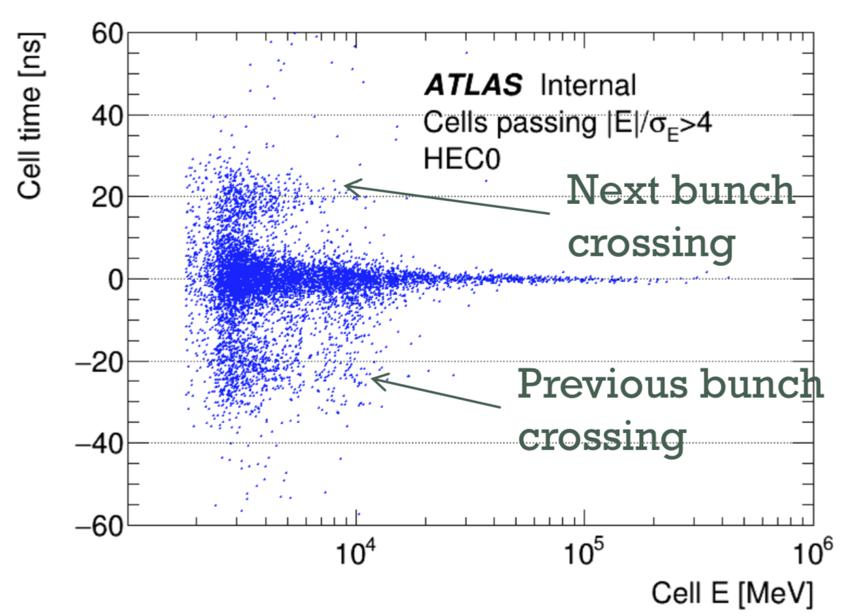
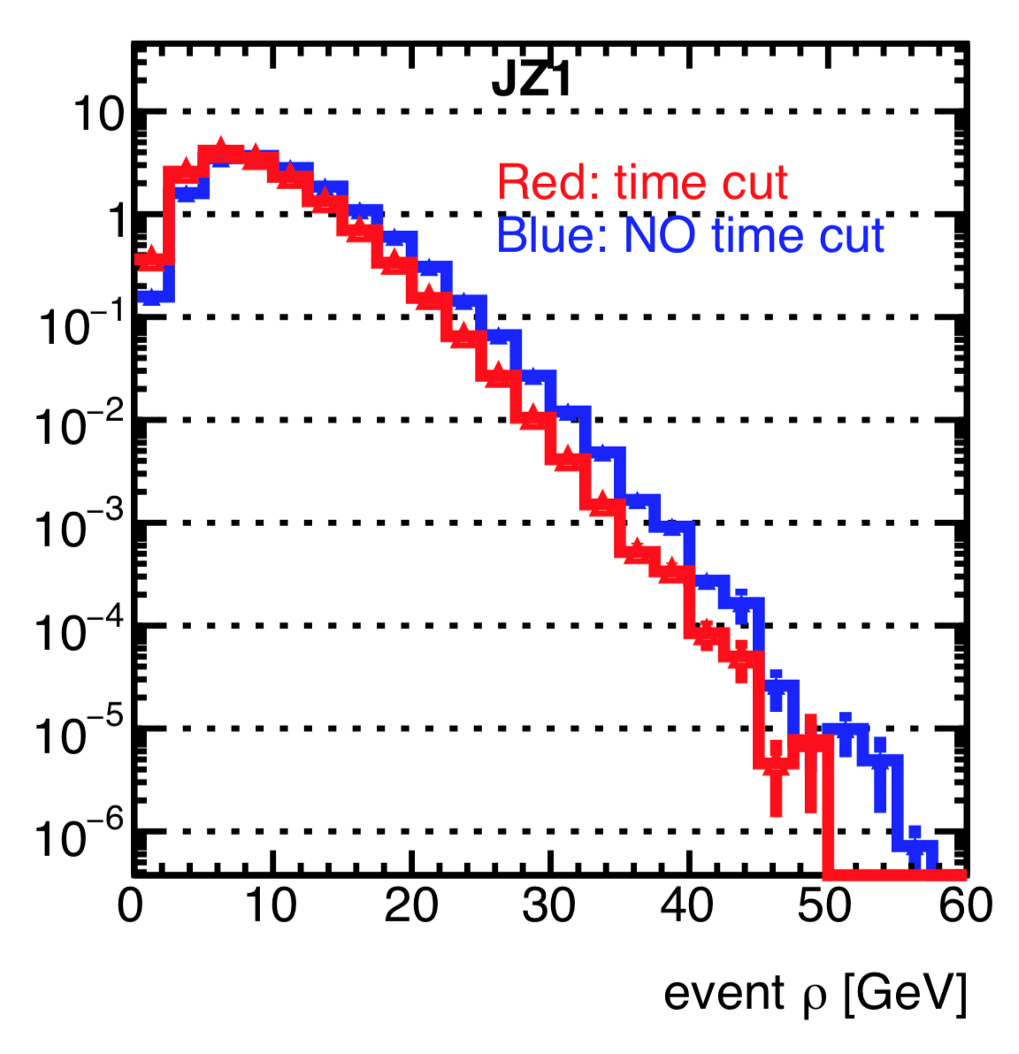
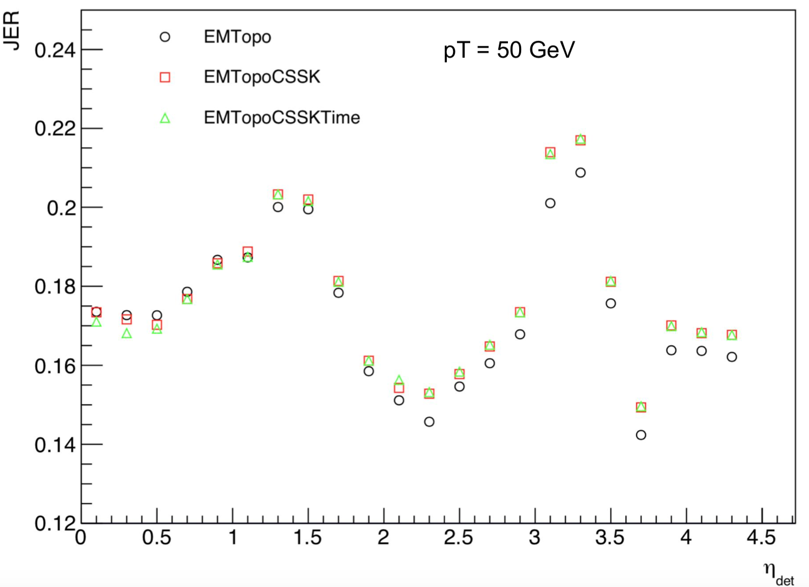
Pileup suppression of Jet/MET inputs
Cluster/cell timing cuts and other methods being investigated to suppress pileup at the input level
Some features still not understood:
Improvement for central jets (Constit.Subtraction+SoftKiller) seems reversed at high η
Improvements also reversed for Pflow jets
But potential gains in pileup stability and energy resolution, especially at low-p_{T}
See talk by Jennifer Roloff and Pablo Rivandeneira

Slide 9
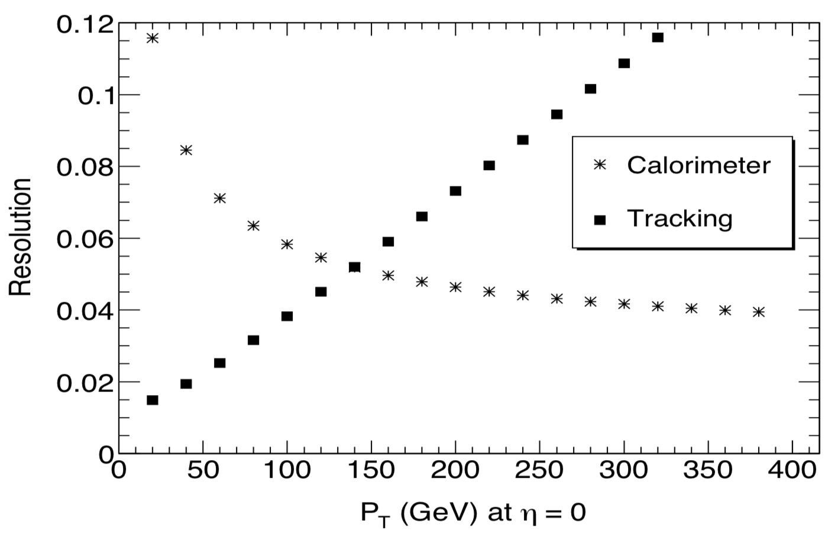
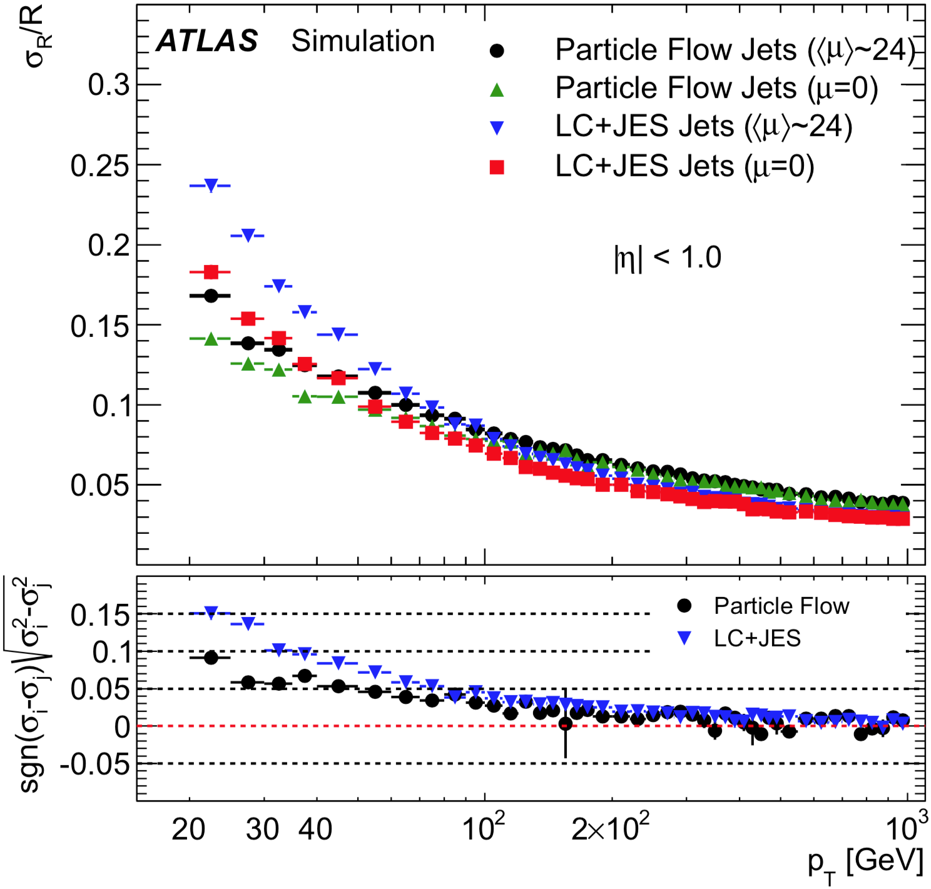
Particle Flow
Calorimeter and tracker provide complementary information
Tracker:
Charged particles only
Better angular resolution
Pileup discrimination built in
Better efficiency and momentum resolution at low p_{T}
Calorimeters:
Both neutral and charged particles.
Better energy resolution at high p_{T}
Alternative approaches to TopoClusters
Particle Flow (PFO) – Good for low p_{T}
Track Calo Clusters (TCC) – for high p_{T}
Unified Flow Objects (UFO): try to get best of both
Notes:
Track Calo Clusters (TCC): Improve angular resolution of high pT particles
✴ Reconstruction of highly boosted t/W/Z/H decays
✴ Tracks can resolve structure within clusters due to their spatial resolution.

Slide 10
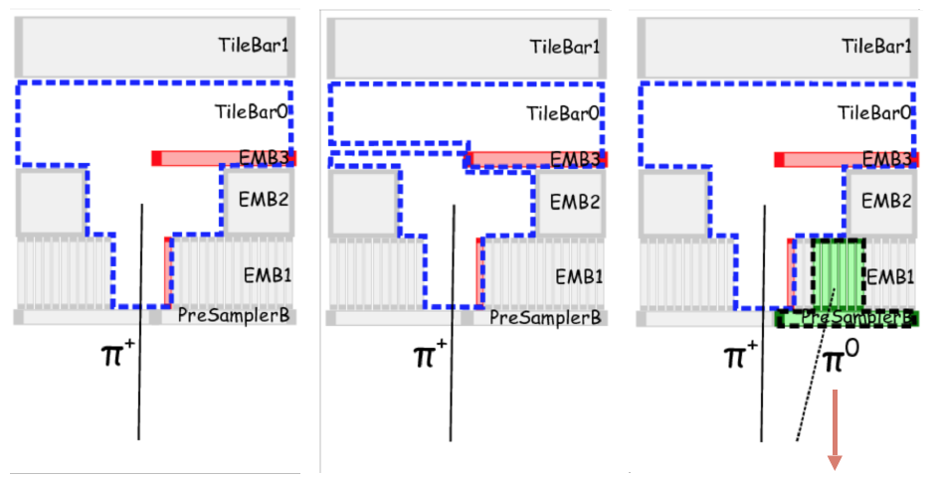
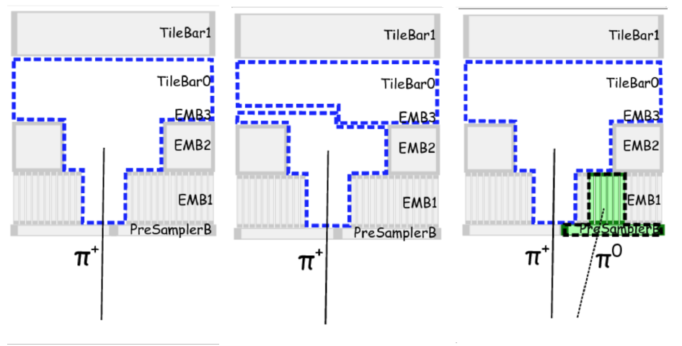
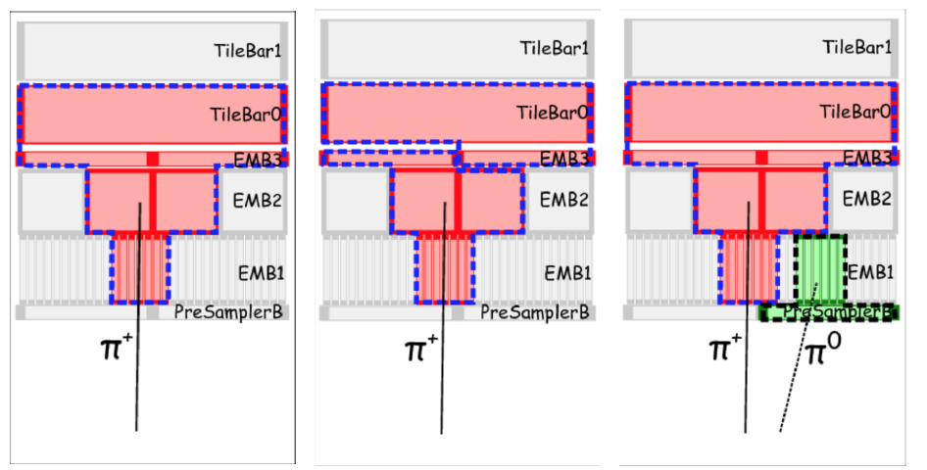
Particle Flow Objects
Eur. Phys. J. C 77 (2017) 466
Subtract calorimeter energy deposits that match an extrapolated track
Main thing is to avoid double counting of energy in tracks and clusters
At the end we have: tracks (charged particles), remaining clusters (neutrals)
See talk by Dilia Maria Quintero

Slide 11
Unified Flow Objects (UFOs)
See talk by Dilia Maria Quintero

Slide 12
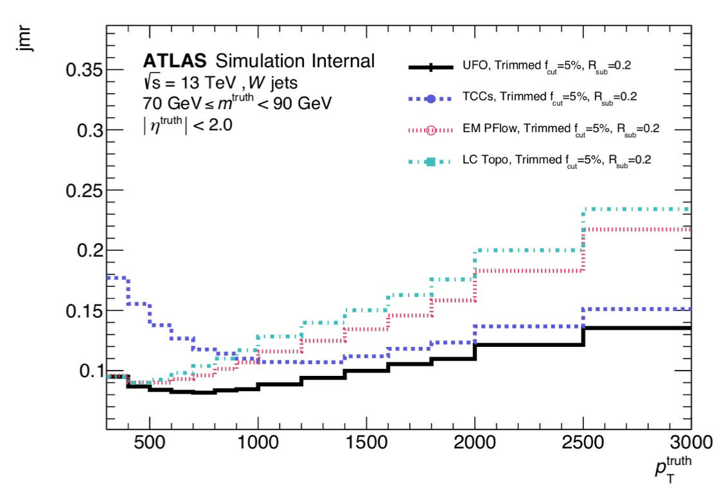
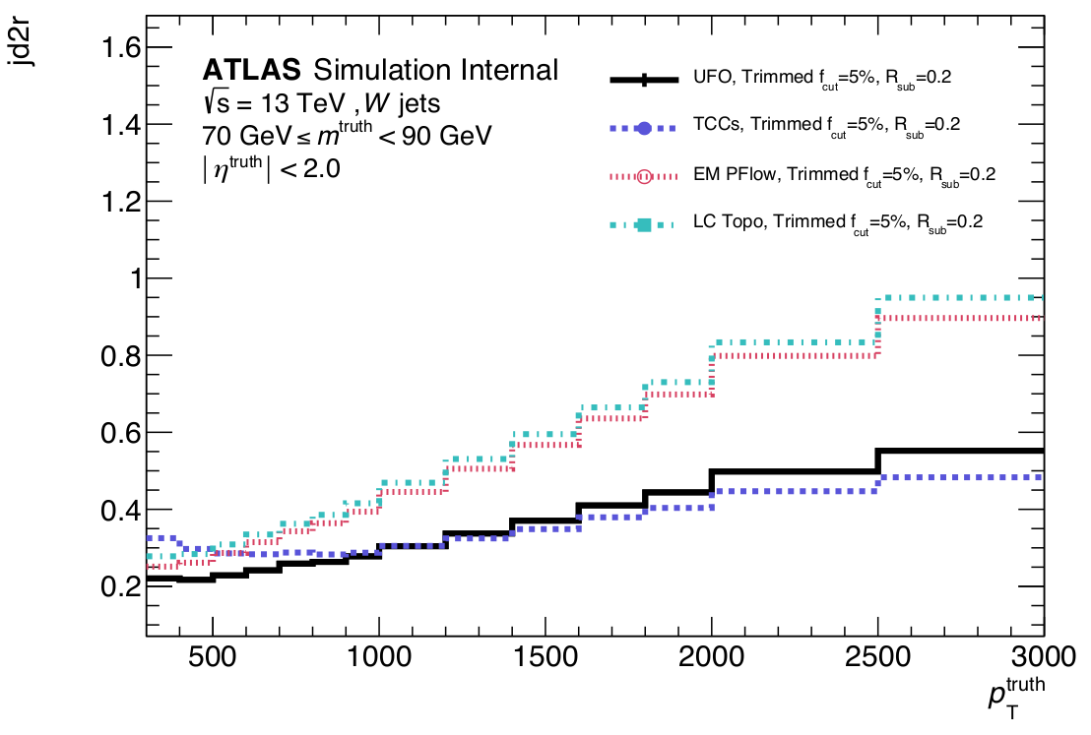
Unified Flow Objects (UFOs)
PFlow already default for small-R jets
Good UFO performance for large-R jets
UFOs will be default for substructure/large-R jets
Less relevant on short term for small-R
Need to understand performance to decide on uses in trigger
See talk by TJ in Jet Trigger meeting

Slide 13
Missing ET

Slide 14
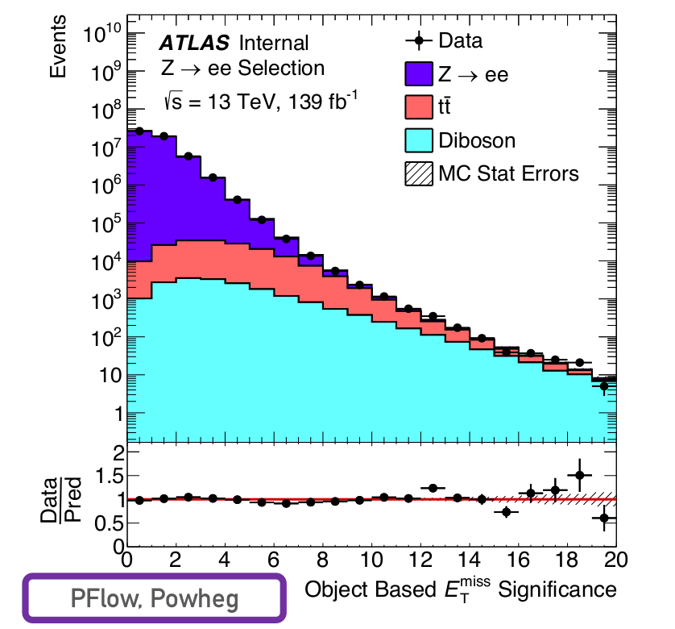
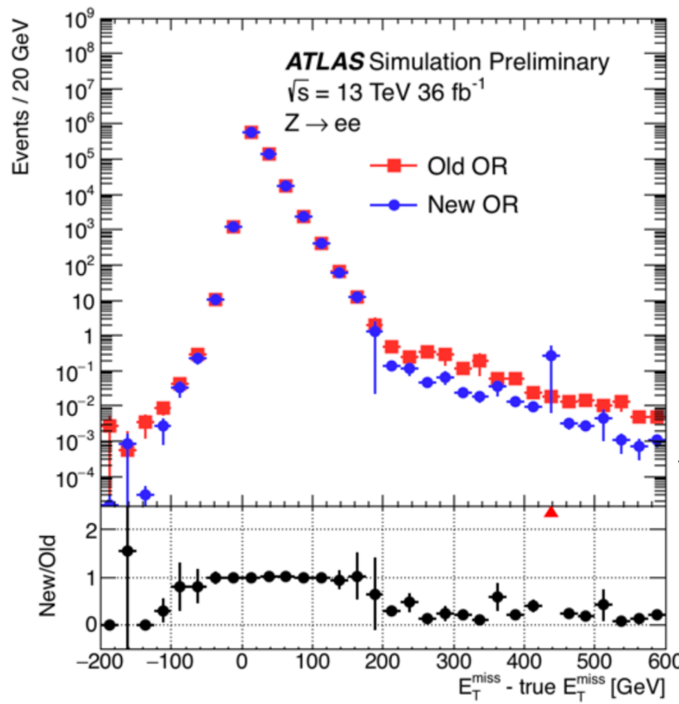
Offline
MET signicance is increasingly used and working well
Overlap removal in MET: Electron/photon/jet ambiguity resolution lead to improvements

Slide 15
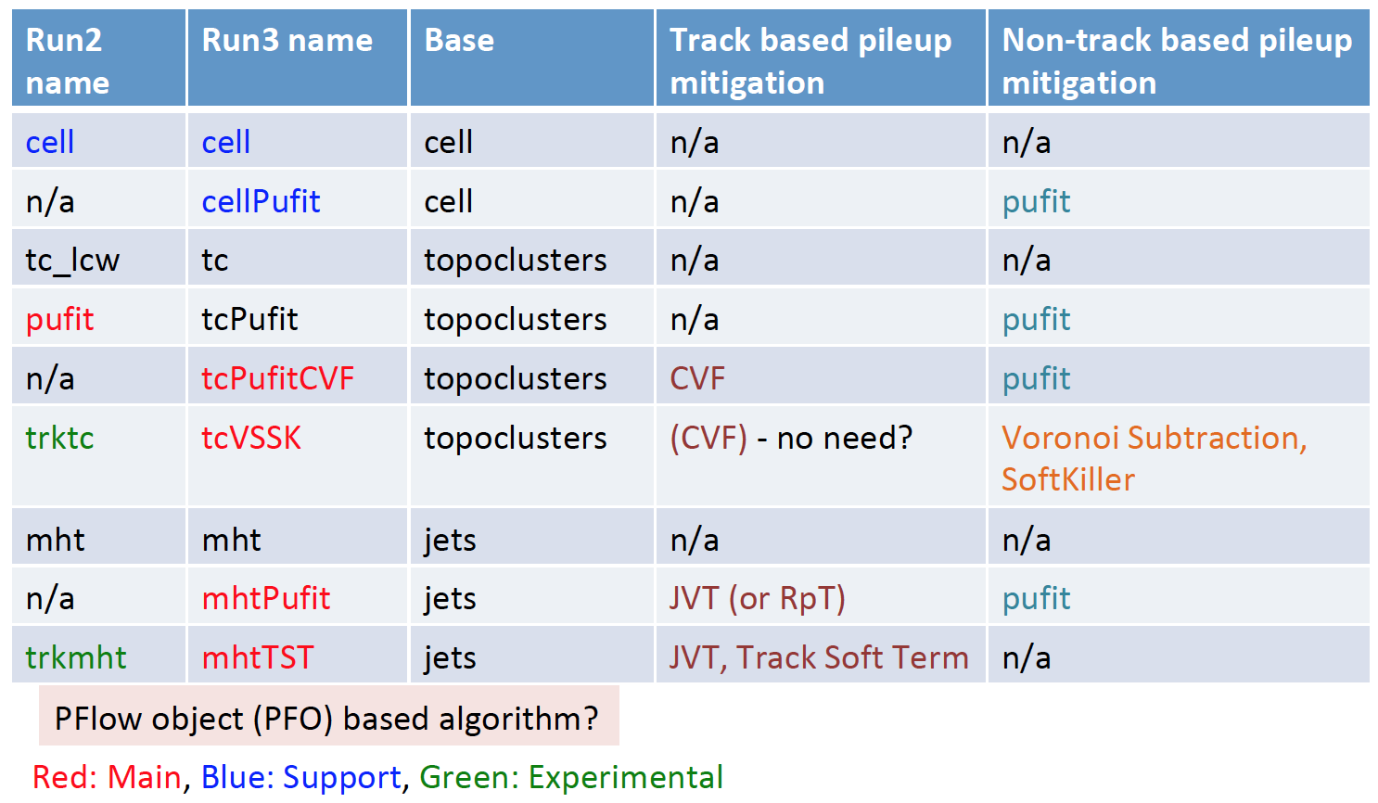
Trigger vs Offline MET
Offline: object-based algorithm using: e±, γ, μ, τ and jets + Soft Term
Trigger: use calo cells, TopoClusters, Jets
3 basic algorithms × pileup mitigation methods
9 algorithms are being considered for Run3
See talk by Kenji Hamano

Slide 16
Trigger
See talk by Kenji Hamano

Slide 17
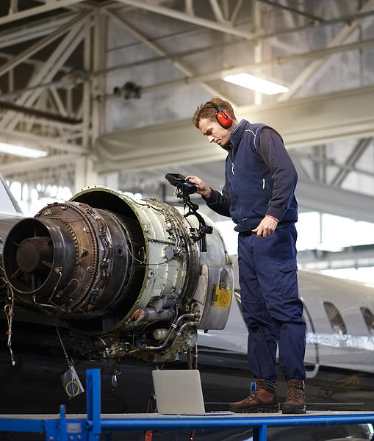
Jet Trigger Calibration

Slide 18
Ingredients of jet calibration
Start with offline calibration
Use tracks whenever possible
From 2017: used tracking in jet triggers used for b-tagging chains

Slide 19
Ideal World
Full-scan tracking at the HLT would mean:
No complicated RoI-based tracking
All triggers would have tracking, not just b chains
PFlow available for all thresholds
Better match with offline jets
Less rate wasted with migrations from below the threshold
Pileup suppression with JVT
Less rate wasted from pileup effects
Latest developments in Jiri’s talk last week
See Ben’s contribution in HCW2019

Slide 20
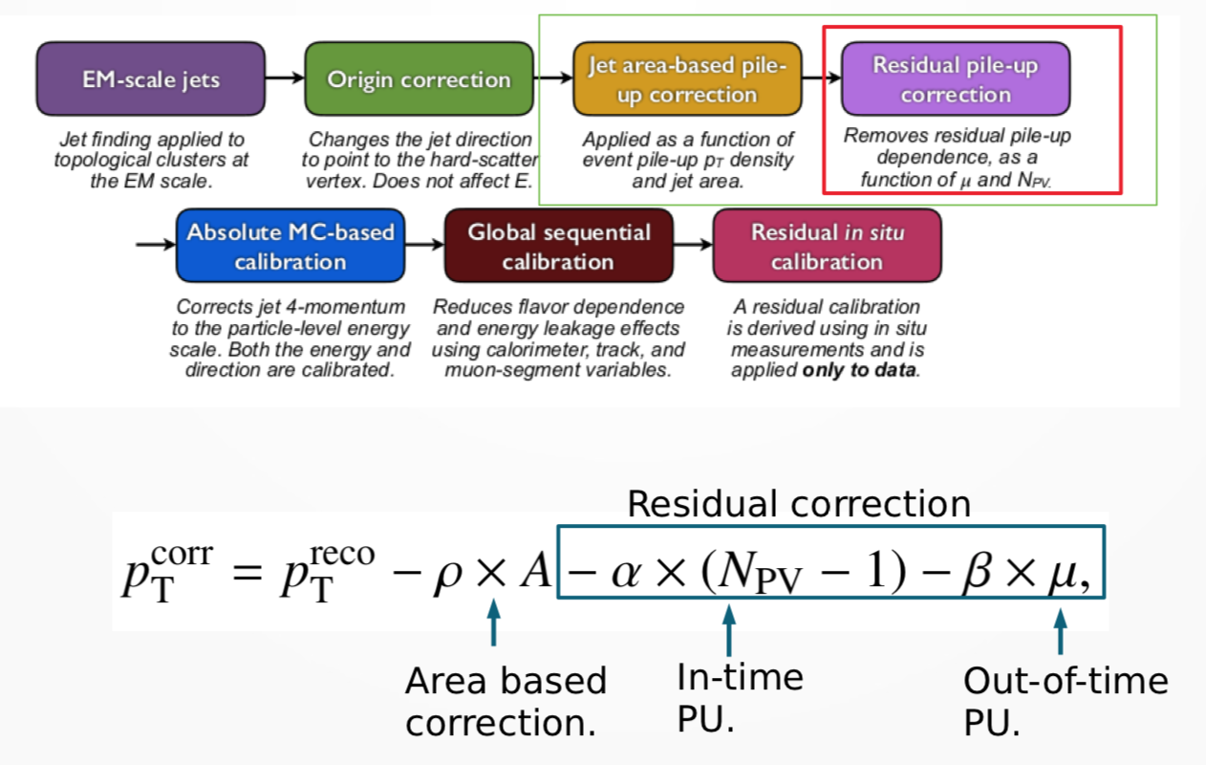
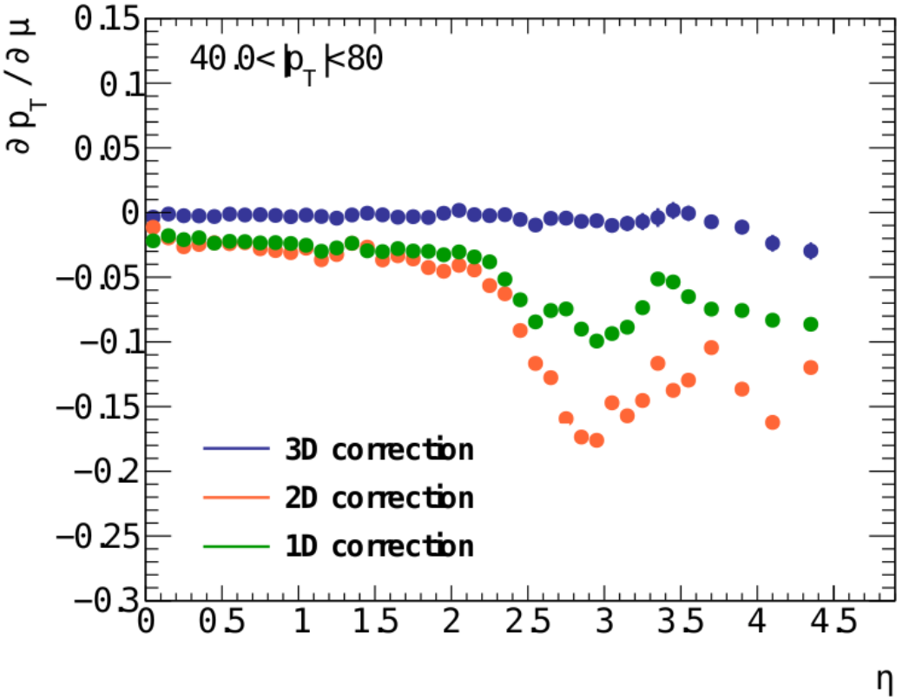
Residual pileup subtraction
See talk by Jennifer Roloff and Pablo Rivandeneira

Slide 21
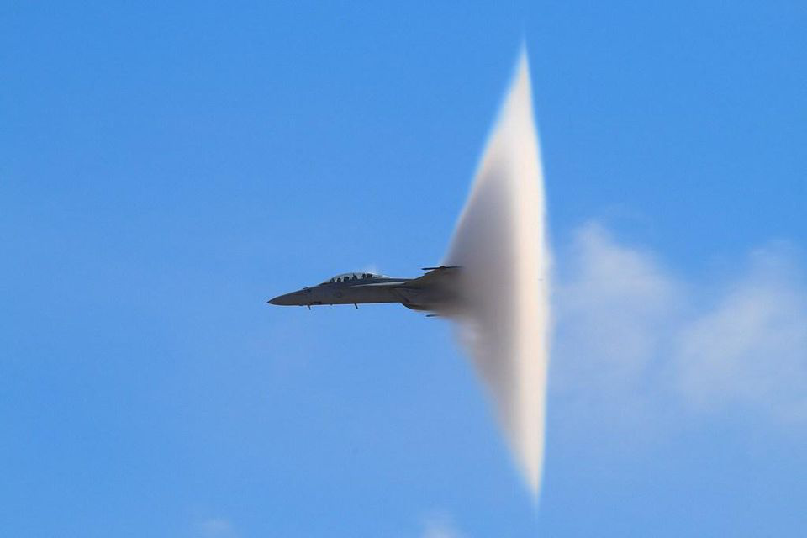
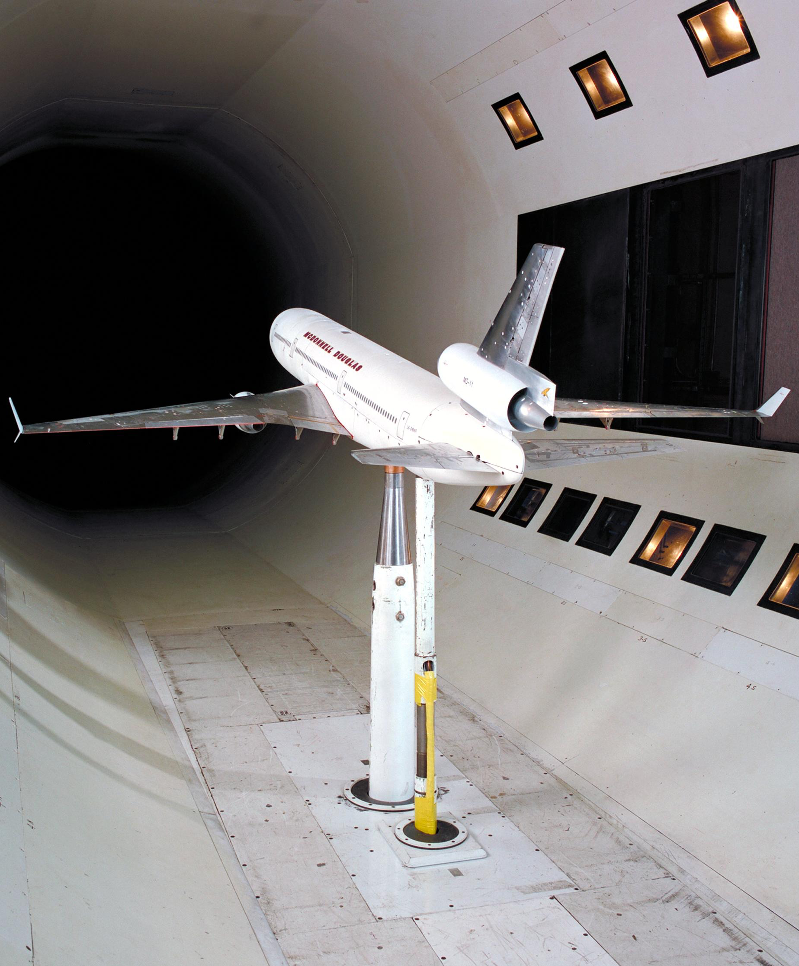
Jet Trigger Performance in Run 2

Slide 22
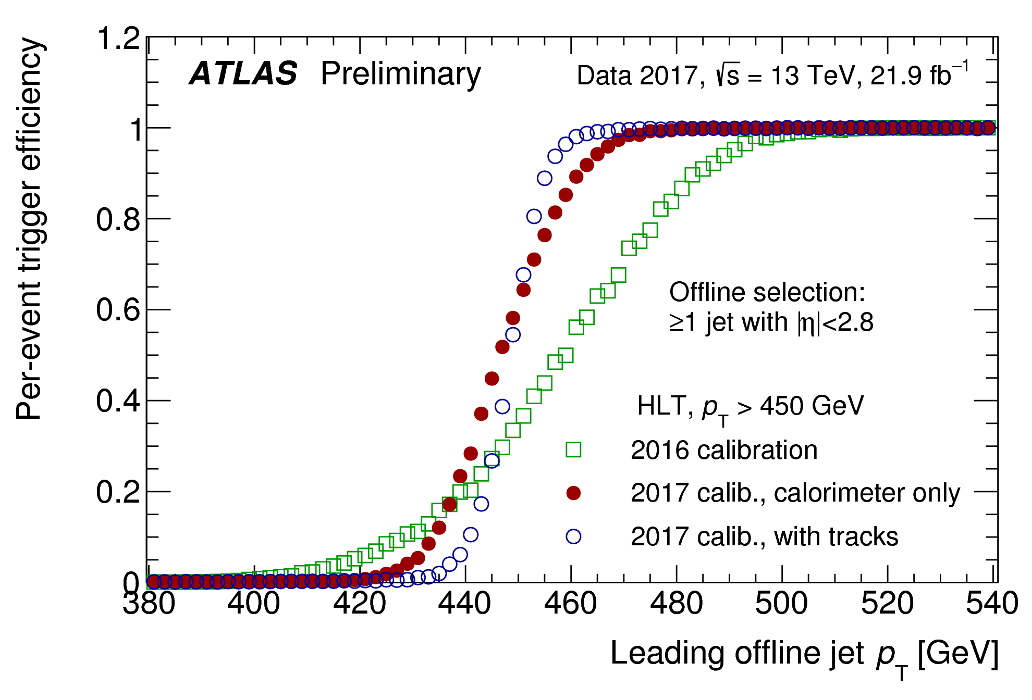
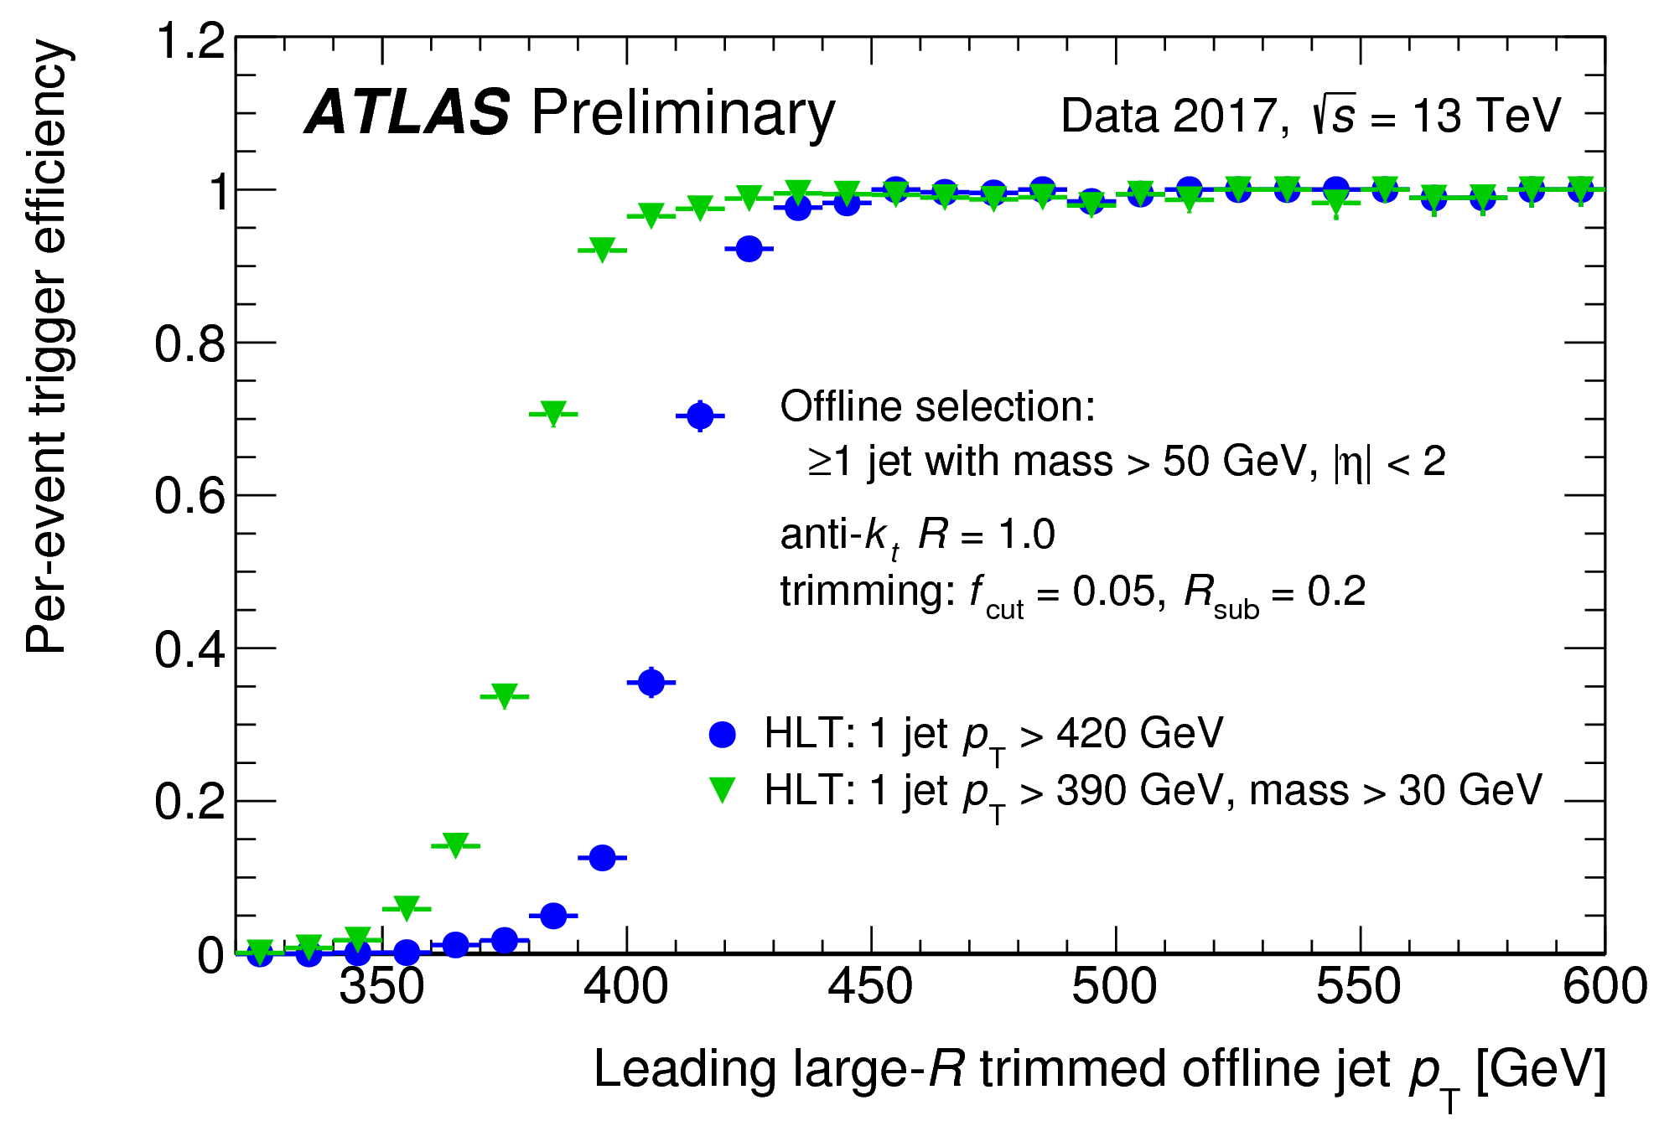
2017 Performance
See ATL-DAQ-PUB-2018-002
Single-jet trigger with different calibrations
2016 calibration
2017 calorimeter-only calibration
2017 calibration plus GSC and in-situ corrections
Better jet resolution!
HLT large-R single-jet triggers
|η|< 2.0
jet mass > 50 GeV

Slide 23
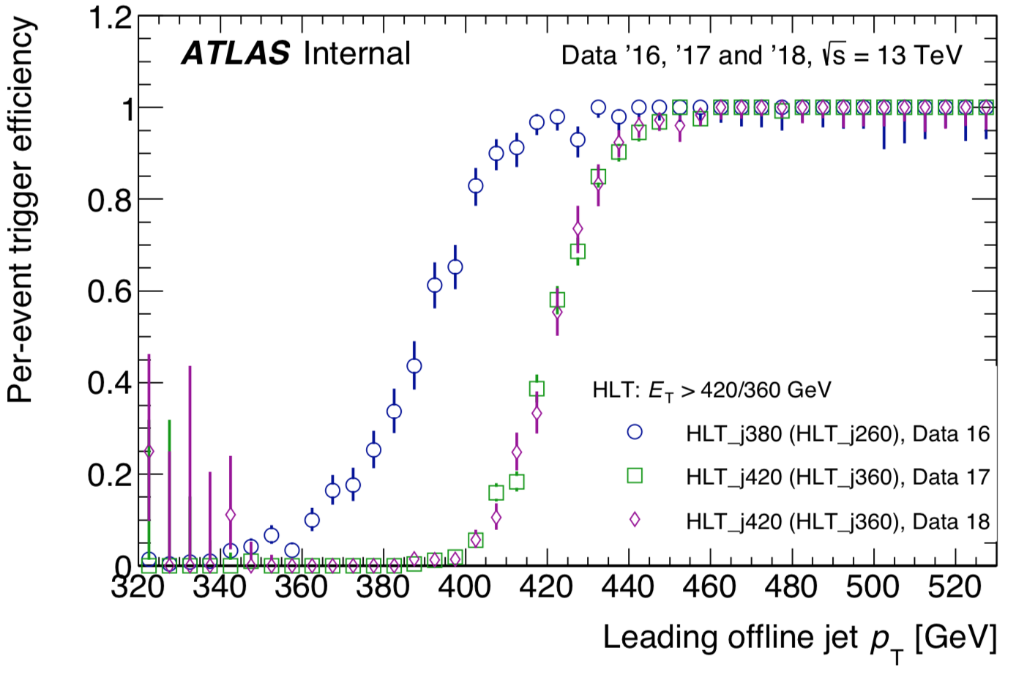
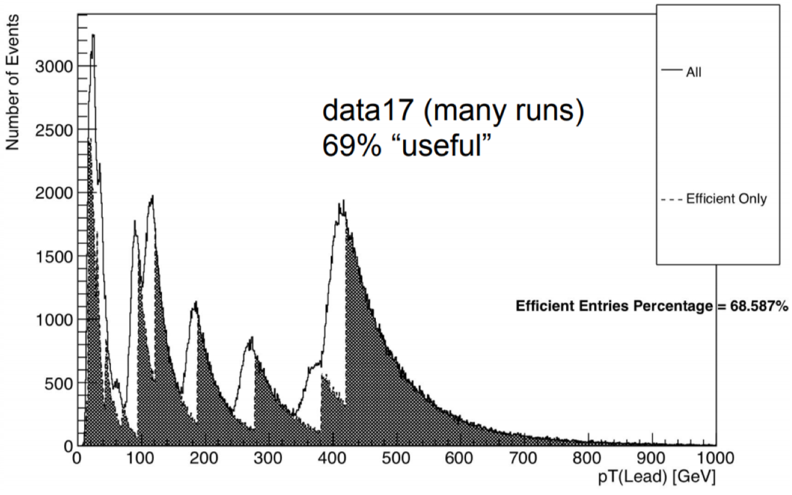
Latest updates
Preliminary plots
Work in progress; not full stats
Lowest unprescaled single jet turn-on
2016 data
NOTE: your latest calibration doesn’t exist when trigger is running...
2017 and 208
Updated JES
Added GSC
Added in-situ correction
Impact of HLT calibration: (shaded: >99% efficiency)
Efficiency increased from 51% (2015) to 69%

Slide 24
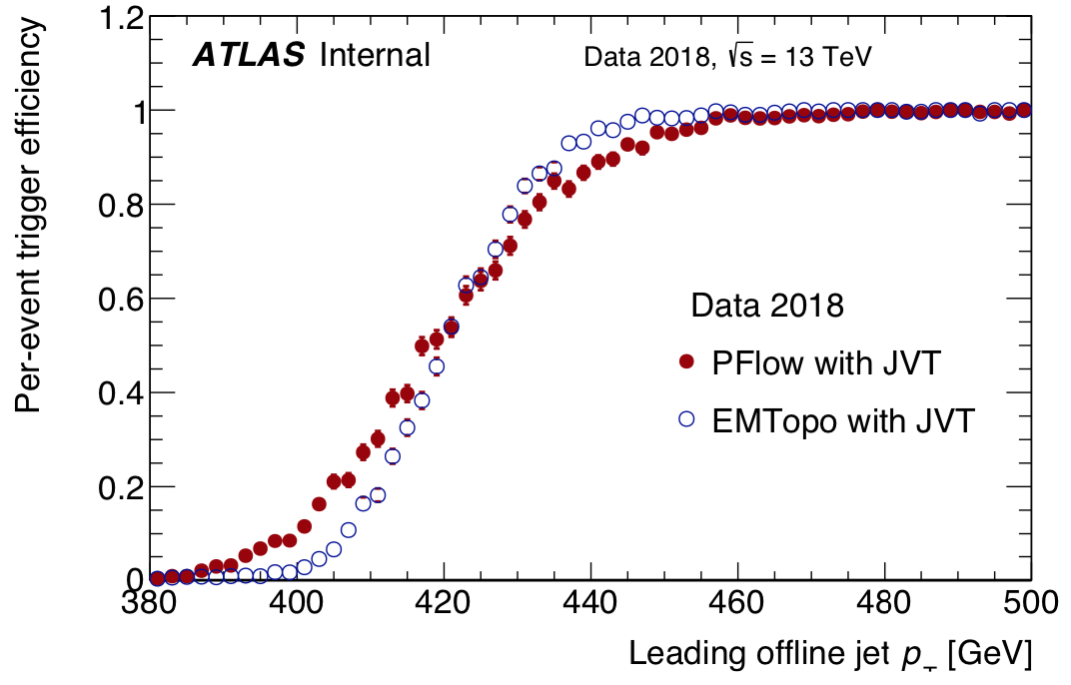
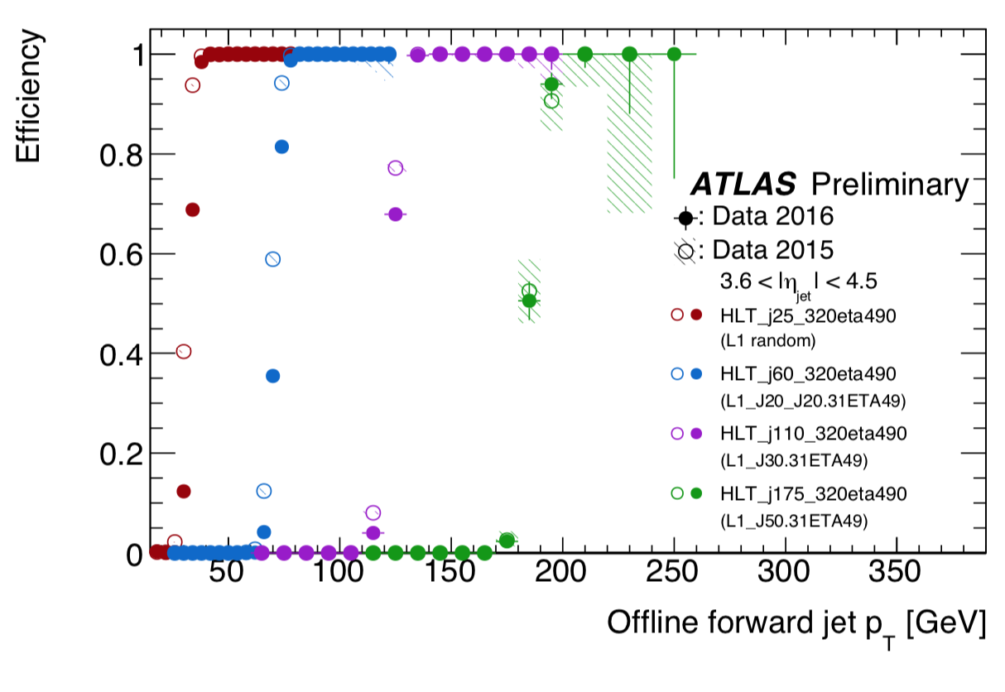
EMTopo trigger jets plotted vs offline EMTopo or Pflow
Note: x-axis is either EMTopo or PFlow
For completeness: forward jets

Slide 25
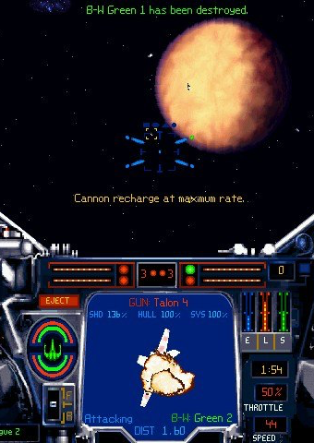
Software

Slide 26
Software for Run 3
Replacing JetRecTool with new, simpler JetAlgorithm
To replace JetRecTool’s convoluted internal logic and use
Run a IJetProvider (new interface) to either build jets or grab existing ones.
Run all IJetModifiers (existing interface), including moment calculation, calibrations, etc
Entirely new configuration system for both jets and MET
Currently have multiple particle ow EDM classes:
PFO, original TCC, TCC schema evolved for UFO
Will harmonize this with a single particle flow EDM class, with links to tracks and/or clusters
See talk by Bill Balunas

Slide 27
Jet / MET Monitoring and Validation

Slide 28
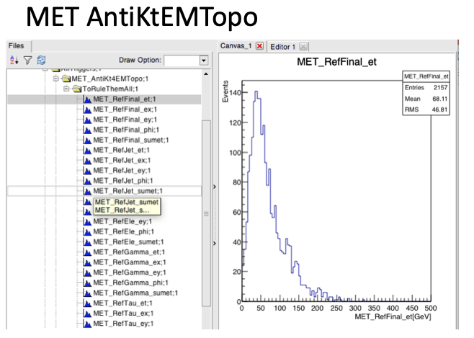
Monitoring and Validation
Data quality monitoring for Run 3:
New AthenaMT compatible monitoring framework
JetEtmiss & calo combined monitoring software being re-written for new framework
Covering Jets, MET, Calo, and Pflow
Ideas on automating monitoring with Machine Learning
Train on defects,
Use ML to pre-label new data
Validation:
Opinion was that there is room for improvement!
Plans/ideas, e.g. testing configs, using articial jets to cover phase space
Plans to develop testing framework based on unit tests
Good cross talk between offline and trigger in these areas!
See talks by Lee Sawyer, P-A Delsart, GalenGledhill

Slide 29
Conclusions
Very interesting workshop!
Lots going on in Jet/MET group
Software and EDM changes
Pileup suppression in inputs
New calibration techniques
DQ using machine learning
etc
Also very healthy interaction with trigger

Slide 30
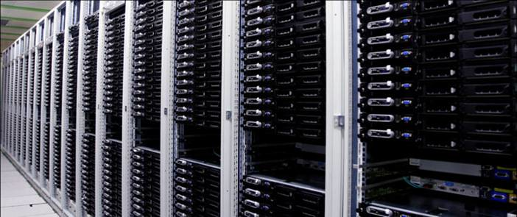
Backup

Slide 31
Tracks in the jet trigger(*)
(*) In an FTK-less world

Slide 32
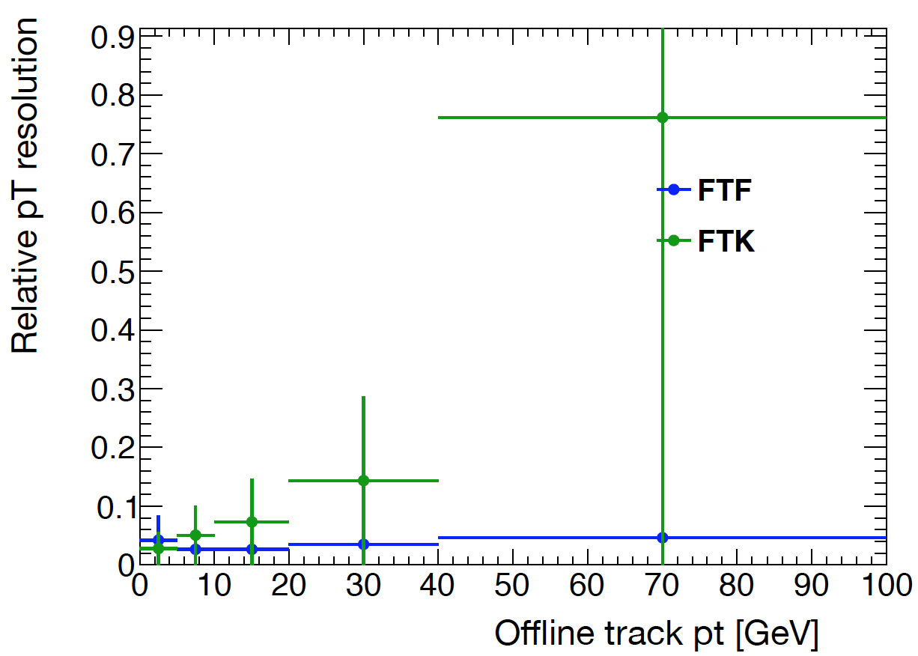
FTK vs FTF comparison
TJ Khoo
Took 21.3 AOD sample with FTF & FTK tracks (ART test)
Match tracks to offline with min deltaR cut of 0.01
Good enough, no overlaps
Applied 500 MeV pT cut and TightPrimary WP
Compare resolution and efficiency for FTF and FTK (non-refit)
Resolution is width of Gaussian (fitted to +/- 2 sigma)
Rate wrt no JVT | JVT>0.15
HLT_j15 | 81%
HLT_j45 | 85%
HLT_4j15 | 13%
HLT_2j45 | 45%
HLT_4j45 | 76%
HLT_6j45 | 68%
p_{T} < 1 GeV

Slide 33
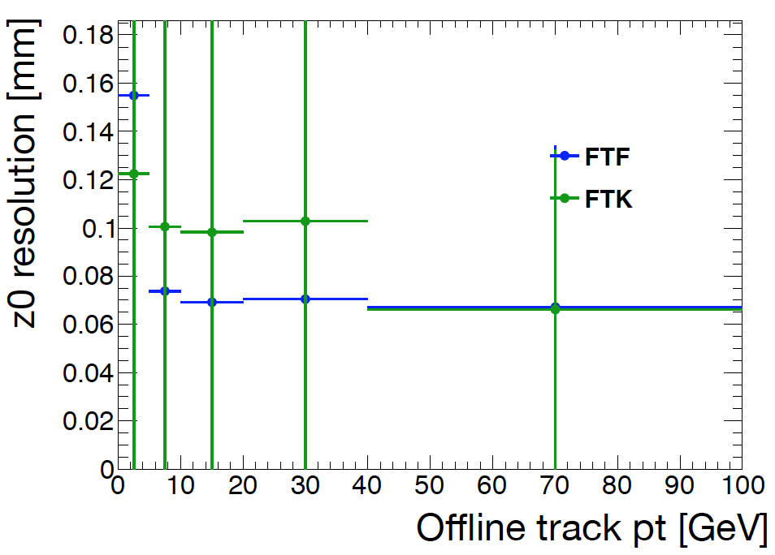
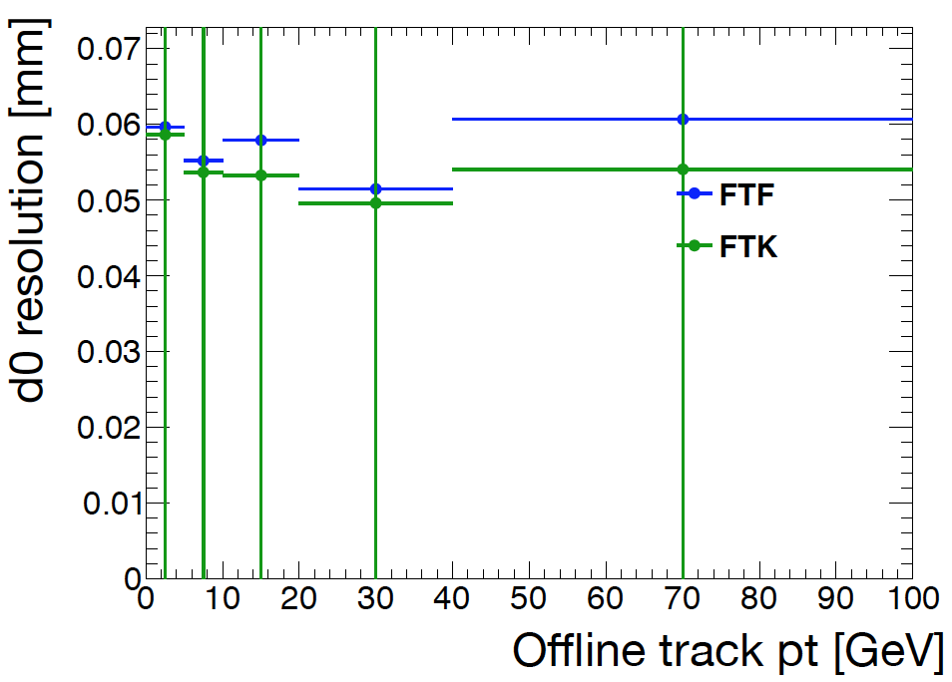
FTK vs FTF comparison
Performance of these FTF tracks seems better than FTK benchmark
Except resolutions at very low p_{T}
And have not checked fake rate
BUT: this version of FTF takes 5s/event
Not only tracks, also need vertexing algorithm
Goal is 1s/evt but compatible with FTK performance ; currently 5s/evt

Slide 34
Tracking scenarios
First: need a better assessment of PFlow performance with HLT tracks
Initial results from 2016, but raised questions recently
Need to establish that the HLT PFlow gives us a significant benefit over pure calo triggers.
Baseline procedure would be:
Run HLT fast-tracking (re-optimised for speed, performance similar to FTK)
Run PFlow with HLT tracks & clusters
Run PFlow jet-finding
Plan B (if we get decent FTF track performance but fail CPU constraints):
Build jets from topoclusters for pre-filtering (no track GSC)
Run HLT fast-tracking (reoptimised for speed, performance similar to FTK)
Run PFlow with HLT tracks & clusters
Run PFlow jet-finding
Plan C (if PF still worth it but plans A and B fail CPU constraints):
Do tracking only in RoIs around jets (a la current b-jet tracking) with low enough thresholds to build vertices and achieve some pileup suppression

Slide 35
Slides by TJ in Jet Trigger meeting

Slide 36
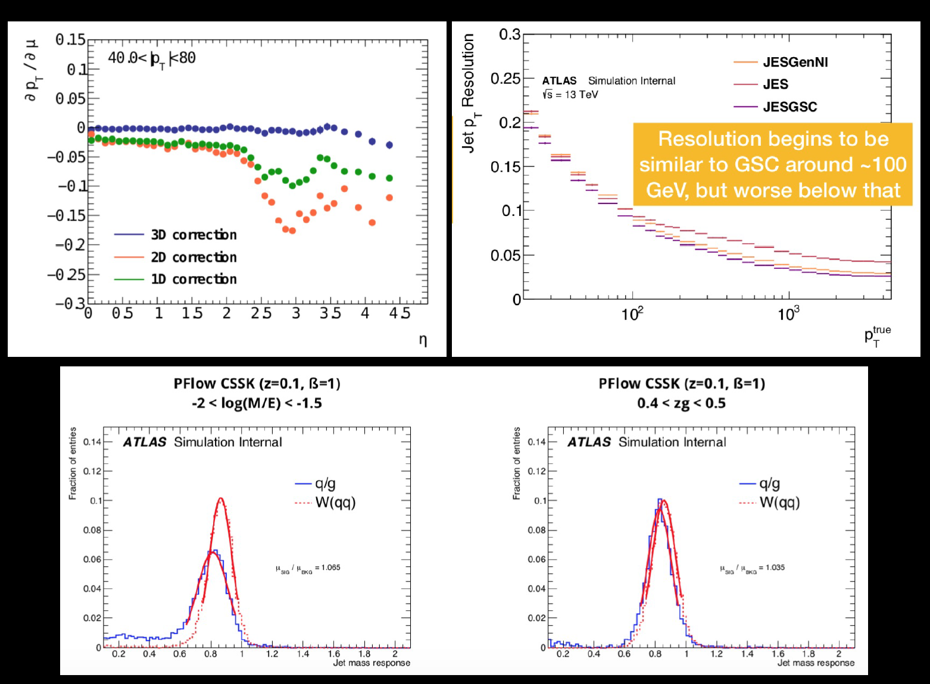

Slide 38
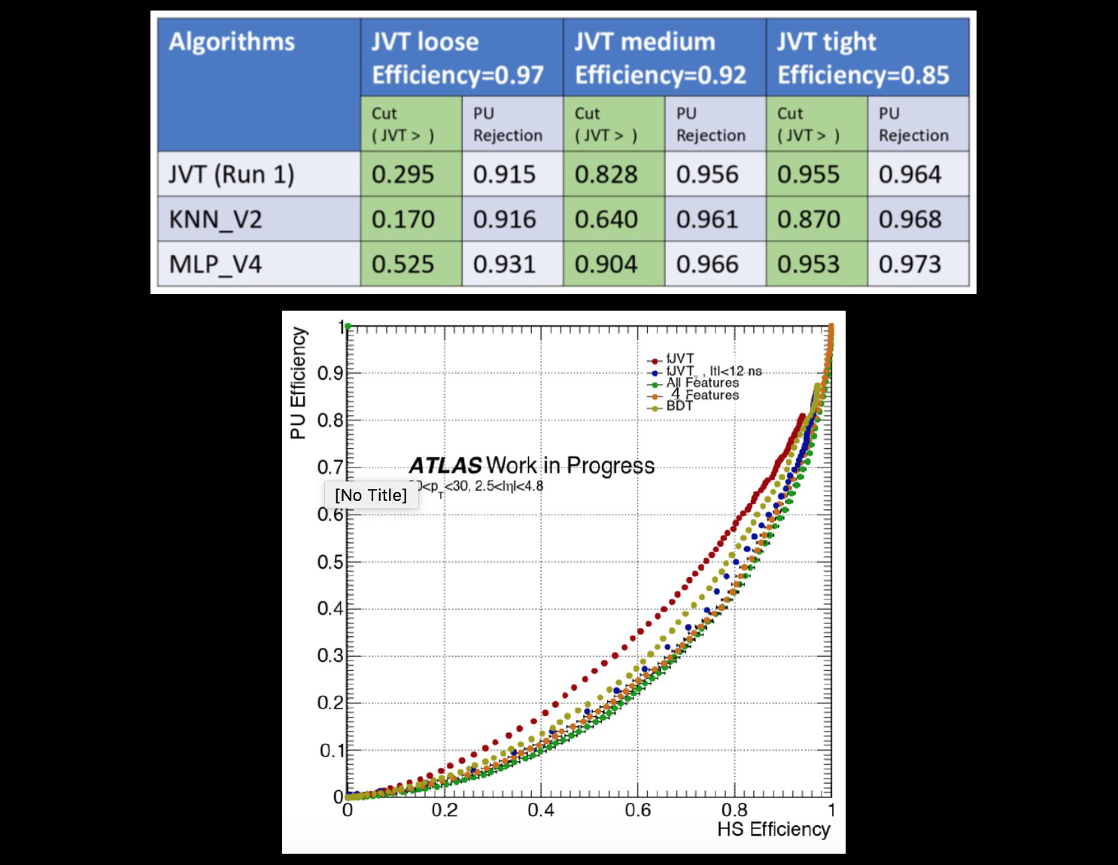

Slide 40
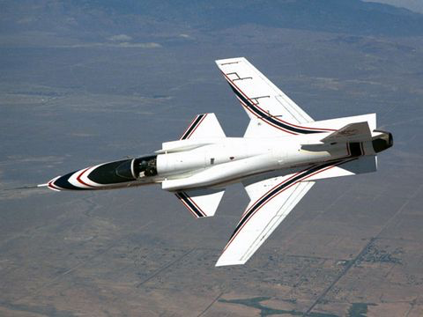
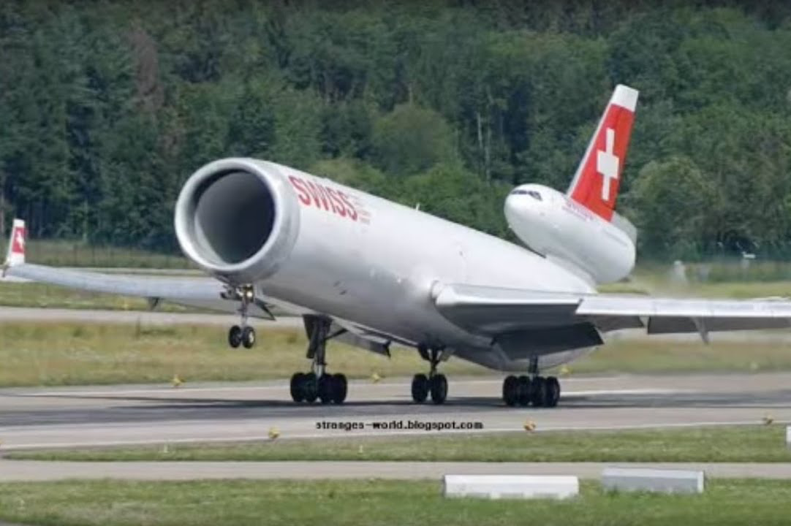
News Summary

Slide 41
New unified EDM: a single particle flow EDM class, with links to tracks and/or clusters
Data quality monitoring:
Automating with machine learning techniques
Using artificial jets to cover phase space in tests
ETC... (to be completed)

