Slide 1
Jet trigger with initial 13TeV collisions
R.Gonçalo (LIP), D.Miller (Chicago)
On behalf of the Jet Trigger Signature Group
Trigger General Meeting – 26 May 2015

Slide 2
Reprocessed run 265573
Reprocessing JIRA: https://its.cern.ch/jira/browse/ATR-11205,
  Menu: MC_pp_v5, no L1 prescales
    https://atlas-trigconf.cern.ch/reprocessing/smkey/75/l1key/24/hltkey/53/
    Supermasterkey : 75
    Release : 21
    LVL1prescalekey : 24
    HLTprescalekey : 53
  P1HLT 20.2.1.2, AMI r6715
Some initial findings (to be confirmed):
  No events in j70 (from EFCentFullScanMultiJetHypo_1_0eta320_70_a4_tc_em_subjes_FS)
    Found to be missing in menu except for multi-jet and b-jet triggers
  j80 may be misconfigured (spectrum at ~90GeV, above threshold)
    Found to exist only as j80_xe80 (& related) in menu
  EFCentFullScanMultiJetHypo_1_0eta320_30_a4_tc_em_jes_PS seems to be misconfigured (spectrum starts at 90GeV)
  a10 plots basically empty
  j100_2j50 (b-tagging chain?) seems to show only 0 or 3 jets (??)

Slide 9
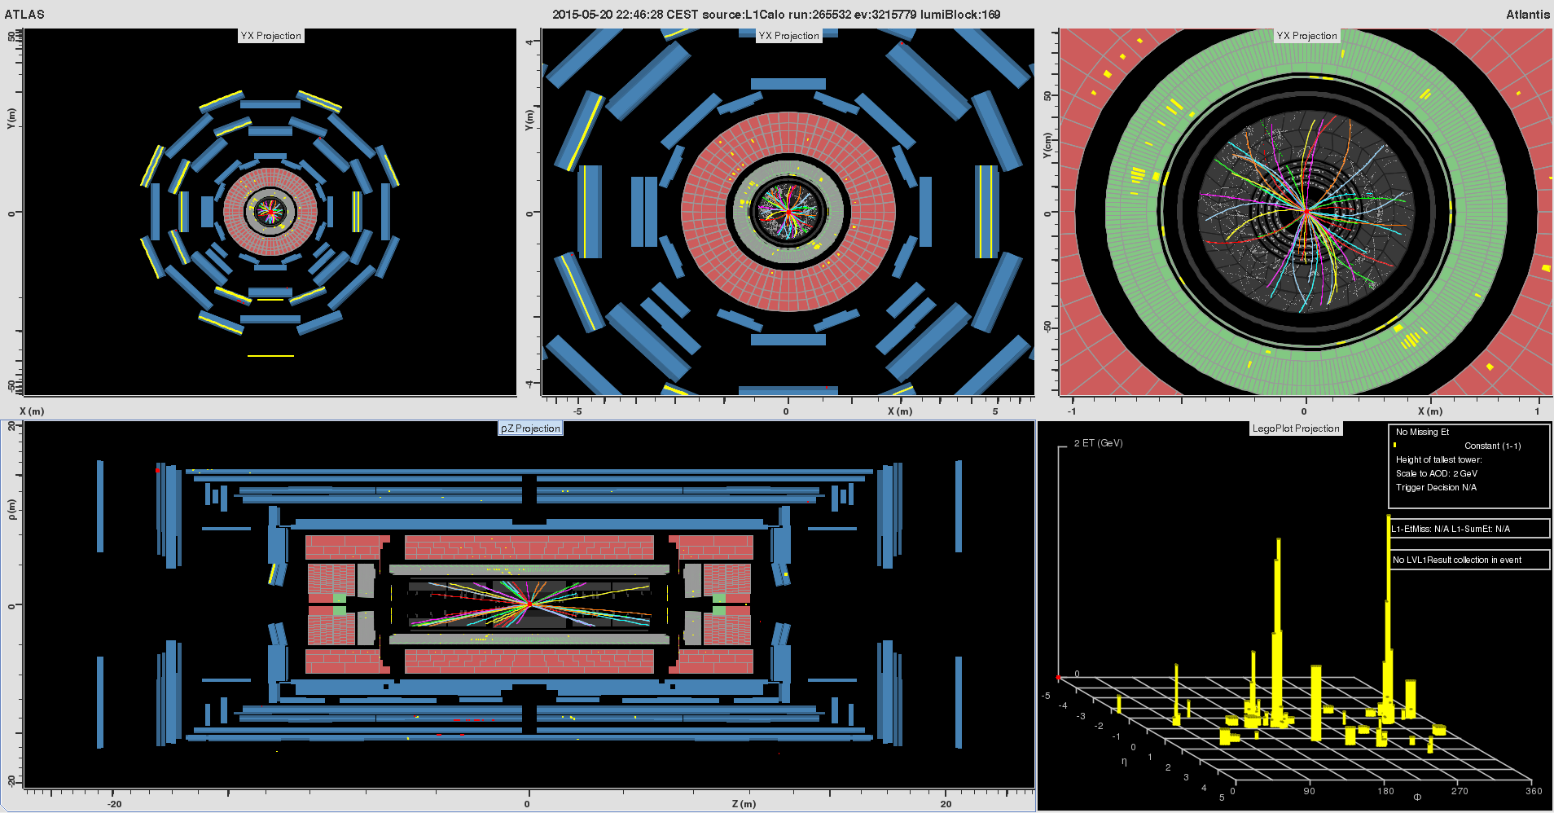
Are those jets?

Slide 10
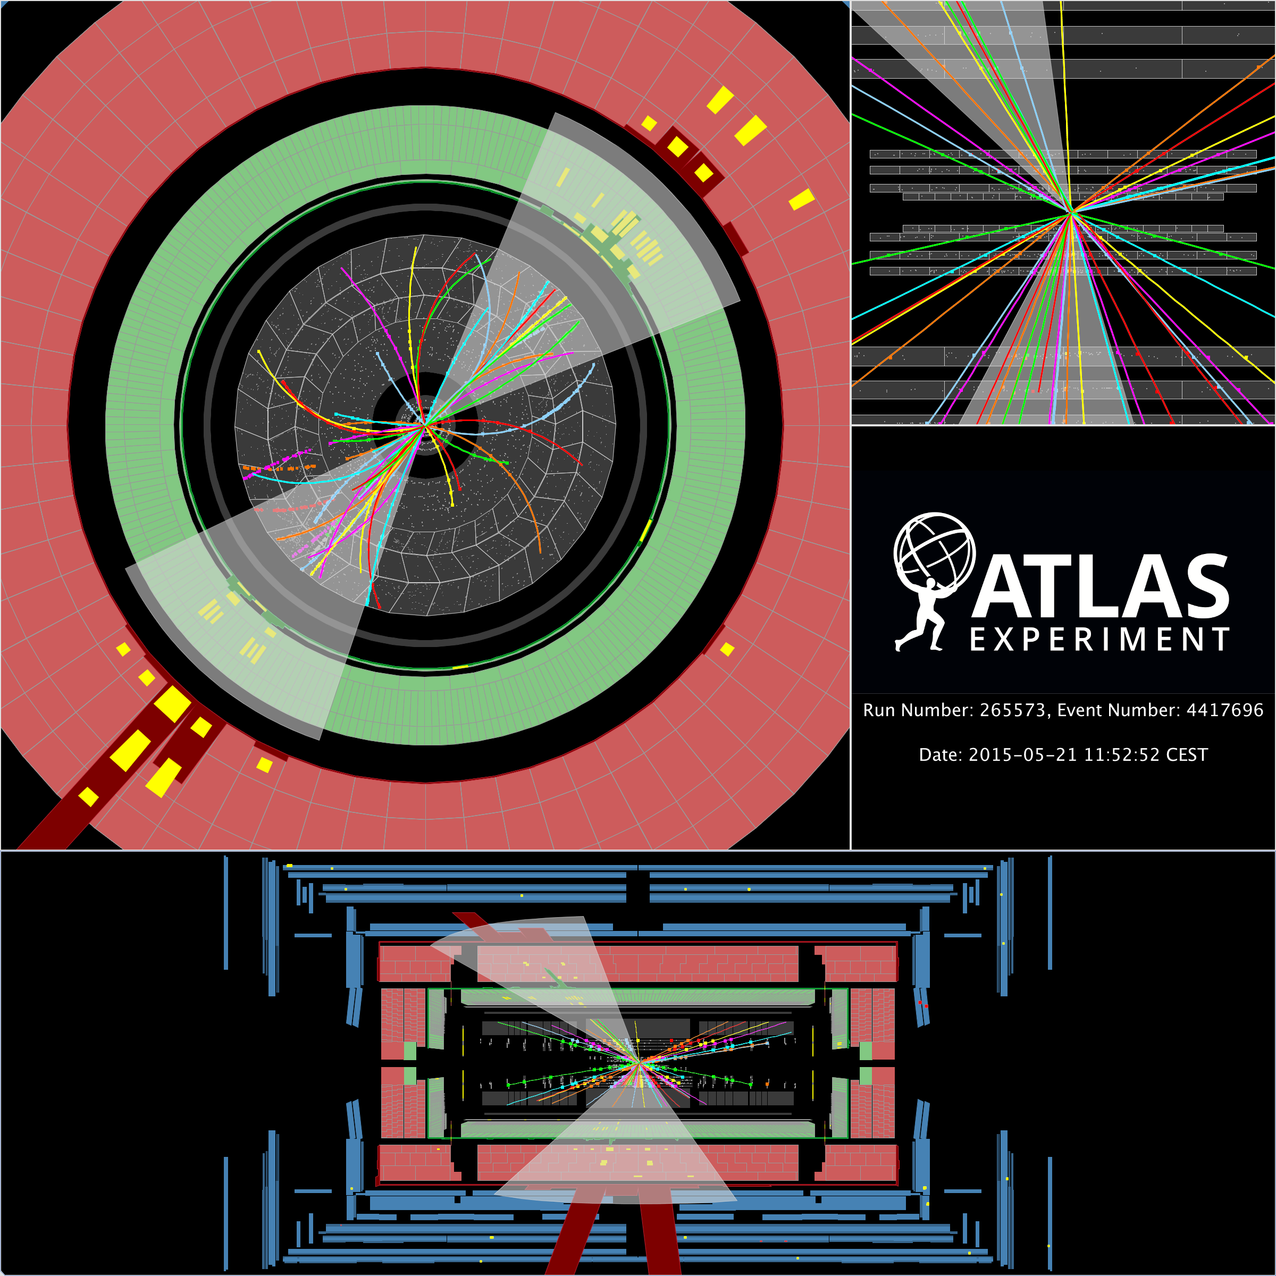
Di-jets in 13TeV Collisions

