Slide 1
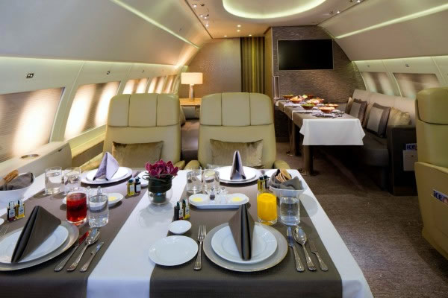
Jet Menu for rel.20.0.0/MC2015
Ricardo Gonçalo (LIP), David Miller (Chicago)
On behalf of the jet signature group
Trigger General Meeting
26 November 2014

Slide 2
Key
Jet Algorithm:
a4 = anti-kt jet finding algorithm with R parameter of 0.4
a10 = anti-kt jet finding algorithm with R parameter of 1.0
Input objects used for jet finding:
tc = TopoClusters reconstructed from calorimeter cells
TT = Level 1 TriggerTowers read out in HLT to allow fast but coarse full calo scan (a.k.a. Level 1.5)
Calorimeter scan:
PS = partial calorimeter scan seeded by L1 RoI or L1.5
FS = full calorimeter scan (default)
Pseudorapidity range:
xxETAyy = jets in interval xx < |η| < yy – default is 0eta32 (old central jets)
Cluster Energy Scale correction:
em = no weights applied
lcw = local cluster weighting
Jet Energy Scale correction:
jes = JES calibration factors without pileup subtraction
sub = pileup subtraction applied but no JES factors
subjes = both pileup subtraction and JES factors
Some possible combinations:
a4tcem = jets built from EM-scale clusters with no jet level calibration
a10tcemsubjes = jets built from EM-scale clusters with pile-up subtraction and jet-level calibration
a10TTem = jets built from TriggerTowers with no jet level calibration
a4tclcwsub = jets built from LC-scale clusters with only a pile-up subtraction applied at the jet level
a10tclcw_PS = jets built from LC-scale clusters found in a SuperRoI seeded by all L1_Jx items

Slide 3
Inclusive single jet chains
Level 1 seed | Rate @ 0.5 & 2x10³⁴ | HLT chain | Rate @ 0.5 & 2x10³⁴ | Prescale@2x10³⁴ | Clients
L1_RD0 |  | j55_a4tcemsubjes | O(Hz) | ? | bootstrap
 |  | j60_a4tcemsubjes | O(Hz) | ? | bootstrap
J12 | 0.95 / 3.8 MHz | j55_a4tcemsubjes | 150 / 600 kHz | 600,000 – 1 Hz | taus
J15 | 0.53 / 2.1 MHz | j60_a4tcemsubjes | 100 / 400 kHz | 400,000 – 1 Hz | taus, btag
J20 | 240 / 970 kHz | j85_a4tcemsubjes | 21 / 85 kHz | 85,000 – 1 Hz | taus, multi-j
 |  | j85_a4tcemjes
 |  | j85_a4tclcwsubjes
 |  | j85_a4tclcwjes
J25 | 130 / 510 kHz | j100_a4tcemsubjes | 10 / 41 kHz | 41,000 – 1 Hz | taus
J30 | 75 / 300 kHz | j110_a4tcemsubjes | 6.5 / 26 kHz | 26,000 – 1 Hz | LAr calib
J40 | 32 / 130 kHz | j150_a4tcemsubjes | 1.6 / 6.5 kHz | 6500 – 1 Hz | J+MET
J50 | 15 / 60 kHz | j175_a4tcemsubjes | 0.75 / 3 kHz | 3000 – 1 Hz | multijet
 |  | j175_a4tcemjes
 |  | j175_a4tclcwsubjes
 |  | j175_a4tclcwjes

Slide 4
Inclusive single jet chains
Level 1 seed | Rate @ 0.5 & 2x10³⁴ | HLT chain | Rate @ 0.5 & 2x10³⁴ | Prescale@2x10³⁴ | Clients
J60 | 7.5 / 30 kHz | j200_a4tcemsubjes | 0.4 / 1.6 kHz | 1600 – 1 Hz | btag
J75 | 4 / 17 kHz | j260_a4tcemsubjes | 140 / 400 Hz | 400 – 1 Hz | btag, low Lumi
J85 | 2.5 / 10 kHz | j300_a4tcemsubjes | 67 / 270Hz | 200 – ≈1 Hz | multijet, medium Lumi
 |  | j320_a4tcemsubjes | 43 / 170 Hz | 150 – ≈1 Hz | multijet, medium Lumi
J100 | 1.3 / 5 kHz | j360_a4tcemjes | 22 / 90 Hz | 100 – ≈1 Hz | unprescaled at 1x10³² or lower: aim for 1-2 points during year to change lowest unprescaled chain Also re-think set of cross-check chains with different calibrations if needed
 |  | j380_a4tcemsubjes | 16 / 65 Hz | 50 – ≈1 Hz
 |  | j380_a4tcemjes
 |  | j380_a4tclcwsubjes
 |  | j380_a4tclcwjes
 |  | j400_a4tcemsubjes | 9 / 35 Hz | unprescaled
 |  | j400_a4tcemjes
 |  | j400_a4tclcwsubjes
 |  | j400_a4tclcwjes
J120 | 1.3 / 2.7 kHz | j460_a4tcemjes + cross-check chains | <1 / 2.8 Hz | unprescaled | High Lumi
J400 | 0 / 0 Hz | noAlg | 5.5 Hz | unprescaled | Passthrough

Slide 5
Multi-jet and fat jet chains
Level 1 seed | @ 0.5 & 2x10³⁴ | HLT chain | @ 0.5 & 2x10³⁴ | Prescale@2x10³⁴ | Clients
3J40 | 0.4 / 1.6 kHz | 4j85_a4tcemsubjes | 45 / 180 Hz | 180 – 1 Hz
3J50 | 0.3 / 1.0 kHz | 4j100_a4tcemsubjes | 12 / 50 Hz | unprescaled | SUSY, SM, top, jets
4J15 | 2.4 / 9.5 kHz | 5j55_a4tcemsubjes | 65 / 260 Hz | 260 – 1 Hz
4J20 | 0.5 / 1.9 kHz | 5j60_a4tcemsubjes | 40 / 170 Hz | 170 – 1 Hz
4J20 | 0.5 / 1.9 kHz | 5j85_a4tcemsubjes | 4 / 15 Hz | unprescaled | SUSY, SM, top, jets
 |  | 5j85_a4tcemjes
 |  | 5j85_a4tclcwsubjes
 |  | 5j85_a4tclcwjes
5J15.0ETA24 | 0.1 / 0.3 kHz | 6j45.0eta24_a4tcemsubjes | 25 / 100 Hz | 100 – 1 Hz | SUSY, SM (*)
5J15.0ETA24 | 0.1 / 0.3 kHz | 6j50.0eta24_a4tcemsubjes | 10 / 40 Hz | unprescaled | SUSY, SM (*)
5J15.0ETA24 | 0.1 / 0.3 kHz | 6j55.0eta24_a4tcemsubjes | 8 / 30 Hz | 30 – 1 Hz | SUSY, SM (*)
HT150 | 3 / 12 kHz | j360_a10tcemsubjes | 14 / 60 Hz | 60 – 1 Hz | exotics, jets
HT190 | 1.2 / 5 kHz | j450_a10tcemsubjes | 2 / 8 Hz | unprescaled | exotics, jets
(*) A new study from SUSY indicates that 6j chains can/should start from 4J20 to save bandwidth – need to understand if this is also ok for SM

Slide 6
Forward jet and HT chains
Level 1 seed | Rate @ 0.5 & 2x10³⁴ | HLT chain | Rate @ 0.5 & 2x10³⁴ | Prescale@2x10³⁴ | Clients
J15.24ETA49 | ? | j60.24eta49 | ? | ? – 1 Hz | egamma
J15.28ETA32 | ? | j60.28eta32 | ? | ? – 1 Hz | SUSY, SM, top, jets
J20.28ETA32 | ? | j85.28eta32 | ? | ? – 1 Hz | jets
J15.32ETA49 | ? | j60.32eta49 | ? | ? – 1 Hz | jets
J20.32ETA49 | ? | j85.32eta49 | ? | ? – 1 Hz | jets
J30.32ETA49 | ? | j110.32eta49 | ? | ? – 1 Hz | jets
J50.32ETA49 | ? | j175.32eta49 | 0 | unprescaled | Jets, SM
J75.32ETA49 | ? | j260.32eta49 | 0 | unprescaled | SM
J100.32ETA49 | ? | j360.32eta49 | 0 | unprescaled | SM
Default R parameter and calibration is a4tcemsubjes
Add cross-check chains (a4tcemjes, a4tclcwsubjes, a4tclcwjes) for:
j85.28eta32, j85.32eta49, j175.32eta49, j260.32eta49, j360.32eta49
Level 1 seed | Rate @ 0.5 & 2x10³⁴ | HLT chain | Rate @ 0.5 & 2x10³⁴ | Prescale@2x10³⁴ | Clients
HT190 | 1.2 / 5 kHz | ht1000 | 3.5/14 Hz (0 unique) | unprescaled
HT150 |  | Ht500(?) |  | prescaled

Slide 7
Primary Jet Menu Items at low & high lumi
5x10³³ menu: j360, fatjet360, 4j85, 5j60, 6j50.0ETA24, ht800
2x10³⁴ menu: j400, fatjet450, 4j100, 5j85, 6j50.0ETA24, ht1000
Default calibration: emsubjes
Plus cross check chains for specific thresholds
NOTE: cross check chains should be run with coherent prescale
In each scenario, total jet menu rate adds up to around 100Hz
Chain Type | L1 Seed at 0.5x10³⁴ | HLT Item at 0.5x10³⁴ | L1 Seed at 2x10³⁴ | HLT Item at 2x10³⁴
Single jet | J75 | j360 | j100 | j400
Single fat jet | HT150 | j360_a10 | HT190 | j450_a10
4 jets | 3J40 | 4j85 | 3J50 | 4j100
5 jets | 4J15 | 5j60 | 4J20 | 5j85
6 jets | 5J15.0ETA24 | 6j50.0ETA24 | 5J15.0ETA24 | 6j50.0ETA24
HT trigger | HT190 | ht800 | HT190 | ht1000

Slide 8
Isolated track triggers
Needed for several measurements including calorimeter E/p studies
Would like to include them in the trigger menu now even though studies have not yet begun
Request similar “hadCalib” items as in Run I seeded from random triggers
HLT_hadCalib_trkXX_L1RDO
For MC15, would like to have the same 9 GeV threshold in place.
Hope to have threshold studies available soon for data.

Slide 9
Requests for the low-<mu> run
Special bandwidth considerations needed for this run
Huge number of clients: lumi, physics, calo, tracker, reconstruction, etc.
Needed provide data for jet-related studies
Forward jet triggers for eta intercalibration without pileup
Minbias triggers for material map studies
Isolated track triggers (HLT_hadCalib_trkXX_L1RD0) for E/p

Slide 10
To Do:
From the discussion during the meeting:
Add in thresholds between j400 and j460
j420, j440?
Add in additional very low threshold triggers starting from random L1_RD0
j15, j20, j30, j45
Run cross-check chains in coherent-prescale mode
Finish tuning HLT ht chains

Slide 11
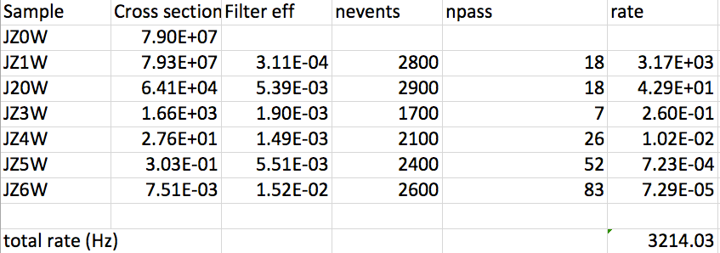
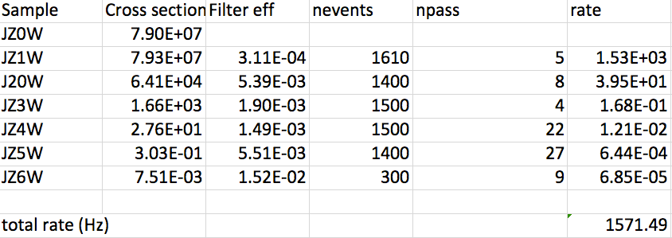
Bonus: rates with pileup correction
Conditions:
L=2x10³⁴
4j45 rate
No event weighting
Only fixed ρ=6 here
ρ calculation works in private code so far
Top: no areas subtraction
Bottom: with ρ=6 area subtraction

