Slide 1
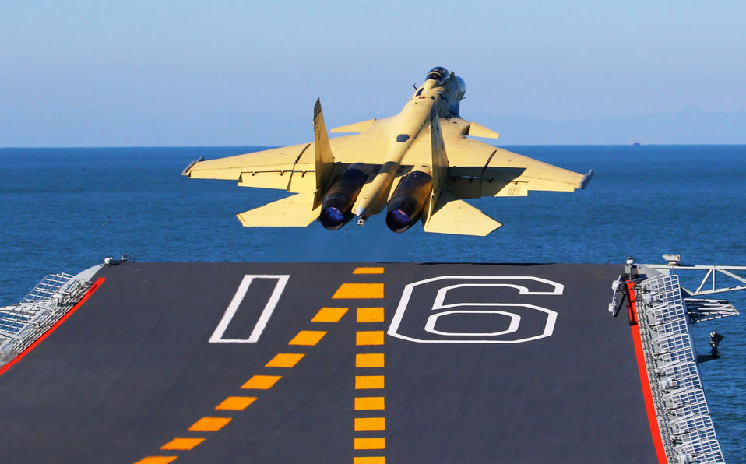
Jet Trigger Commissioning Plans
Ricardo Gonçalo (LIP) David Miller (Chicago)
on behalf of the Jet Trigger Signature Group
Trigger General Meeting, 29 October 2014

Slide 2
Outlook
Commissioning strategy
Commissioning so far
Commissioning timeline
Specific Issues
Questions and pending actions

Slide 3
Jet trigger commissioning strategy
Run new features online as early as possible for functional validation and finding potential problems – commission with collisions later
Compare with offline jets
Large overlap in performance is essential to avoid wasting bandwidth
Includes pileup subtraction
Main goal is to commission/run with calorimeter full-scan
But keep partial-scan as (essential) plan B
Staged approach:
Cosmics runs
M5 and M6 so far, much more work to follow
Improve monitoring, build up operations team, fine-tune strategy
Continue during beam commissioning period
Take all opportunities to deploy new features early
Be ready to use collisions data when it comes
Move quickly from commissioning to physics
Different calibrations, pileup subtraction, jet cleaning, L1Topo, combined triggers, tracks, re-clustering, grooming, etc
Determine data/MC corrections for early use in physics analyses

Slide 4
Jet trigger commissioning strategy
Tight coupling with commissioning of HLTCalo
Studies of clustering performance and timing are key
Will need both EM and LCW clusters early on
Coordination with offline calo/jet critical for choices here
Comparison with offline jets is critical
First few runs will already establish the baseline performance
Need full set of supporting triggers with multiple calibration options
Kinematic comparisons with offline (scale and resolution in eta, phi, Et)
Effects of jet cleaning studied
Would benefit from special early runs with relaxed prescales for low threshold supporting triggers
Forward jets typically very difficult to study early
Need J+FJ for calibration sample for jet eta intercalibration

Slide 5
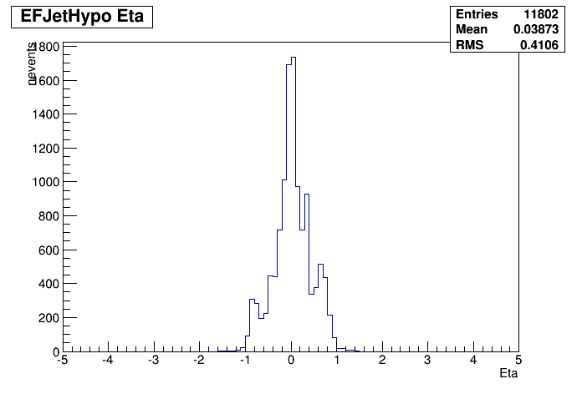
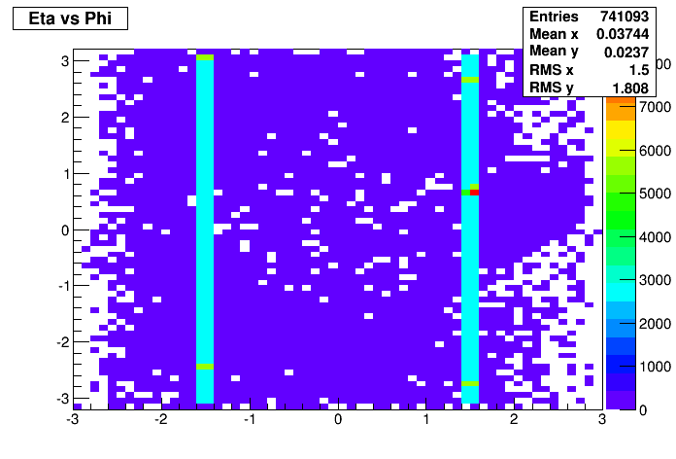
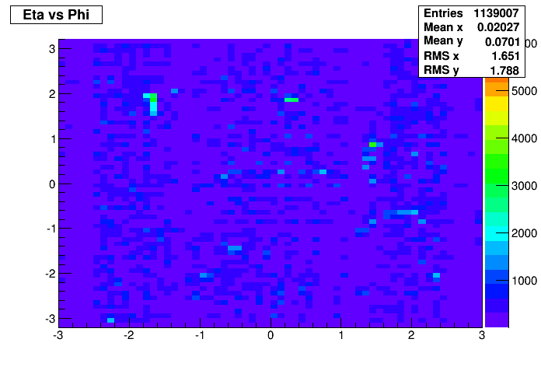
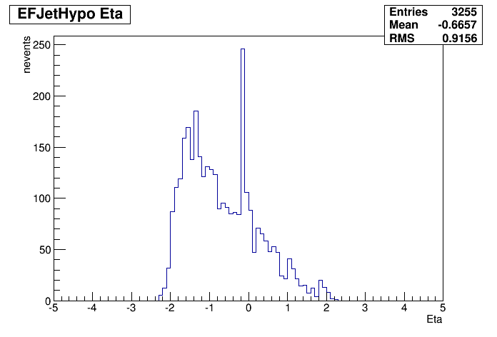
Jet trigger commissioning so far
Cosmics runs: jet triggers in M5 and M6
EF_j0_perf_L1MU10, EF_j0_perf_L1J10, EF_j0_perf_L1RD0_EMPTY
No offline monitoring plots yet, but online plots quite interesting
Effect of noise clear in many low ET clusters in e.g. run 242651 (left)
Solved later in run 242841 (right) – possibly noise masks applied now
Online / on-the-job training for several future experts: Aparajita, Sebastien, Antonia, Lee

Slide 6
Jet trigger commissioning so far
Cosmics runs: jet triggers in M5 and M6
EF_j0_perf_L1MU10, EF_j0_perf_L1J10, EF_j0_perf_L1RD0_EMPTY
No offline monitoring plots yet, but online plots quite interesting
Effect of noise clear in many low ET clusters in e.g. run 242651 (left)
Solved later in run 242841 (right) – possibly noise masks applied now
Online / on-the-job training for several future experts: Aparajita, Sebastien, Antonia, Lee

Slide 7
Comissioning timeline
Should use well extra time afforded by LHC schedule
Cosmics and single beam periods useful to deploy new (validated) features
Important to be ready to analyze data quickly
CHEP in 1 month

Slide 8
Jet trigger commissioning strategy
Use data from special run in May for initial comparisons with offline jets
Data from 50ns run:
Should allow detailed comparisons with offline
Need low-prescale triggers to collect calibration data (forward jets, eta intercalibration)
Pileup subtraction: use 50ns run to study higher pileup
Determine trigger efficiencies/corrections
Move to physics running
CHEP
IEEE ICC

Slide 9
Jet trigger commissioning strategy
Move to 25 ns run – final commissioning:
Check performance against 50ns run
Find differences: noise, calibration, pileup subtraction etc
Probably need to re-derive efficiencies/corrections
Accumulate calibration data for final 2015 jet calibration etc
EPS
LHCP

Slide 10
Specific issues
L1Topo Trigger Validation in Run II
HT and multijet triggers:
M7: L1_HT0_AJ0all.ETA49 -> noalg_L1HT0-AJ0all.ETA49
Do functional validation with cosmics
Ideally compare with offline reconstruction using random L1
With collisions: E.g.: HT200_AJ20all.ETA25
Use single jet and lower threshold multijet triggers
VBF Triggers
Use lower threshold and unprescaled dijet triggers
Need to ensure coverage across eta for dijets
Use same asymmetric (J30_J20) combination at L1
Asymmetry trigger
Use same threshold multijet trigger (4J15)

Slide 11
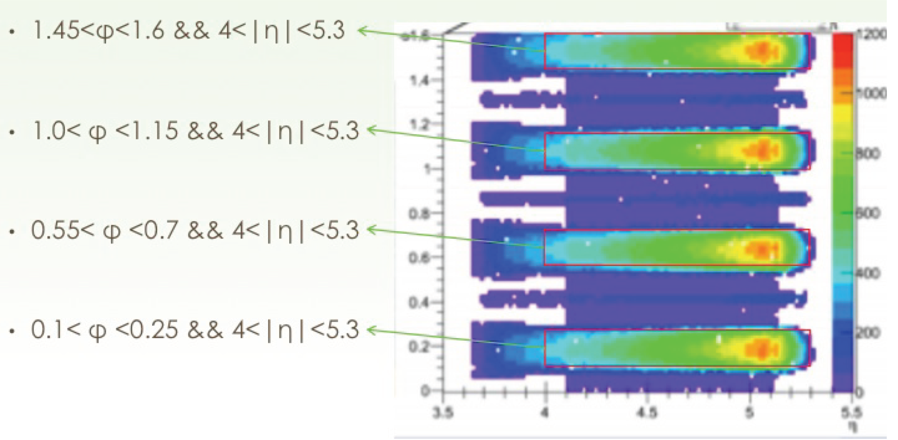
Specific issues – Jet calibration data
Very important to collect enough data early on for offline jet calibration
Forward region and intercalibration
Even more important due to added material from IBL
Need ≈x16 increase in forward region
Eta=4

Slide 12
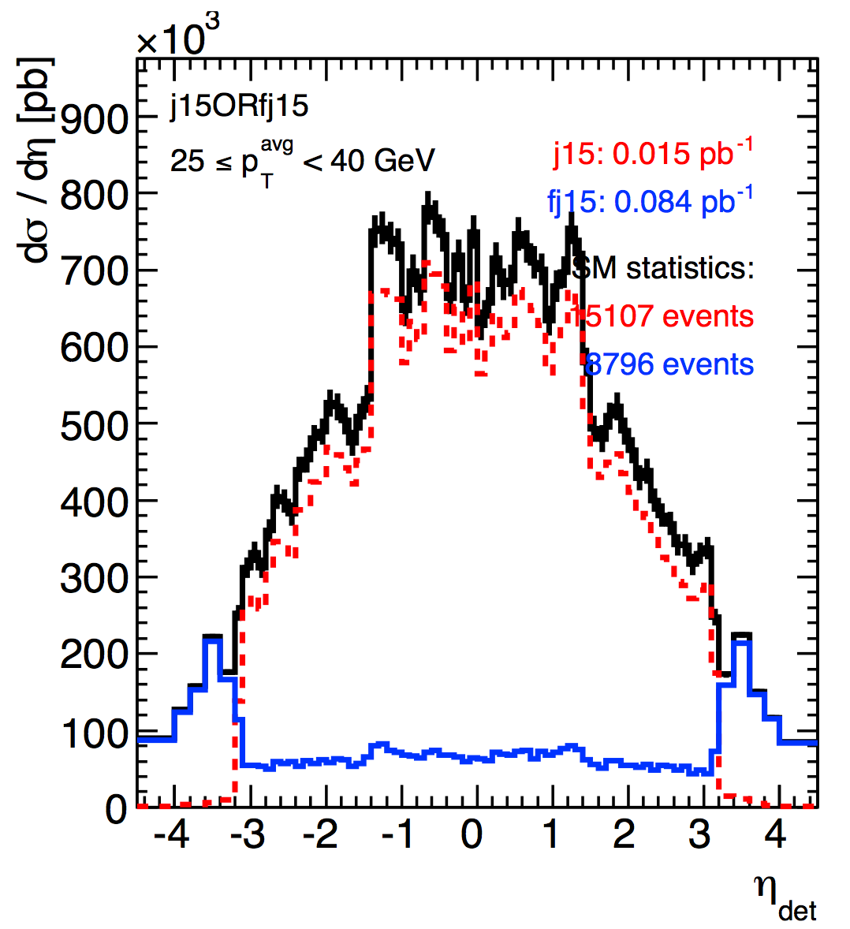
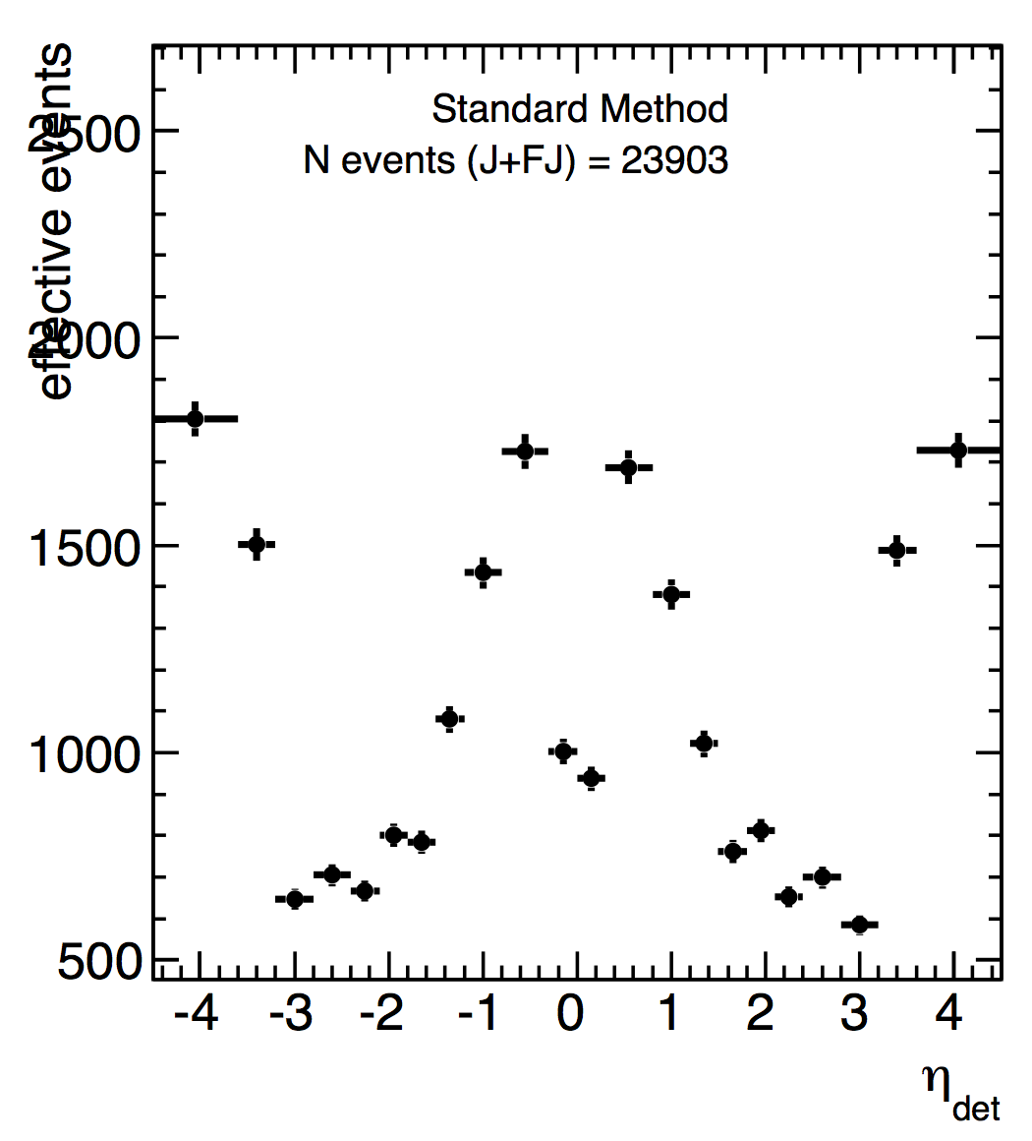
Problem:
Lowest pT bin is critically low: fewer than 10k events in lower <p_{T}> bins
Also critically low for forward jets with <p_{T}> between 65-115 GeV
Current thoughts:
L1Random: for the low <p_{T}> bins
Central + forward jets (j20?) for <p_{T}> around 75 GeV - 115 GeV
Jim Lacey

Slide 13
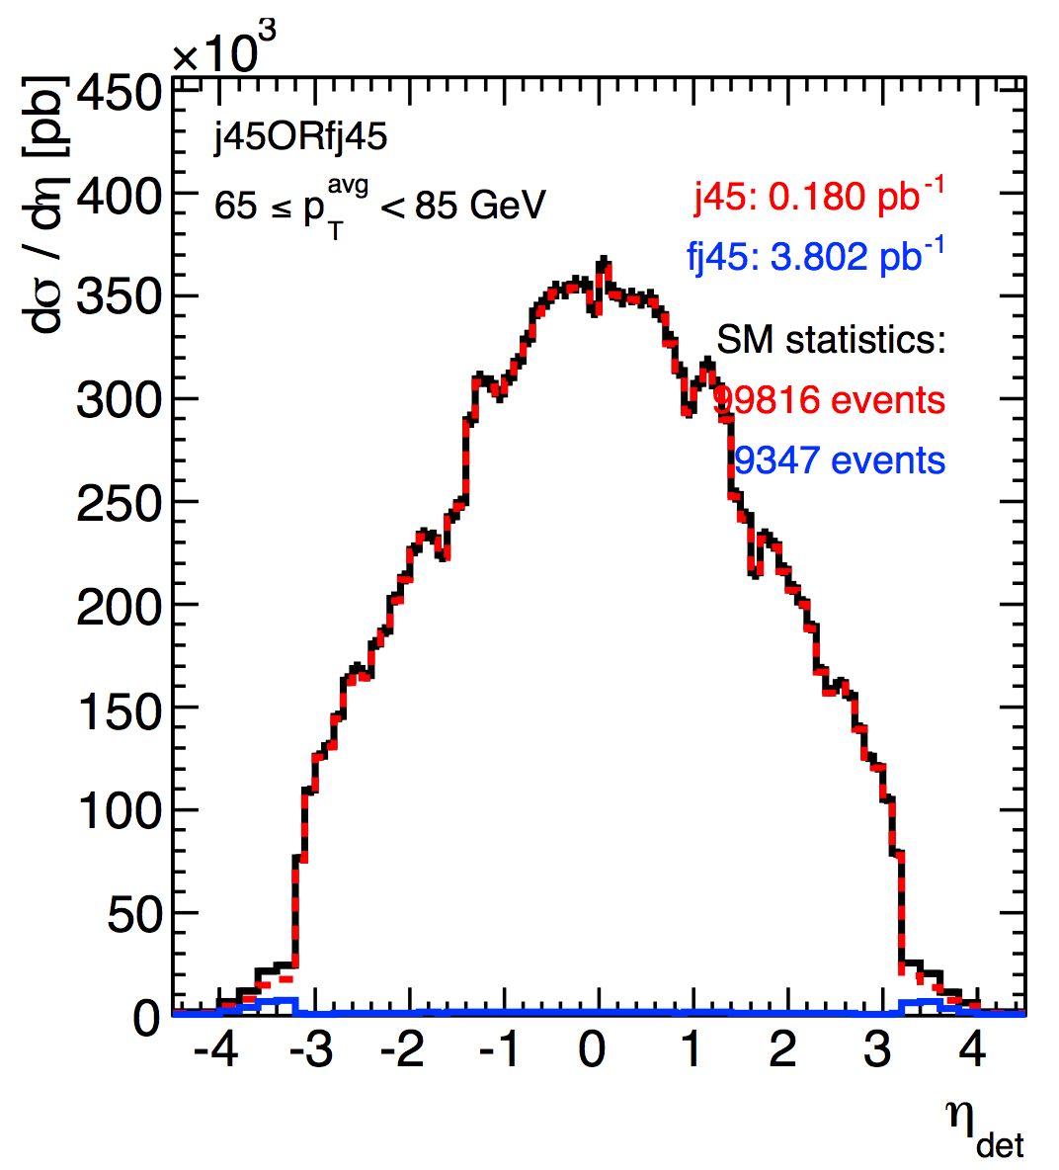
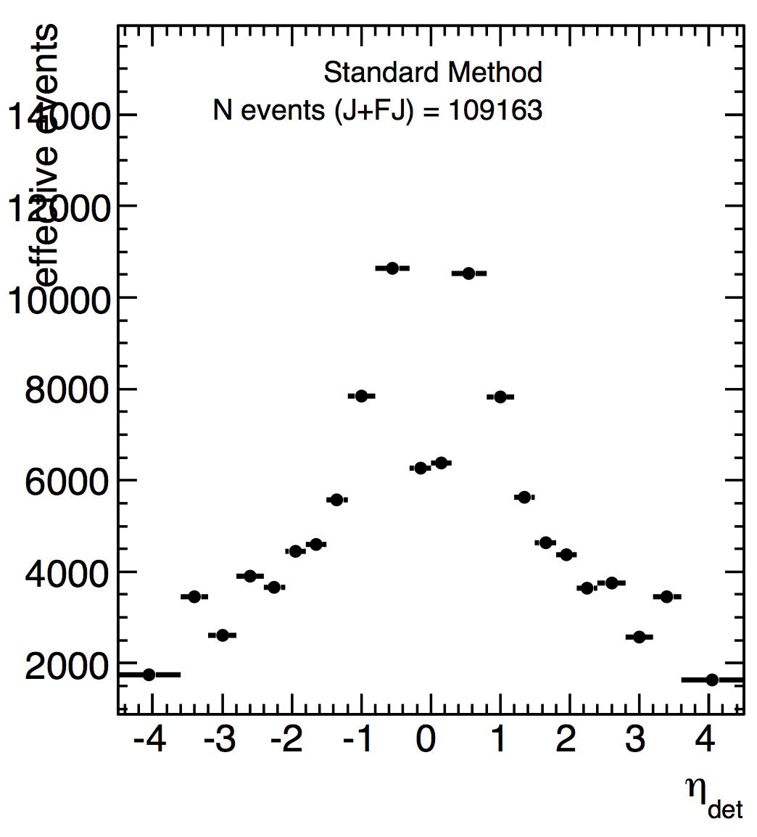
Problem:
Lowest pT bin is critically low: fewer than 10k events in lower <p_{T}> bins
Also critically low for forward jets with <p_{T}> between 65-115 GeV
Current thoughts:
L1Random: for the low <p_{T}> bins
Central + forward jets (j20?) for <p_{T}> around 75 GeV - 115 GeV
Jim Lacey

Slide 14
Questions from Kunihiro:
Strategy to validate the Run2 Jet in-situ
How much luminosity (time) do you expect to need for it?
Needs to be worked out
Which default jet setting, e.g. calibration (LCW,HAD,etc), FS or PS, to start with for 50ns data?
Need all useful combinations! Focus on FS but keep PS as plan B.
Plan to optimize the PS parameters (seed, hypo, RoI size)? Plan to commission with 50ns data and possibly change them at 25ns run start?
Start with MC studies: parameter choice already reasonably clear
Commissioning triggers, or backup triggers (with different methods)?
First ideas in previous slides but nee to be firmed up

Slide 15
Strategy to commission L1Topo triggers
First ideas in previous slides but nee to be firmed up
How to validate/optimize w.r.t. pile-up?
It is a bit hard situation that we have higher pile-up - at beginning (50ns) - what is your plan, and how is the situation on performance/timing as long as MC predicts?
Use higher 50ns pileup as a rehearsal for 25ns: note this is likely to be initial physics data
Progress in Lisbon WS action items:
#13: Comment on need for LCW – needed!
#14: Report on studies on particle flow in trigger – to start
#15: Report on use cases for track trigger – under discussion
#21: Groomed jet, re-clustered narrow jets, boson tagging, jet eta range for inclusive trigger – starting but no results
#25: Report on E/p trigger for jet – planned but no results

