Slide 1
Summary of the Jet Trigger Contributions to the Jet & MET Trigger Session at HCW 2014
(the first – but not last – dedicated trigger session at HCW!)
Trigger General Meeting – 24/9/2014
Ricardo Goncalo, David Miller

Slide 2
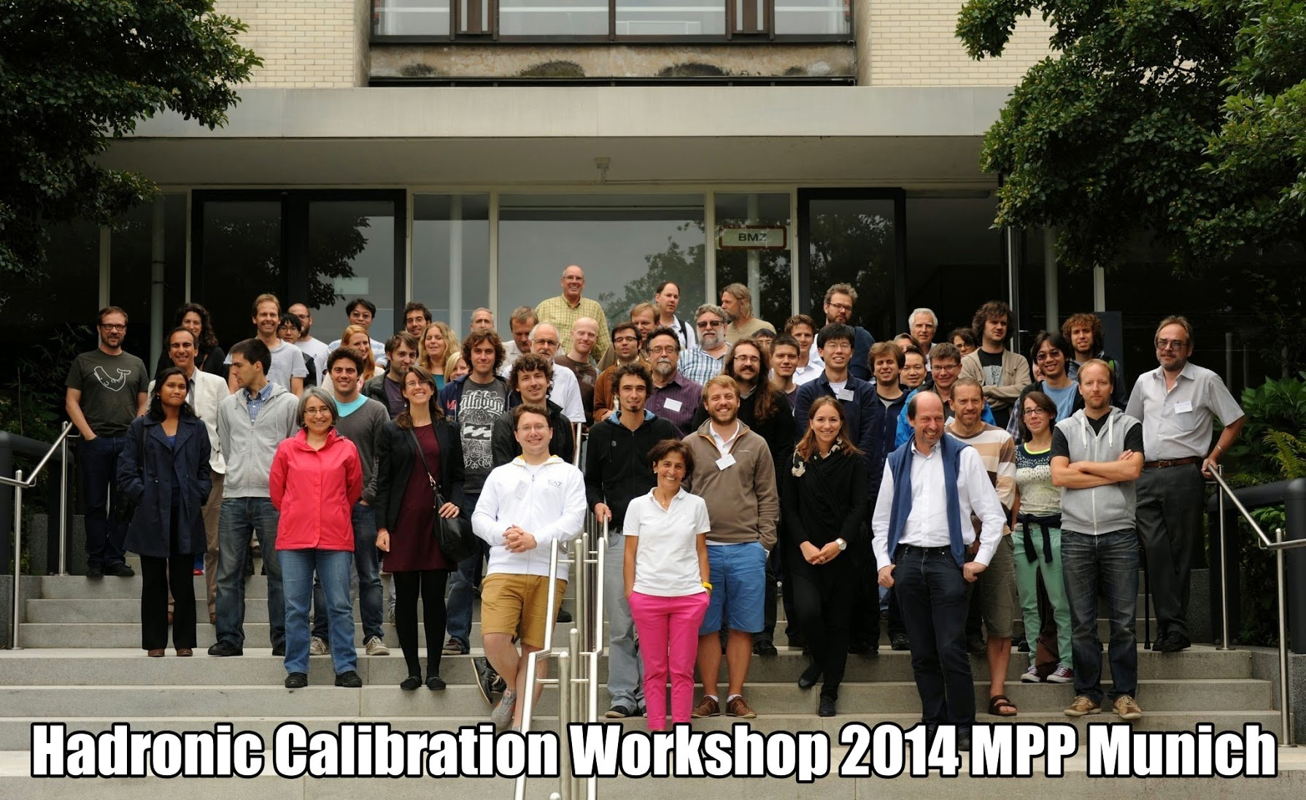
Very lively and useful workshop!
First time there was a trigger session in HCW – very good for harmonisation!
192 contributions to HCW, 25+ in Jet/MET trigger session
Won’t cover full set of subjects here
  Particle flow coming of age
  Simulation / fast simulation / ISF
  IBL and increased dead material
  Calibration and noise suppression
  Jet cleaning
  Jet energy scale and resolution
  Substructure techniques
  Tagging (q/g, boson, top, etc)
  Missing ET
  Monitoring and validation
  Software and analysis model
  Jets in run III and HL-HLC
  etc
Concentrate on issues involving trigger:
  Jet trigger use cases; – Jet trigger monitoring
  Jet calibration and pileup subtraction plus TopoCluster timing measurements

Slide 3
Single jet triggers in the hadronic diboson resonance search (VV->JJ)
VV->JJ team (Enrique Must)

Slide 4
Joakim Olsson

Slide 5
L1 HT triggers for fat jets: signal
UBA (Devesa, Reisin, Otero, Piegaia)

Slide 6
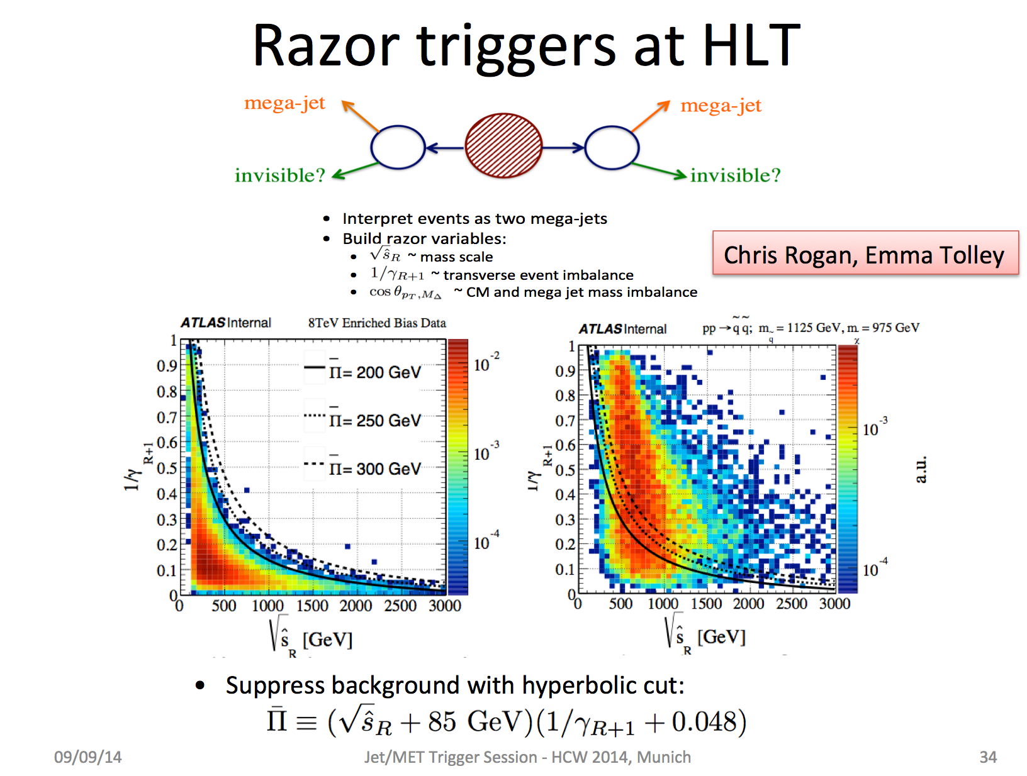

Slide 7
Razor trigger implementation
Larry Lee

Slide 8
Unique efficiencies of the razor triggers
Read the
Y-axis for a
given trigger
and then look
at the value
for any trigger
on the X-axis to
see the benefit
Razor triggers with
Different L1 seeds
(HT and multijet)
Chris Rogan, Emma Tolley

Slide 9
Fat jet trigger at L1 for Run III
Giordon Stark

Slide 10
Monitoring and Validation (I)

Slide 11
Monitoring and Validation (II)
Lee Sawyer

Slide 13
Overview of the offline jet calibration

Slide 14
Overview of the offline jet calibration
Requires full event topoclusters for rho calculation
Only requires derived constants:
f(pT, eta)
Requires full event tracks and PV identification
Requires extra jet info like layer energies and full tracking info

Slide 15
Pile-up subtraction: rho
Requires full event topoclusters for rho calculation

Slide 16
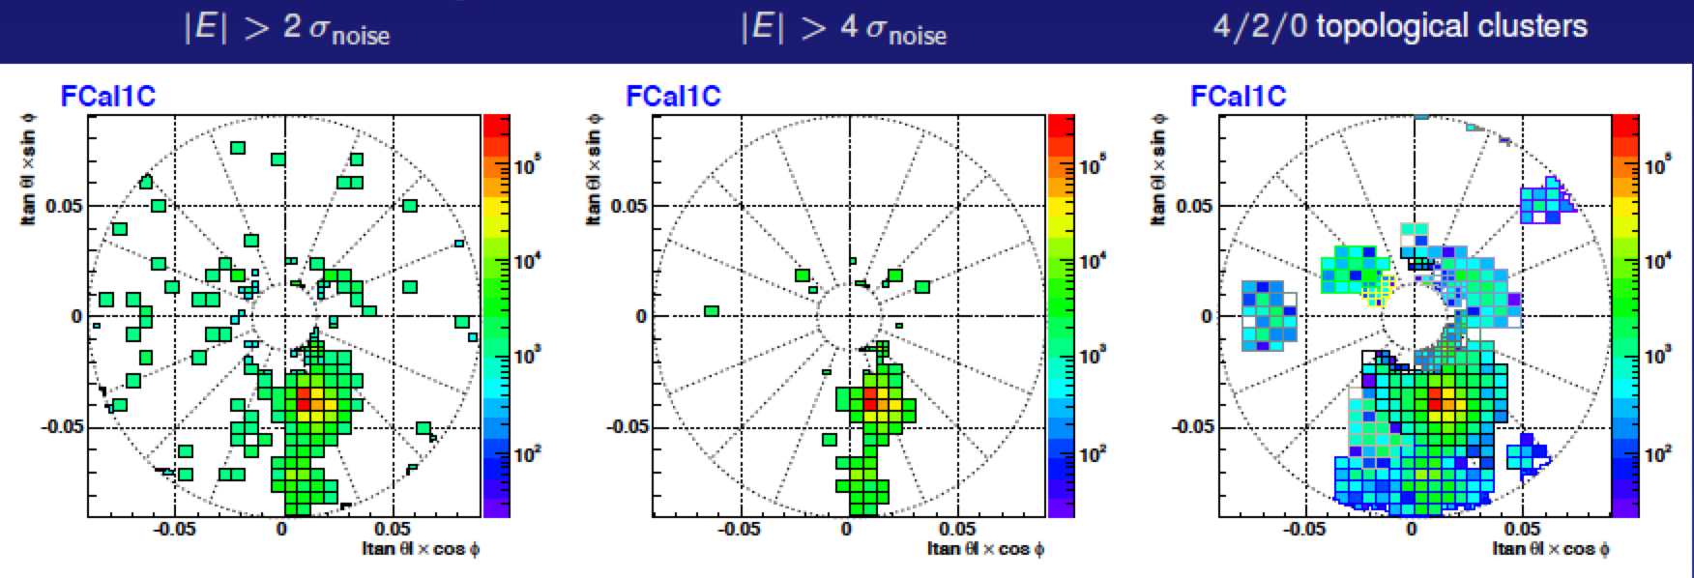
TopoClustering, Full and Partial Scan, and all that…
Several techniques developed and maintained in the offline world that are needed in trigger
  Pileup suppression will become more important
  Calibration should be taken from offline
  We don’t have the capability to keep maintain our own versions (and would complicate things)
TopoCluster making:
  3D groups of adjoining cells started from seed cells (4σ above noise)
  Add adjoining cells if above 2σ above noise, plus an extra layer 0σ above noise (4/2/0 scheme)
  Split initial clusters into smaller ones surrounding hot spots – splitting
  Following that: calculate cluster moments, classify clusters (EM/HAD), apply calibration, find jets, calibrate

Slide 17
Latest timing tests
Ademar Delgado
Rel_0, devval, on a test bed pc
RoI size of 1x1 (Partial Scan)
Chains: L1 J20 → EF j110; also tried multijet chains for comparison
Geometry - ATLAS-IBL-03-00-00
ConditionsTag - OFLCOND-MC12-IBL-20-80-25
  p_{T} (lead Anti-k_{T}6 truth jet) = 80-200 GeV sample
mc12 14TeV.147911.Pythia8 AU2CT10 jetjet JZ2W.recon.RDO.e1996 s1715 s1691 r4741
  pileup- 80
mc12 14TeV.147912.Pythia8 AU2CT10 jetjet JZ2W.recon.RDO.e1996 s1715 s1691 r4739
  pileup- 40
Will redo with wider range of samples

Slide 18
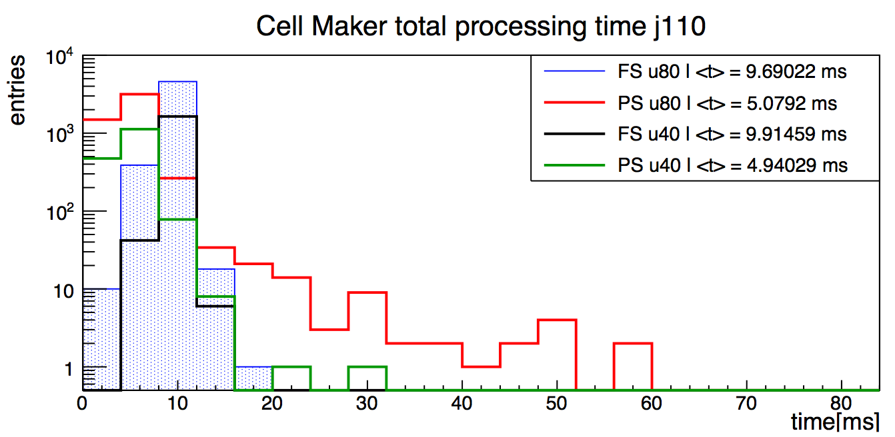
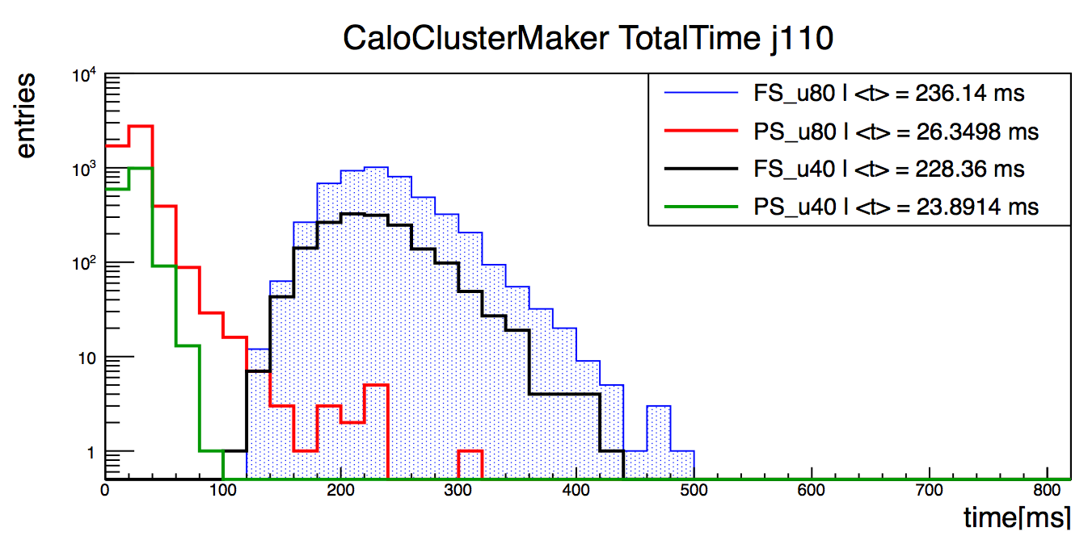
CellContainer and cluster making
Cell maker:
  Partial scan much less costly on average
  But longer tails and bigger dependence on pileup
Cluster Maker:
  Full Scan total time much larger than Partial Scan
  Breakdown in next slide
Ademar Delgado

Slide 19
Partial vs Full Scan – Timing Summary
Ademar Delgado
Cluster making time roughly same as calibration
PS much less than FS but longer tails
Small effect from pileup
Comparing to r.17:
  6% increase in clustering in r.19
  6x reduction in cell container making (60 to 10ms/evt)
Clustering [ms] | <μ>=40 | <μ>=80 | Calibration [ms] | <μ>=40 | <μ>=80
Cells | 9.9 | 9.7 | Moments | 27.0 | 29.7
Clusters | 53.7 | 52.7 | Dead Material | 18.5 | 17.2
Cluster splitting | 57.7 | 61.9 | Out of cluster | 17.8 | 16.3
Full calorimeter scan |  |  | Local calibration | 23.9 | 26.4
 |  |  | Out of cluster Pi0 | 17.8 | 16
Totals: | 121.3 | 124.3 | Totals: | 105 | 105.6
Clustering [ms] | <μ>=40 | <μ>=80 | Calibration [ms] | <μ>=40 | <μ>=80
Cells | 4.9 | 5.1 | Moments | 2.3 | 2.5
Clusters | 4.8 | 5.4 | Dead Material | 2.1 | 2.4
Cluster splitting | 6.0 | 6.6 | Out of cluster | 2.0 | 2.2
Partial calorimeter scan |  |  | Local calibration | 2.9 | 3.2
 |  |  | Out of cluster Pi0 | 2.0 | 2.2
Totals: | 15.7 | 17.1 | Totals: | 11.3 | 12.5

Slide 20
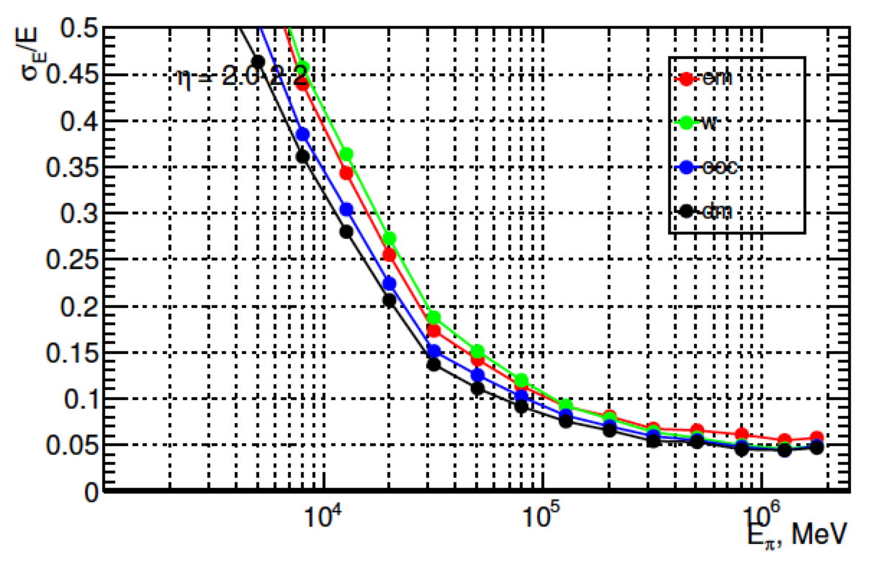
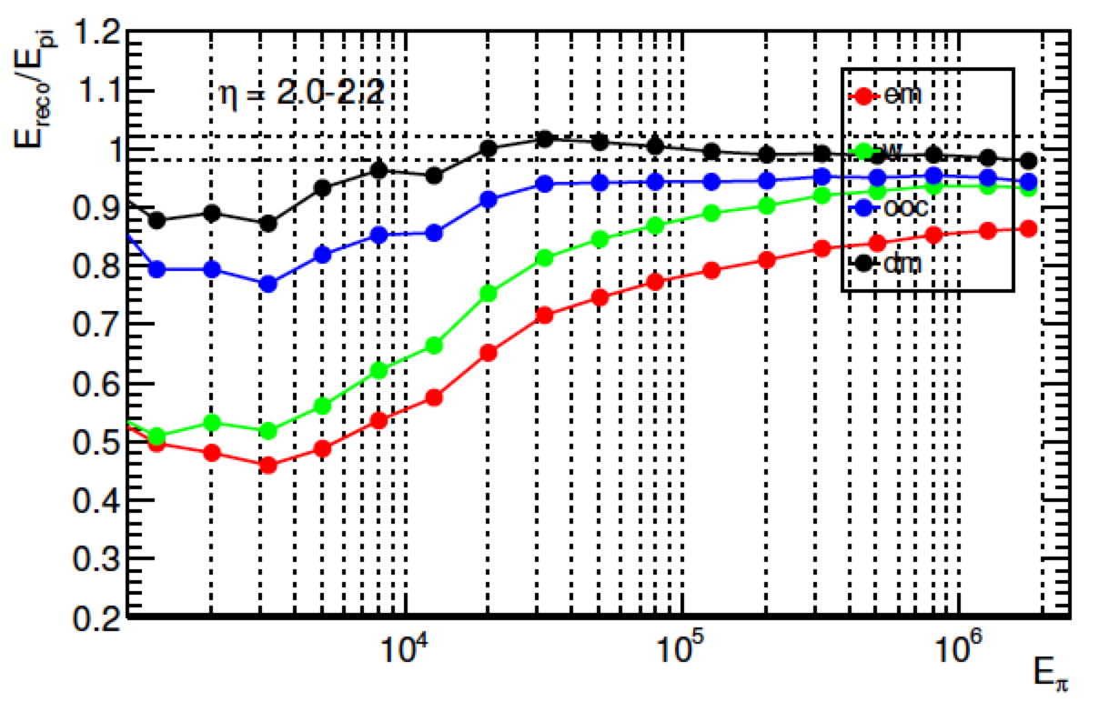
Calibration
Sven Menke
Resolution and linearity improvement for charged pions after each correction:
  EM
  LCW
  Out of cluster
  Dead material
Conditions:
  <μ>=0
  IBL geometry
  2<|η|<2.2
  4 samplings

Slide 21
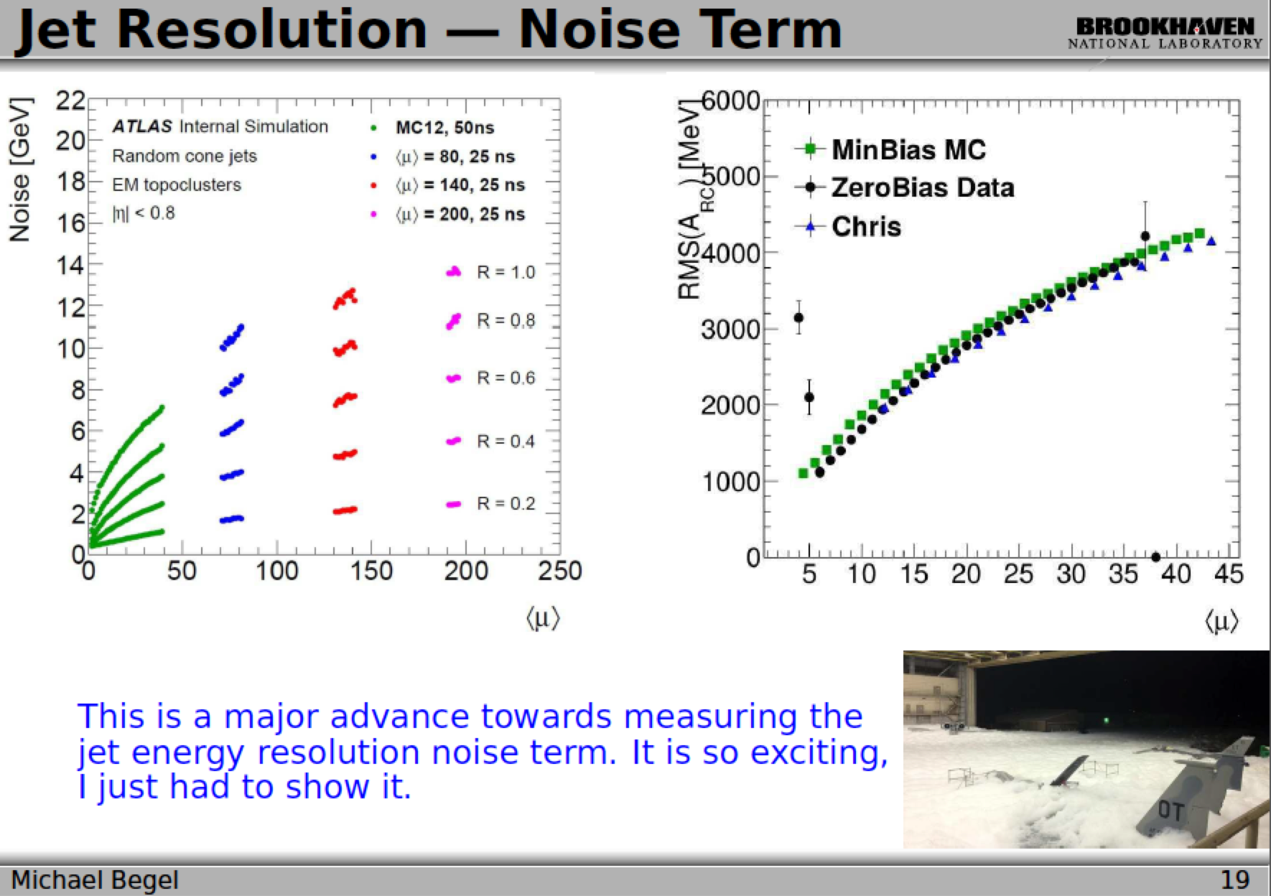

Slide 22
Summary
Very lively discussions and many issues covered
Great interaction with offline jet/MET group
  Extremely useful for e.g. software development and monitoring
Made clear that we should strive for full-scan as default solution if at all possible
  Pileup subtraction essential to good performance in coming LHC runs
  Keep in sync with offline developments to help maintainability and make use of offline effort
  New timing breakdown suggests solutions
Keep studying performance impact from L1 (nMCM), L1.5 (calibration?), HLT clustering and pileup, etc

Slide 23
Backup

Slide 24
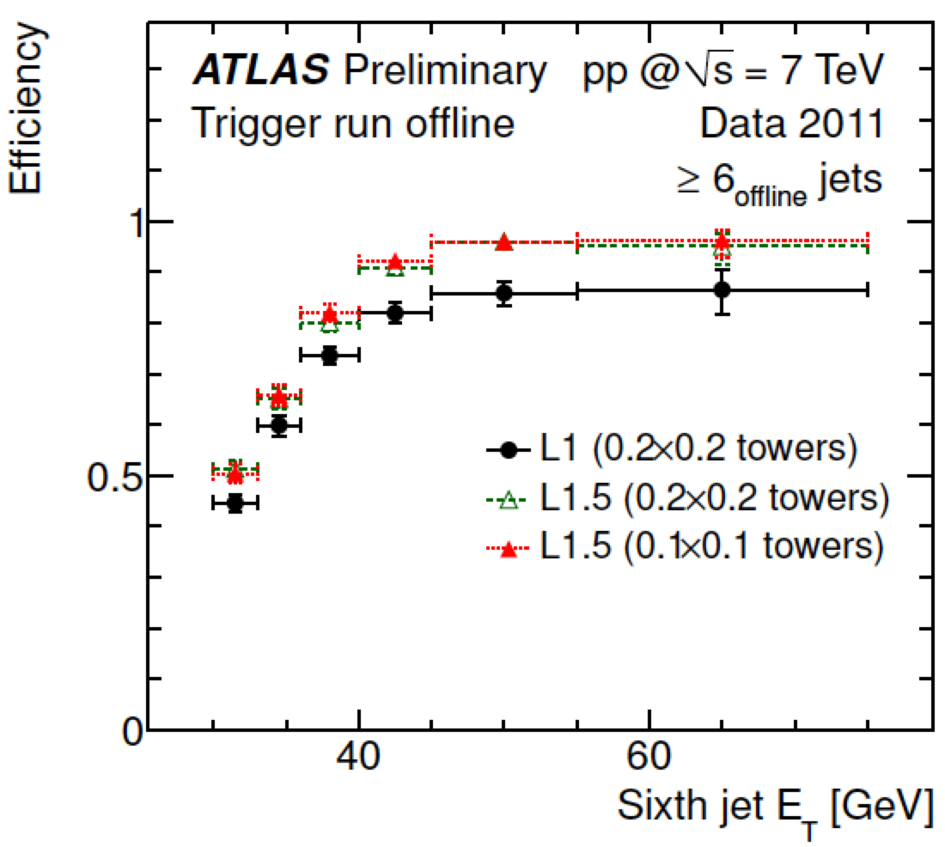
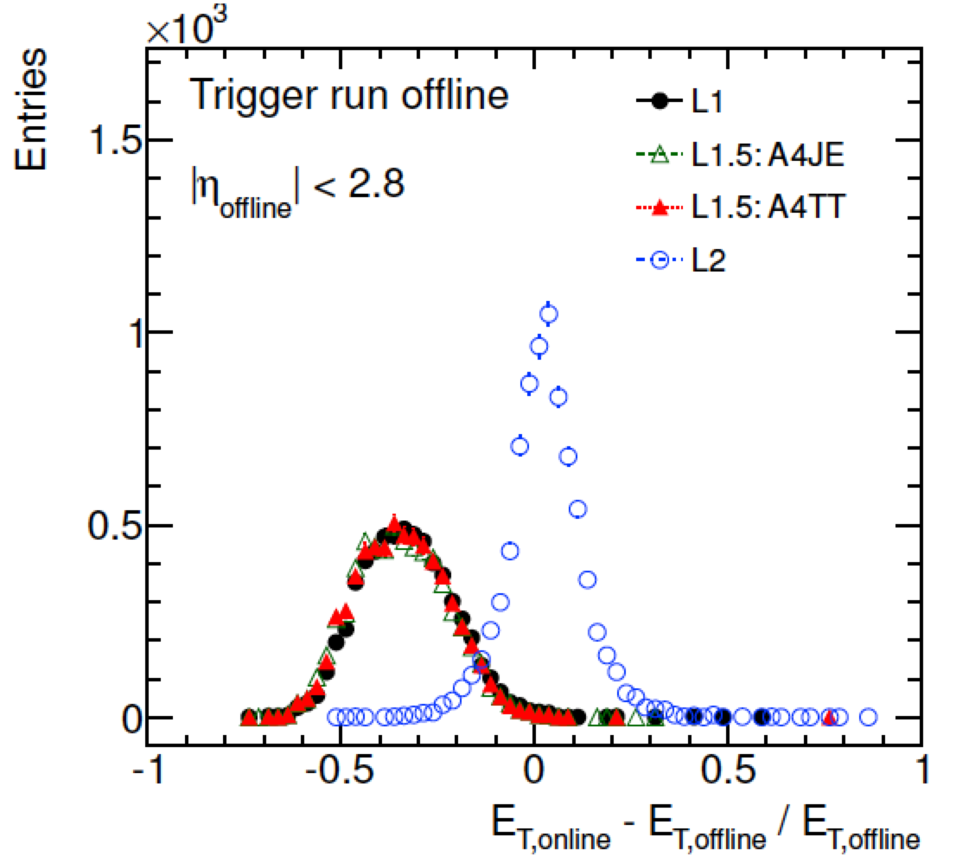
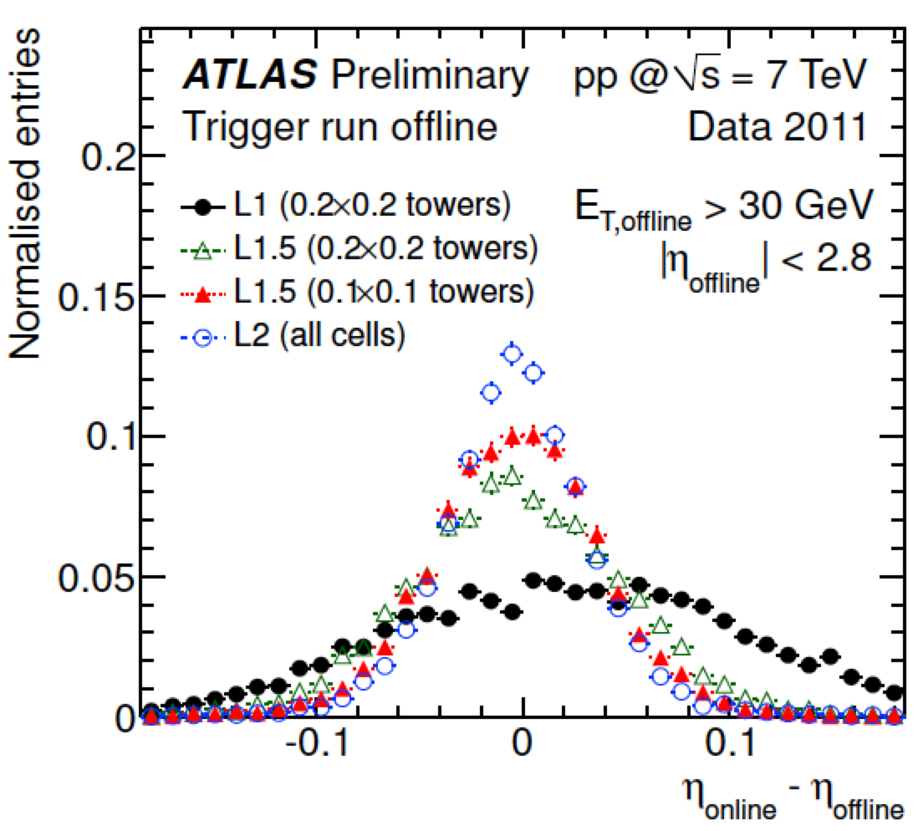
L1.5 performance
The TriggerTower full scan recovers L1 inefficiency for close-by jets
  See ATL-COM-DAQ-2012-009
Reasonable spacial resolution
Energy resolution same as L1
  See ATL-COM-DAQ-2012-009

Slide 25
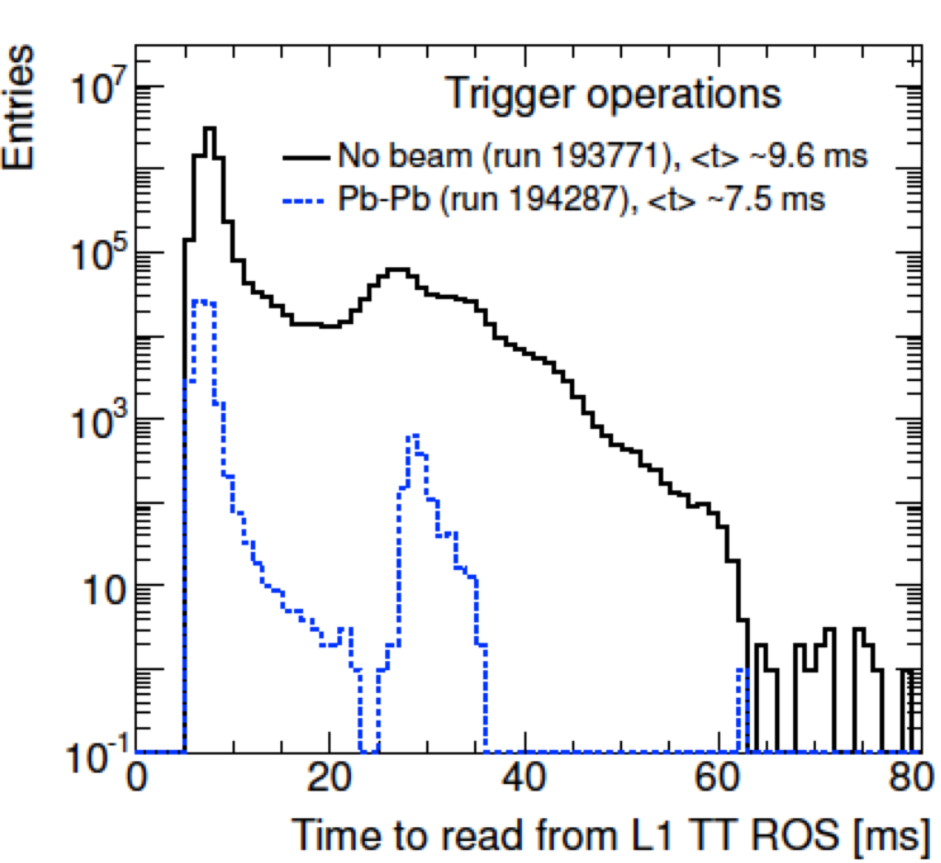
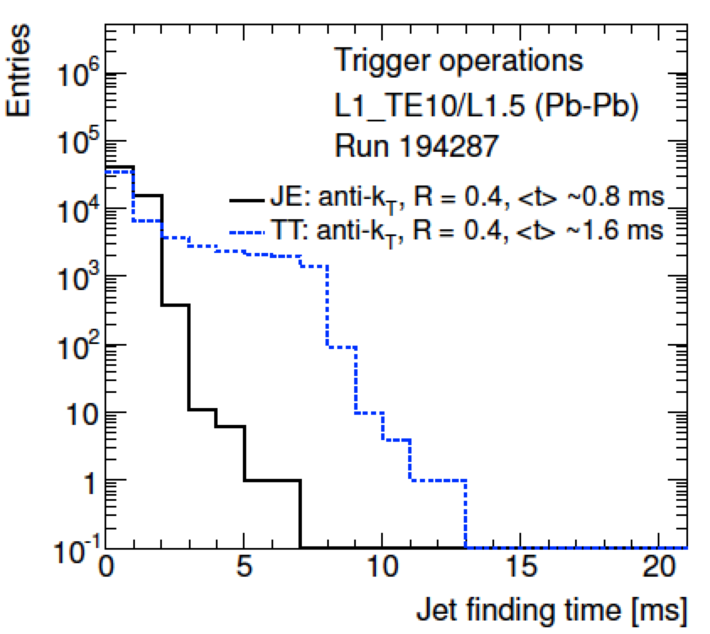
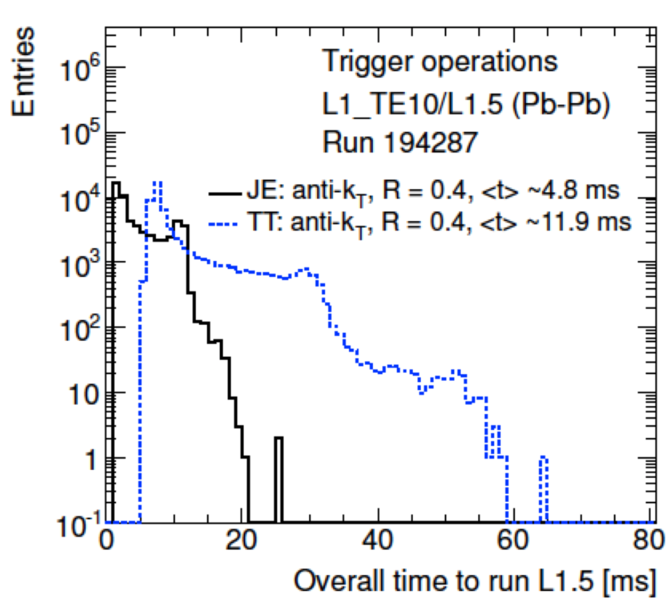
L1.5 cost
From Run I tests (see ATL-COM-DAQ-2012-015):
  L1Calo ROSes (3 for TT, 1 for JE) read out at up to 7kHz
  Expect up to 15kHz with upgraded ROSes
Total time around 12ms
  Readout time around 9ms
  Jet finding (anti-kT 0.4) around 1-2ms

Slide 26
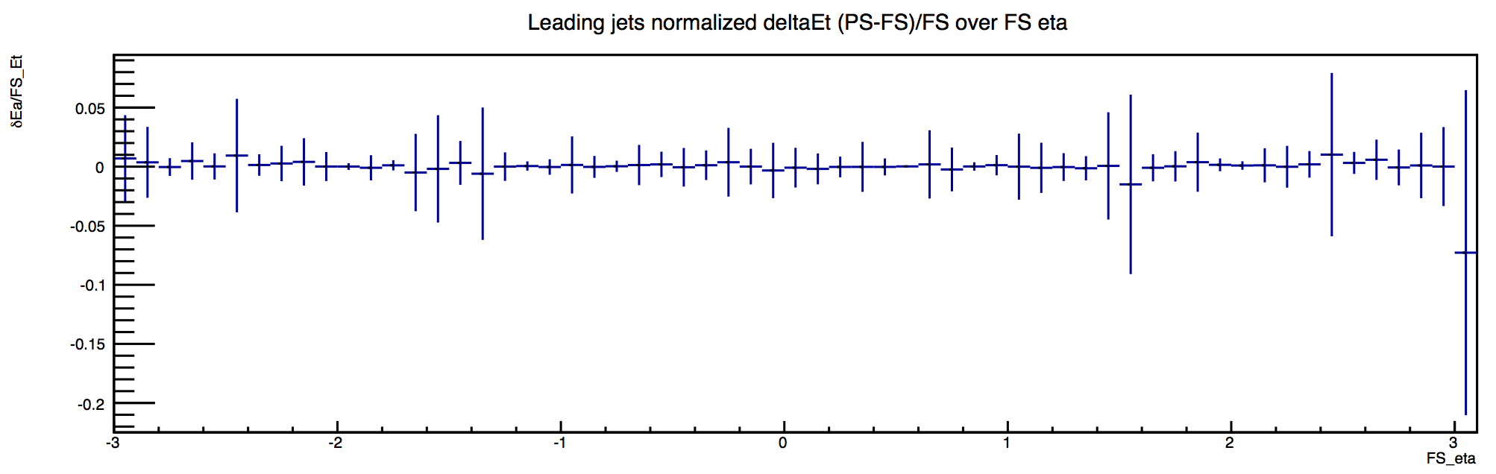
TopoCluster performance
David Freeborn
Comparing PS to FS
Assumes FS performance is closer to offline
E_{T} of 3rd jet in 3j50
sRoI size 1x1
Events have
Ademar Delgado
(E_{T}^{PS} - E_{T}^{FS})/E_{T}^{FS} versus η^{FS}

