Slide 1
Jet Slice – use of TopoClusters
Ricardo Gonçalo (LIP) and David Miller (Chicago)
For the Jet Trigger Group
Trigger General Meeting – 20 August 2014

Slide 2
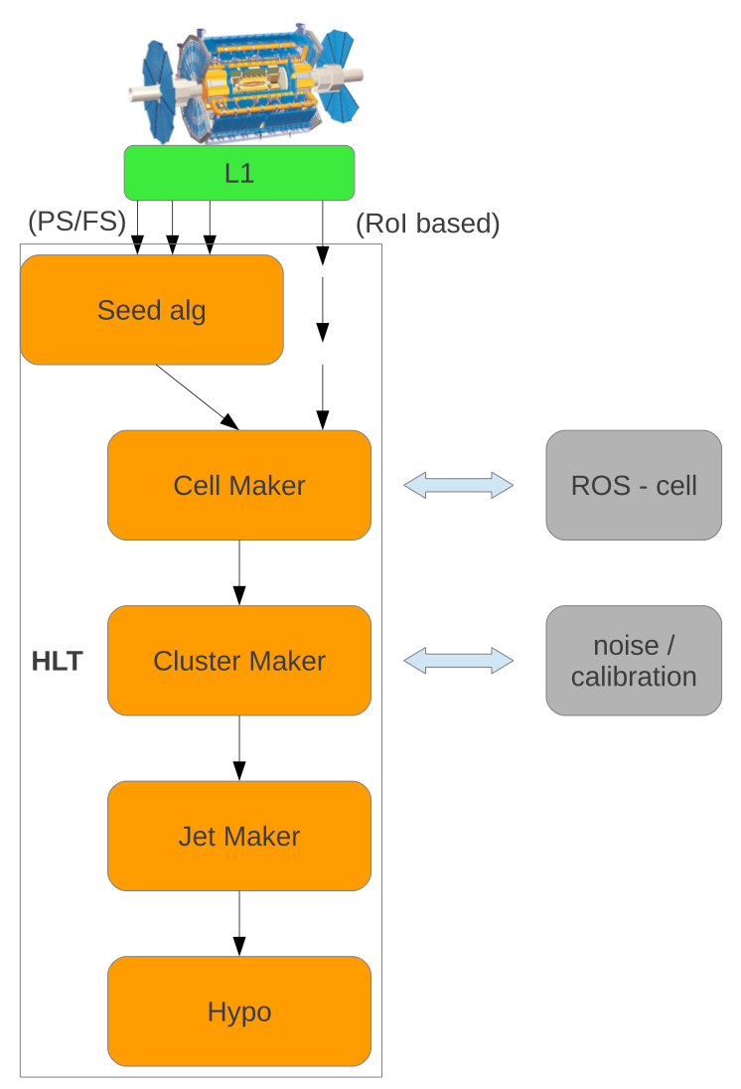
Use of TopoClusters
L1.5
TopoClusters:
  Essential to have performance close to offline
  Good resolution wrt offline paramount to control rates
Additionally:
  TriggerTower full scan (L1.5)
  Runs Anti-kT jet reco on 0.1x0.1 TriggerTowers
  Avoids bias from close-by jets
  Current plan is to run L1.5 to seed HLT reconstruction
Could not test with L1.5 yet
  But see Run I cost and performance in next slide

Slide 3
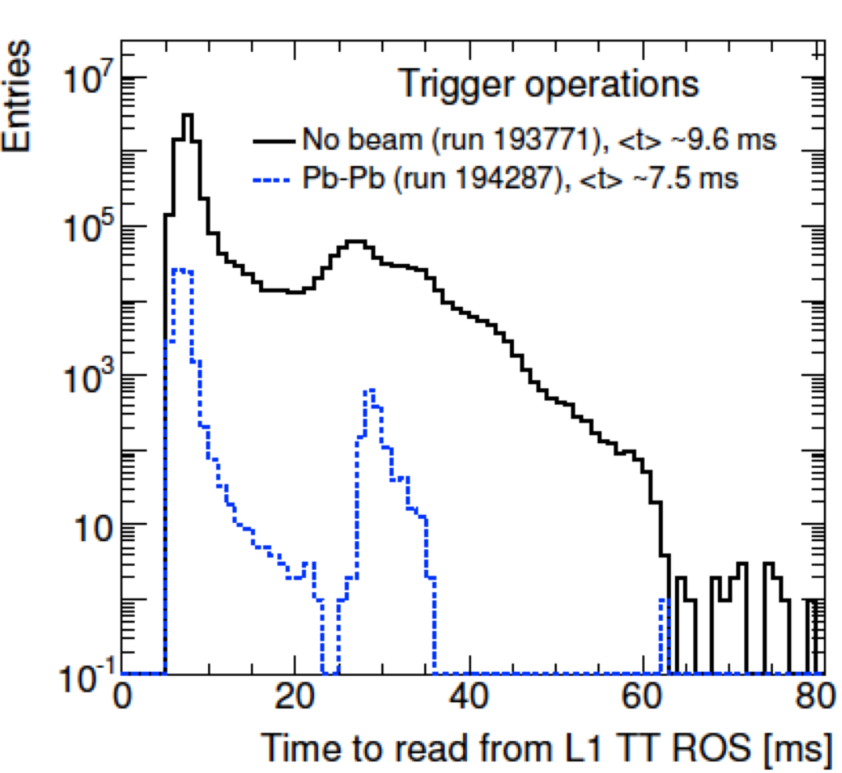
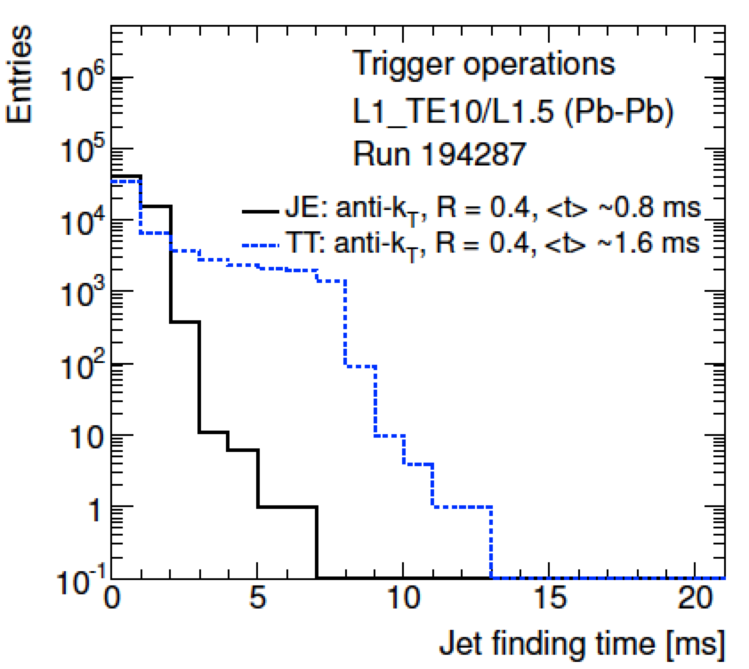
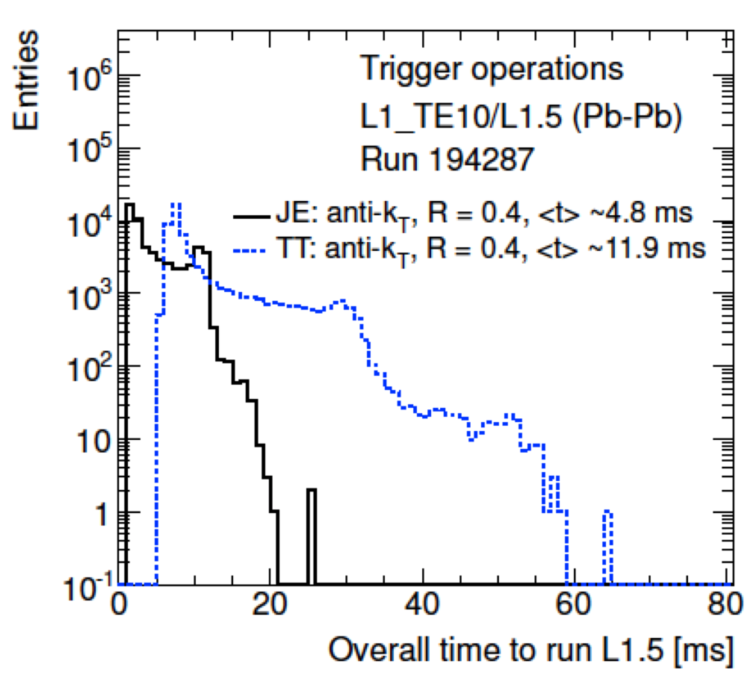
L1.5 cost
From Run I tests (see ATL-COM-DAQ-2012-015):
  L1Calo ROSes (3 for TT, 1 for JE) read out at up to 7kHz
  Expect up to 15kHz with upgraded ROSes
Total time around 12ms
  Readout time around 9ms
  Jet finding (anti-kT 0.4) around 1-2ms

Slide 4
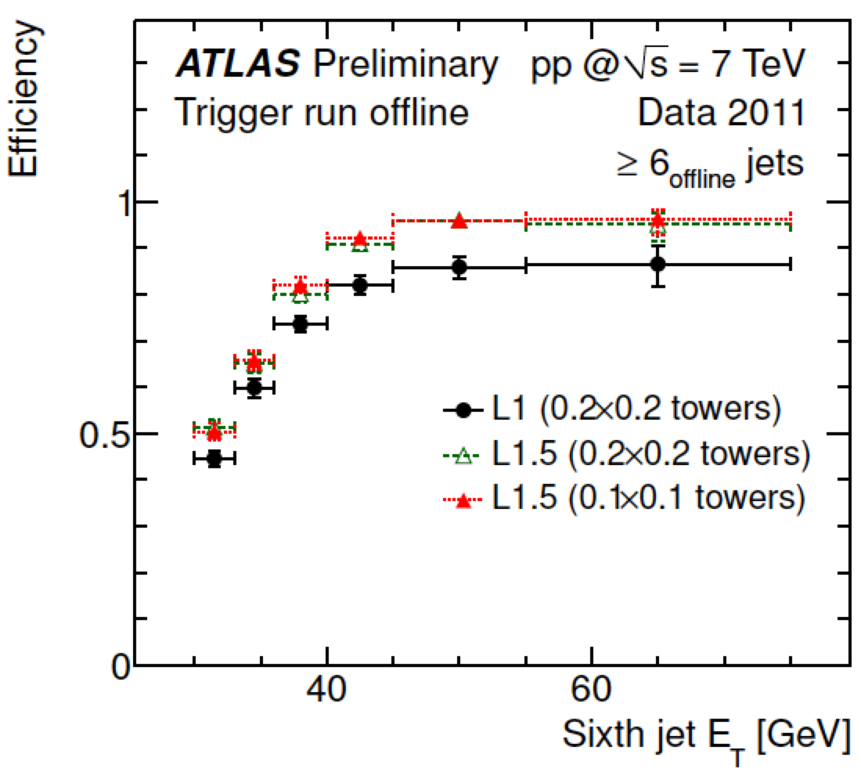
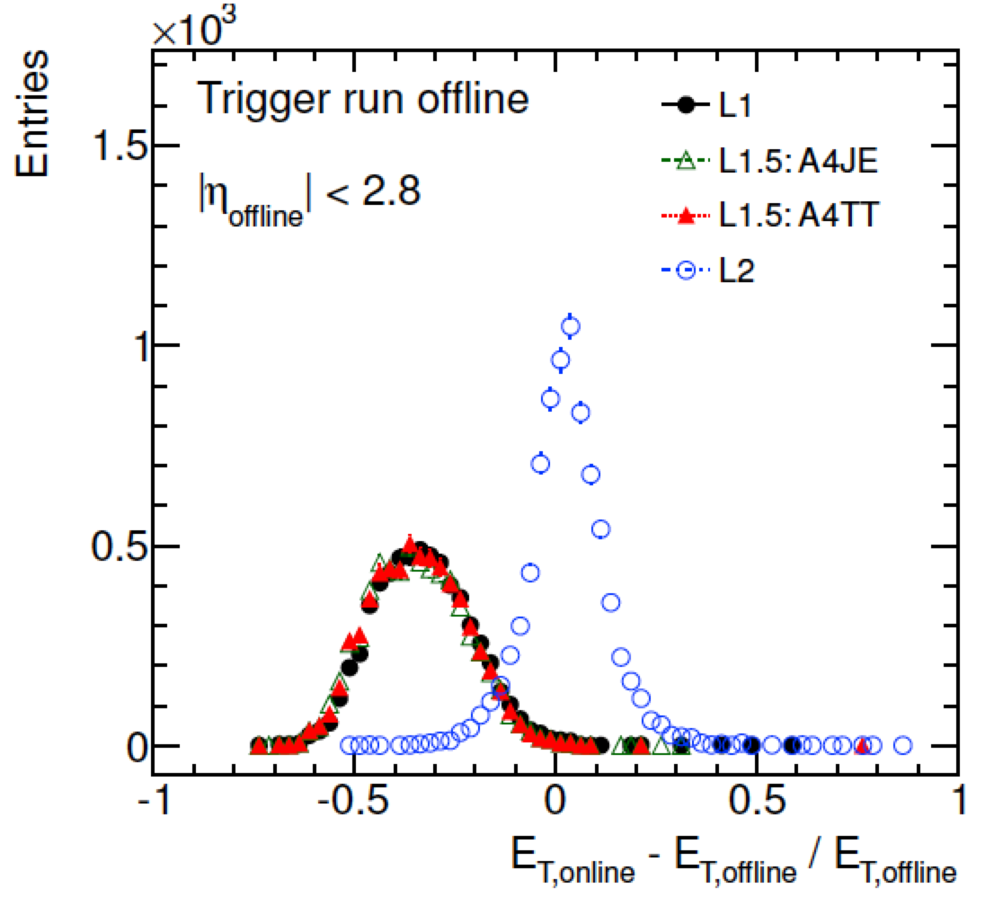
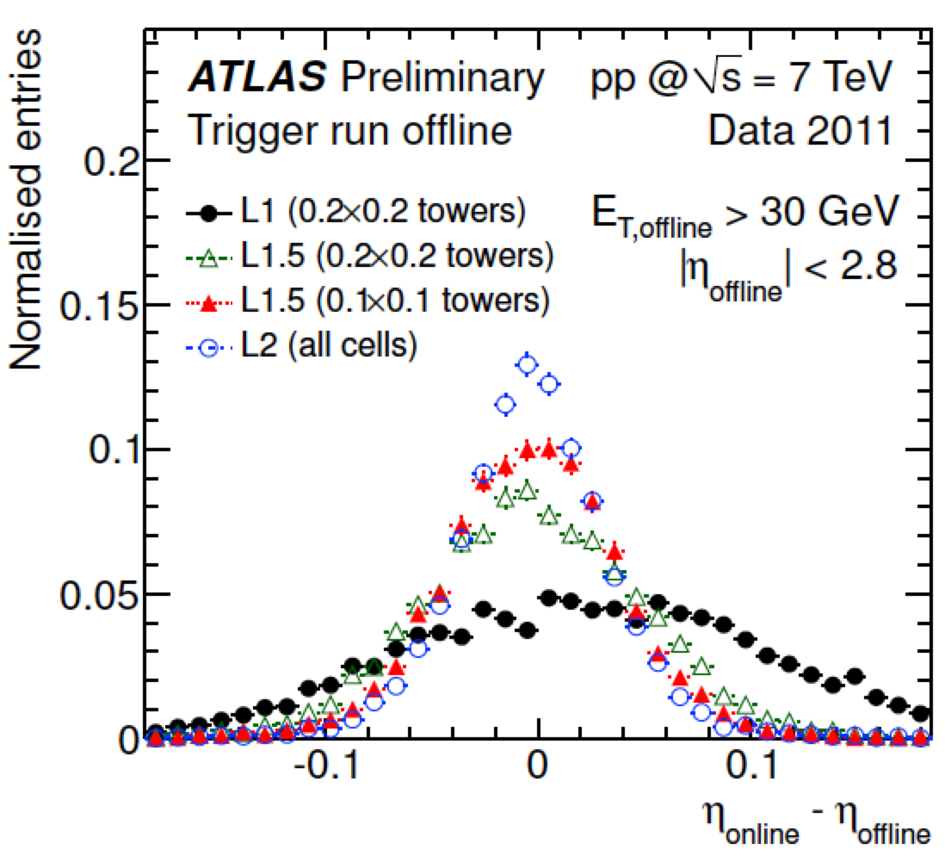
L1.5 performance
The TriggerTower full scan recovers L1 inefficiency for close-by jets
  See ATL-COM-DAQ-2012-009
Reasonable spacial resolution
Energy resolution same as L1
  See ATL-COM-DAQ-2012-009

Slide 5
TopoCluster making and Partial vs Full Scan
L1.5 code not working at present: partial results only
  Partial scan seeded directly by L1 for now
Latest numbers comparing partial scan vs full-scan of calorimeter cells, both using TopoClusters
  Full-scan should have performance close to offline
  Again, this is essential – cannot show direct comparisons now, but studies are ongoing
Details:
  MC sample: mc12 14TeV JZ2W: akT0.6 (truth); E_{T}=80-200 GeV; <μ>= 80
  L1_J20 seed shown here L1_J50 also studied
  Opening sRoI’s of 1x1 or 1.5x1.5 around L1 RoIs, 0.8x0.8 also studied

Slide 6
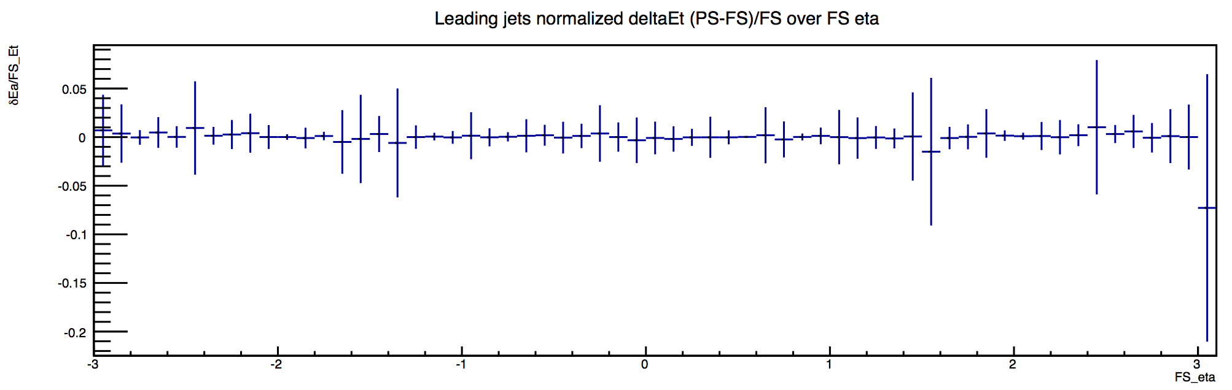
TopoCluster performance
David Freeborn
Comparing PS to FS
Assumes FS performance is closer to offline
E_{T} of 3rd jet in 3j50
sRoI size 1x1
Events have
Ademar Delgado
(E_{T}^{PS} - E_{T}^{FS})/E_{T}^{FS} versus η^{FS}

Slide 7
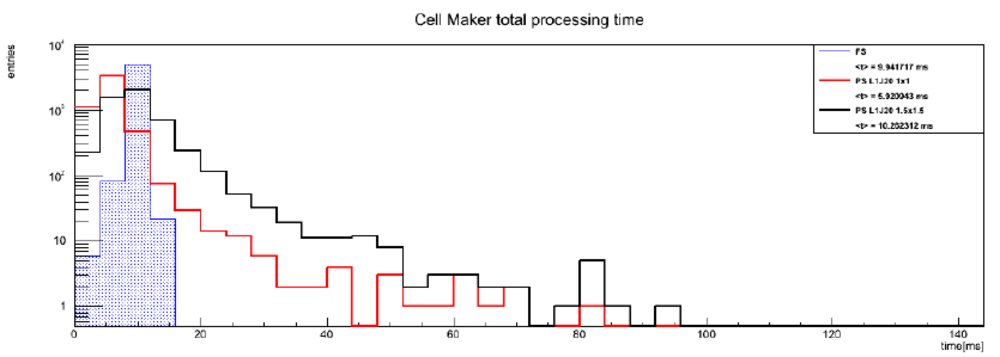
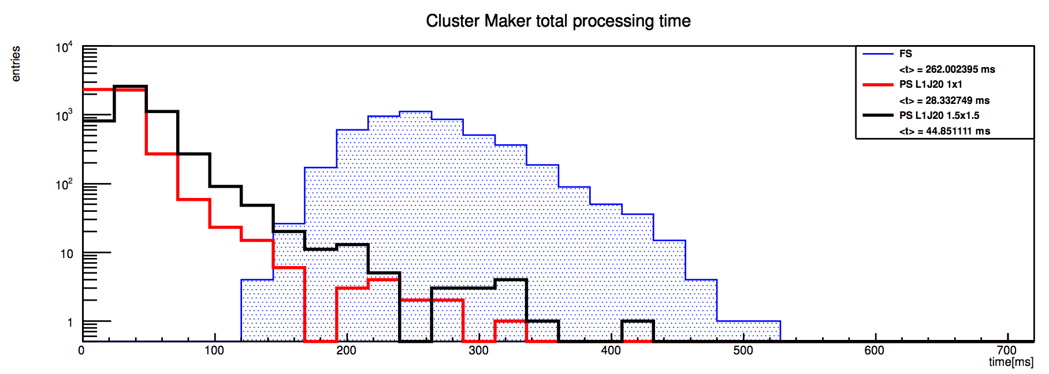
TopoCluster making cost
Ademar Delgado
FS: <t>≈10ms
PS: <t>≈6ms – L1_J20 1x1 sRoI
PS: <t>≈10ms – L1_J20 1.5x1.5 sRoI
FS: <t>≈260ms
PS: <t>≈28ms – L1_J20 1x1 sRoI
PS: <t>≈45ms – L1_J20 1.5x1.5 sRoI

Slide 8
Conclusions… so far
TopoClusters essential for the jet trigger
  The cost is high, but we believe the gains will be measured in physics
  PS, L1.5, and the menu provide tunable parameters to minimize impact of processing time
To-do (many things…):
  Direct comparison with offline jets
  Study performance of different calibration methods – both time and energy/position important
  Using L1.5 to seed TopoCluster and jet finding
  Optimisation of PS parameters: sRoI size, L1 seed – although reasonable values are now clear
  Establishing menu after/in parallel with reconstruction options
  Development: fixing some geometrical effects coming from RegionSelector, etc

Slide 9
Backup

Slide 10
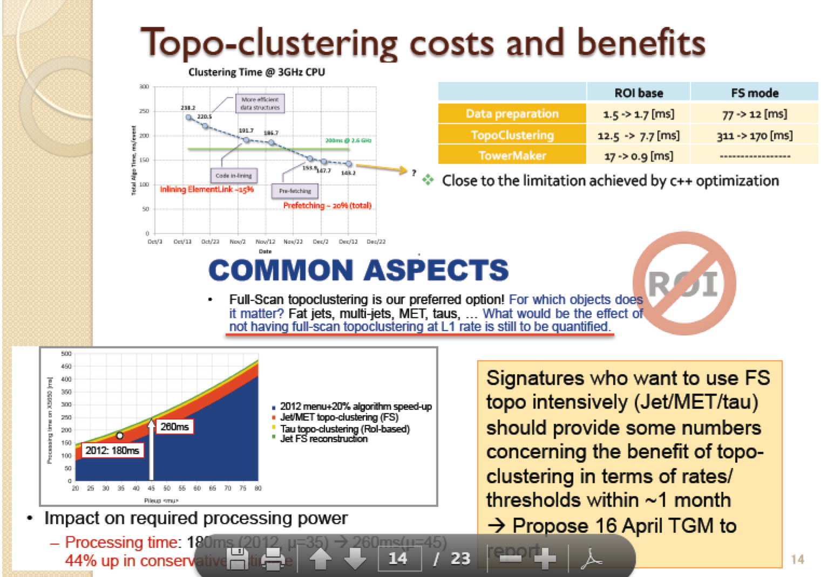
Additional costs: Jet Calibration
Signature coordination meeting – 20 Mar 14: https://indico.cern.ch/event/308670/

Slide 11
