Slide 1
Plots for approval
Plots show the efficiency to match offline b-tagged jets with L1_J20 triggered jets and with FTK-based track jets

Slide 2
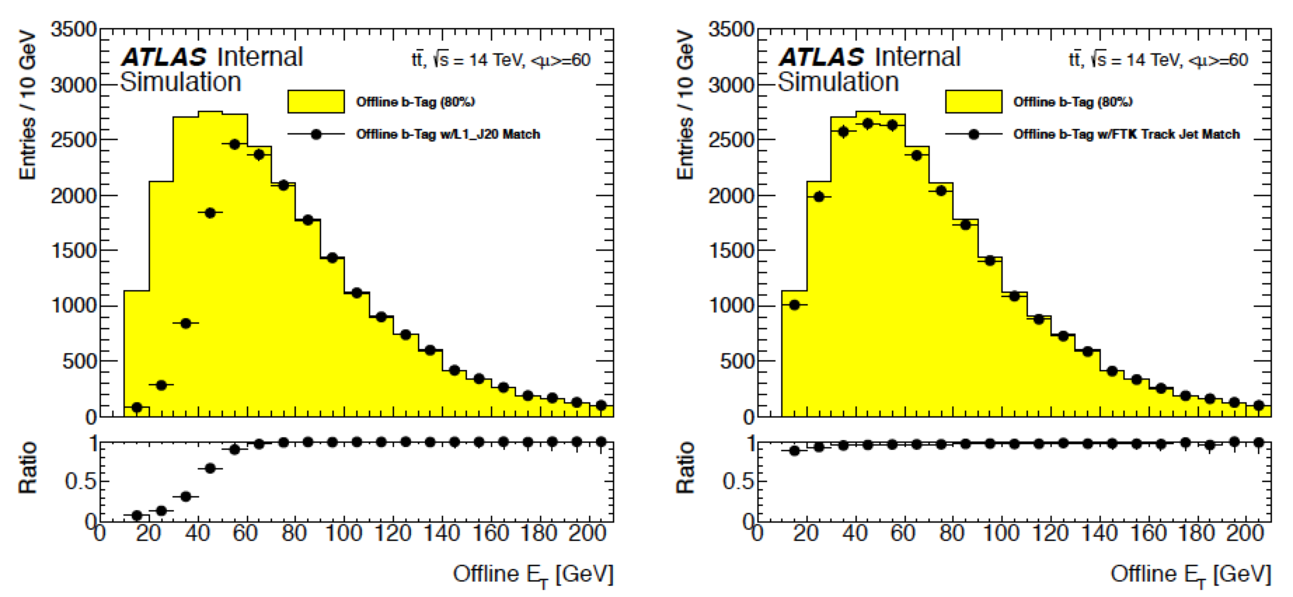
For approval:

Slide 3
