Slide 1
Jet Slice Status Report
Ricardo Gonçalo (LIP) and David Miller (Chicago)
For the Jet Trigger Group
Trigger General Meeting – 9 July 2014

Slide 2
Outlook
Ongoing activity
Full-scan versus partial-scan
Plans
Mailing lists:
atlas-trig-jet@cern.ch: announcements and general news
atlas-trig-jet-menu@cern.ch: technical – jet trigger menu and software
atlas-trig-jet-monitoring@cern.ch: monitoring and validation
atlas-trig-jet-pileup@cern.ch: pileup discussions

Slide 3
Ongoing Activity
Study of partial scan versus Full scan – see below
Software:
Software development and maintenance
Monitoring software for Run II
Validation software for Run II
Trigger performance and Menu optimization studies
Pileup studies:
Use of offline pileup subtraction in HLT
Develop tools to assess pileup effect on rates and efficiencies
Use of tracks (incl. FTK) for pileup suppression
Other:
E/p trigger development
HT trigger
Jet reclustering

Slide 4
Developments for run II
L2 – EF merge:
No L2 jets anymore!
Suffered from offline migration and xAOD work
Main triggers: TopoCluster jets
DC14 readiness:
Baseline menu and software running
Problem with xAOD writing possibly solved today
Problem with jet area calculation fixed temporarily
Permanent solution seeds random numbers from event nr – later
Other:
Should also have TriggerTower-based chains in our toolbox
Investigating fat jets and substructure
Counting on nMCM improvements – will need simulation

Slide 5
Partial scan versus full scan
For Run II we may be able to do a Full Scan of the calo at L1 rate
But we need a plan B in case this is not feasible – Partial Scan
Purpose of study is to assess the partial vs full scan performance
CPU + I/O time, jet resolution (=> backgr. rejection), rate, etc…
HLT
L1
Cell container
TopoCluster
Jets
Hypo
Full Scan
Partial Scan
TE
dummy
Cell container
TE
sRoI
Cell container
TE

Slide 6
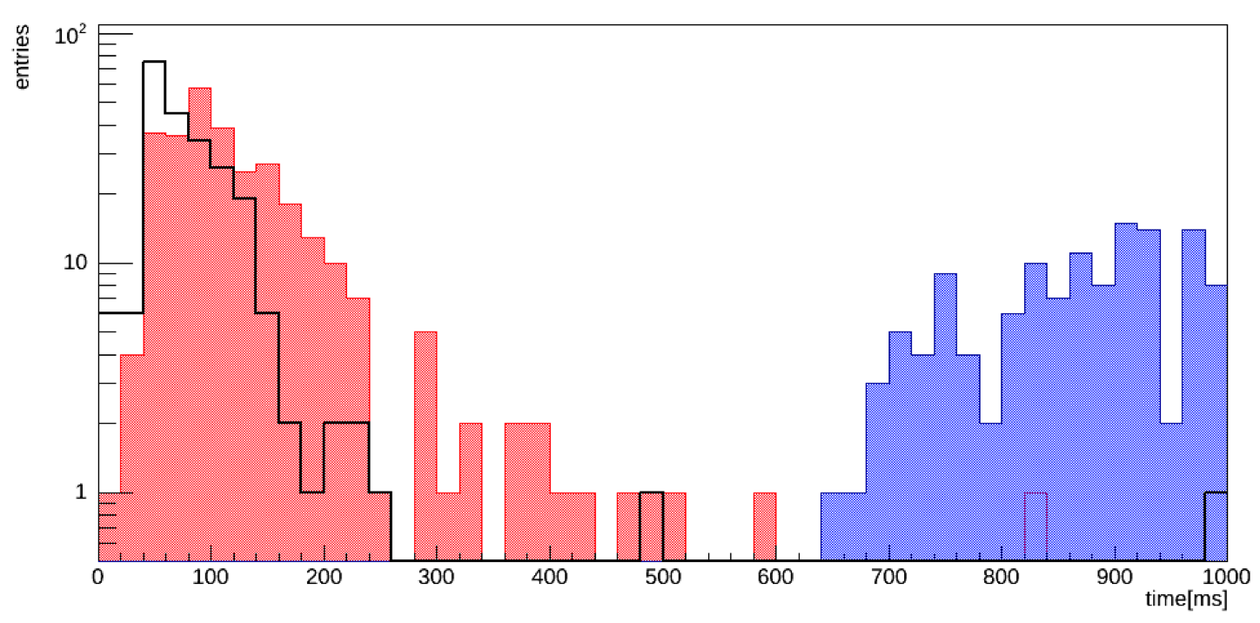
CPU time performance
Total time clearly FS ≈10x higher than PS (see backup)
Sample mc12 14TeV di-jet JZ2W (80-200GeV) <μ>=80
Breakdown in next slide
Full scan
Partial scan (L1_J20)
Partial scan (L1_J50)

Slide 7
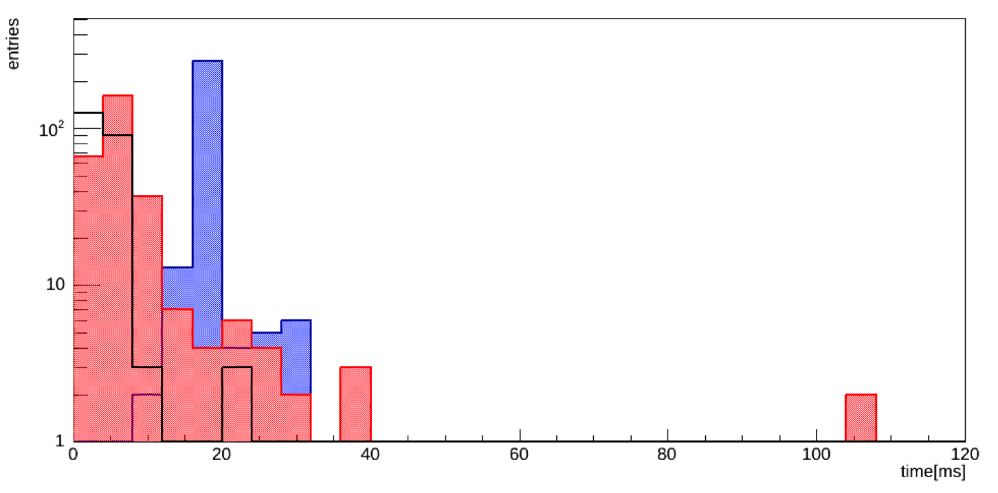
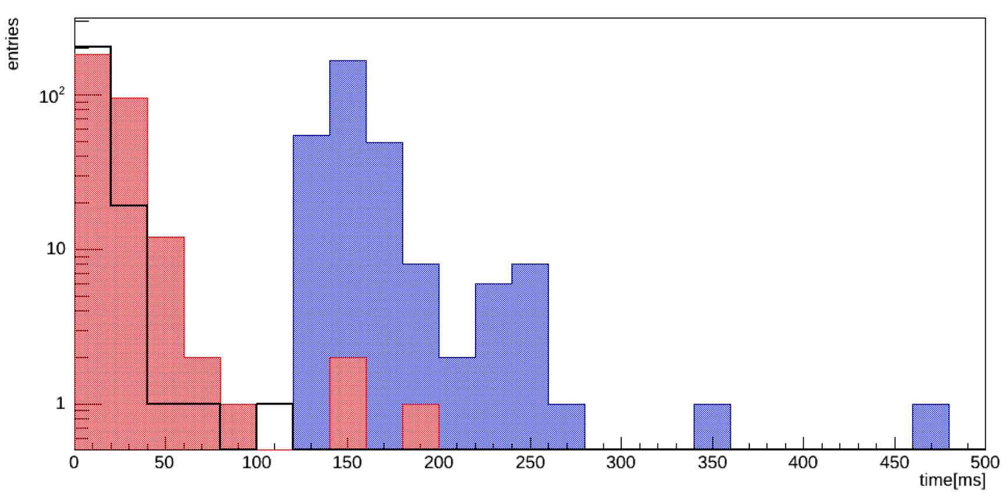
Cell container maker
TopoCluster maker
Full scan
Partial scan (L1_J20)
Partial scan (L1_J50)

Slide 8
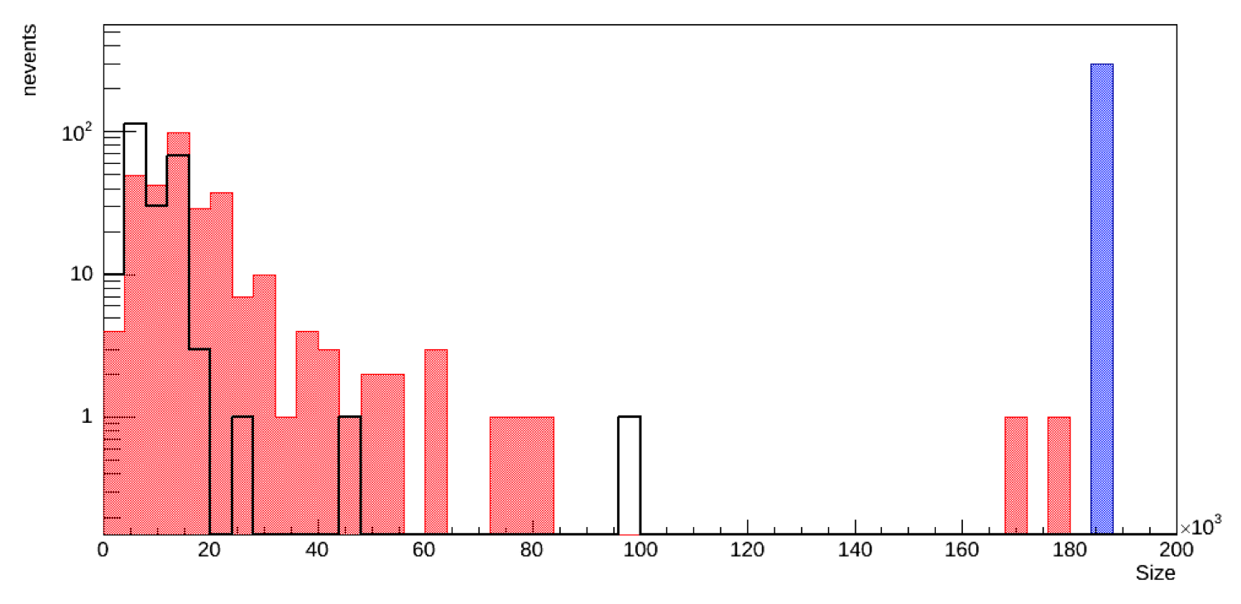
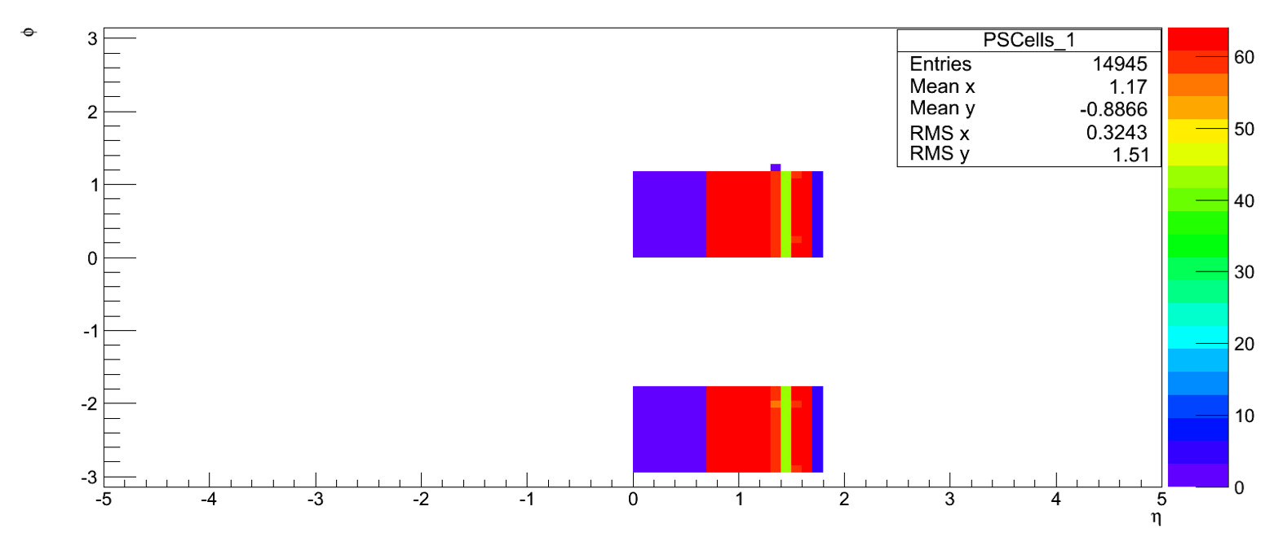
Number of input cells depends on L1 item seeding Super RoI maker
Potential issue if we use PS: Tile region much wider than LAr (potential bias)
φ
η

Slide 9
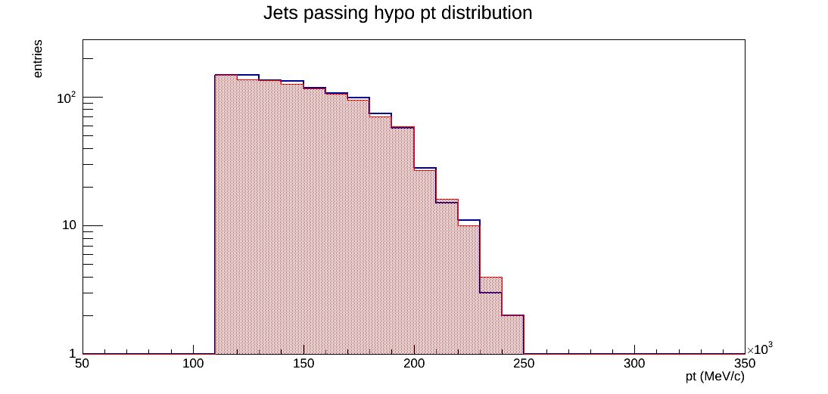
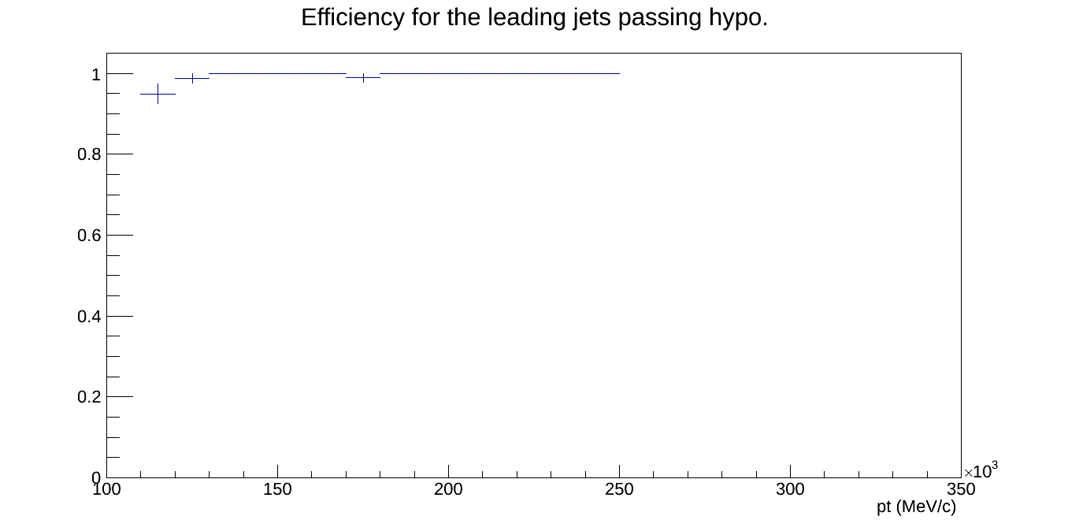
Performance
Jet reconstruction performace essential to use PS solution
Generally good
Small difference at threshold (PS vs FS)
Small differences in efficiency (PS vs FS)
Also good correlation (PS vs FS) seen in jet position
Area around L1 RoI used for sRoI making would need to be optimized

Slide 10
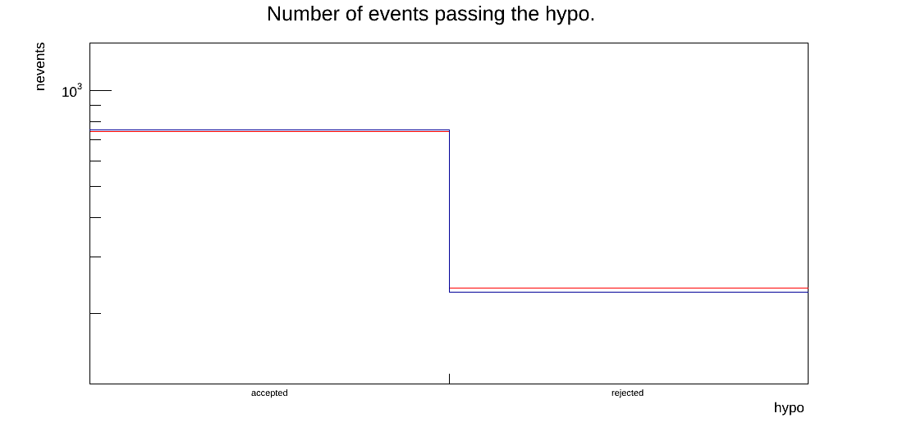
Performance
Jet reconstruction performace essential to use PS solution
Generally good
Small difference at threshold (PS vs FS)
Small differences in efficiency (PS vs FS)
Also good correlation (PS vs FS) seen in jet position
Area around L1 RoI used for sRoI making would need to be optimized

Slide 11
Plans
DC14 is current highest priority
Several open software tasks, but in “bug fixing mode”
Basic jet trigger functionality almost in place
After this will need detailed performance and bias studies for signals and rate estimates for backgrounds
Will inform tuning menu for Run II
Prepare monitoring infrastructure and team of experts to support online tests and running
Other developments:
Should have TriggerTower based chains in our toolbox
Substructure, reclustering, etc

Slide 12
Backup

Slide 13
FS vs PS test conditions
Tests made with mc12 14TeV di-jet JZ2W sample
On a test bed pc
chain EF_j110, with L1_J20 and L1_J50 L1 items
Super RoI (sRoI) made from squares in ηxφ = 1x1 around L1 RoIs
Sample details:
mc12 14TeV.147911.Pythia8_AU2CT10_jetjet_JZ2W.recon.RDO.e1996 s1715 s1691 r4741
80-200 GeV sample
Pileup: 80
Other:
Geometry - ATLAS-IBL-03-00-00
ConditionsTag - OFLCOND-MC12-IBL-20-80-25
Release: AtlasP1HLT,19.0.X.Y-VAL,64,here,rel_0
Changed TriggerMenu, and other small fixes.

Slide 14
Total Full Scan Time

