Slide 1
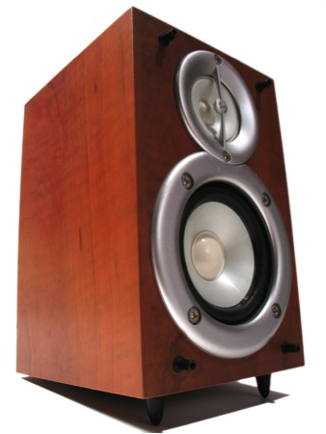
TDAQ Speakers Committee Report
J Taylor Childers (Uni. Heidelberg)
Sarah Demers (Yale Uni.)
Kostas Kordas (Univ. of Thessaloniki)
Ricardo Goncalo (Royal Holloway)

Slide 2
Reminder
Look at TDAQ Speakers Committee (TDSC) wiki for information on future conferences and record of contributions sent:
https://twiki.cern.ch/twiki/bin/viewauth/Atlas/TDAQSpeakersCommittee

Slide 3
Statistics
Posters:
14 Cat. A
4 Cat. C
Talks:
21 Cat. A
8 Cat. C
TBD:
23 abstracts
Future:
3 abstract deadlines to come
Emails to TDSC:
1103 since January… no, 1104! no, 1105!…
Conference | Conf. date | Posters | Talks | Obs.
Bormio2011 | Jan 2011 | 1 (A)
ACES2011 | Mar 2011 | 2 (A) | 3 (A) + 1 (C) | 4 invited
SCCG2011 | Apr 2011 |  |  | 1 reject
ANIMMA2011 | Jun 2011 |  | 1 (C)
TIPP2011 | Jun 2011 |  | 6 (A)
PLHC2011 | Jun 2011 | 2 (A) |  | 1 cancelled
VERTEX2011 | Jun 2011 |  | 1 (C) | invited
EPS-HEP2011 | Jul 2011 | 3 (A) | 1 (A) | 3 rejected
LP2011 | Aug 2011 | 1 (A)
PIC2011 | Aug 2011 | 3 (A)
RD2011 | Jul 2011 |  | 2 (C)
ACAT2011 | Sep 2011 | 2 (A) + 2 (C) | 3 (C)
TWEPP-11 | Sep 2011 | 1 (C) | 3 (A)
ICATPP2011 | Oct 2011 |  | 2 (A)
IEEE-NSS2011 | Oct 2011 |  | 4 (A) | 2 unkn. 1 rej. 1 withdr.
ICALEPCS2011 | Oct 2011 | 1 (C) | 1 (A)
HCP2011 | Nov 2011 |  |  | 1 (A) submitted
HSTD-8 | Dec 2011 |  |  | 1 (A) submitted
HEP2011 | Jan 2012 |  | 1 (A)
CHEP2012 | May 2012 |  |  | 8 (A) 11 (C) submitted
 | Total: | 14 (A) 4 (C) | 21 (A) 8 (C) | 23 unknown

Slide 4
Talk/poster/proceedings approval procedure
Procedures are simple and well described in our Twiki
Note that abstracts sent to conferences MUST be checked by TDSC – mostly just ensure internal consistency and no overlap
In addition, slides, posters and proceedings papers MUST be reviewed
Agree on abstract within appropriate subgroup
Submit abstract to TDSC for a particular conference
Yes
Submit abstract to conference
TDAQ approves abstract
No

Slide 5
Reminder of speaker selection procedure
Speaker priority for conference talks comes from nominations by:
Institute Representatives
TDAQ Subgroup Convener
TDSC, guided by the TDMT, assigns final priority based on:
Date of last TDAQ conference talk
Job needs (looking for job)
Subgroup convener’s input
Level of contribution within TDAQ
Note:
Giving a TDAQ talk has no effect on eligibility to give an ATLAS talk
Showing a poster also independent and has no effect on eligibility
Institute Reps. encouraged to nominate their members – both for TDAQ talks and (separately) in SCAB database for physics talks

Slide 6
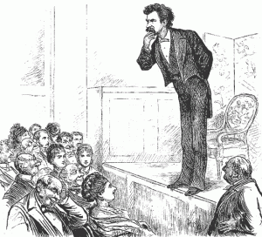
Tools for speaker selection & bookkeeping
The Twiki is our main tool for bookkeeping contributions to conferences
To manage author list and speaker selection currently use Excel …
Big effort to keep up to date – last iteration we found people who are now in CMS…
We would like a solution which:
Facilitates producing TDAQ author lists
Facilitates TDSC access to “priority” of each TDAQ speaker
Is easy to keep up to date:
Easy to update information on TDAQ members’ activity
Easy to update speaker priority through “nominations”
TDSC interacted with GLANCE team to adapt ATLAS SC authors database
Still in development – not yet clear when it could be in production
Glance team implemented new roles:
System Project Leader TDAQ – will nominate atlas people
TDSC Member – will see nomination information
TDSC Chair – as a separate role: can enter TDSC priority
Institute Representative – can nominate own institute members
TDAQ Sub-group Convener – can nominate TDAQ members

Slide 7
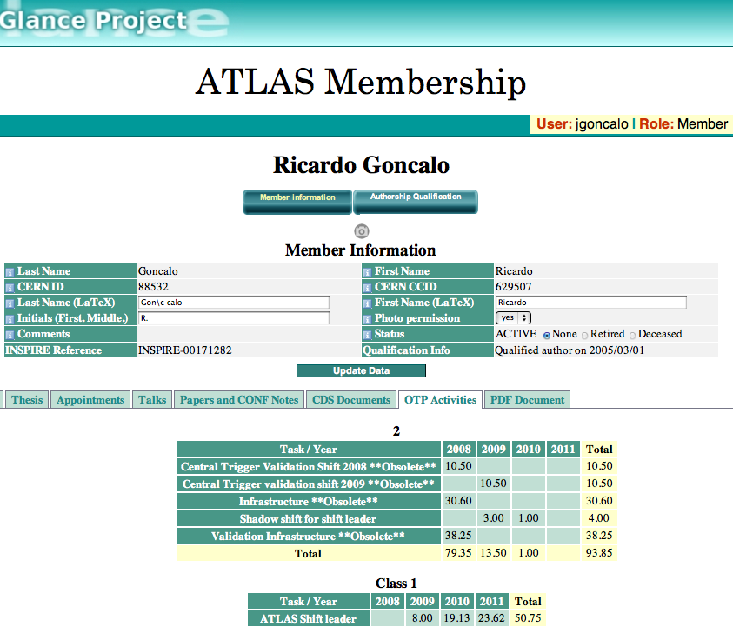
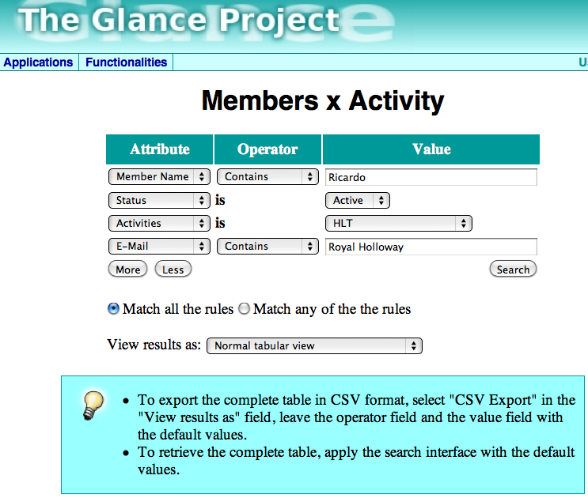
Glance interface
Only use will tell, but looks promising
With the right functionality could make some tasks a lot easier
Important to keep TDAQ member activities info up to date: DAQ, LVL1 Trigger, and HLT

Slide 8
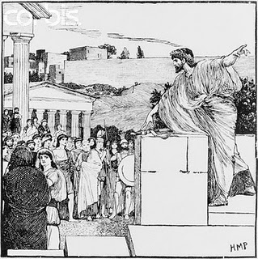
Current Issues
Authors list
New TDAQ authors list just finalized: ATL-DAQ-PUB-2011-002
http://cdsweb.cern.ch/record/1386334
TIPP 2011 Proceedings deadline extended to 15 October
Note this means an internal deadline of 2nd October
One paper still pending (online luminosity)
TIPP2011 speakers submitting proceedings to the conference were asked to sign a copyright form
CERN is negotiating with publishers to define agreement
Speakers should NOT sign copyright form before negotiations done – should be finished by Monday
If same situation arises in future conferences please as us for guidance

Slide 9
Conclusions
We’re sending :
18 posters and 29 talks to various conferences
23 other abstracts pending (mostly for 2012)
Reminder of procedures for submitting abstracts etc
Information on past or future conferences can be found in TDSC Twiki: https://twiki.cern.ch/twiki/bin/viewauth/Atlas/TDAQSpeakersCommittee
Tools for bookkeeping and managing speakers & conferences are evolving
Will need input and support from TDAQ Institute Representatives
New TDAQ Authors List ready: ATL-COM-DAQ-2011-095

