Slide 1
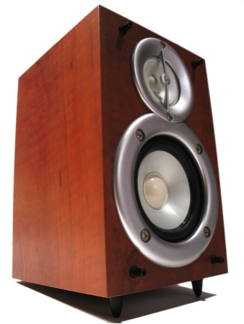
TDAQ Speakers Committee Report
J Taylor Childers (Uni. Heidelberg)
Sarah Demers (Yale Uni.)
Kostas Kordas (Univ. of Thessaloniki)
Ricardo Goncalo (Royal Holloway)

Slide 2
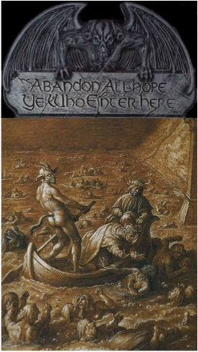
Thanks and Welcome!!!
Many THANKS to Kostas and Sarah for lots of work over the last two years!
And WELCOME to the newly elected members of the TDAQ Speakers Committee!!

Slide 3
Reminders
Look at TDAQ Speakers Committee (TDSC) wiki for information on future conferences and record of contributions sent:
https://twiki.cern.ch/twiki/bin/viewauth/Atlas/TDAQSpeakersCommittee
TDAQ author – new list since October 2011 – obtain from the above link

Slide 4
2011 Statistics
25 Posters:
20 Cat. A
5 Cat. C
29 Talks:
19 Cat. A
10 Cat. C
Big conferences in 2012:
IEEE - Real Time
CHEP
IEEE - NSS
Emails to TDSC:
2940 since January… no, 2941! no, 2942!…
Conference | Conf. date | Posters | Talks | Obs.
Bormio2011 | Jan 2011 | 1 (A)
ACES2011 | Mar 2011 | 2 (A) | 3 (A) + 1 (C) | 4 invited
ANIMMA2011 | Jun 2011 | 1(C) | 1 (C)
TIPP2011 | Jun 2011 |  | 6 (A)
PLHC2011 | Jun 2011 | 2 (A) |  | 1 cancelled
VERTEX2011 | Jun 2011 |  | 1 (C) | invited
EPS-HEP2011 | Jul 2011 | 6 (A) | 1 (A) | 3 rejected
LP2011 | Aug 2011 | 1 (A)
PIC2011 | Aug 2011 | 3 (A)
RD2011 | Jul 2011 |  | 2 (C)
ACAT2011 | Sep 2011 | 2 (A) + 2 (C) | 3 (C)
TWEPP-11 | Sep 2011 | 1 (C) | 3 (A)
ICATPP2011 | Oct 2011 |  | 2 (A)
IEEE-NSS2011 | Oct 2011 | 1(A) | 3 (A) + 2(C) | 2 unkn. 1 rej. 1 withdr.
ICALEPCS2011 | Oct 2011 | 1 (C) | 1 (A)
HCP2011 | Nov 2011 | 1(A) |  | 1 (A)
HSTD-8 | Dec 2011 | 1(A) |  | 1 (A)
 | Total: | 20(A)+5(C) | 19(A)+10(C)

Slide 5
Some More Statistics
Conference | #emails | #talks | #posters
ACAT | 207 | 3 | 4
ACES | 96 | 4 | 2
ANIMMA | 36 | 0 | 1
Bormio | 64 | 0 | 1
RD2011 | 23 | 2 | 0
PIC | 85 | 0 | 3
EPSHEP | 264 | 1 | 6
HCP | 66 | 0 | 1
HSTD-8 | 37 | 0 | 1
ICALEPCS | 68 | 1 | 1
ICATPP | 82 | 2 | 0
IEEE/NSS | 351 | 5 | 1
LP | 12 | 0 | 1
PLHC | 67 | 0 | 2
TIPP | 508 | 6 | 0
TWEPP | 142 | 3 | 1
VERTEX | 30 | 1 | 0
iWORID | 2 | 0 | 0
A lot of communication is needed for each conference
With authors, referees, conveners, etc
On average >30 emails per talk or poster
And distribution has long tails…

Slide 6
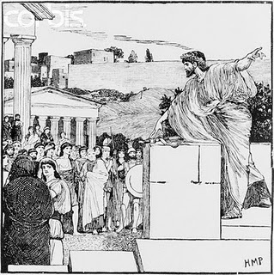
Conclusions
Welcome to the new TDSC members!
29 talks and 25 posters sent to conferences in 2011
Plea to authors and reviewers…
Please don’t wait until the last few days before posting slides, proceedings or review comments
Last two conferences needed deadline extensions
A few horror stories upon which we shall not dwell…

Slide 7
Backup slides

Slide 8
Talk/poster/proceedings approval procedure
Procedures are simple and well described in our Twiki
Note that abstracts sent to conferences MUST be checked by TDSC – mostly just ensure internal consistency and no overlap
In addition, slides, posters and proceedings papers MUST be reviewed
Agree on abstract within appropriate subgroup
Submit abstract to TDSC for a particular conference
Yes
Submit abstract to conference
TDAQ approves abstract
No

Slide 9
Reminder of speaker selection procedure
Speaker priority for conference talks comes from nominations by:
Institute Representatives
TDAQ Subgroup Convener
TDSC, guided by the TDMT, assigns final priority based on:
Date of last TDAQ conference talk
Job needs (looking for job)
Subgroup convener’s input
Level of contribution within TDAQ
Note:
Giving a TDAQ talk has no effect on eligibility to give an ATLAS talk
Showing a poster also independent and has no effect on eligibility
Institute Reps. encouraged to nominate their members – both for TDAQ talks and (separately) in SCAB database for physics talks

Slide 10
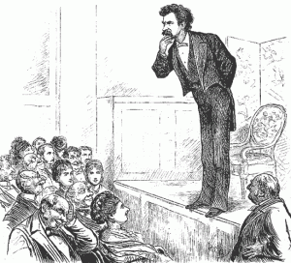
Tools for speaker selection & bookkeeping
The Twiki is our main tool for bookkeeping contributions to conferences
To manage author list and speaker selection currently use Excel …
Big effort to keep up to date – last iteration we found people who are now in CMS…
We would like a solution which:
Facilitates producing TDAQ author lists
Facilitates TDSC access to “priority” of each TDAQ speaker
Is easy to keep up to date:
Easy to update information on TDAQ members’ activity
Easy to update speaker priority through “nominations”
TDSC interacted with GLANCE team to adapt ATLAS SC authors database
Still in development – not yet clear when it could be in production
Glance team implemented new roles:
System Project Leader TDAQ – will nominate atlas people
TDSC Member – will see nomination information
TDSC Chair – as a separate role: can enter TDSC priority
Institute Representative – can nominate own institute members
TDAQ Sub-group Convener – can nominate TDAQ members

Slide 11
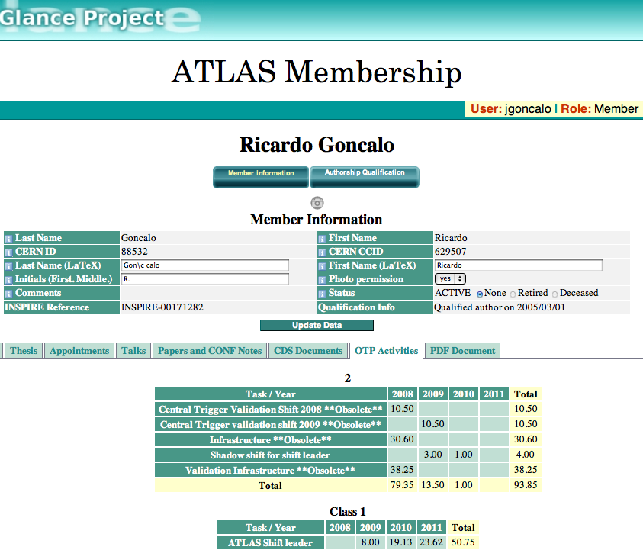
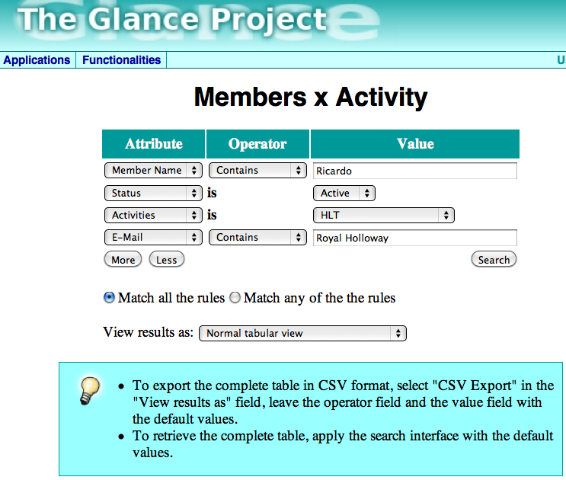
Glance interface
Only use will tell, but looks promising
With the right functionality could make some tasks a lot easier
Important to keep TDAQ member activities info up to date: DAQ, LVL1 Trigger, and HLT

