Slide 1
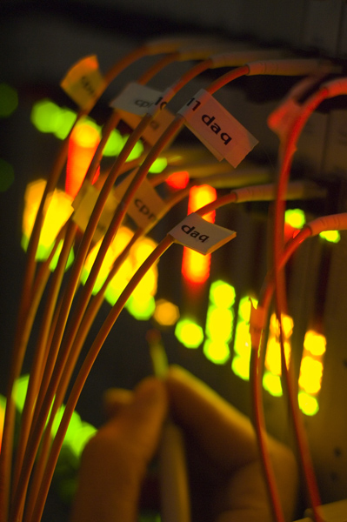
Offline Trigger Monitoring
TDAQ Training
30 July 2010
On behalf of the Trigger Offline Monitoring Experts team

Slide 2
Introduction

Slide 3
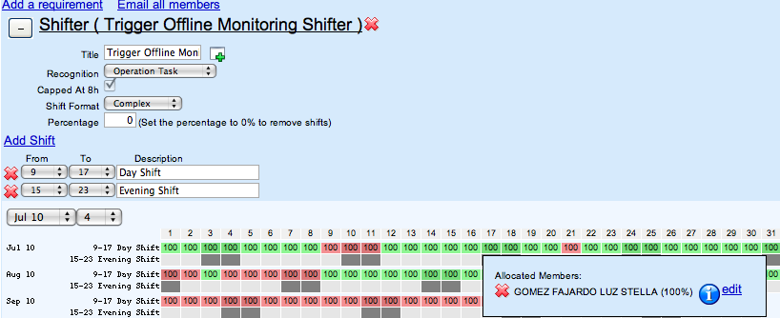
Aims:
The offline trigger monitoring shifter has two main tasks:
Monitor the Debug Stream analysis
Monitor the trigger Data Quality
Practicals:
The trigger shifter is in constant contact with a Trigger Offline Expert on call
A small team of experts rotate to make sure there is always someone on call
Will also be able to answer the shifter’s questions/doubts
The expert will direct the shifter’s work
Especially in case non-standard operations are needed
One shift per day from 9am to 3pm in the TDAQ Satellite Control Room (SCR)
Look for category “Trigger Offline Monitoring Shifter” (task 46640) in OTP
It will be possible to do this shift remotely once the all the tools are available and the LHC is running smoothly – probably sometime in 2011
Organization:
The activity is overseen by Alessandro Di Mattia and is an essential part of the Trigger Operations area
It makes sure that the trigger is working without problems and that the data collected is good for analysis

Slide 4
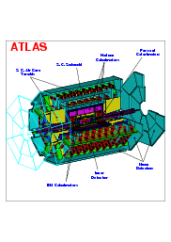
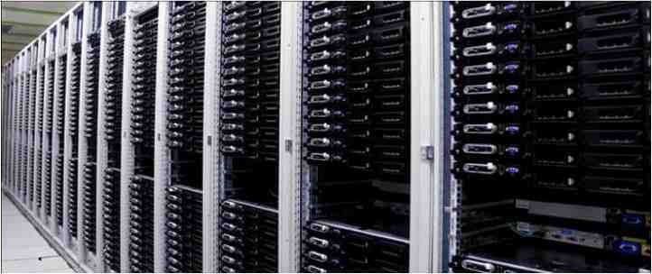
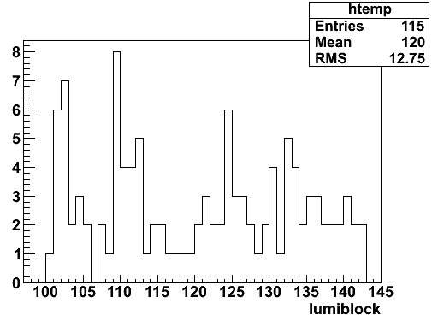
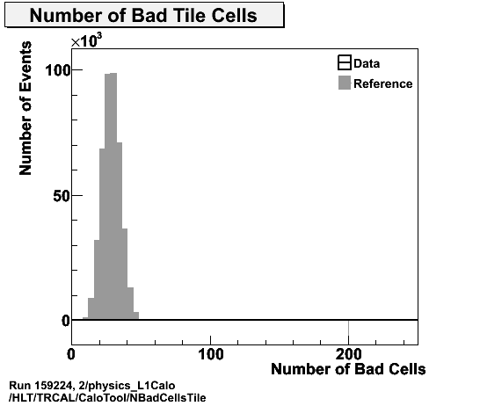
ATLAS Trigger/DAQ
Trigger Reprocessing in Tier0
DEBUG Streams
CASTOR
Pre-reprocessing Analysis
Post-reprocessing Analysis
PHYSICS Streams
Offline Monitoring and Reconstruction in Tier0
Data
Quality
from
Tier0
Histos
DEBUG stream analysis
Trigger DATA QUALITY

Slide 5
Debug Stream Monitoring

Slide 6
ATLAS Trigger/DAQ
Trigger Reprocessing in Tier0
DEBUG Streams
CASTOR
Pre-reprocessing Analysis
Post-reprocessing Analysis
Debug Stream analysis:
Events generating error conditions either in the DAQ infrastructure or the HLT software are sent to debug streams:
debug_EFHLTTimeout
debug_efdProcTimeout
debug_L2ForcedAccept
etc
They are reprocessed in the Tier0 and a set of analysis histograms are produced pre- and post-reprocessing to help diagnose the error

Slide 7
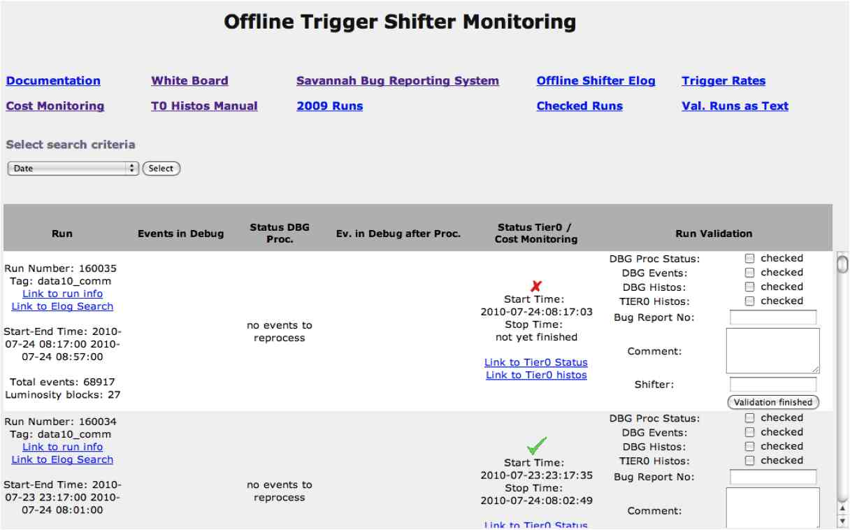
Debug Stream Monitoring: https://voatlas17.cern.ch/offmon_new/offlineshifter.php
Webpage dedicated to the use of the offline shifter and expert on call
Automatically displays the recorded runs and provides a nice way to keep the information about past runs
Provides access to the debug stream contents and to analysis histograms before and after reprocessing

Slide 8
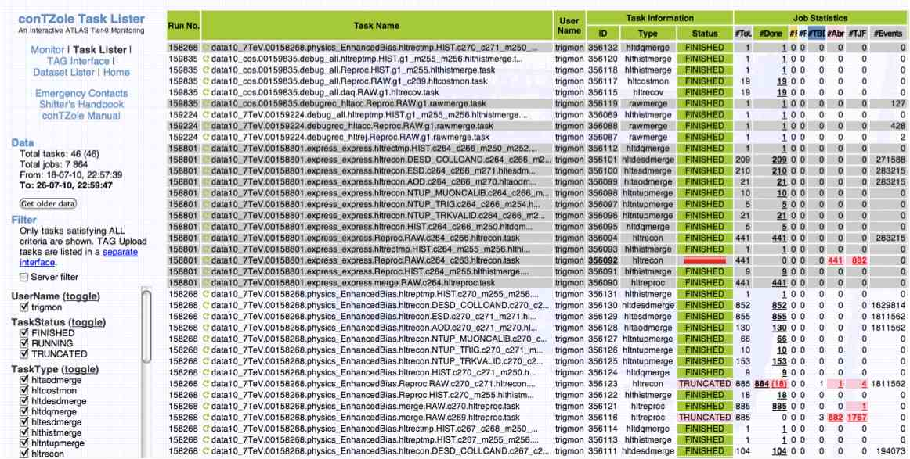
The HLT reprocessing is controlled by the TOM interface which is also used to do ad-hoc re-processings of old runs to test new software, debug errors etc
Running jobs can be monitored in the conTZole Task Lister: https://atlas-tz-monitoring-caf.cern.ch/taskLister.html

Slide 9
Trigger Data Quality Assessment

Slide 10
ATLAS Trigger/DAQ
The trigger software is monitored online – each trigger algorithm running on each working node publishes monitoring histograms
…and offline – monitoring algorithms run in Tier0 during event reconstruction and produce histograms from online trigger data
Slice experts take care of checking the monitoring data from each run at the moment
This will be increasingly the task of the offline trigger shifter
PHYSICS Streams
Offline Monitoring and Reconstruction in Tier0
Data
Quality
from
Tier0
Histos
Trigger DATA QUALITY

Slide 11
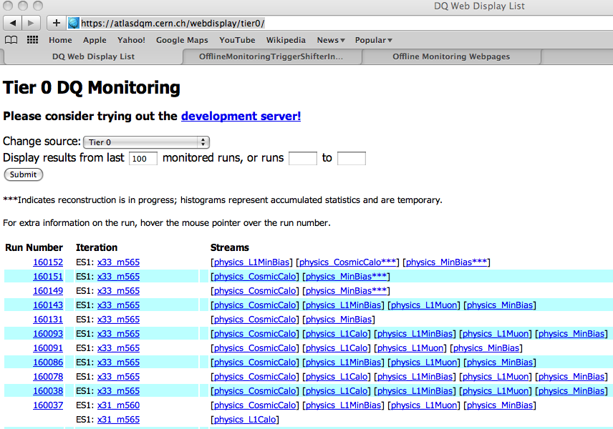
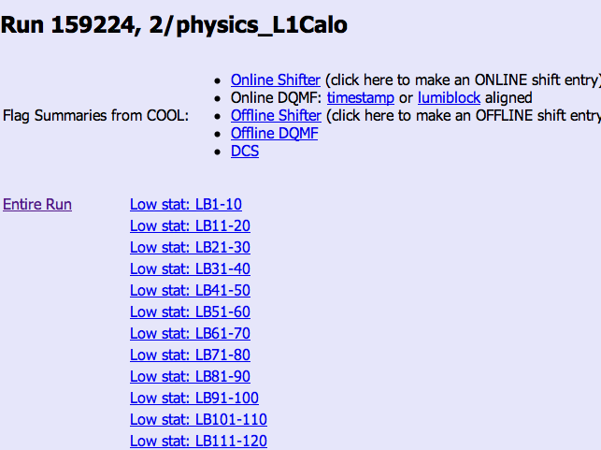
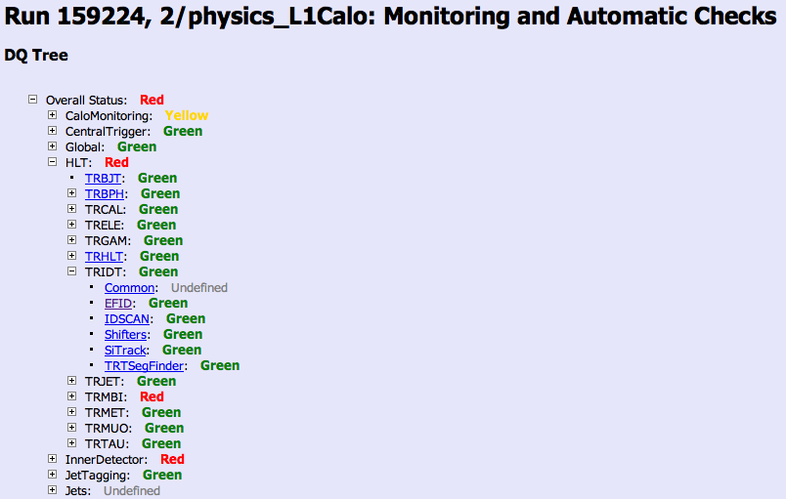
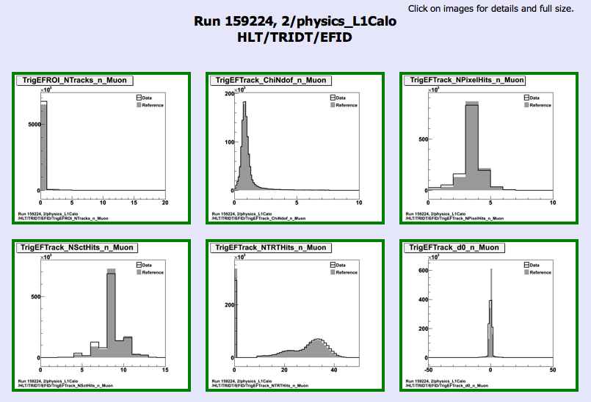
Go to https://atlasdqm.cern.ch/webdisplay/tier0/
Click on the stream and run that you like, e.g. 159224/L1Calo
Look under HLT: each link corresponds to a trigger domain: e.g. HLT->EFID

Slide 12
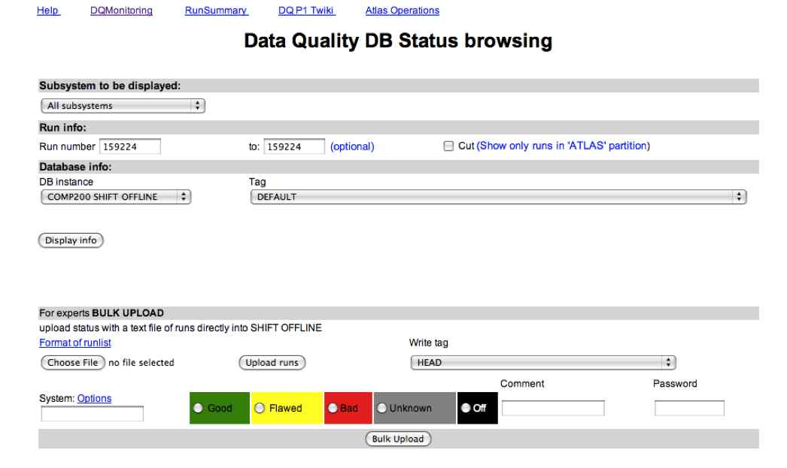
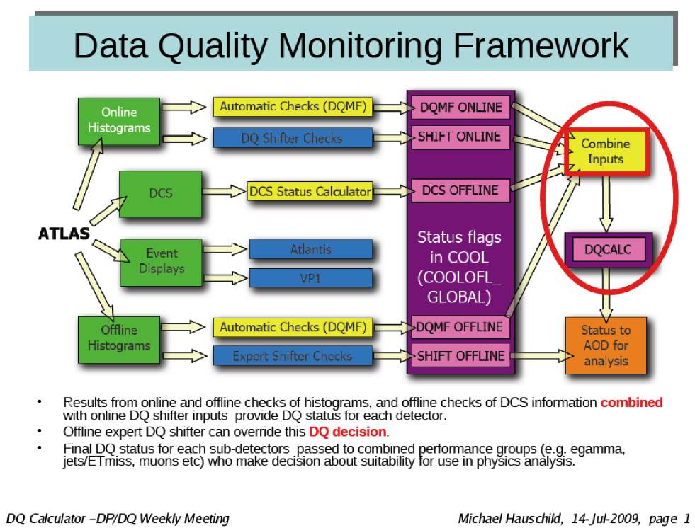
Once you determine if a run is good or bad, update the corresponding Data Quality (DQ) flags – only the “ShiftOFFLINE” flags are updated by the shifter
To update DQ flags go to: https://atlasdqm.web.cern.ch/atlasdqm/DQBrowser/DBQuery.php

Slide 13
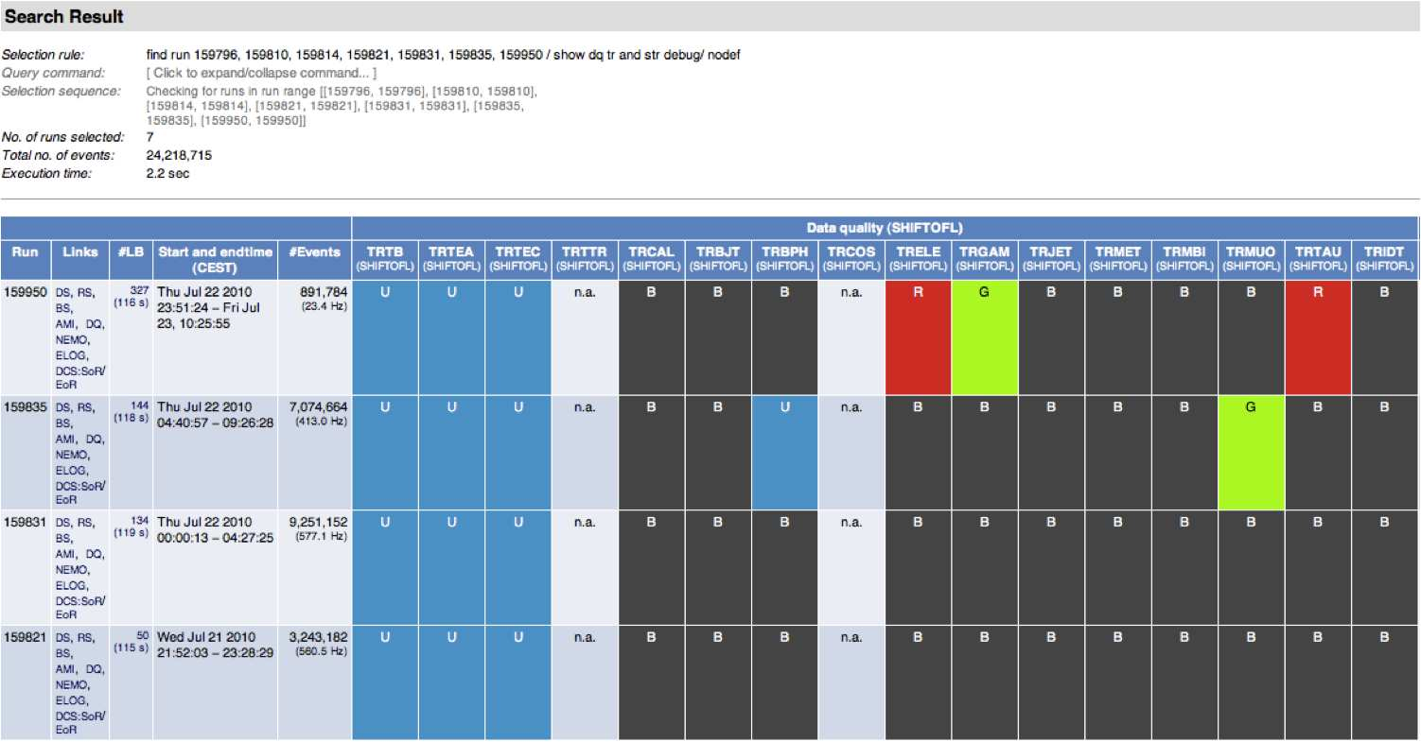
The flags are then combined with the DQ flags set online and automatically by DQMF and used to select data for analysis using the Good Run Lists

Slide 14
Documentation

