Slide 1


Commissioning Requirements from Hadronic Signatures
Missing!
&
Florian Bernlocher (Bonn), Hugo Beauchemin (Tufts), David Miller (Chicago), Ricardo Gonçalo (LIP)
On behalf of the Jet and E_{T}^{miss} Signature Groups
TDAQ Week - 3 December 2014

Slide 2

Missing E_{T} Commissioning Plans

Slide 3
Overview
https://its.cern.ch/jira/browse/ATR-9566
Primary Triggers
Support Triggers
L1_XE
L1_KF-XE
Pre-scaled triggers
with low xe thresholds
O(6 kHz)
xe_cell
xe_tclcw/tcem
xe_mht
xe_pufit
Rerun chains for orthogonally
triggered events, e.g. Muons
Unique rate after L1
should be similar
O(30 Hz)

Slide 4
Commissioning strategy of chains with KF-MET improved coefficients
Plan to use the 50 ns run to derive a set of data-driven calibration coefficients and test the MC based coefficients.
  Most physics analyses don’t have dedicated plans for the 1/fb of the 50 ns run
  Plan to make a full comparison of L1_XE met & L1_KF-XE MET to formulate a recommendation for combined chains.
  Update coefficients then prior to the 25 ns data taking
Repeat exercise with early 25 ns data; if no large problem isolated plan to use 50 ns coefficients for entire data taking period.

Slide 5
Changes required for 25 vs 50 ns running
Plan to use the 50 ns run for quick performance studies on all HLT algorithms.
  Goal is to reduce the number of HLT algorithm candidates down to maximal two.
  For these duplicate the combined chains for the first 25 ns run.

Slide 6

Use of FEBs in XE Triggers
With the current implementation, FEBs can be calculated only by unpacking the full calorimeter information (as far as we understand)
  Benefit of only unpacking partial information gone; but actual MET calculation still incredibly fast (factor of 10 faster than cell based)
No use intended at the moment
  But in a scenario of a lower L1 threshold (departing from the ~ 6 kHz upper limit), they could be used to protect the HLT whilst gaining overall turn-on.

Slide 7
Need for L1.5 jets and calibration
At this point no use for L1.5 jets
Calibration at HLT:
  For MHT plan to use same prescription as jet signature group (i.e. uncalibrated clusters to build jets that are then calibrated)
  For clusters: setup to use either uncalibrated or calibrated clusters. Current studies indicate that calibration has no big impact (contrary of what was seen in 2012)

Slide 8
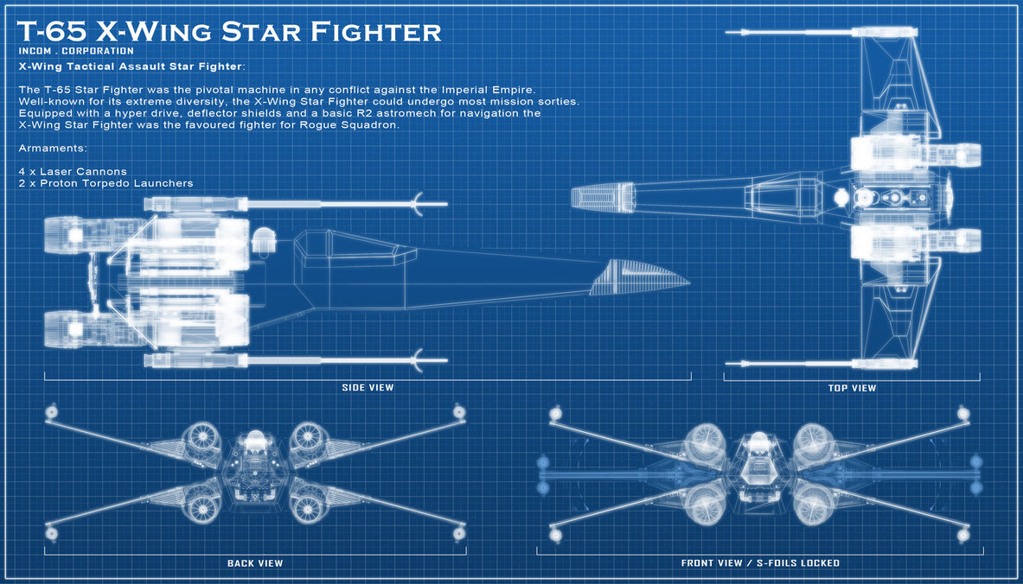
Jet Trigger plans

Slide 9
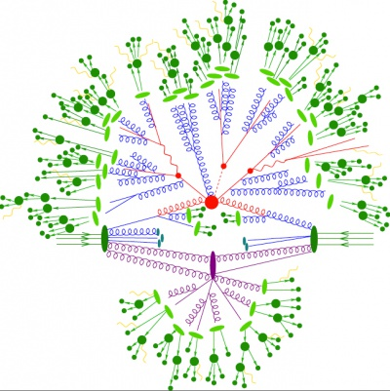
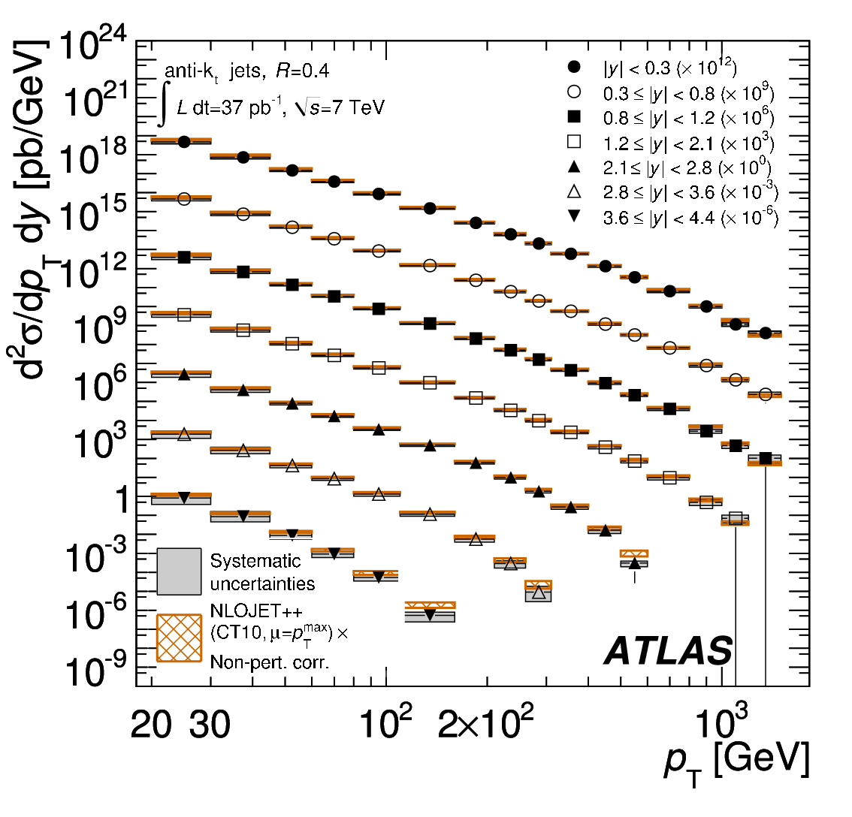

Unusual trigger…
  Jets defined by jet algorithm
  Jets have non-negligible size in detector
  Nearby jets influence reconstruction
  Signal is same as background
  Just selecting phase space (i.e. physics!)
  Very steeply falling spectrum
  Jet p_{T} resolution determines “background” rate
Region of Interest (RoI) approach not really suitable
Reproduce offline reconstruction as much as possible
All jets are connected

Slide 10
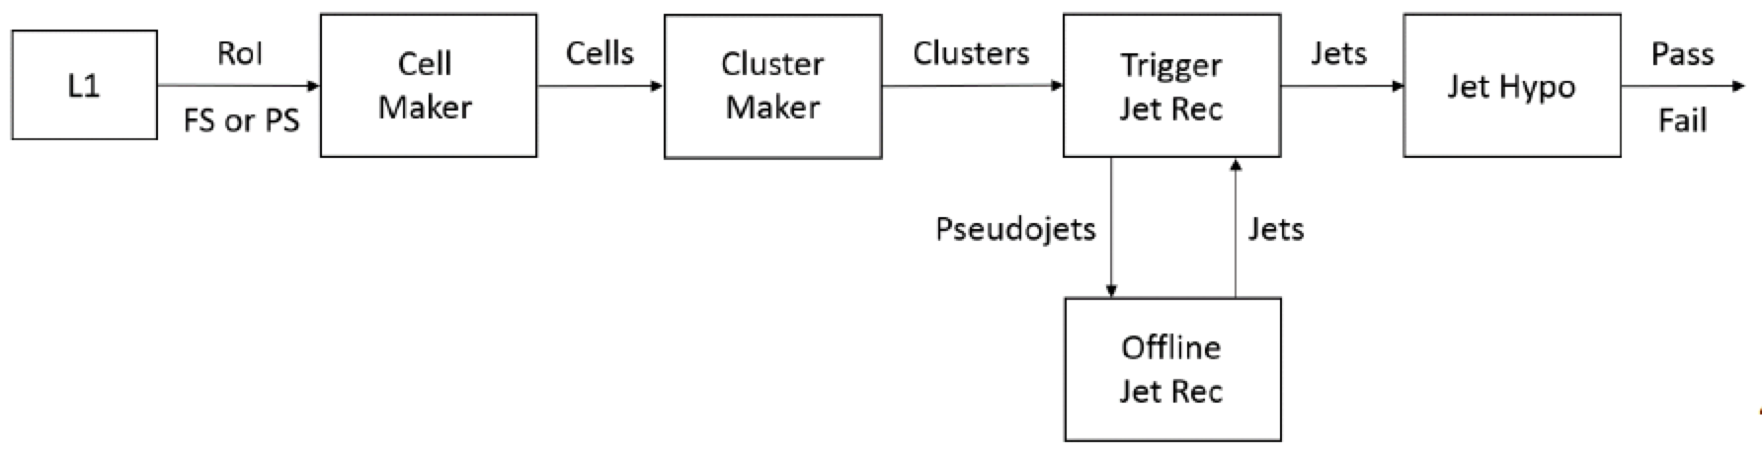
Architecture & SW changes for Run II
Merged High Level Trigger instead of separate L2 & Event Filter
L1Topo topological processor at Level 1
Migration to xAOD led to major software changes
Peter Sherwood
Valentinos Christodolou
Challenging!
  Re-writing of jet trigger software and config, updated monitoring, etc
Opportunities!
  Improve on RoI-based jet reconstruction in Level 2
  Greater re-use of offline jet reconstruction and calibration
  Good collaboration with HLTCalo and offline jet groups (thanks!)
Main obstacle: CPU time, mainly clustering

Slide 11
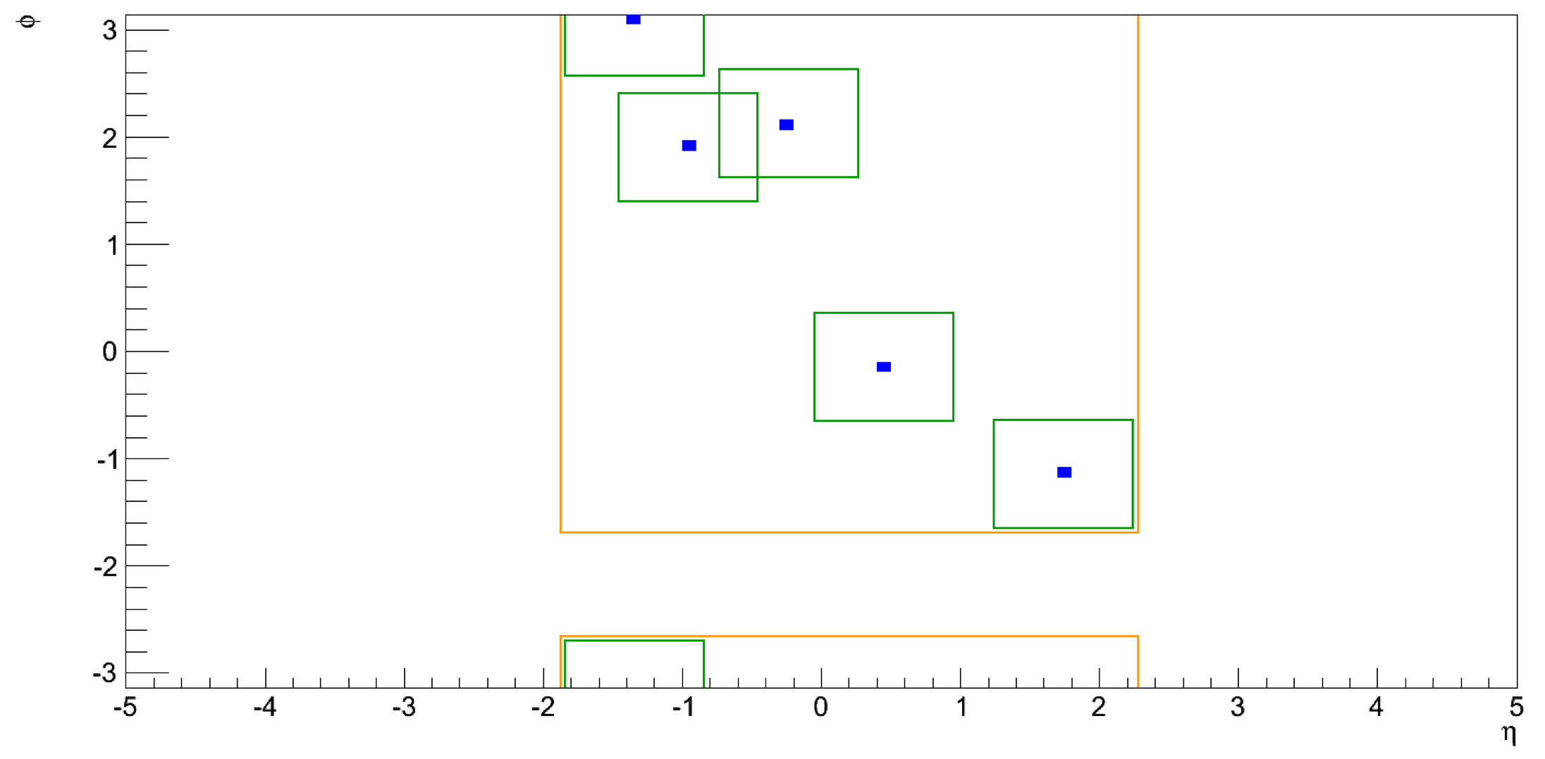
Partial solution: Partial Scan
Ademar Delgado, Mark Sutton
David Freeborn
Partial vs Full scan
E_{T} of 3rd jet in 3j50
sRoI size 1x1
HLT jet finding on Super RoI built from union of all L1 RoIs
  Or better alternative: start from Trigger Tower full scan (L1.5)
  Tuneable parameters: L1_Jx (or L1.5 seed), size of RoIs making sRoI
  Good jet reconstruction performance and costs
  Efficiency: (L1_J20) ≈ 99.5% wrt Full Scan (j110)
Major downside: no jet area subtraction of pileup

Slide 12
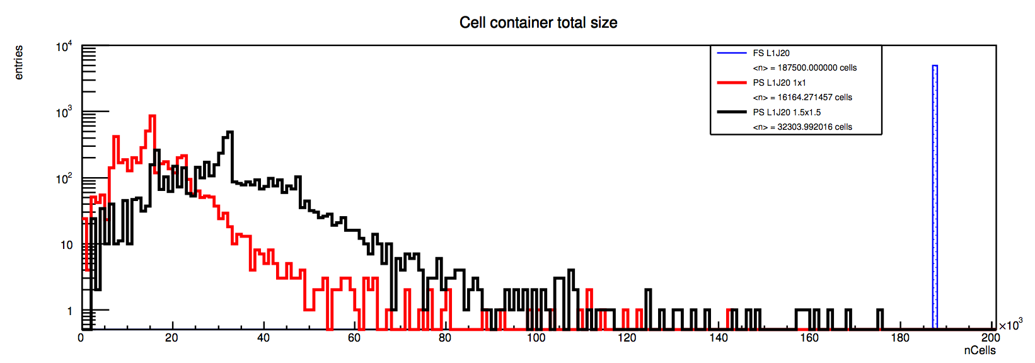
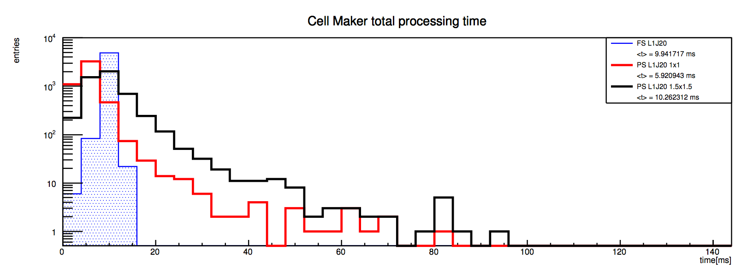
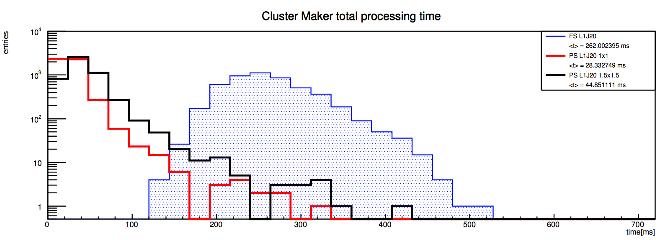
Cost…
Ademar Delgado
JZ2W (80-200GeV)
Full Scan : <n> ≈ 190k cells
Partial Scan: L1_J20 1x1 :
<n> ≈ 16k cells
Partial Scan: L1_J20 1.5x1.5 :
<n> ≈32k cells
Nr of cells
JZ2W (80-200GeV)
Full Scan : <t> ≈ 10ms
Partial Scan: L1_J20 1x1:
<t> ≈ 6ms
Partial Scan: L1_J20 1.5x1.5 :
<t> ≈ 10ms
CellMaker time
JZ2W (80-200GeV)
Full Scan : <t> ≈ 260ms (actually… this was a glitch)
Partial Scan: L1_J20 1x1:
<t> ≈ 30ms
Partial Scan: L1_J20 1.5x1.5 :
<t> ≈ 45ms
ClusterMaker time

Slide 13
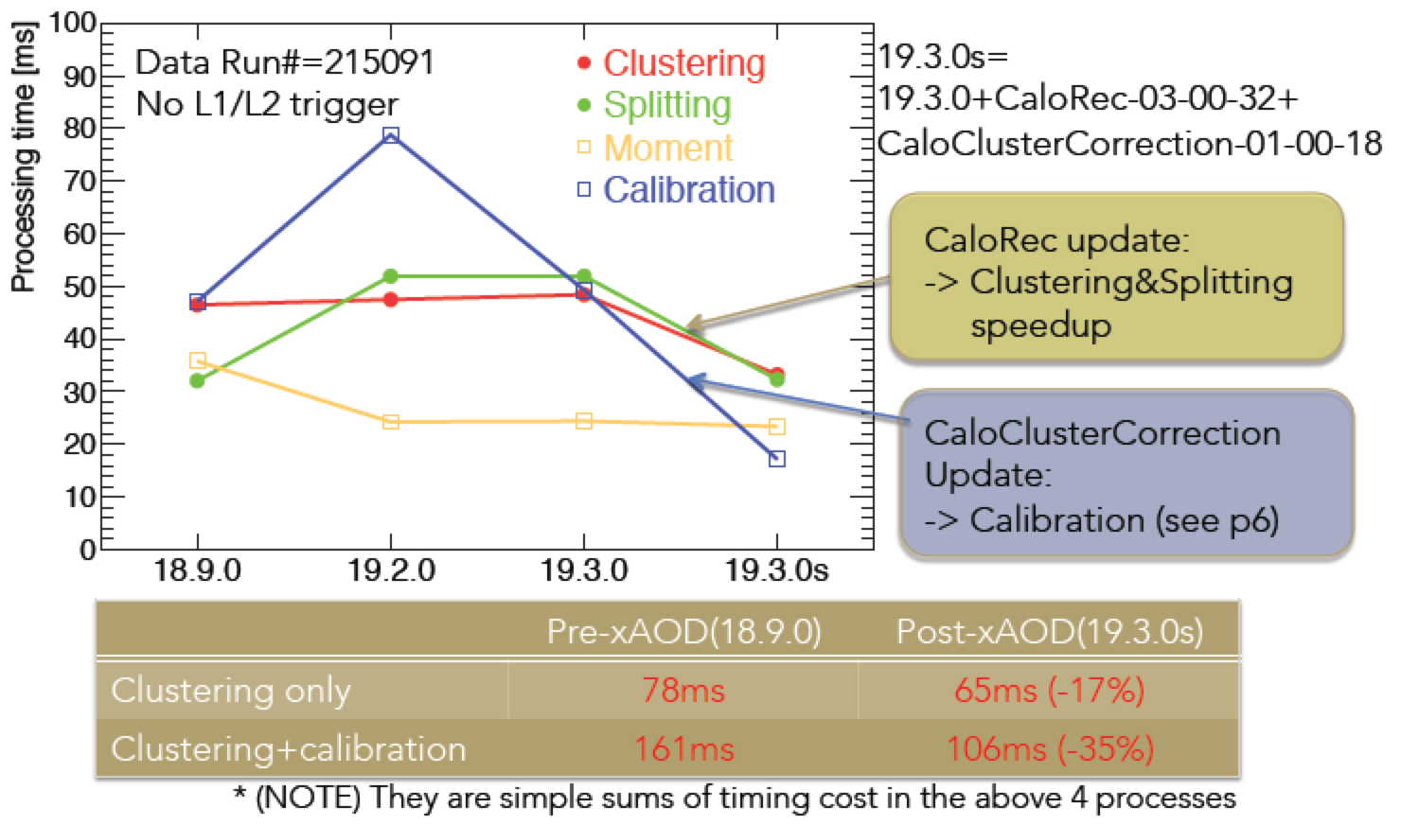
Improvements in clustering time
Updates to TopoCluster lead to much improved CPU time
TopoCluster:
Clustering
Splitting
Moment calculation
Calibration
Full calorimeter scan in HLT
Cluster making:
  80ms/evt
Cluster+Calibration (LCW):
  140ms/evt
New baseline plan:
Full calorimeter scan
Keep Partial Scan: plan B
Plan to use L1.5 to reduce rate for TopoCluster scan (in progress)
Naoko Kanaya, Craig Wigglesworth, Walter Lampl

Slide 14

Jet Trigger Commissioning Plans

Slide 15
Primary Jet Menu Items at low & high lumi
Menu for MC15 under final discussion right now
  5x10³³ menu: j360, fatjet360, 4j85, 5j60, 6j50.0ETA24, ht800
  2x10³⁴ menu: j400, fatjet450, 4j100, 5j85, 6j50.0ETA24, ht1000
Default calibration: emsubjes
  Calibrated (jes) + pileup subtract jets (sub) EM-scale clusters (em)
“Cross-check” chains with alternative calibrations for a few strategic thresholds
  E.g.: j360_a4tcemjes/j380_a4tcemsubjes/j380_a4tcemjes/j380_a4tclcwsubjes
Support triggers:
  Low-E_{T}, prescaled, single and multijet chains; random-seeded low-ET chains
Chain Type | L1 Seed at 0.5x10³⁴ | HLT Item at 0.5x10³⁴ | L1 Seed at 2x10³⁴ | HLT Item at 2x10³⁴
Single jet | J75 | j360 | j100 | j400
Single fat jet | HT150 | j360_a10 | HT190 | j450_a10
4 jets | 3J40 | 4j85 | 3J50 | 4j100
5 jets | 4J15 | 5j60 | 4J20 | 5j85
6 jets | 5J15.0ETA24 | 6j50.0ETA24 | 5J15.0ETA24 | 6j50.0ETA24
HT trigger | HT190 | ht800 | HT190 | ht1000

Slide 16
Jet trigger commissioning strategy
Run new features online as early as possible for functional validation
Compare with offline jets
  Large overlap in performance is essential to avoid wasting bandwidth
Tight coupling with commissioning of HLTCalo
  Studies of clustering performance and timing are key
  Will need both EM and LCW clusters early on
Comparison with offline jets is critical
  First few runs will already establish the baseline performance
Would benefit from special early runs with relaxed prescales for low threshold supporting triggers
  Forward jets typically very difficult to study early
  Need J+FJ for calibration sample for jet eta intercalibration

Slide 17
Questions & Answers
Changes required from 50ns to 25ns run?
  No particular changes required - no large differences expected
  Plan to use early runs (run in May and 50 ns run) to compare different calibration options and make final decision on baseline calibration to be used
  Repeat exercise with early 25 ns data to find any potential problems
  Accumulate data as early as possible (50ns run) for jet and calorimeter calibration
Need for L1.5 and calibration?
  We plan to runL1.5 before cell-based full scan
  Idea is to have a handle to reduce HLT input rate
  Would benefit from being able to calibrate TriggerTower readout, to go beyond L1 resolution
TopoClusters? Yes, definitely!
  Would like to be able to choose best calibration for physics (CPU time allowing)

Slide 18
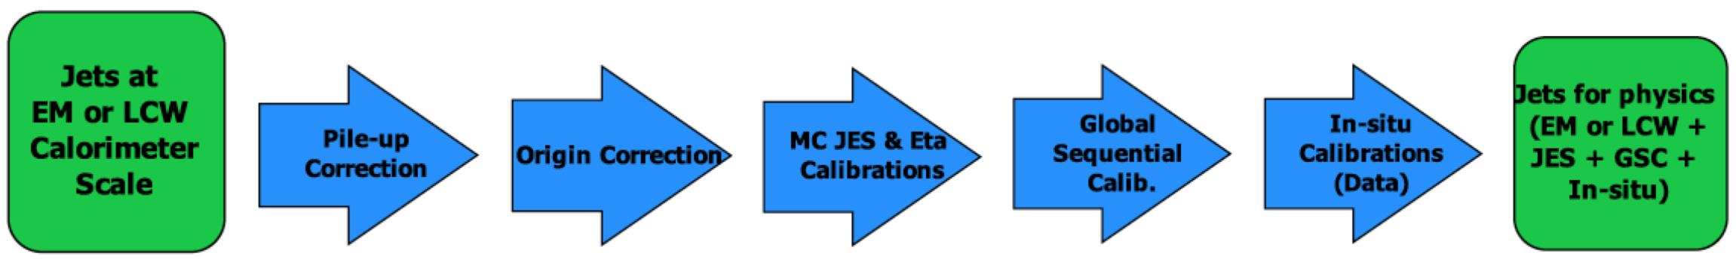
Jet Calibration in HLT
Apply as much as possible of offline jet calibration
Concentrate on steps leading to larger improvements
Essential:
  Pileup (jet area) subtraction and Jet Energy Scale: working
In progress/plans:
  Global Sequential Calibration: some factorizable steps possible
  Tracking-based steps may be possible but not yet addressed
Requires full event scan for energy density calculation
Requires full event tracking and pr. vertex
Calibration parametrized vs p_{T} & η
Requires full tracking & calo details(*)
Calibration parametrized vs p_{T} & η
Peter Sherwood, Nuno Anjos

Slide 19
Key
Jet Algorithm:
  a4 = anti-kt jet finding algorithm with R parameter of 0.4
  a10 = anti-kt jet finding algorithm with R parameter of 1.0
Input objects used for jet finding:
  tc = TopoClusters reconstructed from calorimeter cells
  TT = Level 1 TriggerTowers read out in HLT to allow fast but coarse full calo scan (a.k.a. Level 1.5)
Calorimeter scan:
  PS = partial calorimeter scan seeded by L1 RoI or L1.5
  FS = full calorimeter scan (default)
Pseudorapidity range:
  xxETAyy = jets in interval xx < |η| < yy – default is 0eta32 (old central jets)
Cluster Energy Scale correction:
  em = no weights applied
  lcw = local cluster weighting
Jet Energy Scale correction:
  jes = JES calibration factors without pileup subtraction
  sub = pileup subtraction applied but no JES factors
  subjes = both pileup subtraction and JES factors
Some possible combinations:
  a4tcem = jets built from EM-scale clusters with no jet level calibration
  a10tcemsubjes = jets built from EM-scale clusters with pile-up subtraction and jet-level calibration
  a10TTem = jets built from TriggerTowers with no jet level calibration
  a4tclcwsub = jets built from LC-scale clusters with only a pile-up subtraction applied at the jet level
  a10tclcw_PS = jets built from LC-scale clusters found in a SuperRoI seeded by all L1_Jx items

Slide 20
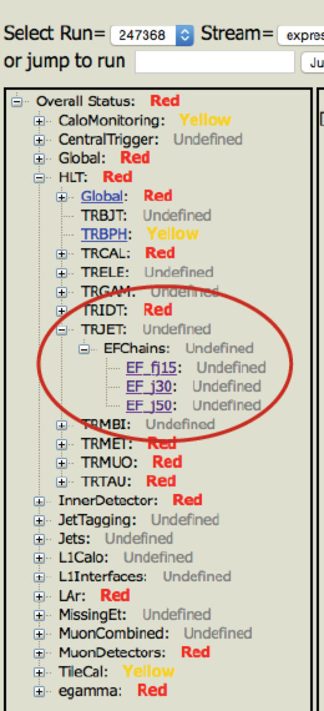
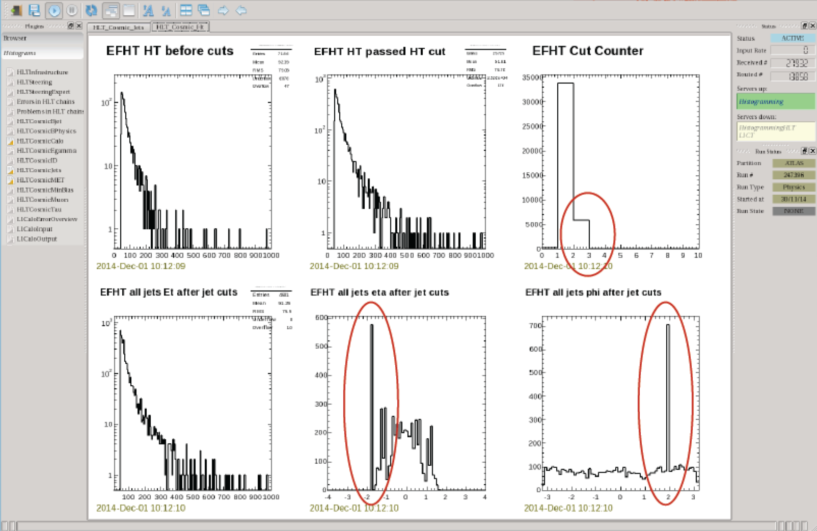
Commissioning so far…
Running jet chains since M5
  j0 seeded from MU10, J10, RD0; ht from J10; no hypo
Online monitoring working
  Improvements following experience from M weeks
Offline monitoring now working as well
Also allowing us to train team of experts
Lee Sawyer, Sebastien Prince, Aparajita Dattagupta

Slide 21
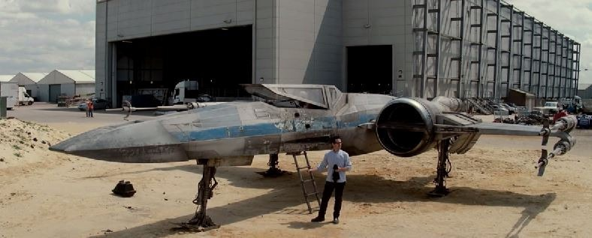
Conclusions
Big changes in Jet Trigger for Run II
Baseline plan:
  Trigger Tower full scan to reduce input rate
  Full calorimeter scan – Partial Scan as plan B
  Jet area subtraction and as much as possible of offline calibration
Long road to get here – but main features working
  Much room for improvement! Volunteers (very) gladly accepted!

Slide 22

Bonus slides

Slide 23
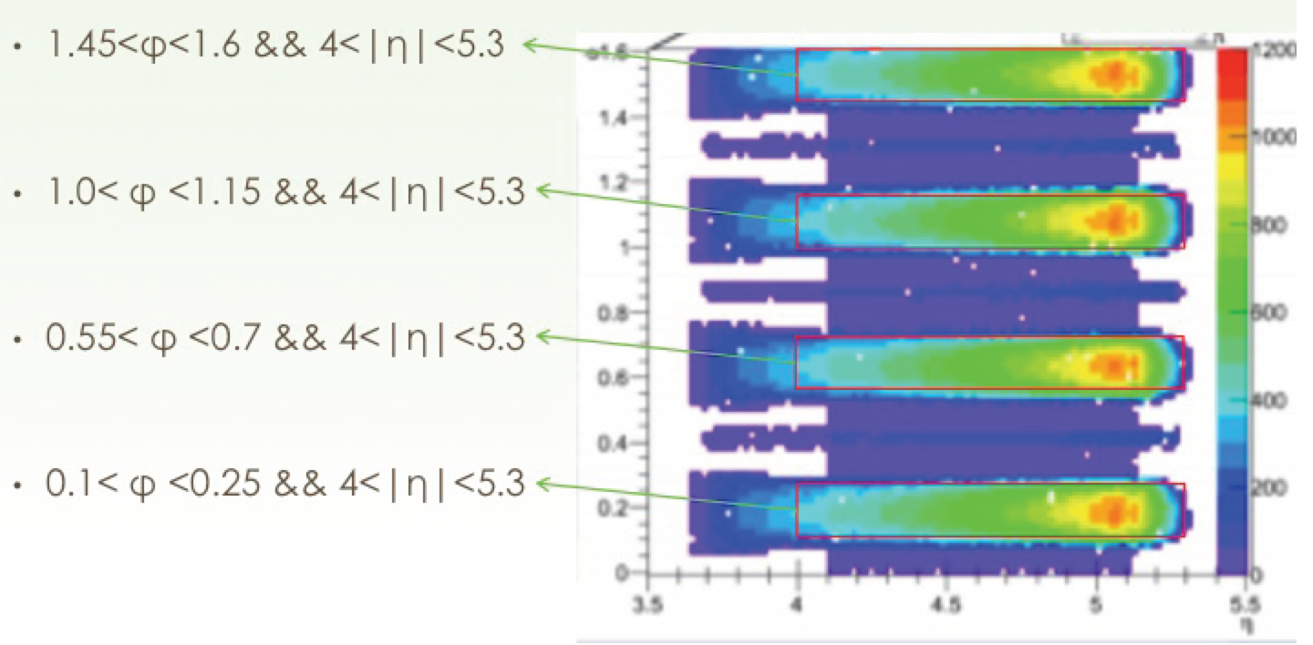
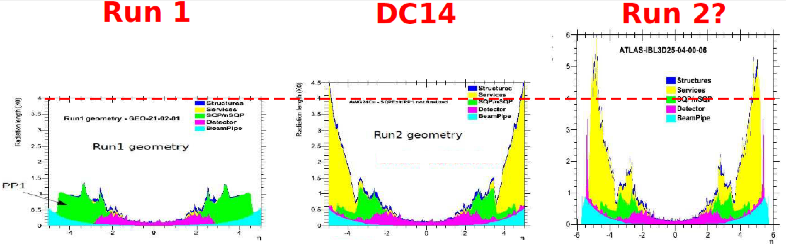
Specific issues – Jet calibration data
Very important to collect enough data early on for offline jet calibration
Forward region and intercalibration
Even more important due to added material from IBL
  Need ≈x16 increase in forward region
Eta=4

Slide 24
L1 Proposal
Item | 0.5 x 10³⁴ | 1.0 x 10³⁴ | 1.5 x 10³⁴ | 2.0 x 10³⁴
L1_XE35 | 32 kHz | 64 kHz | 96.6 kHz | 128.8 kHz
L1_XE40 | 19 kHz | 38.3 kHz | 57.5 kHz | 76.7 kHz
L1_XE50 | 5.7 kHz | 11.3 kHz | 17 kHz | 22.6 kHz
L1_XE60 | 2.1 kHz | 4.3 kHz | 6.4 kHz | 8.6 kHz
L1_XE70 | 1.6 kHz | 3.2 kHz | 4.8 kHz | 6.3 kHz
 | 50 ns run 1/fb | 25 ns run 5/fb | 25 ns run 9/fb
Rates from menuFastTopo.py

Slide 25
L1 Proposal
Cannot add L1_KF-XE at this point to the menu, since simulation not ready; propose duplicate menu with similar thresholds
Proposed Evolution Pattern for unprescaled chains
Item | 0.5 x 10³⁴ | 1.0 x 10³⁴ | 1.5 x 10³⁴ | 2.0 x 10³⁴
L1_XE35 | 35.3 kHz | 70.7 kHz | 106.0 kHz | 141.3 kHz
L1_XE40 | 21.2 kHz | 42.3 kHz | 63.5 kHz | 84.6 kHz
L1_XE50 | 6.1 kHz | 12.2 kHz | 18.3 kHz | 24.4 kHz
L1_XE60 | 2.2 kHz | 4.3 kHz | 6.5 kHz | 8.6 kHz
L1_XE70 | 1.4 kHz | 2.8 kHz | 4.1 kHz | 5.5 kHz
 | 50 ns run 1/fb | 25 ns run 5/fb | 25 ns run 9/fb
Rates from menuFastL1Calo.py
Foreseen rate at L1: ~ 6 kHz (3.5 kHz unique)

Slide 26
HLT Proposal
XE rates from menuFastTopo.py & menuFast.py differ a lot (factor of 10 not uncommon)
Item | 0.5 x 10³⁴ | 1.0 x 10³⁴ | 1.5 x 10³⁴ | 1.5 x 10³⁴
 | L1_XE50 | L1_XE60 | L1_XE60 | L1_XE70
HLT_xe70 | x | x
HLT_xe80 | x | x | x
HLT_xe90 |  | x | x | x
HLT_xe100 |  |  | x | x
 | 50 ns run 1/fb | 25 ns run 5/fb | 25 ns run 9/fb | 25 ns run 9/fb
EM scale cuts;
mht & tclcw should
be higher
Contingency &
learning from early
data taking

Slide 27
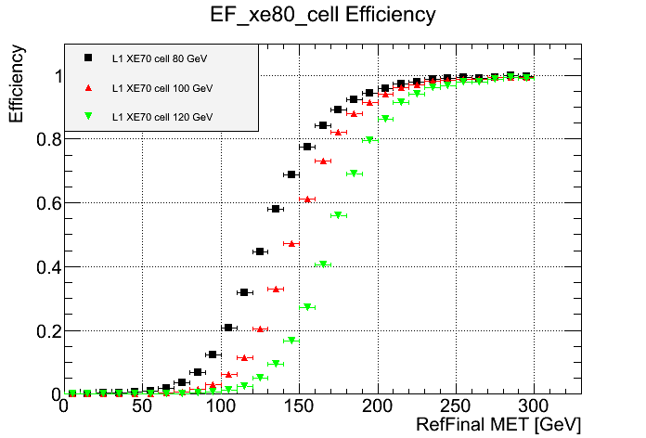
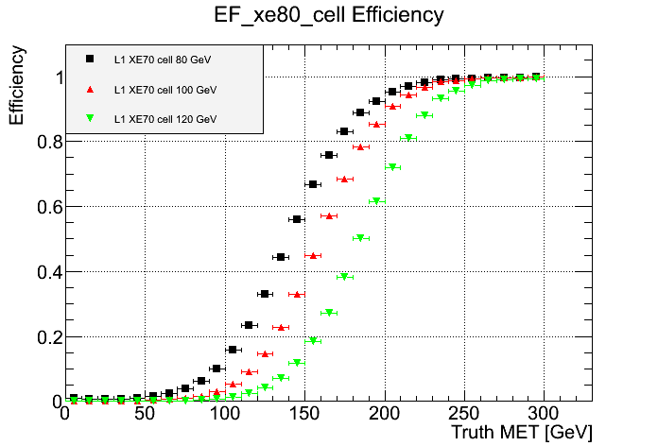
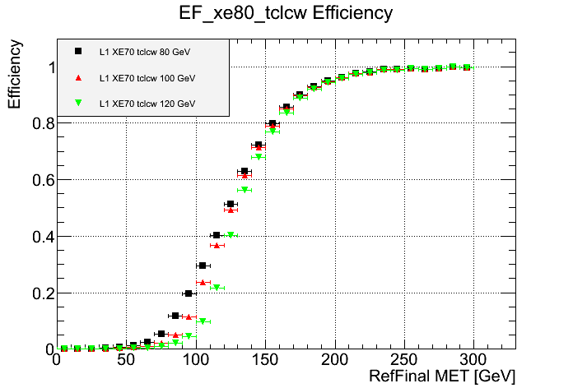
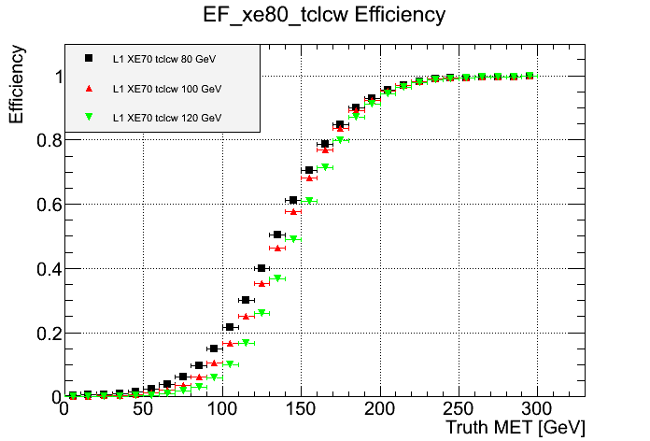
Turn-on curves for L1_XE70 & HLT_xe_tclcw & cells

Slide 28
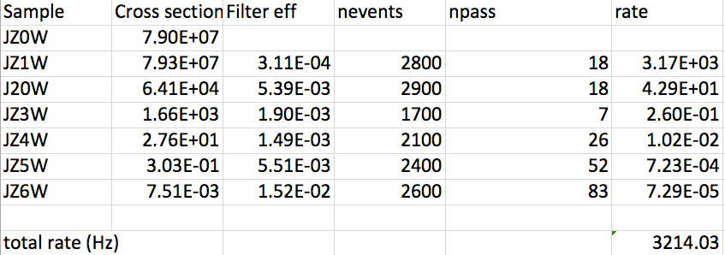
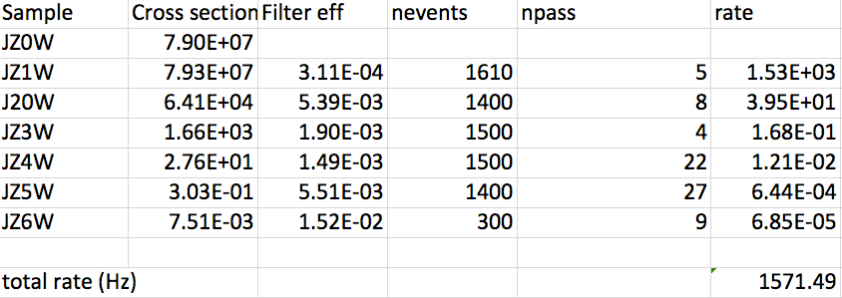
Bonus: rates with pileup correction
Erich Varnes
Conditions:
  L=2x10³⁴
  4j45 rate
  No event weighting
Only fixed ρ=6 here
ρ calculation works in private code so far
Top: no areas subtraction
Bottom: with ρ=6 area subtraction

Slide 29
Pile-up subtraction: rho
Requires full event topoclusters for rho calculation

Slide 30
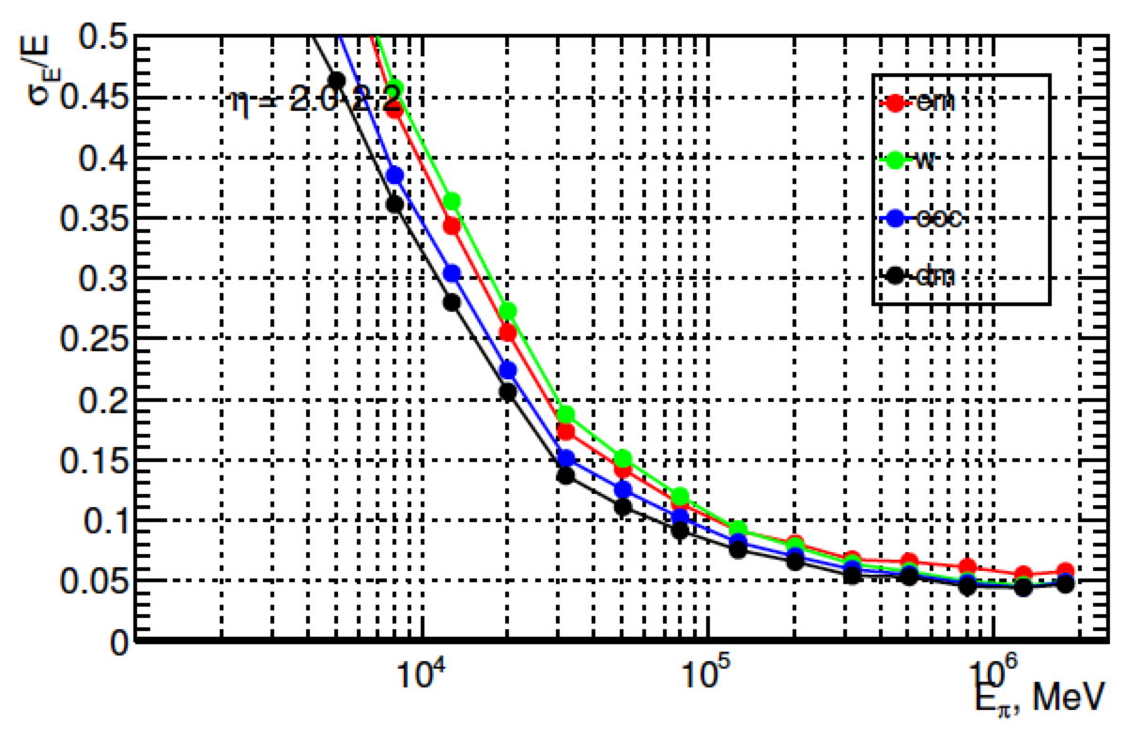
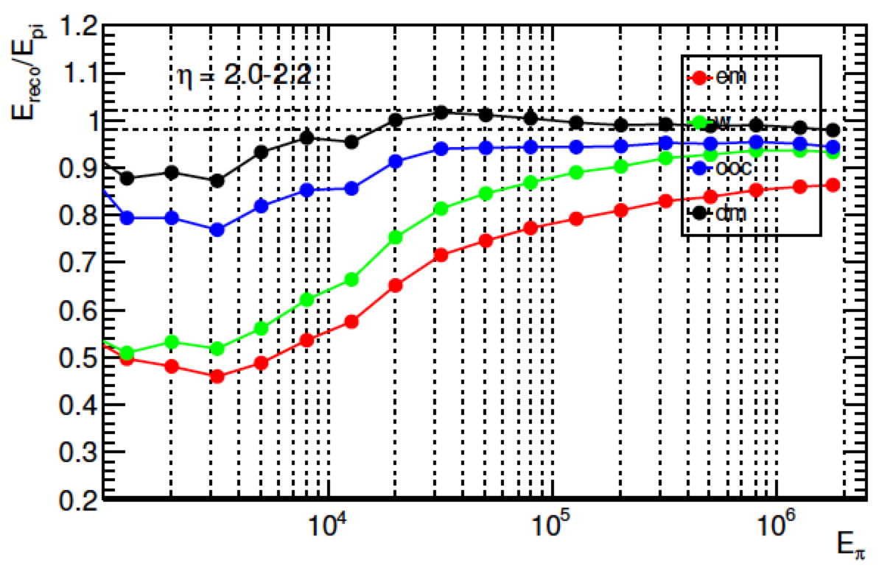
Cluster Calibration
Sven Menke
Resolution and linearity improvement for charged pions after each correction:
  EM
  LCW
  Out of cluster
  Dead material
Conditions:
  <μ>=0
  IBL geometry
  2<|η|<2.2
  4 samplings

Slide 31
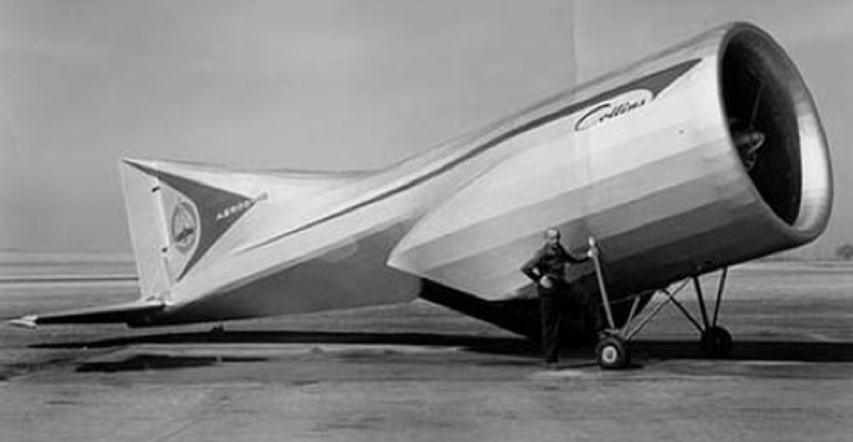
L1Topo, Fat Jets, et al.
L1Topo allows to cut on complex quantities using L1 objects
Example here:
  Optimization of fat-jet L1 seed
  HTC: E_{T} sum of all jets with E_{T}>20GeV within |η|<2.5
Several other studies, like:
  HT trigger for stop searches
  Fat-jet trigger for VV->jj
  Razor triggers for resonances decaying to jets+invisible particles
UBA (Devesa, Reisin, Otero, Piegaia)

