Slide 1
New Trigger Effort at RHUL
Royal Holloway students have started to contribute to the trigger:
Daniel Hayden – e/gamma outliers in first data
Clive Edwards – Optimization of L2 electron candidates found by TrigElectronFex
Matthew Rose – HLT code cleanup

Slide 2
e/gamma Outliers with First Data
Dan Hayden
Looking for problematic e/gamma candidates in first beam data
Take all Good Runs in the L1CaloEM stream for 900 GeV Run (Now re-doing with 7 TeV Data)
Compare E_{T} reconstructed at the different Trigger Levels: L1 vs L2, L1 vs EF, and L2 vs EF
Work done together with Matthew Tamsett, who did L# vs Offline
Investigate events > 3 sigma away from the mean of the pseudo resolution distribution e.g. (L1et - L2et )/ L2et
Group outliers into "families" of known problems when possible
Look for any events which cannot be explained!
Work contributed to TrigEGamma COM Note:
https://svnweb.cern.ch/trac/atlasgrp/browser/Trigger/EgammaTrigger/2009CollisionNote/TrigEgamma2009CollisionNote.pdf

Slide 3
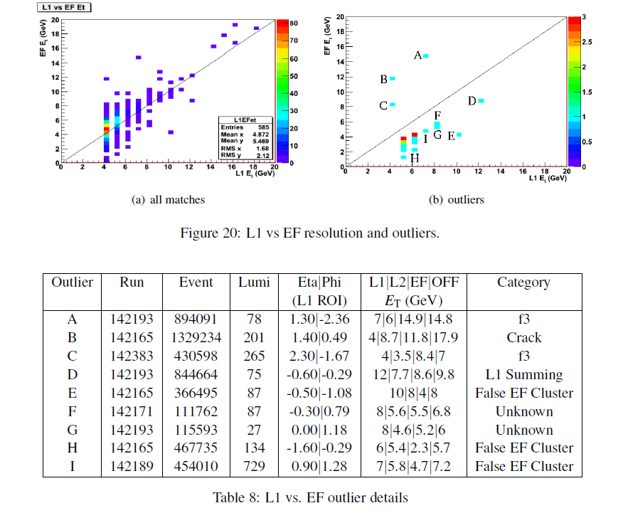
Dan Hayden

Slide 4
Clive Edwards

Slide 5
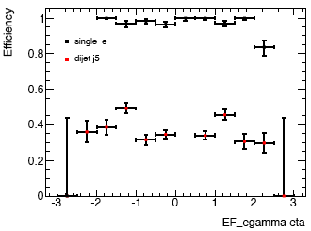
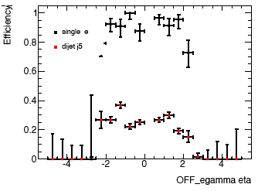
Initial results
Clive Edwards
Very much “work in progress”
Currently finding the best way to measure performance
Must compare TrigElectrons to electron candidates found at both EF and offline
Must be able to maintain/improve trigger efficiency and rate while improving purity of TrigElectrons built by FEX

Slide 6
Trigger Software Cleanup
Matt Rose
Trigger code needs to cope with strict constraints of execution time, memory allocation and memory leaking
Matt’s task is to improve the trigger code according to the rules described in:
https://twiki.cern.ch/twiki/bin/view/Atlas/TriggerCodingGuidelines
Applying the guidelines retrospectively to trigger code, thus:
Ensuring that it builds without errors or warnings on all platforms
Improving general coding practice in order to make the code build faster
Aim for code to crash less often, run more efficiently and report errors in a clearer way
The work has started and is ongoing

