Slide 1
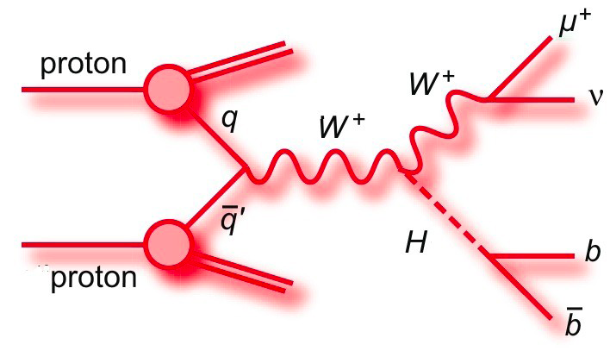
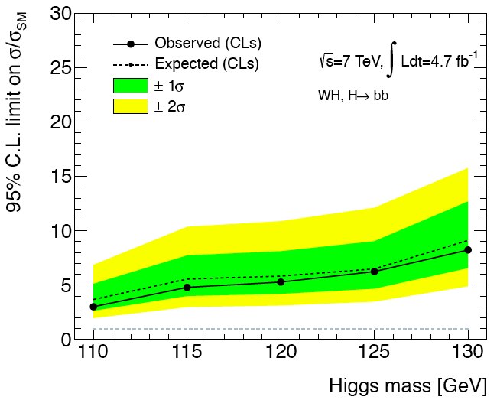
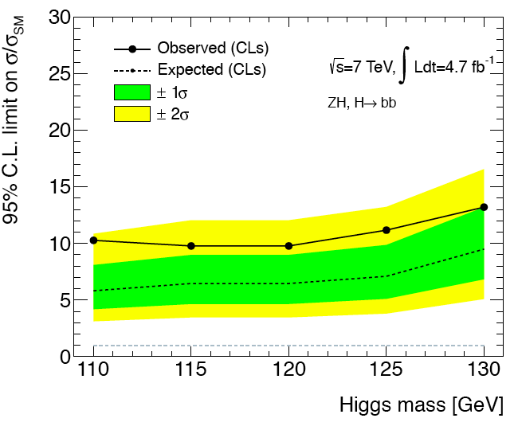
H->bb Status and Plans
Difficult analyses!
But important to add much needed sensitivity
Later will be essential for measuring Higgs properties
Several strands of activity:
Inclusive analyses:
WH->lνbb/ZH->llbb
1st LHC H->bb results (1fb⁻¹) made public for EPS 2011
ZH->ννbb
1st ATLAS results to show at Moriond
ttH, H->bb
first data-based results obtained Jan.2012
VBF H->bb
Jet-substructure analyses:
Novel technique, difficult and yet unproven
First W mass plot shown in EPS 2011
WH/ZH – note in preparation
Z->bb – calibration channel – promising results!
WH->lνbb
Extremely preliminary
ZH->llbb

Slide 2
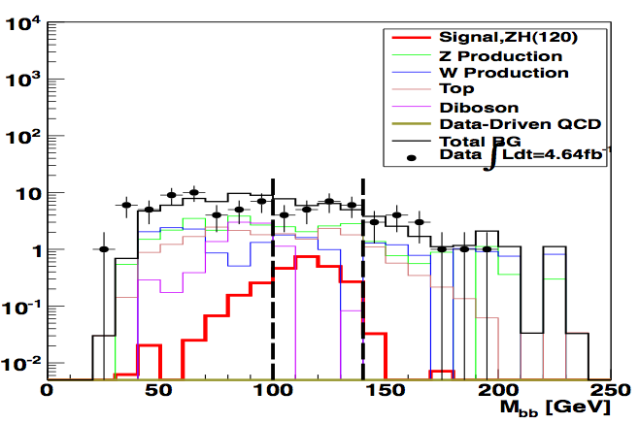
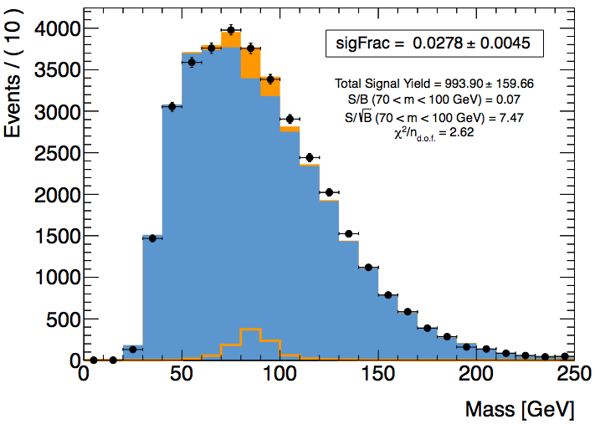
H->bb Status and Plans
Current plans for Moriond:
Publication on inclusive WH/ZH
Advanced stage – paper draft being circulated to Higgs group today
Aim to contribute to 2011 ATLAS + CMS combination
Include ZH->ννbb
Longer-term plans:
Improve sensitivity of course!...
For Summer (ICHEP etc) and later:
Merge sub-jet and inclusive analyses – jet substructure may improve highest p_{T}(H) bin of inclusive analyses
Multivariate techniques - ongoing
New channels: ttH, VBF H->bb, boosted gg->H?
Add new 2012 data!
Analyses depend crucially on good performance:
Trigger
Jet, MET, b-tagging trigger crucial for for several analyses: VBF, Z->bb
Looking into possibility of using low-priority stream to keep lower-threshold events
B-tagging – lots of fruitful interaction with H.F. group
Jet reconstruction – to be strengthened
Pileup rejection
ZH->ννbb

