Slide 1

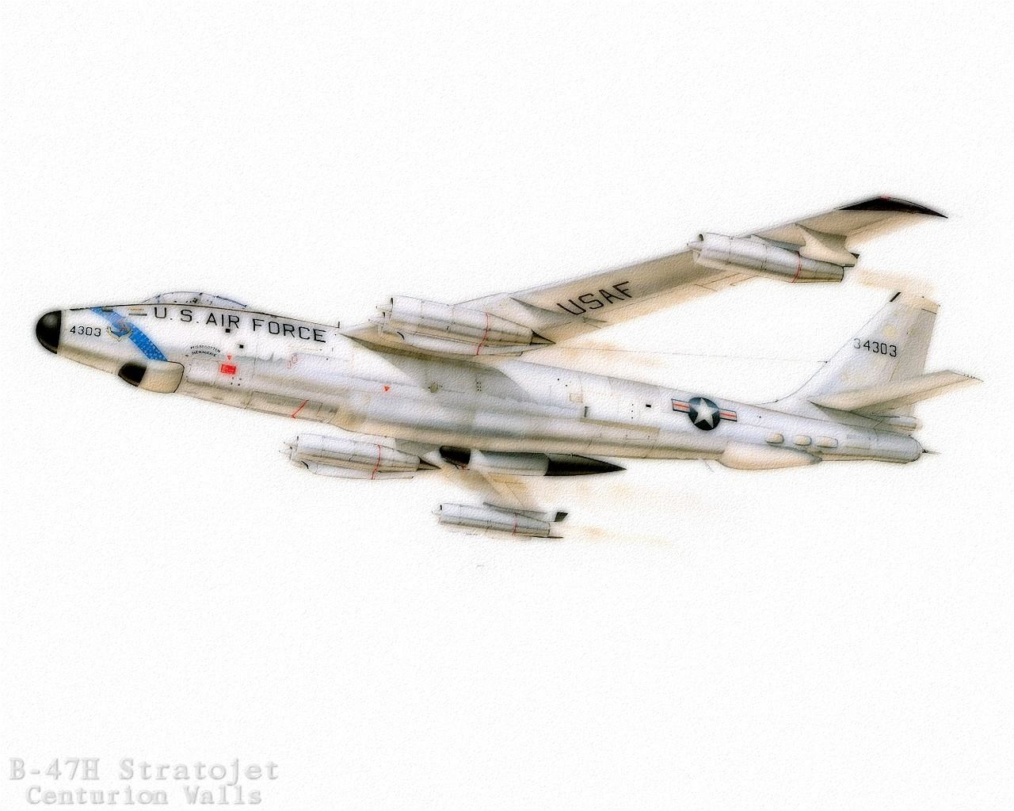



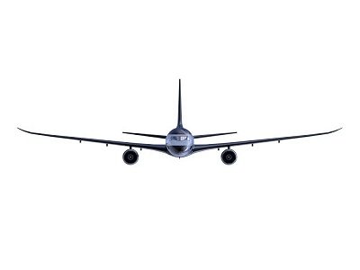
Higgs & Jets
Ricardo Gonçalo (RHUL)
on behalf of the ATLAS Higgs Working Group
ATLAS Hadronic Calibration Workshop – SLAC 19-23 September 2011

Slide 2
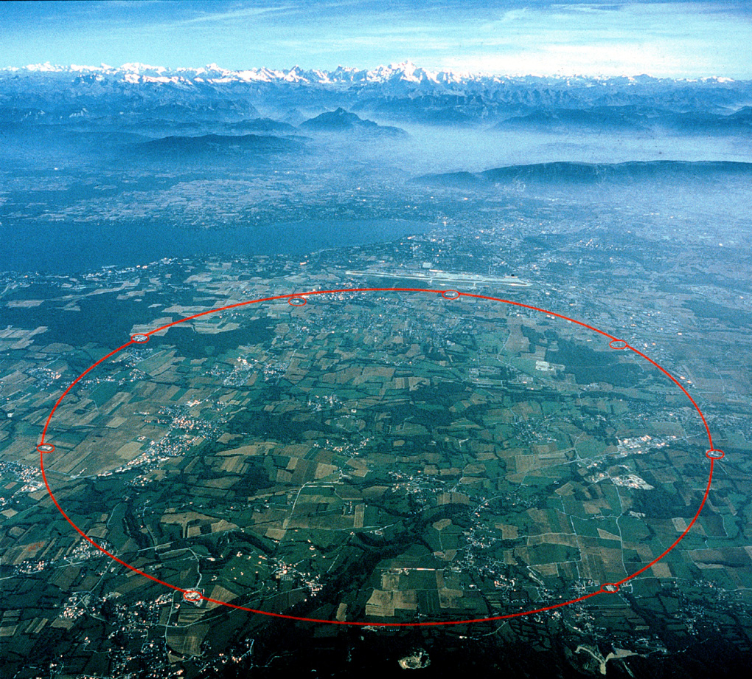
Outline
Recap and status of Higgs searches
Jet/E_{T}^{miss} performance issues – channel by channel
Jet energy scale/resolution and di-jet mass resolution
Pileup and Jet Vertex Fraction
Conclusions
Many thanks to: Marc Escalier, Taiki Yamamura, Andew Mehta, Paul Thompson Lianliang Ma, Bill Quayle, Martin Flechl, Liron Barak, Arnaud Ferrari, Daniel Pelikan, Alex Martyniuk, Konstantinos Nikolopoulos, Bill Murray, Eilam Gross

Slide 3


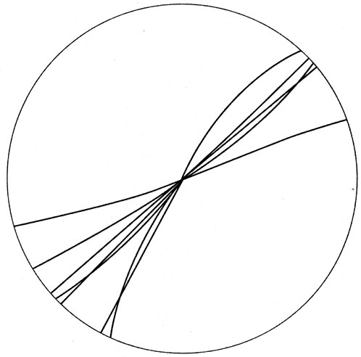
Disclaimer
JES
I may not be completely up to date on developments – I was offline for the last 2 weeks
All I tried was to give an idea of where the jet and E_{T}^{miss} performance matters most for Higgs analyses
  And so where improvements would be most beneficial
JVF
H->bb

Slide 4
Of all things Higgsy

Slide 5
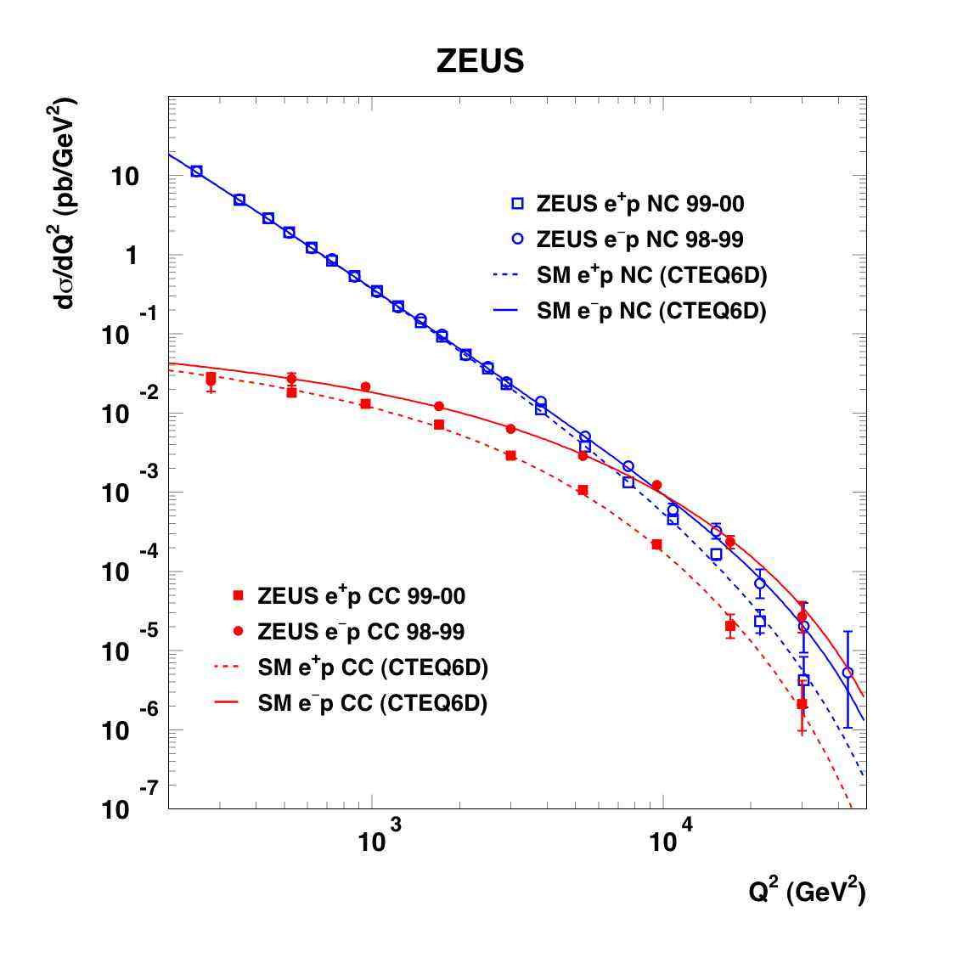
Why all the fuss?
Electroweak symmetry breaking/unification and the need to account for massive particles is clear from experimental data
The simplest model of electroweak symmetry breaking predicts one Higgs scalar – the boson mass is the only free parameter in this model
Without the Higgs boson, some cross section calculations would return wrong/un-physical results (W_{L}W_{L} scattering)
Z⁰/γ*
W±
http://www-zeus.desy.de/physics/sfew/PUBLIC/sfew_results/preliminary/dis04/

Slide 6
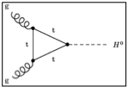
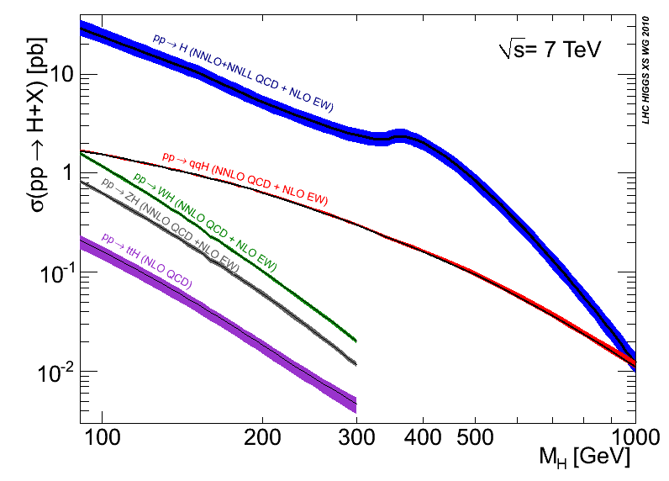
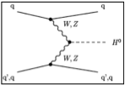
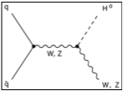
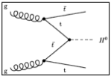
Higgs physics at the LHC: SM case
CERN-2011-002; arXiv:1101.0593
Disfavoured by EW precision fits
Excluded by LEP
Excluded by Tevatron
Notes:
Main production channels: gluon fusion, Vector Boson Fusion, associated production with vector bosons, associated production with ttbar pair
Animation

Slide 7
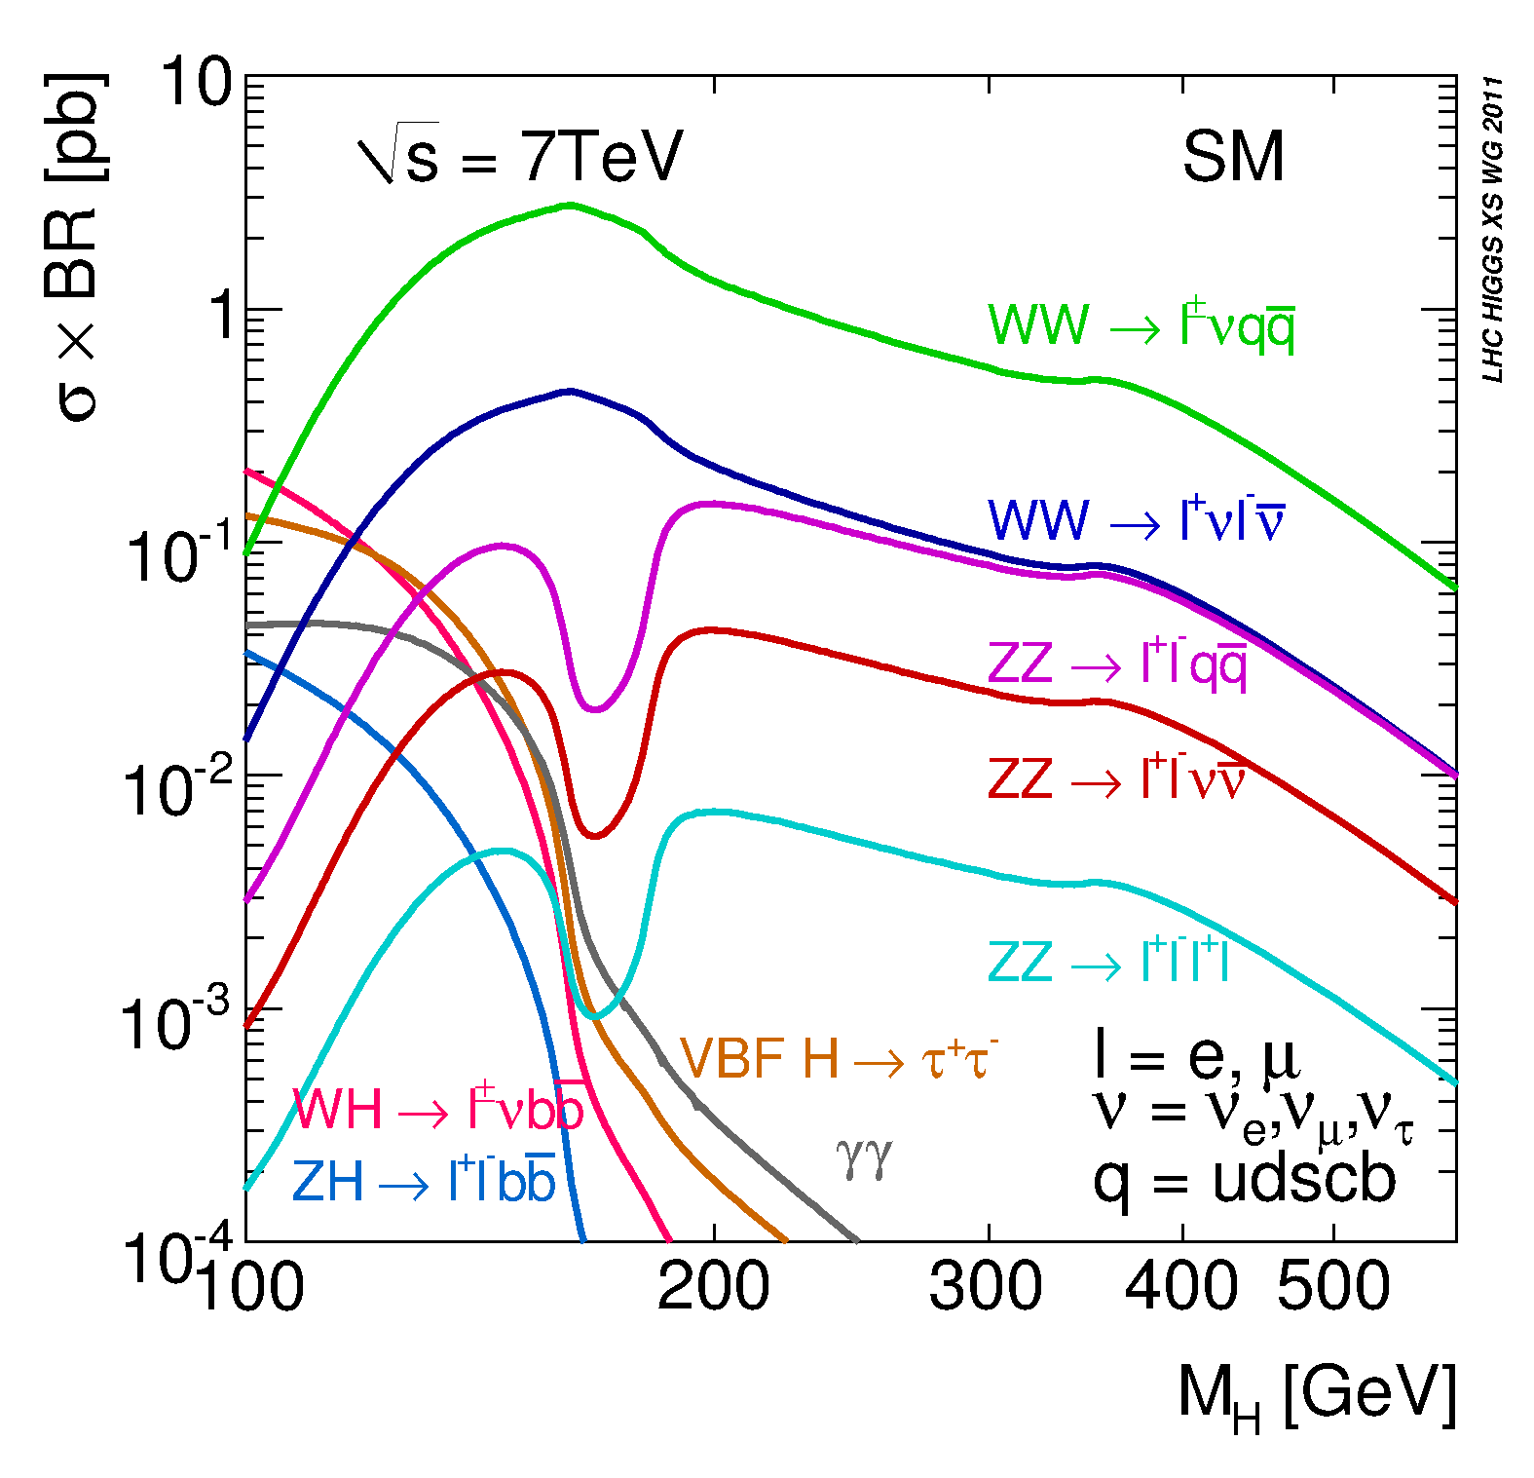
SM channels explored in ATLAS
H→γγ: rare channel, but the best for low mass
H→ττ: good signal/background, important at low mass, rare
Associated prod. H→ bb-bar
  ttH, WH, ZH
  Contributes to discovery
  Very important for Higgs property studies if SM Higgs is discovered
H→WW^{(*)}:
  →lνlν: very important in the intermediate mass range
  → lνqq: highest rate, important at high mass
H→ZZ^{(*)}:
  → 4l: golden channel
  → llνν: good for high mass
  → llbb: also high mass
Events expected with L=1 fb⁻¹:
m_{H}, GeV | WW→lνlν | ZZ→4l | γγ
120 | 127 | 1.5 | 43
150 | 390 | 4.6 | 16
300 | 89 | 3.8 | 0.04

Slide 8
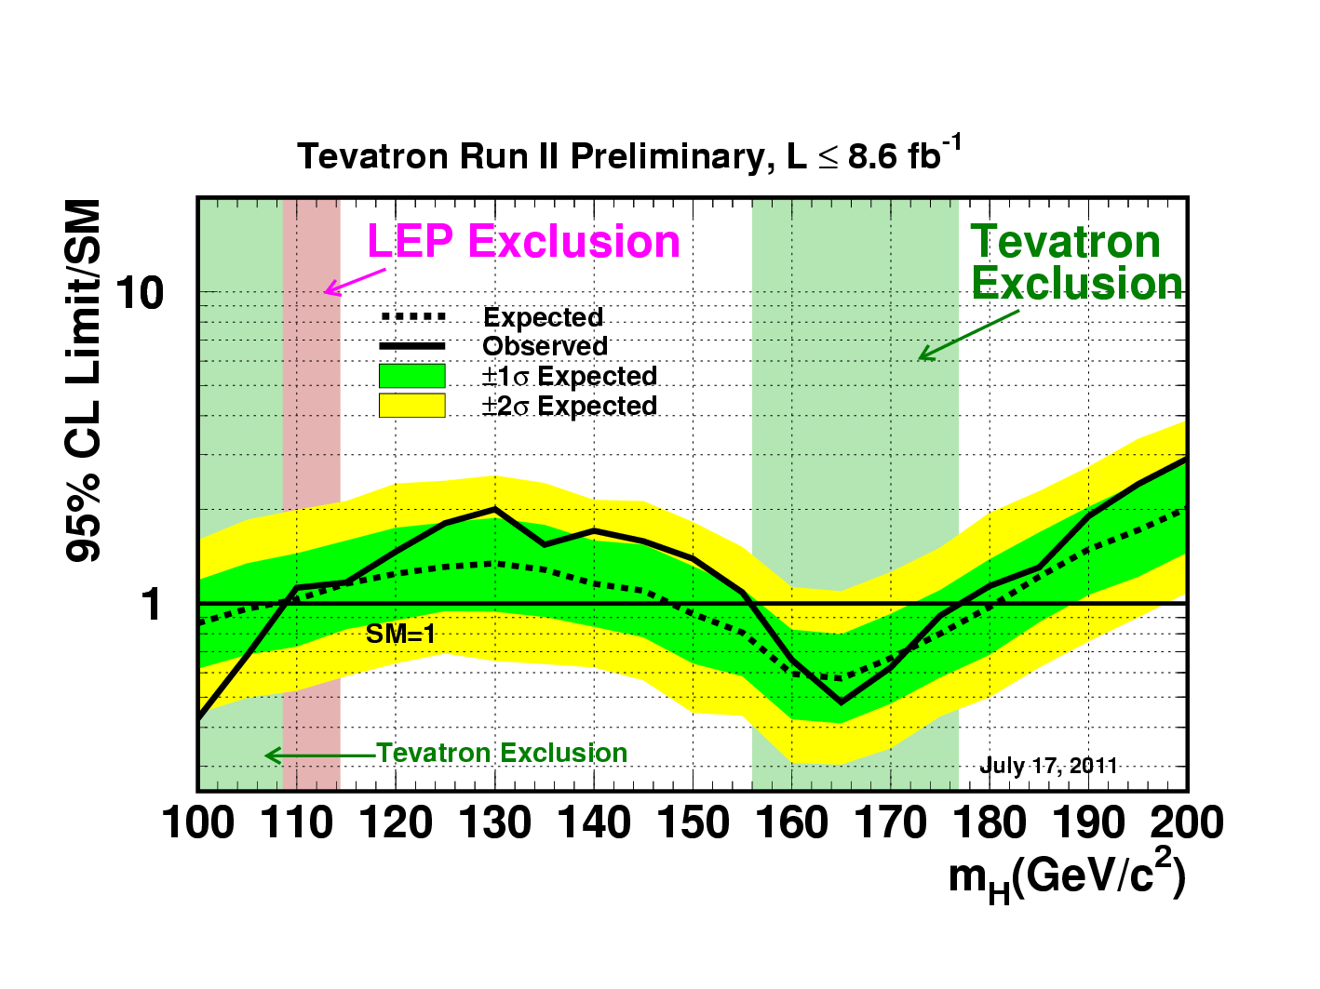
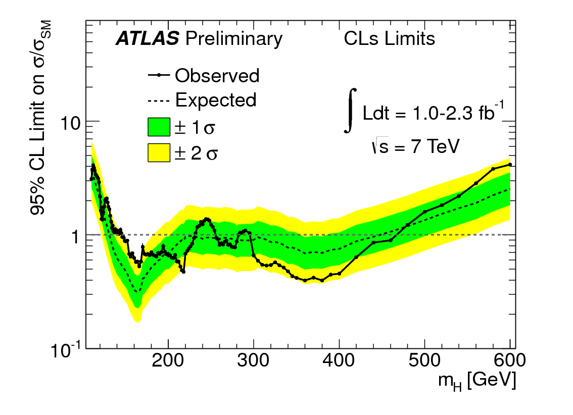
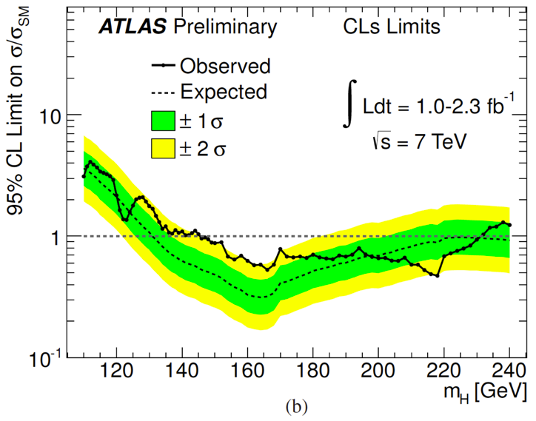
Where we are now…
115
130
140
Expected exclusion: 130 GeV – 440 GeV
Observed: 146 – 232, 256 – 282, 296 – 466 GeV
Similar for CMS: 145 – 216, 226 – 288, 310 – 400 GeV

Slide 9
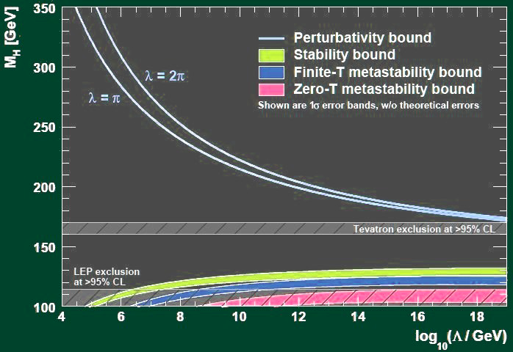
What next?
Likely to have sensitivity to exclude ≈125 GeV – 500 GeV until end of year!
End of Standard Model Higgs?
Or will we find something at low mass around 140 GeV?
Even if no SM Higgs, many scenarios of “beyond SM” Higgs mechanism – this was just the simplest case!
Electroweak symmetry breaking and particle masses will still be there – WHY?
To find the answer we rely on an excellent performance of all parts of ATLAS – Jet / ETmiss performance crucial!

Slide 10
Of Higgs and Hadronic calibration

Slide 11
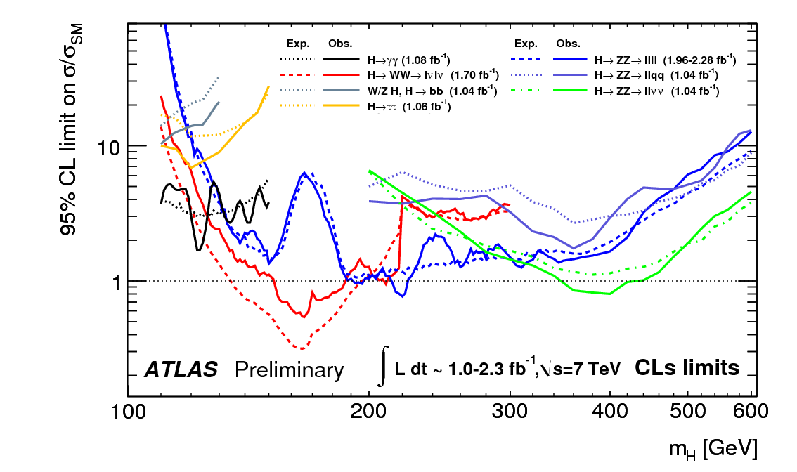
Where jet/E_{t}^{miss} really matters:
MET
B-jet
JVF
Jets
MET
JVF
Fwd jets
Jets
Fwd jets
MET
JES
MET
JES

Slide 12
H->γγ
H->γγ + MET starting to be studied – aiming at a confirmation channel if Higgs found at low mass
H->γγ + N jets (N = 0, 1, 2) being developed (standard analysis is inclusive H->γγ)
Ongoing mysteries:
  Addition of H->γγ + 2 jets has very small impact – under study
  Jet multiplicity not reproduced in background MC - using a reweighting procedure (below)

Slide 13
Status of H+2jets analysis
Event selection (example)
◆ 0jet-bin
◆ 1jet-bin
◆ 2jet-bin
(A) Pt(γ1)>40GeV,
(A) Pt(γ1)>40GeV,
(A) Pt(γ1)>40GeV,
Pt(γ2)>25GeV
Pt(γ2)>25GeV
Pt(γ2)>25GeV
(B) Pt(j1)>25GeV,
(B) Pt(j1)>40GeV,
|η(j1)|<4.5
Pt(j2)>25GeV
(C) M(γγj) > 250GeV
(|η(jet)|<4.5)
-1
Expected limit (1.08fb )
・ Very loose selection
Improved by ～10%.
for 2 jet-bin at present,
@95%C.L.
in order to obtain
σ*Br(H→γγ)/SM
sufficient statistics.
Inclusive
・ Optimization is not yet
H+0/1/2jets
finalized.
mH (GeV)

Slide 14
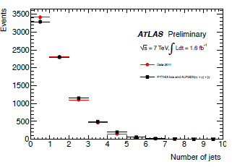
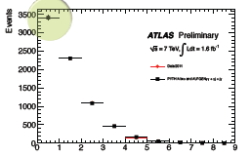
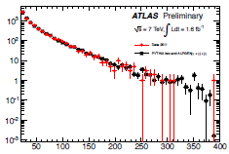
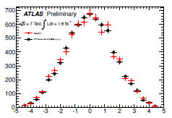
Jet distributions
-1
(after inclusive selection, 1.6fb )
◆ data/MC comparison
・ By applying the reweighting w.r.t N(jet), basic
＜N(jet)＞
distributions for jets are in good agreement
data
between data and MC.
MC
・ Detailed studies are not yet done…
(NLO effect, pileup effect etc.)
Apply reweighting
to MC w.r.t. N(jet)
＜N(jet)＞
＜pT(jet)＞
＜η(jet)＞
data
data
data
MC
MC
MC

Slide 15
H -> bb
Two channels: WH and ZH
  Obviously very dependent on jet reconstruction performance
  Both analyses use E_{t}^{miss} for cut or veto
Analyses select good W or Z and then search for Higgs in m_{bb} spectrum
  ZH relatively clean, but lower xsection
  WH has twice higher xsection but also higher backgrounds
    In particular, 3-jet bin dominated by ttbar
    Need to cut on number of jets => need JVF
CMS has published better H->bb results than us (although later ;-)
  The difference mostly from better optimized analyses and the inclusion of ZH->ννbb
  But there are hints of differences in performance:
    Better di-jet mass resolution using energy-flow jets (and higher-p_{T} jets)
    More agressive JES and b-tagging uncertainties
    E.g.: similar systematics except JES (1%) and b-tagging (10%) – 9% and 16% for us, respectively (note this is partly due to higher jet p_{T} cut)

Slide 16
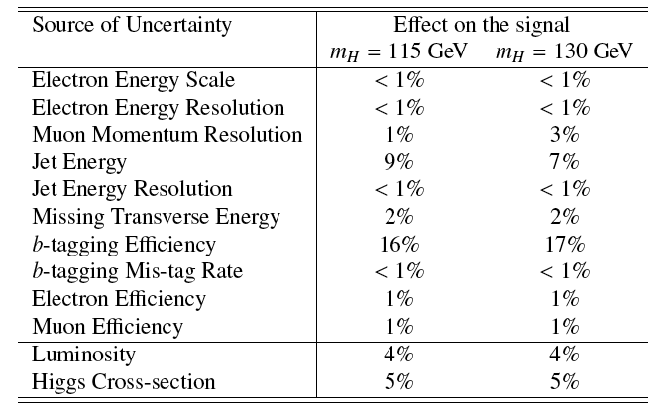

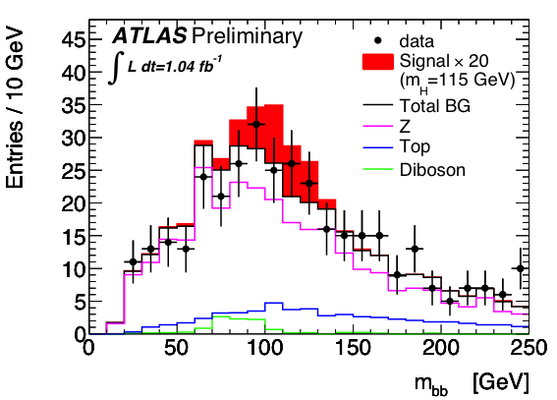
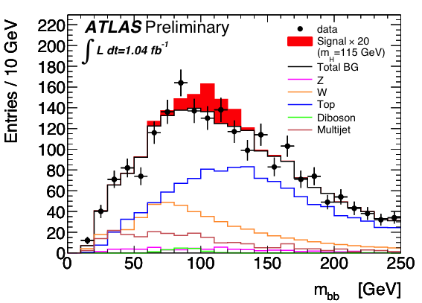
M(bb) spectra and systematics
ZH➝llbb
WH➝lνbb

Slide 17
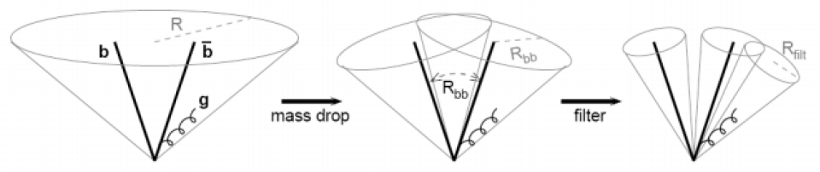
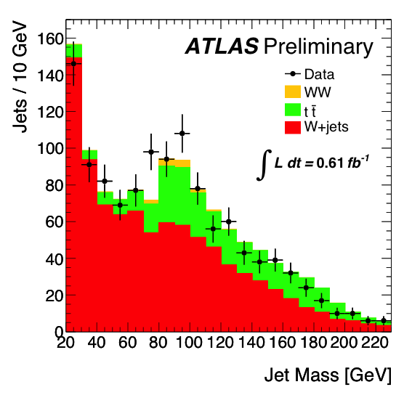
Alternative to inclusive channels: search for high-pT Higgs to bb:
  J. M. Butterworth, A. R. Davison, M. Rubin, and G. P. Salam, Phys. Rev. Lett. 100 (2008) 242001, arXiv:0802.2470 [hep-ph]
p_{T}^{H} > 200GeV ≈ 5% of inclusive cross section but improved significance
Select W➝lν events and search for a H➝bb jet
  Search for high-p_{T} jet (Cambridge-Aachen algorithm, R=1.2)
  Search jet clustering history in reverse and look for large mass drop
  Re-cluster with small R parameter to find sub jets
Peak consistent with W➝jj in tt events
Proof of principle for future jet substructure analysis
See talk by Adam Davison next

Slide 18
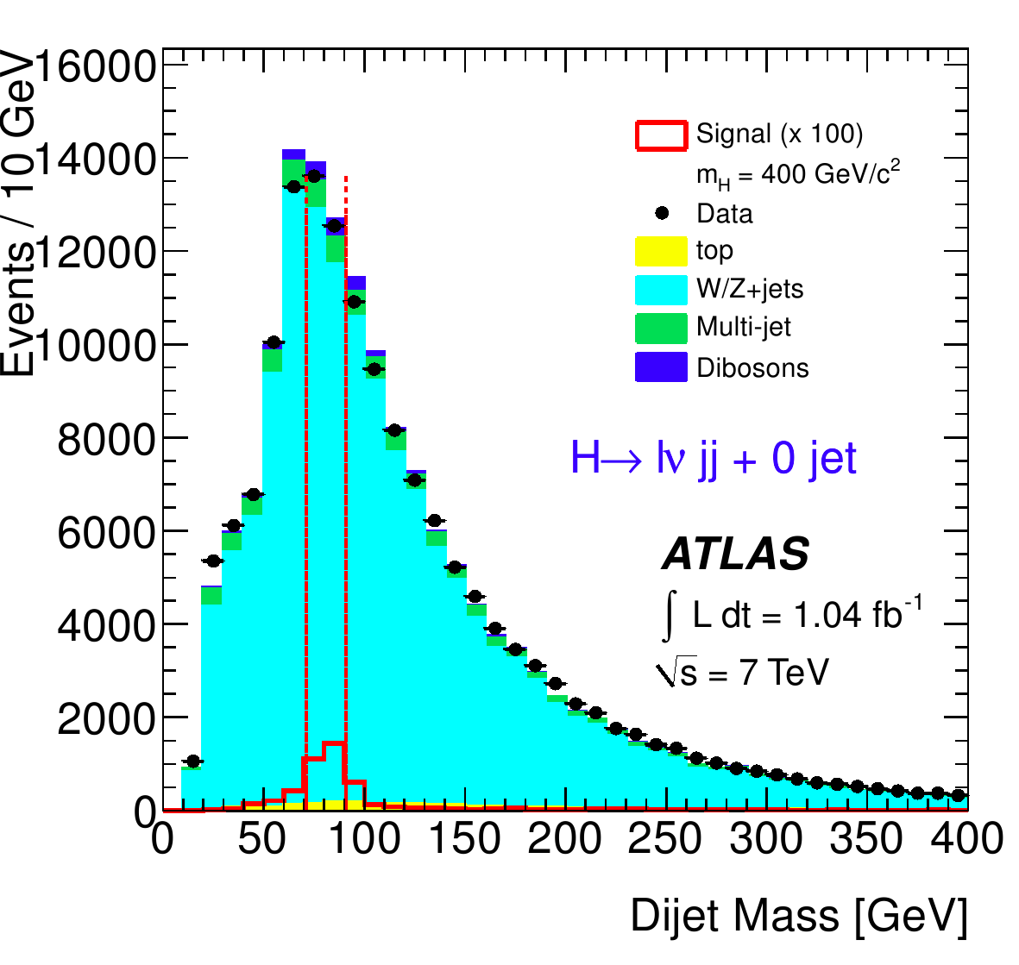
Jets in H→WW→lνqq
JES uncertainty enters the signal efficiency systematic via
  Tight cut on the invariant mass of the W→qq candidate (see plot)
  Missing E_{T} measurement
Large JES systematic uncertainty: ≈17%
Note: the background uncertainty is not a big issue in this analysis, since the background comes from a fit

Slide 19
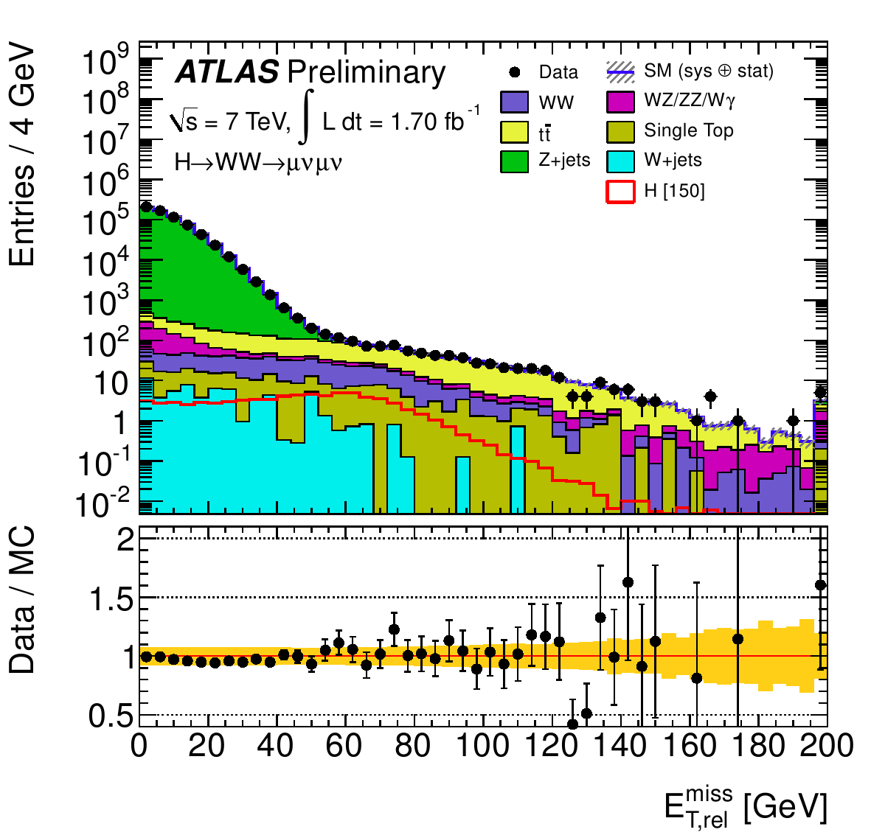
Jets in H→WW→lνlν
Events are binned in jet multiplicity (H+0j and H+1j), but jets are not used for reconstruction of masses, etc
Jet uncertainties affect migration between jet bins
Control samples attempt to mitigate effect of jet systematics on the background estimates
Jet calibration can affect the MET, and a cut on MET suppresses the Z background by a large factor in this analysis
Pythia Z MC
(Analysis default is Alpgen)

Slide 20
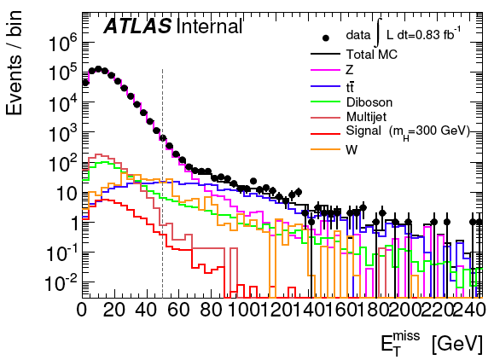
H -> ZZ -> llqq/llνν
Two relevant channels: H -> ZZ -> llqq and H -> ZZ -> llνν
H -> ZZ -> llqq
  Anti-k_{T} R=0.4 (EM+JES)
  p_{T}^{jet} > 25 GeV
  |η_{jet}|< 2.5
  |JVF| > 0.75
  E_{T}^{miss} < 50 GeV
  Calculation uses “signal” muons for MET
  muon term
  B-tagging used to create event categories
H -> ZZ -> llνν
  Anti-k_{T} R=0.4 (EM+JES)
  B-jet event veto
  p_{T}^{jet} > 20 GeV (25 GeV for b-tagged jet veto)
  |η_{jet}|< 4.5 (2.5 for b-tagged jet veto)
  E_{T}^{miss} calculation using only “signal” muons for MET muon term
    Cut threshold depends on Higgs mass hypothesis

Slide 21
H -> ZZ -> llνν/llqq
Impressions:
Pileup:
  Suppressing pileup is essential
    See e.g. joint jet-tracking meeting contribution on JVF: ttps://indico.cern.ch/getFile.py/access?subContId=3&contribId=1&resId=0&materialId=slides&confId=147426
E_{T}^{miss} reconstruction:
  Systematic uncertainty recipe seems to overestimate true uncertainty – MC/data agreement much better than estimated uncertainty
  Moving towards using METRefFinal in this analyses would be welcome (status?)

Slide 22
Going beyond the SM Higgs
In the MSSM, 2 Higgs doublets give 5 physical particles
  Three neutral: h, H (CP-even), A (CP-odd); two charged: H±
Important parameters: m_{A}, tan β = v1/v2
As tan β increases, Higgs decays to b quarks and tau leptons enhanced over vector bosons
Analyses below looking for charged Higgs – clear sign of new physics…
BR(h)
BR(A)
BR(H±)

Slide 23
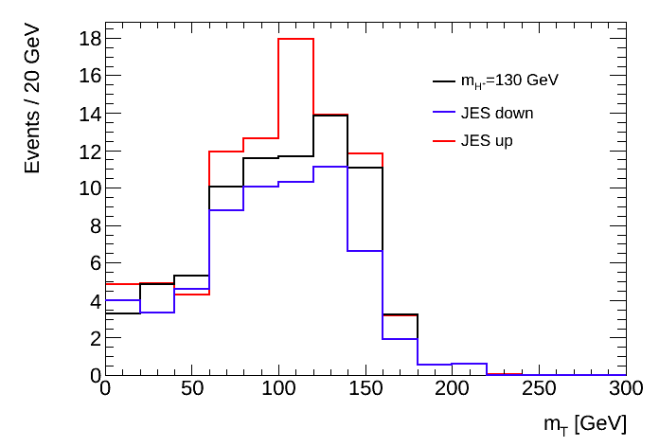
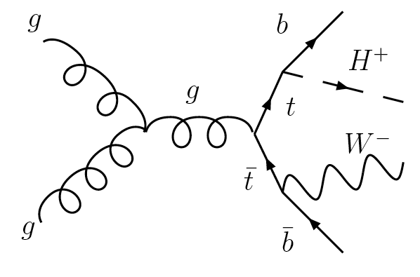
H⁺ -> τ_{had}ν
τ⁺
ν
j
j
Production channel: tt -> bWbH⁺ -> bqq bτ_{had}ν
Final discriminant: transverse mass m_{T}(τ+MET)
Jet Energy Scale systematic uncertainty up/down variation
Shows strong dependence

Slide 24
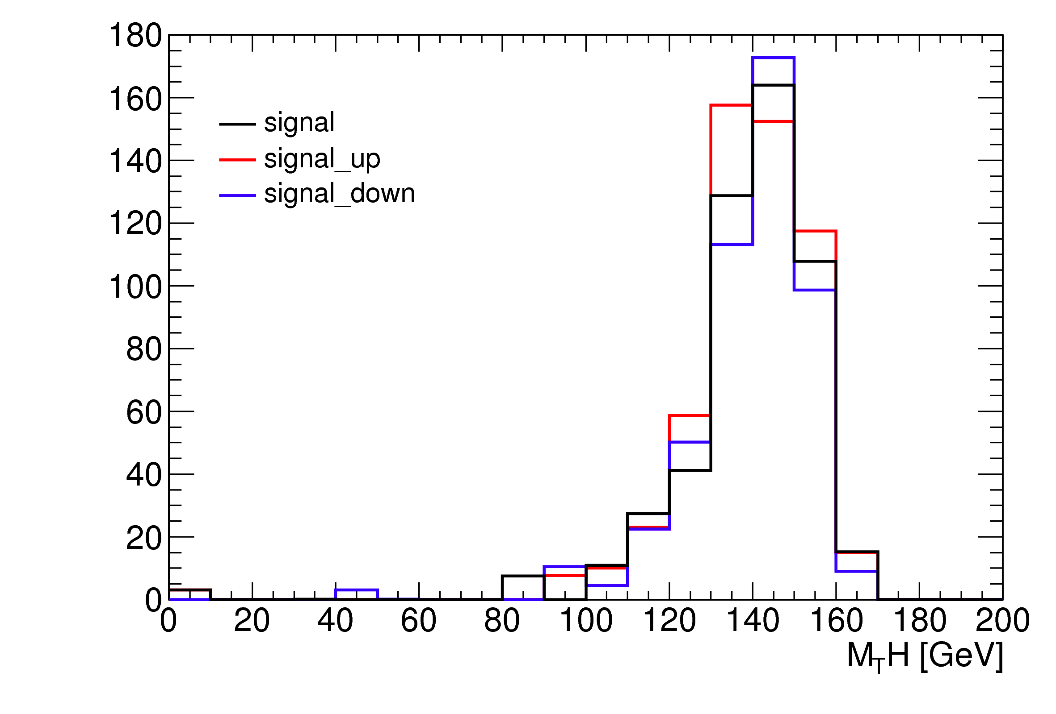
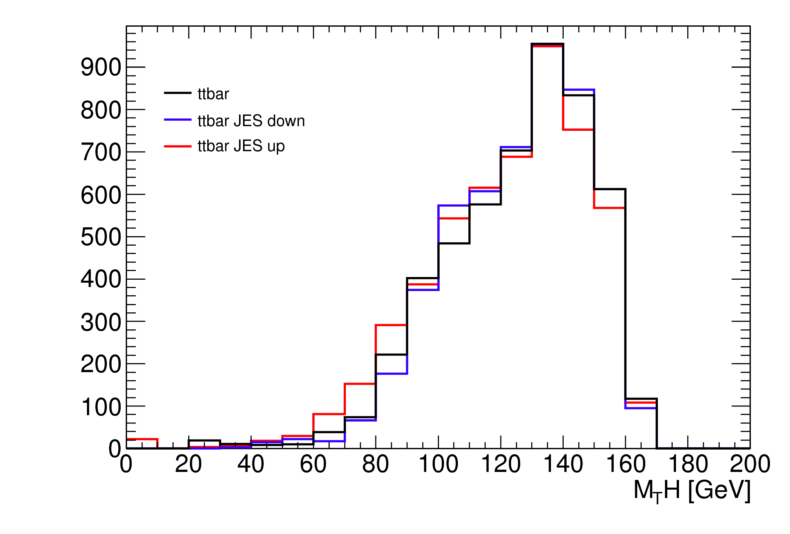
H⁺ -> τ_{lep}ν hadronic top channel
Production channel: tt -> bWbH⁺ -> bqq bτ_{lep}ν
Jet Energy Scale systematic uncertainty up/down variation
Left: signal 130 GeV, right: dominant background ttbar
Final discriminant: generalized m_{T}(H⁺)

Slide 25
Jet Energy Scale and Jet Resolution

Slide 26
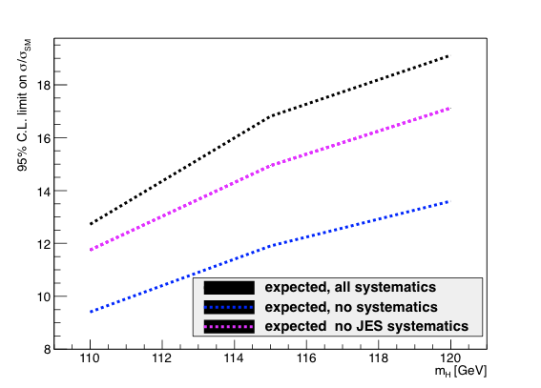
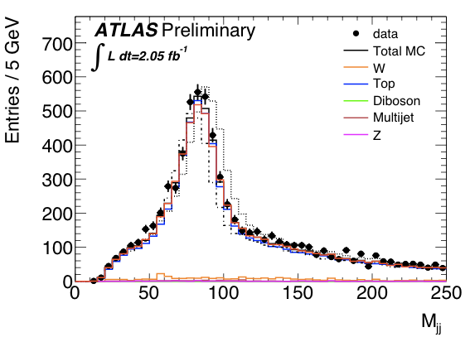
Jet energy scale
Top:
mjj for W->jj in top events
Cuts used: pTjet > 25 GeV, η < 2.5
The JES uncertainty seems overestimated
Bottom:
Effect of JES uncertainty on WH->lνbb analysis expected limit (1fb-1)
Note CMS quote 1% rather than our ≈7%
B-tag efficiency systematic is still dominant (≈16%) – can we improve on it?

Slide 27
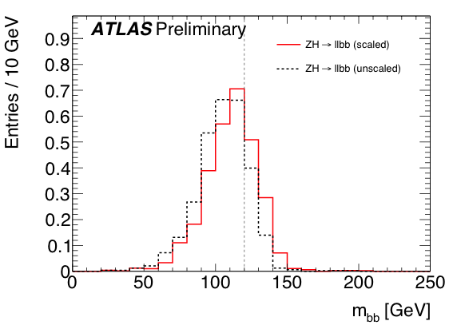
B-jet energy scale
H->bb Monte Carlo
Dashed line shows JES-corrected m_{bb} peak
B-jet energy scale set through p_{T}-dependent scale factor
Used in WH/ZH->bb and H->ZZ->llqq analyses
Not perfect, can still be improved!…

Slide 28
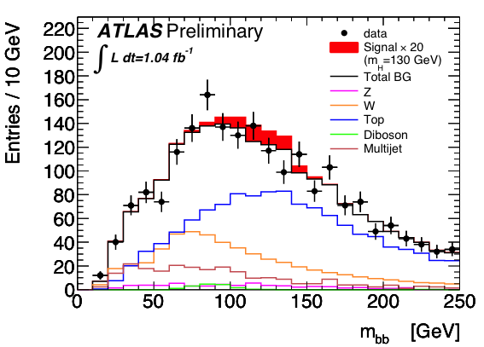
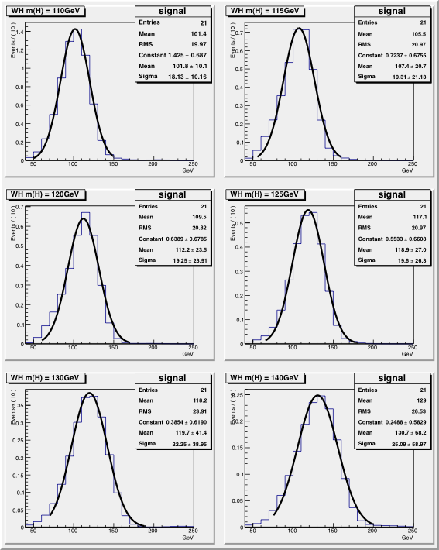
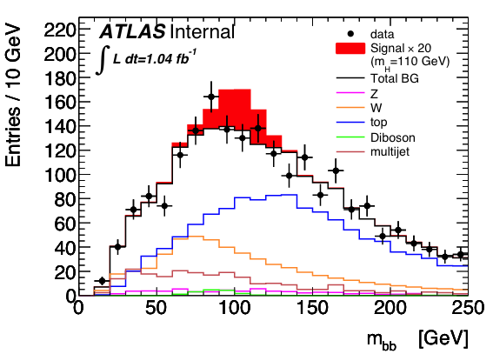
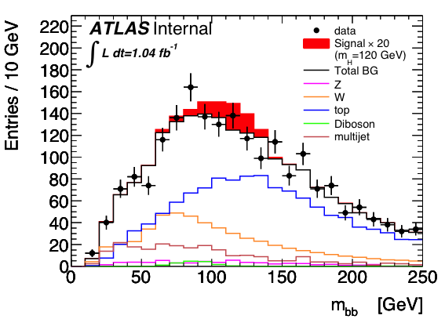
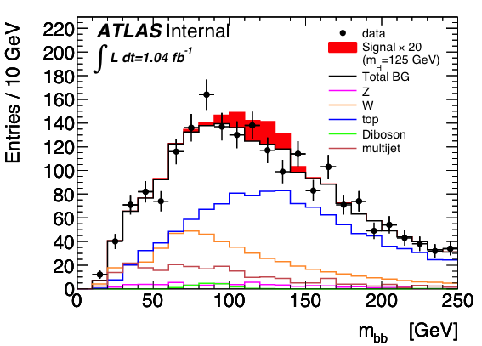
Jet resolution effect on di-jet mass
Focusing on the WH -> lνbb example
Very large di-jet mass resolution (≈20GeV)
Any improvement would lead to better significance

Slide 29
Attempt at conclusions

Slide 30
Missing Energy
Feeling is it would be good to use METRefFinal
Major drawback is that it depends on definitions of many objects – muons, electrons, jets
Not clear How to deal with analysis-dependent object selections
There’s a feeling that the systematic uncertainty is overestimated

Slide 31
Jet reconstruction
JES systematic uncertainty also seems to be over-estimated
Can we optimize jets for kinematic region of interest? How?
CMS uses energy-flow jets – could we benefit from something similar?

Slide 32
Finally…
What is clear is that good ATLAS physics can only come from good reconstruction performance! We’re all in the same boat!
… as I said in the beginning, this is not the end of the discussion, just the beginning (the end of the beginning?)

Slide 33
Backup slides

Slide 34
Including the Tevatron…
115
130
140
≈115 GeV: CMS and ATLAS see small excess – inconsistent w. Tevatron
≈130 GeV: Tevatron and ATLAS see some excess
≈140 GeV: Tevatron, CMS and ATLAS see some excess
Though CMS, ATLAS prefer very small signal (CMS best fit is 0.6*SM)

Slide 35
Backup info for H->γγ
H->γγ + N jets:
  See e.g. talk by Taiki Yamamura here: https://indico.cern.ch/conferenceDisplay.py?confId=152120
  Jet selection:
    |η_{jet}|<4.5
    jet variables (D3PD):
    AntiKt4TopoEM
    jet_AntiKt4TopoEM_pt [E,eta,phi]
  Njet reweighting:
    MC used is γγ and γj from Alpgen and Pythia
    See e.g. talk by Olivier Davignon here: https://indico.cern.ch/conferenceDisplay.py?confId=152120
Initial H->γγ + MET study: https://indico.cern.ch/conferenceDisplay.py?confId=143672

Slide 36
Backup info for H->bb
ZH:
Trigger:
  e (p_{T}^{e}>20GeV) or μ (p_{T}^{μ}>18GeV)
  2e/2μ trigger (p_{T}>12GeV)
Exactly 2 leptons p_{T} > 20GeV
  Opposite charge for μ
Z mass cut: 76 < m_{ll} < 106 GeV
E_{T}^{miss} < 50GeV
Two leading jets b tagged
WH:
Trigger: e (p_{T}^{e}>20GeV) or μ (p_{T}^{μ}>18GeV)
Exactly 1 lepton – p_{T} > 25GeV
M_{T} = √2p_{T}^{l}p_{T}^{ν}(1 - cos Δφ_{lν} ) > 40 GeV
E_{T}^{miss} > 25GeV
Exactly 2 jets (anti-k_{T} 0.4; E_{T} > 25GeV) to reduce top background
Both jets b tagged

Slide 37
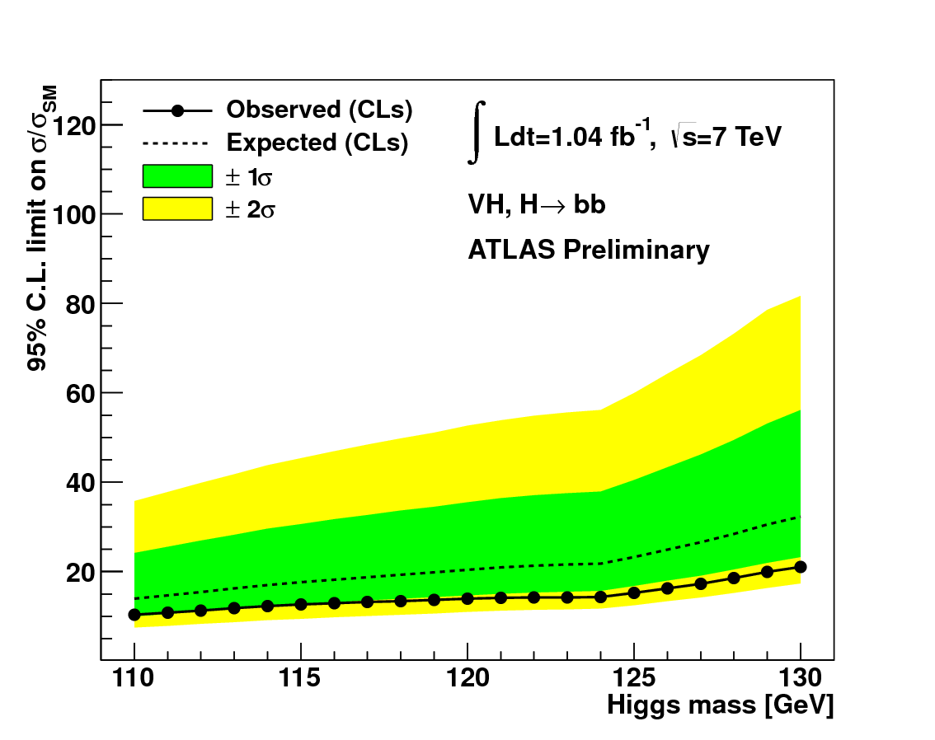
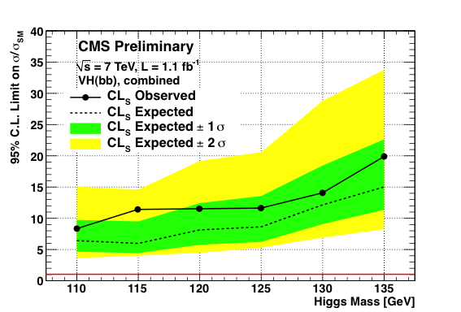
Comparison with CMS H->bb Note
CDS record: http://cdsweb.cern.ch/record/1376636?ln=en
Subjective impression:
  Looks as clever as our own analysis but better optimized
Some different strategic choices:
  Included ZH->ννbb – best significance channel (S/√(S+B) = 0.25 @ m_{H}=115GeV)
  B-jet selection:
    1 tight b-jet & 1 loose b-jet
    Used sum of b-tag weights to select H->bb jet pair (Σp_{T}^{jet} for WH)
  Selected a more boosted topology (but no jet substructure analysis):
    Cut on vector boson and Higgs p_{T} allows cut on Δφ(V,H)
  Used m(H)-dependent m(bb) cuts
  Used BDT: 10-20% improvement in each channel wrt cut-based
According to note some significant differences in performance:
  Better di-jet mass resolution
  Better JES and b-tagging uncertainties

Slide 38
Comparison between CMS’ LP2011 results and our EPS2011 CONF note
Channels | Included ZH->ννbb channel (best significance)
Multivariate | Boosted Decision Tree: ≈ 10 – 20% improvement in each channel
Monte Carlo | Hwg++/Powheg (NLO) for signal; Madgraph for some backgr
Trigger: some work spent optimizing this, esp. e triggers | Used particle flow for MET triggers & ≠ triggers for ≠ run periods WH: mu17, e22_2j30_j25_xe15 Z(ll)H: mu17, e17i_e8i Z(νν)H: j20 OR xe150
Missing energy | Particle-flow based MET and MET significance
Jets | Particle-flow jets: p_{T} > 30 GeV (WH), 20 GeV (llbb), 80/30 GeV (ννbb)
Pileup rejection | JVF-like algorithm plus calo-based algorithm
Leptons | p_{T}^{μ} > 20GeV, p_{T}^{e}>20(ZH)/30(WH)
B-tagging | Similar to IP3D+SV1; 1 tight (ε=50%) b-jet & 1 loose (ε=72%) b-jet Used sum of b-tag weights to select H->bb jet pair (Σp_{T}^{jet} for WH)
Other cuts | Cut on Δφ(V,H) in conjunction with p_{T}^{V} and p_{T}^{bb} (≈ 100-160 GeV) m(bb) window cuts: m_{H} ± 15 GeV
m(H) reconstruction | Efficiency of m_{H} window cut (m_{H}±15GeV) ≈75-80% If normal distr. => 1.2×σ(bb), i.e. σ(bb)≈13 GeV (20GeV for us)
Systematics | Similar except: JES (1%) & of b-tagging (10%) – (9% & 16% for us)

Slide 39
Alternative to inclusive channels: search for high-pT Higgs to bb:
  J. M. Butterworth, A. R. Davison, M. Rubin, and G. P. Salam, Phys. Rev. Lett. 100 (2008) 242001, arXiv:0802.2470 [hep-ph]
p_{T}^{H} > 200GeV ≈ 5% of inclusive cross section but improved significance
Select W➝lν events and search for a H➝bb jet
  Search for high-p_{T} jet (Cambridge-Aachen algorithm, R=1.2)
  Search jet clustering history in reverse and look for large mass drop
  Re-cluster with small R parameter to find sub jets
Peak consistent with W➝jj in tt events
Proof of principle for future analysis
See talk by Adam Davison next

Slide 40
H->WW backup info
H->WW->lνqq cuts:
Leptons:
  p_{T}^{lep} > 20 GeV (isolated)
  |η_{lep}|< 2.47 (e, excl. crack) / 2.4 (μ)
Jets & MET:
  Anti-k_{T} R=0.4 (calibrated topoclusters, EM+JES)
  p_{T}^{jet} > 25 GeV
  |η_{jet}|< 4.5
  E_{T}^{miss} > 30 GeV
H→WW→lνqq
  JES systematic uncertainty important
H -> WW -> lνlν
  Jets & E_{T}^{miss}:
  Anti-k_{T} R=0.4 (calibrated topoclusters, EM+JES)
  Uses B-jet veto
  Does not use JVF cut in current results – but will use soon )(see Haifeng Li’s contribution to JVF session)
  Uses E_{T}^{miss} projection (E_{T,rel}^{miss})

Slide 41
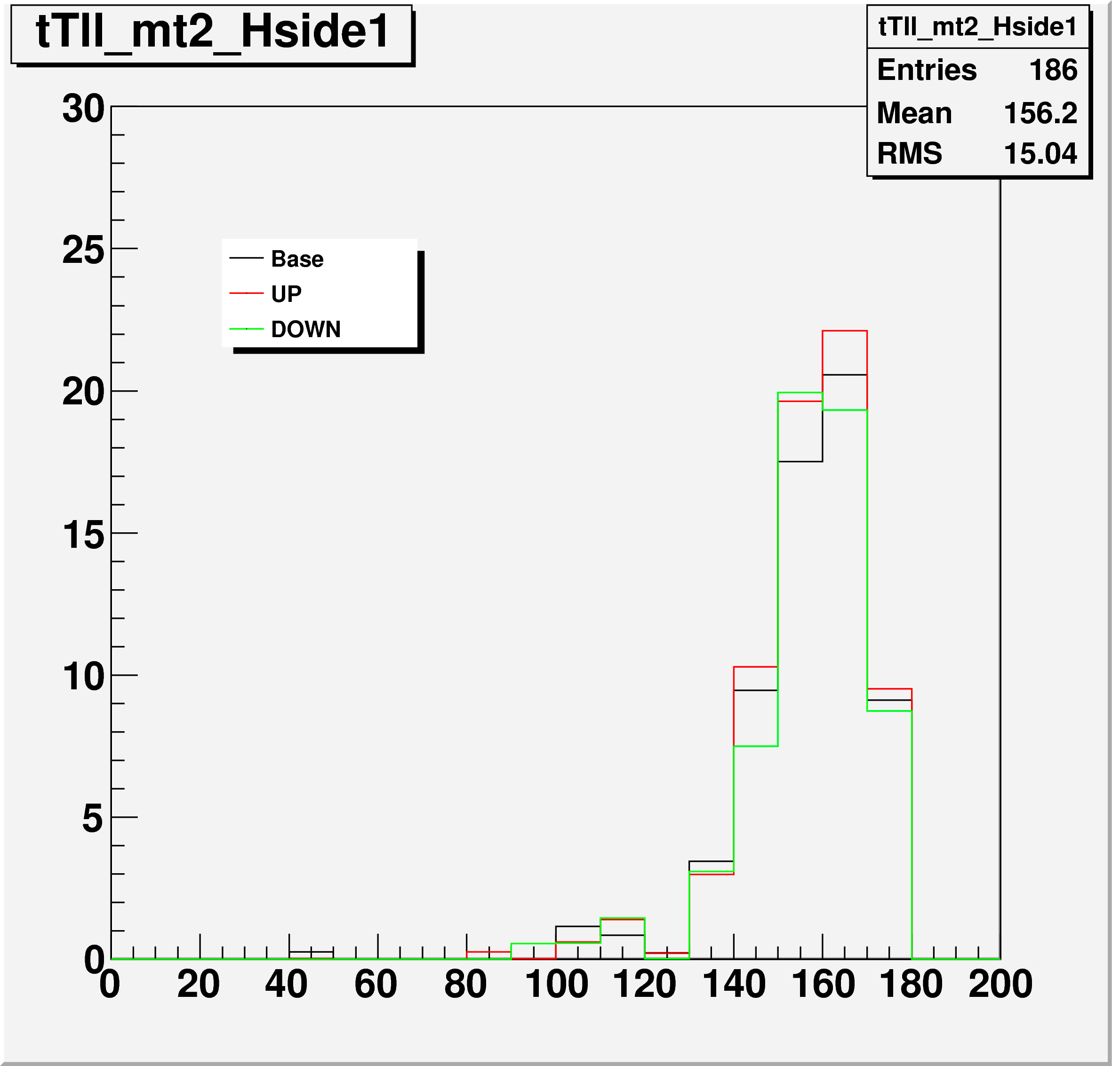

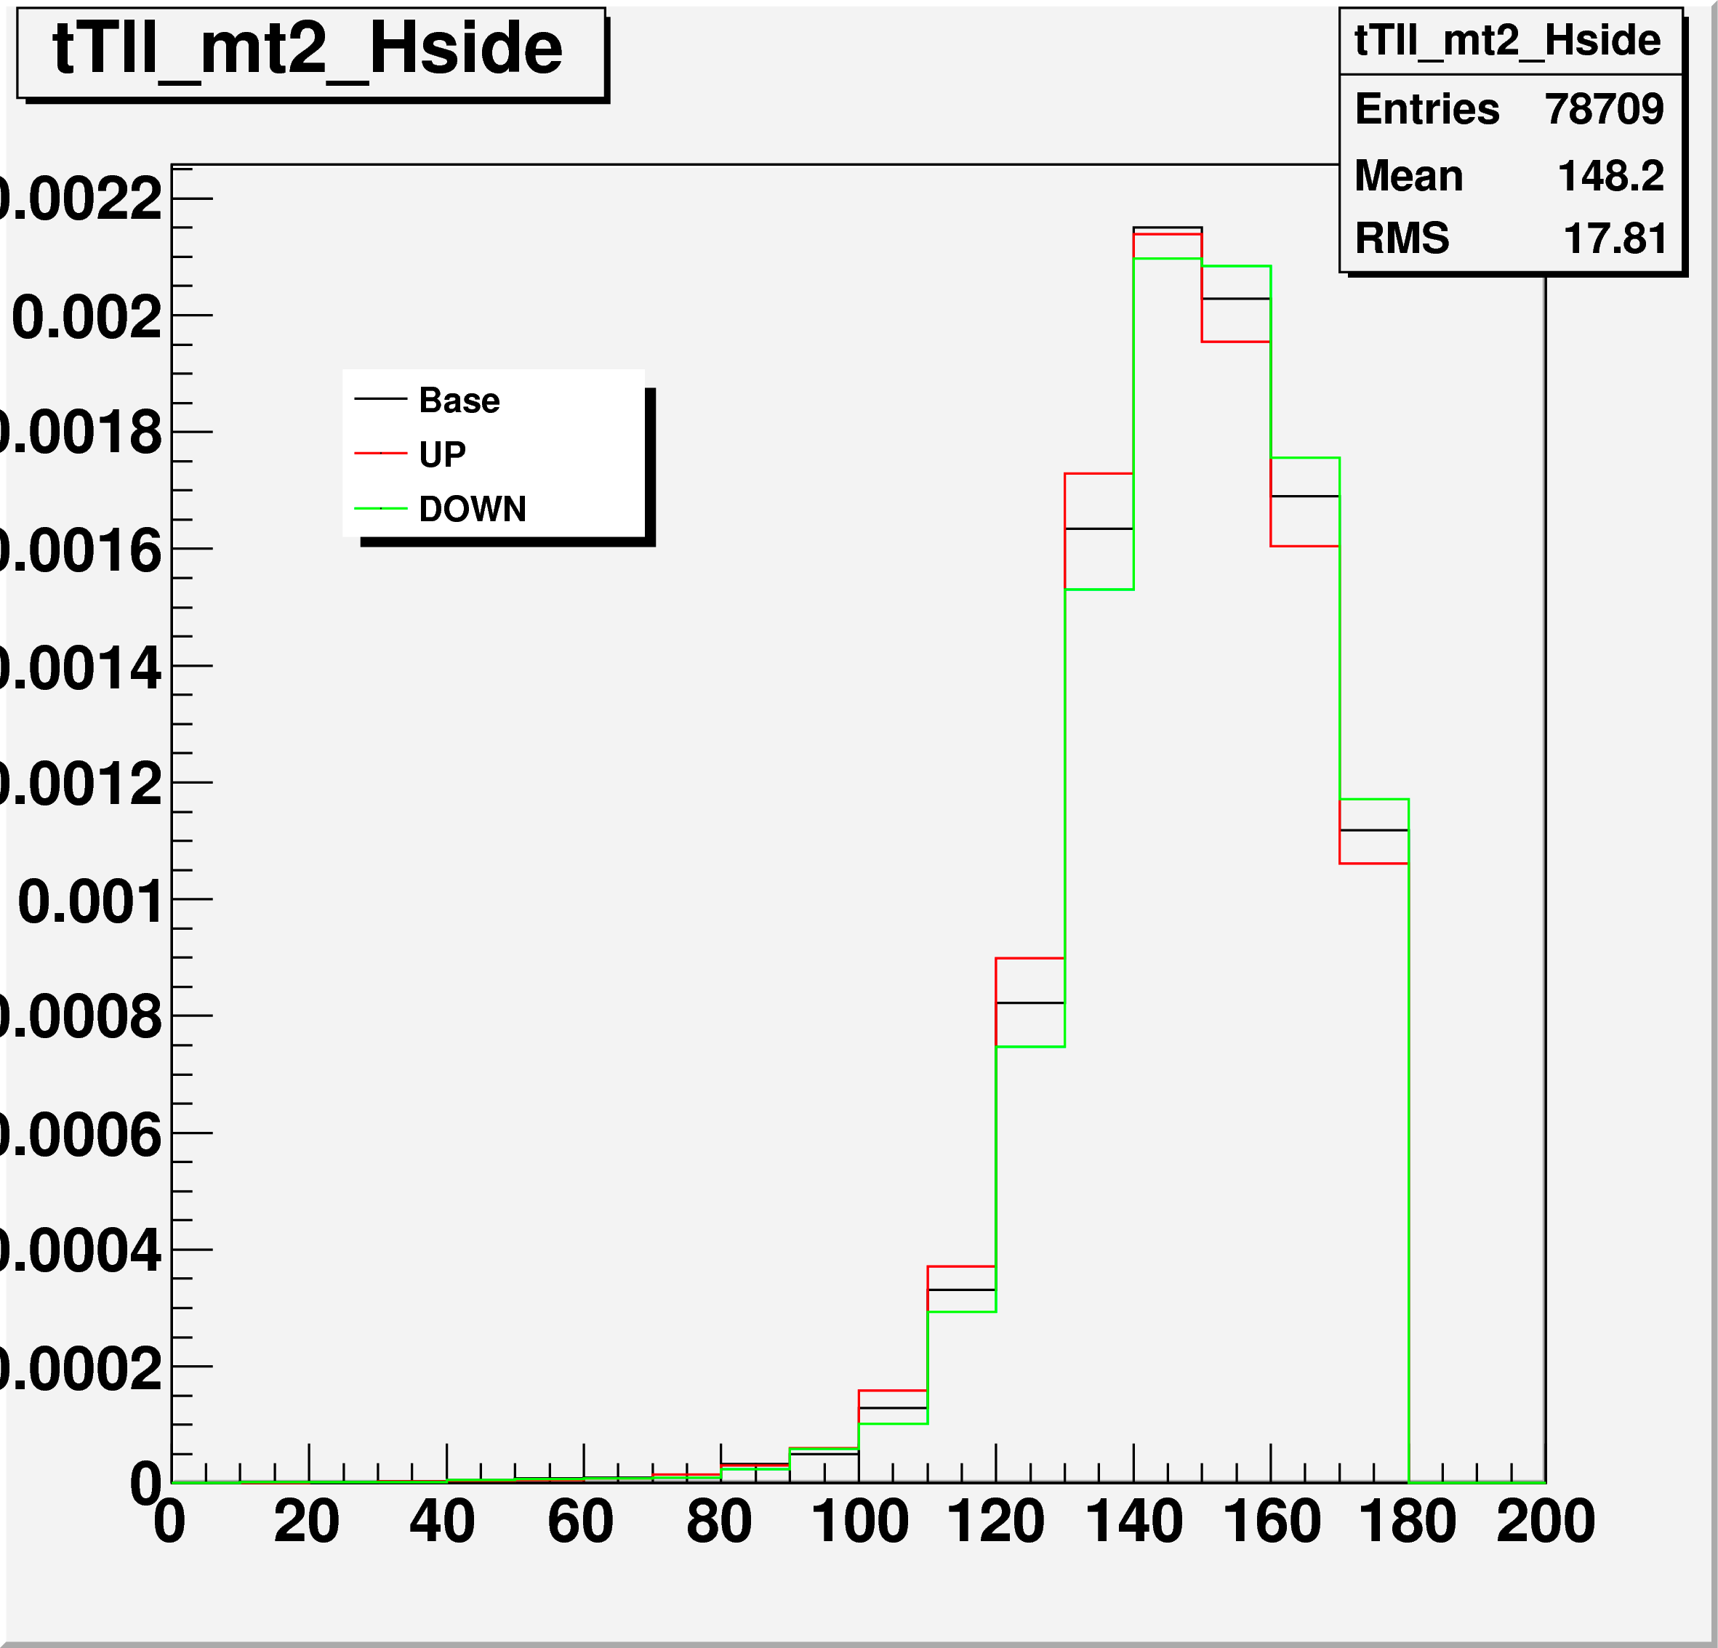
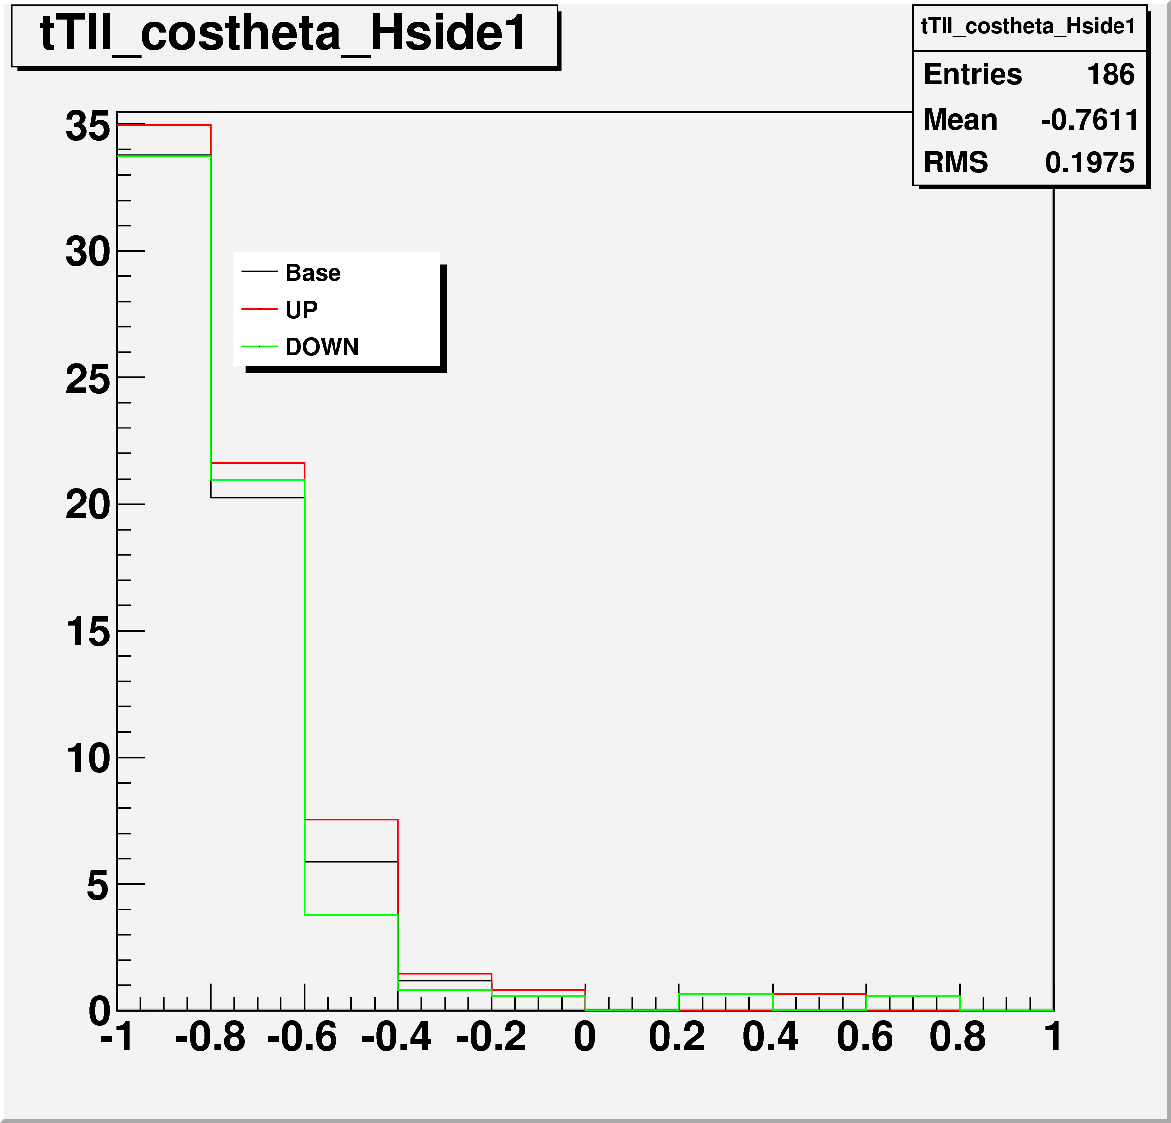
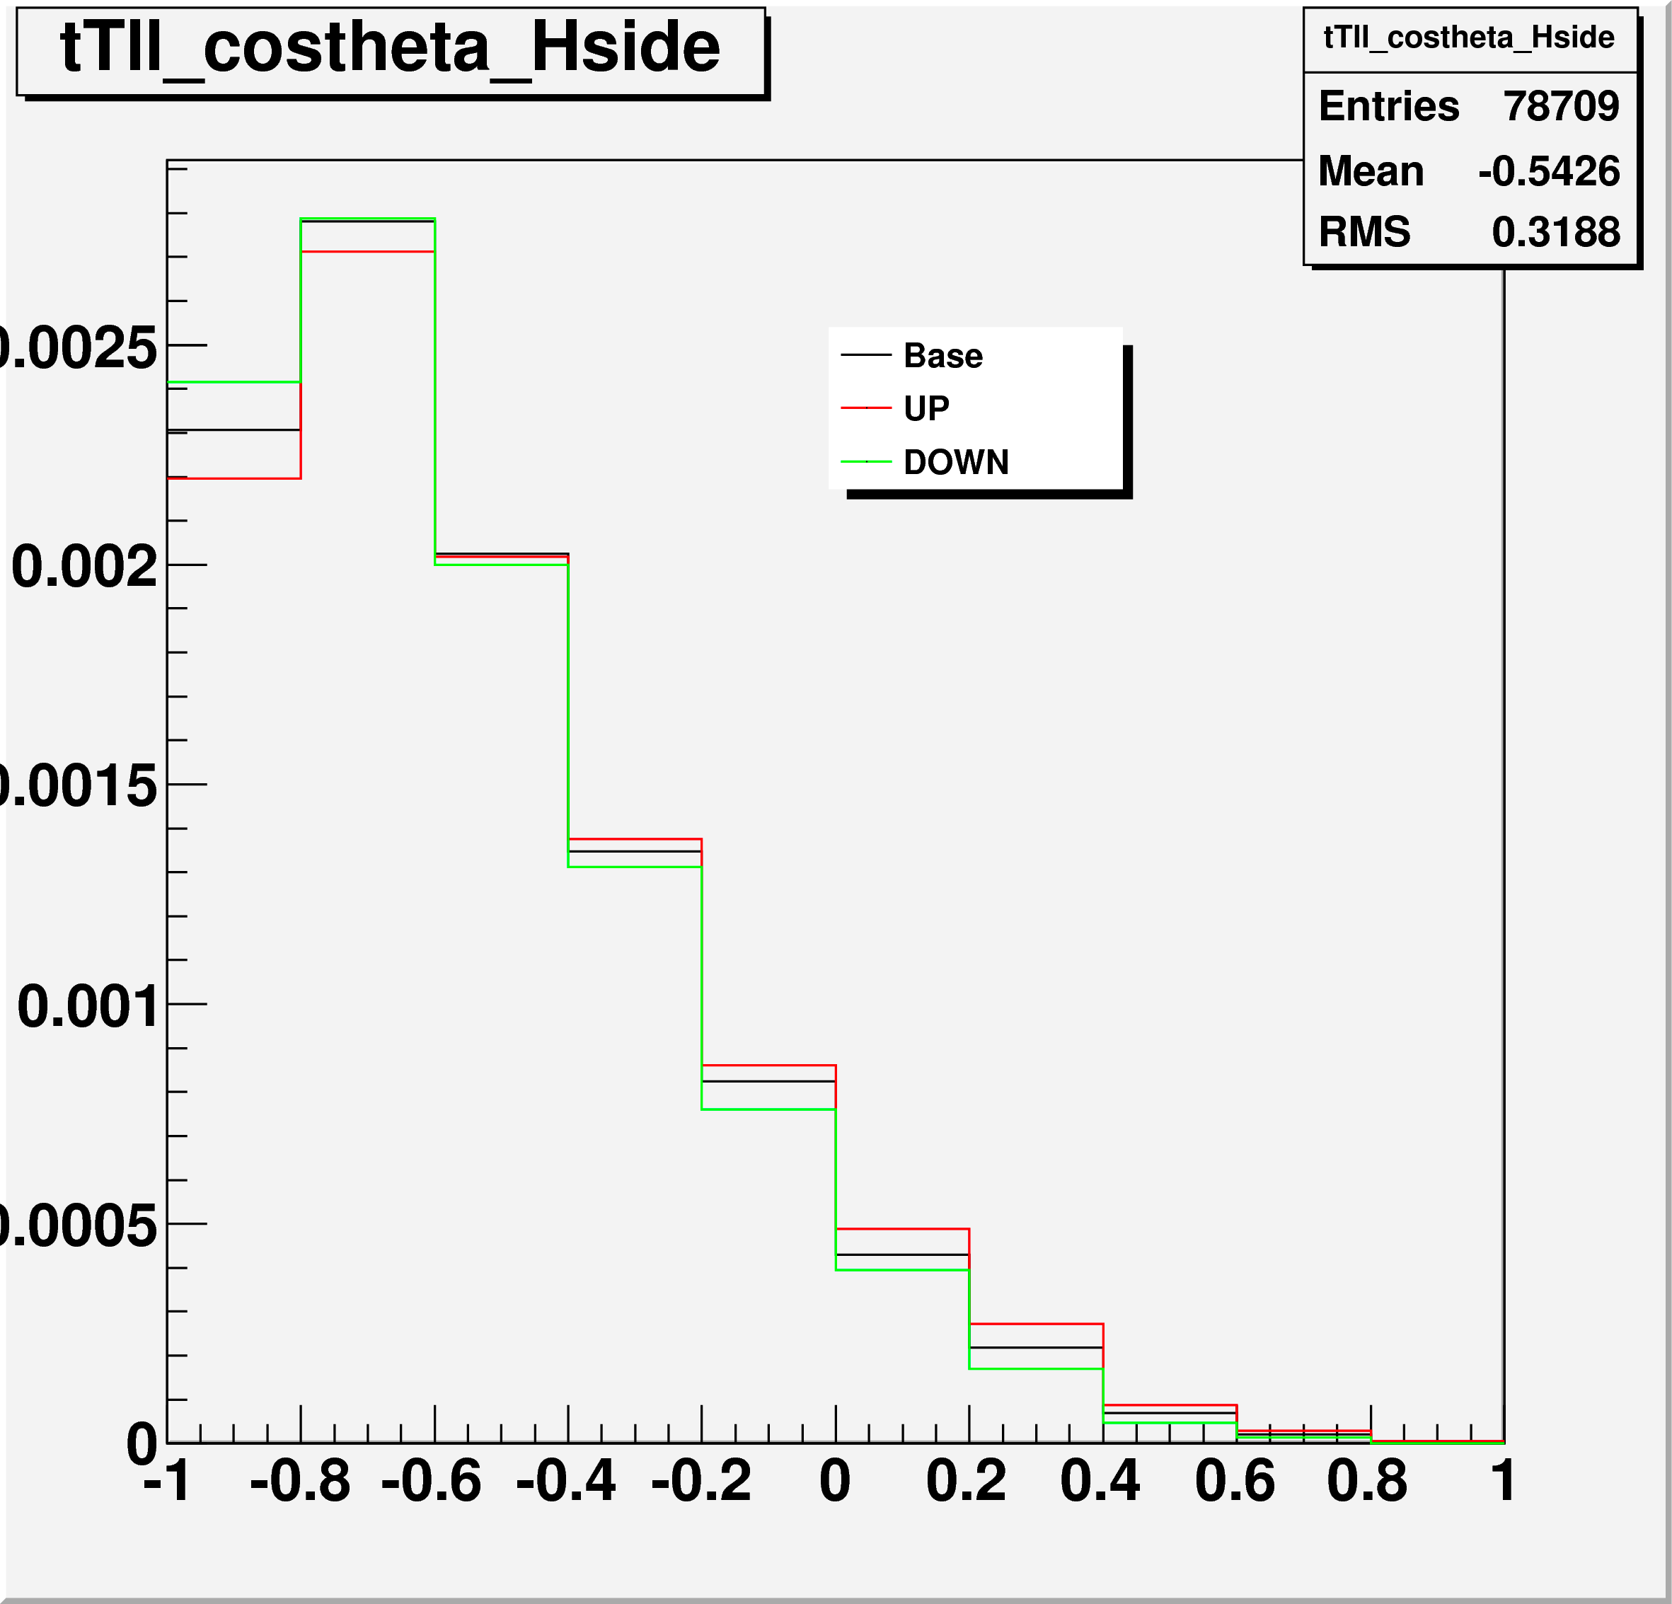
H⁺ -> τ_{lep}ν semi-leptonic top channel
Production channel: tt -> bWbH⁺ -> blν bτ_{lep}ν
Jet Energy Scale systematic up/down variations
Left: Final discriminant: generalized mT2(H+)
  Top: signal 140 GeV; bottom: dominant background ttbar
Bottom: cos*θ Important discriminating variable, also used for background normalization
  Center: signal 140 GeV; right: dominant background ttbar

Slide 42
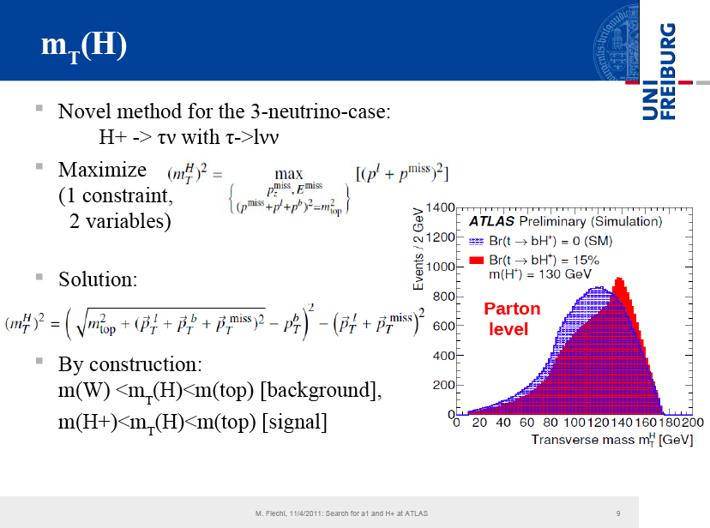

Slide 43
