Slide 1
Comments on Scalar Charm Pair Production paper draft 1
Ricardo Gonçalo on behalf of the Editorial Board

Slide 2
Search for Scalar Charm Pair Production with the ATLAS Detector in pp Collisions at sqrt(s) = 8 TeV
Paper draft 1 (SUSY-2014-03): https://cds.cern.ch/record/1967424
CONF note (CONF-SUSY-2014-05): https://cds.cern.ch/record/1970407
Ed.Board: Ricardo Goncalo (chair), Michael Medinnis, Kerim Suruliz, Troels Petersen
Many thanks to the Editors and Analysis Team for great work and collaboration!

Slide 3
Overview
11 comments from 9 people/institutes
Analysis and paper draft in well received:
“The paper looks very well written and only few minor comments follow”
“Congratulations for this analysis that will have impact!”
“It was a pleasure to read this very well written paper addressing an interesting SUSY scenario”
“We congratulate the analysis team on an interesting analysis and a very well written PRL draft”
A few items to discuss a this meeting, but No showstoppers
Not discussed here:
Small suggested text changes (36) – implemented by authors choice or justified
Bibliography suggestions (11) – many thanks for improvements/clarifications
Clarifications, e.g. details of trigger used, detailed justification of cuts
1 update to table 1 (thanks to Rob McPherson and RAL group)

Slide 4
For discussion at Open Reading
Standard way to name squarks:
scalar charm
scalar charm quark
scharm
charm squark
Etc?

Slide 5
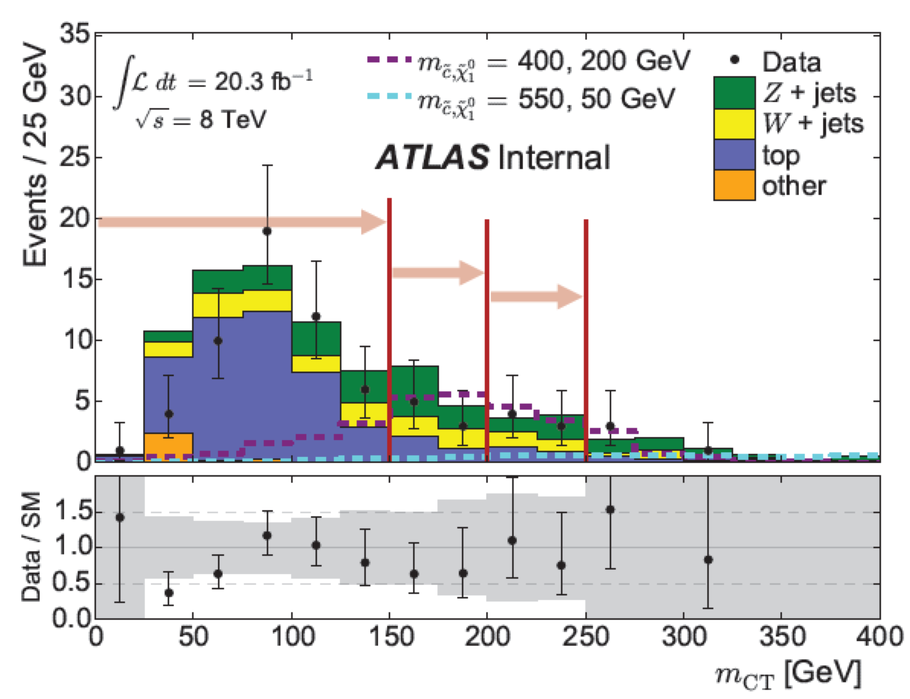
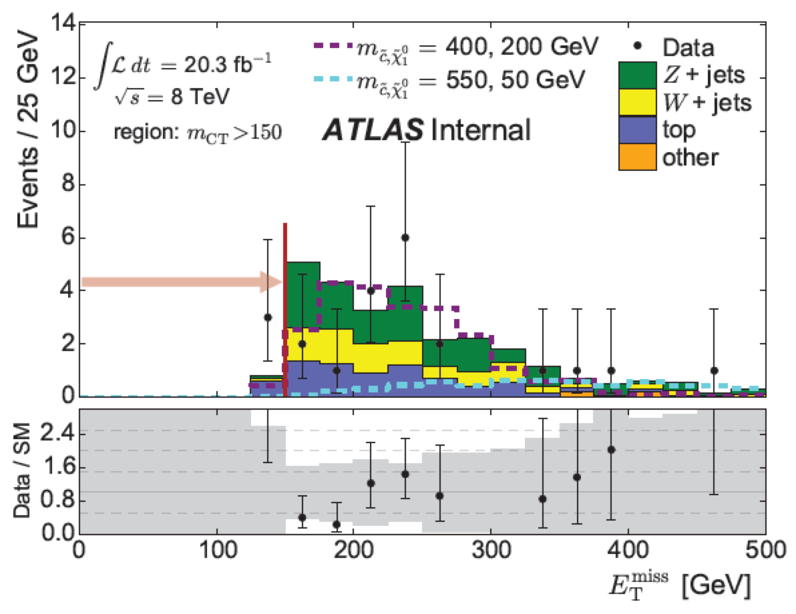
Arrows:
For figures we realised that we don’t quite like the arrows given in some of the plots. They are more confusing than helpful.
Figure 1 top:
Can you put logy scale ? As you mention in the text the formula about the edge (l.136), logy scale will allow the reader to see it.
Can you extend the x-axis to 500 GeV as this is where we expect the edge for the 550-50 case.
Figure 1 bottom:
I find mcc [Fig.4 top] more interesting than Etmiss since the MCT cut basically remove Etmiss

Slide 6
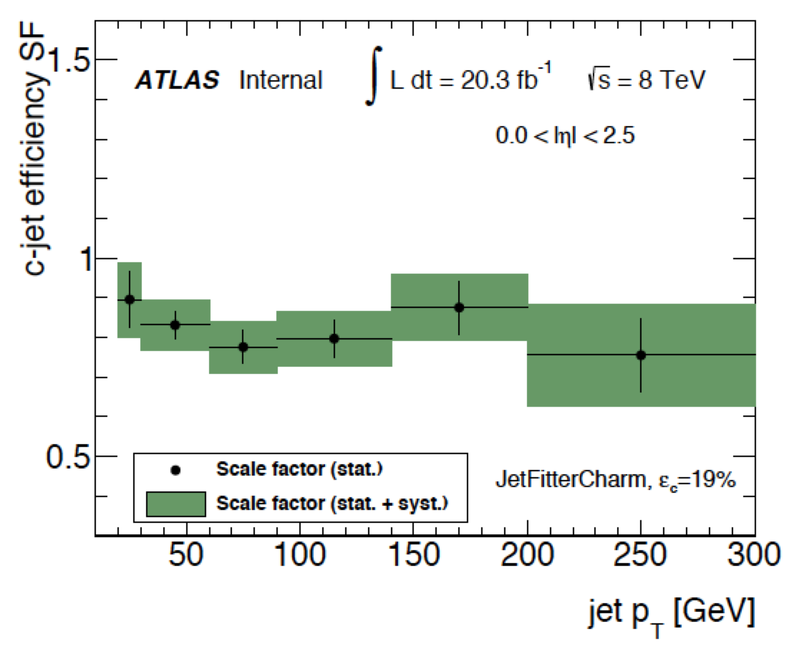
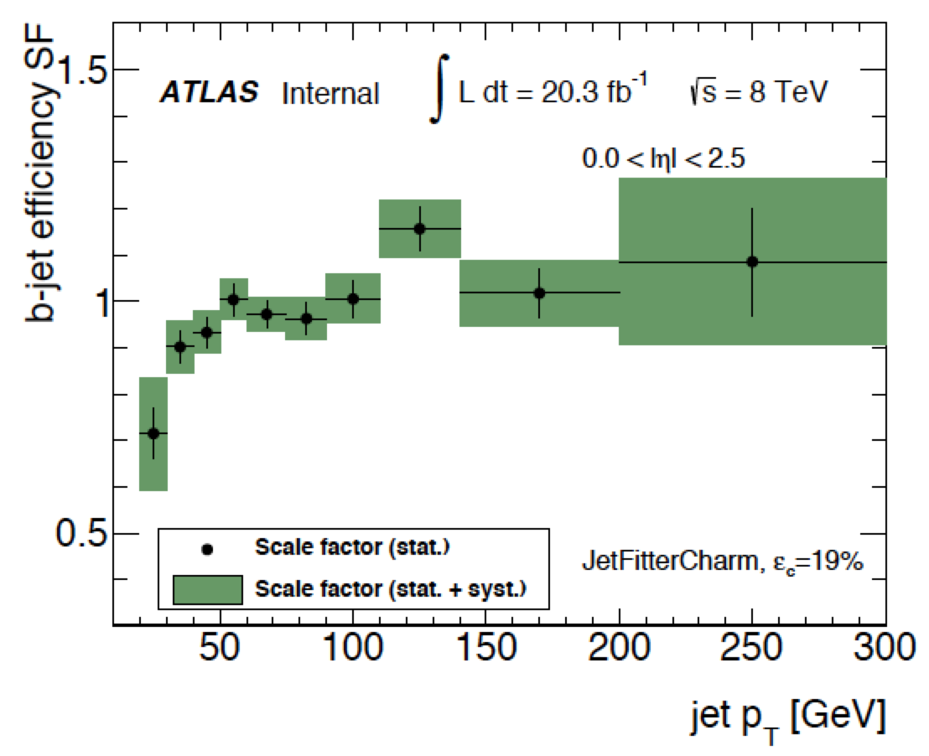
Charm tagging:
Ongoing, in collaboration with Flavour Tagging group
Additional material on c/b/light tagging efficiency to be added to paper
No additional material to be added for CONF note
The c-tagging calibration method is documented in Ref [34]
Note that this is not the first use of c-tagging in an ATLAS paper – see stop -> charm + LSP paper (Ref [49] of the paper)
Also discussed in Appendix D4 of Support Note (ATL-COM-PHYS-2014-391)

Slide 7
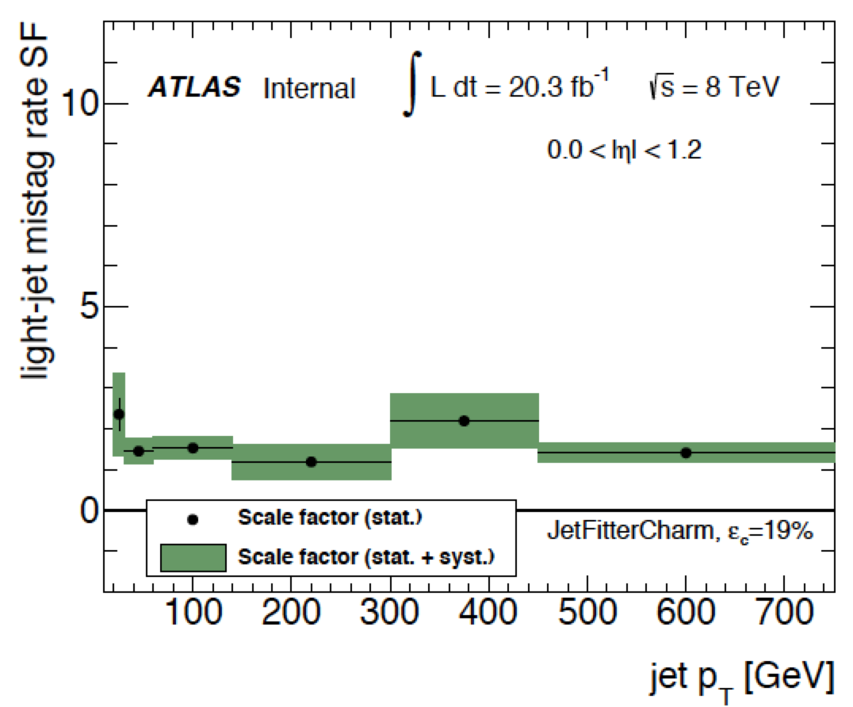
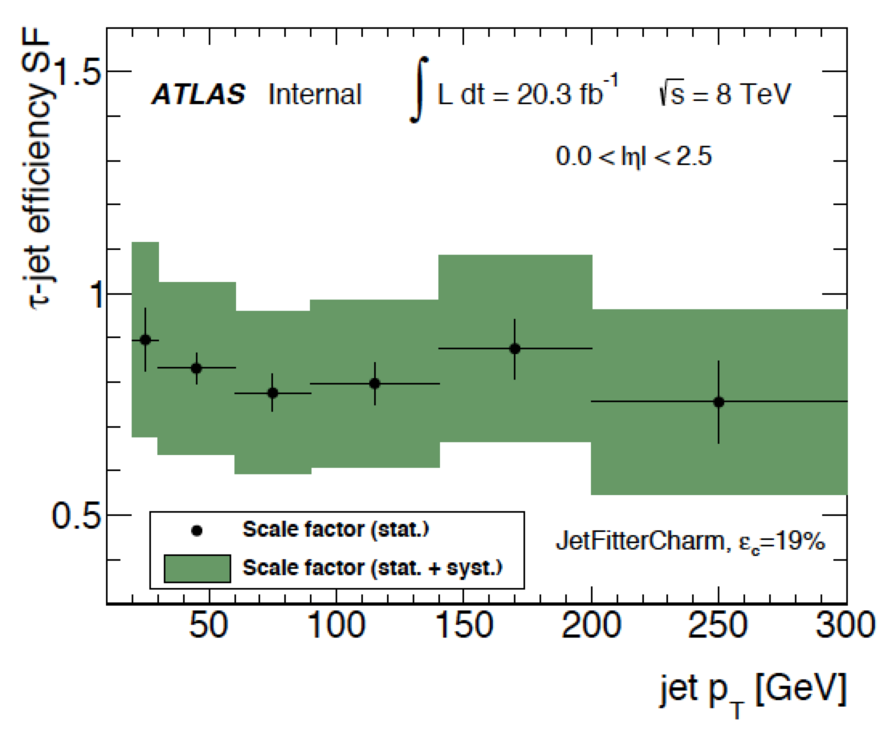
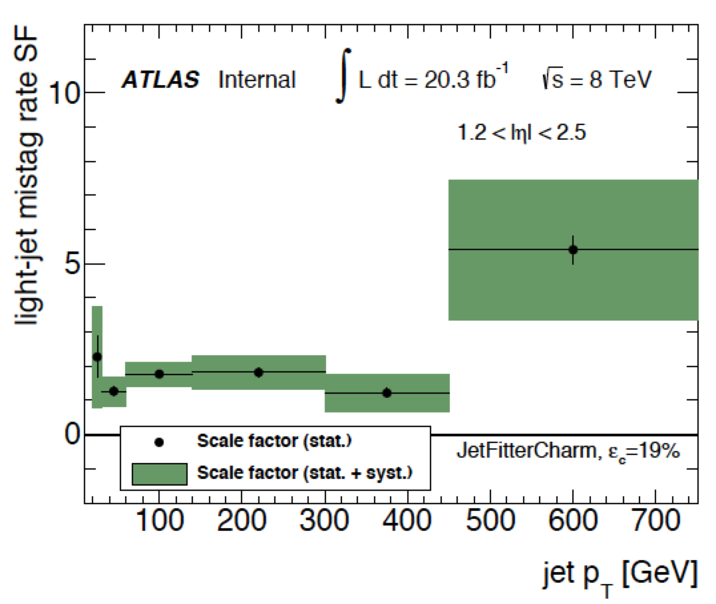

Slide 8
General Comments
While I appreciate that PRL imposes significant constraints on the length, it is often difficult to follow the motivation for the cuts that are used. I really wonder whether PRL is the correct journal for such an analysis, where it is not possible to motivate the control regions that are used etc.
From our perspective this seems to be exactly the sort of analysis that the collaboration should and ought to be publishing in PRL, exactly because of its simplicity. We very much hope that ATLAS can continue to publish short letters where appropriate.

Slide 9
- l.17 What about up, down and strange squarks ? I guess they should be in a similar position as the scharm no ?
The scharm quark evades flavour physics constraints on squark mixing rather better than u, d, s, and is also more predisposed to mix with a stop. Therefore a better case can be made for a single light scharm than a single light s-up, s-down or s-strange. Also, experimentally it is much more accessible, due to the ability to charm tag.

Slide 10
Do the results presented in this paper (Figure 2 and the numerical limits quoted in the abstract/summary) apply to a single scalar charm quark state, or do they assume a L-R degenerate scalar charm quark pair? Depending on the χ₁~ composition, I believe that either c~_R and c~_L could decay into the c~ χ₁~, and be pair produced via the diagram in Fig.5 in the additional material. Especially since you refer to the constraints in Ref [16] arXiv:1405.7875 where specific assumptions are made, it would be useful to know how the cross-section assumed in this paper is computed.
They belong to a single scalar charm state. This is reported at line 295, but please let us know if you think that statement is unclear.

Slide 11
Line 292. New physics --> new particles. This analysis uses the same old physics, like conservation of momentum. If you want to be more specific, you can say "supersymmetric particles". Note that the limits we set are in the context of specific models, and not a general "new physics".
The analysis tests a null hypothesis of existing Standard Model physics, and uses it to constrain how any new physics may contribute to the cross section. The new physics could be SUSY particles, non-SUSY particles, non-conservation of momentum or other unknown physics. The limits are not set in the context of specific models, they are are as model-independent as any such limits can be.

Slide 12
Specific Comments
Can we remove "first" from "first dedicated search"? We can let the community decide precedence. Besides, if it were to happen that CMS were to get a result into print before we do, I would argue that this paper is still worth publishing. That means the "first" doesn’t really matter.
We believe there is value in indicating this. In the unlikely event of an analysis from CMS become apparent before our submission we will have opportunity to remove this statement.

Slide 13
Line 74: Isolation criteria similar to those in Ref 31 is a bit too fuzzy, be more precise
There was a long discussion of this in the preparation of the paper with the Ed Board and convenors, and agreement was made on this presentation. For the discussion see: https://cds.cern.ch/record/1710414/comments

Slide 14
Fig 2: why do you include the theory uncertainty into the Expected Limit (yellow error band) in this figure? Normally the expected limit, and its uncertainty, is compared to the Observed Limit (the red line in this figure) to see if they look consistent. But since the theory uncertainly in included in both the expected and observed limit, this normal use of the expected limit band is (nearly) impossible. It would be more intuitive (to me anyway) to include only the experimental uncertainties in the expected limit band so that the robustness of the observed limit can be judged, and then include the theory uncertainty band only in the observed limit so that conservative limits can be inferred.
We do indeed follow the usual practice for the SUSY group in including only the experimental uncertainty (and the theory uncertainties on the background) in the yellow band. The legend has been amended accordingly.

Slide 15
line 198: (about Control Regions) is it possible to shortly report on the extent of the expected signal contamination?
For the simplified model used, the contamination is formally zero, since the simplified model used for the signal produces only jets and invisible neutralinos. In other SUSY models some processes might contaminate the 1-lepton control region, the details depending on the spectra and branching ratios of the particular models selected. The transverse mass cut will reduce any such contamination.

Slide 16
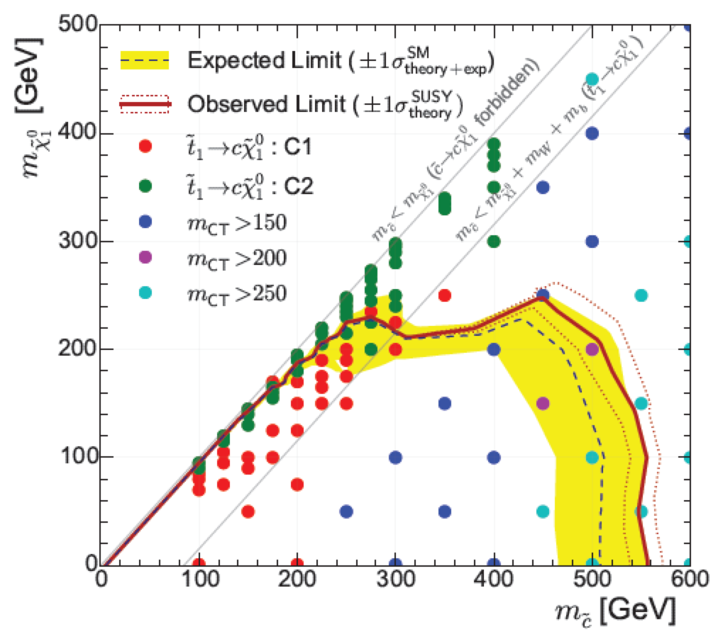
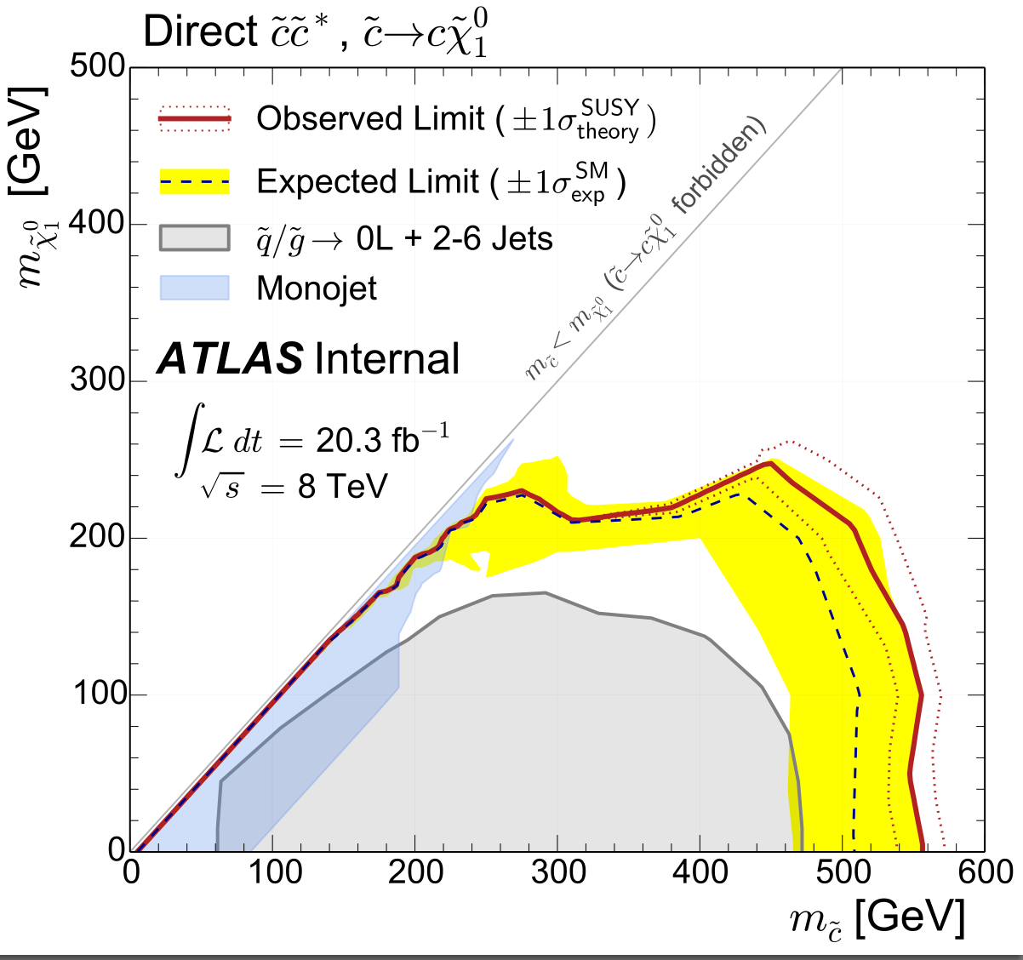
Questions about comparison with existing analyses:
…add another plot to the auxiliary material akin to Fig 2, but showing the limits obtained from the 0L+2-6jets+MET and the bb+MET analyses, both for the given direct ~c~c signal model.
New figure 6 of the auxiliary material

Slide 17
I am also a bit puzzled by the fact that the number of data events is of the order to 2 sigma smaller than the expectations. However, the observed limit is only about 1 sigma higher. Is this somehow constrained by the control regions?
Though not entirely intuitive, this is a feature of the standard HistFitter limit-setting procedure. The background expectations in the tables are calculated from a background fit which ignores the signal region, so the comparison is between the (blinded) expectation and the observed data. The “expected” exclusion, on the other hand, is drawn from a fit which includes the data in the signal region. In the case presented, the observed data in the SR pulls down the background estimate, resulting in less tension between the fit backgrounds and the data. This puts the expected exclusion within 1 sigma of the “observed” exclusion.

Slide 18
Conclusions
Discussion…
No showstoppers as fara s I can see
Plan is to publish a CONF note for CERN seminar, followed by paper in short timescale
EdBoard supports this plan
Thanks!

