Slide 1
Trigger Data for Analysis
ATLAS Software tutorial
27th – 29th July 2010
Jörg Stelzer DESY, Attila Krasznahorkay NYU, Ricardo Gonçalo RHUL

Slide 2
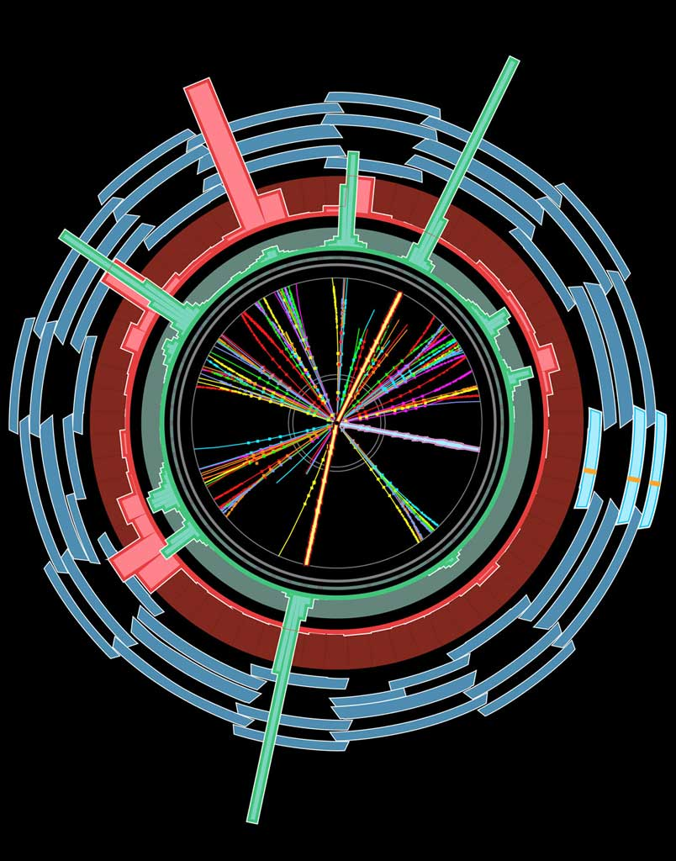
The Trigger
EM ROI
L2 calorim.
An example
Electromagnetic
clusters
Level1:
Region of Interest is found and position in EM calorimeter is passed to Level 2
cluster?
L2 tracking
track?
Level 2 seeded by Level 1
Fast reconstruction algorithms
Reconstruction within RoI
match?
E.F.calorim.
E.F.tracking
track?
Ev.Filter seeded by Level 2
Offline reconstruction algorithms
Refined alignment and calibration
e/γ reconst.
e/γ OK?

Slide 3
The Trigger Execution
The Trigger Execution
FEX algo’s are executed to create
features on which selection in HYPO algo’s is based
Chain:
  Started, if seed has fired and chain is not prescaled
  Stopped at step, if a HYPO is not passed
  Last HYPO passed → chain passed
Event:
  Passed, if at least one EF chain is passed
  Put into all streams that are associated with the passed EF chains
Trigger objects associated with triggers through Navigation TriggerElements
Trigger information in
  Trigger Decision + Configuration +
  +
EM ROI
EM ROI
FEX
EM_ROI
Feature
HYPO
L2 calorim.
L2 calorim.
TE Pass/Fail
TrigEMCluster
cluster?
cluster?
L2 tracking
TrigInDetTracks
track?
match?
E.F.calorim.
TE Pass/Fail
E.F.calorim.
CaloCluster
E.F.tracking
TE Pass/Fail
EFTrack
track?
e/γ reconst.
e/γ reconst.
TE Pass/Fail
egamma
ESD
AOD
DPD
TAG
γ OK?
e OK?
γ OK?
e OK?
Navigation
Feature

Slide 4
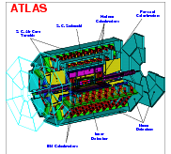
Trigger Configuration + Data
TriggerDB
All configuration data
Preparation
Stores
decoded Trigger Menu
Configures
Data
taking
Online
Conditions
Database
COOL
Encoded trigger result
from all 3 levels
Decoded trigger menu
Reconstruction
Trigger Result
passed?, passed through?, prescaled?, last successful step in trigger execution?
Trigger EDM
Trigger objects for trigger selection studies
Trigger Configuration
Trigger names, prescales, pass throughs
access through TrigDecisionTool
ESD
AOD
With decreasing
amount of detail
Trigger aware
analysis
DPD
TAG

Slide 5
Trigger-Aware Analysis – Introductory Comments
Analysis based on single trigger chain or an ‘OR’ of a few chains (a ‘ChainGroup’)
Chain definition – algorithms, cuts, multiplicities – do not change during a run, but can change between runs
  Important for analysis on DPD, where multiple runs are merged, check the ChainGroup content between each run
Prescales at LVL1 and at HLT can change between luminosity blocks
  A negative prescale means that this trigger is off. This is important for calculating the integrated luminosity. Check each luminosity block.

Slide 6
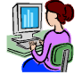
Bringing it Together – TrigDecisionTool
ESD
AOD
DPD
contain persistent
Configuration can change between runs
Decision +
Navigation
EDM
Configuration
Unpacking
Dec. + Nav.
EDM P/T
convertion
IOV based
P/T conv.
BUT:
Prescales can change between lumiblocks
(trigger on/off)
IOVDbSvc
Upon Request
ConfigSvc
Transient:
TrigDecision
Feature Nav.
Configuration
TrigDecisionTool

Slide 7
What’s there? – Trigger Decision
Lvl1 decision after dead-time veto
HLT decision, information for pass-through’ed and for resurrected triggers
Bunch groups that fired
For more detailed studies:
  Lvl1 decision before prescale, before veto
  Error codes for HLT-algorithms
  Last step of chain execution

Slide 8
Tool Usage
Alg.h: define ToolHandle to a TrigDecisionTool
Alg.cxx – Alg::Alg(): declare ToolHandle as public tool
Alg.cxx – Alg::initialize(): retrieve tool
  Has to be in initialize()!
Alg.cxx – Alg::execute(): use tool
private:
ToolHandle<Trig::TrigDecisionTool> tdt;
MyAlgo::MyAlgo(const std::string &name, …) tdt("Trig::TrigDecisionTool/TrigDecisionTool”)
{…}
StatusCode sc = tdt.retrieve();
if (tdt->isPassed (“L2_e15i”)) {
log << MSG::INFO << ”I’m happy!“ << endreq;
}
TWIKI: https://twiki.cern.ch/twiki/bin/view/Atlas/TrigDecisionTool15
Doxygen: http://atlas-computing.web.cern.ch/.../TrigDecisionTool/html/

Slide 9
Working with ChainGroups
Alg.h: define ChainGroup pointer
Alg.cxx – Alg::initialize(): declare ChainGroup
  Note: the ChainGroup automatically updates with each run (chain content) and lumiblock (prescales)
  Use regular expressions, e.g. “EF_e.*”
Alg.cxx – Alg::execute():
  Access to trigger configuration
  Access to trigger decision
  Access to trigger objects
const Trig::ChainGroup* mMyTrigger;
mMyTrigger =
tdt.createChainGroup(“EF_e10_loose”,”EF_mu10”,...);
bool useLB = ! mMyTrigger->getListOfTriggers().empty();
bool myEvent = mMyTrigger.isPassed();
const Trig::FeatureContainer fc = mMyTrigger.features();
const std::vector< Trig::Feature< TrigTau > > taus =
fc.get();
Anonymous ChainGroups:
Note that one can work without steps 1 and 2. In Alg::execute() define the triggers on the fly:
Equally fast (TDT keeps ChainGroups)
string tr (“EF_e10_loose”);
bool useLB = ! tdt->getListOfTriggers().empty(tr);
bool myEvent = tdt->isPassed(tr);
const Trig::FeatureContainer fc = tdt.features(tr);

Slide 10
What’s there? – Features and Navigation
Access to features through the “TriggerNavigation”
Features are created by FEX algorithms, they appear in StoreGate. A FEX also creates a “TriggerElement” (TE)
  A TE is used as handle to the feature
  A TE has a pass/fail state set by the corresponding HYPO
The navigation gives you all the features that were created in a chain
  Or just those that were successful (features in ROI’s which passed all cuts) – that is the default!
  Can also give you combinations of features (for multi-object triggers)
  Ancestor function to navigate, e.g. from electron to track and cluster

Slide 11
Athena Example for using Features
FeatureContainer for ‘EF_tau16i_loose_2j23’
Access the feature
You need to know the type of the Feature: ‘JetCollection’ in EF
Access the object (implicit conversion)
Access information of object
Find corresponding L2 jet using TDT::ancestor<T>
FeatureContainer f = tdt->features("EF_tau16i_loose_2j23"); // creating the feature container
std::vector< Feature<JetCollection> > jetColls = f.get<JetCollection>();
mLog << MSG::INFO << "Number of JetCollections: " << jetColls.size() << endreq;
if(jetColls.size()>0) {
const Feature<JetCollection>& jcf = jetColls[0]; // get the first Feature
mLog << MSG::INFO << "Label: " << jcf.label() << endreq;
const JetCollection* jc = jcf; // implicit Feature -> object conversion
mLog << MSG::INFO << "Number of Jets: " << jc->size() << endreq;
JetCollection::const_iterator jIt = jc->begin();
for (; jIt != jc->end(); ++jIt ) {
Jet* jet = *jIt;
mLog << MSG::INFO << "Jet e : " << jet->e() << endreq;
}
// find the corresponding jets in Lvl2 through the inheritance tree (navigation does that all)
Feature<TrigT2Jet> l2jetF = tdt->ancestor<TrigT2Jet>(jcf);
mLog << MSG::INFO<<"Found “<< (l2jetF.empty()?"no ":"“)<< "corresponding L2 Jet.”<<endreq;
if ( !l2jetF.empty() ) {
const TrigT2Jet* t2jet = l2jetF.cptr(); // explicit Feature -> object conversion
mLog << MSG::INFO << " e : " << t2jet->e() << endreq;
}
}
Output:
Number of JetCollections: 1
TE Label: TrigJetRec
Number of Jets: 1
Jet e : 82827.9
Found corresponding L2 Jet.
e : 83197.4

Slide 12
Trigger Object Matching
Why?
  Some analyses require object level trigger information: Tag and Probe
  Some analyses have multiple objects of same type and need matching for detailed efficiency estimation
  Trigger selection design and optimisation
Matching framework available in Trigger/TrigAnalysis/TrigObjectMatching package in release 15.3.0 and later
Examples available in Trigger/TrigAnalysis/TrigAnalysisExamples in release 15.4.0 and later
  TrigMatchExAlg - Athena example of matching for each common offline type
  TrigMatchExampleARA - Example of trigger matching in ARA
  TagAndProbeExAlg - Athena example of tag and probe analysis with trigger matching
TWiki available with detailed information for users and developers
  https://twiki.cern.ch/twiki/bin/view/Atlas/TriggerObjectsMatching

Slide 13
What’s there? – Configuration Data
L1 Items: name, prescale
  For more detailed studies: version, CTP-Id, bunch group, thresholds and multiplicities
HLT Chains: name, level, prescale, streams
  For more detailed studies: version, counter, trigger elements and multiplicities
Trigger Release, configuration keys (useful for lookup in the TriggerDB)
  No access with the TDT, but checkConfigTrigger.py

Slide 14
Configuration Access with the TDT
std::vector< std::string > | getListOfTriggers (const Trig::ChainGroup *chaingroup) const
 | List of trigger names of the ChainGroup chaingroup
std::vector< std::string > | getListOfStreams (const Trig::ChainGroup *chaingroup) const
 | List of stream names of the ChainGroup chaingroup
std::vector< std::vector< std::string > > | getListOfTriggerElements (const Trig::ChainGroup *chaingroup) const
 | List of lists of TE names in ChainGroup chaingroup. Inner vectors are for a single trigger step, the length of those is the trigger multiplicity.
float | getPrescale (const Trig::ChainGroup *chaingroup, unsigned int condition=TrigDefs::Physics) const
 | Prescale of the ChainGroup chaingroup.
All methods come with two flavors, argument:
  const Trig::ChainGroup *chaingroup
  const std::string &triggerNames=“.*”
Here the ChainGroup is created on the fly from the pattern ‘triggerNames’ (regexp - “.*” means ‘all’)
All functions are forwarded from ChainGroup, tdt->fnc(chgr,…) is equivalent to
chGr->fnc(…)
Prescales: For single triggers the prescale combined for all levels is returned. If a multi-trigger ChainGroup contains an unprescaled trigger, the return value is 1. It is 0 otherwise.

Slide 15
Tools to Investige the Trigger Setup
http://atlas-trigconf.cern.ch:
  Main web portal to trigger configuration by run number, MC menu name, configuration keys
  Uses TriggerTool and AtlCoolTrigger.py underneath
TriggerTool:
  Java based GUI to browse the TriggerDB (replica) for all information
  Also used at point 1 for preparation of trigger
AtlCoolTrigger.py:
  Command line tool to show release, configuration keys, menu information, streams for data
http://atlas-runquery.cern.ch/
  Query page for trigger chains, prescales, trigger release for data

Slide 16
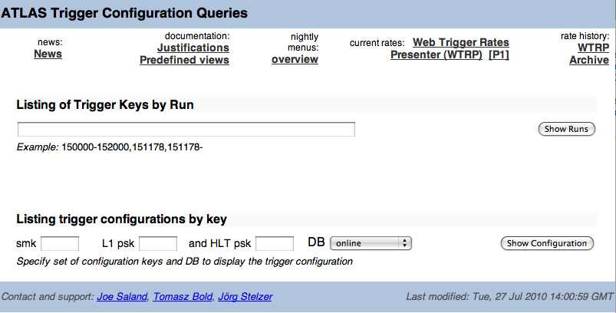
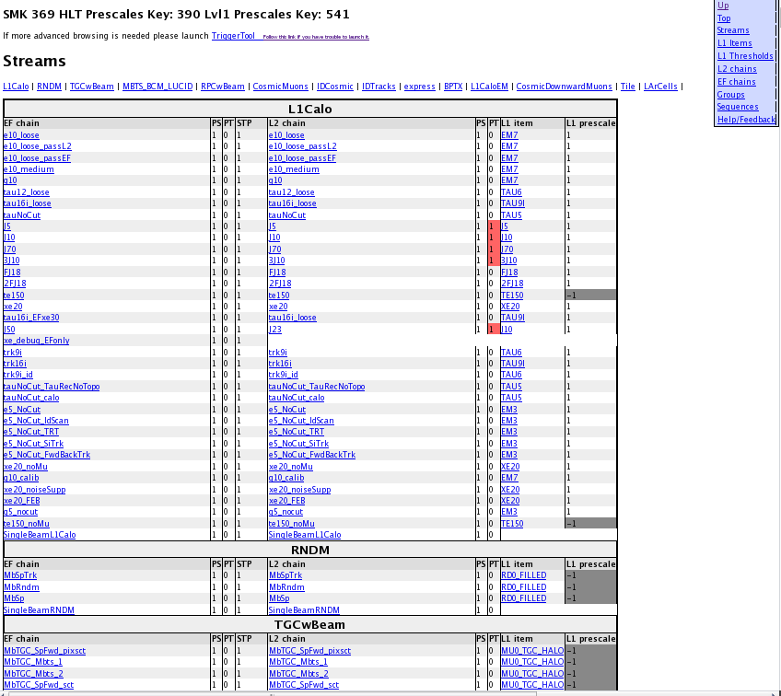
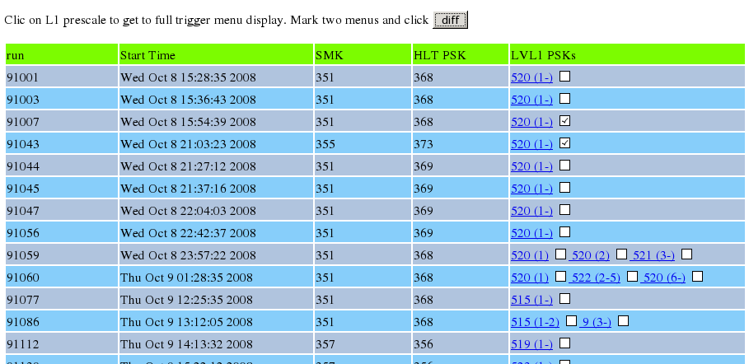
Example for the Configuration Portal
Go to http://atlas-trigconf.cern.ch
3. Browse the trigger configuration
(definition, algorithms, selection cuts)
1. Enter
run-range
2. Click on link in resulting run list
Also with simple comparison functionality

Slide 17
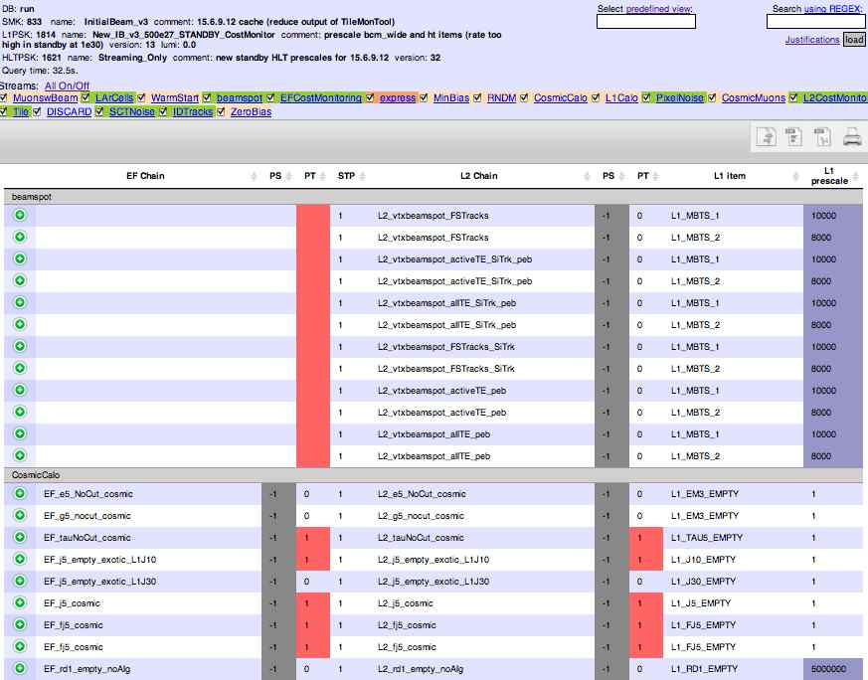
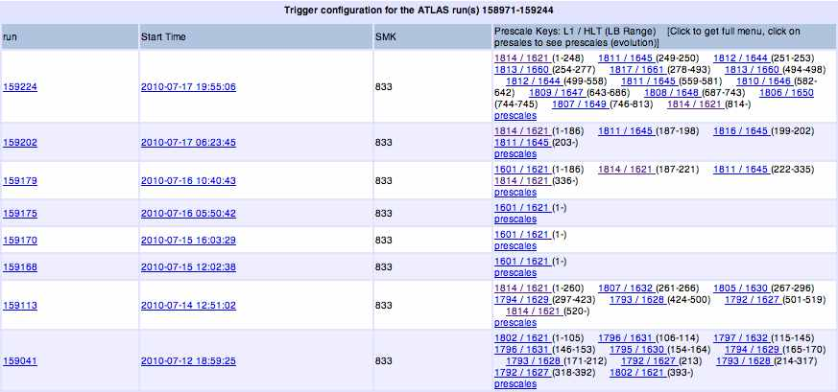
Example for the Configuration Portal
Go to http://atlas-trigconf.cern.ch
3. Browse the trigger configuration
(streams, justifications, definition,
algorithms, selection cuts)
1. Enter
run-range
2. Click on link in resulting run list

Slide 18
Trigger Menu Listing
Trigger Menu and L1 rates stored in COOL, HLT rates coming. Quick access via
  AtlCoolTrigger.py (command line tool)
    AtlCoolTrigger.py –r 91000‐99000 (many run summary)
    AtlCoolTrigger –v –m –r 90272 (single run menu)
      Prints keys, trigger menus, streams, allows diff‐ing of menus in different runs, creates menu in xml format
  Run summary pages (WEB based):http://atlas-service-db-runlist.web.cern.ch/atlas-service-db-runlist/query.html
    Trigger names, rates for single run

Slide 19
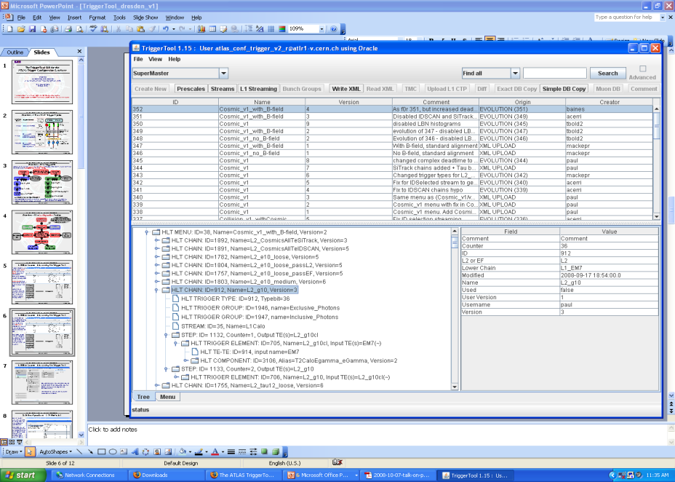
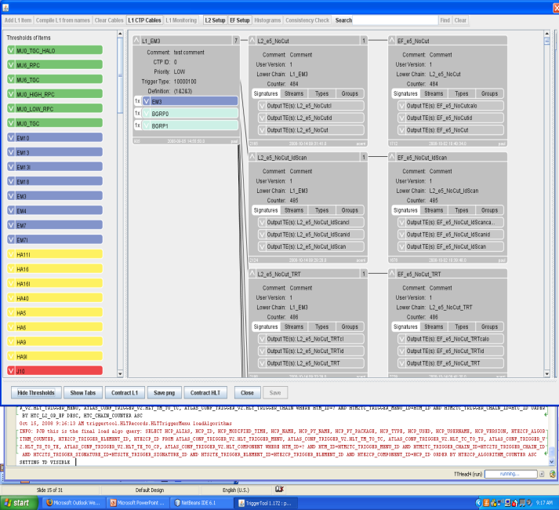
TriggerTool
Java based front end to TriggerDB, launch from the web (Java web-start): http://www.cern.ch/triggertool
  Overview of all trigger configurations (data taking and MC)
  Detailed and convenient investigation of trigger menus
    Trigger definition L1->L2->EF:
    prescales, threshold algorithms, selection criteria, streaming information, etc.
Possibility to compare
different trigger configurations
Used at point 1 for trigger operation
TDAQ training tutorial for the TT

Slide 20
Scripts to Check Pool File Content
File:AOD.pool.root
Size: 55955.492 kb
Nbr Events: 250
Trigger configuration summary:
SMK: 0, HLTpsk: 0, L1psk: 0
Config source: TriggerMenuXML/LVL1config_MC_lumi1E31_no_prescale_15.1.0.xml and TriggerMenuXML/HLTconfig_MC_lumi1E31_no_prescale_15.1.0.xml
L1 Items : 146
HLT Chains : 556
================================================================================
ID level Trigger name Passed events: raw, after PS, after PT/Veto
================================================================================
LVL1 Global LVL1 250
LVL2 Global LVL2 250
EF Global EF (LVL3) 250
--------------------------------------------------------------------------------
13 LVL1 L1_2EM13 71 71 71
14 LVL1 L1_2EM13I 34 34 34
163 LVL1 L1_2EM13_MU6 8 8 8
....
--------------------------------------------------------------------------------
...
77 LVL2 L2_2g10 118 118 118
246 LVL2 L2_2g10_mu6 12 12 12
....
--------------------------------------------------------------------------------
...
477 EF EF_2e6_medium 8 8 8
478 EF EF_2e6_medium1 7 7 7
79 EF EF_2g20 39 39 39
248 EF EF_2j42_xe30 3 3 3
....
================================================================================
checkTrigger.py AOD.pool.root
  Runs over ESD/AOD/DPD and presents
  detailed (chain‐wise) counts of the
  trigger decision
checkTriggerConfig.py ‐d AOD.pool.root
  Runs on ESD/AOD/DPD and presents
  detailed trigger configuration(s)
  Shows multiple configurations (merged DPD)
> checkTriggerConfig.py –d data09_cos.00121733.physics_L1Calo.recon.ESD.r733_tid073522/ESD.073522._000001.pool.root.1
…
EF: EF_mu0_tgc_halo_IDSCAN (1.00), L2: L2_mu0_tgc_halo_IDSCAN (1.00), L1: L1_MU0_TGC_HALO (1) [streams: TGCwBeam]
…

Slide 21
Summary
Trigger data access in Athena, ARA, C++, or python with the TrigDecisionTool!
  Many examples, plus a large number of people to provide help when needed (hn-atlas-TriggerHelp at cern.ch)
Tools to check the trigger information for given run
  Configuration: TriggerTool or http://atlas-trigconf.cern.ch
  Pool files: checkTrigger.py and checkTriggerConfig.py
Prescales to be checked for each lumiblock → luminosity
  Remember that negative prescale means trigger did not run
Important for analysis: matching of offline reconstruction and trigger objects

Slide 22
Additional Information
Trigger user info: https://twiki.cern.ch/twiki/bin/view/Atlas/TriggerUserPages
Tutorials: https://twiki.cern.ch/twiki/bin/view/Atlas/TriggerSoftwareTutorialPage
TDT Twiki: https://twiki.cern.ch/twiki/bin/view/Atlas/TrigDecisionTool
TDT Doxygen: http://atlas-computing.web.cern.ch/atlas-computing/links/nightlyDevDirectory/AtlasOffline/latest_doxygen/InstallArea/doc//TrigDecisionTool/html/index.html
Trigger obj matching: https://twiki.cern.ch/twiki/bin/view/Atlas/TriggerObjectsMatching
TrigAnalysisExample: http://atlas-computing.web.cern.ch/atlas-computing/links/nightlyDevDirectory/AtlasOffline/latest_doxygen/InstallArea/doc/TrigAnalysisExamples/html/index.html
UserAnalysis example: https://twiki.cern.ch/twiki/bin/view/AtlasProtected/UserAnalysis
Trigger Configuration: http://trigconf.cern.ch
TriggerTool: http://www.cern.ch/triggertool
Run query: http://atlas-runquery.cern.ch/
Trigger EDM: https://twiki.cern.ch/twiki/bin/view/Atlas/TriggerEDM, http://alxr.usatlas.bnl.gov/lxr/source/atlas/Trigger/TrigEvent/TrigEventARA/TrigEventARA/selection.xml
TriggerMenu group: https://twiki.cern.ch/twiki/bin/view/Atlas/TriggerPhysicsMenu
TriggerSW group: https://twiki.cern.ch/twiki/bin/view/Atlas/TAPMCoreSW
TriggerConfig group: https://twiki.cern.ch/twiki/bin/view/Atlas/TriggerConfiguration
Help on e-groups: hn-atlas-TriggerHelp at cern.ch

Slide 23
Details
On the issues described above

Slide 24
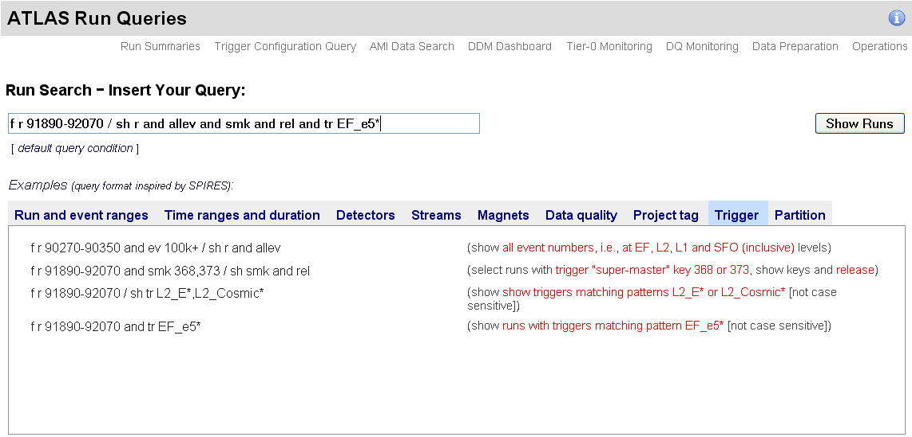
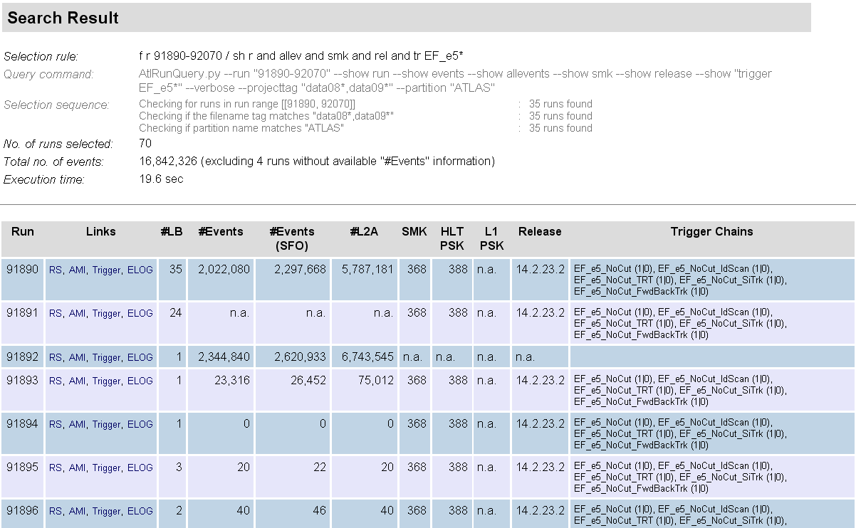
Trigger Content of Atlas-Runquery
Search for runs by release, configuration key, trigger content
Display and have links to run-summary, AMI, trigconf.ch, e-log

Slide 25
What’s there? – Trigger Decision
Lvl1 decision after dead-time veto
HLT decision, information for pass-through’ed and for resurrected triggers
Bunch groups that fired
For more detailed studies:
  Lvl1 decision before prescale, before veto
  Error codes for HLT-algorithms
  Last step of chain execution

Slide 26
Decision Access with the TDT
bool | isPassed (const Trig::ChainGroup *chaingroup, unsigned int condition=TrigDefs::Physics) const
 | true if given group of chains passed
char | getBGCode () const
 | Get the bunch group code byte. BG X fired (X=0..7): getBGCode() & (0x1<<X)
All trigger decisions through “isPassed()”, behavior depends on “condition” argument:
TrigDefs::Physics: [default]
  Pseudonym for requireDecision | enforceLogicalFlow, which means that both conditions are applied. Default for isPassed() and for getPrescale().
TrigDefs::enforceLogicalFlow, TrigDefs::fullChain:
  combination of all three trigger levels.
TrigDefs::requireDecision:
  A decision must have been made, pass due to pass-through or resurrection is not enough.
TrigDefs::passedThrough:
  Event was passed through. A trigger chain can have a pass-through factor in order to record events independent of the decision. This is useful for understanding the trigger behavior. Restrict the isPassed() to those events, requireDecision must be off.
TrigDefs::allowResurrectedDecision:
  If a trigger is prescaled on a given event, that trigger chain is not executed. If that event is accepted it is often important to know also the trigger decision and features of the prescaled trigger (orthogonal triggers for efficiency determination.) For a fraction of these cases we execute the trigger and safe its decision. This is accessed with allowResurrectedDecision (requireDecision must be off.)

Slide 27
What’s there? – Configuration Data
L1 Items: name, prescale
  For more detailed studies: version, CTP-Id, bunch group, thresholds and multiplicities
HLT Chains: name, level, prescale, streams
  For more detailed studies: version, counter, trigger elements and multiplicities
Trigger Release, configuration keys (useful for lookup in the TriggerDB)
  No access with the TDT, but checkConfigTrigger.py

Slide 28
Configuration Access with the TDT
std::vector< std::string > | getListOfTriggers (const Trig::ChainGroup *chaingroup) const
 | List of trigger names of the ChainGroup chaingroup
std::vector< std::string > | getListOfStreams (const Trig::ChainGroup *chaingroup) const
 | List of stream names of the ChainGroup chaingroup
std::vector< std::vector< std::string > > | getListOfTriggerElements (const Trig::ChainGroup *chaingroup) const
 | List of lists of TE names in ChainGroup chaingroup. Inner vectors are for a single trigger step, the length of those is the trigger multiplicity.
float | getPrescale (const Trig::ChainGroup *chaingroup, unsigned int condition=TrigDefs::Physics) const
 | Prescale of the ChainGroup chaingroup.
All methods come with two flavors, argument:
  const Trig::ChainGroup *chaingroup
  const std::string &triggerNames=“.*”
Here the ChainGroup is created on the fly from the pattern ‘triggerNames’ (regexp - “.*” means ‘all’)
All functions are forwarded from ChainGroup, tdt->fnc(chgr,…) is equivalent to
chGr->fnc(…)
Prescales: For single triggers the prescale combined for all levels is returned. If a multi-trigger ChainGroup contains an unprescaled trigger, the return value is 1. It is 0 otherwise.

Slide 29
What’s there? – Features and Navigation
Access to features through the “TriggerNavigation”
Features are created by FEX algorithms, they appear in StoreGate. A FEX also creates a “TriggerElement” (TE)
  A TE is used as handle to the feature
  A TE has a pass/fail state set by the corresponding HYPO
The navigation gives you all the features that were created in a chain
  Or just those that were successful (features in ROI’s which passed all cuts) – that is the default!
  Can also give you combinations of features (for multi-object triggers)
  Ancestor function to navigate, e.g. from electron to track and cluster

Slide 30
Feature Access with the TDT
const FeatureContainer | features (const ChainGroup *group, unsigned int condition=TrigDefs::Physics) const
 | returns all features related to given chain group
template<class T> const Feature< T > | ancestor (const HLT::TriggerElement *te, std::string label="") const
 | gives back feature matching (by seeding relation) te - is trigger element to start with, note that thanks to conversion operators Feature object can be given here as well
condition == TrigDefs::Physics: contains features where ROI passed the last HYPO
condition != TrigDefs::Physics: all features created in trigger
FeatureContainer:
template<class T> const std::vector < Trig::Feature< T > > | get (const std::string &label="", unsigned int condition=TrigDefs::Physics, const std::string &teName="") const
 | returns flattened vector of Features of given type This method is in fact sullied by 3 arguments.
const std::vector < Trig::Combination > & | getCombinations () const
 | returns reference to combinations collected through append
Combination
template<class T> const std::vector < Trig::Feature< T > > | get (const std::string &label="", unsigned int condition=TrigDefs::Physics, const std::string &teName="") const
 | Method used to get objects.

Slide 31
Working with Features
Access always a two or three step process
  FeatureContainer fc from the TDT
  2. List of Features<T> from fc
    or
  2. List of Combinations from fc and 3. list of Features<T> from each Combination
Feature< T > has access to
  Its constant object: const T*
  The TriggerElement to which the object has been attached
    This can be used with TDT::ancestor(TriggerElement*) method to find predecessors
  Label (key in SG)
Feature< T >:
 | operator const T * () const
 | implicit conversion to object pointer (explicit conversion cptr () for python)
 | operator const HLT::TriggerElement * () const
 | implicit conversion to TriggerElement (explicit conversion te () for python)
 | operator const std::string () const
 | explicit conversion to feature label (explicit conversion label () for pyton)

Slide 32
Expert Access with the TDT
Some methods are not needed for most physics analyses, but for detailed trigger investigation (rate tool, timing tools, trigger validation)
Access via
Trig::ExpertMethods* em = tdt->ExperimentalAndExpertMethods();
em->enable();
ExpertMethods:
const TrigConf::TriggerItem * | getItemConfigurationDetails (const std::string &chain)
 | return TrigConf::TriggerItem chain: name of the item
const TrigConf::HLTChain * | getChainConfigurationDetails (const std::string &chain)
 | return TrigConf::HLTChain chain: name of the chain
const LVL1CTP::Lvl1Item * | getItemDetails (const std::string &chain) const
 | return LVL1CTP::Lvl1Item chain: name of the item
const HLT::Chain * | getChainDetails (const std::string &chain) const
 | return HLT::Chain chain: name of the chain
const HLT::NavigationCore * | getNavigation () const
 | return HLT::NavigationCore
Access to trigger configuration
Access to complete trigger decision
Access to Navigation

Slide 33
Trigger Object Types
FEXs create trigger objects, which they attach to a TriggerElement, sometimes with a Label.
    Two examples for the current 10³¹ menu and 15.4.0:
      InDet::Pixel_TrgClusterization/PixelClustering_Tau_EFID attaches PixelClusterContainer objects to EFtau16i_loosetr.
      TrigJetRec/TrigJetRec_Cone attaches JetCollection objects to EF_j23, this time with the extra label "TrigJetRec"
Q: Which FEX creates what type of object and what label ?
  A: One needs to know the trigger software, and read the literature or look at the code. Use LXR and the algorithm classname to find out what is produced.
  This can be of help:
    Looking at the Trigger EDM TWIKI (type, label, slice, LXR): https://twiki.cern.ch/twiki/bin/view/Atlas/TriggerEDM
    Checking the AOD content (which labels exist for which type in the file):
      checkFile.py AOD.pool.root
    I recommend looking at TrigEventARA/selection.xml for the type used in the navigation (the one you need)

Slide 34
Trigger Object Labels
Feature access methods in the TrigDecisionTool have an optional argument “label”. These correspond to the StoreGate keys (minus "HLT_").
      > checkFile.py AOD.pool.root |grep TrigRoiDescriptor
52.334 kb 5.552 kb 0.022 kb 0.199 250 (B) TrigRoiDescriptorCollection_tlp1_HLT_TrigCaloRinger
56.061 kb 7.773 kb 0.031 kb 0.186 250 (B) TrigRoiDescriptorCollection_tlp1_HLT_secondaryRoI_EF
63.160 kb 10.673 kb 0.043 kb 0.164 250 (B) TrigRoiDescriptorCollection_tlp1_HLT_forMS
63.160 kb 10.679 kb 0.043 kb 0.164 250 (B) TrigRoiDescriptorCollection_tlp1_HLT_forID
66.552 kb 11.474 kb 0.046 kb 0.156 250 (B) TrigRoiDescriptorCollection_tlp1_HLT_secondaryRoI_L2
96.685 kb 25.609 kb 0.102 kb 0.108 250 (B) TrigRoiDescriptorCollection_tlp1_HLT_TrigT2CaloEgamma
96.325 kb 27.150 kb 0.109 kb 0.108 250 (B) TrigRoiDescriptorCollection_tlp1_HLT_TrigT2CaloTau
110.456 kb 31.728 kb 0.127 kb 0.095 250 (B) TrigRoiDescriptorCollection_tlp1_HLT_TrigT2CaloJet
163.605 kb 38.949 kb 0.156 kb 0.065 250 (B) TrigRoiDescriptorCollection_tlp1_HLT_initialRoI
217.361 kb 60.725 kb 0.243 kb 0.050 250 (B) TrigRoiDescriptorCollection_tlp1_HLT
240.863 kb 70.211 kb 0.281 kb 0.046 250 (B) TrigRoiDescriptorCollection_tlp1_HLT_T2TauFinal
Correct way to get the initial RoIDescriptor (build from LVL1 ROI):
vector< Feature<TrigRoiDescriptor> > roi = fc.get<TrigRoiDescriptor>("initialRoI");
Note: the persistent data the type is TrigRoiDescriptorCollection, while through the navigation you get TrigRoiDescriptor objects. Again, the best way to find out is, at the moment, to look at TrigEventARA/selection.xml.

Slide 35
Athena / ARA | C++ / python
14.2.22+: ARA with trigger data works, but limited to configuration and trigger object access. TrigDecisionTool and Navigation don’t work with ARA here.
15.3.0+: new TrigDecisionTool. Everything works with ARA and like in Athena.
  Running over multiple files with different configurations works seamlessly
Athena and ARA work both in C++ and in python
  Note templated functions syntax:
    C++: fc.get<TrigRoiDescriptor>("initialRoI")
    Python: fc.get('TrigRoiDescriptor')('initialRoI')
  Implicit convertions don’t work in python
    Use Feature::cptr() and Feature::te()
  Examples for all 4 cases are in Trigger/TrigAnalysis/TrigAnalysisExamples

Slide 36
Matching Framework Overview
Two basic questions
  What chains is the offline object associated with?
    chainPassedByObject - does reco object match a passed trigger object in a given chain?
    chainsPassedByObject - list of chains that reco object passes
  What are the properties of the trigger object the offline object is associated with?
    matchToTriggerObjects - vector of trigger objects matching to reco object in given chain
    matchToTriggerObject - return best matching trigger object in given chain

Slide 37
Matching Framework Implementation
Three basic problems:
  Object distance
  Generic object matching
  Trigger specific matching
Obj A
x
Obj B
Float
Obj B_{i1}
/
Obj A
x
Obj B₁
Obj B_{n}
, …,
Obj B_{i1}
, …,
Obj B_{im}
Obj A
x
Chain
Bool
/
Obj B_{i1}

Slide 38
Some subtleties
Distance definition is implemented as a function object and passed as an argument
  By default, ΔR is used
  Arbitrarily complex matching possible
Quality of matches
  Smallest ΔR is not a guarantee of a good match
Container type objects
  EF trigger objects attached as containers, so matches are to a container rather than an individual trigger object
What it means to pass a chain
  Chain passed if match to trigger object associated with active trigger element
  For multi-object triggers or intermediate trigger objects, an offline object can pass a failed chain
Relative trigger level efficiencies
  Possible to pass EF without passing L2 (passthrough, direction resolution effects)

