Slide 1
Trigger Data for physics analysis
Ricardo Gonçalo – Royal Holloway
ATLAS Software Tutorial – 22nd to 24th April 2009

Slide 2
The Trigger
EM ROI
L2 calorim.
An example
Electromagnetic
clusters
Level1:
Region of Interest is found and position in EM calorimeter is passed to Level 2
cluster?
L2 tracking
track?
Level 2 seeded by Level 1
Fast reconstruction algorithms
Reconstruction within RoI
match?
E.F.calorim.
E.F.tracking
track?
Ev.Filter seeded by Level 2
Offline reconstruction algorithms
Refined alignment and calibration
e/γ reconst.
e/γ OK?

Slide 3
FEX
FEature eXtraction algos produce
Features on which selection in
HYPOthesis algos is based
EMROI
features
L2 calorim.
L2 calorim.
HYPO
TrigEMCluster
T.E.
OK?
OK?
Chain:
Started, if seed has fired and chain is not prescaled
Stopped at step, if a HYPO is not passed
Last HYPO passed → chain passed
Event:
Passed, if at least one EF chain is passed
Put into all streams that are associated with any passed EF chain
Trigger information in
Trigger Decision +
Trigger features +
Trigger Navigation +
Configuration
L2 tracking
TrigInDetTracks
T.E.
match?
E.F.calorim.
E.F.calorim.
CaloCluster
T.E.
E.F.tracking
track?
ESD
AOD
DPD
TAG
e/γ reconst.
e/γ reconst.
decision
egamma
T.E.
features
γ OK?
e± OK?
T.E.
passed e/γ trigger

Slide 4
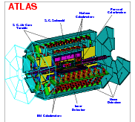
Trigger Configuration + Data
TriggerDB All configuration data
Preparation
Stores
decoded Trigger Menu
Configures
Data
taking
Online
Conditions
Database
COOL
Encoded trigger result
from all 3 levels
Decoded trigger menu
Reconstruction
Trigger Result
passed?, passed through?, prescaled?, last successful step in trigger execution?
Trigger EDM (Features)
Trigger objects for trigger selection & studies
Trigger Configuration
Trigger names, prescales, pass throughs
access through ITrigDecisionTool
ESD
AOD
With decreasing amount of detail
Trigger aware analysis
DPD
TAG

Slide 5
Trigger-aware analysis
Analysis based on single trigger chain or an ‘OR’ of a few chains
Chain definition – algorithms, cuts, multiplicities – do not change during a run, but can change between runs
Important for analysis on DPD, where multiple runs are merged
Prescales at LVL1 or at HLT can change between luminosity blocks
A negative prescale means that this trigger is off. This is important for calculating the integrated luminosity

Slide 6
Bringing it Together – TrigDecisionTool
ESD
AOD
DPD
contain persistent
Configuration can change between runs
Decision + Navigation
EDM
Configuration
Unpacking
Dec. + Nav.
EDM P/T
convertion
IOV based P/T conv.
BUT:
Prescales can change between lumiblocks
(trigger on/off)
IOVDbSvc
Upon Request
ConfigSvc
Transient:
TrigDecision
Feature Nav.
Configuration
TrigDecisionTool

Slide 7
Usage: Just like any other Tool
ToolHandle to a TrigDecisionTool in your algorithm header
Initialize ToolHandle in constructor as public tool
Retrieve tool in initialization
Be careful in the CBNT framework initialize is done in eventloop (use BeforeInitialize)
Use tool in execute
private:
ToolHandle<TrigDecisionTool> m_trigDec;
MyAlgo::MyAlgo(const std::string &name, …) : m_trigDec("TrigDec::TrigDecisionTool/TrigDecisionTool”)
{
declareProperty("TrigDecisionTool", m_trigDec, \
”The tool to access TrigDecision”);
}
StatusCode sc = m_trigDec.retrieve();
std::string chainname(“L2_e15i”);
if (m_trigDec->isConfigured( chainname )) {
if ( m_trigDec->isPassed( chainname )) {
(*m_log) << MSG::INFO << ”I’m happy!"
<< endreq;
}
}

Slide 8
What’s there? – Configuration Data
L1 Items: name, version, CTP-Id, prescale
To come: bunch-group for each item
Also to come: Definition of L1Items in terms of thresholds
HLT Chains: name, version, level, counter, prescale, trigger elements
Streams: chains feeding into each stream
Chain-groups: chains belonging to each group
Bunch-groups: name of each of the 8 BG

Slide 9
Access to Configuration
const std::vector< const TrigConf::TriggerItem * > |  | getL1ConfigurationItems () const
 |  | return vector of ALL L1 configuration items (even those that weren't active for this event)
const std::vector< const TrigConf::HLTChain * > |  | getConfigurationChains () const
 |  | gets vector of ALL HLT configuration chains (even those that weren't active for this event)
std::vector< std::string > |  | getConfiguredChainNames (TrigLevel lvl) const
 |  | gets vector of HLT configured chain names for each level (even those that weren't active for this event)
virtual std::vector< std::string > |  | getConfiguredChainNames () const
 |  | list of all configured chains (both levels of HLT and L1)
virtual std::map< std::string, std::vector< std::string > > |  | getConfiguredGroups () const
 |  | Returns mapping from group names to chain names.
virtual std::map< std::string, std::vector< std::string > > |  | getConfiguredStreams () const
 |  | Returns mapping from stream names to chain names.
float |  | getFullChainPrescaleFactor (TrigLevel lvl, unsigned int chain_counter) const
 |  | get presacle factor taking into account all factors in previous levels also.
float |  | getFullChainPrescaleFactor (const std::string &chain_name) const
 |  | get presacle factor taking into account all factors in previous levels also.

Slide 10
What’s there? – Trigger Decision
Lvl1 decision before and after prescale and after veto (deadtime veto)
HLT decision before and after prescale, and after pass-through
Last step of chain execution
Error codes for algorithm
Bunch group fired (to come)
For more detailed trigger studies

Slide 11
Access to TrigDecision
bool |  | isPassed (TrigLevel lvl) const
 |  | check if given trigger level is passed It means that at least one chain (in case of HLT) or item (in LVL1 jargon) is satisfied.
bool |  | isPassedRaw (const std::string &chain_name) const
 |  | checks if the given chain filter is satisfied by name (filter decision after ps)
bool |  | isPrescaled (const std::string &chain_name) const
 |  | checks if prescale is set (L1 is after filter, L2 and EF BEFORE filter) by name (defined for HLT chain, will return false for LVL1 item)
bool |  | isPassedThrough (const std::string &chain_name) const
 |  | checks if chain passed due to the Pass-Through mechanism by name (defined for HLT chain, will return false for LVL1 item)
bool |  | isL1Veto (const std::string &chain_name) const
 |  | checks if LVL1 item was rejected due to the Veto mechanism by name (will return false for HLT chain)
bool |  | isPassed (const std::string &chain_name) const
 |  | checks if the given chain is satisfied by name (after ps and passthrough)
bool |  | isPhysicsPassed (const std::string &chain_name) const
 |  | checks if the given chain/item and lower levels (EF+L2+L1) is satisfied by name for physics (ignores pass through)
bool |  | isError (TrigLevel lvl) const
 |  | returns the HLTResult error
virtual bool |  | isGroupPassed (const std::string &group_name) const
 |  | checks if any chain in this group passed (by any means, also Pass-Through)
virtual bool |  | isStreamPassed (const std::string &stream_name) const
 |  | checks if stream tag present in the event
bool |  | isTriggerPassed () const
 |  | check if the trigger decision was positive This means that all configured triggers passed that event.

Slide 12
What’s there? – Features
Features can be retrieved through the “TriggerNavigation” using the TrigDecisionTool
Features are created by FEX algorithms. They appear in StoreGate in containers according to FEX name. A FEX also creates a “TriggerElement” (TE)
A TE is used as handle to the feature
A TE has a pass/fail state set by the HYPO corresponding to the FEX
So the navigation can give you the TE’s for all the FEX that run in a chain
Or just those that passed the last step in the chain
From there you get the features (type templated)
This is the correct way to retrieve the features for each RoI
TrigEMCluster
T.E.
TrigInDetTrack
T.E.
CaloCluster
T.E.
egamma
T.E.

Slide 13
Access to Features
const std::vector< const HLT::TriggerElement * > * |  | getChainTEs (std::string chain_name, int step=-1)
 |  | get list of TriggerElements from Navigation structure which were mentioned in the chain
std::string |  | getTELabel (const HLT::TriggerElement *te) const
 |  | get TriggerElement human readable label (like L2_e10calo) TE by itself does not hold label but only identifier which is 32bit integer.
template<class T> HLT::ErrorCode |  | getFeature (const HLT::TriggerElement *te, const T *&feature, const std::string &label="")
 |  | find feature (single object) attached to TE or any of it's predecessor If objects of given type are not found attached to given TE then the HLT::Navigation tree is followed down until object is found or root node is met.
template<class T> HLT::ErrorCode |  | getFeatures (const HLT::TriggerElement *te, std::vector< const T * > &feature, const std::string &label="")
 |  | find features (list of objects) attached to TE or any of it's predecessor The structure is searched down until the TE is found which has object of this type attached.
template<class T> HLT::ErrorCode |  | getPassFeatures (std::string chain_name, std::vector< const T * > &vec_features, const std::string &label="")
 |  | accessor for users analyzing trigger output.
template<class T> HLT::ErrorCode |  | getAllFeatures (std::string chain_name, std::vector< const T * > &vec_features, const std::string &label="")
 |  | accessor for users analyzing trigger output.
HLT::ErrorCode |  | getPassL1RoIs (std::string chain_name, std::vector< const TrigRoiDescriptor * > &vec_roi)
 |  | similar to getPassRoIs but only initial (those coming from LVL1) descriptors are given back
HLT::ErrorCode |  | getAllL1RoIs (std::vector< const TrigRoiDescriptor * > &vec_roi, TrigLevel lvl)
 |  | get list of TrigRoIDescriptor for RoIs which were present

Slide 14
Athena Example for using Features
You need to know the type of the Feature
You need to know the chain in which it was produced
Here we get all TrigTauCluster that contributed to the passing of the chain
std::vector<const TrigTauCluster* > taucl;
ec = m_trigDec->getPassFeatures("L2_tau12", taucl);
if (ec == HLT::OK) {
std::vector<const TrigTauCluster* >::const_iterator CI;
for (CI = taucl.begin(); CI != taucl.end() ; ++CI) {
log << MSG::INFO
<< ”Energy in EB sampling 1: “
<< (*CI)->energy(CaloSampling::EMB1) << endreq;
log << MSG::INFO
<< “ Energy in EB sampling 2: “
<< (*CI)->energy(CaloSampling::EMB2) << endreq;
}
} else return StatusCode::FAILURE;
TrigDecChecker INFO REGTEST Energy in EB sampling 1: 26935
TrigDecChecker INFO REGTEST Energy in EB sampling 2: 53473

Slide 15
Athena ROOT Access
Since 14.2.22 ARA with trigger data works out of the box
Lot’s of work went into flattening of the trigger EDM containers
Necessary to access features in ARA
Two main improvements:
Feature access through navigation (i.e. per RoI)
Access to trigger configuration
Interface similar to TrigDecisionTool, but currently not the same

Slide 16
ARA Example (I)
Preparation: create transient objects of information
For configuration data hidden inside TriggerConfARAA
import ROOT, PyCintex , AthenaROOTAccess.transientTree
from TrigConfigSvc.TriggerConfigARA import TriggerConfigARA
from TrigSteering.Chain import Chain
myFiles = ["AOD1.pool.root", "AOD2.pool.root", "AOD3.pool.root"]
CollectionTree = ROOT.TChainROOTAccess('CollectionTree')
for myfile in myFiles:
CollectionTree.Add(myfile)
transientTree = AthenaROOTAccess.transientTree.makeTree(CollectionTree)
trigconf = TriggerConfigARA(myFiles)
Three things to import
List of pool files
Create transient event data tree
Create transient configuration wrapper

Slide 17
ARA Example (II)
for evt in xrange(transientTree.GetEntries()):
transientTree.GetEntry(evt)
eventID = transientTree.McEventInfo.event_ID()
updated = trigconf.update(eventID.run_number(), eventID.lumi_block())
if updated:
print trigconf
for chainname in trigconf.HLTChains:
print trigconf.HLTChains [chainname]
ef = transientTree.TrigDecision.geEFResult()
chains = [Chain[ch] for ch in ef.getChainResult()]
for c in chains:
print "Chain : counter = %i, success = %i PS = %i PT = %i => final success = %i" \
% (c.getChainCounter(), c.chainPassedRaw(), c.isPrescaled(), c.isPassedThrough(), \
c.chainPassed())
e = c.getErrorCode()
print " : error -> action = %i code = %i reason = %i steeringInternalReason = %i" \
% (e.action(), e.code, e.reason(), e.steeringInternalReason())
Loop over event
EventInfo for #run/lb
Trigger Configuration
Check for new and update trigger configuration (based on run/lb)
Print chains
Trigger Decision
Get EF result and deserialize chains
Print chain decision
– or error code

Slide 18
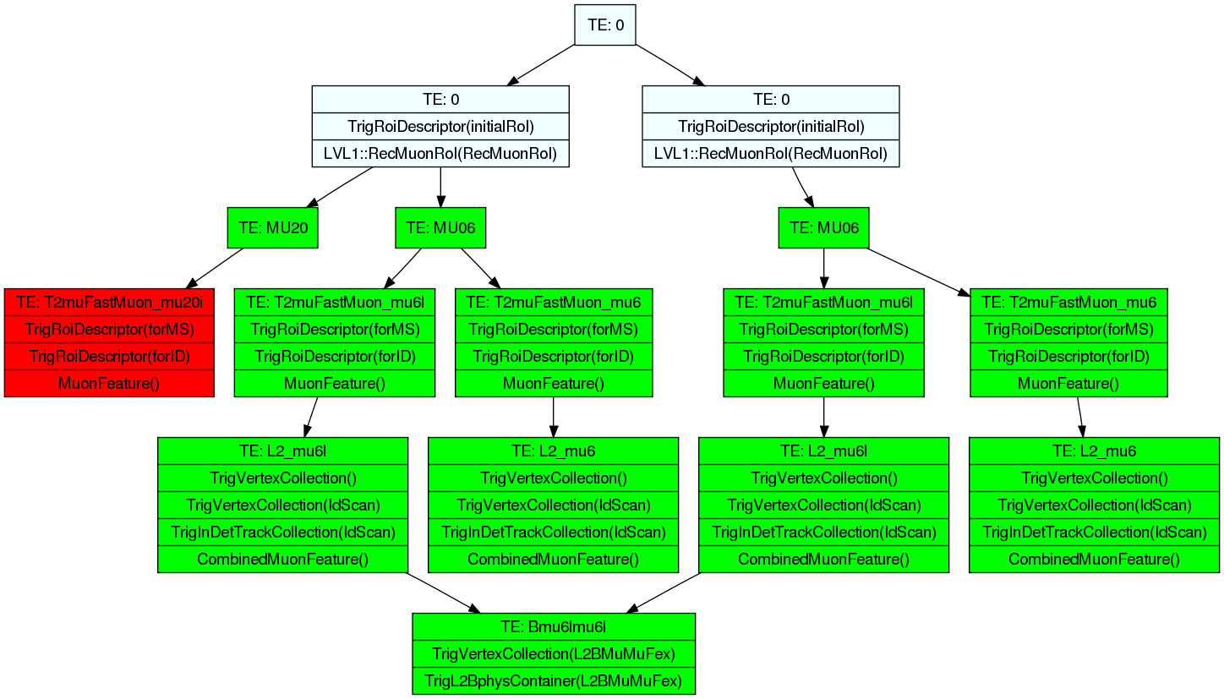
ARA Example (III)
Also access to Trigger Navigation
Examples on https://twiki.cern.ch/twiki/bin/view/Atlas/TriggerARA14
Example Navigation structure of B->μμ trigger with multiple
Muon candidate ROI’s
Graphics from Till Eifert

Slide 19
Trigger information slimming
Initial
EM
RoI
EM
RoI
X
Muon
RoI
EM
RoI
Needed for producing custom DPDs (e.g. Physics DPDs or user DPDs)
Feature Removal – remove objects according to type and FEX
Pruning – remove entire RoIs (see example above)
Squeezing – compress navigation information (no information loss)
Slimming – remove chains belonging to groups or streams
More info in: https://twiki.cern.ch/twiki/bin/view/Atlas/HLTTrigNavigationSlimming

Slide 20
Tools to Investige the Trigger Setup
Run-summary page: trigger chains, prescales, rates – web based
Query single run
AtlCoolTrigger.py: same, but command line
Views many runs
TriggerTool: Java based GUI to browse the TriggerDB (replica) for all information
http://trigconf.cern.ch as web front-end to TriggerTool and AtlCoolTrigger.py

Slide 21
Trigger Menu Listing
Triger Menu and L1 rates stored in COOL, HLT rates coming. Quick access via
Run summary pages (WEB based)
http://atlas-service-db-runlist.web.cern.ch/atlas-service-db-runlist/query.html
Trigger names, rates
AtlCoolTrigger.py (command line tool)
AtlCoolTrigger –r 91000‐99000 (many run summary)
AtlCoolTrigger –v –m –r 90272 (single run menu)
Prints keys, trigger menus, streams, allows diff‐ing of menus in different runs

Slide 22
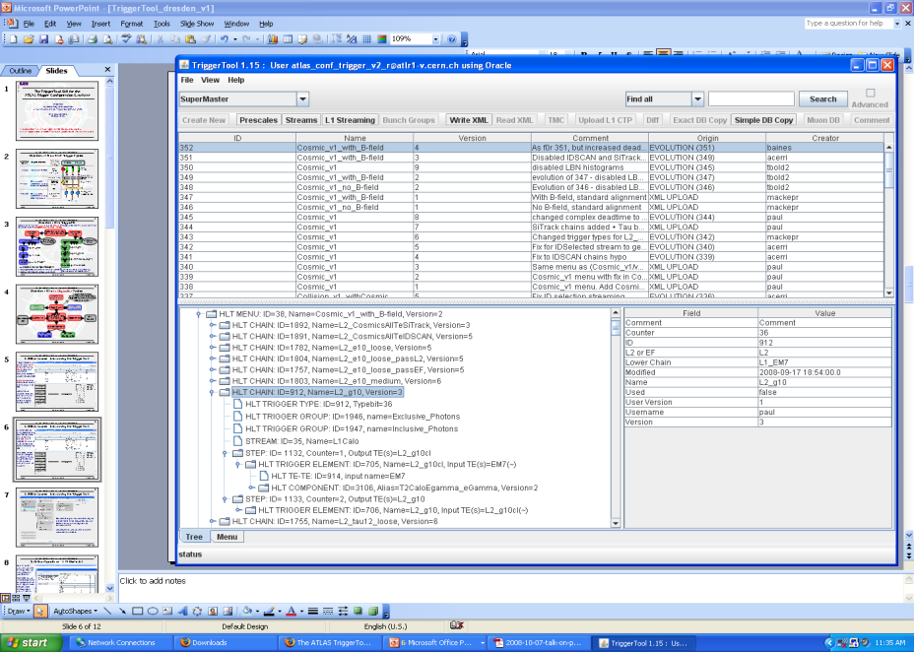
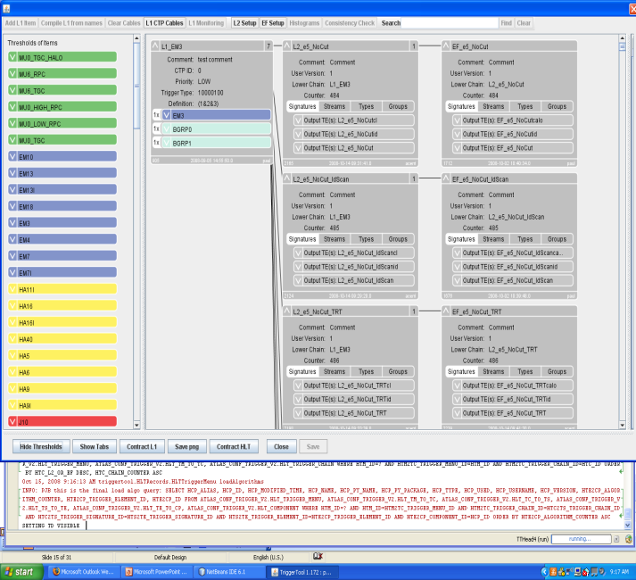
TriggerTool
Java based front end to TriggerDB, launch from the web (Java web-start): http://www.cern.ch/triggertool
Overview of all trigger configurations
Detailed and convenient investigation of trigger menus
Trigger definition L1->L2->EF: prescales, threshold algorithms, selection criteria, streaming information, etc.
Possibility to compare different trigger configurations

Slide 23
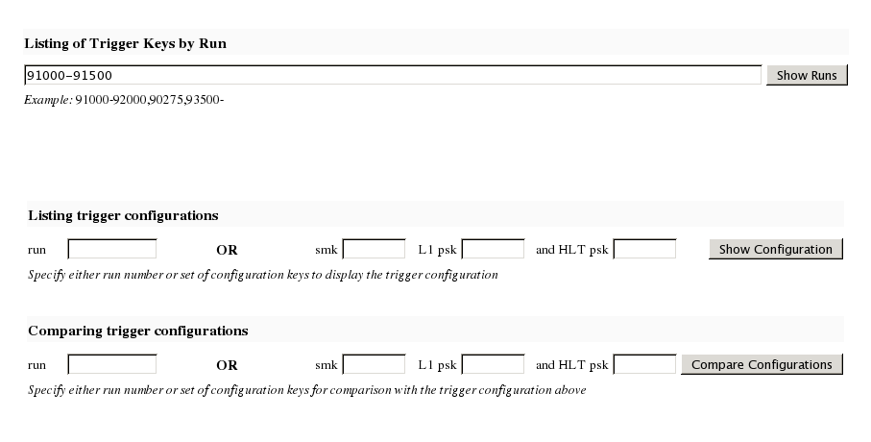
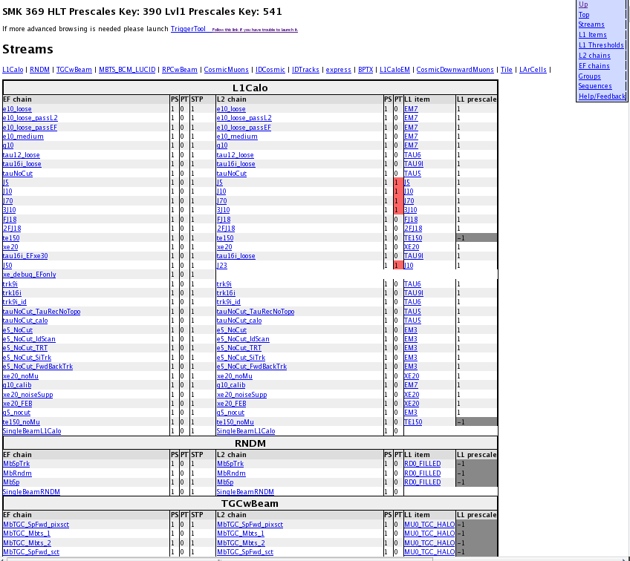
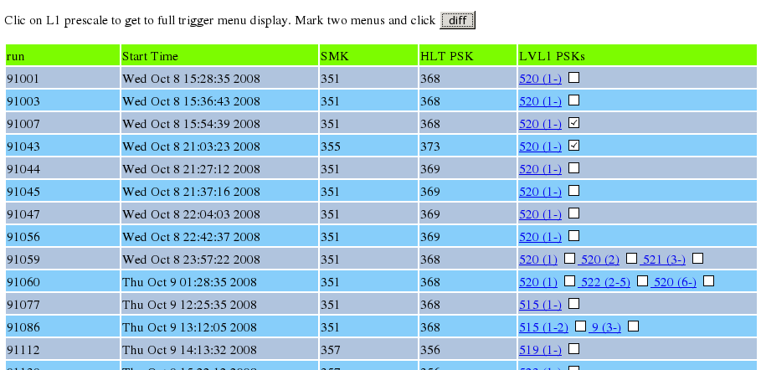
Web Interface to COOL and the TriggerDB
Web interface http://trigconf.cern.ch
Runs TriggerTool on the server, result presented as dynamic html pages
1. Search run-range
3. Trigger configuration (browsable) (definition, algorithms, selection cuts)
2. Run list
Also with simple comparison functionality

Slide 24
Scripts to Check Pool File Content
checkTrigger.py AOD.pool.root
Runs over ESD/AOD/DPD and presents detailed (chain‐wise) counts of the trigger decision
checkTriggerConfig.py ‐d AOD.pool.root
Runs over ESD/AOD/DPD and presents detailed trigger configuration(s) in the file
Shows multiple configurations, in DPD possible/likely

Slide 25
Coming soon…
New TrigDecisionTool interface
Logical groups of triggers to support analysis needs
OR of triggers – regular expressions allowed
Consistent scheme for returning features – used in simple and combined triggers
E.g. retrieve combinations of electron and muon passing e15_mu10
Same interface for Athena and ARA
Simplified interface (but no loss in functionality)
Also called TrigDecisionTool (both coexist at the moment)
Coming very soon (15.2.0?) – currently being tested
When finished, documentation and tutorial will follow
myTrigger = tdt.createChainGroup(“EF_e10_loose”,”EF_e15”,”EF_e15i”);
bool myEvent = tdt.decision().isPassed(myTrigger);

Slide 26
Additional Information
General Trigger info: https://twiki.cern.ch/twiki/bin/view/Atlas/TriggerUserPages
Tutorials: https://twiki.cern.ch/twiki/bin/view/Atlas/TriggerSoftwareTutorialPage
Trigger Event Data Model (EDM) : https://twiki.cern.ch/twiki/bin/view/Atlas/TriggerEDM
TrigDecisionTool:
Twiki: https://twiki.cern.ch/twiki/bin/view/Atlas/TrigDecisionTool
Doxygen:http://atlas-computing.web.cern.ch/atlas-computing/links/latestDocDirectory/TrigDecision/html/classTrigDec_1_1TrigDecisionTool.html
Athena examples:
AnalysisSkeleton: https://twiki.cern.ch/twiki/bin/view/AtlasProtected/UserAnalysis
TrigDecisionChecker: http://atlas-sw.cern.ch/cgi-bin/viewcvs-atlas.cgi/offline/Trigger/TrigValidation/TrigValAlgs/TrigValAlgs/TrigDecisionChecker.h?revision=1.2&view=markup
ARA example:
ARA: https://twiki.cern.ch/twiki/bin/view/Atlas/TriggerARA14
Trigger Configuration: https://twiki.cern.ch/twiki/bin/view/Atlas/TriggerConfiguration?topic=TrigDecisionTool
Run summary pages: http://atlas-service-db-runlist.web.cern.ch/atlas-service-db-runlist/query.html
(include link to start up the TriggerTool)
Trigger information slimming: https://twiki.cern.ch/twiki/bin/view/Atlas/HLTTrigNavigationSlimming
TriggerMenu working group: https://twiki.cern.ch/twiki/bin/view/Atlas/TriggerPhysicsMenu
Help: Hypernews forum hn-atlas-TriggerHelp@cern.ch

