Slide 1


What’s in the ATLAS data : Trigger Decision
ATLAS Offline Software Tutorial
CERN, 20-22 August 2008
Ricardo Gonçalo - RHUL

Slide 2
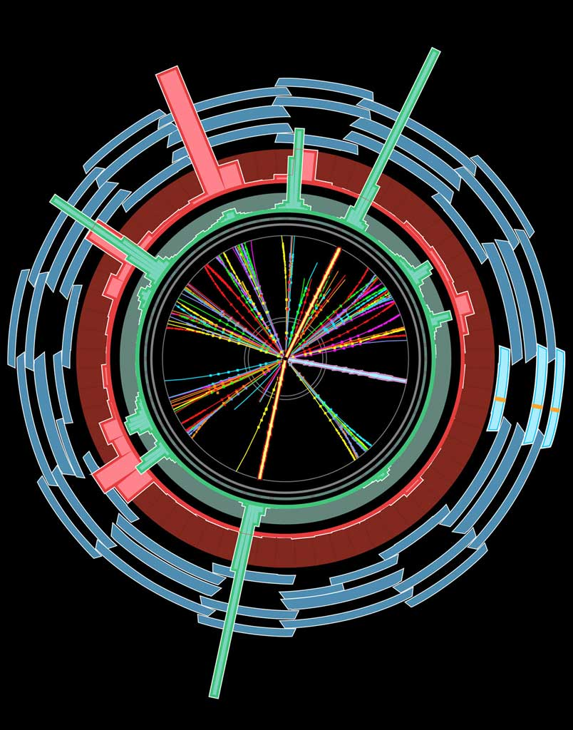
Trigger Selection
Level1 Region of Interest is found and position in EM calorimeter is passed to Level 2
EM ROI
L2 calorim.
Event rejection possible at each step
cluster?
Electromagnetic
clusters
Level 2 seeded by Level 1
Fast reconstruction algorithms
Reconstruction within RoI
L2 tracking
track?
match?
E.F.calorim.
E.F.tracking
Ev.Filter seeded by Level 2
Offline reconstruction algorithms
Refined alignment and calibration
track?
e/γ reconst.
e/γ OK?

Slide 3
EMROI
Algorithm execution managed by Steering
  Based on static trigger configuration
Step-wise processing and early rejection
  Chains stopped as soon as a step fails
  Event passes if at least one chain is successful
Feature Extraction algorithms (FEX)
  Features (i.e. objects) cached to avoid time-consuming reconstruction
Navigation links between TriggerElements
  Navigation to objects possible in chain tree
Trigger objects stored in ESD/AOD/DPD
  Trigger “features” (id tracks, clusters, muon candidates, electron candidates, etc)
  Navigation links (TriggerElements)
  Trigger Configuration (file header)
L2 calorim.
L2 calorim.
TrigEMCluster
T.E.
cluster?
cluster?
L2 tracking
TrigInDetTracks
T.E.
track
match?
E.F.calorim.
E.F.calorim.
CaloCluster
T.E.
E.F.tracking
track?
e/γ reconst.
e/γ reconst.
egamma
T.E.
γ OK?
e± OK?

Slide 4
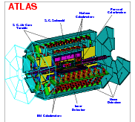
Configuration Data Flow
TriggerDB
All configuration data
Preparation
Configures
Stores
decoded Trigger Menu
Data
taking
Online
Conditions
Database
Encoded trigger decision
(trigger result from all 3 levels )
Decoded Trigger Menu
Trigger Result
passed?, passed through?, prescaled?, last successful step in trigger execution?
Trigger EDM
Trigger objects for trigger selection studies
Trigger Configuration
Trigger names (version), prescales, pass throughs
access through TrigDecisionTool
ESD
Reconstruction/
Trigger aware
analysis
AOD
With decreasing
amount of detail
DPD
TAG

Slide 5

TrigDecisionTool
The TrigDecisionTool is the analysis interface to the trigger information in Athena
  It reads the trigger decision object (TrigDecision) and the trigger configuration
Dynamic information (event-by-event)
  What triggers passed/failed
  Did they pass because of e.g. passthrough?
  Navigate/retrieve trigger objects from each chain
Configuration information:
  Configured chains
  Prescale and passthrough factors
  (Trigger) stream tags
TrigEMCluster
T.E.
Class TrigDecision
private:
int m_configMasterKey;
Lvl1Result m_l1_result;
DataLink<HLTResult> m_l2_result;
DataLink<HLTResult> m_ef_result;
TrigInDetTracks
T.E.
TrigDecisionTool
CaloCluster
T.E.
HLT configuration
list of chains and sequences
CTP Configuration
egamma
T.E.

Slide 6
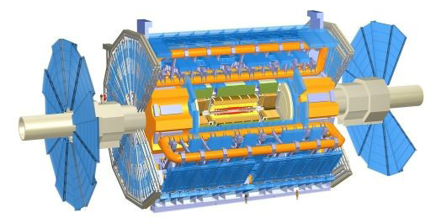
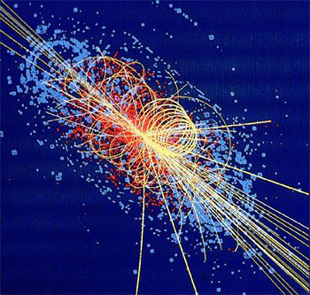
Different configuration data supports for different use cases: online, offline, AOD/ESD analysis
Persistent object stored POOL
Contains CTPDecision and HLTResult
Transient object
On request by Tool, expands and caches Configuration and Navigation information
TrigConfigSvc
Common interface to several configuration DB implementations
TrigDecision
transient object
T/P
converter
TrigDecision_p3
persistent object
unpack
TrigDecisionTool
user interface
TrigConfigSvc
TriggerDB
COOL
TrigDecisionTool: user interface; unpacks and interprets TrigDecision through configuration info
AOD header

Slide 7
How-to use TrigDecisionTool in Athena
Add to your algorithm a ToolHandle to point to a TrigDecisionTool
Initialize ToolHandle in constructor (adviseable to use as public tool)
Retrieve tool in initialization
Use tool in execute
private:
ToolHandle<TrigDecisionTool> m_trigDec;
MyAlgo::MyAlgo(const std::string &name, … m_trigDec("TrigDec::TrigDecisionTool/ TrigDecisionTool”)
{
declareProperty("TrigDecisionTool", m_trigDec, ”The tool to access TrigDecision”);
StatusCode sc = m_trigDec.retrieve();
if ( sc.isFailure() ) {
(*m_log)<< MSG::ERROR<< “Help!”<< endreq;
return sc;
}
std::string sig_name(“L2_e15i”);
if (m_trigDec->isConfigured( sig_name )) {
if ( m_trigDec->isPassed( sig_name )) {
(*m_log) << MSG::INFO
<< ”I’m happy!"
<< endreq;
}
}
e15i
isolated
p_{T}>15 GeV
electron
More complete example in TrigDecisionTool14 twiki

Slide 8
Retrieving trigger objects
std::vector<const TrigTauCluster* > vec_tauClust;
ec = m_trigDec->getPassFeatures("L2_"+trigItem, vec_tauClus);
if (ec == HLT::OK) {
std::vector<const TrigTauCluster* >::const_iterator CI=vec_tauClus.begin();
for ( ; CI != vec_tauClust.end() ; ++CI) {
(*m_log) << MSG::INFO
<< ”Energy in EB sampling 1: "<< (*CI)->energy(CaloSampling::EMB1)
<< “ Energy in EB sampling 2: "<<(*CI)->energy(CaloSampling::EMB2)
<< " Energy in EB sampling 3: "<<(*CI)->energy(CaloSampling::EMB3)
<< endreq;
}
} else return StatusCode::FAILURE;
TrigDecChecker INFO REGTEST L1 RoI Eta,Phi: 0.4, -1.47262
TrigDecChecker INFO REGTEST Energy in EB sampling 1: 26935
Energy in EB sampling 2: 53473
Energy in EB sampling 3: 824
TrigDecChecker INFO REGTEST L2 leading track pt: 55944.9

Slide 9
What else can it do?
Well documented in the code and in Doxygen

Slide 10
Outlook
The trigger information available for analysis is now quite complete
Work currently ongoing (or at least in the pipeline):
  Providing/improving access to trigger data outside Athena
  Slimming navigation for inclusion in DPDs
    Will be included without slimming in 2008
  Cleaning up the TrigDecisionTool interface
  Providing “navigation” links between offline objects and trigger navigation as a common feature
The first priority: make the trigger run with real data!
  …And use this experience to find what else we need

Slide 11
More info
General Trigger info:
Trigger User Pages, general entry point for information: https://twiki.cern.ch/twiki/bin/view/Atlas/TriggerUserPages
Trigger Event Data Model (EDM) : https://twiki.cern.ch/twiki/bin/view/Atlas/TriggerEDM
TrigDecisionTool:
Doxygen: http://atlas-computing.web.cern.ch/atlas-computing/links/latestDocDirectory/TrigDecision/html/classTrigDec_1_1TrigDecisionTool.html
Wiki:
  Release 13: https://twiki.cern.ch/twiki/bin/view/Atlas/TrigDecisionTool14
  Release 14: https://twiki.cern.ch/twiki/bin/view/Atlas/TrigDecisionTool14
(with examples using AnalysisSkeleton)
Example using RecExCommon environment: TrigDecisionChecker http://atlas-sw.cern.ch/cgi-bin/viewcvs-atlas.cgi/offline/Trigger/TrigValidation/TrigValAlgs/TrigValAlgs/TrigDecisionChecker.h?revision=1.2&view=markup
(test algorithm used for trigger validation)
Outside Athena:
ARA: (April ATLAS Overview Week) http://indico.cern.ch/materialDisplay.py?contribId=56&sessionId=10&materialId=slides&confId=22136
SPyRoot: (not official trigger wiki) https://twiki.cern.ch/twiki/bin/view/Atlas/SPyRootRetrievingTriggerObjects
When something goes wrong:
  TriggerHelp Hypernews forum (hn-atlas-TriggerHelp@cern.ch)

Slide 12
Backup

Slide 13
Calo
MuTrCh
40 MHz
Other detectors
1 PB/s
LVL1
2.5 μs
Calorimeter
Trigger
Muon
Trigger
LVL1 Acc.
75 kHz
ROD
ROD
ROD
120 GB/s
H
L
T
LVL2
ROS
~40ms
L2SV
ROB
ROB
ROB
L2P
RoI data
L2P
L2N
3 GB/s
L2P
Event Builder
2 kHz
Event Filter
~4sec
EB
EFP
EFP
EFP
EFN
200 Hz
300 MB/s

Slide 14
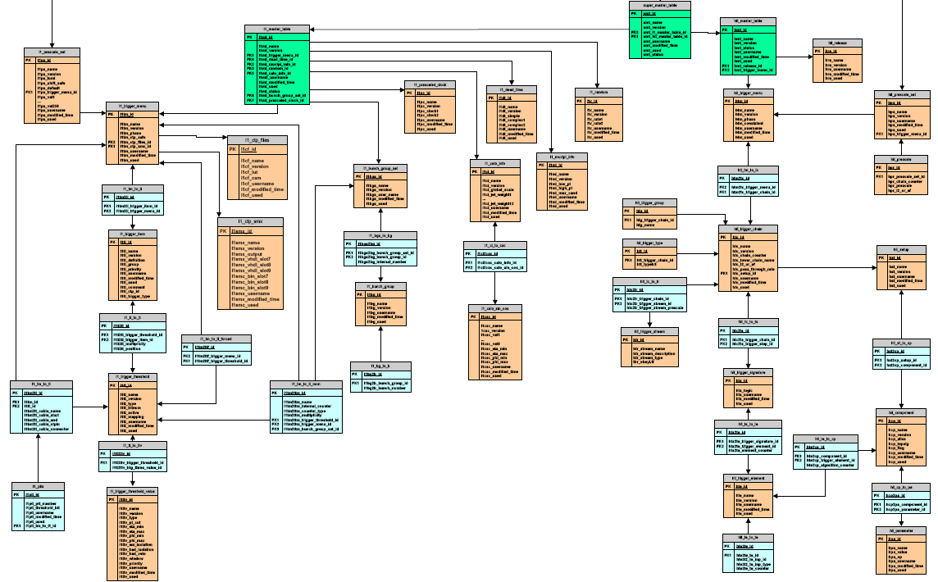
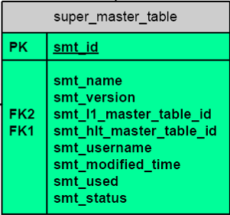
L1 Master
Super Master
HLT Master
- SuperMaster table contains links to L1 and HLT master tables
- HLTMaster table defines complete HLT configuration
- L1Master table defines complete L1 configuration: the L1 menu and CTP config
the supermaster ID (“key”) chooses matching L1 + HLT trigger menus
Aim to configure the trigger from DB also outside point1 - trigger validation on the CAF; trigger simulation; trigger development
The advantage is to access the same trigger configuration as was used for data taking
➔ easy to achieve reproducibility
TriggerDB to be available at Tier0/1 (Oracle), and Tier2 (SQlite)
First running version in 14.2.10
Configuration Database
Level 1
HLT
3

Slide 15
