Slide 1
Trigger Data for physics analysis
Ricardo Gonçalo – Royal Holloway
ATLAS Software Tutorial – 22nd to 24th April 2009

Slide 2
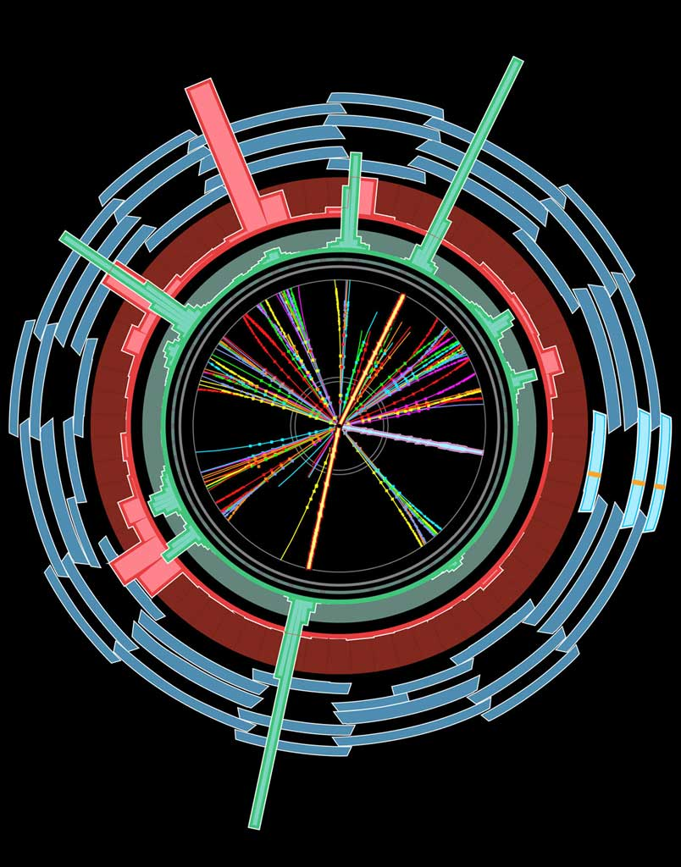
The Trigger
EM ROI
L2 calorim.
An example
Electromagnetic
clusters
Level1:
Region of Interest is found and position in EM calorimeter is passed to Level 2
cluster?
L2 tracking
track?
Level 2 seeded by Level 1
Fast reconstruction algorithms
Reconstruction within RoI
match?
E.F.calorim.
E.F.tracking
track?
Ev.Filter seeded by Level 2
Offline reconstruction algorithms
Refined alignment and calibration
e/γ reconst.
e/γ OK?

Slide 3
FEX
FEature eXtraction algos produce
Features on which selection in
HYPOthesis algos is based
EMROI
features
L2 calorim.
L2 calorim.
HYPO
TrigEMCluster
T.E.
OK?
OK?
Chain:
  Started, if seed has fired and chain is not prescaled
  Stopped at step, if a HYPO is not passed
  Last HYPO passed → chain passed
Event:
  Passed, if at least one EF chain is passed
  Put into all streams that are associated with any passed EF chain
Trigger information in
  Trigger Decision +
  Trigger features +
  Trigger Navigation +
  Configuration
L2 tracking
TrigInDetTracks
T.E.
match?
E.F.calorim.
E.F.calorim.
CaloCluster
T.E.
E.F.tracking
track?
ESD
AOD
DPD
TAG
e/γ reconst.
e/γ reconst.
decision
egamma
T.E.
features
γ OK?
e± OK?
T.E.
passed e/γ trigger

Slide 4
What’s there? – Features
Features can be retrieved through the “TriggerNavigation” using the TrigDecisionTool
Features are created by FEX algorithms. They appear in StoreGate in containers according to FEX name. A FEX also creates a “TriggerElement” (TE)
  A TE is used as handle to the feature
  A TE has a pass/fail state set by the HYPO corresponding to the FEX
So the navigation can give you the TE’s for all the FEX that run in a chain
  Or just those that passed the last step in the chain
  From there you get the features (type templated)
  This is the correct way to retrieve the features for each RoI
TrigEMCluster
T.E.
TrigInDetTrack
T.E.
CaloCluster
T.E.
egamma
T.E.

Slide 5
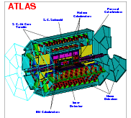
Trigger Configuration + Data
TriggerDB
All configuration data
Preparation
Stores
decoded Trigger Menu
Configures
Data
taking
Online
Conditions
Database
COOL
Encoded trigger result
from all 3 levels
Decoded trigger menu
Reconstruction
Trigger Result
passed?, passed through?, prescaled?, last successful step in trigger execution?
Trigger EDM (Features)
Trigger objects for trigger selection & studies
Trigger Configuration
Trigger names, prescales, pass throughs
access through ITrigDecisionTool
ESD
AOD
With decreasing
amount of detail
Trigger aware
analysis
DPD
TAG

Slide 6
What’s there? – Configuration Data
L1 Items: name, version, CTP-Id, prescale
  To come: bunch-group for each item
  Also to come: Definition of L1Items in terms of thresholds
HLT Chains: name, version, level, counter, prescale, trigger elements
Streams: chains feeding into each stream
Chain-groups: chains belonging to each group
Bunch-groups: name of each of the 8 BG

Slide 7
Trigger-aware analysis
Analysis based on single trigger chain or an ‘OR’ of a few chains
Chain definition – algorithms, cuts, multiplicities – do not change during a run, but can change between runs
  Important for analysis on DPD, where multiple runs are merged
Prescales at LVL1 or at HLT can change between luminosity blocks
  A negative prescale means that this trigger is off. This is important for calculating the integrated luminosity

Slide 8
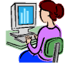
Bringing it Together – TrigDecisionTool
ESD
AOD
DPD
contain persistent
Configuration can change between runs
Decision +
Navigation
EDM
Configuration
Unpacking
Dec. + Nav.
EDM P/T
convertion
IOV based
P/T conv.
BUT:
Prescales can change between lumiblocks
(trigger on/off)
IOVDbSvc
Upon Request
ConfigSvc
Transient:
TrigDecision
Feature Nav.
Configuration
TrigDecisionTool

Slide 9
Migration to new TrigDecisionTool in rel. 15.2.0!!!
The standard user interface to trigger data for physics analysis
Major change from release 15.2.0 to:
  Provide new functionality
  Simplify the API
  Increase robustness
  Allow easy use in both Athena and ARA
See last tutorial for old version (<15.2.0)
  http://indico.cern.ch/conferenceDisplay.py?confId=55063
The two versions coexist in Athena for now (old one won’t be supported for long)
  In different namespaces: old TrigDec::/ new Trig:: and TrigDefs::
Documentation:
  Wiki: https://twiki.cern.ch/twiki/bin/view/Atlas/TrigDecisionTool15
  Examples: Trigger/TrigAnalysis/TrigAnalysisExamples

Slide 10
Usage: Just like any other Tool
ToolHandle to a TrigDecisionTool in your algorithm header
Initialize ToolHandle in constructor as public tool
Retrieve tool in initialization
Use tool in execute()
private:
ToolHandle<Trig::TrigDecisionTool> m_trigDec;
MyAlgo::MyAlgo(const std::string &name, …) : m_trigDec("Trig::TrigDecisionTool/TrigDecisionTool”)
{
declareProperty("TrigDecisionTool", m_trigDec, \
”The tool to access TrigDecision”);
}
StatusCode sc = m_trigDec.retrieve();
(*m_log) << MSG::INFO
<< "L2_mu.* passed/failed: "
<< m_trigDec->isPassed("L2_mu.*")
<< endreq;

Slide 11

TrigDecisionTool and ChainGroups
Important concept in the new tool: ChainGroup
  They work as an OR of triggers
  Created from a vector of trigger names, comma-separated list or regular expressions:
  const ChainGroup* getChainGroup(const string& names)
Can be used e.g. to get pass/fail information:
Can be created on the fly:

Slide 12
Accessing features created by a chain
Use chains or chain groups to access trigger features produced by each trigger/group
  FeatureContainer gives access to Trigger Elements and trigger objects for simple or complex triggers
  Combinations allows to retrieve e.g. combinations of objects satisfying combined triggers like EF_tau16_2j23
FeatureContainer f = m_trigDec->features(“L2_e15”);
FeatureContainer::combination_const_iterator it;
for (it = f.getCombinations().begin(); it != f.getCombinations().end(); ++it) {
std::vector< Feature<TrigRoiDescriptor> > initRois =
cIt->get<TrigRoiDescriptor>("initialRoI");
}

Slide 13
Trigger information slimming
Initial
EM
RoI
EM
RoI
X
Muon
RoI
EM
RoI
Needed for producing custom DPDs (e.g. Physics DPDs or user DPDs)
Feature Removal – remove objects according to type and FEX
Pruning – remove entire RoIs (see example above)
Squeezing – compress navigation information (no information loss)
Slimming – remove chains belonging to groups or streams
More info in: https://twiki.cern.ch/twiki/bin/view/Atlas/HLTTrigNavigationSlimming

Slide 14
Tools to Investige the Trigger Setup
Run-summary page: trigger chains, prescales, rates – web based
  Query single run
AtlCoolTrigger.py: same, but command line
  Views many runs
TriggerTool: Java based GUI to browse the TriggerDB (replica) for all information
http://trigconf.cern.ch as web front-end to TriggerTool and AtlCoolTrigger.py

Slide 15
Trigger Menu Listing
Triger Menu and L1 rates stored in COOL, HLT rates coming. Quick access via
  Run summary pages (WEB based)
  http://atlas-service-db-runlist.web.cern.ch/atlas-service-db-runlist/query.html
    Trigger names, rates
  AtlCoolTrigger.py (command line tool)
    AtlCoolTrigger –r 91000‐99000 (many run summary)
    AtlCoolTrigger –v –m –r 90272 (single run menu)
    Prints keys, trigger menus, streams, allows diff‐ing of menus in different runs

Slide 16
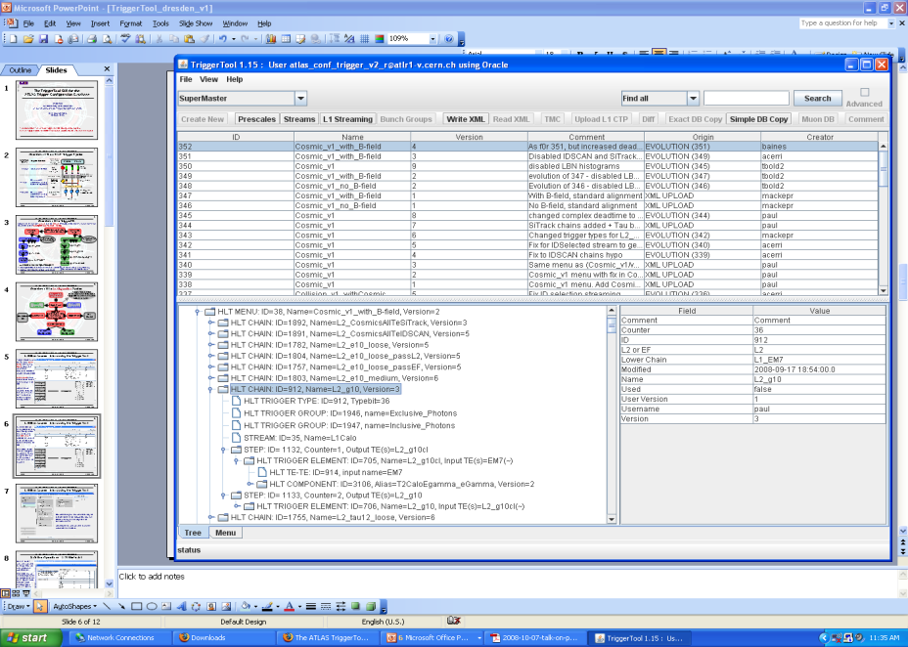
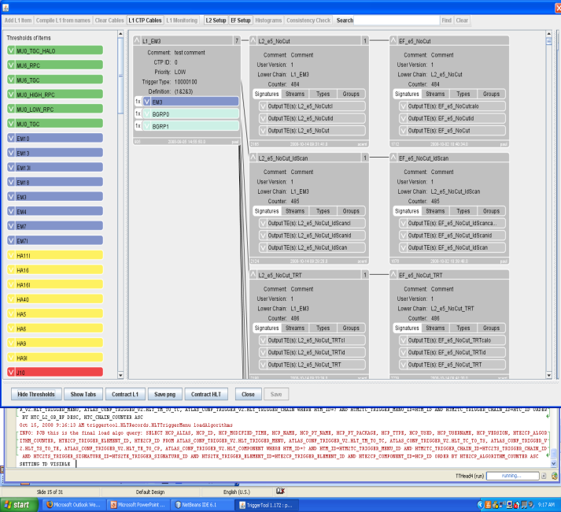
TriggerTool
Java based front end to TriggerDB, launch from the web (Java web-start): http://www.cern.ch/triggertool
  Overview of all trigger configurations
  Detailed and convenient investigation of trigger menus
    Trigger definition L1->L2->EF:
    prescales, threshold algorithms, selection criteria, streaming information, etc.
Possibility to compare
different trigger configurations

Slide 17
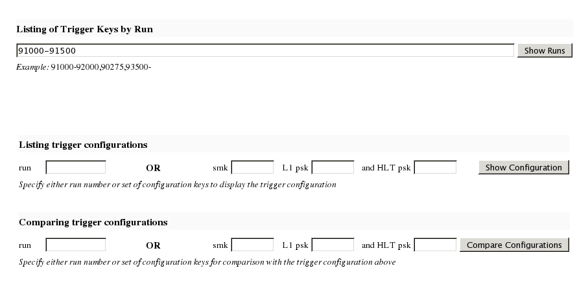
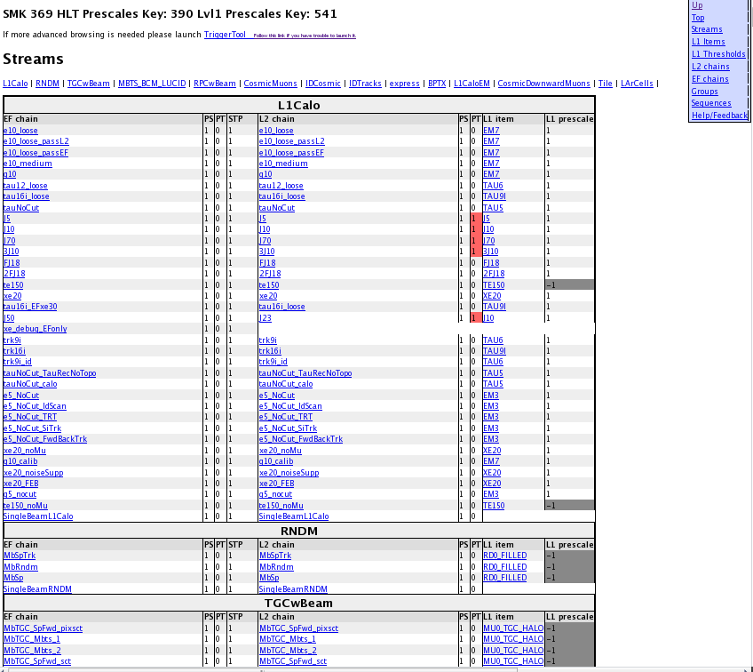
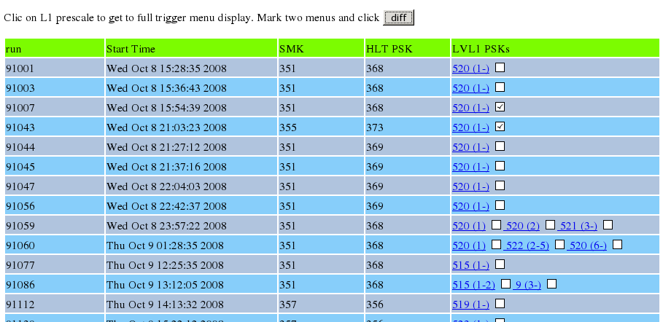
Web Interface to COOL and the TriggerDB
Web interface http://trigconf.cern.ch
  Runs TriggerTool on the server, result presented as dynamic html pages
1. Search
run-range
3. Trigger configuration (browsable)
(definition, algorithms, selection cuts)
2. Run list
Also with simple comparison functionality

Slide 18
Scripts to Check Pool File Content
checkTrigger.py AOD.pool.root
  Runs over ESD/AOD/DPD and presents detailed (chain‐wise) counts of the trigger decision
checkTriggerConfig.py ‐d AOD.pool.root
  Runs over ESD/AOD/DPD and presents detailed trigger configuration(s) in the file
  Shows multiple configurations, in DPD possible/likely

Slide 19
Additional Information
General Trigger info: https://twiki.cern.ch/twiki/bin/view/Atlas/TriggerUserPages
Tutorials: https://twiki.cern.ch/twiki/bin/view/Atlas/TriggerSoftwareTutorialPage
Trigger Event Data Model (EDM) : https://twiki.cern.ch/twiki/bin/view/Atlas/TriggerEDM
TrigDecisionTool – all releases/versions:
Twiki: https://twiki.cern.ch/twiki/bin/view/Atlas/TrigDecisionTool
Athena examples:
TrigAnalysisExamples package:
http://atlas-computing.web.cern.ch/atlas-computing/links/nightlyDevDirectory/AtlasOffline/latest_doxygen/InstallArea/doc//TrigAnalysisExamples/html/
TrigDecisionChecker (pre-15.X.0 for the moment): http://atlas-sw.cern.ch/cgi-bin/viewcvs-atlas.cgi/offline/Trigger/TrigValidation/TrigValAlgs/TrigValAlgs/TrigDecisionChecker.h?revision=1.2&view=markup
ARA example:
ARA: https://twiki.cern.ch/twiki/bin/view/Atlas/TriggerARA14
Trigger Configuration: https://twiki.cern.ch/twiki/bin/view/Atlas/TriggerConfiguration?topic=TrigDecisionTool
Run summary pages: http://atlas-service-db-runlist.web.cern.ch/atlas-service-db-runlist/query.html
(include link to start up the TriggerTool)
Trigger information slimming: https://twiki.cern.ch/twiki/bin/view/Atlas/HLTTrigNavigationSlimming
TriggerMenu working group: https://twiki.cern.ch/twiki/bin/view/Atlas/TriggerPhysicsMenu
Help! Hypernews forum hn-atlas-TriggerHelp@cern.ch

