Slide 1
Jet/MET/HLTCalo On-Call Report
Ricardo Gonçalo – LIP
E_{T}^{miss} Trigger Meeting – 27/5/2015

Slide 2
Run by Run DQ Summary
Run | Duration | Ended | Events | Online Hist. | Offline Hist. | Obs.
265085 | 500.9m | Mon 08:48 | 1902928 | MET 2 peak Jet ok Calo ok | Jets ok MET ok | Some spikes in calo
265171 | 21.9m | Mon 17:22 | 3386435 | Empty | Empty | Low stats
265182 | 789.2m | Tue 08:55 | 1616881 | Calo ok Met ok Jet ok | Jets ok Met ok | Jet spike η,φ=0.6,-1 Calo spikes η=±2, φ=-3 TC/Jet-MET spike at φ=0
265270 | 35.9m | Tue 18:43 | 1471540 | Empty | Empty | Low stats
265309 | 31.4m | Tue 22:02 | 303364 | Calo ok Met ok Jet ok | Met ok Jet ok | Jet spike η=-0.2, φ=1.7 Calo spike η=-0.2, φ=1.7
265311 | 91.2m | Tue 23:41 | 674661 | Calo ok Met ok Jet ok | Met ok Jet ok | Jet spike η=-0.2, φ=1.7 Calo spike η=-0.2, φ=1.7

Slide 3
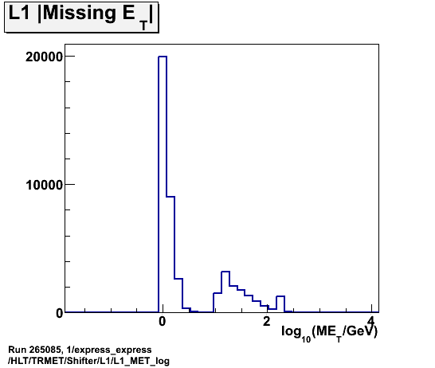
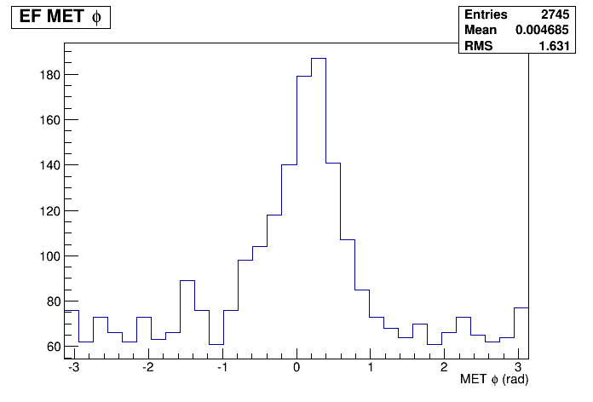
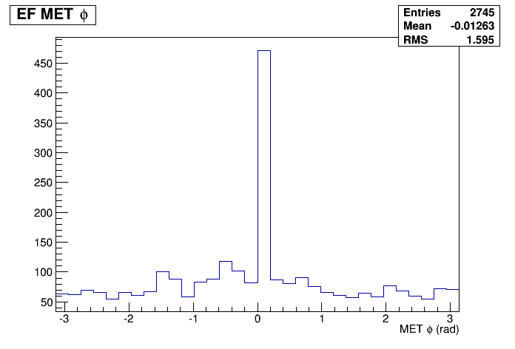
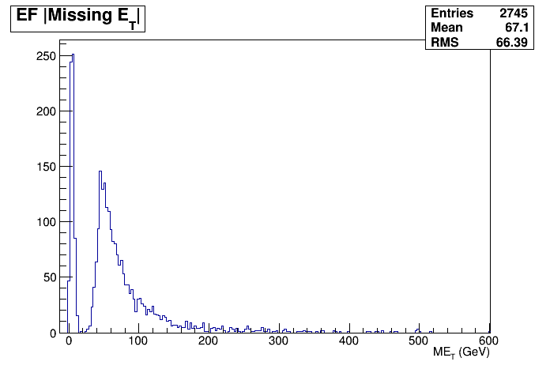
Run 265085
Spike in zero MET still there https://its.cern.ch/jira/browse/ATR-11175
But also in L1 from random trig
New mystery: also peak around phi=0?!
EFMissingET_Fex_topoClustersPS
EFMissingET_Fex_Jets

Slide 4
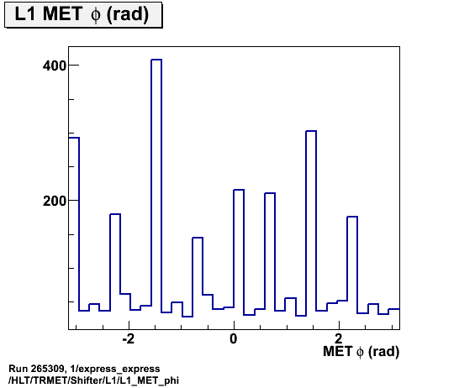
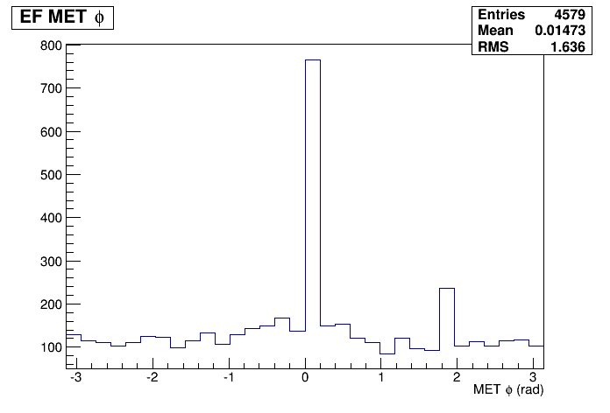
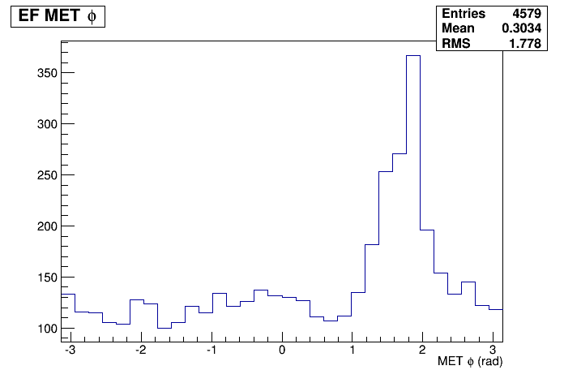
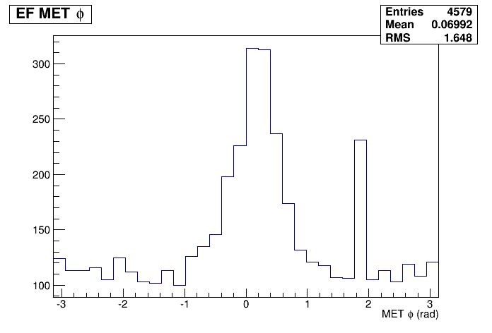
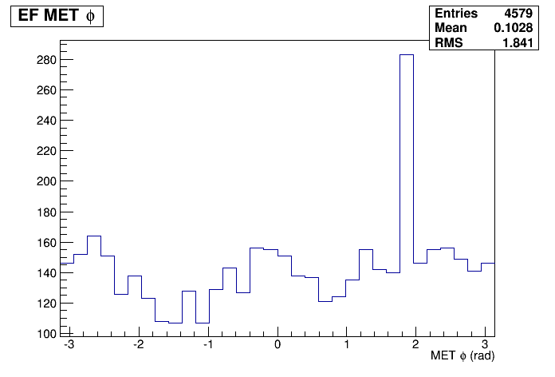
MET peak at phi=0?
L1_MET_Phi
Not in TopoCluster-based and PU MET – (but note there is a small spike)
Still there in jet-based MET and Pileup Suppressed MET from TopoClusters
Note spike in same place as TC-based MET
Also in L1_XE
Will follow up with MET experts
Run 265182
EFMissingET_Fex_Jets/EF_MET_phi
Run 265182
EFMissingET_Fex_topoClustersPUC/EF_MET_phi
Run 265182
EFMissingET_Fex_topoClustersPS/EF_MET_phi
Run 265182
EFMissingET_Fex_topoClusters/EF_MET_phi

Slide 5
Run by Run DQ Summary
Run | Duration | Ended | Events | Online Hist. | Offline Hist. | Obs.
265318 | 470.3m | Wed 09:08 | 4509748 | Met ok Calo ok Jet ok | Jet ok Met ok | Jet spike η,φ=0.6,-1 (and iscontinuity in φ=0??) Met 2 peaks; spike φ=2; peak aroun φ=0 for TC Calo TC spike η,φ=0.8,-2.5; excess –φ
265321 | 71.2m | Wed 10:28 | 535868 | Jet xs: φ = 0 & ±π | Spikes: φ = 0 & ±π | Calo spikes at: η=2, -1.8, -2.2, -2.5; : φ = 0 and ±π
265529 | 58.3m | Wed 19:22 | 220326 | Calo, jet, met empty | empty | No HLT
265660 | 698.9m | Fri 09:01 | 3445341 | Calo/jet spike Met | Jet ok Met ok | Calo/jet spike η,φ=0.6,-1 tcem cluster spikes: η=2, -1.8, -2.2, -2.5;

Slide 6
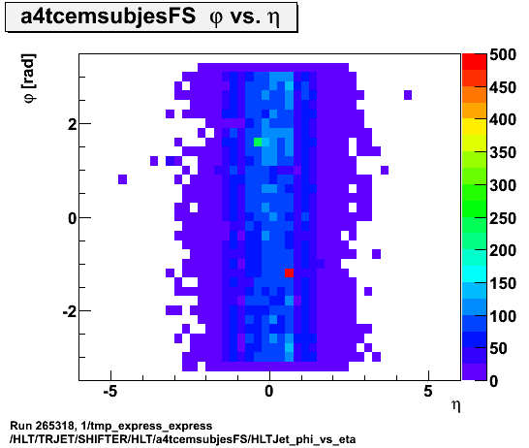
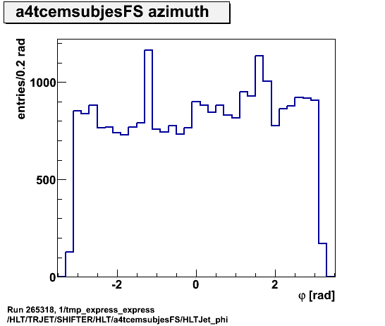
Run 265318
Jets: Discontinuity in phi=0??

Slide 7
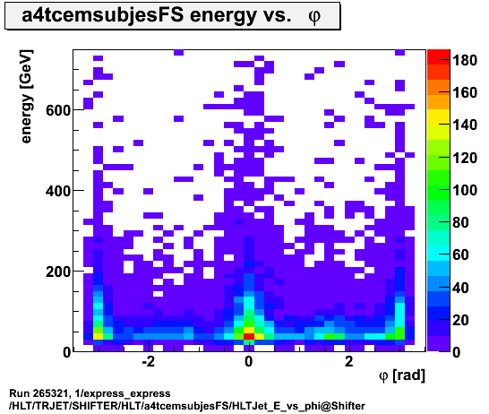
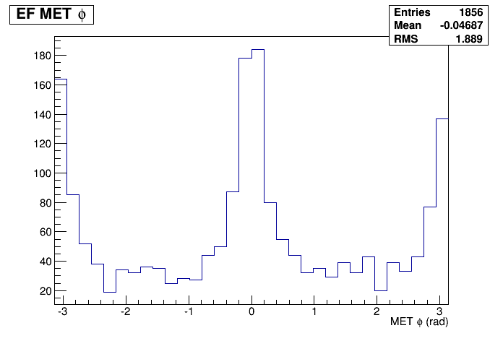
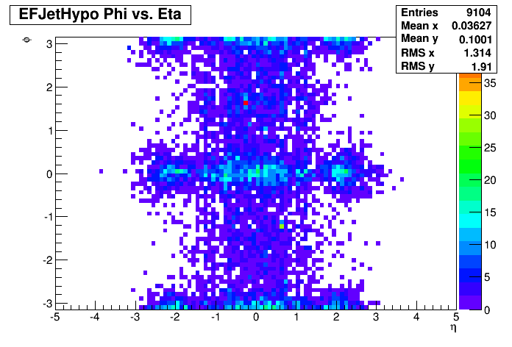
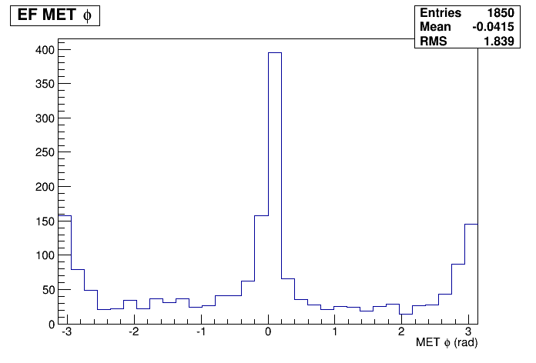
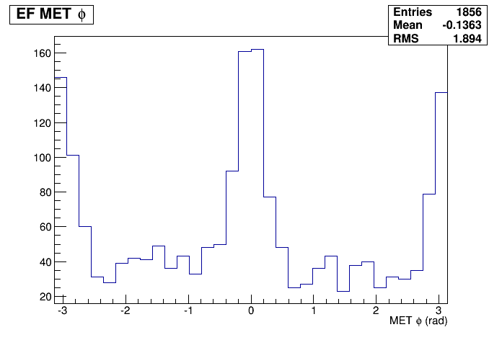
Run 265321
MET spikes in Phi=0 and ±π
Can also be seen in jet distribution, so perhaps detector related?
Appears in several MET flavours, e.g.:
EFMissingET_Fex_2sidednoiseSupp
EFMissingET_Fex_topoClusters
EFMissingET_Fex_topoClusters
EFMissingET_Fex_Jets
EFMissingET_Fex_2sidednoiseSupp
EFCentFullScanMultiJetHypo_1_0eta320_0_a4_tc_em_subjes_FS

Slide 8
Sign-off/defects
Run | HLTCalo | Jet | MET
265321 | Spikes at φ = 0 & ±π | Spikes at φ = 0 & ±π | Spikes at φ = 0 & ±π

Slide 9
Run by Run DQ Summary
Run | Duration | Ended | Events | Online Hist. | Offline Hist. | Obs.
265661 | 106.0m | Fri 11:08 | 443244 | Jet/MET spikes at φ = 0 & ±π | Met ok Jet spikes at: φ = 0 & ±π | Calo spikes at φ = 0, 2 & -3
265811 | 581.8m | Sat 08:19 | 3064474 | Calo/jet spike η,φ=0.6,-1 | Jet spike Met ok | Calo spikes at φ = 0, 2 & -3 Jet spike η,φ=0.6,-1
265813 | 46.7m | Sat 09:39 | 201618 | Some spikes | Some spikes | Low stats
265814 | 248.6m | Sat 13:58 | 1041133 | Jet/Met ok | Empty | HLT disabled in express stream
265843 | 130.8m | Sat 16:27 | 23930481 | empty | Empty | HLT disabled in express stream

Slide 10
Run by Run DQ Summary
Run | Duration | Ended | Events | Online Hist. | Offline Hist. | Obs.
265881 | 814.0m | Sun 09:06 | 6758471 | Jet ok Met ok Calo ok Spikes… | Jet ok Met ok | Calo spikes at: η=2, 0.8, -1.8, -2.2, -2.5 and φ = 0, 2 & -3 Jet spike η,φ=0.6,-1 j15 now active but empty
265882 | 585.7m | Sun 19:08 | 2284406 | Calo tclcw empty Met and jet empty | Met ok Jet empty | Very low stats for em clusters!?? tcem clusters: spikes at φ = 1, 2 & -2 tclcw plots empty

Slide 11
Collision runs
Run | Duration | Ended | Events | Online Hist. | Offline Hist. | Obs.
263962 |  |  |  |  |  | 900GeV collisions!
263964 | 130m | Tue 12:41 | 1808555 | No HLT | Ok jet Ok met | 900GeV collisions!
263965 | 225m | Tue 15:09 | 3289095 | No HLT | Ok jet Ok met | 900GeV collisions!
265532 |  | Wed 20:04 | 5052417 | Empty | Empty | 13TeV collisions; no HLT
265545 |  | Thu 08:37 | 5408249 | Empty | Empty | 13TeV collisions; no HLT
265573 |  | Thu 10:55 | 12482144 | Empty | Empty | 13TeV collisions; no HLT

Slide 12
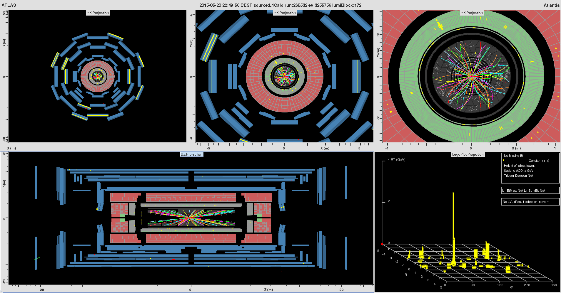
20/5/2015 – first 13TeV collisions

Slide 13
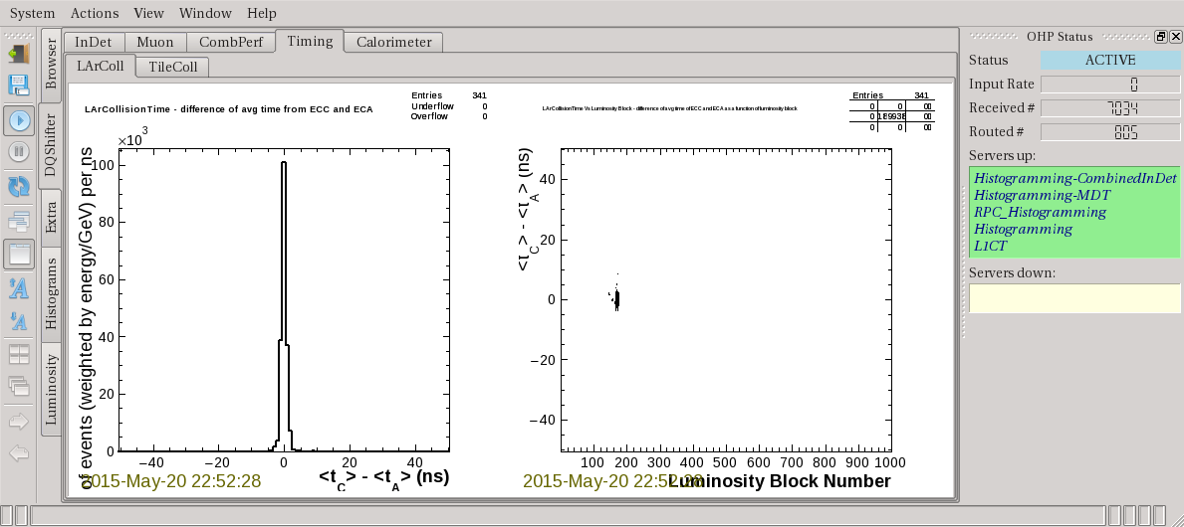
20/5/2015 – first 13TeV collisions

Slide 14
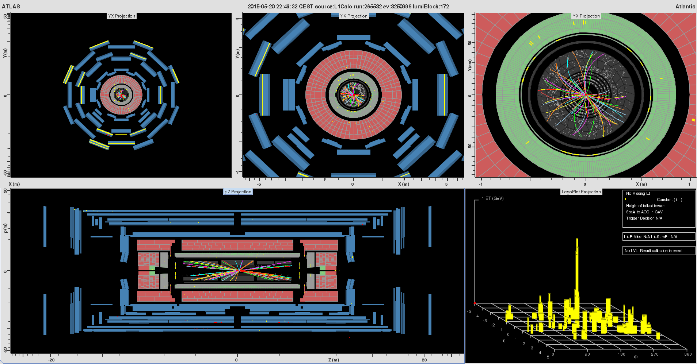
MET?

Slide 15
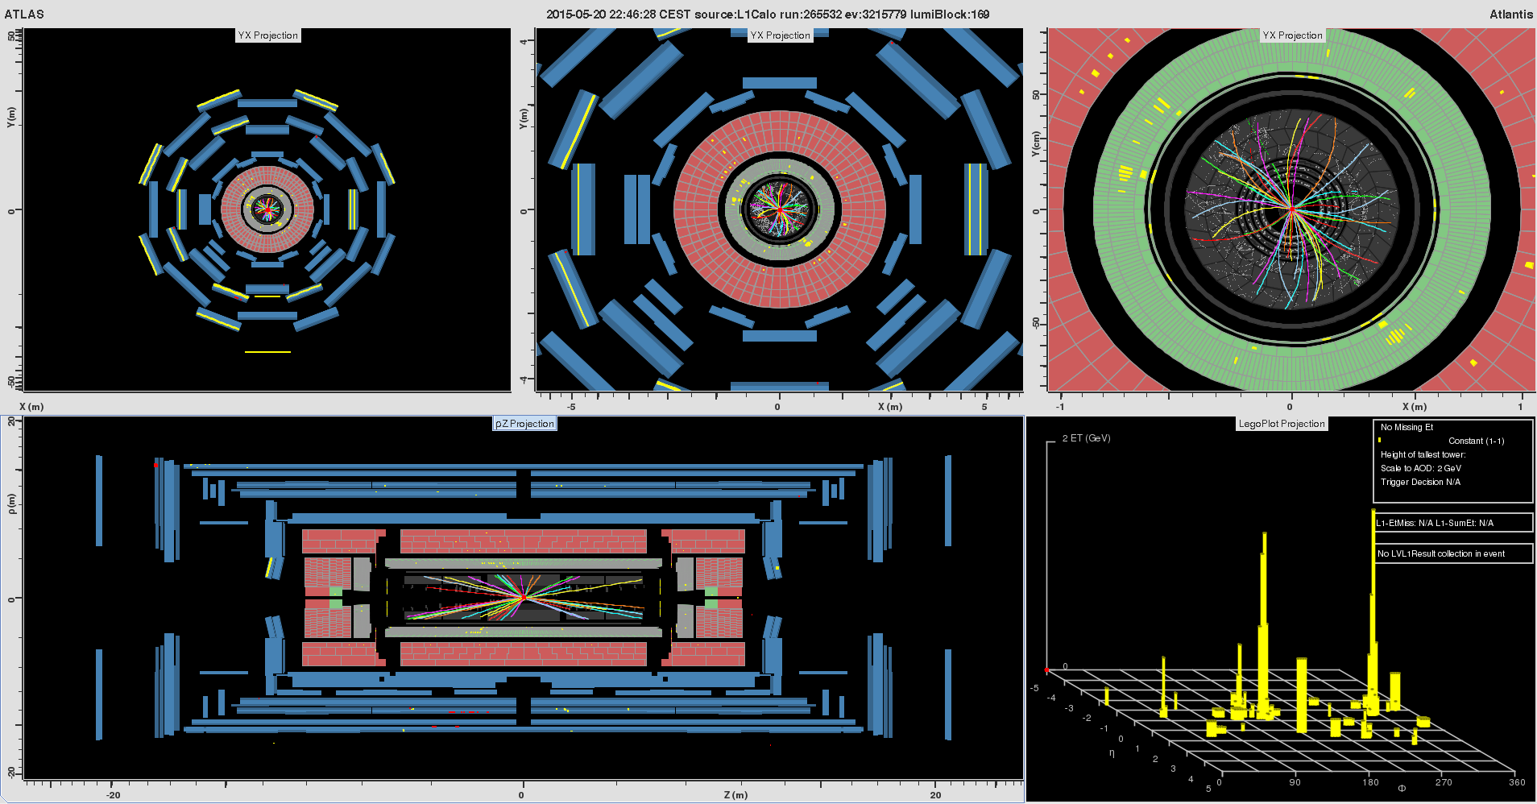
Are those jets?

Slide 16
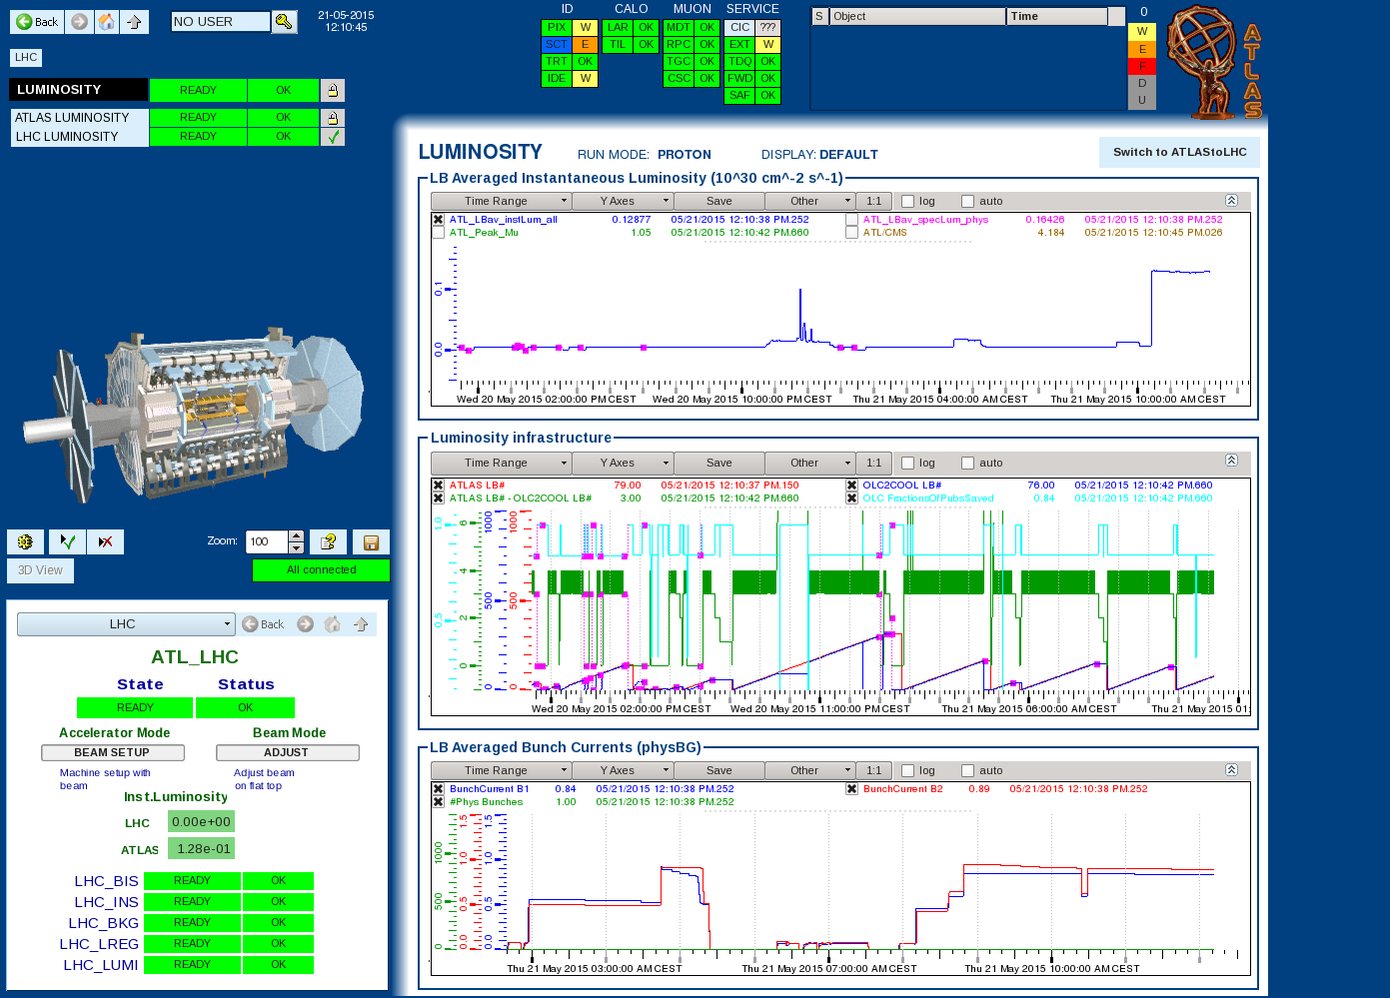

Slide 17
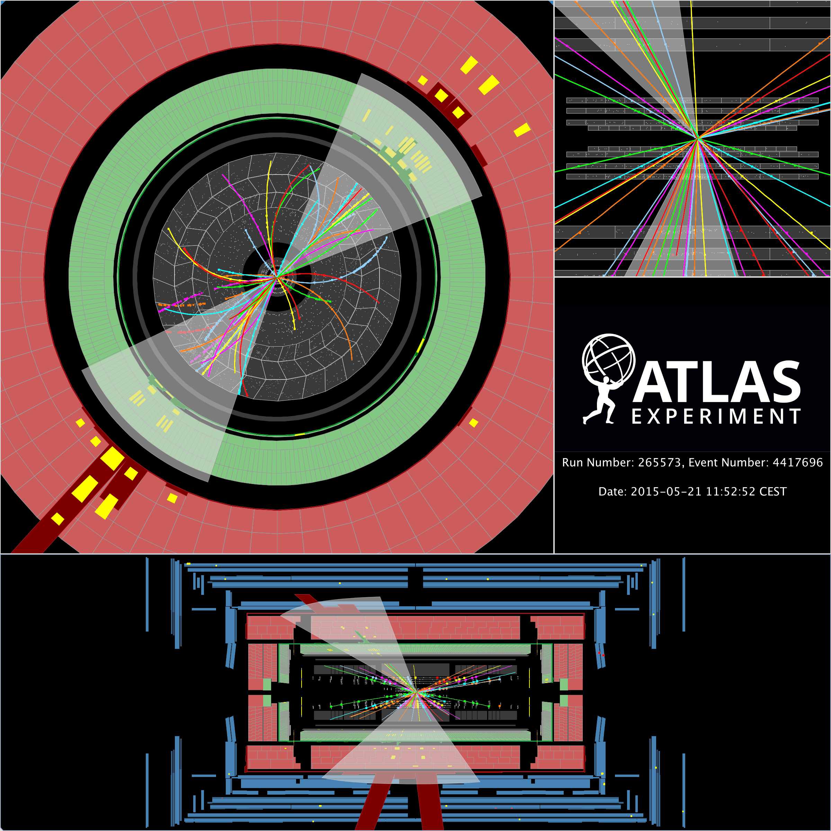
Di-jets in 13TeV Collisions!!!

Slide 18
Reprocessing – 1
https://its.cern.ch/jira/browse/ATR-11131
Purpose: Tune procedures for week 1 with ADC
Release: AtlasP1HLT,20.2.1.2
Menu: Physics_pp_v5
Run: 263993
Stream: physics_Main
Prescales: [default]
Apply L1 prescales?: no
Rerun L1?: no
Reconstruction?: no
Reco release: n/a
Reco Outputs: n/a
Reference reprocessing: n/a
Split into:
https://its.cern.ch/jira/browse/ATR-11205
https://its.cern.ch/jira/browse/ATR-11209
☒

Slide 19
Reprocessing – 2
☑
https://its.cern.ch/jira/browse/ATR-11189
Purpose: Reprocessing to validate AtlasCAFHLT,20.2.1.2.2
Release: AtlasCAFHLT,20.2.1.2.2
Menu: MC_pp_v5
Run: 212967
Stream: EnhancedBias
Prescales: [default]
Apply L1 prescales?: no
Rerun L1?: yes
Reconstruction?: first (for fast turn-around) without then with
Reco release: AtlasProduction, 20.1. 4 5 . 11 1
Checked histos from HIST_HLTMON file produced
Just checked that all (well, maybe 95% of the) plots from each chain looked ok. Did not compare to reference
All fine
Also a RECO part to sign off soon
☒

Slide 20
Reprocessing – 3
https://its.cern.ch/jira/browse/ATR-11194
Purpose: HLT reprocessing of 264034/L1Calo stream with offline outputs for ID trigger studies
Release: AtlasCAFHLT,20.2.1.2.2
Menu: MC_pp_v5
Run: 264034
Stream: L1Calo
Prescales: [default]
Apply L1 prescales?: no
Rerun L1?: no
Reconstruction?: yes
Reco release: AtlasProduction,20.1.5.1
Reco Outputs: n/a
Reference reprocessing: None

Slide 21
Reprocessing – 4
https://its.cern.ch/jira/browse/ATR-11155
Purpose: Reprocessing to validate AtlasCAFHLT,20.2.1.2.1
Release: AtlasCAFHLT,20.2.1.2.1
Menu: MC_pp_v5
Run: 212967
Stream: EnhancedBias
Prescales: [default]
Apply L1 prescales?: no
Rerun L1?: yes
Reconstruction?: yes
Reco release: AtlasProduction,20.1.4.11
Reco Outputs: HIST.AOD.ESD.NTUP_TRIGRATE.NTUP_TRIGCOST.NTUP_TRIGEBWGHT
Reference reprocessing: https://its.cern.ch/jira/browse/ATR-11022

Slide 22
Reprocessing – 5
https://its.cern.ch/jira/browse/ATR-11205
Purpose: Test procedures, tools and measure turnaround time
Release: AtlasP1HLT,20.2.1.2
Menu: MC_pp_v5
Run: 265532
Stream: physics_Main
Prescales: [default]
Apply L1 prescales?: no
Rerun L1?: yes
Reconstruction?: no
Reco release: n/a
Reco Outputs: n/a
Reference reprocessing: none

Slide 23
Reprocessing – 5
https://its.cern.ch/jira/browse/ATR-11209
Purpose: Test procedures, tools and measure turnaround time
Release: AtlasCAFHLT,20.2.1.2.2
Menu: Physics_pp_v5
Run: 265545
Stream: physics_Main
Prescales: [default]
Apply L1 prescales?: no
Rerun L1?: yes
Reconstruction?: no
Reco release: n/a
Reco Outputs: n/a
Reference reprocessing: n/a

Slide 24
Reprocessing – 6
https://its.cern.ch/jira/browse/ATR-11214
Purpose: test saving BS output and running subsequent RAW toCOST and ESDtoAOD steps separately
Release: AtlasCAFHLT,20.2.1.2.2
Menu: MC_pp_v5
Run: 212967
Stream: EnhancedBias
Prescales: [default]
Apply L1 prescales?: no
Rerun L1?: yes
Reconstruction?: yes
Reco release: AtlasProduction,20.1.5.1
HLT Outputs: HIST_HLTMON.BS
Reco outputs: all
Allow pilots to run and the "finish" H:LT+RECO leaving subsequent stepos to complete.

Slide 25
Bonus slides

Slide 26
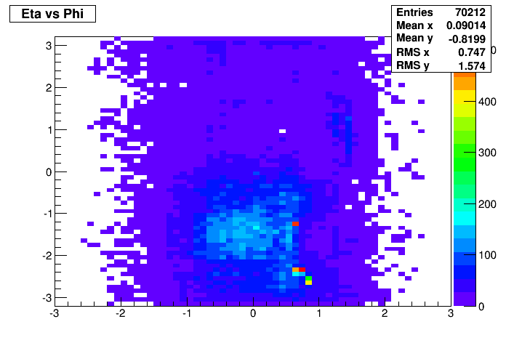
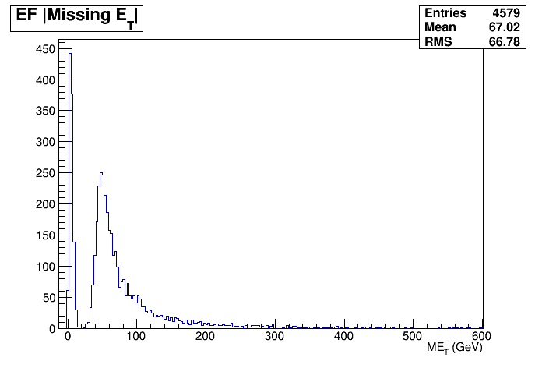
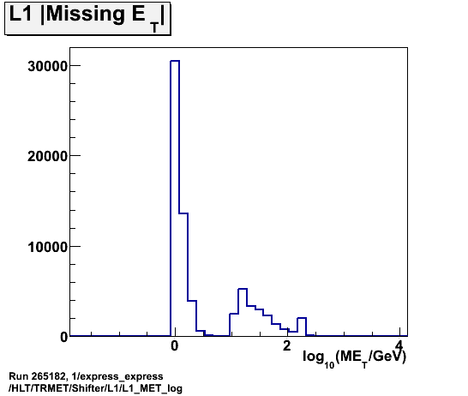
Run 265182
Latest solved mysteries..
Excess in TrigCaloClusterMaker_topo Eta_vs_Phi from L1Muon-seeded tau chains
Two-peak structure in xe35 from L1_RD0
HLT
L1

