Slide 1
News
Ricardo – ttH@LIP, 21/5/2014

Slide 2
TopRootCore – Evolution
Email from Simon Head: TopRootCore is becoming AnalysisTop
Built "first" AnalysisTop release: AnalysisTop-1.5.0
Intended to replace old TopRootCore system of making tags
Available over cvmfs, on lxplus, grid sites, and local institutes
Can be used in exactly the same way as our old tag-based TRC
Should improve stability of the software on the grid
Example: run the D3PD2MiniSL code on lxplus:
setupATLAS
mkdir AnalysisTop-1.5.0 && cd AnalysisTop-1.5.0
rcSetup Top,1.5.0
D3PD2MiniSL -filterMask 0xfff -checkFilterOnly
Instructions:
https://twiki.cern.ch/twiki/bin/view/AtlasProtected/TopD3PDStartGuide
Has:
Updated to the final 2012 muon momentum corrections
Latest b-tagging calibrations
List of changes see:
https://twiki.cern.ch/twiki/bin/viewauth/AtlasProtected/TopRootCoreRelease

Slide 3
ATLAS ttH Publication Plans
Target: as many results as possible for Higgs Hunting (Jul 21-23)
Also preliminary ttH combination at that point
For papers, target is ATLAS circulation June 10 (H+, l+j/dil bb, γγ).
For CONF notes, target is approval start of July (allhad bb, multileptons). In these cases want paper ready and starting circulation 2nd half of July.

Slide 4
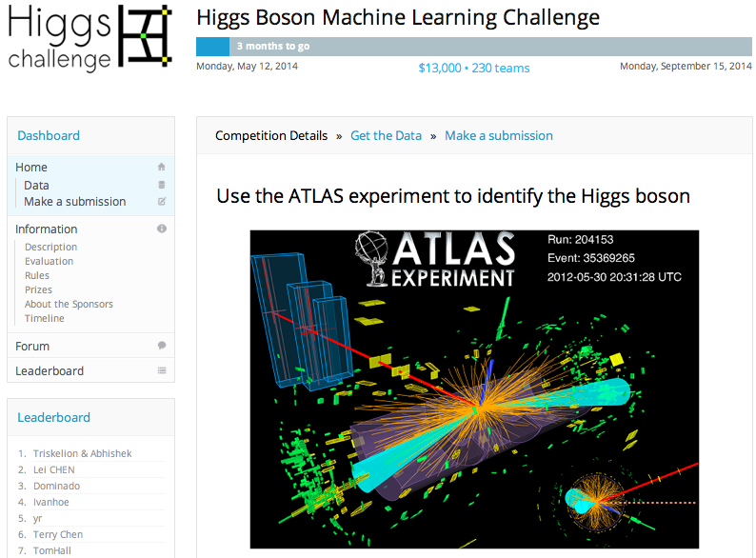
Higgs Boson Machile Learning Challenge
https://www.kaggle.com/c/higgs-boson

