Slide 1
Trigger Status and Menu Optimization
LHCC Referee Meeting with ATLAS – 7th July 2009
Ricardo Gonçalo (RHUL) on behalf of ATLAS Trigger/DAQ

Slide 2
Outline
Recent activity
Highlights from recent results
Planning for 2009/10 run
Online and offline monitoring
Trigger menus for the coming run
Conclusions

Slide 3
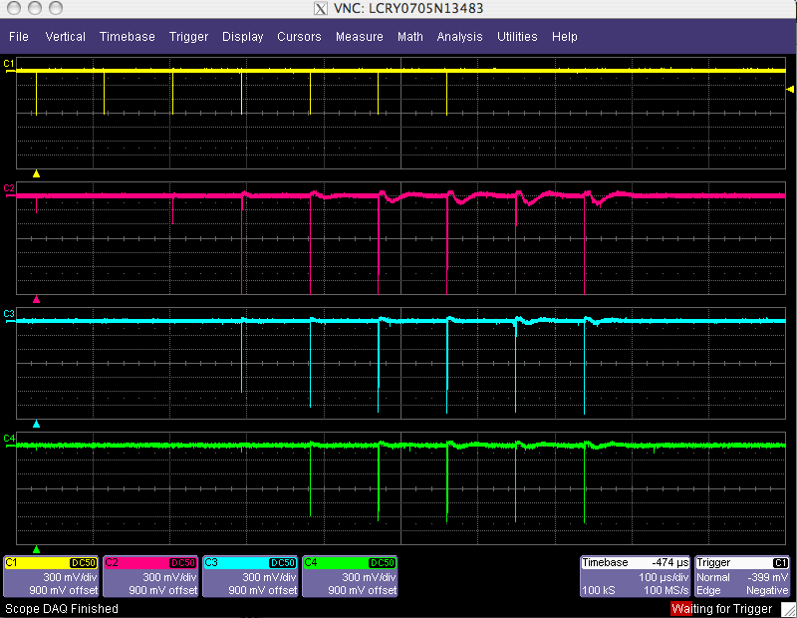
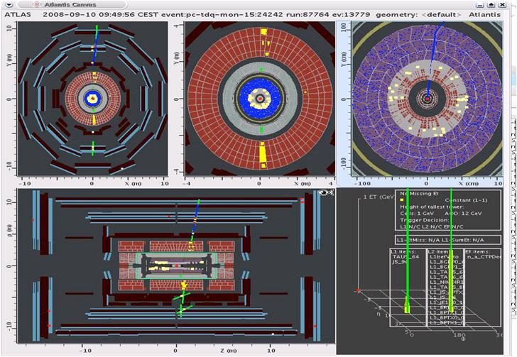
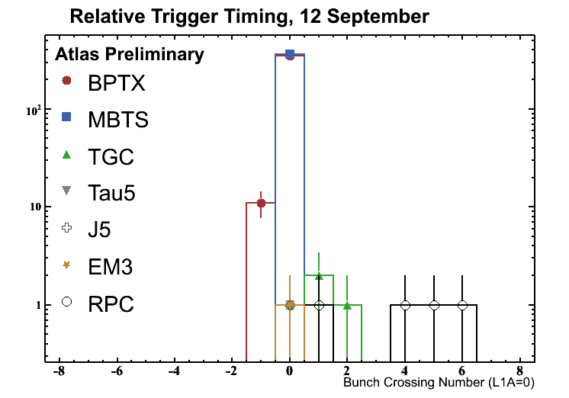
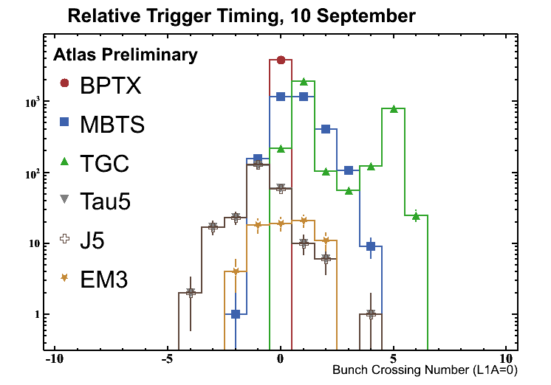
Recent activity
Much has happened since the last Trigger report at this meeting:
See talk by Nick Ellis in September 22nd LHCC review: http://indico.cern.ch/conferenceDisplay.py?confId=26620
The short single-beam run and the cosmics runs in 2008/09 provided a good stress test of the Trigger/DAQ system
The trigger successfully worked with LHC beams for the first time!
Excellent progress was made on timing-in the various detectors in late 2008 and 2009
Trigger successfully selected events for detector and trigger commissioning
Since then the collected data were thoroughly analyzed:
Residual problems were identified and fixed
Lessons from the operational experience have led to new tools and improved procedures
Cosmic event triggered by the L1 tau and jet triggers
Oscilloscope traces from beam pickup (yellow) and min.bias scintillators for single injected bunch

Slide 4
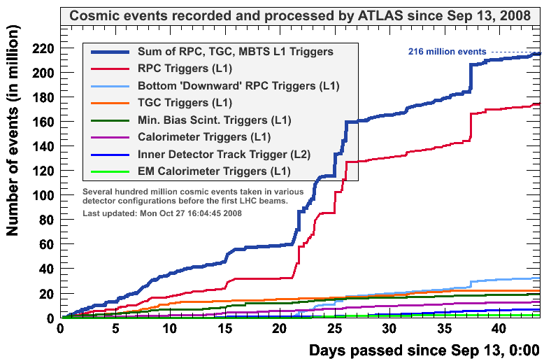
Single-beam and cosmic runs
Single-beam events were selected with various triggers: beam pickups, minimum-bias trigger scintillators, calorimeters and forward muon detectors
Data streaming done by the High-Level Trigger (HLT) based on Level 1 trigger type and on Level 2 tracking (see figure)
HLT algorithms exercised online to reconstruct trigger data
Running in parasitic mode without rejecting events
Contributed much to weeding out problems in real environment
Monitoring benefited much from exercise
Heavy use of CAF for testing bug fixes and new menus before deployment
Menus updated almost daily, responding to feedback from data analysis and to needs from commissioning of detector systems
Menu configuration machinery responded fast and well to new demands
Number of events recorded into each stream in 2008

Slide 5
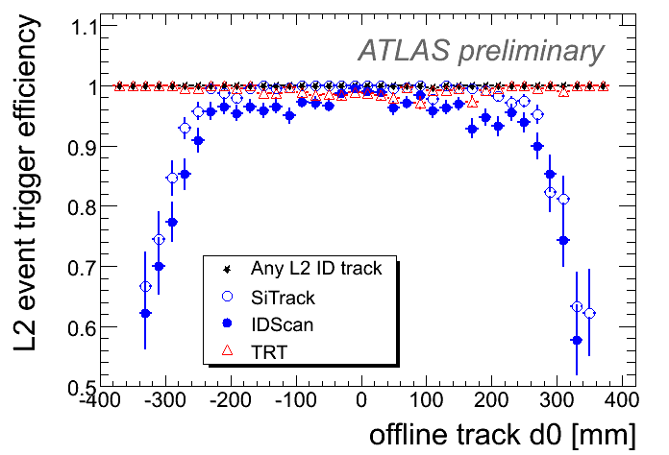
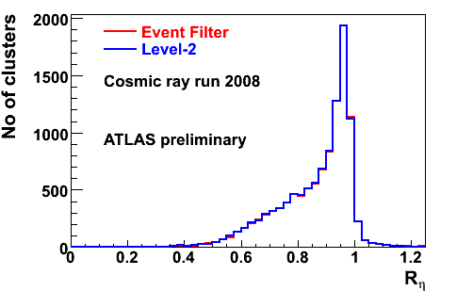
Highlights from cosmic runs
Complete HLT infrastructure was tested
Including the algorithm steering and configuration
Also the online and offline monitoring
Weak points were identified and were/are being addressed – e.g. new trigger rate display
Level 2 inner detector tracking algorithms were useful to select events with track candidates (top figure)
Modified algorithms to accept tracks not coming from nominal IP
Used to create stream enriched in good track candidates for inner detector and offline tracking commissioning
Many HLT algorithms were exercised with cosmics by relaxing selection thresholds and requirements (bottom figure)…many other examples would be possible…
Level 2 tracking efficiency for events with a good track reconstructed offline
E_{3x7}/E_{7x7} cells in LAr calorimeter for trigger clusters matching a cluster reconstructed offline

Slide 6
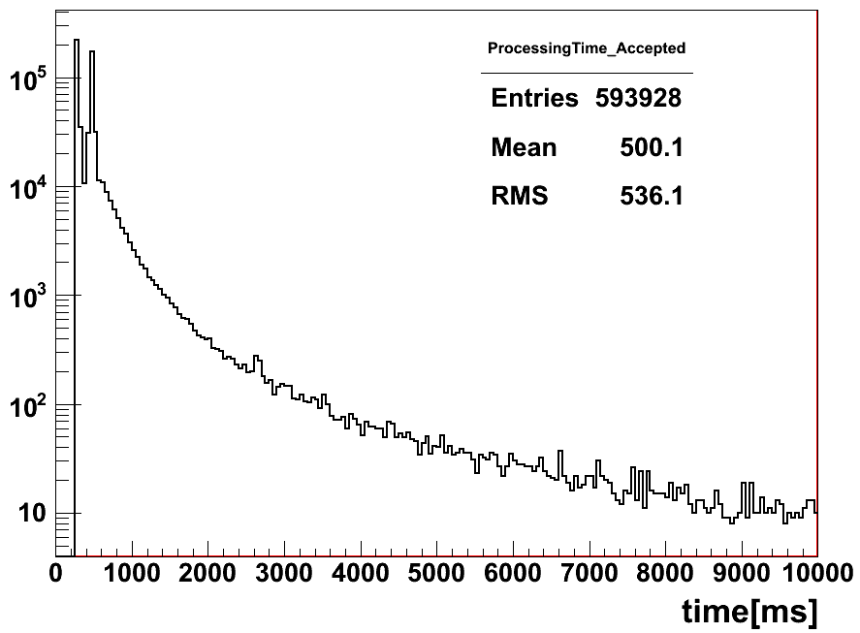
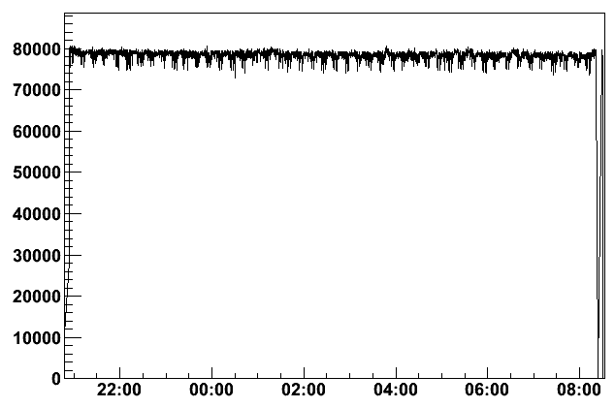
Technical runs
Event Filter processing time for accepted events
Playback of simulated collision data through the DAQ system
Performed regularly to integrate new software releases in online environment
Allows to test new DAQ and HLT software in real system
Allows to test the system with collision-type data: enhanced bias, physics channels
Preparation before running detectors on cosmics
Estimate system performance:
Estimated processing time compatible with design goals (top figure); mean HLT average should be ~ 40ms at Level 2 and ~ 4s at the Event Filter or less
Throughput rate: tested up to ~78-90kHz input to Level 2 (bottom figure; 50-75kHz expected)
Event building rate of ~5kHz starts to compete with Level 2 data requests (~2kHz event building rate expected); E.B. design rate is 3.5kHz
Note: processing time is strongly dependent on event topology and on trigger menu
HLT input rate test: input rate (Hz) versus time (hours)

Slide 7
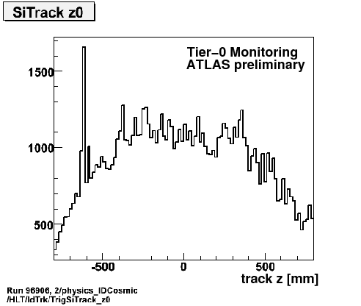
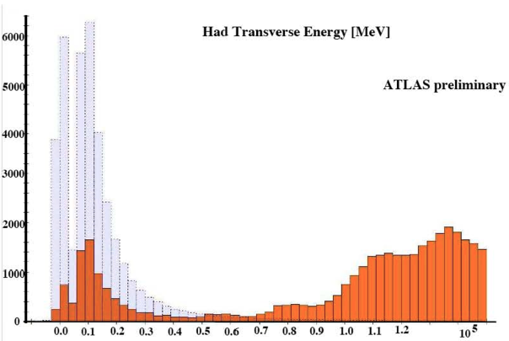
Monitoring and diagnosing problems
Monitoring essential to quickly spot and diagnose problems
Both online – in control room – and offline, trigger monitoring was exercised in the cosmics and technical runs
Online monitoring based on histograms of:
Trigger rates
Overlap between trigger streams
Characteristic event quantities for each selection
Offline monitoring based on:
Histograms produced during Tier0 event reconstruction
Re-processing and error analysis of events from the debug stream
Improved trigger monitoring currently being tested with cosmic events
noisy module
Level 2 calorimeter transverse energy (MeV)
Reference histogram
Measured: mismatch due to calibration laser pulses in this run

Slide 8
Offline testing and monitoring
As learned from the 2008 run, it is essential to thoroughly test new menus and HLT algorithms with real data before online deployment
Also, it is important to be able to react quickly to new problems – or risk wasting bandwidth collecting bad data
The CAF is an essential part of the trigger strategy for this:
Used for automatic re-processing events from the debug stream, where an error condition occurred online – e.g. a time-out during a Level 2 data request
Used to test new menus once they are loaded to the trigger configuration database and before they are deployed online
Needs to provide access to RAW data from a small number of runs where a problem was identified until the debugging is completed
This is essential and allows us to study problematic events offline, correct weaknesses in the software and test the fixes – it minimizes lost time and disruption to online running
Other debugging tools are provided by:
The monitoring histograms produced during event reconstruction at Tier 0
The production of commissioning ntuples at Tier 1 for fast analysis of problems (and Tier 0 for time-critical needs)
The “Preseries” subfarm: a set of HLT nodes serving as a test platform and not used for normal trigger processing

Slide 9
Planning for the 2009/10 run
A set of reviews was done after last year’s run to examine critically what had been done
Touched the following subjects: offline monitoring infrastructure, tools for online monitoring and debugging, shift crew operation and tools, information flow, timing measurements, configuration and streaming
The trigger workshop in February 2009 was an important milestone:
Reviewed the trigger activity in the 2008 single-beam and cosmics run and establish plans to prepare for the 2009 run
https://twiki.cern.ch/twiki/bin/view/Atlas/TriggerWorkshop2009
Led by panel from broader ATLAS community and with experience from other experiments
Raised interest and involved people from detector, physics, combined performance, data preparation, etc
Resulted in a report and ~80 identified action items with responsible people’s names attached
Touching on all areas from trigger menus to monitoring, documentation, configuration etc
We have been following up on these for the last five months in the various trigger domains
Many translated into agreed procedures, software deliverables or tools

Slide 10
Commissioning plans
Combined ATLAS cosmic run will start at T0 – 4 weeks with all systems and 24h coverage
The trigger will start with the already familiar Level 1 selection for cosmic events
Menu will be ready at T0 – 10 weeks, to be deployed at T0 – 8 weeks for runs with some systems
Have the HLT in passthrough mode – exercise the algorithms, event data, monitoring etc without rejecting events
Data streaming by the HLT based on Level 1 trigger type and on tracking/cosmic event algorithms
Exercise HLT algorithms with loose event selection to accept and process cosmic events
Single-beam events to be selected with dedicated menu
Based on use of beam pickup and minimum bias scintillators
Refine timing of signals from various detector systems
Continue to exercise HLT algorithms in passthrough mode using beam-gas events and halo muons
Initial collisions triggered with Level 1 only
Significant amount of work on e.g. Level 1 calibration needs to be done with initial collisions
This data will be essential for commissioning of detectors, Level 1trigger, HLT selections
HLT deployed to reject events only when needed to keep event rate within budget
Both Level 1 and HLT trigger prescales can now be updated during the run to increase operational flexibility – prescale factors constant within luminosity blocks
Now creating conditions to have fast feedback from the trigger on the collected samples
Using Tier 1 and/or CAF to process events and create monitoring histograms and dedicated ntuples (root) with fast turnaroun

Slide 11
Menus for initial data
Cosmics menus have been thoroughly exercised in recent runs in May and June
Level 1 calorimeter and muon trigger have been reliably providing triggers for cosmics runs this year
Evolution of cosmics menu will contain some muon triggers in physics configuration
The initial-beam menu will be used for single-beam running and first collisions
It will need to be able to handle different LHC scenarios and be resilient to a badly timed-in detectors
Rely on beam pickup to identify filled bunches
Experience from single-beam running in 2008 used in the design of this menu
Bunch-group mechanism will be commissioned carefully to replace beam pickups
High-Level trigger will be used to reject events only when necessary
Cosmics menu 1
Cosmics menu 2
Initial beam menu

Slide 12
Menu evolution
The evolution of the trigger menu is very much tied to the evolution of the LHC luminosity (and to the beam energy)
Several commissioning menus are being put in place for the initial beam period with detector and trigger commissioning as the highest priority
Procedures for menu evolution agreed but still need to be tested in real life
Menus exist or are being developed in Monte Carlo simulation for average luminosities of 10³¹cm⁻²s⁻¹ and 10³²cm⁻²s⁻¹
These are possible scenarios for the coming run
Depending on the detailed bunch spacing scenario, this could mean up to 5 overlapping events per bunch crossing, on average – might require changes to the menu, in order to keep the rate manageable
These menus provide a reference for planning and evolving the online trigger menu as the LHC luminosity grows
Some high-p_{T} physics triggers, needed for analysis in channels with low cross section, are “un-prescalable”
Some practical questions remain on what menus should be used in Monte-Carlo production
Can have impact on the analysis of initial data
It must be possible to simulate the response of menus/algorithms used in online event selection

Slide 13
Conclusions
The trigger was ready for beam in 2008 and a lot was achieved from the single-beam and 2008/09 cosmics runs
The HLT was successfully used to stream single-beam events and to select and stream cosmic events for detector commissioning
The cosmics runs provided vital experience from prolonged stable running (>200 million cosmics recorded)
Level 1 (muon, calorimeter) triggers were selecting events from the start and reliably providing events for detector commissioning since then
The lessons learned from this initial running period were extremely important in planning for this year's activities
Addressing weak areas, improving robustness, preparing for the unexpected
As a result we are even better prepared for running in 2009

Slide 14
Backup slides

Slide 15
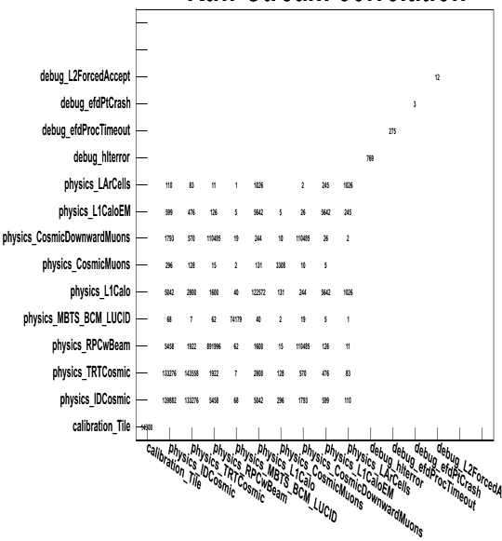
Trigger stream overlap
Data streams determined by the high-level trigger
ATLAS inclusive streaming model relies on small overlap between streams
Exclusive debug streams for events with online error conditions
Stream overlap for cosmics run with debug, “physics” and calibration streams defined

Slide 16
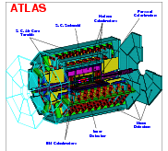
Trigger information for physics analysis
TriggerDB All configuration data
Preparation
Stores
decoded Trigger Menu
Configures
Data
taking
Online
Conditions
Database
COOL
Reconstruction
Encoded trigger result
from all 3 levels
Decoded trigger menu
Trigger Result
passed?, passed through?, prescaled?, last successful step in trigger execution?
Trigger EDM (Features)
Trigger objects for trigger selection & studies
Trigger Configuration
Trigger names, prescales, pass throughs
access through ITrigDecisionTool
ESD
AOD
With decreasing amount of detail
Trigger aware analysis
DPD
TAG

Slide 17
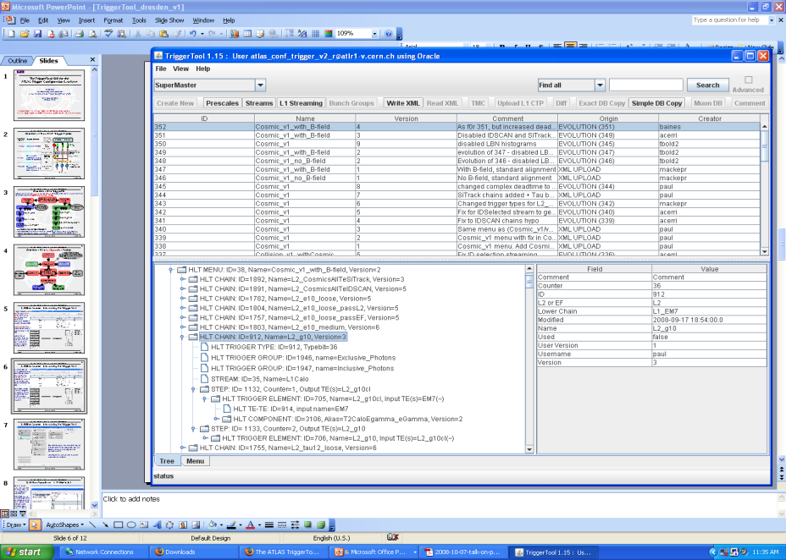
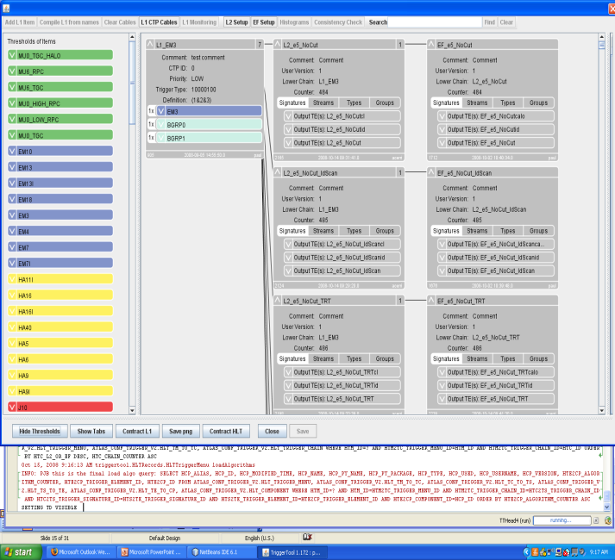
Trigger menu configuration
Java based front end to TriggerDB, launch from the web (Java web-start): http://www.cern.ch/triggertool
Overview of all trigger configurations
Detailed and convenient investigation of trigger menus
Trigger definition L1->L2->EF: prescales, threshold algorithms, selection criteria, streaming information, etc.
Possibility to compare different trigger configurations

Slide 18
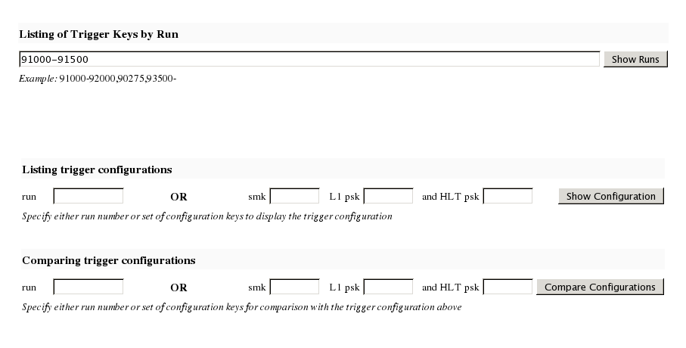
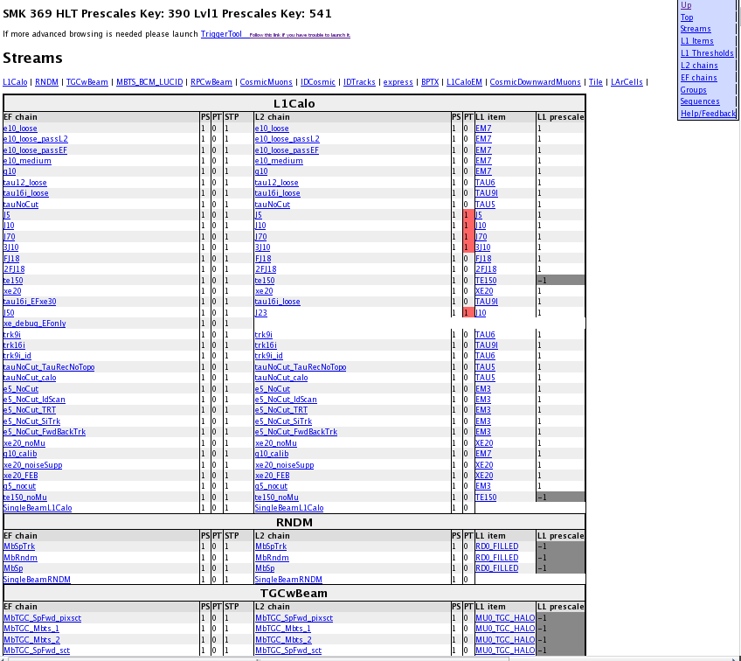
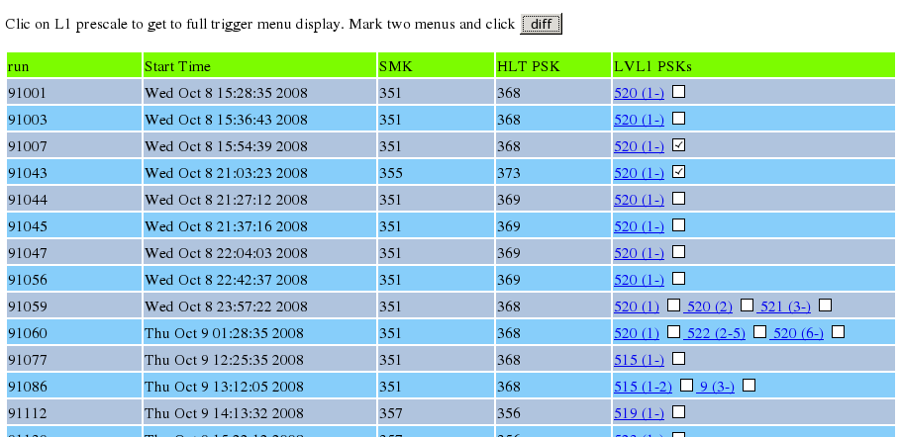
Web-based access to trigger configuration
Web interface http://trigconf.cern.ch
Runs TriggerTool on the server, result presented as dynamic html pages
1. Search run-range
3. Trigger configuration (browsable) (definition, algorithms, selection cuts)
2. Run list
Also with simple comparison functionality

Slide 19
Types of bunch crossings
A
C
Both bunches filled:
Both bunches empty:
A
C
Empty bunch crossing after filled:
C
A
A-side filled:
A
C
C-side filled:
A
C

Slide 20
Bunch groups
All bunch crossings are numbered with Bunch-Crossing IDentifiers (BCID)
A set of BCIDs falling into one category is called a bunch group.
Bunch groups are realised as 7 lists of numbers that set internal thresholds in the Central Trigger Processor (CTP)
Relying on the bunch group mechanism means relying on the clocks
This requires well timed-in detectors and is not feasible with initial beams
BGRP0 | Not in BCR veto
BGRP1 | Filled
BGRP2 | Empty reserved for calibration
BGRP3 | Empty
BGRP4 | Unpaired beam1
BGRP5 | Unpaired beam2
BGRP6 | Empty after filled
Beam:
L1_EM3 = EM3 & BGRP0 & BGRP1
Cosmic:
L1_EM3_EMPTY = EM3 & BGRP0 & BGRP3
Makes a well-defined cosmic slice possible in a physics menu!

Slide 25
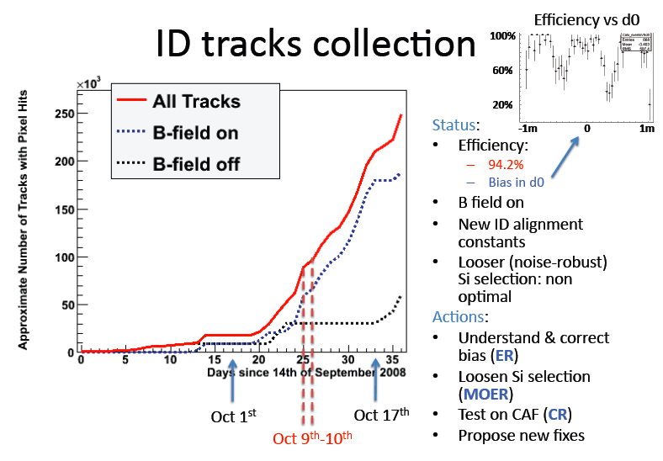

Slide 26
