Slide 1
Jet Trigger News
R.Goncalo (LIP), D.Miller (Chicago), Andy Pilkington (Manchester)
Jet Trigger Signature Group Meeting
16 June 2015

Slide 2
OTP Accounting
Please send us your estimates by Monday next week
Regarding effort estimate for each person:
Units are FTE fraction. This is a rate so it is independent of the amount of time the task has been done for. Please just give the average effort during the months worked.
1 FTE corresponds to 1 person working 8 hours per day, 5 days per week.
e.g. if someone worked half their time for the year so far, enter 0.5 with a start month of January and end month of June
e.g. if someone worked half their time from April onwards, enter 0.5 with a start month of April and end month of June
One decimal place, i.e. 10% precision, will suffice.
Please note this is only class 3 - class 1 & 2 tasks are entered directly into OTP when booked.

Slide 3
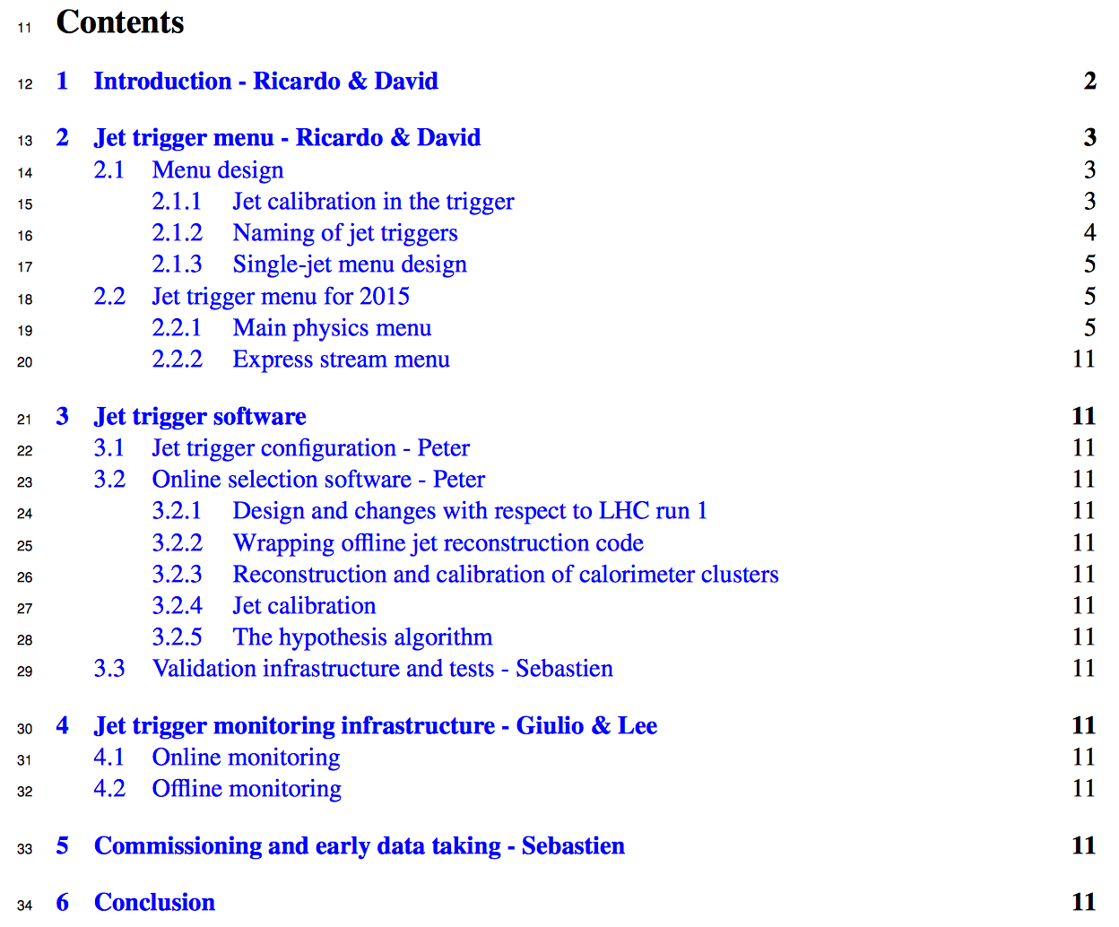
Jet Trigger Documentation
Jet Trigger Validation Wiki
https://twiki.cern.ch/twiki/bin/view/Atlas/JetSliceValidation
Ana updated the wiki (THANKS!)
Comments?
Jet Trigger internal note:
Intro & Menu parts progressing
Split main file jet.tex into different files so people can add edit concurrently
Instructions:
Make pdf:
cd trunk
make
Get directory:
svn co svn+ssh://[username]@svn.cern.ch/reps/atlasgroups/ Trigger/TriggerNotes/JetTrigger/JetInternal2015/trunk

Slide 4
Bonus Slides

Slide 5
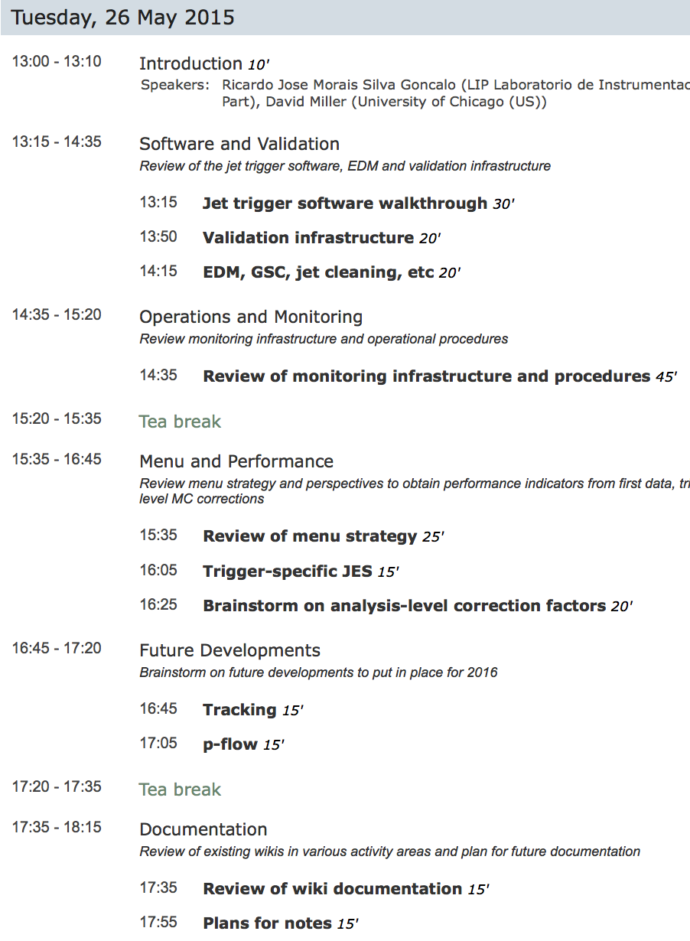
Jet Trigger Readiness Review
Last week!
Agenda: https://indico.cern.ch/event/354893/
Today: list of actions emerging from the review

Slide 6
1 – Software & Validation
Development suite – quick, concise tests to be run while developing code
Valentinos & Peter
Code documentation in SVN – add to doc directory of jet trigger packages
Take section from internal note and put in svn
Add information on running TrigJetValidation package by hand
Valentinos
Follow-up on what is necessary to update HLT jet calibration factors
David & Ricardo
What exactly (if anything) do we need to change in the offline packages?
Can we start to discuss necessary changes are going to be before we officially request them?
Need to start private discussions now with Nuno, Peter, David Adams, Pierre-Antoine, Mark Hodgkinson – ask Ricardo to initiate

Slide 7
2 – Operations & Monitoring
Update documentation on how to configure monitoring histograms
Giulio & Lee
Add turn-on curves to offline monitoring package (under way) and comparisons to offline monitoring
Giulio
Set up new file centrally for online and offline monitoring testing
Must contain multiple jet definitions, lumi blocks, all event info
Ask Giulio to initiate discussion with Central Trigger DQ?
Rapid monitoring configuration changes (less than 2 weeks…)
David & Ricardo to follow up
Update triggers in the jet monitoring to be those in the Express Stream
Giulio & Lee

Slide 8
3 – Documentation
Make the “Tasks and Topics” for the Jet Trigger more clear and prominent
David, Andy, Ricardo
Archive truly out-of-date Run 1 TWiki information and merge general Jet Trigger information that is currently categorized as only “Run 1” with Run 2 documentation - Andy?
Provide clearer documentation for software on the twikis - Done
How to run the jet trigger
How to run the ATN and RTT tests
Sebastien?
Update the DQ TWiki pages
Lee & Giulio
Provide common code examples
David & Andy to follow up?
Rate calculation
Trigger efficiencies
Pile-up dependence
Trigger Emulation
https://twiki.cern.ch/twiki/bin/view/Atlas/HowToEmulateTheTrigger
https://twiki.cern.ch/twiki/bin/view/Atlas/JetTriggerEmulation
Internal note – see next page

Slide 9
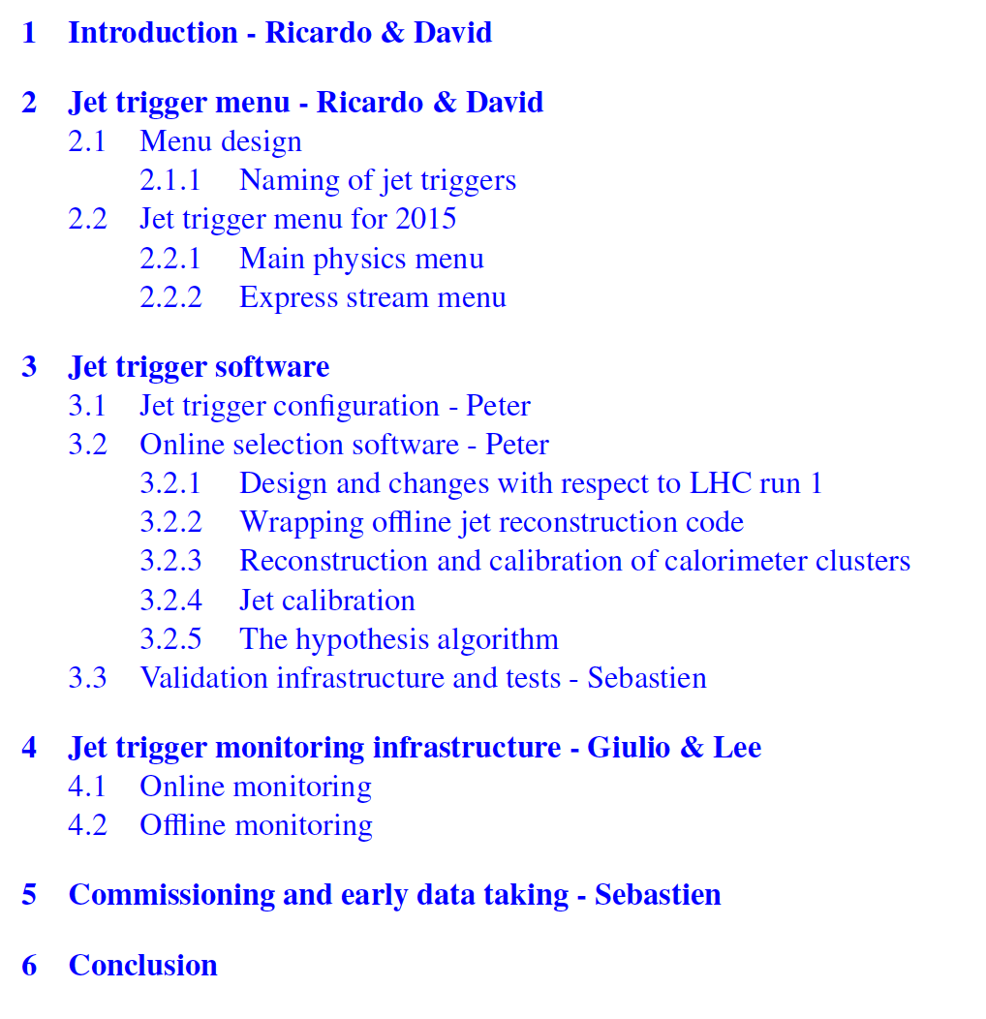

Slide 10
4 – Future developments & Other
New studies - David & Andy?
Check the HLT jet menu used in the ATLAS+IBL and ATLAS+ITK simulation samples to ensure that it has a reasonable representation of the various types of planned triggers and that the D3PDDumper properly outputs everything we need?
What are your current plans for implementing the substructure quantities in the EF trigger? Do you plan to use the standard offline filtering values? Any taggers? JMS? It would be useful to schedule a presentation at an upcoming Substructure meeting.
Add HLT jets into dijet eta intercalibration
Michaela – done
2011 paper – Mark Sutton, Mario, Sue, Ricardo

Slide 11
Passing the baton
On July 1st
Ricardo retires from Jet Trigger convenership to a life of leisure
David becomes convener until October 1st
Andy Pilkington becomes deputy
Then David goes to the greener pastures of Jet/MET CP group. Congrats!

Slide 12
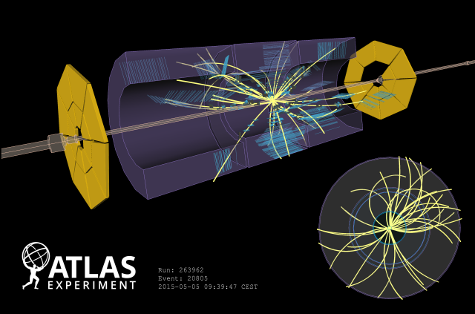
First LHC Run-II Collisions!
Display of one of the first collision events recorded at 900 GeV centre-of-mass energy on 5 May, 2015. Tracks are reconstructed from hits in the SCT and TRT detectors.

