Slide 1
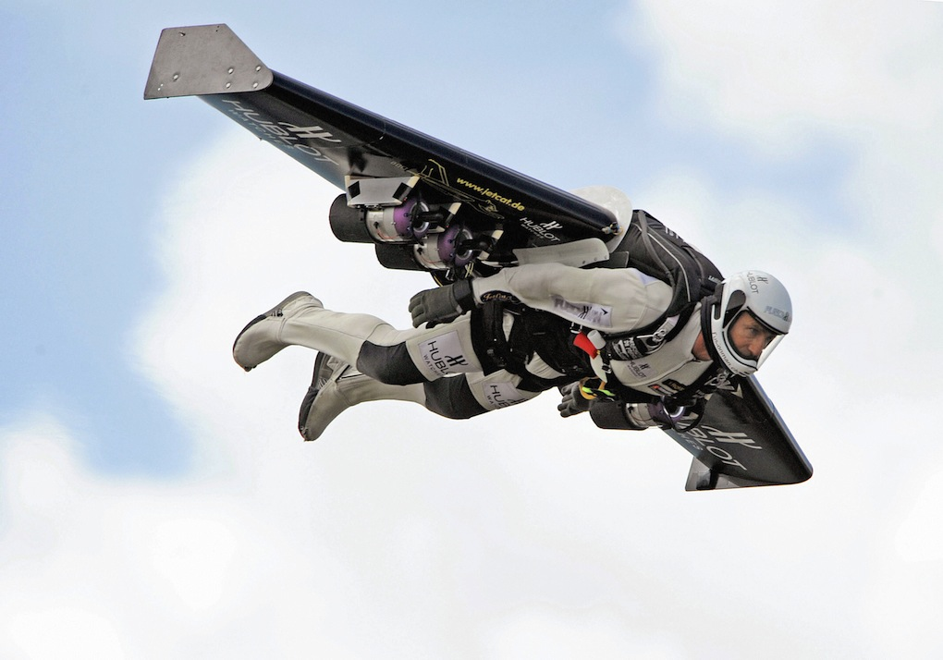
Jet Trigger News
R.Goncalo (LIP), D.Miller (Chicago)
Jet Trigger Signature Group Meeting
19 May 2015

Slide 2
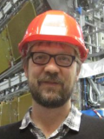
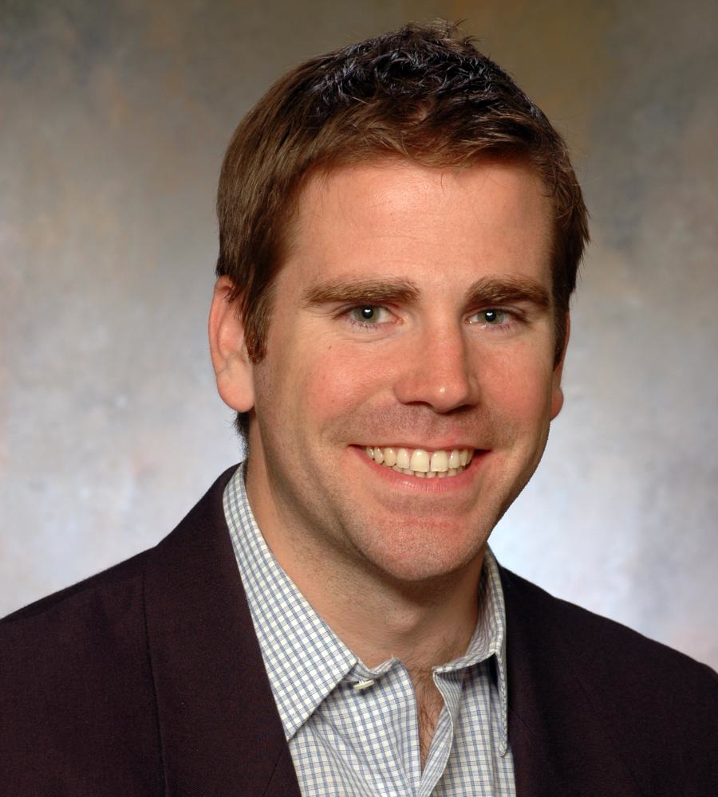
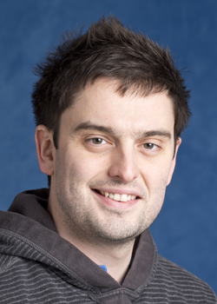
Passing the baton
On July 1st
Ricardo retires from Jet Trigger convenership to a life of leisure
David becomes convener until October 1st
Andy Pilkington becomes deputy
Then David goes to the greener pastures of Jet/MET CP group. Congrats!

Slide 3
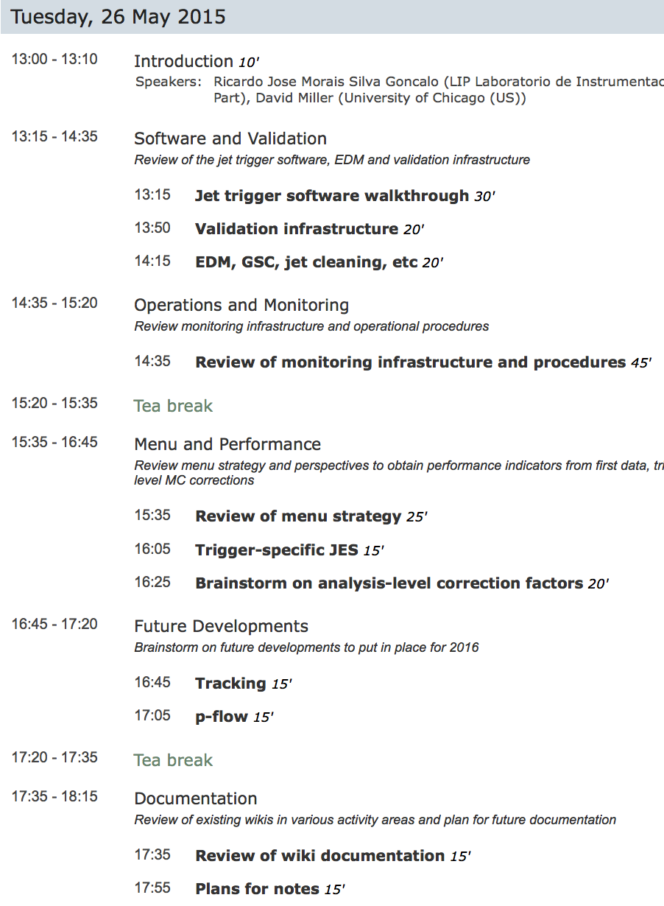
Jet Trigger Readiness Review
Next week!
13:00 to 18:00
Booked Room C
Will contact people to assign talks/tasks soon

Slide 4
Conferences
Group members are encouraged to submit abstracts to conferences for any subject in the jet trigger area
Let us know so we can avoid any duplication and provide help
See TDSC page for open calls: https://twiki.cern.ch/twiki/bin/viewauth/Atlas/TDAQSpeakersCommittee2015
Example:
CSE 2015 - 18th IEEE International Conference on Computational Science and Engineering
21.-23. October 2015 in Porto, Lisbon.
Conference website: http://paginas.fe.up.pt/~specs/events/cse2015/index.php?page=home
Abstract submission deadline to the TDAQ Speakers Committee is 25. May 2015.
The conference submission deadline is 1. June 2015.
Authors are invited to submit original papers (8 pages max) in English
Please be aware that the TDAQ Speakers Committee rules state that the presenter will be chosen in consultation with the management and relevant system experts.

Slide 5
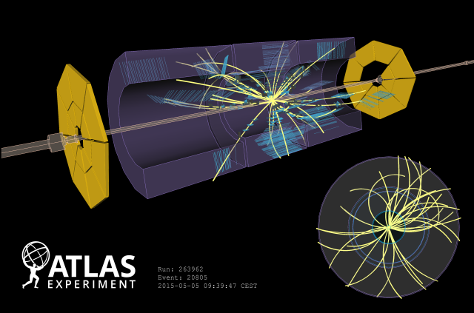
First LHC Run-II Collisions!
Display of one of the first collision events recorded at 900 GeV centre-of-mass energy on 5 May, 2015. Tracks are reconstructed from hits in the SCT and TRT detectors.

