Slide 1
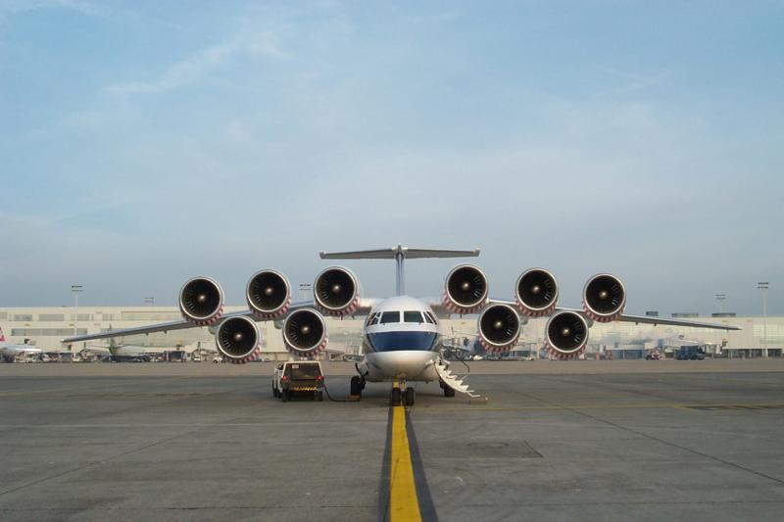
Jet Trigger News and some validation checks
R.Goncalo (LIP), D.Miller (Chicago)
Jet Trigger Signature Group Meeting
5 May 2015

Slide 2
News from Point 1

Slide 3
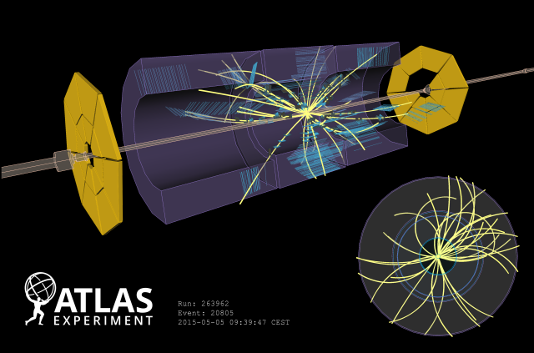
First LHC Run-II Collisions!
Display of one of the first collision events recorded at 900 GeV centre-of-mass energy on 5 May, 2015. Tracks are reconstructed from hits in the SCT and TRT detectors.

Slide 4
Jet Trigger Readiness Review
Propose to hold a readiness review ½ day or day meeting at the end of May (26th?)
See where we are and what still needs work
Prepare future work
Ideas? Problems? Agreement? Disagreement? Otherwise?
Draft programme:
Software and validation
Jet trigger software walkthrough to review where we are and give people a better understanding of the software
Close look at validation tools to see where we can make validation easier and more robust
Data scouting , GSC and cleaning
Operations and monitoring
Walkthrough to look at the monitoring (online and offline)
Look at on-call shift together with MET and HLTCalo - anything missing?
Menu and performance
Overview of the menu
Trigger JES
Readiness to get performance estimates with first collision data
Future developments
Pending actions from the Lisbon workshop last year (still): E/p trigger; particle flow; use cases for tracking in jet triggers; groomed jets, usage of Mj at L1 or HLT; b-tagging, and overlap with EF HT
Anything else
Documentation
Quick review of what wikis etc need more work
Preparation for: INT note on the jet menu and software; CONF note on initial performance

Slide 5
Sample A ttbar alidation for MC15a
Task | Test | Container | ?
1 | 1 | run_1/HLT/JetMon/HLT/a10tcemsubFS | OK
Ref: 1) AthenaMP (r6595) 2) As 1) but with updated digi-window (r6632) Test: Full MC15 setup (AthenaMP) in 20.1.4.7 incl. digi window update; same pileup as test |  | run_1/HLT/JetMon/HLT/a4tcemjesFS | OK
 |  | run_1/HLT/JetMon/HLT/a4tcemjesPS | OK
 |  | run_1/HLT/JetMon/HLT/a4tcemsubFS | OK
 |  | run_1/HLT/JetMon/HLT/a4tcemsubjesFS | OK
 |  | run_1/HLT/JetMon/HLT/a4tclcwjesFS | OK
1 | 2 | run_1/HLT/JetMon/HLT/a10tcemsubFS | OK
Ref: 1) AthenaMP (r6595) 2) As 1) but with updated digi-window (r6632) Test: Full MC15 setup (AthenaMP) in 20.1.4.7 incl digi window update; slightly updated pileup distribution |  | run_1/HLT/JetMon/HLT/a4tcemjesFS | OK
 |  | run_1/HLT/JetMon/HLT/a4tcemjesPS | OK
 |  | run_1/HLT/JetMon/HLT/a4tcemsubFS | OK
 |  | run_1/HLT/JetMon/HLT/a4tcemsubjesFS | OK
 |  | run_1/HLT/JetMon/HLT/a4tclcwjesFS | OK

Slide 6
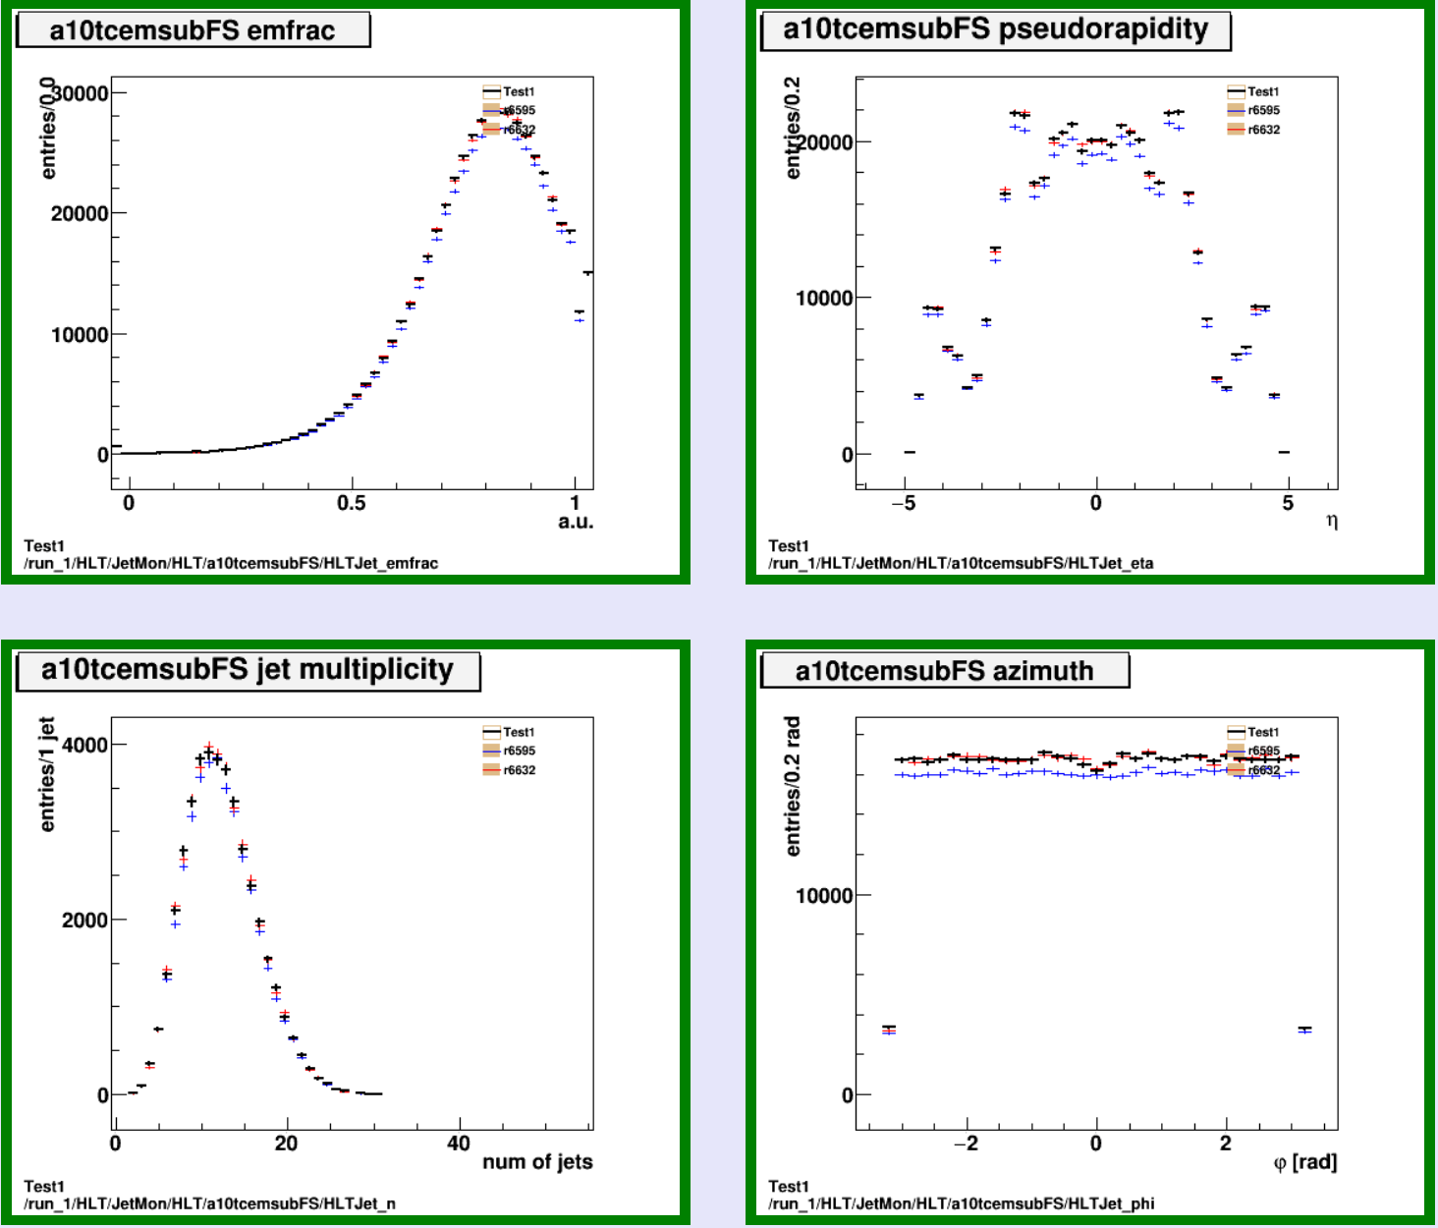
Test 1
Ref:
R6595
r6632: as 1) but with updated digi-window
Test: incl. digi-window update; same pileup as ref
Slightly less events with jets passing L1 in ref.1
Consistent with same digi. window in ref.2 and test?

Slide 7
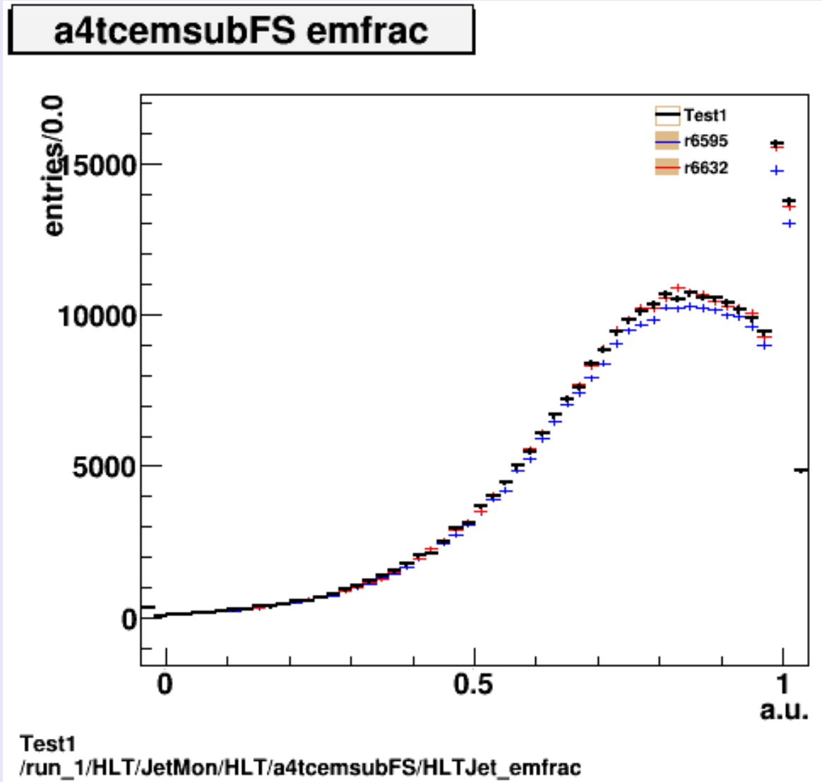
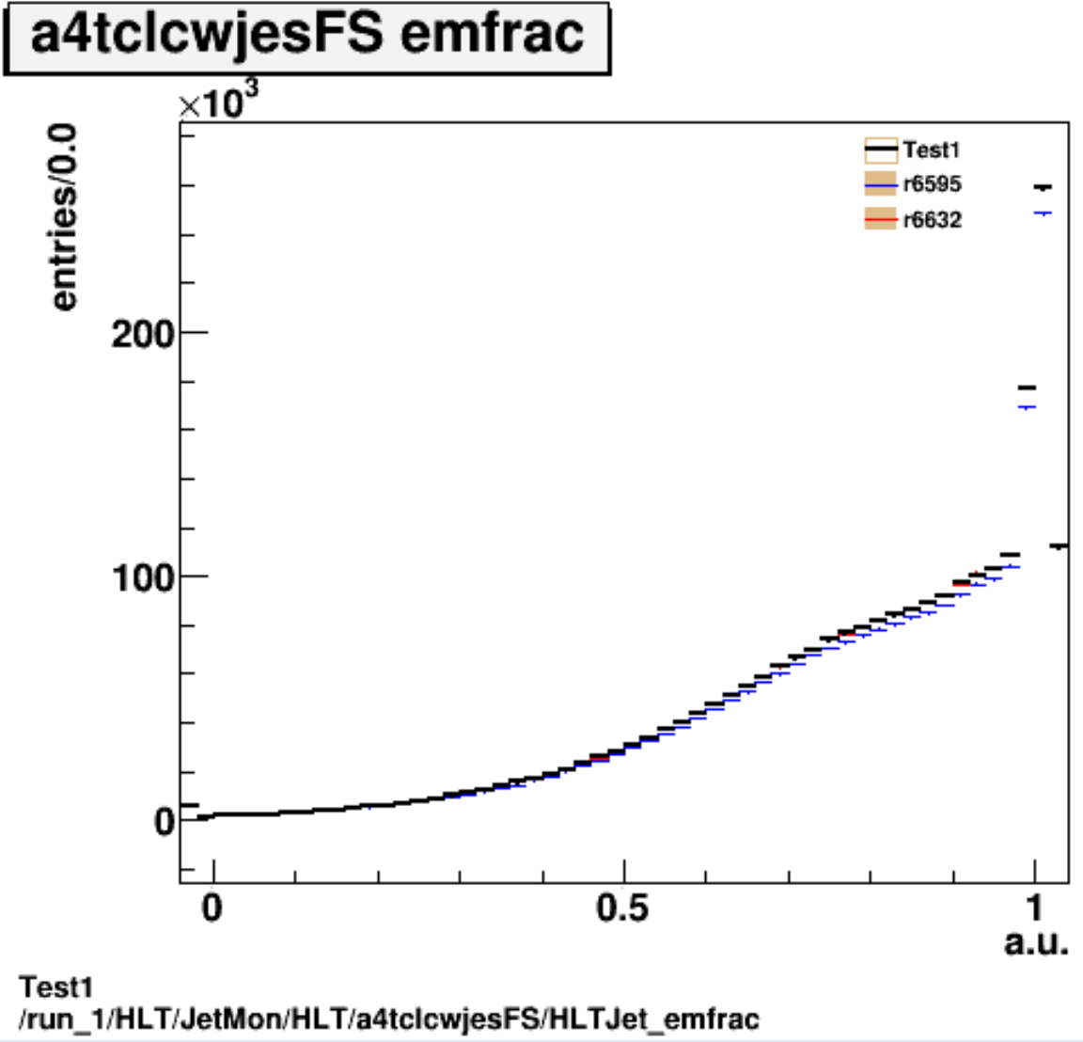
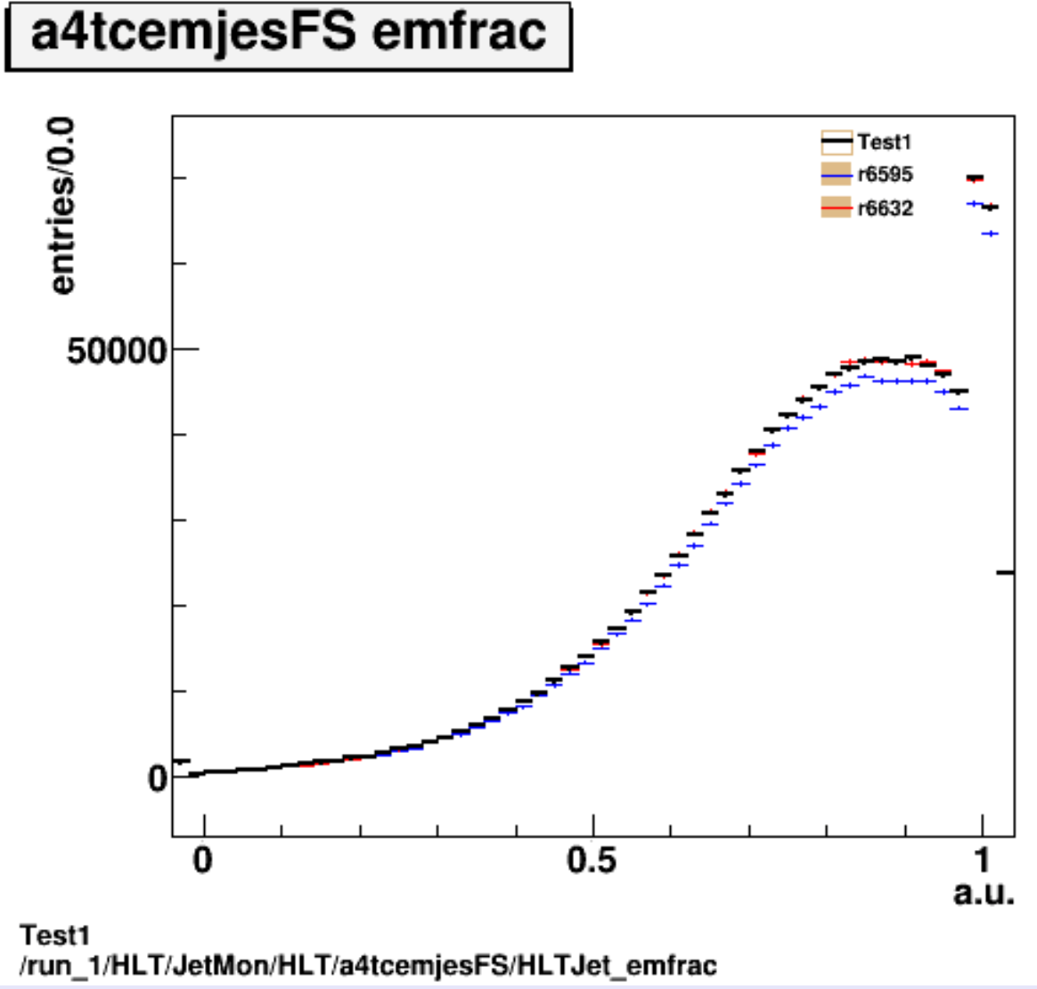
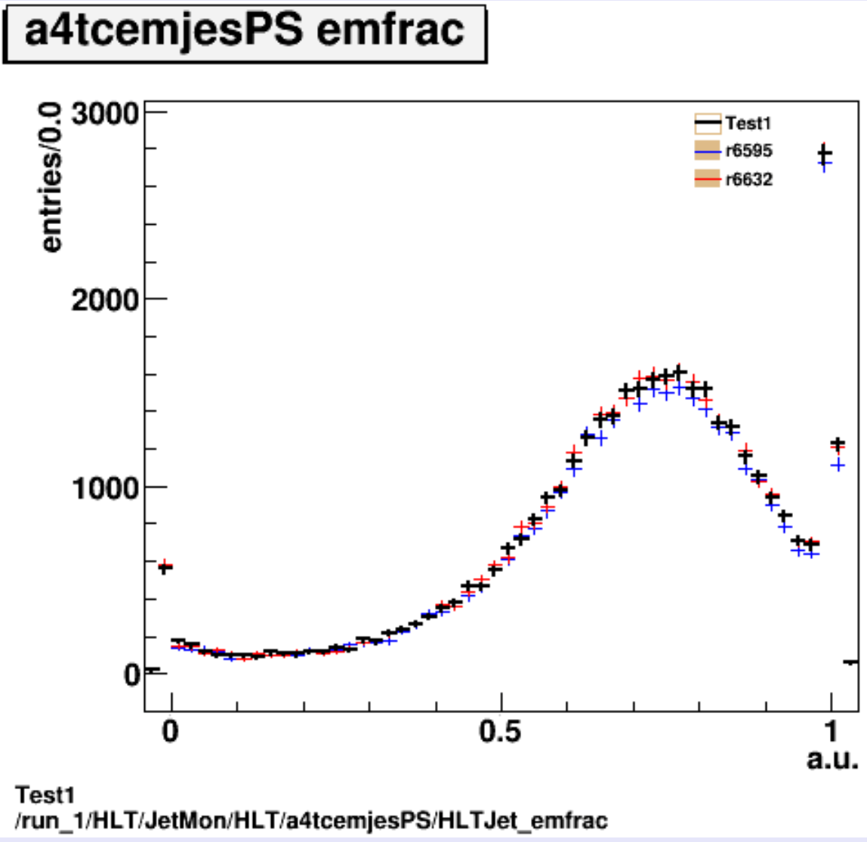
Test 1
Ref:
R6595
r6632: as 1) but with updated digi-window
Test: incl. digi-window update; same pileup as ref.
Differences in EMfrac between EM and LCW calibrations as expected

Slide 8
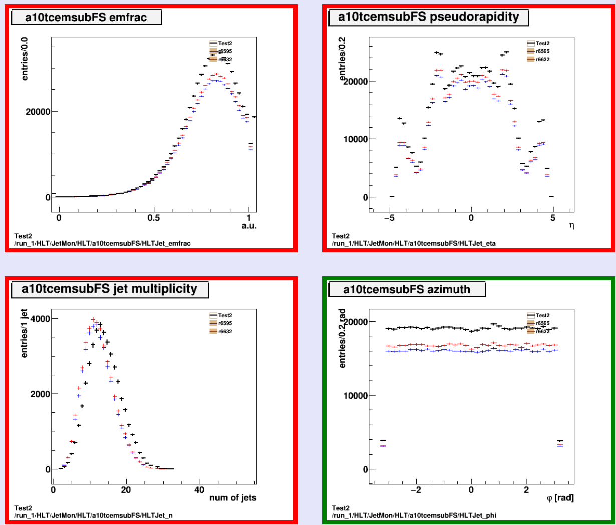
Test 2
Ref:
R6595
r6632: as 1) but with updated digi-window
Test: Full MC15 setup (AthenaMP) in 20.1.4.7 incl digi window update; slightly updated pileup
More jets in test, consistent with more pileup on average

Slide 9
Validation Summary
Ref:
R6595
r6632: as 1) but with updated digi-window
Test 1: includes updated digi-window
Test 2: updated pileup
Conclusions:
Looks essentially fine
Small doubt about what to expect from difference digitization window in test 1

