Slide 1
Jet/MET Trigger On-Call Report And some validation as well
Ricardo Gonçalo – LIP
Jet Trigger Meeting – 20/4/2015

Slide 2
14 April – pre-run meeting
Jets:
Aparajita: running same chains and fom
261182 - Same behavior as yesterday’s run 261141
Check if jet menu is ok in recent runs
Naoko seeing problems in cluster monitoring
Runs to check:
261182 (ptag data15_cos, duration 901.4m, 4388397 events, ATLAS Ready lumi 0.00/nb, ended Mon 09:49)
261308 (ptag data15_cos, duration 92.3m, 2226448 events, ATLAS Ready lumi 0.00/nb, ended Mon 19:59)
DQ Backlog:
TRIG_HLT_JET 259565 259566 259745 259756 259771 259921 260095 260272 260273 260466 260653 260758 261070 261141 261142
TRIG_HLT_MET 259565 259566 259745 259756 259771 259921 260095 260272 260273, 260466 260653 260758 261070 261141 261142
Others:
We’re going to move to the new monitoring configuration soon – need to check all DQ runs
Problem reported in https://its.cern.ch/jira/browse/ATR-10559 with EtaHypo_HEC_larhec_L1J12_FIRSTEMPTY - Carlos taking care of it
Offline: Problems with offline reprocessing – cannot do any reprocessing at the moment – Jiri will follow up
Releases:
Soon deploying new Physics_pp_v5 menu online – currently problems in deploying L1 menu
>100 new tags swept into P1CAFHLT – but looks ok

Slide 3
Last validation towards MC15a
Strategy for 20.1.4.5 validation
Task 1 - no pileup (20.1.4.5 s/w test)
(All with 03-01-00 GEO, reduced digi time window and trigger split and have 25ns calo reco settings)
Ref: No pileup test 3 from task 1 from yesterday's meeting: s2578_r6540 (19.2.3.3, 20.1.4.3)
Test1: As ref but in 20.1.4.5 : s2578_r6588 (19.2.3.3, 20.1.4.5)
Test2: As test one but latest SDR-28 conditions : s2578_r6589 (19.2.3.3, 20.1.4.5)
Task 2 - 50ns pileup
(All with 03-01-00 GEO, reduced digi time window and trigger split)
Ref: No pileup test 1 from task 1 : s2578_r6588 (19.2.3.3, 20.1.4.5)
Test 1: 20.1.4.5 with 50ns pileup - s2578_r6590 (19.2.3.3, 20.1.4.5)
Effect of pileup clearly visible
Test 2: As test 1 but with digi window from --pileupFinalBunch = 6 - s2578_r6591 (19.2.3.3, 20.1.4.5)
Test 3: As test 1 but with SDR-26 for updated LCW for jets - s2578_r6593 (19.2.3.3, 20.1.4.5)
Test 4 As test 3 but with SDR-28 to test deads maps and b-tag calib - s2578_r6594 (19.2.3.3, 20.1.4.5)
Test 5: as test 4 but with AthenaMP - s2578_r6595 (19.2.3.3, 20.1.4.5) - direct clone of r6582
Check with the ttbar sample as soon as we have it
Submit to normal memory queue with corecount = 8
Task 3 - 25ns pileup
(All with 03-01-00 GEO, reduced digi time window and trigger split)
Ref1: No pileup test 1 from task 1 : s2578_r6588 (19.2.3.3, 20.1.4.5)
Ref2: 50 ns pileup test 1 from task 2: s2578_r6590 (19.2.3.3, 20.1.4.5)
Test 1: 20.1.4.5 with 25ns pileup - s2578_r6596 (19.2.3.3, 20.1.4.5)
All histograms with p1878

Slide 4
Sample A ttbar alidation for MC15a
Task | Test | Tags / container | ?
1 | 1 | s2578_r6588 run_1/HLT/JetMon/HLT/a10tcemsubFS | OK
no pileup with 25ns calo reco as reference (20.1.4.3) but with 20.1.4.5 |  | s2578_r6588 run_1/HLT/JetMon/HLT/a4tcemjesFS | OK
 |  | s2578_r6588 run_1/HLT/JetMon/HLT/a4tcemjesPS | OK
 |  | s2578_r6588 run_1/HLT/JetMon/HLT/a4tcemsubFS | OK
 |  | s2578_r6588 run_1/HLT/JetMon/HLT/a4tcemsubjesFS | OK
 |  | s2578_r6588 run_1/HLT/JetMon/HLT/a4tclcwjesFS | OK
1 | 2 | s2578_r6589 run_1/HLT/JetMon/HLT/a10tcemsubFS | OK
No pileup with 25ns calo reco as test 1 but SDR-28 conditions |  | s2578_r6589 run_1/HLT/JetMon/HLT/a4tcemjesFS | OK
 |  | s2578_r6589 run_1/HLT/JetMon/HLT/a4tcemjesPS | OK
 |  | s2578_r6589 run_1/HLT/JetMon/HLT/a4tcemsubFS | OK
 |  | s2578_r6589 run_1/HLT/JetMon/HLT/a4tcemsubjesFS | OK
 |  | s2578_r6589 run_1/HLT/JetMon/HLT/a4tclcwjesFS | OK

Slide 5
Sample A ttbar validation for MC15a
Task | Test | Tags / container | ?
2 | 1 | s2578_r6590 run_1/HLT/JetMon/HLT/a10tcemsubFS | OK
50 ns pileup |  | s2578_r6590 run_1/HLT/JetMon/HLT/a4tcemjesFS | OK
 |  | s2578_r6590 run_1/HLT/JetMon/HLT/a4tcemjesPS | OK
 |  | s2578_r6590 run_1/HLT/JetMon/HLT/a4tcemsubFS | OK
 |  | s2578_r6590 run_1/HLT/JetMon/HLT/a4tcemsubjesFS | OK
 |  | s2578_r6590 run_1/HLT/JetMon/HLT/a4tclcwjesFS | OK
2 | 2 | s2578_r6591 run_1/HLT/JetMon/HLT/a10tcemsubFS | OK
as test 1 but digitization time window set via pileupFinalBunch = 6 |  | s2578_r6591 run_1/HLT/JetMon/HLT/a4tcemjesFS | OK
 |  | s2578_r6591 run_1/HLT/JetMon/HLT/a4tcemjesPS | OK
 |  | s2578_r6591 run_1/HLT/JetMon/HLT/a4tcemsubFS | OK
 |  | s2578_r6591 run_1/HLT/JetMon/HLT/a4tcemsubjesFS | OK
 |  | s2578_r6591 run_1/HLT/JetMon/HLT/a4tclcwjesFS | OK

Slide 6
Sample A ttbar validation for MC15a
Task | Test | Tags / container | ?
2 | 3 | s2578_r6593 run_1/HLT/JetMon/HLT/a10tcemsubFS | OK
50 ns pileup |  | s2578_r6593 run_1/HLT/JetMon/HLT/a4tcemjesFS | OK
 |  | s2578_r6593 run_1/HLT/JetMon/HLT/a4tcemjesPS | OK
 |  | s2578_r6593 run_1/HLT/JetMon/HLT/a4tcemsubFS | OK
 |  | s2578_r6593 run_1/HLT/JetMon/HLT/a4tcemsubjesFS | OK
 |  | s2578_r6593 run_1/HLT/JetMon/HLT/a4tclcwjesFS | OK
2 | 4 | s2578_r6594 run_1/HLT/JetMon/HLT/a10tcemsubFS | OK
50 ns pileup |  | s2578_r6594 run_1/HLT/JetMon/HLT/a4tcemjesFS | OK
 |  | s2578_r6594 run_1/HLT/JetMon/HLT/a4tcemjesPS | OK
 |  | s2578_r6594 run_1/HLT/JetMon/HLT/a4tcemsubFS | OK
 |  | s2578_r6594 run_1/HLT/JetMon/HLT/a4tcemsubjesFS | OK
 |  | s2578_r6594 run_1/HLT/JetMon/HLT/a4tclcwjesFS | OK

Slide 7
Sample A ttbar validation for MC15a
Task | Test | Tags / container | ?
2 | 5 | s2578_r6595 run_1/HLT/JetMon/HLT/a10tcemsubFS | OK
25 ns pileup |  | s2578_r6595 run_1/HLT/JetMon/HLT/a4tcemjesFS | OK
 |  | s2578_r6595 run_1/HLT/JetMon/HLT/a4tcemjesPS | OK
 |  | s2578_r6595 run_1/HLT/JetMon/HLT/a4tcemsubFS | OK
 |  | s2578_r6595 run_1/HLT/JetMon/HLT/a4tcemsubjesFS | OK
 |  | s2578_r6595 run_1/HLT/JetMon/HLT/a4tclcwjesFS | OK
3 |  | s2578_r6596 run_1/HLT/JetMon/HLT/a10tcemsubFS | OK
25 ns pileup |  | s2578_r6596 run_1/HLT/JetMon/HLT/a4tcemjesFS | OK
 |  | s2578_r6596 run_1/HLT/JetMon/HLT/a4tcemjesPS | OK
 |  | s2578_r6596 run_1/HLT/JetMon/HLT/a4tcemsubFS | OK
 |  | s2578_r6596 run_1/HLT/JetMon/HLT/a4tcemsubjesFS | OK
 |  | s2578_r6596 run_1/HLT/JetMon/HLT/a4tclcwjesFS | OK

Slide 8
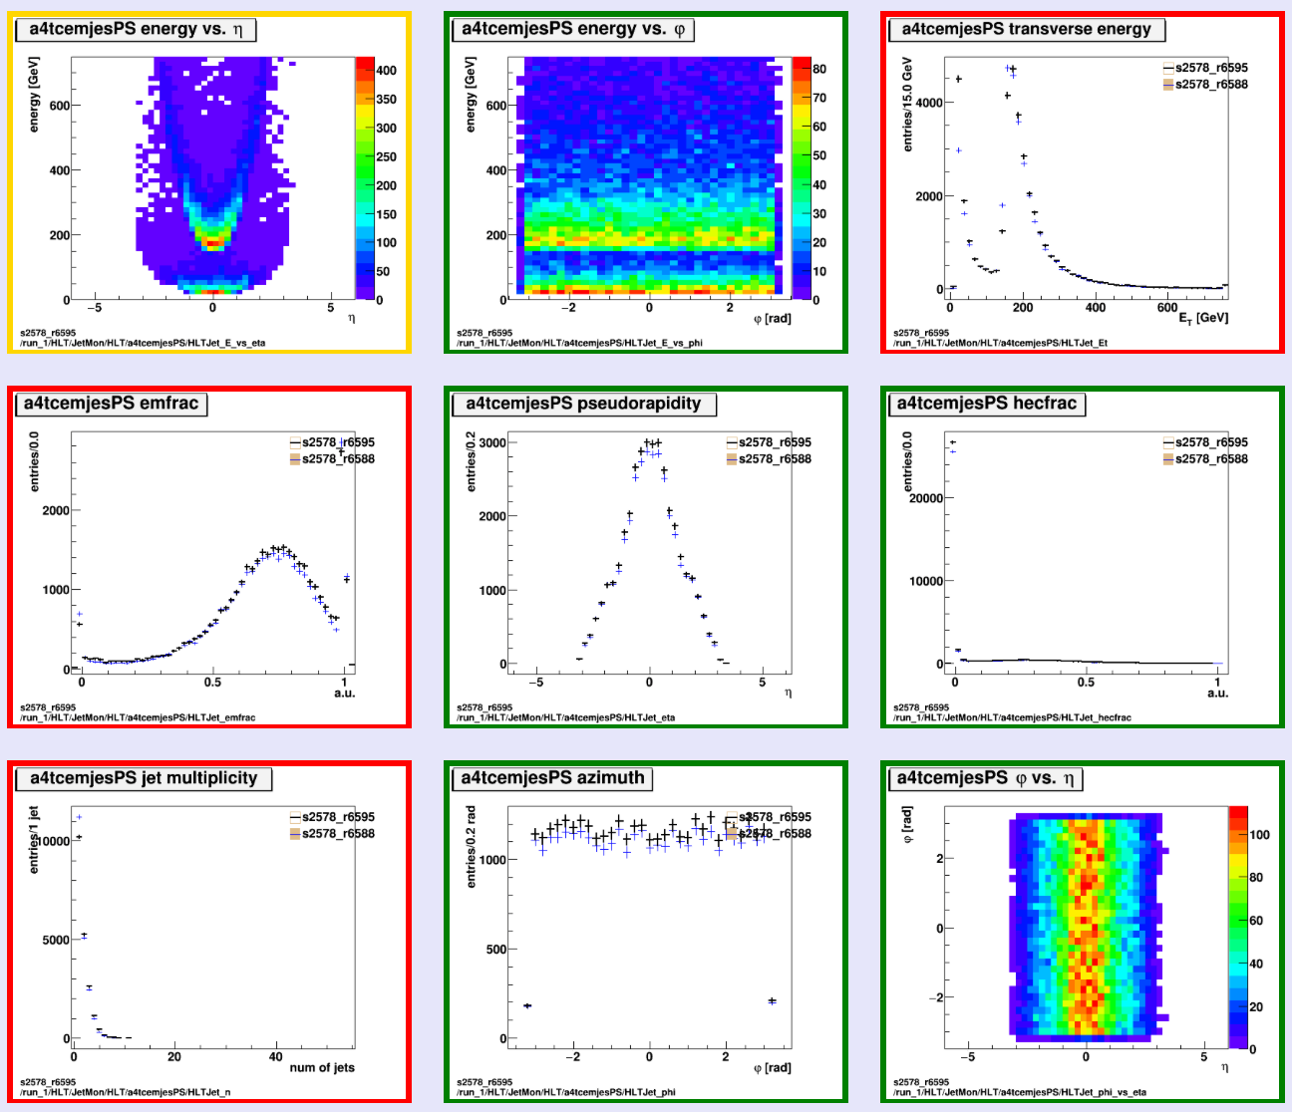
Histograms
L1_J100 turn on
L1_J100 turn on
s2578_r6595 run_1/HLT/JetMon/HLT/a4tcemjesPS
|eta|<3.2 for these PS chains
Good pileup behaviour wrt no-PU reference

Slide 9
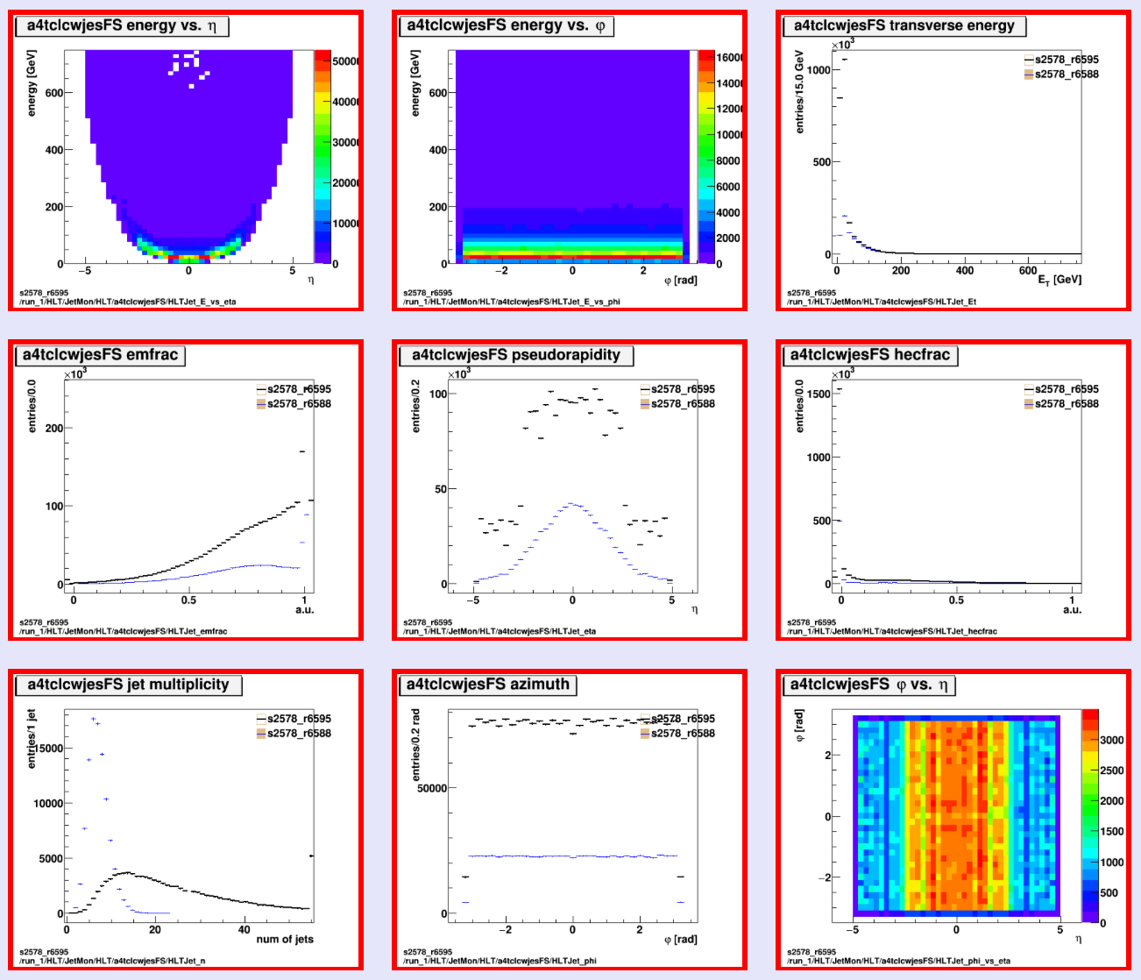
Histograms
Sharp turn-on wrt offline
Sensitive to pileup
s2578_r6595 run_1/HLT/JetMon/HLT/a4tclcwjesFS
Sensitive to pileup

Slide 10
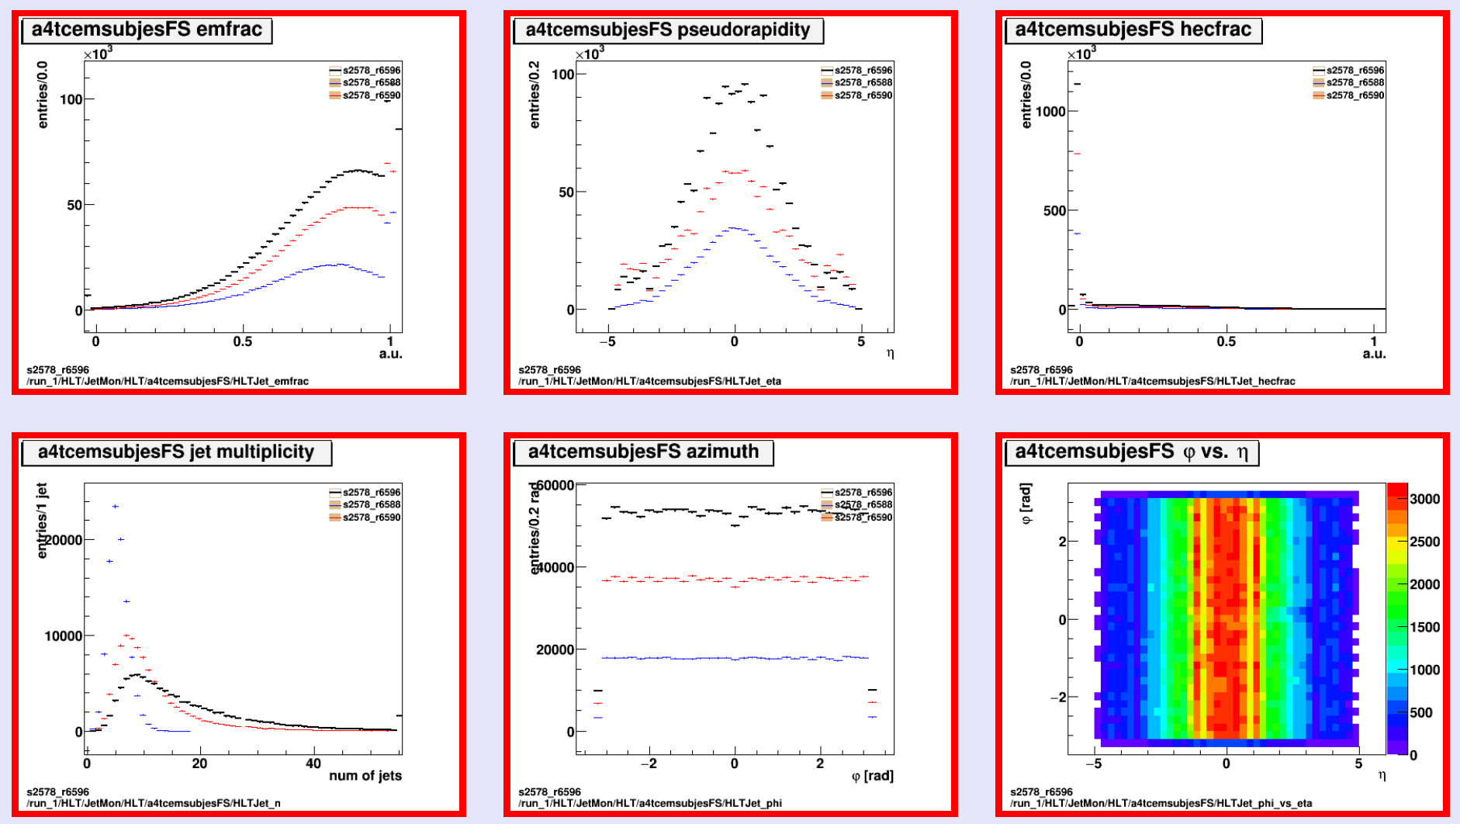
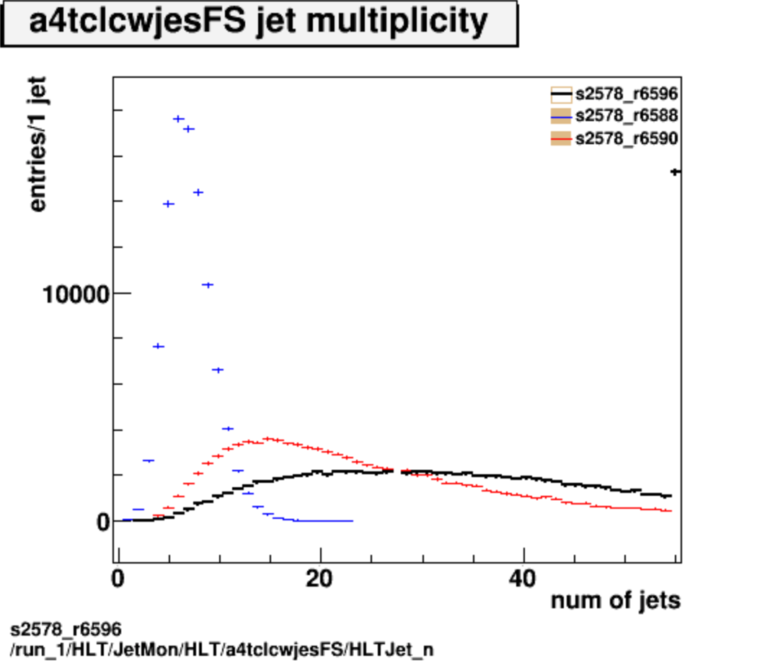
Histograms
No pileup
50ns pileup
25ns pileup
No pileup
50ns pileup
25ns pileup
s2578_r6596 run_1/HLT/JetMon/HLT/a4tcemsubjesFS

Slide 11
Run by Run DQ Summary
Run | Duration | Ended | Events | Online Hist. | Offline Hist. | Obs.
261182 | 901.4m | Mon 09:49 | 4388397 | Empty | OK | Only perf chains running
261308 | 92.3m | Mon 19:59 | 2226448 | Empty | OK | Only perf chains running
261320 | 791.4m | Tue 09:21 | 3928412 | Empty | OK | Only perf chains running
261456 | 846.4m | Wed 10:08 | 4718001 | Empty | OK | Only perf chains running
261615 | 639.6m | Thu 09:03 | 3590430 | OK | OK | j0 and ht0 now active
261921 | 716.6m | Fri 08:46 | 3851449 | OK | OK | j0 and ht0 active
261939 | 60.4m | Fri 10:25 | 273820 | Empty | OK | j0 and ht0 deactivated!
262088 | 515.2m | Sat 10:02 | 2758593 | Empty | OK | j0 and ht0 deactivated!
262094 | 173.5m | Sat 13:12 | 881611 | OK? | OK? | Low stats; j0/ht0 ok now
262153 | 782.4m | Sun 10:02 | 4164054 | OK | OK
262163 | 145.6m | Sun 12:52 | 761893 | Empty | Empty | Low stats; no j0 or ht0
262166 | 62.0m | Sun 14:01 | 306861 | Empty | Empty | Low stats; no j0 or ht0
262192 | 81.5m | Sun 17:53 | 406989 | Empty | Empty | Low stats; j0, ht0 active
262194 | 977.0m | Mon 10:44 | 5273906 | OK |  | j0 & ht0; not yet j0_lcw ok

Slide 12
Sign-off/defects
Old runs (offline histos only): 260095 260272
261182 – ok
Only j0_perf and ht0_perf active
Calo spike in (eta,phi)=(2,-3)
261308 – ok
New calo spike at (eta,phi)=(-2,1)
261320 – ok
Calo spike at (eta,phi)=(2,-3)
Disappeared: calo spike at (eta,phi)=(-2,1)
Smaller calo spike at (eta,phi)=(2,-0.7)
261456 – ok
Calo spike at (eta,phi)=(2,-3)
261615 – ok
j0 and ht0 chains (from L1_J12) now re-activated
Just small calorimeter spikes at phi=-1.2 and 1.6 (hard to see in eta)
261921 – ok
Calo spike at (eta,phi)=(2,-0.7)
Calo spike at (eta,phi)=(2,-3)
261039 – ok
Low stats
262088 – ok
Low stats
262095 – ok
Low stats
262153 – ok
Calo spike at (eta,phi)=(-0.5,1.7)
262163 – ok
Low stats
262166 – ok
Low stats
262192 – ok
Low stats
262194 – ok
Calo spike at (eta,phi)=(-1.2,-0.5)
Calo spike at (eta,phi)=(1.5,-0.5)

Slide 13
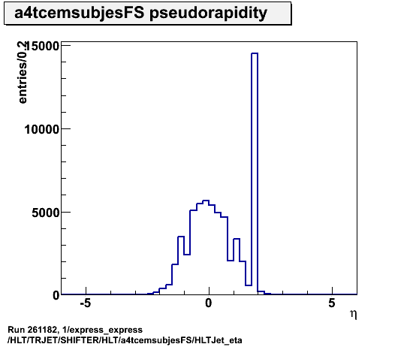
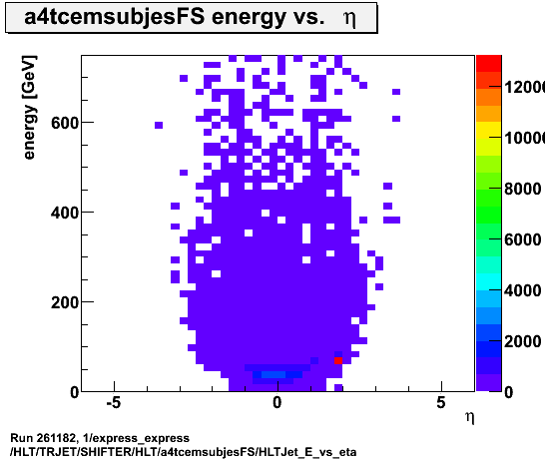
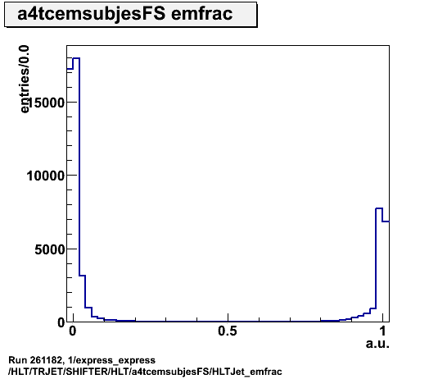
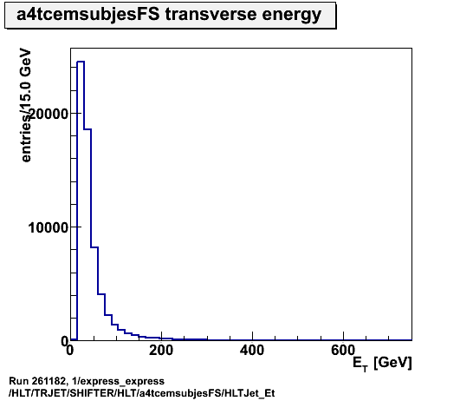
Run 261182
Jets menu:
Running only j0_perf_L1J12 and ht0_perf_L1J12
MET menu:
Running xe35, xe35_tc_lcw, xe35_tc_em, xe35_pueta, xe35_pufit, HLT_xe35_l2fsperf_wEFMuFEB_wEFMu, xe35_mht, xe35_L2FS
Offline histos ok:
a4tcemsubjesFS in express stream
Calorimeter spike at (eta,phi)=(2,-3)

Slide 14
Run 261182 Menu
Running only
j0_perf_L1J12 and ht0_perf_L1J12
These are prescaled out:
HLT_j0_L1J12
HLT_j0_jes_L1J12
HLT_j0_lcw_jes_L1J12
HLT_j0_sub_L1J12
HLT_j0_nojcalib_L1J12
HLT_j0_jes_PS_L1J12
HLT_j0_a10_nojcalib_L1J12
HLT_j0_a10_lcw_sub_L1J12
HLT_j0_a10r_lcw_sub_L1J12
HLT_ht0_L1J12
HLT_j0_a10_nojcalib_L1RD0_EMPTY
HLT_j0_a10r_lcw_sub_L1RD0_EMPTY
HLT_j15_L1J12
Created Jira to request activation of remaining chains:
https://its.cern.ch/jira/browse/ATR-10816
Only j0_L1J12 and ht0_L1J12 activated since this is now the STANDBY menu – from run 261615
MET menu looks better:
Running:
xe35, xe35_tc_lcw, xe35_tc_em, xe35_pueta, xe35_pufit, HLT_xe35_l2fsperf_wEFMuFEB_wEFMu, xe35_mht, xe35_L2FS
These are prescaled out:
HLT_xe0_L1All
HLT_xe0_L1XE35
HLT_xe0_tc_lcw_L1All
HLT_xe0_tc_lcw_L1XE35
HLT_xe0_tc_em_L1All
HLT_xe0_tc_em_L1XE35
HLT_xe0_tc_pueta_L1All
HLT_xe0_tc_pueta_L1XE35
HLT_xe0_tc_pufit_L1All
HLT_xe0_tc_pufit_L1XE35
HLT_xe0_tc_mht_L1All
HLT_xe0_tc_mht_L1XE35
HLT_xe0_L2FS_L1Al
HLT_xe0_L2FS_L1XE35
HLT_xe0_l2fsperf_wEFMuFEB_wEFMu_L1All
HLT_xe0_l2fsperf_wEFMuFEB_wEFMu_L1XE35

Slide 15
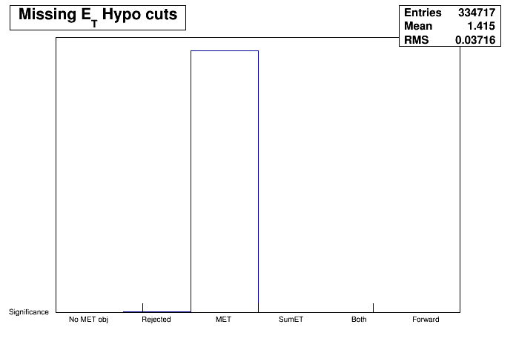
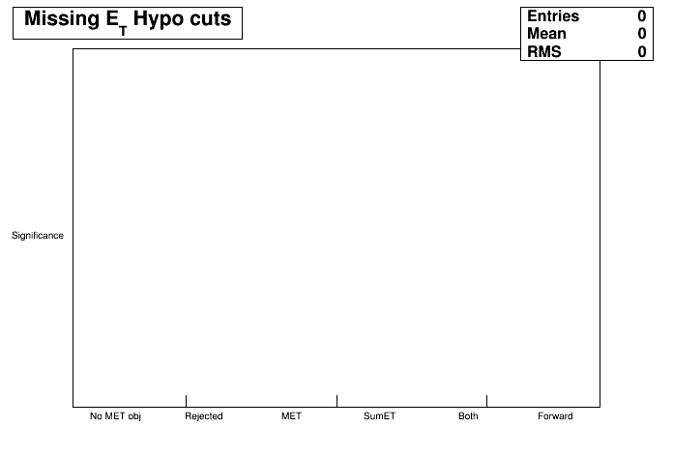
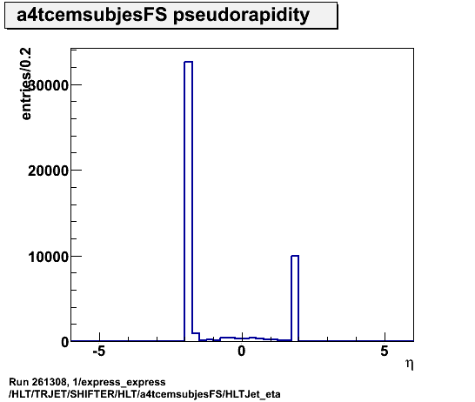
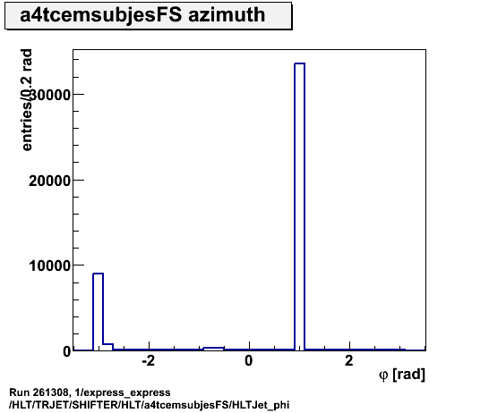
Run 261308
xe35_tclcw
Same as 261182:
Only j0/ht0_perf active
No xe0 chains active
Old calo spike at (eta,phi)=(2,-3)
New calo spike at (eta,phi)=(-2,1)
xe0_tclcw

Slide 16
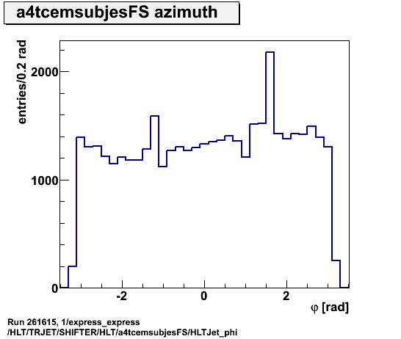
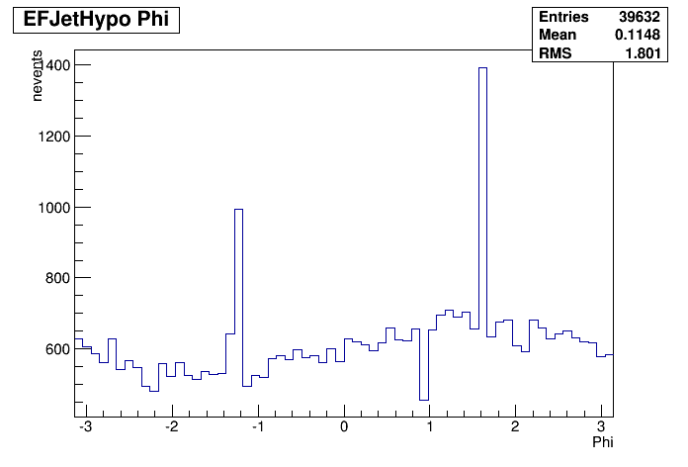
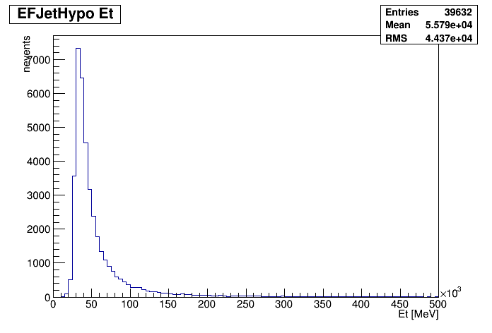
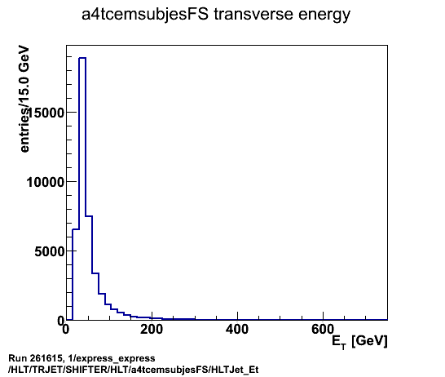
Run 261615
All OK
Re-activated chains: j0_L1J12, ht_L1J12
Small calo spikes (not visible in phi)
All looks ok also for MET
Naoko brought up: we should re-activate also lcw chain

Slide 17
Summary
Sample A validation on ttbar:
Features of different calibrations etc clearly visible in plots
Effect of different pileup scenarios also clear:
50ns pileup increases number of jets
25ns pileup results in even more jets
LCW seems more sensitive to pileup jets than EM+JES
No bad surprises; is performance ok?
Offline on-call shift:
No reprocessings
j0_L1J12 and ht0_L1J12 chains now in online standby menu
j0_lcw_jes_L1J12 requested by HLTCalo and us:
To monitor LCW TopoClusters
Already in nightlies but not in any run checked (last ended Monday am)
Not in imminent base release, so requested for the first cache
Followed in: https://its.cern.ch/jira/browse/ATR-10628

