Slide 1
Jet/MET Trigger On-Call Report
Ricardo Gonçalo – LIP
Jet Trigger Meeting – 31/3/2015

Slide 2
Reprocessings
EnhancedBias from 2012 run 212967
https://its.cern.ch/jira/browse/ATR-10486
Keys:
  SM Key 38: MC_pp_v5_ATR10486
  L1 PS Key 11: MC_pp_v5_default_prescale
  HLT PS Key 22: MC_pp_v5_ATR10486
  Release Key 9: 20.1.3.1
Release: AtlasP1HLT,20.1.3.1
Menu: MC_pp_v5
Tags: r6470_p1831_p1831
Reco release: AtlasProduction,20.1.3.3
Different statistics in reference and reprocessed histos expected
Looked at several chains and all seems fine

Slide 4
Run by Run
Run | Duration | Ended | Events | Online Hist. | Offline Hist. | Obs.
258389 | 868.6m | Mon 09:26 | 13939343 | OK | OK | Update web display
258504 | 58.2m | Mon 18:12 | 13571 | -- | -- | No HLT chains
258513 | 27.4m | Mon 18:52 | 1303 | Empty | Empty | Stats too low
258543 | 135.4m | Mon 22:42 | 1854183 | OK | OK | spike eta=2 & phi=-2.9
258544 | 562.7m | Tue 08:13 | 7932891 | OK | OK | Update web display
258617 | 31.7m | Tue 13:02 | 384599 | Empty | Empty | No jet/MET active chain
258727 | 105.2m | Tue 20:59 | 1388601 | OK | Empty | Stats very low
258745 | 29.4m | Tue 21:43 | 287543 | OK | OK | Low stats
258764 | 140.0m | Wed 02:00 | 2803579 | OK | OK | spike eta=2 & phi=-2.9
258769 | 429.8m | Wed 09:25 | 5748420 | OK | OK | spike eta=2 & phi=-2.9
258800 | 138.0m | Wed 14:40 | 12941 | Empty | Empty | Stats too low
258853 | 91.3m | Wed 20:31 | 1261266 | Empty | Empty | No L1Calo
258865 | 668.5m | Thu 08:21 | 8497789 | OK | OK | spike eta=2 & phi=-2.9

Slide 5
Run | Duration | Ended | Events | Online Hist. | Offline Hist. | Obs.
259003 | 665.8m | Fri 09:19 | 8 732 033 | xe0 rejects events | Jets ok MET empty | All xe0 chains reject events… https://its.cern.ch/jira/browse/ATR-10692
259101 | 792.4m | Sat 10:20 | 10759068 | xe0 rejecting Jets ok | Histos need update | Updated xe online mon. Problem with HLT Lar (LArADC2MeVTool)
259103 | 44.0m | Sat 11:23 | 341720 | Empty | Empty | Only muon chains
259117 | 283.4m | Sat 16:18 | 3921730 | Empty | Empty | Only muon chains
259165 | 830.1m | Sun 08:30 | 10883786 | Jet xe0 rejecting Jets ok | Jet ok MET empty | Only jet-based xe0 chain now misbehaves
259167 | 49.7m | Sun 10:25 | 614 012 | empty | empty | Only mu chains
259168 | 251.2m | Sun 14:44 | 3 411 942 | empty | empty | Only mu chains
259196 | 195.4m | Sun 18:38 | 2 149 472 | empty | empty | Only mu chains
259237 | 813.5m | Mon 08:29 | 11 401 398 | Jet xe0 & j0 reject | MET empty

Slide 6
DQ run sign off
Procedures for on-call shifters:
  Sign off here https://atlasdqm.cern.ch/defectentry/
  List of runs to sign off from atlasdqm@cern.ch – both TRIG_HLT_MET and TRIG_HLT_JET categories
  Instructions to be updated soon in the Jet/MET Expert Shift Instructions page:
    https://twiki.cern.ch/twiki/bin/view/Atlas/JetMetExpertshiftInstructions
  Sign off on runs with no problems
  Also sign off on runs which (justifiably!) have little stats
  Create DEFECTS for runs with clear problems
  Follow up on problems before either signing off or creating defects
Runs signed off:
  258389 – comment: spike eta=2 & phi=-2.9
  258504 – no HLT
  258513 – low stats
  258517 – no jet/met chains
  258543 – spike eta=2 & phi=-2.9
  Etc…
Current list of missing runs to sign off:
  256721 257577 257585 257588 257667 257687 257710 257728 257739 257764 257810 258225 258229 258242 258262 258263 258274 258303 258337 258342 258356 258513 259003 259055 259059 259065 259080 259097 259101 259103 259117 259165 259167 259168 259196 259237

Slide 7
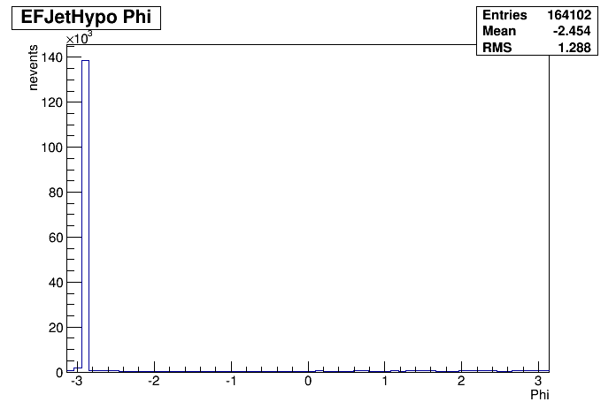
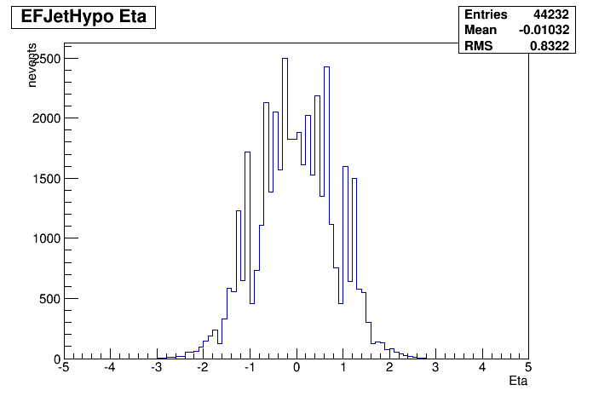
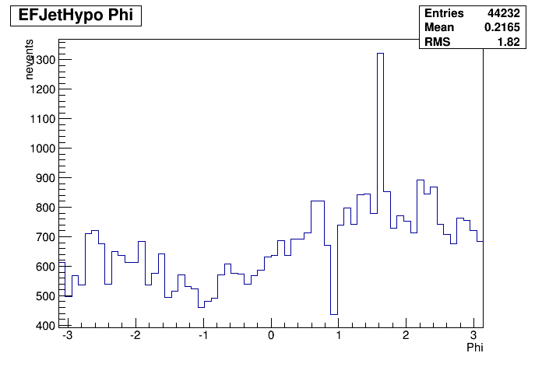
Run 258389
Online histos:
Spike in eta=2 phi=-2.9
Seen e.g. in HLT_j0_a10_nojcalib and several other FS chains (right)
NOT in j0 PS chain! (bottom left)
  Same for run 258743 etc

Slide 8
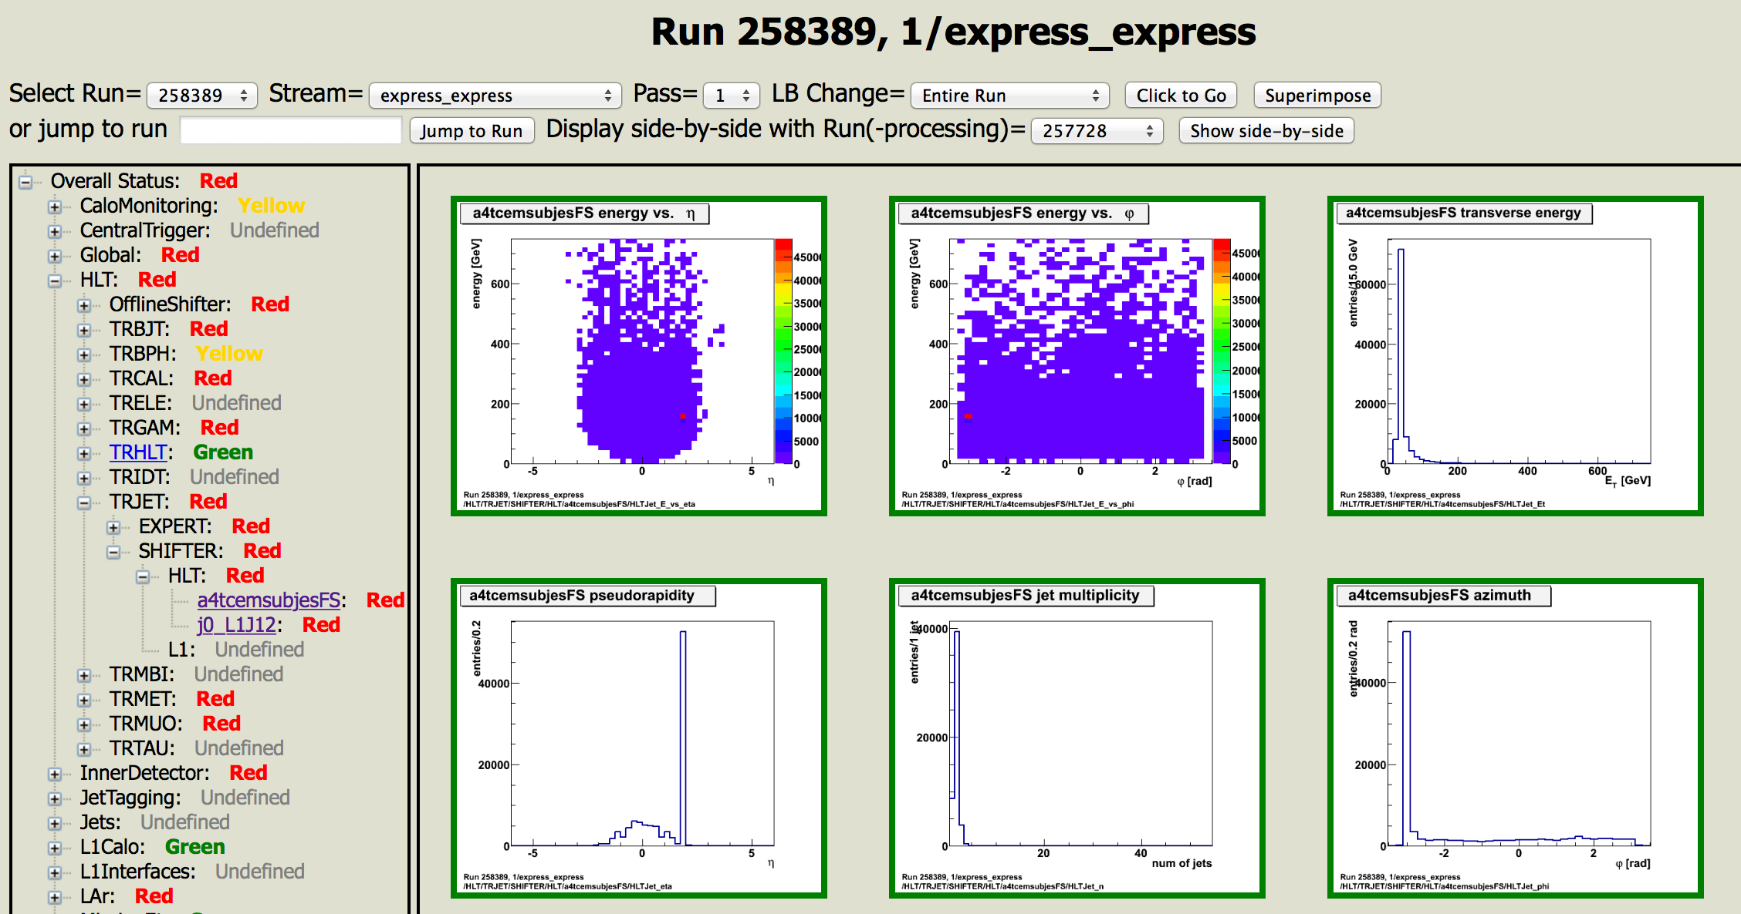
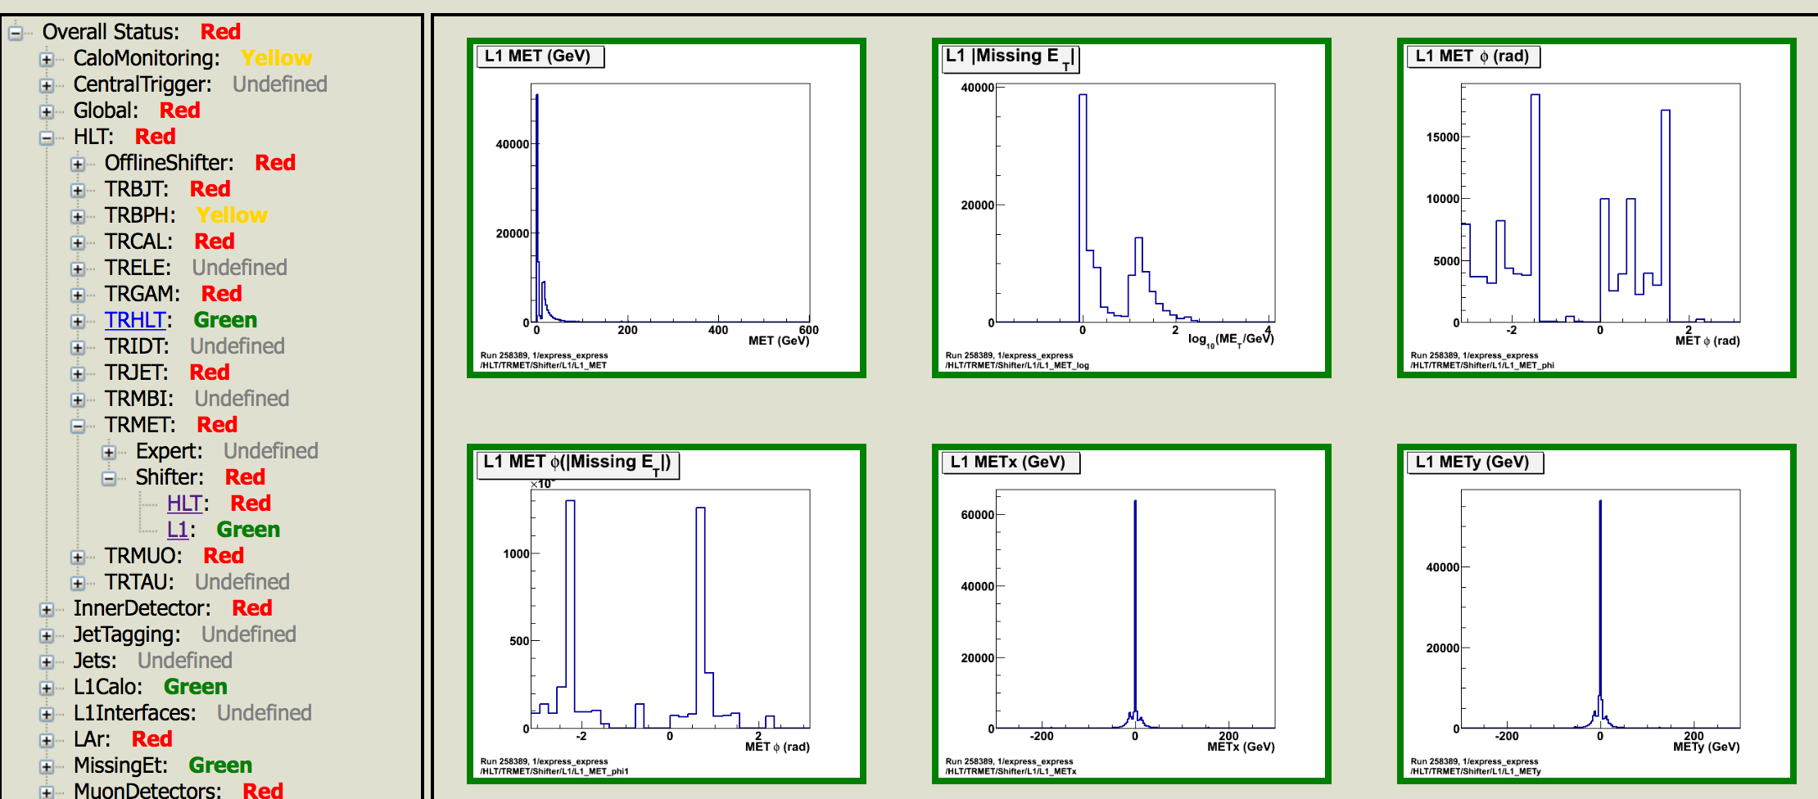
Offline Monitoring
Offline histos from DQ web display
  Jet: one histo empty (eta vs phi)
    Configuration will be updated when 20.1.3.4 goes to Tier0
  MET: Ony L1 generally filled (and seem ok)

Slide 9
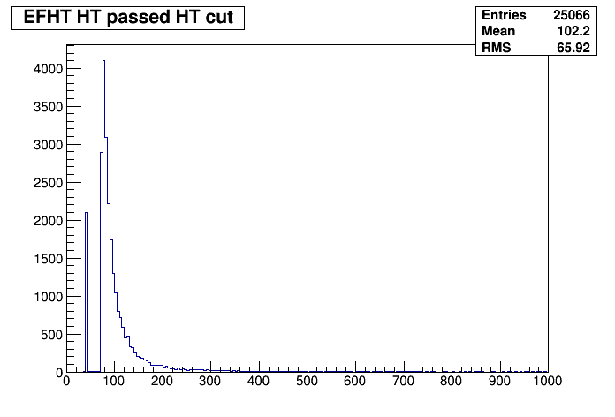
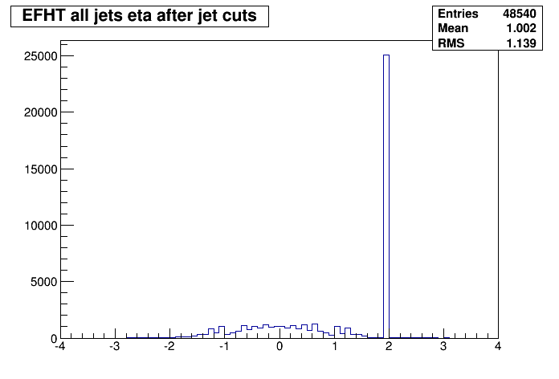
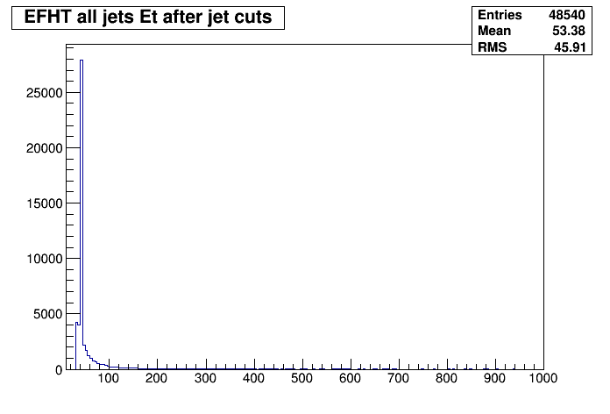
Run 258544
HT chain – low-HT spike visible in jet ET

Slide 10
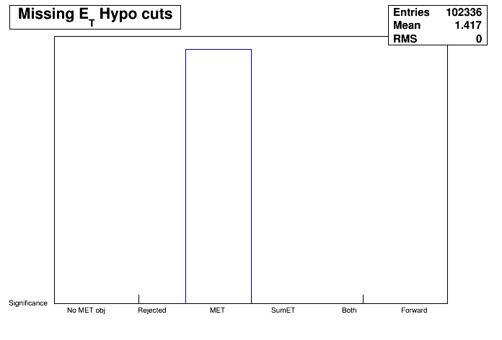
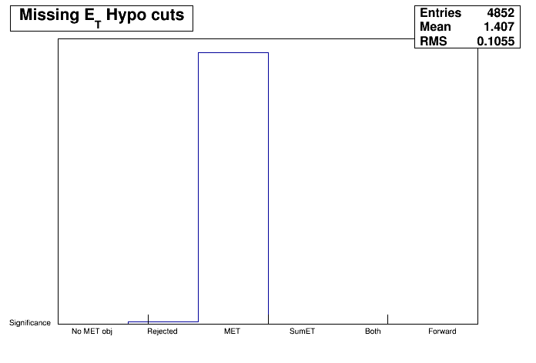
258544
Normal behaviour of MET chains:
  HLT xe35 (right) rejects some events – see comparison with xe0 (left)

Slide 11
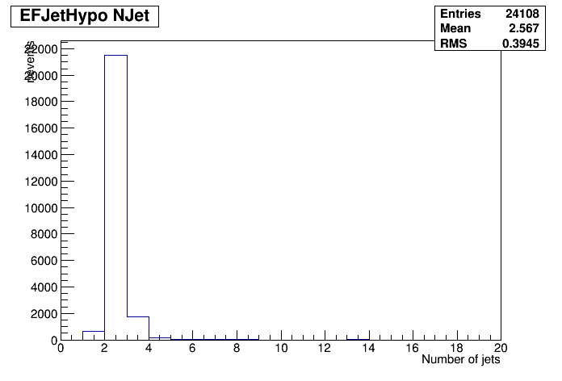
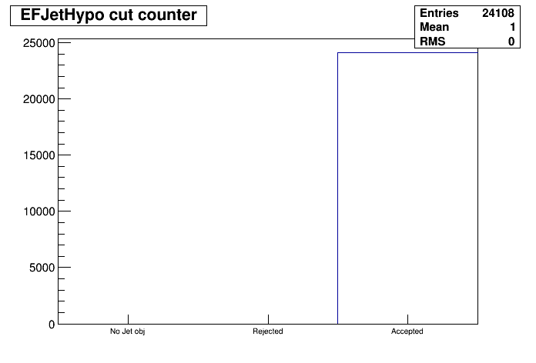
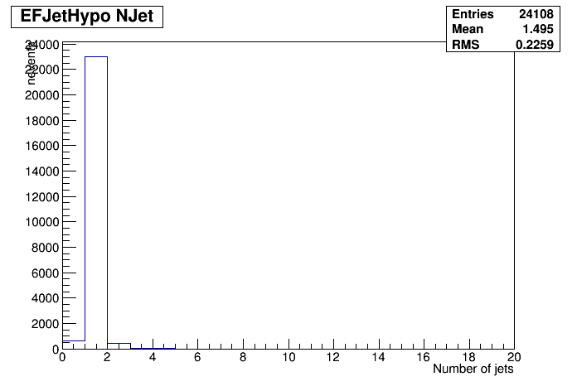
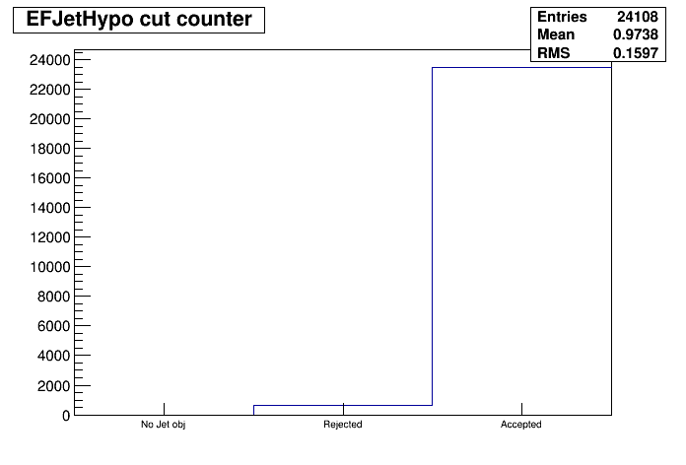
258769
PS chain with 0 cut rejects events
I.e. some events have 0 jets in PS but not in FS
Above: EFJetHypo_j0_0eta320_a4_tc_em_jes_FS
Below: EFJetHypo_j0_0eta320_a4_tc_em_jes_PS

Slide 12
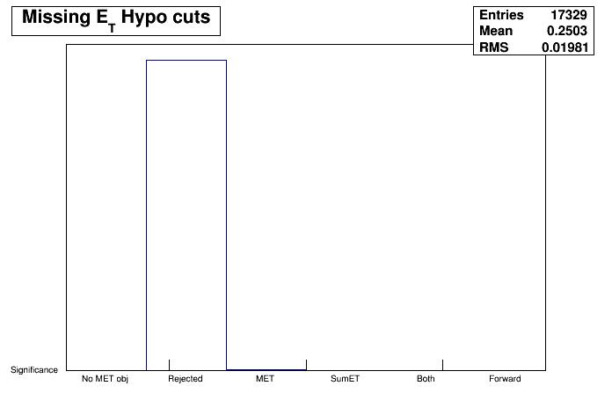
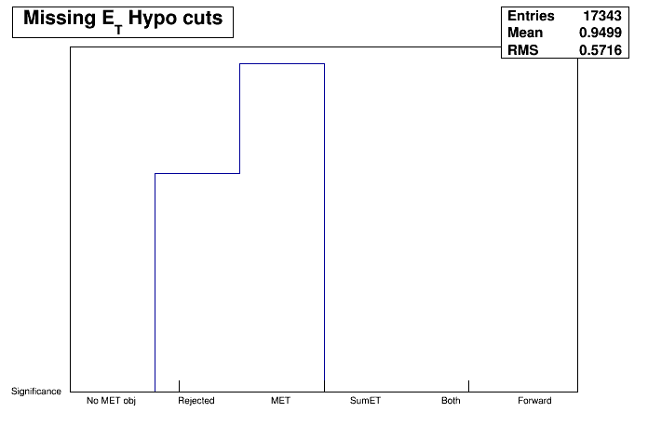
258853
MET chains rejecting many events
elisa log 255694 says this run had no L1Calo – (histo comes from HLT_xe0_tc_lcw_L1All chain?)
Almost all events rejected in EFMetHypo_Jets_xe0_tclcw (up)
Many more than usual rejected in EFMetHypo_TCPS_xe0_tclcw
Zero events in xe35 histos

Slide 13
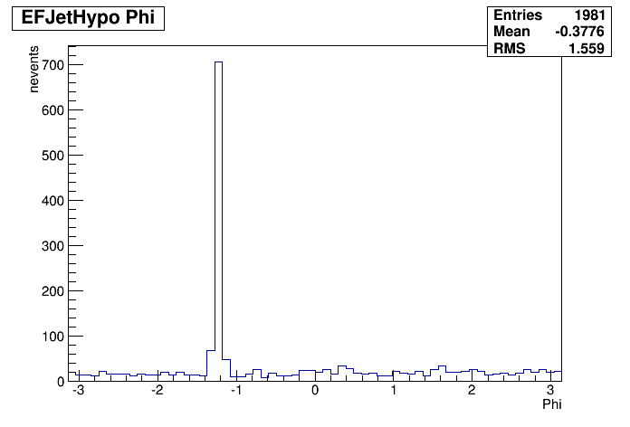
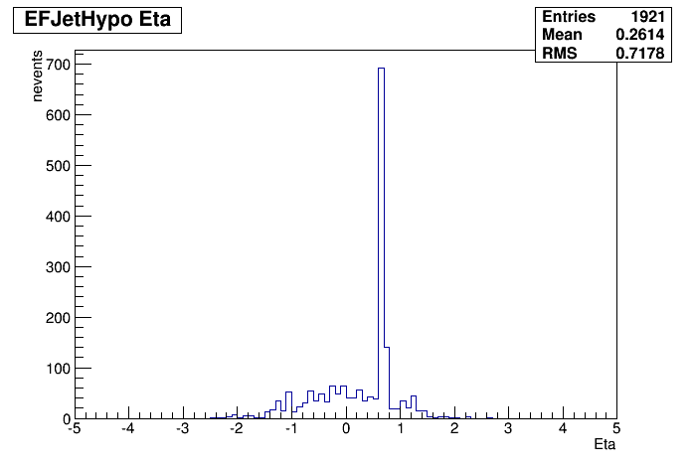
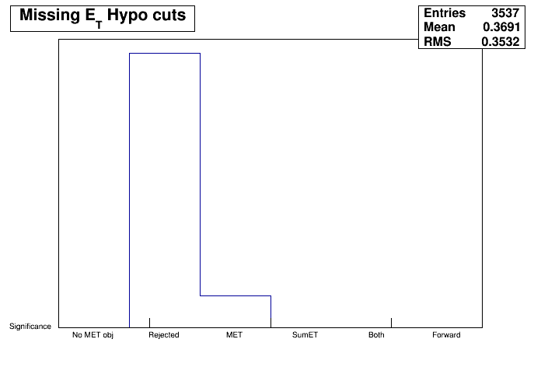

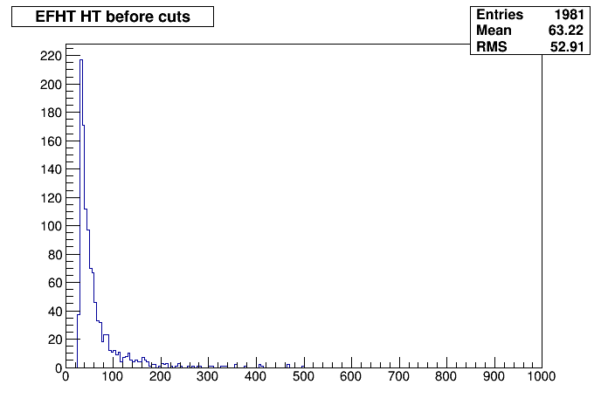
259003 - 259237
Old calorimeter hot cell moved to phi=-1.2, eta=0.8 (top and middle right) for 259101
Distorted HLT XE plots for jet->xe chains
  xe0 (bottom left) reject a higher fraction than xe35 (bottom centre)
  https://its.cern.ch/jira/browse/ATR-10692
A lot more monitoring xe plots than before! ☺
Spike at 40GeV in HT less visible or gone
LAr ERROR: LArADC2MeVTool: Cannot load LArADC2DAC object with key…
  See: https://atlasop.cern.ch/elisa/display/255952

Slide 14
MET monitoring
/EXPERT/EFMissingET_Fex_2sidednoiseSupp/EF_MET_lin
/EXPERT/EFMissingET_Fex_2sidednoiseSupp/EF_MET_log
/EXPERT/EFMissingET_Fex_2sidednoiseSupp/EF_MET_phi
/EXPERT/EFMissingET_Fex_2sidednoiseSupp/EF_MET_status
/EXPERT/EFMissingET_Fex_2sidednoiseSupp/EF_MEx_log
/EXPERT/EFMissingET_Fex_2sidednoiseSupp/EF_MEy_log
/EXPERT/EFMissingET_Fex_2sidednoiseSupp/EF_MEz_log
/EXPERT/EFMissingET_Fex_2sidednoiseSupp/EF_SumEt_lin
/EXPERT/EFMissingET_Fex_2sidednoiseSupp/EF_SumEt_log
/EXPERT/EFMissingET_Fex_2sidednoiseSupp/TotalEMTime
/EXPERT/EFMissingET_Fex_2sidednoiseSupp/TotalHECTime
/EXPERT/EFMissingET_Fex_2sidednoiseSupp/TotalLoadColTime
/EXPERT/EFMissingET_Fex_2sidednoiseSupp/TotalLoopTime
/EXPERT/EFMissingET_Fex_2sidednoiseSupp/TotalRegSelTime
/EXPERT/EFMissingET_Fex_2sidednoiseSupp/TotalTileTime
/EXPERT/EFMissingET_Fex_2sidednoiseSupp/compN_vs_compEt
/EXPERT/EFMissingET_Fex_2sidednoiseSupp/compN_vs_compEt_lin
/EXPERT/EFMissingET_Fex_2sidednoiseSupp/compN_vs_compEx
/EXPERT/EFMissingET_Fex_2sidednoiseSupp/compN_vs_compEy
/EXPERT/EFMissingET_Fex_2sidednoiseSupp/compN_vs_compEz
/EXPERT/EFMissingET_Fex_2sidednoiseSupp/compN_vs_compSumE
/EXPERT/EFMissingET_Fex_2sidednoiseSupp/compN_vs_compSumEt
/EXPERT/EFMissingET_Fex_2sidednoiseSupp/compN_vs_compSumEt_lin
/EXPERT/EFMissingET_Fex_2sidednoiseSupp/compStatus
Many new MET FEX online monitoring plots
Expert plots
May need documentation
But in principle very useful to debug issues

Slide 15
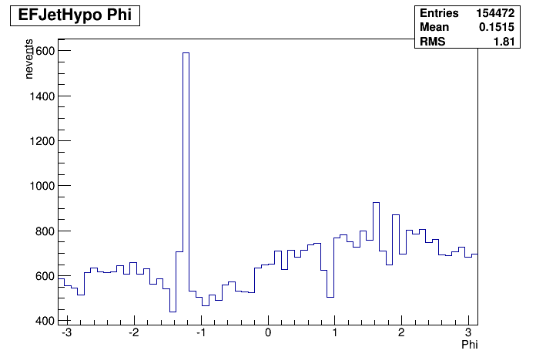
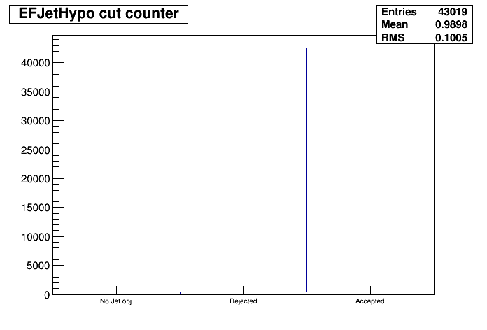
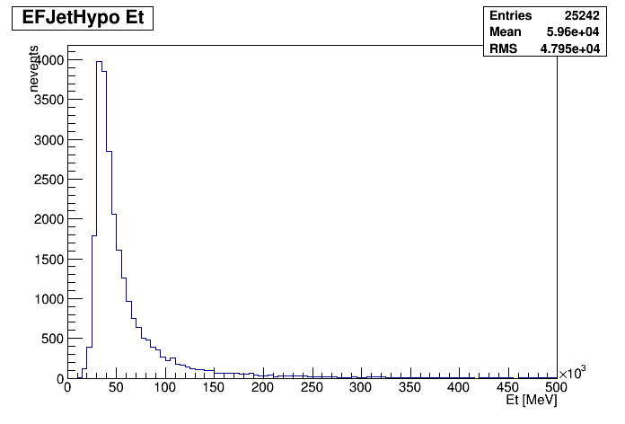
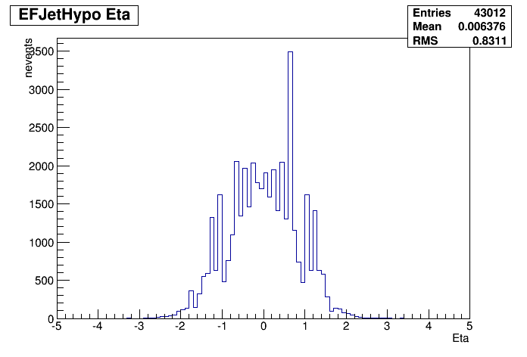
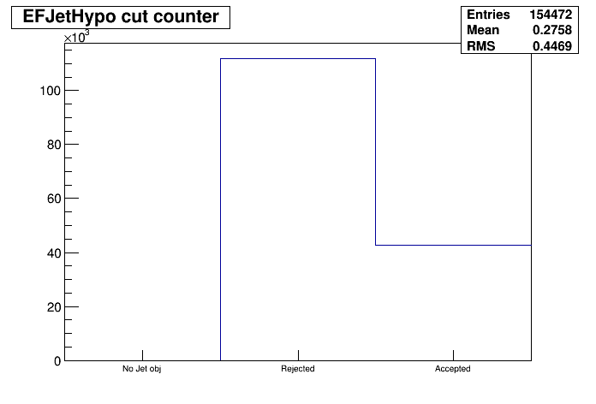
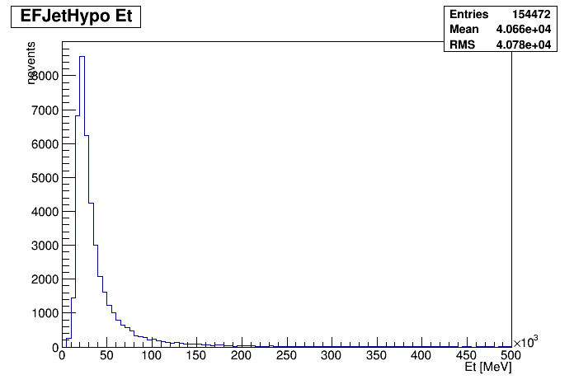
259237
Top: j0_0eta320_a10_tc_em_nojcalib_FS
Bottom: j0_0eta320_a4_tc_em_jes_FS

Slide 16
Summary
Going to AtlasP1HLT-20.1.3.4 today in principle (if it works)
One reprocessing – all fine
New MET monitoring plots
Run 258769: difference in behaviour of PS and FS (not unexpected)
Mysteries for Aparajita:
  From run 259003: possible problem in MET:
    xe0 chains (seeded by L1All) rejecting events
    Jira: https://its.cern.ch/jira/browse/ATR-10692
  Run 259237:
    j0 chain rejecting more events than usual

