Slide 1
Jet Trigger On-Call Shift Summary
Ricardo Gonçalo - LIP

Slide 2
Summary
Online:
No chains running during weekend due to bad TDAQ patch needed for collisions but bad for HLT in cosmics
Deployed new release 20.1.3 yesterday, tested in the afternoon, saw crashes again.
TDAQ applied new patch, crashes went away.
See per-mille level of events in the DEBUG stream
Offline: Three reprocessing ongoing
ID cosmics reprocessing finishes w/o crashes
Low stats:
MET histos filled
Jet histograms empty for chains from L1_J12; j35 from RD0 filled and looks ok
Enhanced Bias reprocessing impossible to do because of MC_v5 menu crashes HLT. Got new rescale key with MB chains disabled, but then other crashes appear. Decision: postpone until fix available in next release.
Low mu pp reprocessing, high-multiplicity trigger, still on hold in reconstruction.

Slide 3
Run by Run
Run | Duration | Ended | Events | Online Hist. | Obs.
256054 | 298.9m | Sun 17:06 | 3812020 | All empty
256050 | 1082.9m | Sun 11:39 | 14243855 | MET: 1 histo fill Jets: empty | Low stats Chains only active in PSK 281 (31 Lumi Blocks) No active HT chains
255988 | 396.7m | Sat 16:49 | 4617087 | Empty | No chains
255978 | 29.4m | Sat 10:04 | 230937 | Empty | No chains
255973 | 707.4m | Sat 09:06 | 9330067 | Empty | No chains
255972 | 75.6m | Fri 21:10 | 869224 | MET: empty HT: empty Jets: see below | Jet/MET chains active only for HLT PSK 276 HT chains not active
255963 | 40.9m | Fri 19:40 | 203526 | Empty | BUT chains active(?)
255815 | 132.5m | Fri 08:54 | 813029 | MET: filled - OK Jets: filled - OK | Jet/MET chains active! HLT PSK 250

Slide 4
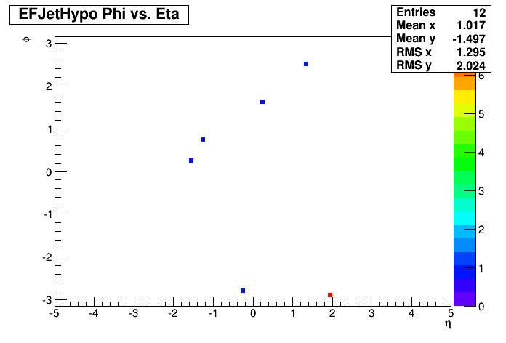
Run 255972 Puzzle…
Empty histos: Njet, ET, eta, phi
Eta_vs_Phi: /j0_a10_tc_em_nocjalib_FSHistogramming.TopMIG-OH:HLT./EXPERT/EFJetHypo_j15000_0eta320_a4_tc_em_subjes_FS/Eta_vs_Phi
I.e. j0 chains but with j15 hypo?!!!
Checked with Peter that config is correct for release (AtlasP1HLT-20.1.2.1)
Only appears in folder HLTDQM
Contacted Martin and Joana to find out what this folder is..
Correct folder in MDA is TopMIG-OH:HLT

Slide 5
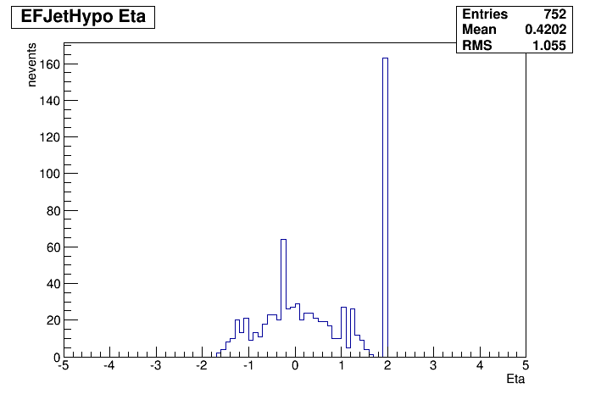
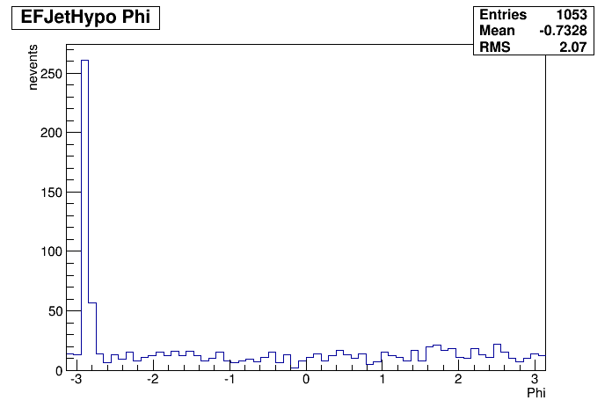
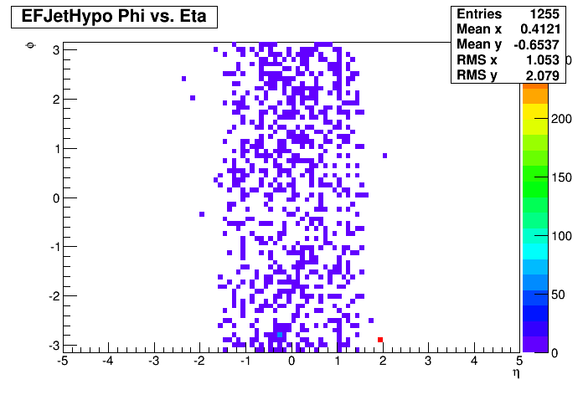
Run 255972 Online Histos
j0 chains with several calibrations
j15 chain with default calibration
Seeded from L1_J12
Noise spikes at phi=-2.9; eta = 2 and -0.1 (not there in previous runs 255815)
j0_0eta320_a4_tc_em_subjes_FS

Slide 6
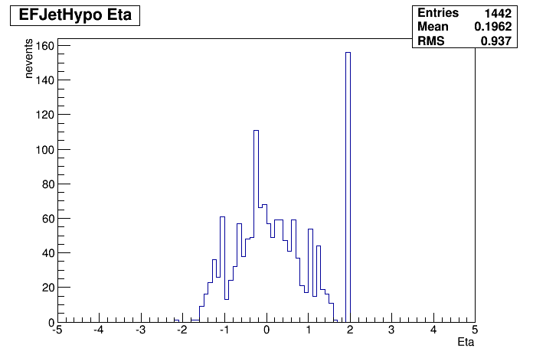
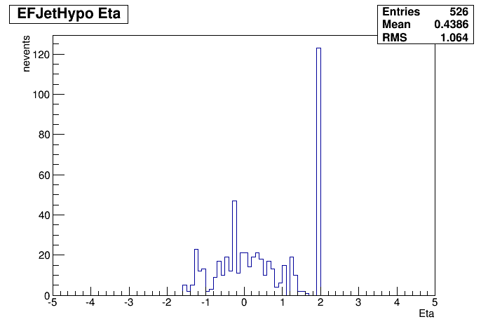
Run 255972 Online Histos
j0 chains with several calibrations
j15 chain with default calibration
Seeded from L1_J12
Noise spikes at phi=-2.9; eta = 2 and -0.1 (not there in previous runs 255815)
j0_0eta320_a4_tc_em_subjes_FS
j0_0eta320_a4_tc_lcw_jes_FS
j0_0eta320_a4_tc_em_nojcalib_FS

Slide 7
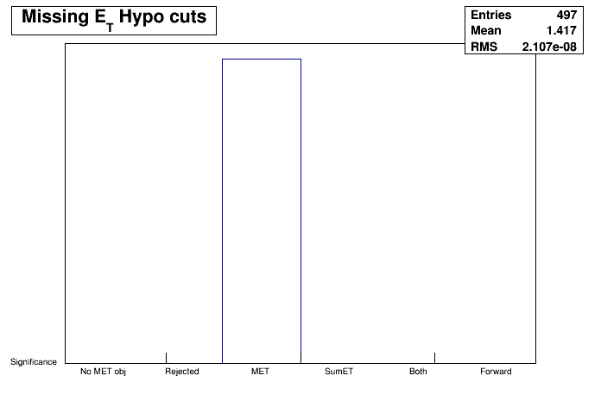
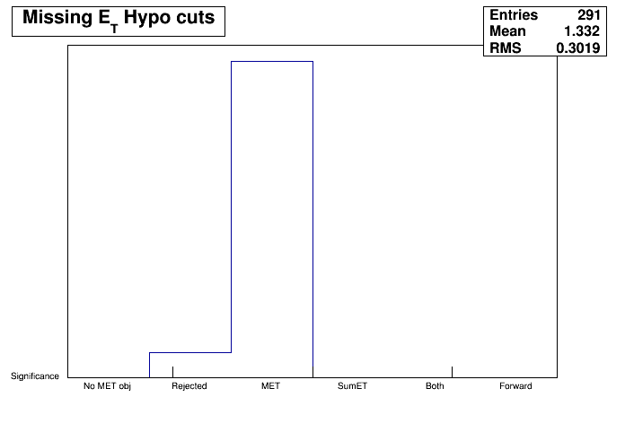
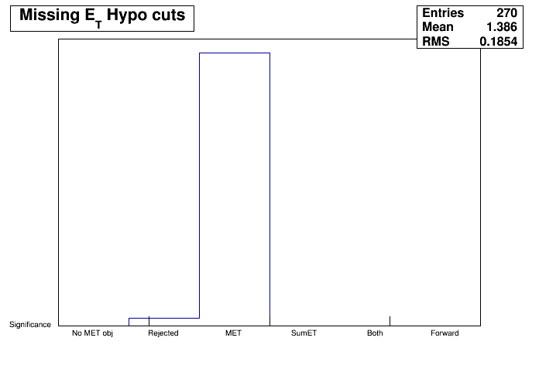
Run 255972 MET
Chains seeded from L1_XE35
Histograms seem to be properly filled
No histograms for:
HLT_xe35_L2FS
HLT_xe35_mht
EFMetHypo_Jets_xe0_tclcw
EFMetHypo_TCPUC_xe35_tclcw
EFMetHypo_Jets_xe35_tclcw

Slide 8
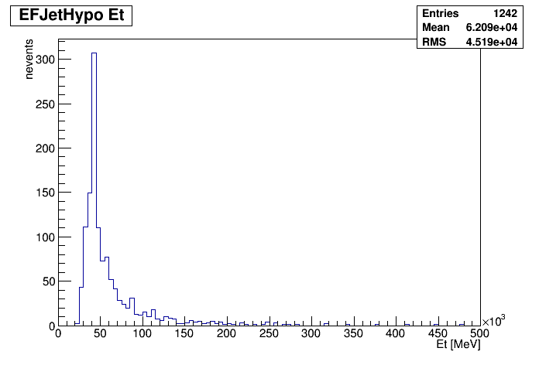
Run 255972
j0_0eta320_a4_tc_em_subjes_FS
Up: Default calibration
Down: no area subtraction
ET>0
0 < eta < 3.2
EM-scale clusters
Anti-kt R=0.4
Jet Energy Scale (old)
Full Scan
j0_0eta320_a4_tc_em_jes_FS

Slide 9
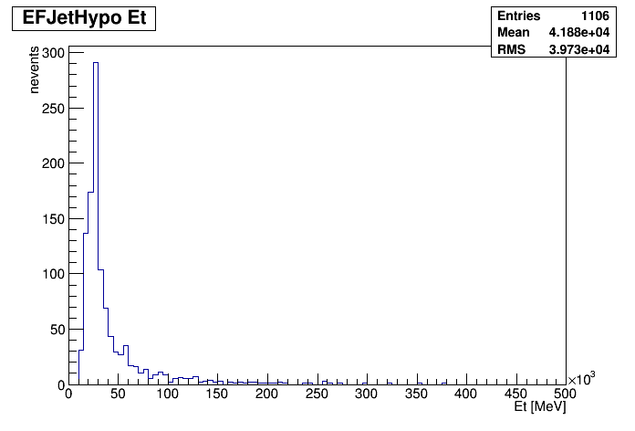
Run 255972
j0_0eta320_a4_tc_em_subjes_FS
Up: Default calibration
Down: no JES or area subtraction
ET>0
0 < eta < 3.2
EM-scale clusters
Anti-kt R=0.4
Jet Energy Scale (old)
Full Scan
j0_0eta320_a4_tc_em_nojcalib_FS

Slide 10
Run 255972
j0_0eta320_a4_tc_em_subjes_FS
Up: Default calibration
Down: no Jet Energy Scale
ET>0
0 < eta < 3.2
EM-scale clusters
Anti-kt R=0.4
Jet Energy Scale (old)
Full Scan
j0_0eta320_a4_tc_em_sub_FS

Slide 11
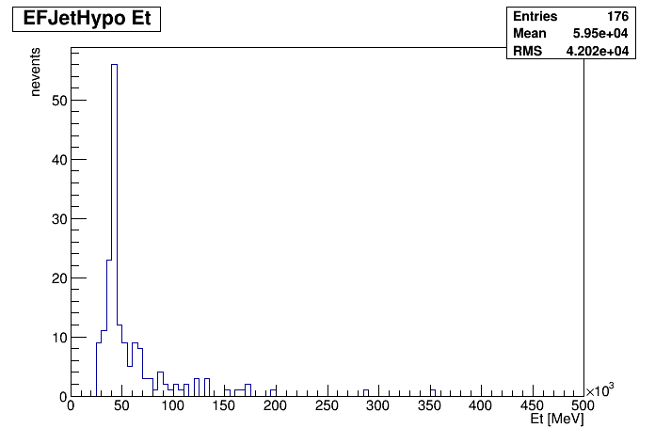
Run 255972
j0_0eta320_a4_tc_em_subjes_FS
Up: j0
Down: j15
Different numbers of events?!
Both seeded from L1_J12
ET>0
0 < eta < 3.2
Anti-kt R=0.4
EM-scale clusters
Default jet calibration:
Jet Energy Scale (old)
Jet area subtraction
Full Scan
j15000_0eta320_a4_tc_em_subjes_FS

Slide 12
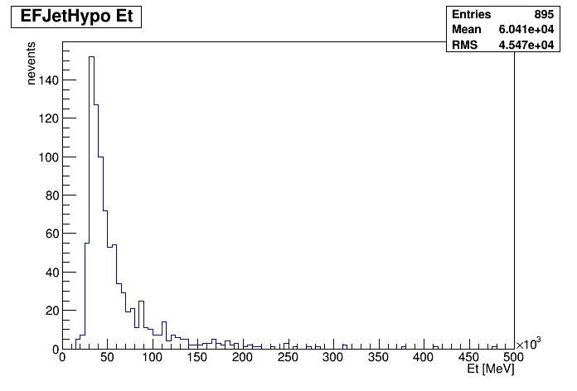
Run 255972
j0_0eta320_a4_tc_em_subjes_FS
Up: Full Scan
Down: Partial Scan
Both seeded from L1_J12
ET>0
0 < eta < 3.2
Anti-kt R=0.4
EM-scale clusters
Default jet calibration:
Jet Energy Scale (old)
Jet area subtraction
j0_0eta320_a4_tc_em_subjes_PS

Slide 13
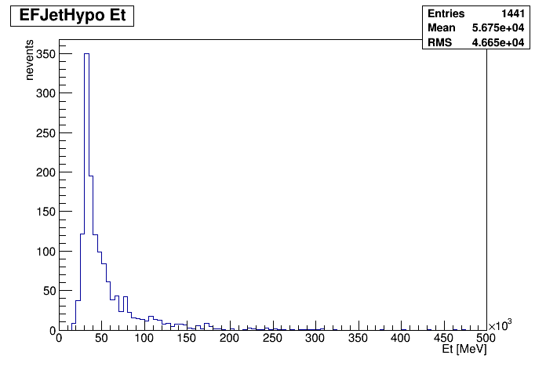
Run 255972
j0_0eta320_a4_tc_em_jes_FS
Up: EM-scale clusters
Down: LCW clusters
ET>0
0 < eta < 3.2
Anti-kt R=0.4
No jet area subtraction
Jet Energy Scale (old)
Full Scan
j0_0eta320_a4_tc_lcw_jes_FS

Slide 14
Run 255972
j0_0eta320_a10_tc_em_nojcalib_FS
Up: no calibration
Down: LCW, area subtraction, no JES
ET>0
0 < eta < 3.2
LCW clusters
Anti-kt R=0.4
Full Scan
j0_0eta320_a10_tc_lcw_sub_FS

