Slide 1
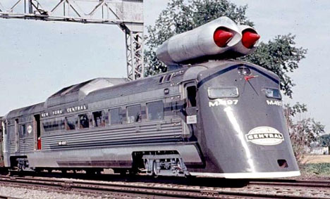
Latest News & Other Issues
Ricardo Goncalo (LIP), David Miller (Chicago)
Jet Trigger Signature Group Meeting 9/2/2015

Slide 2
News
M8 started!
First beam on 23 March – email today from Dave Charlton
Jet EDM configuration:
AODSLIM – bulk MC production; only default a4tcemsubjesFS and a10tcemnojcalibFS collections
AODFULL – all trigger jet collections + clusters; for data and specific MC trigger samples
Starting with tonights rel_2: default trigger EDM in MC jobs changes from AODFULL to AODSLIM – same as bulk MC production (data AODs remain AODFULL)
ATN/RTT test joboptions adapted to overwrite this
Sample T
See: https://its.cern.ch/jira/browse/ATLPHYSVAL-279
MC15 w/ trigger submitted using r6070:
dq2-ls valid1.*_r6070* | grep RDO | sort
dq2-ls valid1.*_r6070* | grep AOD | sort
DC14 w/ pileup w/ trigger: r6067
dq2-ls valid1.*_r6067* | grep RDO | sort
dq2-ls valid1.*_r6067* | grep AOD | sort

Slide 3
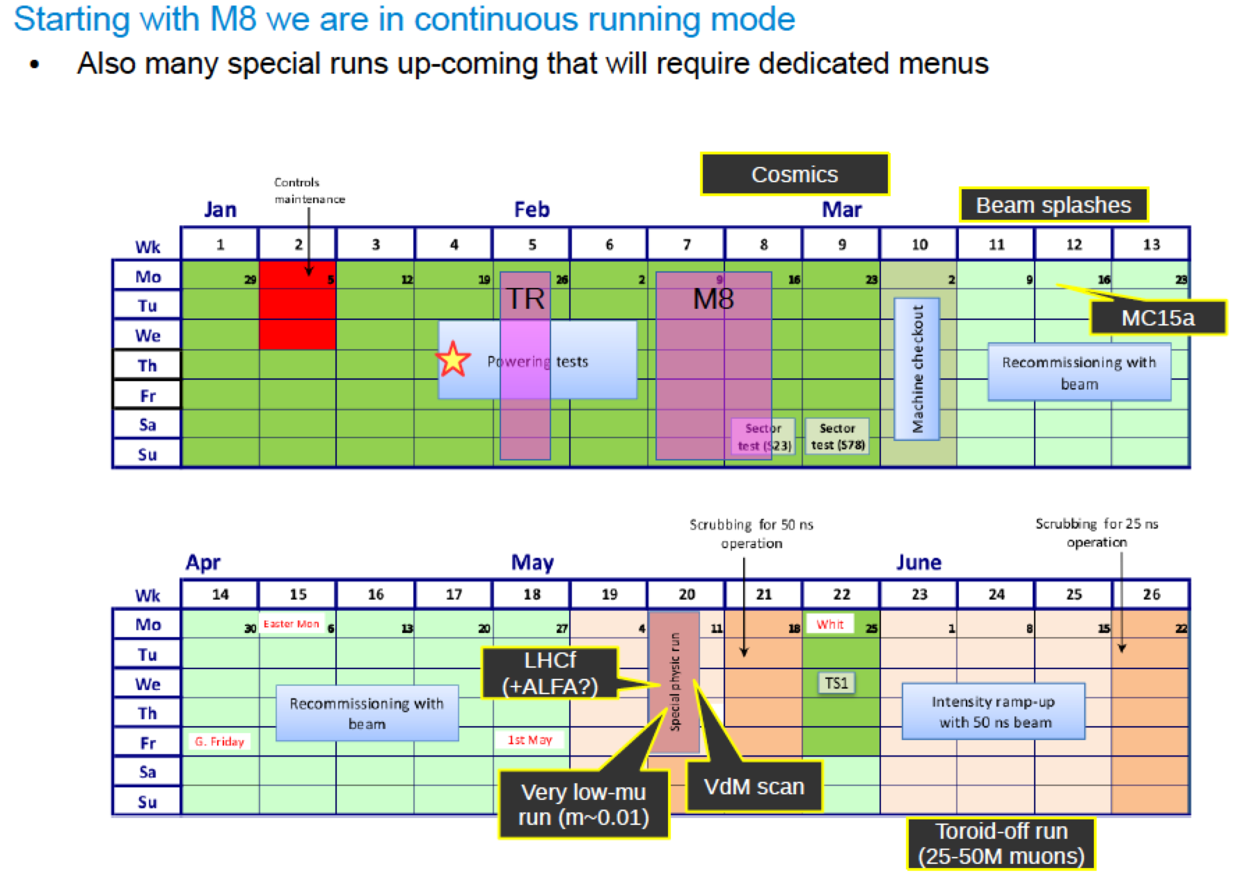
1st Run 2 Beams!

Slide 5
M8 Goals
3 M ID cosmics
Solenoid ON Friday 13th
Have all sub-systems included and run 100 kHz
Validate full Run-2 menu, new CTP, L1topo etc.
Full test of LHC handshake:
Warm start, scan variables etc. (Feb 18th)
Latencies
Measure and test latencies with L1topo and alfa
Tests of Muon alignment run.
For us:
Focus on testing new jet functionality in M8 menu

Slide 6
Menu for M8
Keep existing chains:
j0_perf_L1RD0_EMPTY
j0_perf_L1MU10
j0_perf_L1J12
ht0_perf_L1J12
Add chains to test :
em vs lcw clusters
Jes vs nocalib
area subtraction
PS vs FS
fat-jet chains, including reclustering
starting from L1_J12:
j0_L1J12 default calibration etc (a4 tc em subjes) but with a hypo cutting looser than L1
j0_PS_L1J12 default calibration etc with a hypo and calorimeter Partial Scan readout
j0_jes_L1J12 variation on calibration: jet calibration but no subtraction calibration
j0_lcw_jes_L1J12 variation on cluster calibration: lcw instead of em, with JES
j0_sub_L1J12 variation on calibration: no JES but with area subtraction
j0_nojcalib_L1J12 variation on calibration: no jet calibration
fat jets
j0_a10_nojcalib_L1J12 fat jet (no reclustering) without calibration
j0_a10_lcw_sub_L1J12 fat jet (no reclustering) lcw clusters and area subtraction
j0_a10r_lcw_sub_L1J12 fat jet from reclustering, lcw clusters and area subtraction
fat-jet chains starting from random
j0_a10_nojcalib_L1RD0 fat jet (no reclustering) without calibration
j0_a10r_lcw_sub_L1RD0 fat jet from reclustering, lcw clusters and area subtraction
chain designed to actually cut on events triggered by L1, to improve monitoring
j15_L1J12
ht0_L1J12

Slide 7
Trigger Shifts
Expert Training:
Online Expert, Offline Expert (Reprocessing) and online Release coordinator
5th of Feb, 14.00 – 17.00 – https://indico.cern.ch/event/363334/
Online Release Coordinator shift needs urgently more support!
Some on-call expert shifts still free
Schedule
Shift hand over of all shifts TUESDAY after weekly meeting
Sign in OTP from Tuesday to Monday but hand over on Tuesday
Daily Trigger Operation meeting at 09.00 in SCR – 3196-R-021
Including the DQ issues from signature groups

Slide 8
Signature sign-off procedure
Studies to be done from sample A and sample T – expected 1 week after sample T is produced !
https://twiki.cern.ch/twiki/bin/viewauth/Atlas/TriggerSignOffRel20#Jet
Instructions
Please insert the relevant information next to each trigger chain. Don't edit the twiki page but the relevant table only, by clicking on the 'Edit' button.
The columns in the tables are expected to contain the following information:
HLT Chain : Chain name.
Assigned to : Trigger or Physics group responsible for the trigger sign-off.
Configuration check : Basic check of a reasonable trigger configuration in the menu.
Rate (2e34) : Unprescaled rate.
V5 vs V4 : Comparison between Run1 and Run2 scaled rates / performance, wherever relevant.
Emulation check : Comparison between trigger decision and emulated trigger decision to verify selections and cuts (incl. L1).
Efficiency check : Performance and efficiency curves, on signal and/or background.
Supporting material : Links to presentations and/or plots.
Signed off? : If all above checks have passed!

Slide 9
Express Stream Update
Requested 1 fat-jet chain: j460_a10_sub_L1J100
See wiki:https://twiki.cern.ch/twiki/bin/view/Atlas/ExpressStream#E34_menu_Physics_pp_v4_menu_coll
The express stream has the following features:
Contain a subset of the physics data corresponding to ~10Hz total.
Full events (unlike the calibration stream) but not for physics analysis.
Every event in the express stream will also be in the physics streams.
Will be reconstructed quasi-real time and looked at promptly (before the main reconstruction starts) for calibration and monitoring.
Used to check data quality, monitor the status of the detector, alignment and calibration, etc.
Jet menu in express stream (looking for voluntary for contact person):

Slide 10
Menu Requests for Special Runs
By 6/Feb
Beam-splashes https://its.cern.ch/jira/browse/ATR-9141
By 20/Feb
LHCf run https://its.cern.ch/jira/browse/ATR-9922
ALFA run https://its.cern.ch/jira/browse/ATR-9924
VdM scan https://its.cern.ch/jira/browse/ATR-9879
Low-mu (~0.01) run https://its.cern.ch/jira/browse/ATR-9921
Toroid-off run https://its.cern.ch/jira/browse/ATR-9923
Moderate mu (mu~0.5) run https://its.cern.ch/jira/browse/ATR-9999
All default calibration and detector monitoring streams running
during physics data-taking will be available also during those special runs. No need to re-request them.
Will be followed up by the discussion at the Menu Coordination Meeting in early March (to be announced later)
For beam-splashes, there are already very good discussion ongoing.

Slide 11
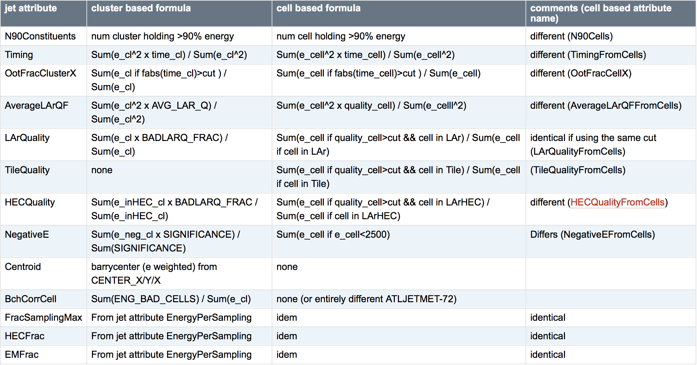
Jet Cleaning Discussion
Run 2 jet moments:
https://twiki.cern.ch/twiki/bin/viewauth/AtlasProtected/Run2JetMoments

Slide 12
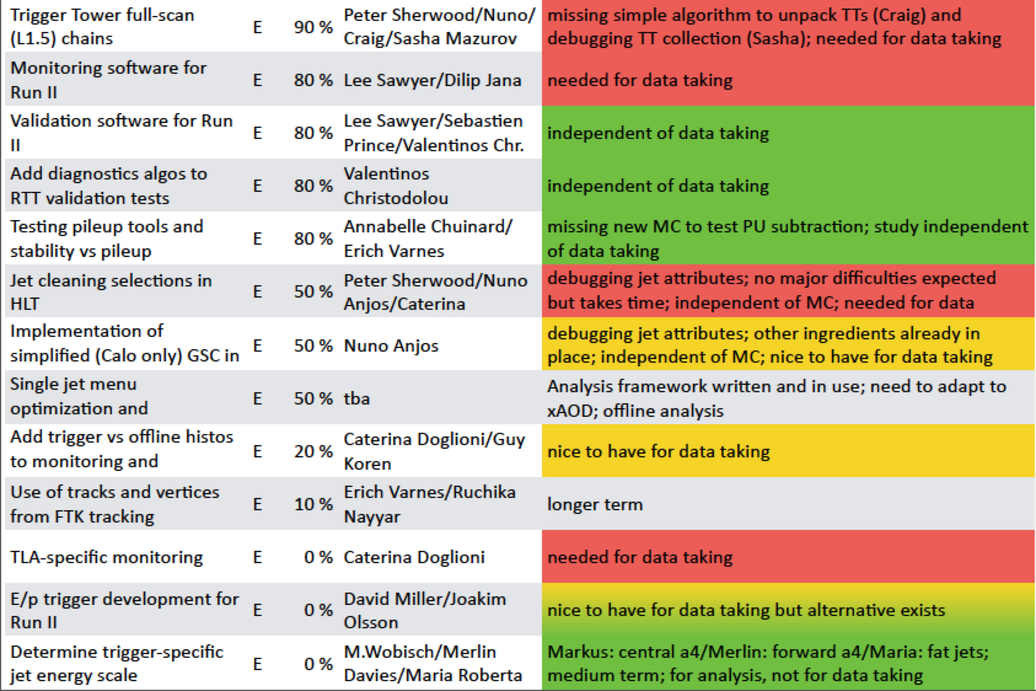
Jet Trigger Deliverables
https://docs.google.com/spreadsheet/ccc?key=0AokQEYCc3bjpdElWR1I2MC1nR2U0Q0pzTFM3U1RleWc&usp=sharing#gid=14

Slide 13
Bonus slides

Slide 14
Author Qualification Procedure
See https://indico.cern.ch/event/363542/contribution/0/material/slides/0.pdf

