Slide 1
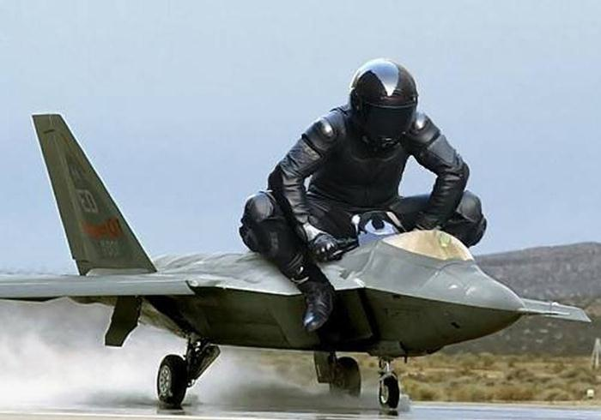
Latest News & Other Issues
Ricardo Goncalo (LIP), David Miller (Chicago)
Jet Trigger Signature Group Meeting 2/2/2015

Slide 2
News
Sample T a few days away, sample A too
  Ready? Will find out soon
M8 around the corner…
Run-II starts this year!
  < 2 months for first beams
  < 2 months for launching MC15a (digi+reco)
  < 4 months to first physics data

Slide 3
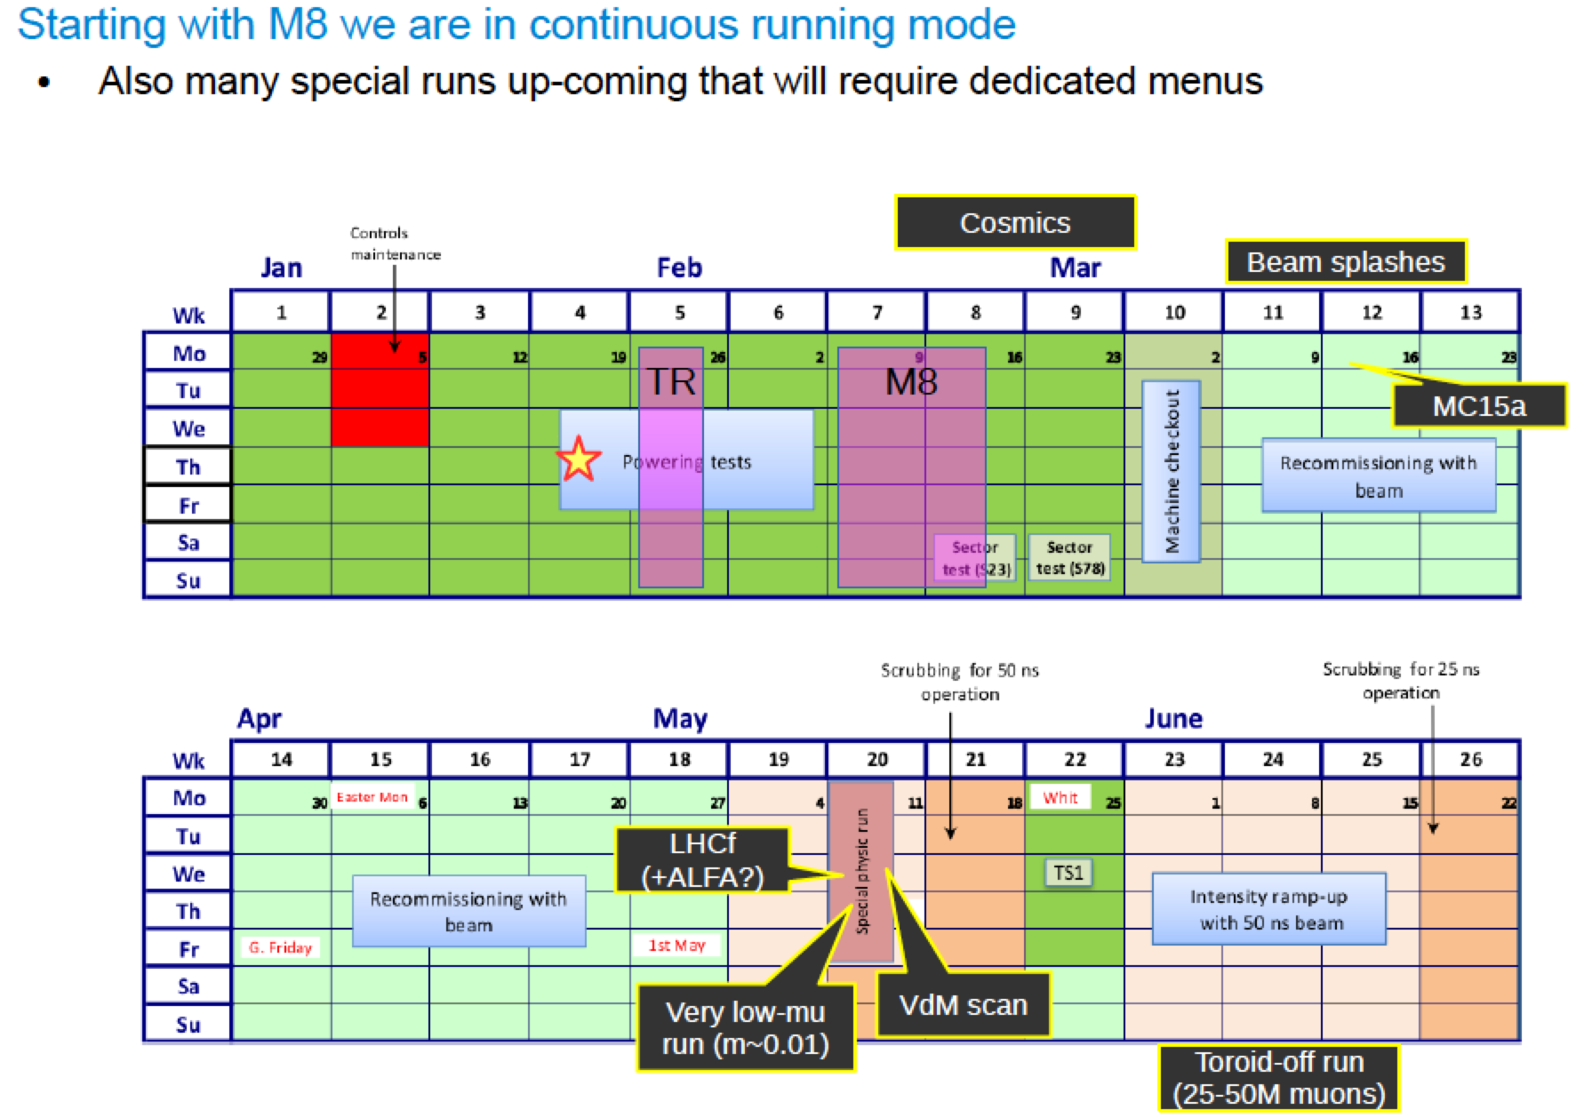
a

Slide 4
Menu for M8
Keep existing chains:
  j0_perf_L1RD0_EMPTY
  j0_perf_L1MU10
  j0_perf_L1J12
  ht0_perf_L1J12
Add chains to test :
  em vs lcw clusters
  Jes vs nocalib
  area subtraction
  PS vs FS
  fat-jet chains, including reclustering
starting from L1_J12:
  j0_L1J12 default calibration etc (a4 tc em subjes) but with a hypo cutting looser than L1
  j0_jes_L1J12 variation on calibration: jet calibration but no subtraction calibration
  j0_lcw_jes_L1J12 variation on cluster calibration: lcw instead of em, with JES
  j0_sub_L1J12 variation on calibration: no JES but with area subtraction
  j0_nojcalib_L1J12 variation on calibration: no jet calibration
fat jets
  j0_a10_nojcalib_L1J12 fat jet (no reclustering) without calibration
  j0_a10_lcw_sub_L1J12 fat jet (no reclustering) lcw clusters and area subtraction
  j0_a10r_lcw_sub_L1J12 fat jet from reclustering, lcw clusters and area subtraction
fat-jet chains starting from random
  j0_a10_nojcalib_L1RD0 fat jet (no reclustering) without calibration
  j0_a10r_lcw_sub_L1RD0 fat jet from reclustering, lcw clusters and area subtraction
chain designed to actually cut on events triggered by L1, to improve monitoring
  j15_L1J12
  ht0_L1J12

Slide 5
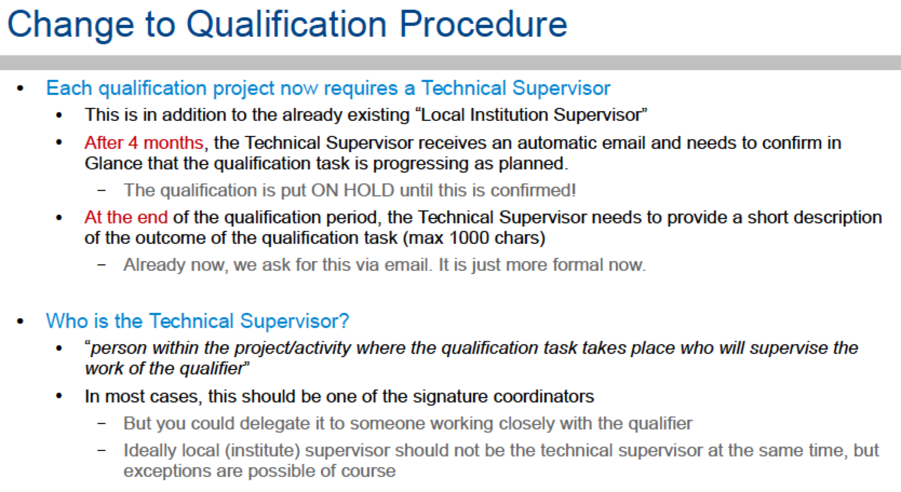
Author Qualification Procedure
See https://indico.cern.ch/event/363542/contribution/0/material/slides/0.pdf

Slide 6
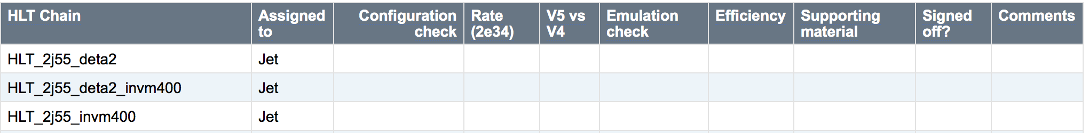
Signature sign-off procedure
Studies to be done from sample A and sample T – expected 1 week after sample T is produced !
https://twiki.cern.ch/twiki/bin/viewauth/Atlas/TriggerSignOffRel20#Jet
Instructions
  Please insert the relevant information next to each trigger chain. Don't edit the twiki page but the relevant table only, by clicking on the 'Edit' button.
  The columns in the tables are expected to contain the following information:
  HLT Chain : Chain name.
  Assigned to : Trigger or Physics group responsible for the trigger sign-off.
  Configuration check : Basic check of a reasonable trigger configuration in the menu.
  Rate (2e34) : Unprescaled rate.
  V5 vs V4 : Comparison between Run1 and Run2 scaled rates / performance, wherever relevant.
  Emulation check : Comparison between trigger decision and emulated trigger decision to verify selections and cuts (incl. L1).
  Efficiency check : Performance and efficiency curves, on signal and/or background.
  Supporting material : Links to presentations and/or plots.
  Signed off? : If all above checks have passed!

Slide 7
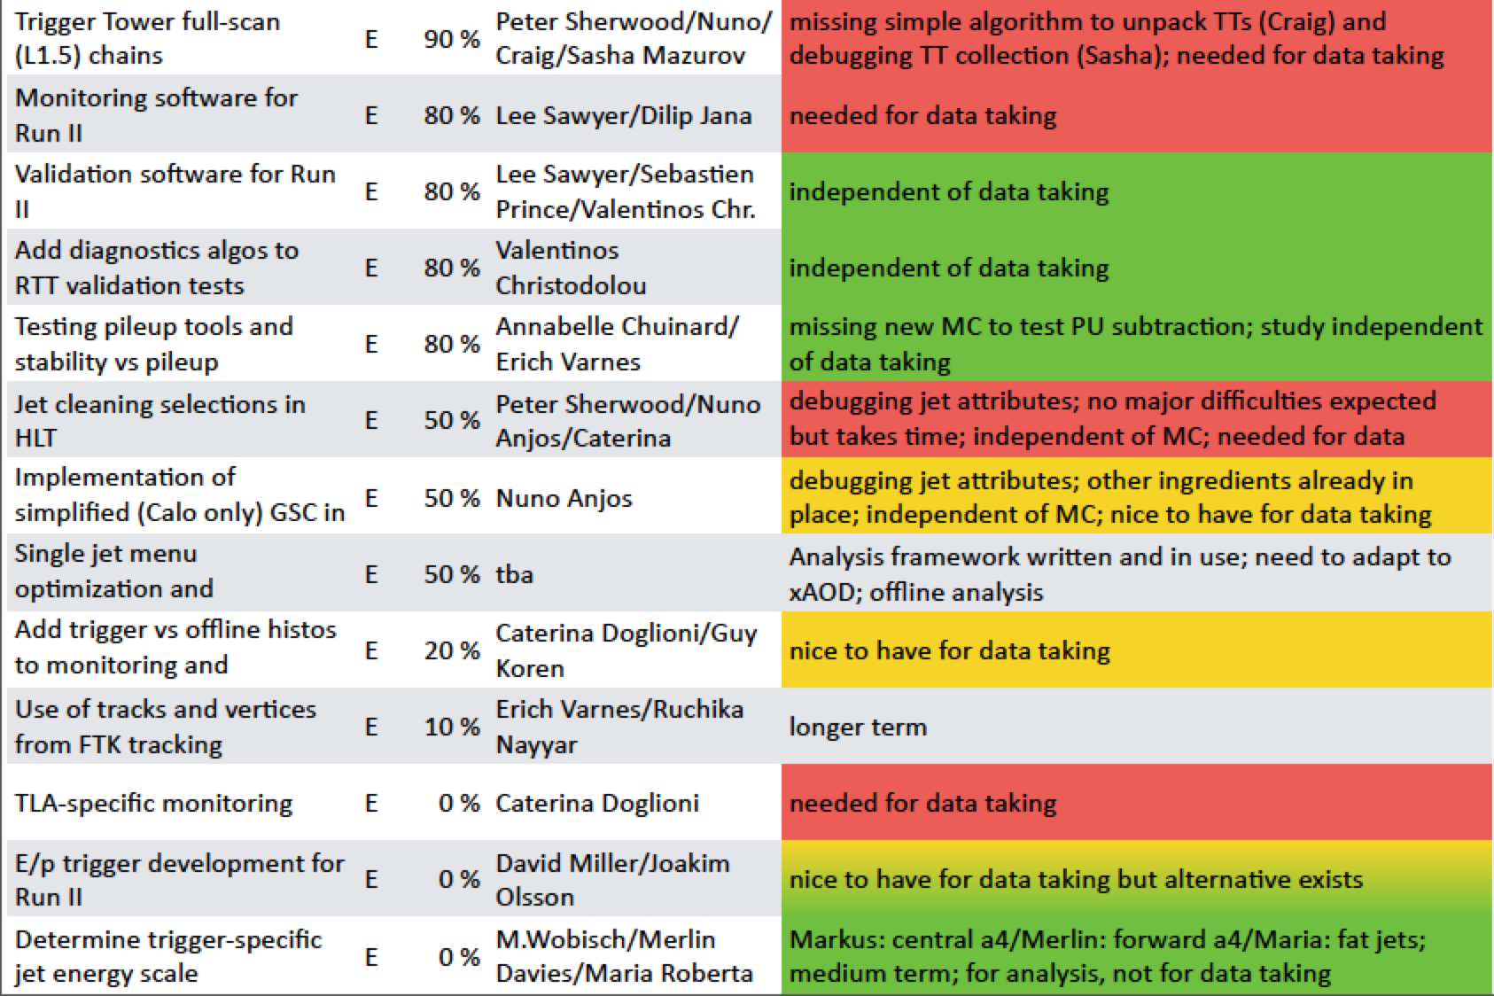
Jet Trigger Deliverables
https://docs.google.com/spreadsheet/ccc?key=0AokQEYCc3bjpdElWR1I2MC1nR2U0Q0pzTFM3U1RleWc&usp=sharing#gid=14

Slide 8
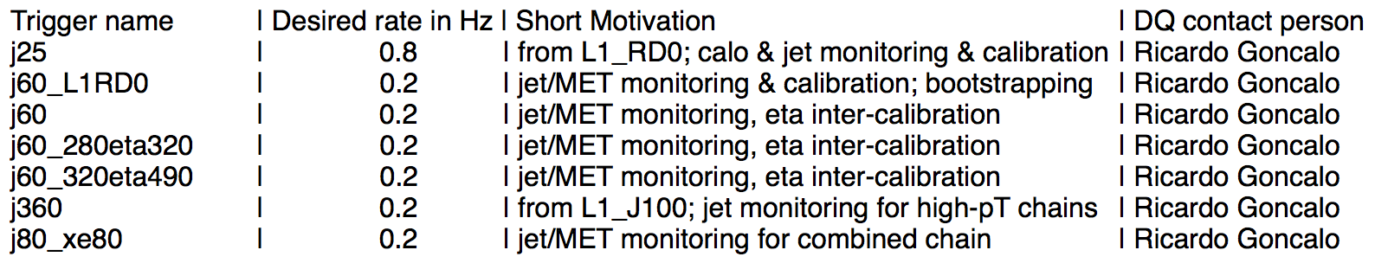
Express stream
See wiki:https://twiki.cern.ch/twiki/bin/view/Atlas/ExpressStream#E34_menu_Physics_pp_v4_menu_coll
The express stream has the following features:
  Contain a subset of the physics data corresponding to ~10Hz total.
  Full events (unlike the calibration stream) but not for physics analysis.
  Every event in the express stream will also be in the physics streams.
  Will be reconstructed quasi-real time and looked at promptly (before the main reconstruction starts) for calibration and monitoring.
  Used to check data quality, monitor the status of the detector, alignment and calibration, etc.
Jet menu in express stream (looking for voluntary for contact person):

