Slide 1
Latest News & Other Issues
Ricardo Goncalo (LIP), David Miller (Chicago)
Jet Trigger Signature Group Meeting 26/1/2015

Slide 2
News
Sample T a few days away, sample A too
M8 around the corner…
Run-II starts this year!
< 2 months for first beams
< 2 months for launching MC15a (digi+reco)
< 4 months to first physics data

Slide 3
a

Slide 4
M8 Menu
Deadline today for requesting chains
We need to test our new functionality online:
Different calibrations:
em vs lcw clusters
Jes vs nocalib
area subtraction
PS vs FS
fat-jet chains, including reclustering
Will put this together today. Ideas welcome.

Slide 5
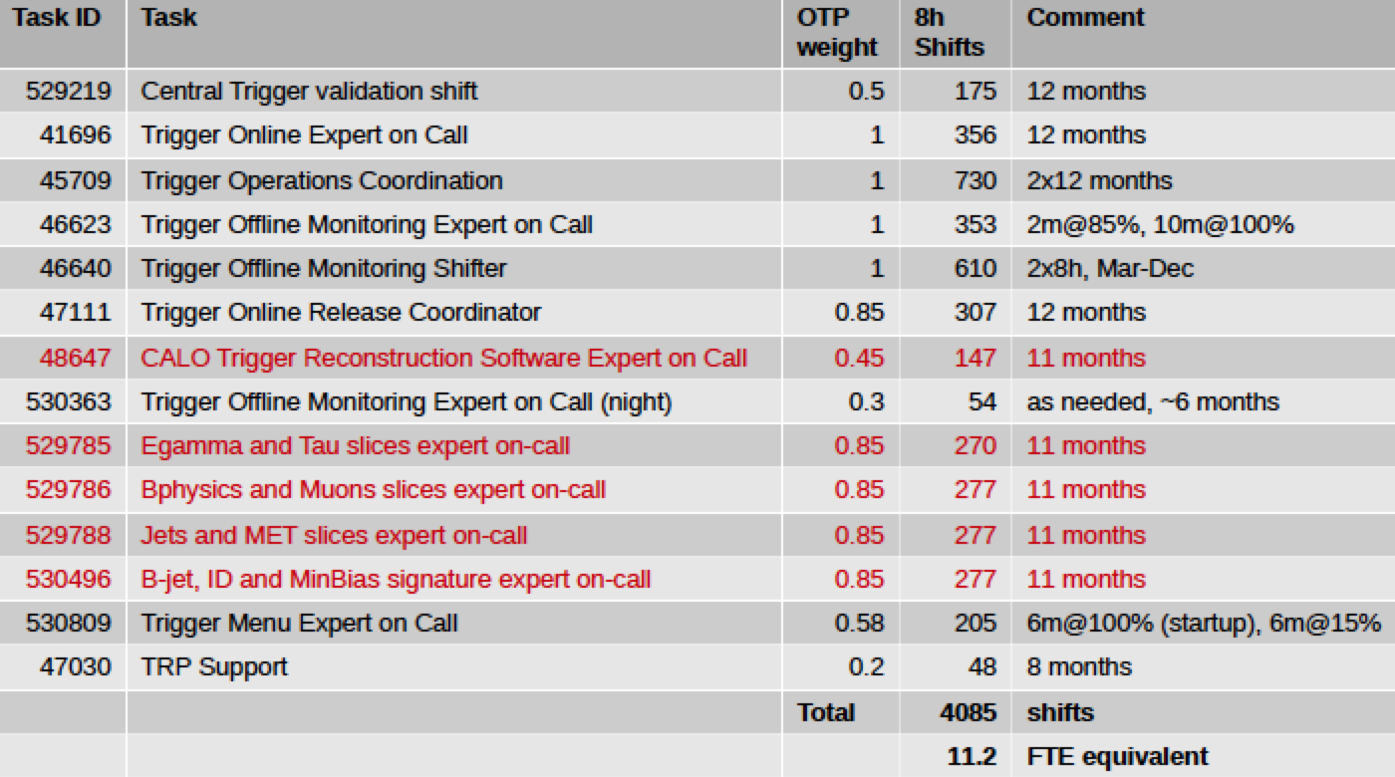
Trigger Class 2 OTP – on-call shifts
On-call tasks and OTP weights for 2015

Slide 6
Author Qualification Procedure
See https://indico.cern.ch/event/363542/contribution/0/material/slides/0.pdf

Slide 7
Signature sign-off procedure
Studies to be done from sample A and sample T – expected 1 week after sample T is produced !
https://twiki.cern.ch/twiki/bin/viewauth/Atlas/TriggerSignOffRel20#Jet
Instructions
Please insert the relevant information next to each trigger chain. Don't edit the twiki page but the relevant table only, by clicking on the 'Edit' button.
The columns in the tables are expected to contain the following information:
HLT Chain : Chain name.
Assigned to : Trigger or Physics group responsible for the trigger sign-off.
Configuration check : Basic check of a reasonable trigger configuration in the menu.
Rate (2e34) : Unprescaled rate.
V5 vs V4 : Comparison between Run1 and Run2 scaled rates / performance, wherever relevant.
Emulation check : Comparison between trigger decision and emulated trigger decision to verify selections and cuts (incl. L1).
Efficiency check : Performance and efficiency curves, on signal and/or background.
Supporting material : Links to presentations and/or plots.
Signed off? : If all above checks have passed!

Slide 8
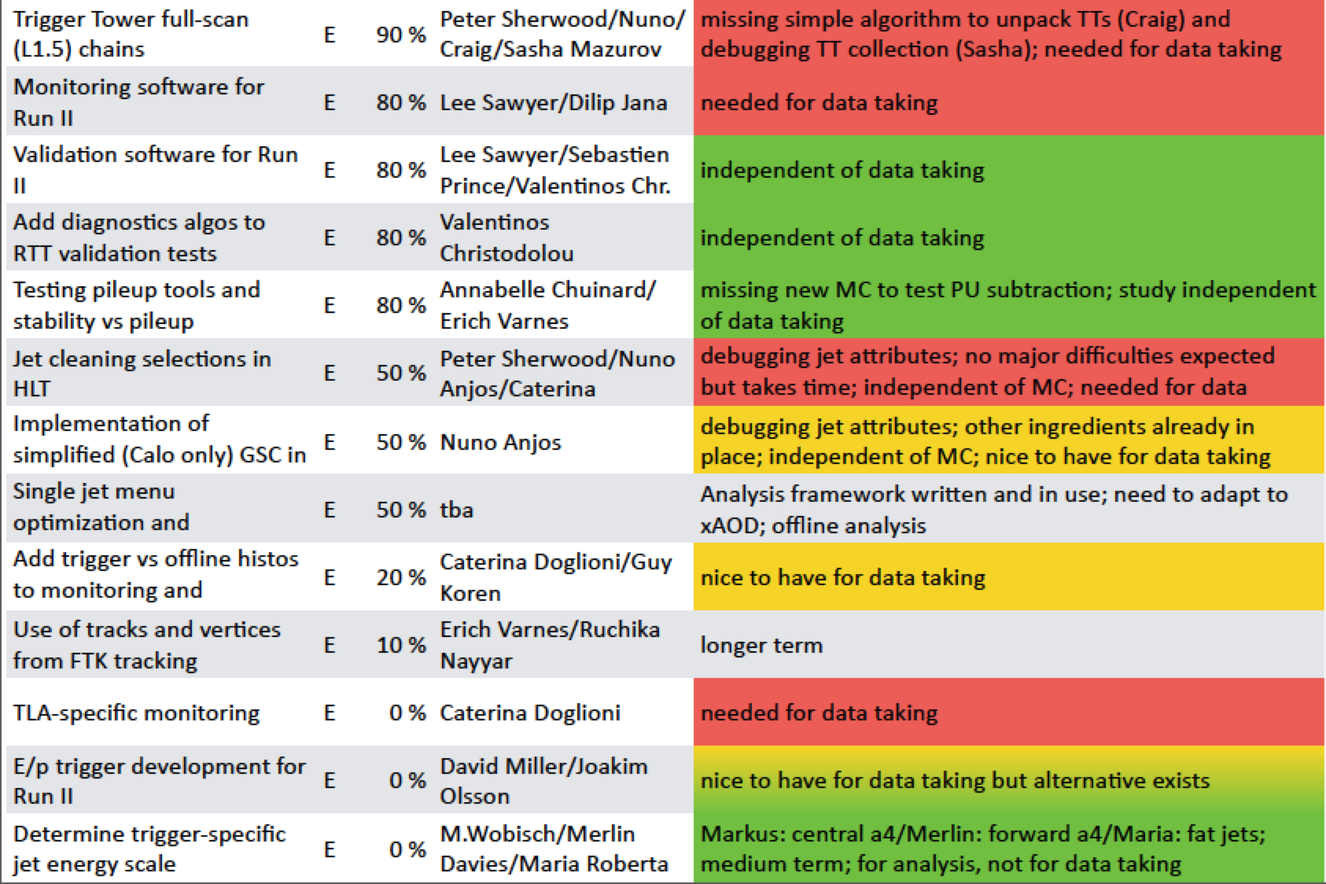
Jet Trigger Deliverables
https://docs.google.com/spreadsheet/ccc?key=0AokQEYCc3bjpdElWR1I2MC1nR2U0Q0pzTFM3U1RleWc&usp=sharing#gid=14

Slide 9
Open Jira items for jet deliverables
Data Scouting:
https://its.cern.ch/jira/browse/ATR-9906
https://its.cern.ch/jira/browse/ATR-9767
Menu:…
L1.5:…
GSC:
https://its.cern.ch/jira/browse/ATLJETMET-175
Trigger EDM (some containers not filled):
https://its.cern.ch/jira/browse/ATR-9865
Jet cleaning:
Jet trigger menu (and Hypo names/TE names discussion):
https://its.cern.ch/jira/browse/ATR-9521
L1 jet seed:
https://its.cern.ch/jira/browse/ATR-9321

Slide 10
Express stream
See wiki:https://twiki.cern.ch/twiki/bin/view/Atlas/ExpressStream#E34_menu_Physics_pp_v4_menu_coll
The express stream has the following features:
Contain a subset of the physics data corresponding to ~10Hz total.
Full events (unlike the calibration stream) but not for physics analysis.
Every event in the express stream will also be in the physics streams.
Will be reconstructed quasi-real time and looked at promptly (before the main reconstruction starts) for calibration and monitoring.
Used to check data quality, monitor the status of the detector, alignment and calibration, etc.
Jet menu in express stream (looking for voluntary for contact person):

