Slide 1
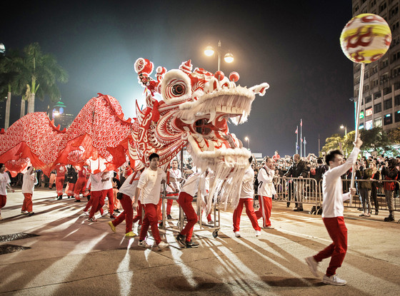
Happy New Year
Ricardo Goncalo (LIP), David Miller (Chicago)
First meeting in 2015
Jet Trigger Signature Group Meeting 12/1/2015

Slide 2
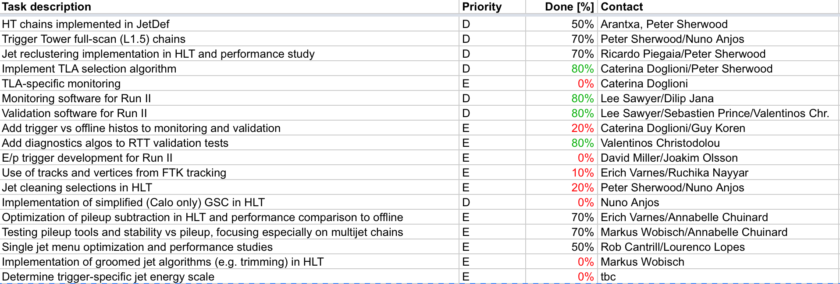
News
Release 20.1.0 to be built very soon
Officially on Wednesday 15 (in 2 days)
To be used for M8 (early Feb.)

