Slide 1
Jet trigger news
R.Gonçalo (LIP) D.Miller (Chicago)
Jet trigger meeting 11 August 2014

Slide 2
News
Trigger Operations
Mini-workshop tomorrow (40-4-C01, 15h-18h)
https://indico.cern.ch/event/332283/ .
Dataset lifetimes
Lifetimes will be introduced (see https://indico.cern.ch/event/286473)
Current proposal:
4 months:
NTUP_TRIG with x-tag (x-tag datasets are superseded by bulk processing)
1 year:
NTUP_TRIG, NTUP_TRIGBJET, NTUP_TRIGMU NTUP_L1CALO, NTUP_L1TGC
What this means:
Datasets older than 1 year and not touched for 9 months can be deleted from both disk and tape
All run-1 trigger ntuples (including reprocessings) will be deleted as soon as this policy takes effect.
2011 jet trigger performance paper
Waiting for MC to add stats for forward jet study

Slide 3
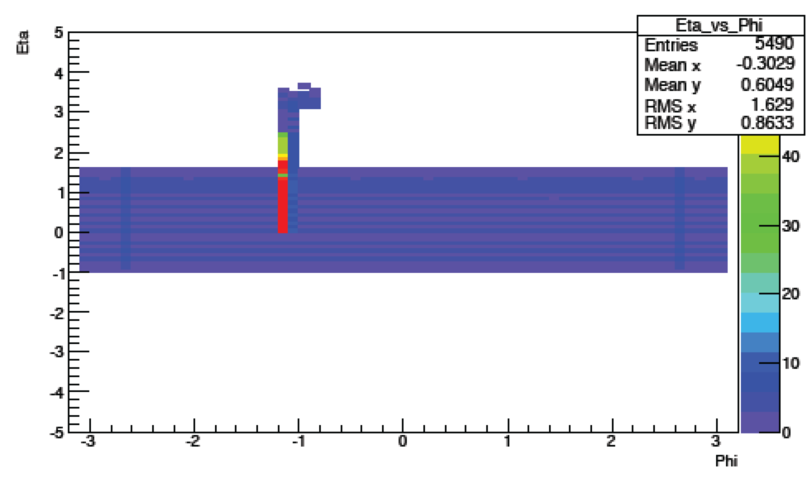
Full-scan versus Partial scan
Bug found, probably in Region Selector, affecting Partial Scan (D.Freeborn)
Seems to affect only very large RoIs and come from geometry (phi wrapping)
Should be fixed by migration of core sw code (Mark Sutton)
But PS vs FS study timeline too short to wait for that (next 2 weeks)
Studies proceeding with smaller RoI sizes – need to check for effects of this bug
Internal note starting, to document study

Slide 4
M5 jet trigger chains
Current proposal:
Chains both with and without LCW
All running TopoClusters and full-scan
Aim to see HLT code running on noise (L1 random triggers)
Also on events with some activity (starting from L1 muon trigger)
HLT in passthrough
Possible chains are (naming to be clarified):
Random seed -> FS jet (passthrough):
j0_perf_L1RNDM —> with LCW
j0_cell_perf_L1RNDM —> without LCW
L1 Mu seed -> FS jet (passthrough):
j0_perf_L1MU10 —> with LCW
j0_cell_perl_L1MU10 —> without LCW

Slide 5
Hadronic Calibration Workshop
2014 Hadronic Calibration Workshop begins in 1 month: https://wwwatlas.mpp.mpg.de/munich-2014/
Jet & MET Trigger Session on Tuesday 9 September 2014: https://indico.cern.ch/event/299407/other-view?view=standard
Instructions for uploading contributions: https://indico.cern.ch/event/299407/page/0
Interesting topics:
Jet & MET trigger performance and lessons from Run I
Calibration considerations for Jet & MET triggers in Run I
Physics analysis experiences and perspective on Jet & MET triggers in Run I
Plans for Jet & MET triggers in Run II
Performance of Jet & MET triggers for physics analysis in Run II
Pile-up dependence of Jet & MET triggers in Run II
Plans for monitoring Jet & MET triggers in Run II
Partial Scan vs. Full Scan Jet triggers in Run II
Performance of topoclustering for Jet & MET triggers for Run II
Use of reclustered jets for fat jet triggers in Run II
Multijet trigger performance and considerations in Run II
Phase I and Phase II Jet & MET triggers
Please submit your contributions as soon as possible, or let us know of your intended contributions

