Slide 1
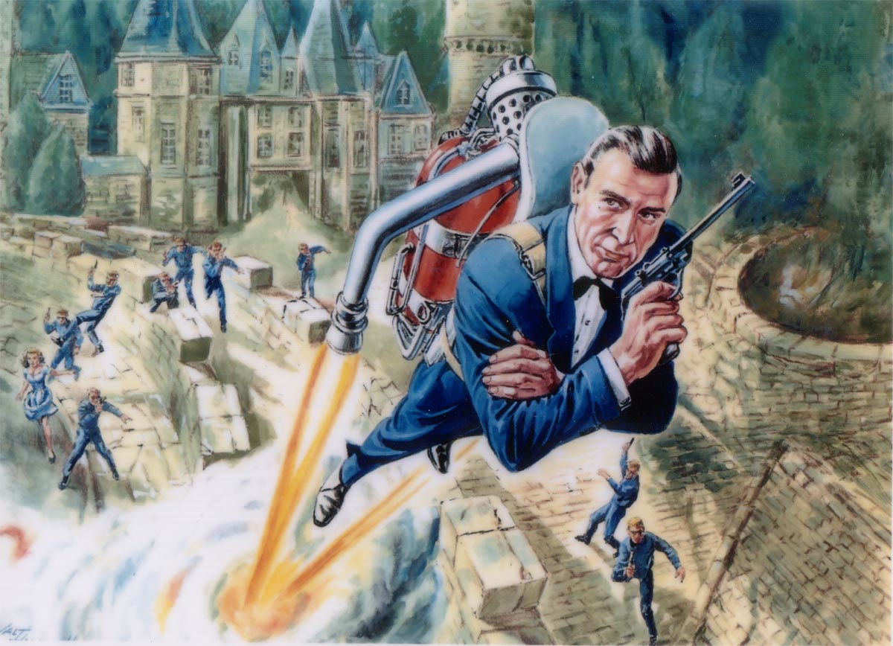
Jet Trigger Meeting - News
Ricardo Gonçalo (LIP Lisbon) David Miller (U. Chicago)
12 May 2014

Slide 2
Quick News
Keep group structure as set up by Mario:
Menu and software – Peter Sherwood
Monitoring and Validation – Lee Sawyer
Pileup – Erich Varnes
Plan to have weekly meetings at 3pm every Monday:
Start at 2pm occasionally – if necessary for some reason
Go over status of the main activities
Doesn’t replace detailed discussions within subgroups
We’ll ask for contributions to be uploaded 1 day before
Status reports to be arranged by subgroup leaders – who will appoint someone as needed
Let us know if you would like to show something else

