Slide 1
Jet/MET/HLTCalo shift report
Ricardo Gonçalo – LIP
Jet trigger weekly meeting – 3/10/2016

Slide 2
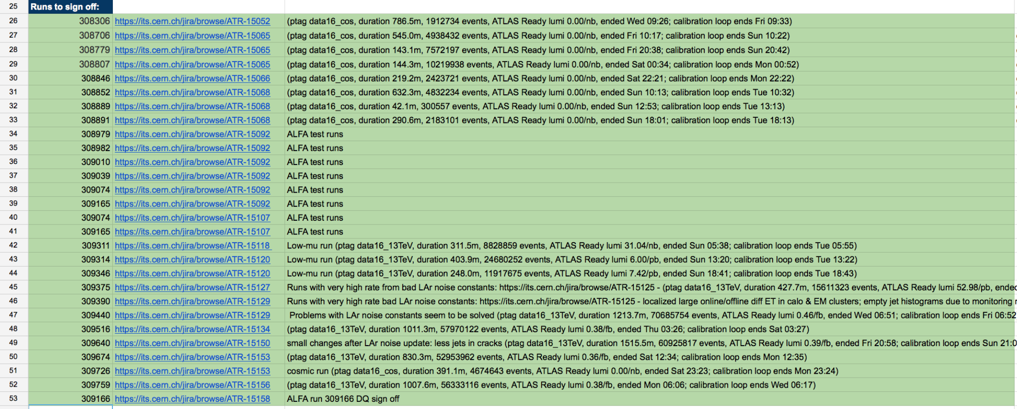
Signed off runs
Runs signed off: 309375, 309390, 309440, 309516, 309640, 309674, 309726, 309759
Main issue found was a bad set of LAr noise constants uploaded by accident (ATR-15125)
Caused high rate and high number of calo clusters

Slide 3
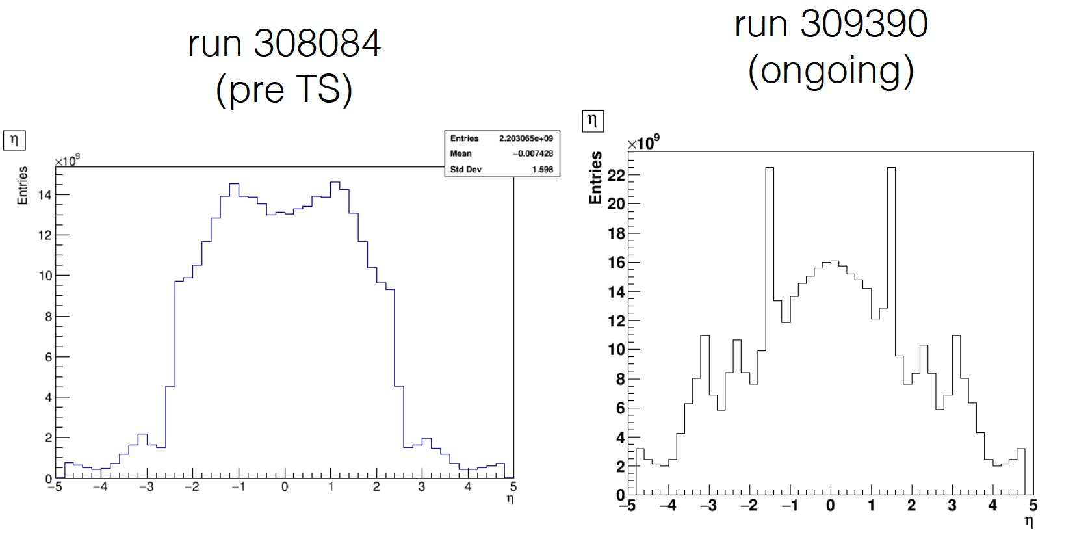
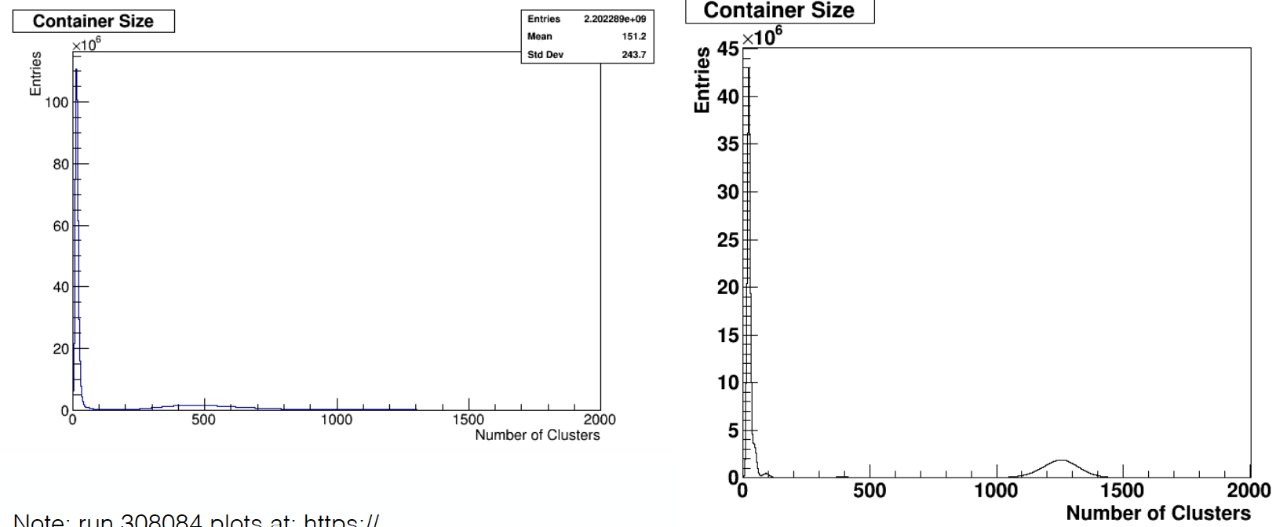
Effect of bad LAr noise
Plots by Joana Miguéns

Slide 4
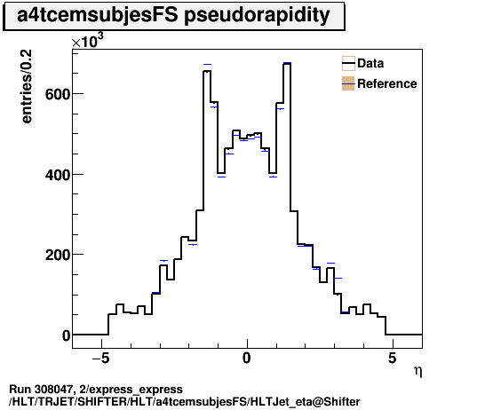
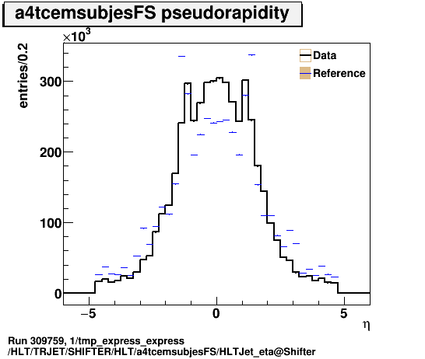
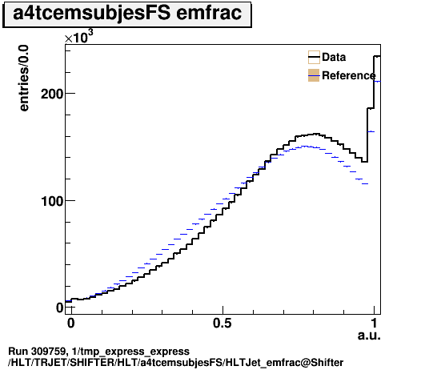
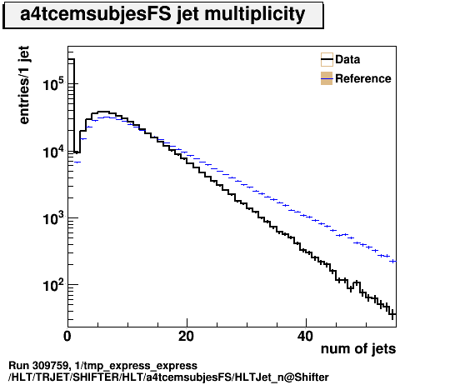
After the LAr noise fix
Some changes left after the LAr noise constants were updated:
Slightly higher Emfrac
Slightly lower Njets
Better behaviour in transition regions
Affects only low-ET jets: a4tcemsubjesFS container shown here)
Also MHT slightly lower
Could also come from bunch structure, but comparison with older run rules this out
2208 bunches in 23 trains for both example runs
Older run: 308047
309759
309759
309759

Slide 5
Reprocessing tests
Several reprocessings showed up in the last few days: nothing noteworthy

Slide 6
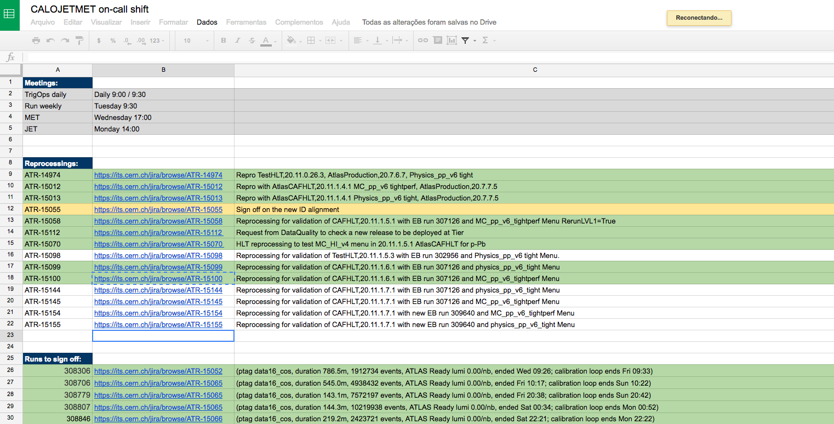
Other
Will update instructions today to:
Have sub-page to collect a catalogue of past problems (old idea… just need a bit of time)
Add link to googledocs spreadsheet
Very useful as a notebook during shift and as a record later

